Slide 1
Parallelism, Multicore, and Synchronization
CS 3410
Computer Science
Cornell University
The slides are the product of many rounds of teaching CS 3410 by Professors Weatherspoon, Bala, Bracy, McKee, and Sirer. Also some slides from Amir Roth & Milo Martin in here.

Slide 2
Announcements
C practice assignment
  Due Monday, April 23rd
P4-Buffer Overflow is due tomorrow
  Due Wednesday, April 18th
P5-Cache Collusion!
  Due Friday, April 27th
  Pizza party & Tournament, Monday, May 7th
Prelim2
  Thursday, May 3rd, 7:30pm 185 Statler Hall

Slide 3

xkcd/619

Slide 4
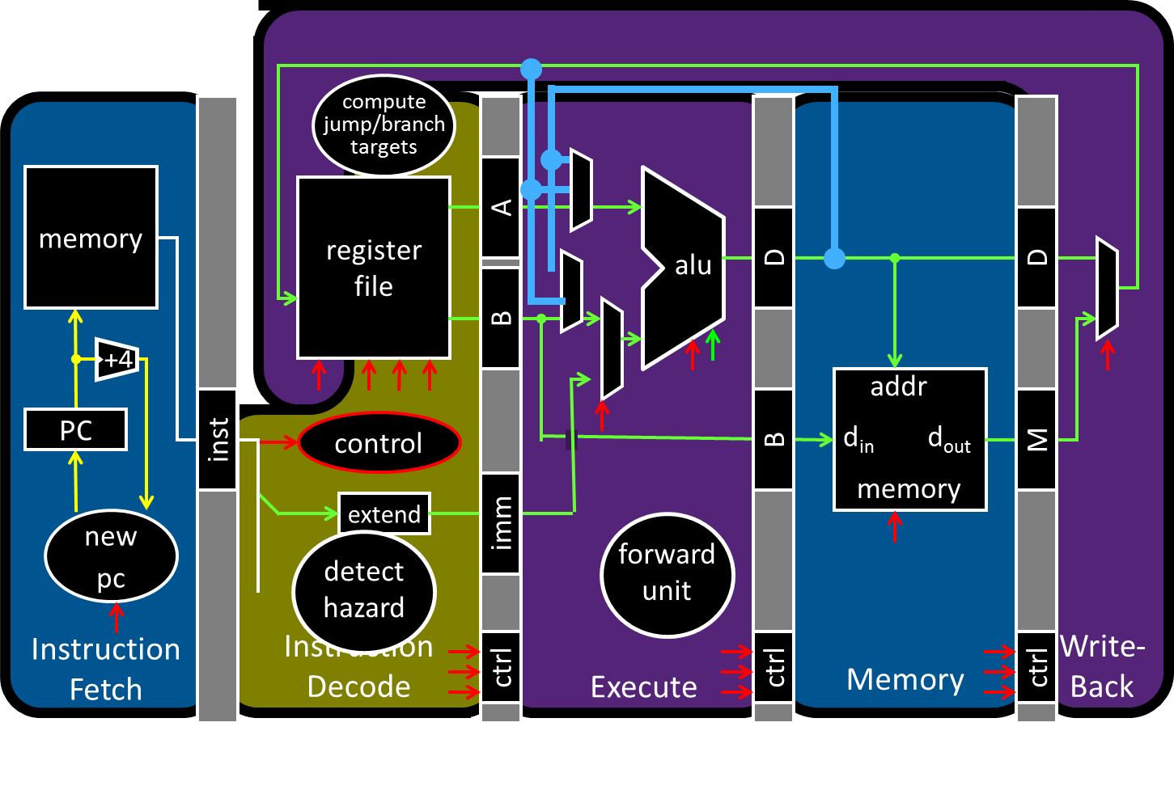
Big Picture: Multicore and Parallelism

Slide 5
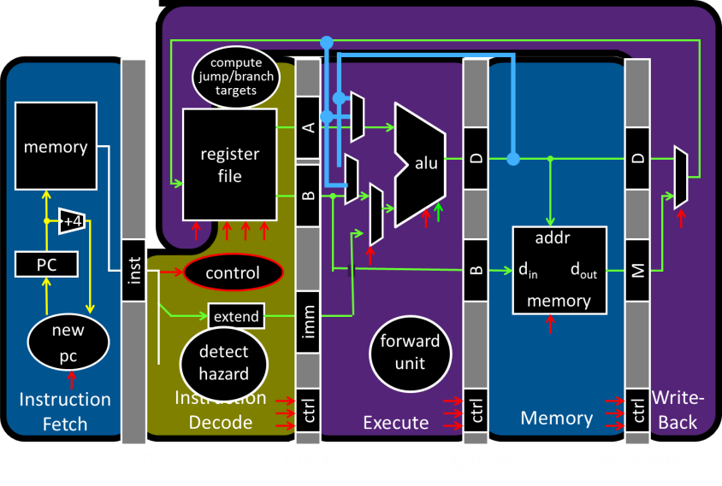
Big Picture: Multicore and Parallelism
Why do I need four computing cores on my phone?!

Slide 6
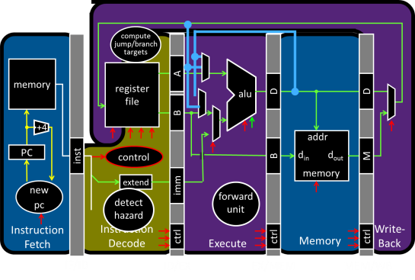
Big Picture: Multicore and Parallelism
Why do I need eight computing cores on my phone?!

Slide 7
Big Picture: Multicore and Parallelism
Why do I need sixteen computing cores on my phone?!

Slide 8
Pitfall: Amdahl’s Law
Execution time after improvement =
affected execution time
amount of improvement
+ execution time unaffected
T_{improved} = $\frac{Taffected}{improvement factor}$+ T_{unaffected}
Notes:
Amdahl’s Law

Slide 9
Pitfall: Amdahl’s Law
Improving an aspect of a computer and expecting a proportional improvement in overall performance
T_{improved} = $\frac{Taffected}{improvement factor}$+ T_{unaffected}
Example: multiply accounts for 80s out of 100s
Multiply can be parallelized
How much improvement do we need in the multiply performance to get 5× overall improvement?
(a) 2x (b) 10x (c) 100x (d) 1000x (e) not possible
Notes:
Clicker question

Slide 10
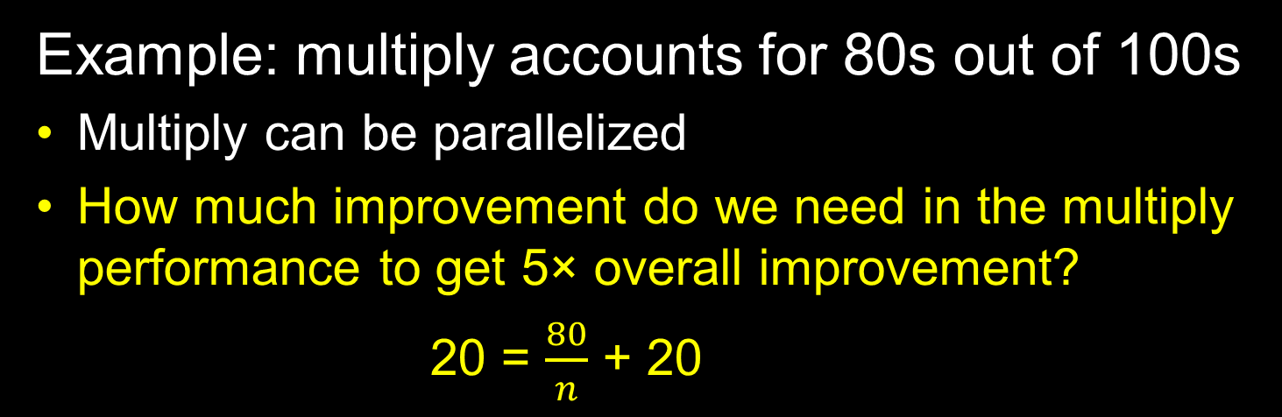
Pitfall: Amdahl’s Law
Improving an aspect of a computer and expecting a proportional improvement in overall performance
T_{improved} = $\frac{Taffected}{improvement factor}$+ T_{unaffected}
Example: multiply accounts for 80s out of 100s
Multiply can be parallelized
How much improvement do we need in the multiply performance to get 5× overall improvement?
20 = $\frac{80}{n}$ + 20
  Can’t be done!
Notes:
Clicker question

Slide 11
Scaling Example
Workload: sum of 10 scalars, and 10 × 10 matrix sum
  Speed up from 10 to 100 processors?
Single processor: Time = (10 + 100) × t_{add}
10 processors
  Time = 100/10 × t_{add} + 10 × t_{add} = 20 × t_{add}
  Speedup = 110/20 = 5.5
100 processors
  Time = 100/100 × t_{add} + 10 × t_{add} = 11 × t_{add}
  Speedup = 110/11 = 10
Assumes load can be balanced across processors
Notes:
Pair up question
10 processors
Speedup = 110/20 = 5.5 (55% of potential)
100 processors
Speedup = 110/11 = 10 (10% of potential)

Slide 12
Scaling Example
What if matrix size is 100 × 100?
Single processor: Time = (10 + 10000) × t_{add}
10 processors
  Time = 10 × t_{add} + 10000/10 × t_{add} = 1010 × t_{add}
  Speedup = 10010/1010 = 9.9
100 processors
  Time = 10 × t_{add} + 10000/100 × t_{add} = 110 × t_{add}
  Speedup = 10010/110 = 91
Assuming load balanced
Notes:
10 processors
Speedup = 10010/1010 = 9.9 (99% of potential)
100 processors
Speedup = 10010/110 = 91 (91% of potential)

Slide 13
Takeaway
Unfortunately, we cannot not obtain unlimited scaling (speedup) by adding unlimited parallel resources, eventual performance is dominated by a component needing to be executed sequentially.
Amdahl's Law is a caution about this diminishing return

Slide 14
Performance Improvement 101
seconds instructions cycles seconds
program program instruction cycle
=
x
x
2 Classic Goals of Architects:
⬇ Clock period (⬆ Clock frequency)
⬇ Cycles per Instruction (⬆ IPC)

Slide 15
Clock frequencies have stalled
Darling of performance improvement for decades
Why is this no longer the strategy?
Hitting Limits:
Pipeline depth
Clock frequency
Moore’s Law & Technology Scaling
Power

Slide 16
Improving IPC via ILP
Exploiting Intra-instruction parallelism:
Pipelining (decode A while fetching B)
Exploiting Instruction Level Parallelism (ILP):
Multiple issue pipeline (2-wide, 4-wide, etc.)
Statically detected by compiler (VLIW)
Dynamically detected by HW
Dynamically Scheduled (OoO)

Slide 17
Instruction-Level Parallelism (ILP)
Pipelining: execute multiple instructions in parallel
Q: How to get more instruction level parallelism?
A: Deeper pipeline
    E.g. 250MHz 1-stage; 500Mhz 2-stage; 1GHz 4-stage; 4GHz 16-stage
Pipeline depth limited by…
    max clock speed (less work per stage ⇒ shorter clock cycle)
    min unit of work
    dependencies, hazards / forwarding logic
Notes:
Draw pictures: 250MHz 1-stage; 500Mhz 2-stage; 1GHz 4-stage; 4GHz 16-stage

Slide 18
Instruction-Level Parallelism (ILP)
Pipelining: execute multiple instructions in parallel
Q: How to get more instruction level parallelism?
A: Multiple issue pipeline
    Start multiple instructions per clock cycle in duplicate stages
ALU/Br
LW/SW
Notes:
Draw picture; 4 stage, 4-way * 4GHz = 16B inst/cycles
Next: Static issue

Slide 19
Multiple issue pipeline
Static multiple issue
aka Very Long Instruction Word
Decisions made by compiler
Dynamic multiple issue
Decisions made on the fly
Cost: More execute hardware
Reading/writing register files: more ports

Slide 20
Static Multiple Issue
a.k.a. Very Long Instruction Word (VLIW)
Compiler groups instructions to be issued together
  Packages them into “issue slots”
How does HW detect and resolve hazards?
It doesn’t. ☺ Compiler must avoid hazards
Example: Static Dual-Issue 32-bit MIPS
  Instructions come in pairs (64-bit aligned)
    One ALU/branch instruction (or nop)
    One load/store instruction (or nop)
Notes:
show program, decode stage
Ideal CPI = 0.5

Slide 21
MIPS with Static Dual Issue
Two-issue packets
  One ALU/branch instruction
  One load/store instruction
  64-bit aligned
    ALU/branch, then load/store
    Pad an unused instruction with nop
Address | Instruction type | Pipeline Stages
n | ALU/branch | IF | ID | EX | MEM | WB
n + 4 | Load/store | IF | ID | EX | MEM | WB
n + 8 | ALU/branch |  | IF | ID | EX | MEM | WB
n + 12 | Load/store |  | IF | ID | EX | MEM | WB
n + 16 | ALU/branch |  |  | IF | ID | EX | MEM | WB
n + 20 | Load/store |  |  | IF | ID | EX | MEM | WB

Slide 22
Scheduling Example
Schedule this for dual-issue MIPS
Loop: lw $t0, 0($s1) # $t0=array element
addu $t0, $t0, $s2 # add scalar in $s2
sw $t0, 0($s1) # store result
addi $s1, $s1,–4 # decrement pointer
bne $s1, $zero, Loop # branch $s1!=0
Loop: lw $t0, 0($s1) # $t0=array element
addu $t0, $t0, $s2 # add scalar in $s2
sw $t0, 0($s1) # store result
addi $s1, $s1,–4 # decrement pointer
bne $s1, $zero, Loop # branch $s1!=0
 | ALU/branch | Load/store | cycle
Loop: | nop | lw $t0, 0($s1) | 1
 | addi $s1, $s1,–4 | nop | 2
 | addu $t0, $t0, $s2 | nop | 3
 | bne $s1, $zero, Loop | sw $t0, 4($s1) | 4
Clicker Question: What is the IPC of this machine?
(A) 0.8 (B) 1.0 (C) 1.25 (D) 1.5 (E) 2.0

Slide 23
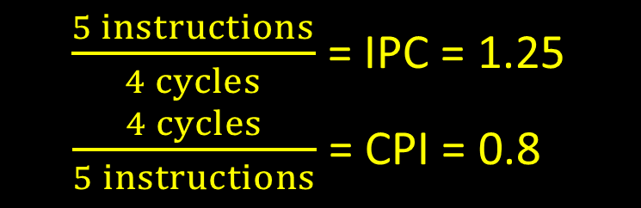
Scheduling Example
Schedule this for dual-issue MIPS
Loop: lw $t0, 0($s1) # $t0=array element
addu $t0, $t0, $s2 # add scalar in $s2
sw $t0, 0($s1) # store result
addi $s1, $s1,–4 # decrement pointer
bne $s1, $zero, Loop # branch $s1!=0
Loop: lw $t0, 0($s1) # $t0=array element
addu $t0, $t0, $s2 # add scalar in $s2
sw $t0, 0($s1) # store result
addi $s1, $s1,–4 # decrement pointer
bne $s1, $zero, Loop # branch $s1!=0
 | ALU/branch | Load/store | cycle
Loop: | nop | lw $t0, 0($s1) | 1
 | addi $s1, $s1,–4 | nop | 2
 | addu $t0, $t0, $s2 | nop | 3
 | bne $s1, $zero, Loop | sw $t0, 4($s1) | 4
$\frac{5 instructions}{4 cycles}$ = IPC = 1.25
$\frac{4 cycles}{5 instructions}$ = CPI = 0.8

Slide 24
Techniques and Limits of Static Scheduling
Goal: larger instruction windows (to play with)
Predication
Loop unrolling
Function in-lining
Basic block modifications (superblocks, etc.)
Roadblocks
Memory dependences (aliasing)
Control dependences

Slide 25
Speculation
Reorder instructions
To fill the issue slot with useful work
Complicated: exceptions may occur

Slide 26
Optimizations to make it work
Move instructions to fill in nops
Need to track hazards and dependencies
Loop unrolling

Slide 27
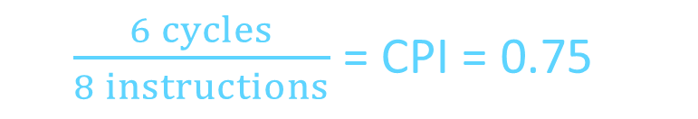
Scheduling Example
Compiler scheduling for dual-issue MIPS…
Loop: lw $t0, 0($s1) # $t0 = A[i]
lw $t1, 4($s1) # $t1 = A[i+1]
addu $t0, $t0, $s2 # add $s2
addu $t1, $t1, $s2 # add $s2
sw $t0, 0($s1) # store A[i]
sw $t1, 4($s1) # store A[i+1]
addi $s1, $s1, +8 # increment pointer
bne $s1, $s3, Loop # continue if $s1!=end
ALU/branch slot Load/store slot cycle
Loop: nop lw $t0, 0($s1) 1
nop lw $t1, 4($s1) 2
addu $t0, $t0, $s2 nop 3
addu $t1, $t1, $s2 sw $t0, 0($s1) 4
addi $s1, $s1, +8 sw $t1, 4($s1) 5
bne $s1, $s3, Loop nop 6
8 cycles
-8
-4
delay slot
6 cycles
$\frac{6 cycles}{8 instructions}$ = CPI = 0.75
Notes:
assume 1 delay slot for loads
can move addi earlier
CPI = 6 cycles / 8 instructions = 0.75
CPI = 5 cycles / 8 instructions = 0.625

Slide 28
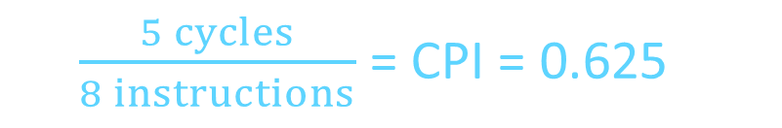
Scheduling Example
Compiler scheduling for dual-issue MIPS…
Loop: lw $t0, 0($s1) # $t0 = A[i]
lw $t1, 4($s1) # $t1 = A[i+1]
addu $t0, $t0, $s2 # add $s2
addu $t1, $t1, $s2 # add $s2
sw $t0, 0($s1) # store A[i]
sw $t1, 4($s1) # store A[i+1]
addi $s1, $s1, +8 # increment pointer
bne $s1, $s3, Loop # continue if $s1!=end
ALU/branch slot Load/store slot cycle
Loop: nop lw $t0, 0($s1) 1
addi $s1, $s1, +8 lw $t1, 4($s1) 2
addu $t0, $t0, $s2 nop 3
addu $t1, $t1, $s2 sw $t0, -8($s1) 4
bne $s1, $s3, Loop sw $t1, -4($s1) 5
8 cycles
-8
-4
5 cycles
$\frac{5 cycles}{8 instructions}$ = CPI = 0.625
Notes:
assume 1 delay slot for loads
can move addi earlier
CPI = 6 cycles / 8 instructions = 0.75
CPI = 5 cycles / 8 instructions = 0.625

Slide 29
Limits of Static Scheduling
Compiler scheduling for dual-issue MIPS…
lw $t0, 0($s1) # load A
addi $t0, $t0, +1 # increment A
sw $t0, 0($s1) # store A
lw $t0, 0($s2) # load B
addi $t0, $t0, +1 # increment B
sw $t0, 0($s2) # store B
ALU/branch slot Load/store slot cycle
nop lw $t0, 0($s1) 1
nop nop 2
addi $t0, $t0, +1 nop 3
nop sw $t0, 0($s1) 4
nop lw $t0, 0($s2) 5
nop nop 6
addi $t0, $t0, +1 nop 7
nop sw $t0, 0($s2) 8
Notes:
Rename registers, move load B up, eliminate delay slot
But! s1 and s2 might be equal => Aliasing!

Slide 30
Limits of Static Scheduling
Compiler scheduling for dual-issue MIPS…
lw $t0, 0($s1) # load A
addi $t0, $t0, +1 # increment A
sw $t0, 0($s1) # store A
lw $t1, 0($s2) # load B
addi $t1, $t1, +1 # increment B
sw $t1, 0($s2) # store B
ALU/branch slot Load/store slot cycle
nop lw $t0, 0($s1) 1
nop nop 2
addi $t0, $t0, +1 nop 3
nop sw $t0, 0($s1) 4
nop lw $t1, 0($s2) 5
nop nop 6
addi $t1, $t1, +1 nop 7
nop sw $t1, 0($s2) 8
Notes:
Rename registers, move load B up, eliminate delay slot
But! s1 and s2 might be equal => Aliasing!

Slide 31
Limits of Static Scheduling
Compiler scheduling for dual-issue MIPS…
lw $t0, 0($s1) # load A
addi $t0, $t0, +1 # increment A
sw $t0, 0($s1) # store A
lw $t1, 0($s2) # load B
addi $t1, $t1, +1 # increment B
sw $t1, 0($s2) # store B
ALU/branch slot Load/store slot cycle
nop lw $t0, 0($s1) 1
nop lw $t1, 0($s2) 2
addi $t0, $t0, +1 nop 3
addi $t1, $t1, +1 sw $t0, 0($s1) 4
nop sw $t1, 0($s2) 5
Problem: What if $s1 and $s2 are equal (aliasing)? Won’t work
Notes:
Rename registers, move load B up, eliminate delay slot
But! s1 and s2 might be equal => Aliasing!

Slide 32
Improving IPC via ILP
Exploiting Intra-instruction parallelism:
Pipelining (decode A while fetching B)
Exploiting Instruction Level Parallelism (ILP):
Multiple issue pipeline (2-wide, 4-wide, etc.)
Statically detected by compiler (VLIW)
Dynamically detected by HW
Dynamically Scheduled (OoO)

Slide 33
Dynamic Multiple Issue
aka SuperScalar Processor (c.f. Intel)
  CPU chooses multiple instructions to issue each cycle
  Compiler can help, by reordering instructions….
  … but CPU resolves hazards
Even better: Speculation/Out-of-order Execution
  Execute instructions as early as possible
  Aggressive register renaming (indirection to the rescue!)
  Guess results of branches, loads, etc.
  Roll back if guesses were wrong
  Don’t commit results until all previous insns committed

Slide 34
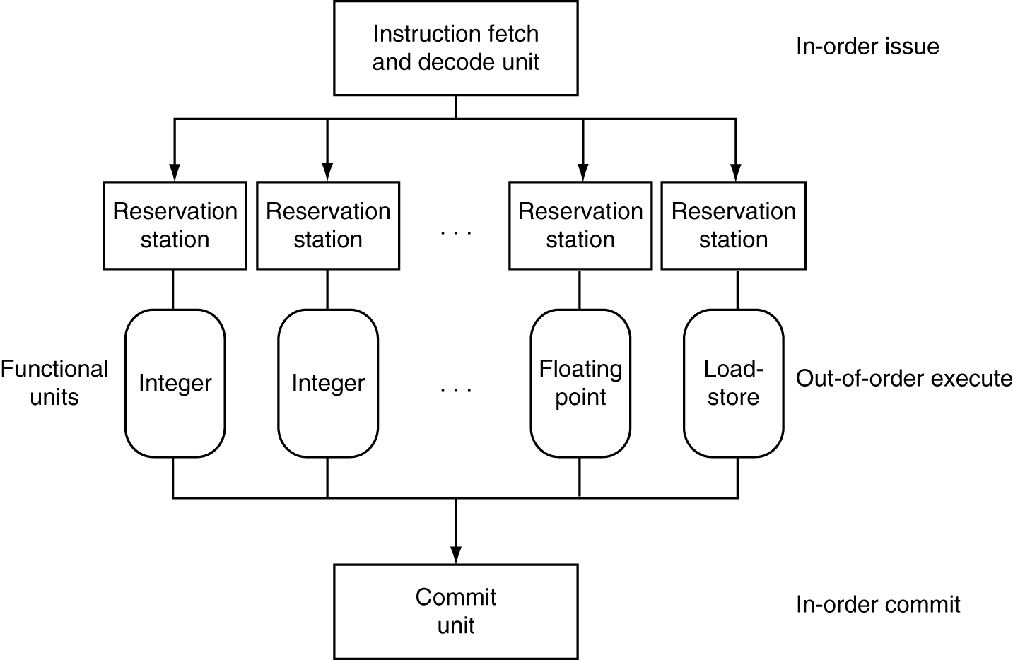
Dynamic Multiple Issue

Slide 35
Effectiveness of OoO Superscalar
It was awesome, but then it stopped improving
Limiting factors?
  Programs dependencies
  Memory dependence detection → be conservative
    e.g. Pointer Aliasing: A[0] += 1; B[0] *= 2;
  Hard to expose parallelism
    Still limited by the fetch stream of the static program
  Structural limits
    Memory delays and limited bandwidth
  Hard to keep pipelines full, especially with branches

Slide 36
Improving IPC via ILP TLP
Exploiting Thread-Level parallelism
Hardware multithreading to improve utilization:
  Multiplexing multiple threads on single CPU
  Sacrifices latency for throughput
  Single thread cannot fully utilize CPU? Try more!
  Three types:
    Course-grain (has preferred thread)
    Fine-grain (round robin between threads)
    Simultaneous (hyperthreading)
Notes:
CGMT: Course-grain (has preferred thread)
FGMT: Fine-grain (round robin between threads)
SMT: Simultaneous (hyperthreading)
Fine grained multithreading (FGMT)
Switch on each cycle
Pros: Can hide very short stalls
Cons: Slows down every thread
Coarse grained multithreading (CGMT)
Switch only on quite long stalls
Pros: removes need for very fast switches
Cons: flush pipeline, short stalls not handled
Symmetric multithreading (SMT)
Leverages multi-issue pipeline with dynamic instruction scheduling and ILP
Exploits functional unit parallelism better than single threads
Always running multiple instructions from multiple threads
No cost of context switching
Uses dynamic scheduling and register renaming through reservation stations
Can use all functional units very efficiently

Slide 37

What is a thread?
Process: multiple threads, code, data and OS state
Threads: share code, data, files, not regs or stack

Slide 38
Standard Multithreading Picture
Time evolution of issue slots
  Color = thread, white = no instruction
time
4-wide
Superscalar
CGMT
FGMT
SMT
  Insns from multiple threads coexist
  Switch to thread B on thread A L2 miss
  Switch threads every cycle
Notes:
CGMT: Course-grain (has preferred thread)
FGMT: Fine-grain (round robin between threads)
SMT: Simultaneous (hyperthreading)
Fine grained multithreading (FGMT)
Switch on each cycle
Pros: Can hide very short stalls
Cons: Slows down every thread
Coarse grained multithreading (CGMT)
Switch only on quite long stalls
Pros: removes need for very fast switches
Cons: flush pipeline, short stalls not handled
Symmetric multithreading (SMT)
Leverages multi-issue pipeline with dynamic instruction scheduling and ILP
Exploits functional unit parallelism better than single threads
Always running multiple instructions from multiple threads
No cost of context switching
Uses dynamic scheduling and register renaming through reservation stations
Can use all functional units very efficiently

Slide 39
Power Efficiency
Q: Does multiple issue / ILP cost much?
A: Yes.
→ Dynamic issue and speculation requires power
CPU | Year | Clock Rate | Pipeline Stages | Issue width | Out-of-order/ Speculation | Cores | Power
i486 | 1989 | 25MHz | 5 | 1 | No | 1 | 5W
Pentium | 1993 | 66MHz | 5 | 2 | No | 1 | 10W
Pentium Pro | 1997 | 200MHz | 10 | 3 | Yes | 1 | 29W
P4 Willamette | 2001 | 2000MHz | 22 | 3 | Yes | 1 | 75W
UltraSparc III | 2003 | 1950MHz | 14 | 4 | No | 1 | 90W
P4 Prescott | 2004 | 3600MHz | 31 | 3 | Yes | 1 | 103W
Those simpler cores did something very right.

Slide 40

Moore’s Law
Dual-core Itanium 2
K10
Itanium 2
K8
P4
Atom
Pentium
486
386
286
8088
8080
4004
8008
Notes:
NVIDIA GF100 has 3B transistors

Slide 41
Why Multicore?
Moore’s law
  A law about transistors
  Smaller means more transistors per die
  And smaller means faster too
But: Power consumption growing too…

Slide 42
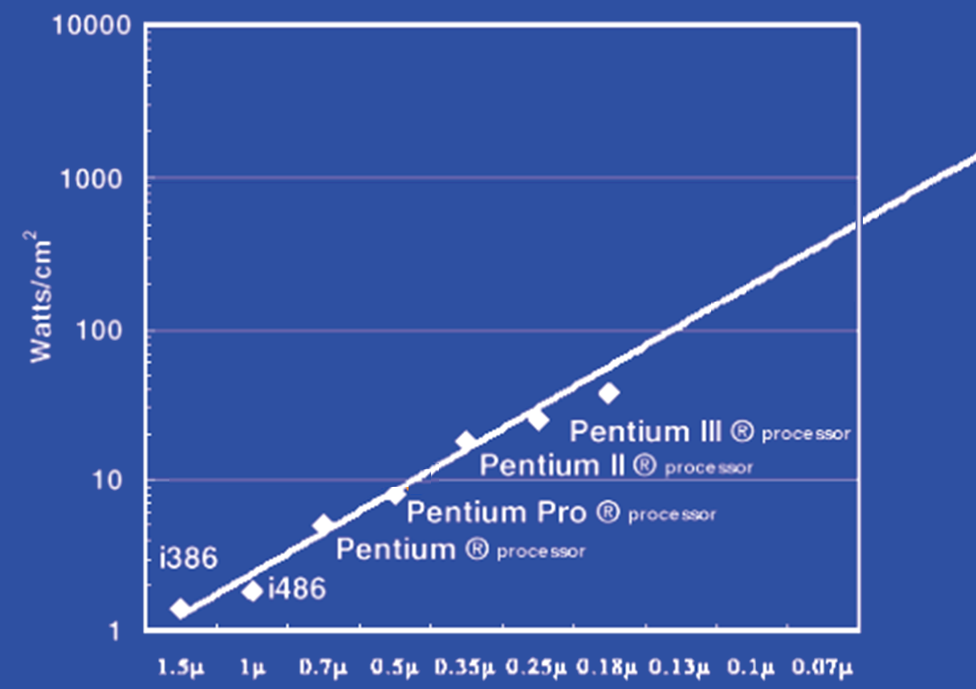
Power Limits
Surface of Sun
Rocket Nozzle
Nuclear Reactor
Xeon
Hot Plate
180nm
32nm
Notes:
Intel Westmere: 32 nm = 0.032u, 130W / 240mm^2 = 54 W/cm^2

Slide 43
Power Wall
Power = capacitance * voltage² * frequency
In practice: Power ~ voltage³
Reducing voltage helps (a lot)
... so does reducing clock speed
Better cooling helps
The power wall
  We can’t reduce voltage further
  We can’t remove more heat
Lower Frequency

Slide 44
Why Multicore?
Performance
1.2x
Single-Core
Overclocked +20%
Power
1.7x
Performance
1.0x
Power
Single-Core
1.0x
Performance
0.8x
1.6x
Single-Core
Underclocked -20%
Dual-Core
Underclocked -20%
Power
0.51x
1.02x

Slide 45
Power Efficiency
Q: Does multiple issue / ILP cost much?
A: Yes.
→ Dynamic issue and speculation requires power
CPU | Year | Clock Rate | Pipeline Stages | Issue width | Out-of-order/ Speculation | Cores | Power
i486 | 1989 | 25MHz | 5 | 1 | No | 1 | 5W
Pentium | 1993 | 66MHz | 5 | 2 | No | 1 | 10W
Pentium Pro | 1997 | 200MHz | 10 | 3 | Yes | 1 | 29W
P4 Willamette | 2001 | 2000MHz | 22 | 3 | Yes | 1 | 75W
UltraSparc III | 2003 | 1950MHz | 14 | 4 | No | 1 | 90W
P4 Prescott | 2004 | 3600MHz | 31 | 3 | Yes | 1 | 103W
Core | 2006 | 2930MHz | 14 | 4 | Yes | 2 | 75W
Core i5 Nehal | 2010 | 3300MHz | 14 | 4 | Yes | 1 | 87W
Core i5 Ivy Br | 2012 | 3400MHz | 14 | 4 | Yes | 8 | 77W
UltraSparc T1 | 2005 | 1200MHz | 6 | 1 | No | 8 | 70W
Those simpler cores did something very right.

Slide 46
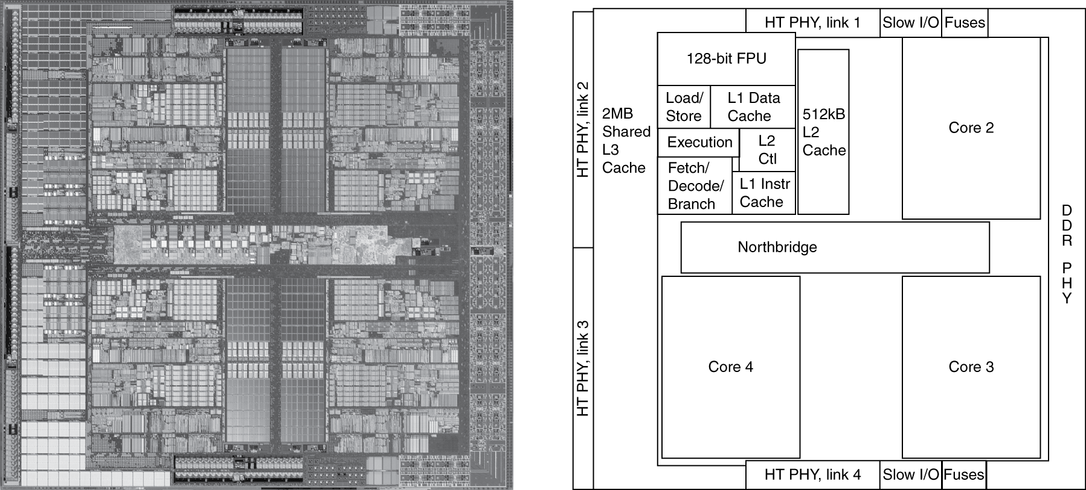
Inside the Processor
AMD Barcelona Quad-Core: 4 processor cores

Slide 47
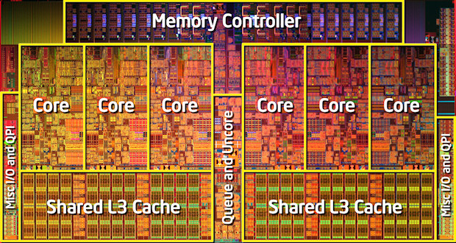
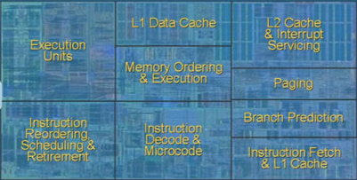
Inside the Processor
Intel Nehalem Hex-Core
4-wide pipeline

Slide 48
Hyperthreading
vs. HT
Multi-Core vs. Multi-Issue
Programs:
Num. Pipelines:
Pipeline Width:
Hyperthreads
  HT = MultiIssue + extra PCs and registers – dependency logic
  HT = MultiCore – redundant functional units + hazard avoidance
Hyperthreads (Intel)
  Illusion of multiple cores on a single core
  Easy to keep HT pipelines full + share functional units
N | 1 | N
N | 1 | 1
1 | N | N
Notes:
HT = MultiIssue + extra PCs and registers – dependency logic
HT = MultiCore – redundant functional units + hazard avoidance

Slide 49
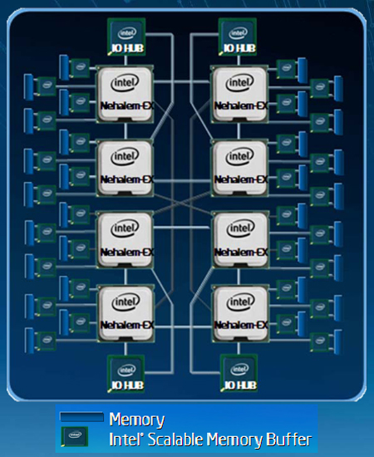
Example: All of the above
8 die (aka 8 sockets)
4 core per socket
2 HT per core
Note: a socket is a processor,
where each processor may
have multiple processing
cores, so this is an example
of a multiprocessor multicore
hyperthreaded system
Notes:
MultiCore: 8 processors dies * 8 cores per processor die
Hyperthreading: 2 HT per core
Dynamic Multi-Issue: 4 issue
Pipeline: 16 stages

Slide 50
Parallel Programming
Q: So lets just all use multicore from now on!
A: Software must be written as parallel program
Multicore difficulties
  Partitioning work
  Coordination & synchronization
  Communications overhead
  How do you write parallel programs?
    ... without knowing exact underlying architecture?
Notes:
Or hyperthreads

Slide 51
Work Partitioning
Partition work so all cores have something to do

Slide 52
Load Balancing
Load Balancing
Need to partition so all cores are actually working

Slide 53
Amdahl’s Law
If tasks have a serial part and a parallel part…
Example:
step 1: divide input data into n pieces
step 2: do work on each piece
step 3: combine all results
Recall: Amdahl’s Law
As number of cores increases …
  time to execute parallel part?
  time to execute serial part?
  Serial part eventually dominates
goes to zero
Remains the same

Slide 54
Amdahl’s Law
Notes:
Underclocking messes up the ratios completely. Work through a 8x slowdown example.

Slide 55
Parallelism is a necessity
Necessity, not luxury
Power wall
Not easy to get performance out of
Many solutions
Pipelining
Multi-issue
Hyperthreading
Multicore

Slide 56
Parallel Programming
Q: So lets just all use multicore from now on!
A: Software must be written as parallel program
Multicore difficulties
  Partitioning work
  Coordination & synchronization
  Communications overhead
  How do you write parallel programs?
    ... without knowing exact underlying architecture?
SW
Your
career…
HW
Notes:
Most is software, but hardware can help:
- communications (fast core-to-core interconnect)
- coordination and synchronization primitives (next time)

Slide 57
Big Picture: Parallelism and Synchronization
How do I take advantage of parallelism?
How do I write (correct) parallel programs?
What primitives do I need to implement correct parallel programs?

Slide 58
Parallelism & Synchronization
Cache Coherency
  Processors cache shared data → they see different (incoherent) values for the same memory location
Synchronizing parallel programs
  Atomic Instructions
  HW support for synchronization
How to write parallel programs
  Threads and processes
  Critical sections, race conditions, and mutexes

Slide 59
Parallelism and Synchronization
Cache Coherency Problem: What happens when to two or more processors cache shared data?

Slide 60
Parallelism and Synchronization
Cache Coherency Problem: What happens when to two or more processors cache shared data?
i.e. the view of memory held by two different processors is through their individual caches.
As a result, processors can see different (incoherent) values to the same memory location.

Slide 61
Parallelism and Synchronization

Slide 62
Parallelism and Synchronization
Each processor core has its own L1 cache

Slide 63
Parallelism and Synchronization
Each processor core has its own L1 cache

Slide 64
Parallelism and Synchronization
Each processor core has its own L1 cache
Core0
Core1
Core2
Core3
Cache
Cache
Cache
Cache
Interconnect
Memory
I/O

Slide 65
Shared Memory Multiprocessors
Shared Memory Multiprocessor (SMP)
  Typical (today): 2 – 4 processor dies, 2 – 8 cores each
  HW provides single physical address space for all processors
Core0
Core1
Core2
Core3
Cache
Cache
Cache
Cache
Interconnect
Memory
I/O
Notes:
How do they share data? How do they coordinate? How do they scale?
Assume physical addresses (ignore virtual memory)
Assume uniform memory access (ignore NUMA)

Slide 66
Shared Memory Multiprocessors
Shared Memory Multiprocessor (SMP)
  Typical (today): 2 – 4 processor dies, 2 – 8 cores each
  HW provides single physical address space for all processors
Core0
Core1
...
...
...
CoreN
Cache
Cache
Cache
Interconnect
Memory
I/O
Notes:
How do they share data? How do they coordinate? How do they scale?
Assume physical addresses (ignore virtual memory)
Assume uniform memory access (ignore NUMA)

Slide 67
Cache Coherency Problem
Thread A (on Core0) Thread B (on Core1)
for(int i = 0, i < 5; i++) { for(int j = 0; j < 5; j++) {
x = x + 1; x = x + 1;
} }
What will the value of x be after both loops finish?
Core0
Core1
...
...
...
CoreN
Cache
Cache
Cache
Interconnect
Memory
I/O
Notes:
How do they share data? How do they coordinate? How do they scale?

Slide 68
Cache Coherency Problem
Thread A (on Core0) Thread B (on Core1)
for(int i = 0, i < 5; i++) { for(int j = 0; j < 5; j++) {
x = x + 1; x = x + 1;
} }
What will the value of x be after both loops finish?
(x starts as 0)
6
8
10
Could be any of the above
Couldn’t be any of the above
Clicker Question
Notes:
How do they share data? How do they coordinate? How do they scale?

Slide 69
Cache Coherency Problem
Thread A (on Core0) Thread B (on Core1)
for(int i = 0, i < 5; i++) { for(int j = 0; j < 5; j++) {
x = x + 1; x = x + 1;
} }
What will the value of x be after both loops finish?
(x starts as 0)
6
8
10
Could be any of the above
Couldn’t be any of the above
Clicker Question
Notes:
How do they share data? How do they coordinate? How do they scale?

Slide 70
Cache Coherency Problem, WB $
Thread A (on Core0) Thread B (on Core1)
for(int i = 0, i < 5; i++) { for(int j = 0; j < 5; j++) {
LW $t0, addr(x) LW $t0, addr(x)
ADDIU $t0, $t0, 1 ADDIU $t0, $t0, 1
SW $t0, addr(x) SW $t0, addr(x)
} }
$t0=0
$t0=0
$t0=1
$t0=1
x=1
x=1
Problem!
Core0
Core1
...
...
...
CoreN
X
1
1
0
Cache
X
0
Cache
Cache
Interconnect
X
0
Memory
I/O
Notes:
How do they share data? How do they coordinate? How do they scale?

Slide 71
Not just a problem for Write-Back Caches
Executing on a write-thru cache
Time step | Event | CPU A’s cache | CPU B’s cache | Memory
0 |  |  |  | 0
Time step | Event | CPU A’s cache | CPU B’s cache | Memory
0 |  |  |  | 0
1 | CPU A reads X | 0 |  | 0
Time step | Event | CPU A’s cache | CPU B’s cache | Memory
0 |  |  |  | 0
1 | CPU A reads X | 0 |  | 0
2 | CPU B reads X | 0 | 0 | 0
Time step | Event | CPU A’s cache | CPU B’s cache | Memory
0 |  |  |  | 0
1 | CPU A reads X | 0 |  | 0
2 | CPU B reads X | 0 | 0 | 0
3 | CPU A writes 1 to X | 1 | 0 | 1
Core0
Core1
...
...
...
CoreN
Cache
Cache
Cache
Interconnect
Memory
I/O

Slide 72
Two issues
Coherence
What values can be returned by a read
Need a globally uniform (consistent) view of a single memory location
Solution: Cache Coherence Protocols
Consistency
When a written value will be returned by a read
Need a globally uniform (consistent) view of all memory locations relative to each other
Solution: Memory Consistency Models

Slide 73
Coherence Defined
Informal: Reads return most recently written value
Formal: For concurrent processes P₁ and P₂
  P writes X before P reads X (with no intervening writes)
  ⇒ read returns written value
    (preserve program order)
  P₁ writes X before P₂ reads X
  ⇒ read returns written value
    (coherent memory view, can’t read old value forever)
  P₁ writes X and P₂ writes X
  ⇒ all processors see writes in the same order
    all see the same final value for X
    Aka write serialization
    (else P_{A} can see P₂’s write before P₁’s and P_{B} can see the opposite; their final understanding of state is wrong)
Notes:
second case: for some definition of “before”
third case: see relativity
complication: clocks are not synchronized across cores
1 light nanosecond = 30cm, so 3GHz can do 1 instruction per 10cm

Slide 74
Cache Coherence Protocols
Operations performed by caches in multiprocessors to ensure coherence
  Migration of data to local caches
    Reduces bandwidth for shared memory
  Replication of read-shared data
    Reduces contention for access
Snooping protocols
  Each cache monitors bus reads/writes

Slide 75
Snooping
Snooping for Hardware Cache Coherence
  All caches monitor bus and all other caches
  Bus read: respond if you have dirty data
  Bus write: update/invalidate your copy of data
Snoop
Snoop
...
Snoop
Core0
Core1
...
...
CoreN
Snoop
Cache
Snoop
Cache
Snoop
Cache
Interconnect
Memory
I/O
Notes:
In reality: very complicated, lots of corner cases

Slide 76
Invalidating Snooping Protocols
Cache gets exclusive access to a block when it is to be written
  Broadcasts an invalidate message on the bus
  Subsequent read in another cache misses
    Owning cache supplies updated value
Time Step | CPU activity | Bus activity | CPU A’s cache | CPU B’s cache | Memory
0 |  |  |  |  | 0
1 | CPU A reads X | Cache miss for X | 0 |  | 0
Time Step | CPU activity | Bus activity | CPU A’s cache | CPU B’s cache | Memory
0 |  |  |  |  | 0
1 | CPU A reads X | Cache miss for X | 0 |  | 0
2 | CPU B reads X | Cache miss for X | 0 | 0 | 0
Time Step | CPU activity | Bus activity | CPU A’s cache | CPU B’s cache | Memory
0 |  |  |  |  | 0
1 | CPU A reads X | Cache miss for X | 0 |  | 0
2 | CPU B reads X | Cache miss for X | 0 | 0 | 0
3 | CPU A writes 1 to X | Invalidate for X | 1 |  | 0
Time Step | CPU activity | Bus activity | CPU A’s cache | CPU B’s cache | Memory
0 |  |  |  |  | 0
1 | CPU A reads X | Cache miss for X | 0 |  | 0
2 | CPU B reads X | Cache miss for X | 0 | 0 | 0
3 | CPU A writes 1 to X | Invalidate for X | 1 |  | 0
4 | CPU B read X | Cache miss for X | 1 | 1 | 1
Time Step | CPU activity | Bus activity | CPU A’s cache | CPU B’s cache | Memory
0 |  |  |  |  | 0

Slide 77
Writing
Write-back policies for bandwidth
Write-invalidate coherence policy
  First invalidate all other copies of data
  Then write it in cache line
  Anybody else can read it
Permits one writer, multiple readers
In reality: many coherence protocols
  Snooping doesn’t scale
  Directory-based protocols
    Caches and memory record sharing status of blocks in a directory

Slide 78
Hardware Cache Coherence
Coherence
  all copies have same data at all times
Coherence controller:
  Examines bus traffic (addresses and data)
  Executes coherence protocol
    What to do with local copy when you see different things happening on bus
Three processor-initiated events
  Ld: load
  St: store
  WB: write-back
Two remote-initiated events
  LdMiss: read miss from another processor
  StMiss: write miss from another processor
CPU
D$ data
CC
D$ tags
bus

Slide 79
VI Coherence Protocol
LdMiss/StMiss
VI (valid-invalid) protocol:
  Two states (per block in cache)
    V (valid): have block
    I (invalid): don’t have block
    Can implement with valid bit
Protocol diagram (left)
  If you load/store a block: transition to V
  If anyone else wants to read/write block:
    Give it up: transition to I state
    Write-back if your own copy is dirty
I
Load, Store
LdMiss, StMiss, WB
V
Load, Store

Slide 80
VI Protocol (Write-Back Cache)
Thread A
lw t0, 0(r3),
ADDIU $t0,$t0,1
sw t0,0(r3)
Thread B
lw t0, 0(r3)
ADDIU $t0,$t0,1
sw t0,0(r3)
CPU0
CPU1
Mem
0
V:0
0
V:1
0
I:
V:1
1
V:2
1
lw by Thread B generates an “other load miss” event (LdMiss)
  Thread A responds by sending its dirty copy, transitioning to I

Slide 81
VI Coherence Question
LdMiss/StMiss
Clicker Question:
  Core A loads x into a register
  Core B wants to load x into a register
  What happens?
  they can both have a copy of X in their cache
  A keeps the copy
  B steals the copy from A, and this is an efficient thing to do
  B steals the copy from A, and this is a sad shame
  B waits until A kicks X out of its cache, then it can complete the load
I
Load, Store
LdMiss, StMiss, WB
V
Load, Store

Slide 82
VI → MSI
LdMiss/StMiss
VI protocol is inefficient
  Only one cached copy allowed in entire system
  Multiple copies can’t exist even if read-only
    Not a problem in example
    Big problem in reality
MSI (modified-shared-invalid)
  Fixes problem: splits “V” state into two states
    M (modified): local dirty copy
    S (shared): local clean copy
  Allows either
    Multiple read-only copies (S-state) --OR--
    Single read/write copy (M-state)
I
Load
StMiss, WB
Store
StMiss
M
Store
S
LdMiss
Load, LdMiss
Load, Store

Slide 83
MSI Protocol (Write-Back Cache)
CPU0
CPU1
Mem
Thread A
lw t0, 0(r3),
ADDIU $t0,$t0,1
sw t0,0(r3)
Thread B
lw t0, 0(r3),
ADDIU $t0,$t0,1
sw t0,0(r3)
0
S:0
0
M:1
0
S:1
S:1
1
I:
M:2
1
lw by Thread B generates a “other load miss” event (LdMiss)
  Thread A responds by sending its dirty copy, transitioning to S
sw by Thread B generates a “other store miss” event (StMiss)
  Thread A responds by transitioning to I

Slide 84
Cache Coherence and Cache Misses
Coherence introduces two new kinds of cache misses
  Upgrade miss
    On stores to read-only blocks
    Delay to acquire write permission to read-only block
  Coherence miss
    Miss to a block evicted by another processor’s requests
Making the cache larger…
  Doesn’t reduce these type of misses
  As cache grows large, these sorts of misses dominate
False sharing
  Two or more processors sharing parts of the same block
  But not the same bytes within that block (no actual sharing)
  Creates pathological “ping-pong” behavior
  Careful data placement may help, but is difficult

Slide 85
More Cache Coherence
In reality: many coherence protocols
  Snooping: VI, MSI, MESI, MOESI, …
    But Snooping doesn’t scale
  Directory-based protocols
    Caches & memory record blocks’ sharing status in directory
    Nothing is free → directory protocols are slower!
Cache Coherency:
requires that reads return most recently written value
Is a hard problem!

Slide 86
Takeaway: Summary of cache coherence
Informally, Cache Coherency requires that reads return most recently written value
Cache coherence hard problem
Snooping protocols are one approach

Slide 87
Next Goal: Synchronization
Is cache coherency sufficient?
i.e. Is cache coherency (what values are read) sufficient to maintain consistency (when a written value will be returned to a read). Both coherency and consistency are required to maintain consistency in shared memory programs.

Slide 88
Are We Done Yet?
CPU0
CPU1
Mem
Thread A
lw t0, 0(r3)
ADDIU $t0,$t0,1
sw t0,0(x)
Thread B
lw t0, 0(r3)
ADDIU $t0,$t0,1
sw t0,0(x)
0
S:0
0
S:0
S:0
0
I:
M:1
0
M:1
I:
1
What just happened???
Is Cache Coherency Protocol Broken??

Slide 89
Is Cache Coherency Sufficient?
Thread A (on Core0) Thread B (on Core1)
for(int i = 0, i < 5; i++) { for(int j = 0; j < 5; j++) {
LW $t0, addr(x) LW $t0, addr(x)
ADDIU $t0, $t0, 1 ADDIU $t0, $t0, 1
SW $t0, addr(x) SW $t0, addr(x)
} }
Very expensive and difficult to maintain consistency
Core0
Core1
...
...
...
CoreN
Cache
Cache
Cache
Interconnect
Memory
I/O
Notes:
Is cache coherence enough? Maybe?
read (1) 40 read (3) 40
Inc (2) 41 inc (4) 41
Write (5) 41 write (6) 41
second case: for some definition of “before”
third case: see relativity
complication: clocks are not synchronized across cores
1 light nanosecond = 30cm, so 3GHz can do 1 instruction per 10cm

Slide 90
Clicker Question
The Previous example shows us that
Caches can be incoherent even if there is a coherence protocol.
Cache coherence protocols are not rich enough to support multi-threaded programs
Coherent caches are not enough to guarantee expected program behavior.
Multithreading is just a really bad idea.
All of the above

Slide 91
Clicker Question
The Previous example shows us that
Caches can be incoherent even if there is a coherence protocol.
Cache coherence protocols are not rich enough to support multi-threaded programs
Coherent caches are not enough to guarantee expected program behavior.
Multithreading is just a really bad idea.
All of the above

Slide 92
Programming with Threads
Need it to exploit multiple processing units
…to parallelize for multicore
…to write servers that handle many clients
Problem: hard even for experienced programmers
  Behavior can depend on subtle timing differences
  Bugs may be impossible to reproduce
Needed: synchronization of threads

Slide 93
Programming with threads
Within a thread: execution is sequential
Between threads?
  No ordering or timing guarantees
  Might even run on different cores at the same time
Problem: hard to program, hard to reason about
  Behavior can depend on subtle timing differences
  Bugs may be impossible to reproduce
Cache coherency is not sufficient…
Need explicit synchronization to make sense of concurrency!

Slide 94
Programming with Threads
Concurrency poses challenges for:
Correctness
  Threads accessing shared memory should not interfere with each other
Liveness
  Threads should not get stuck, should make forward progress
Efficiency
  Program should make good use of available computing resources (e.g., processors).
Fairness
  Resources apportioned fairly between threads

Slide 95
Example: Multi-Threaded Program
Apache web server
void main() {
setup();
while (c = accept_connection()) {
req = read_request(c);
hits[req]++;
send_response(c, req);
}
cleanup();
}
Notes:
Use fork
Use threads

Slide 96
Example: web server
Each client request handled by a separate thread (in parallel)
  Some shared state: hit counter, ...
(look familiar?)
Timing-dependent failure ⇒ race condition
  hard to reproduce ⇒ hard to debug
Thread 52
read hits
addiu
write hits
Thread 205
read hits
addiu
write hits
Thread 52
...
hits = hits + 1;
...
Thread 205
...
hits = hits + 1;
...
Notes:
What happens when two threads execute concurrently?
sequential with threads
between threads is unsynchronized

Slide 97
Two threads, one counter
Possible result: lost update!
Timing-dependent failure ⇒ race condition
  Very hard to reproduce ⇒ Difficult to debug
hits = 0
T1
T2
time
LW (0)
LW (0)
ADDIU/SW: hits = 0 + 1
ADDIU/SW: hits = 0 + 1
hits = 1

Slide 98
Race conditions
Timing-dependent error involving access to shared state
Race conditions depend on how threads are scheduled
  i.e. who wins “races” to update state
Challenges of Race Conditions
  Races are intermittent, may occur rarely
  Timing dependent = small changes can hide bug
Program is correct only if all possible schedules are safe
Number of possible schedules is huge
Imagine adversary who switches contexts at worst possible time

Slide 99
Critical Sections
What if we can designate parts of the execution as critical sections
  Rule: only one thread can be “inside” a critical section
Thread 52
CSEnter()
read hits
addi
write hits
CSExit()
Thread 52
read hits
addi
write hits
Thread 205
CSEnter()
read hits
addi
write hits
CSExit()
Thread 205
read hits
addi
write hits
Notes:
Show picture

Slide 100
Critical Sections
To eliminate races: use critical sections that only one thread can be in
  Contending threads must wait to enter
T1
T2
time
CSEnter();
  Critical section
CSExit();
CSEnter();
  # wait
  # wait
  Critical section
CSExit();
T1
T2

Slide 101
Mutual Exclusion Lock (Mutex)
Implement CSEnter and CSExit; ie. a critical section
Only one thread can hold the lock at a time
“I have the lock”
Mutual Exclusion Lock (mutex)
lock(m): wait till it becomes free, then lock it
unlock(m): unlock it
safe_increment() {
pthread_mutex_lock(&m);
hits = hits + 1;
pthread_mutex_unlock(&m);
}

Slide 102
Mutexes
Only one thread can hold a given mutex at a time
Acquire (lock) mutex on entry to critical section
  Or block if another thread already holds it
Release (unlock) mutex on exit
  Allow one waiting thread (if any) to acquire & proceed
pthread_mutex_init(&m);
pthread_mutex_lock(&m);
# wait
# wait
  hits = hits+1;
pthread_mutex_unlock(&m);
pthread_mutex_lock(&m);
  hits = hits+1;
pthread_mutex_unlock(&m);
T1
T2

Slide 103
Next Goal
How to implement mutex locks?
What are the hardware primitives?
Then, use these mutex locks to implement critical sections, and use critical sections to write parallel safe programs

Slide 104
Hardware Support for Synchronization
Atomic read & write memory operation
  Between read & write: no writes to that address
Many atomic hardware primitives
test and set (x86)
atomic increment (x86)
bus lock prefix (x86)
compare and exchange (x86, ARM deprecated)
linked load / store conditional (pair of insns)
(MIPS, ARM, PowerPC, DEC Alpha, …)

Slide 105
Synchronization in MIPS
Load linked: LL rt, offset(rs)
“I want the value at address X. Also, start monitoring any writes to this address.”
Store conditional: SC rt, offset(rs)
“If no one has changed the value at address X since the LL, perform this store and tell me it worked.”
  Data at location has not changed since the LL?
    SUCCESS:
      Performs the store
      Returns 1 in rt
  Data at location has changed since the LL?
    FAILURE:
      Does not perform the store
      Returns 0 in rt

Slide 106
Synchronization in MIPS
Load linked: LL rt, offset(rs)
Store conditional: SC rt, offset(rs)
  Succeeds if location not changed since the LL
    Returns 1 in rt
  Fails if location is changed
    Returns 0 in rt
Any time a processor intervenes and modifies the value in memory between the LL and SC instruction, the SC returns 0 in $t0, causing the code to try again.
i.e. use this value 0 in $t0 to try again.

Slide 107
Synchronization in MIPS
Load linked: LL rt, offset(rs)
Store conditional: SC rt, offset(rs)
  Succeeds if location not changed since the LL
    Returns 1 in rt
  Fails if location is changed
    Returns 0 in rt
Example: atomic incrementor
i++
↓
LW $t0, 0($s0)
ADDIU $t0, $t0, 1
SW $t0, 0($s0)
atomic(i++)
↓
LL $t0, 0($s0)
ADDIU $t0, $t0, 1
SC $t0, 0($s0)
BEQZ $t0, try
try:
Value in memory changed between LL and SC ?
→ SC returns 0 in $t0 → retry

Slide 108
Atomic Increment in Action
Load linked: LL $t0, offset($s0)
Store conditional: SC $t0, offset($s0)
Time | Thread A | Thread B | Thread A $t0 | Thread B $t0 | Mem [$s0]
0 |  |  |  |  | 0
1 | try: LL $t0, 0($s0)
2 |  | try: LL $t0, 0($s0)
3 | ADDIU $t0, $t0, 1
4 |  | ADDIU $t0, $t0, 1
5 | SC $t0, 0($s0)
6 | BEQZ $t0, try
7 |  | SC $t0, 0 ($s0)
8 |  | BEQZ $t0, try

Slide 109
Atomic Increment in Action
Load linked: LL $t0, offset($s0)
Store conditional: SC $t0, offset($s0)
Time | Thread A | Thread B | Thread A $t0 | Thread B $t0 | Mem [$s0]
0 |  |  |  |  | 0
1 | try: LL $t0, 0($s0) |  | 0 |  | 0
2 |  | try: LL $t0, 0($s0) |  | 0 | 0
3 | ADDIU $t0, $t0, 1 |  | 1 | 0 | 0
4 |  | ADDIU $t0, $t0, 1 | 1 | 1 | 0
5 | SC $t0, 0($s0) |  | 1 | 1 | 1
6 | BEQZ $t0, try |  | 1 | 1 | 1
7 |  | SC $t0, 0 ($s0) | 1 | 0 | 1
8 |  | BEQZ $t0, try | 1 | 0 | 1
Success!
Failure!

Slide 110
Mutex from LL and SC
Linked load / Store Conditional
m = 0; // m=0 means lock is free; otherwise, if m=1, then lock locked
mutex_lock(int *m) {
while(test_and_set(m)){}
}
int test_and_set(int *m) {
old = *m;
*m = 1;
return old;
}
LL Atomic
SC
Notes:
LL just like LW
SC jus like SW, but overwrites src register with 1 “success” or 0 “fail”

Slide 111
Mutex from LL and SC
Linked load / Store Conditional
m = 0; // m=0 means lock is free; otherwise, if m=1, then lock locked
mutex_lock(int *m) {
while(test_and_set(m)){}
}
int test_and_set(int *m) {
LI $t0, 1
LL $t1, 0($a0)
SC $t0, 0($a0)
MOVE $v0, $t1
}
try:
BEQZ $t0, try
Notes:
LL just like LW
SC jus like SW, but overwrites src register with 1 “success” or 0 “fail”

Slide 112
Mutex from LL and SC
Linked load / Store Conditional
m = 0; // m=0 means lock is free; otherwise, if m=1, then lock locked
mutex_lock(int *m) {
while(test_and_set(m)){}
}
int test_and_set(int *m) {
try:
LI $t0, 1
LL $t1, 0($a0)
SC $t0, 0($a0)
BEQZ $t0, try
MOVE $v0, $t1
}
Notes:
LL just like LW
SC jus like SW, but overwrites src register with 1 “success” or 0 “fail”

Slide 113
Mutex from LL and SC
Linked load / Store Conditional
m = 0; // m=0 means lock is free; otherwise, if m=1, then lock locked
mutex_lock(int *m) {
test_and_set:
LI $t0, 1
LL $t1, 0($a0)
BNEZ $t1, test_and_set
SC $t0, 0($a0)
BEQZ $t0, test_and_set
}
mutex_unlock(int *m) {
*m = 0;
}
Notes:
LL just like LW
SC jus like SW, but overwrites src register with 1 “success” or 0 “fail”

Slide 114
Mutex from LL and SC
Linked load / Store Conditional
m = 0; // m=0 means lock is free; otherwise, if m=1, then lock locked
mutex_lock(int *m) {
test_and_set:
LI $t0, 1
LL $t1, 0($a0)
BNEZ $t1, test_and_set
SC $t0, 0($a0)
BEQZ $t0, test_and_set
}
mutex_unlock(int *m) {
SW $zero, 0($a0)
}
This is called a
Spin lock
Aka spin waiting
Notes:
LL just like LW
SC jus like SW, but overwrites src register with 1 “success” or 0 “fail”

Slide 115
Mutex from LL and SC
Linked load / Store Conditional
m = 0; // m=0 means lock is free; otherwise, if m=1, then lock locked
mutex_lock(int *m) {
Time Step | Thread A | Thread B | ThreadA $t0 | ThreadA $t1 | ThreadB $t0 | ThreadB $t1 | Mem M[$a0]
0 |  |  |  |  |  |  | 0
1 | try: LI $t0, 1 | try: LI $t0, 1
2 | LL $t1, 0($a0) | LL $t1, 0($a0)
3 | BNEZ $t1, try | BNEZ $t1, try
4 |  | SC $t0, 0 ($a0)
5 | SC $t0, 0($a0)
6 | BEQZ $t0, try | BEQZ $t0, try
7
Notes:
LL just like LW
SC jus like SW, but overwrites src register with 1 “success” or 0 “fail”

Slide 116
Mutex from LL and SC
Linked load / Store Conditional
m = 0; // m=0 means lock is free; otherwise, if m=1, then lock locked
mutex_lock(int *m) {
Time Step | Thread A | Thread B | ThreadA $t0 | ThreadA $t1 | ThreadB $t0 | ThreadB $t1 | Mem M[$a0]
0 |  |  |  |  |  |  | 0
1 | try: LI $t0, 1 | try: LI $t0, 1 | 1 |  | 1 |  | 0
2 | LL $t1, 0($a0) | LL $t1, 0($a0) | 1 | 0 | 1 | 0 | 0
3 | BNEZ $t1, try | BNEZ $t1, try | 1 | 0 | 1 | 0 | 0
4 |  | SC $t0, 0 ($a0) | 0 | 0 | 1 | 0 | 1
5 | SC $t0, 0($a0) |  | 0 | 0 | 1 | 0 | 1
6 | BEQZ $t0, try | BEQZ $t0, try | 0 | 0 | 1 | 0 | 1
7
Notes:
LL just like LW
SC jus like SW, but overwrites src register with 1 “success” or 0 “fail”

Slide 117
Mutex from LL and SC
Linked load / Store Conditional
m = 0; // m=0 means lock is free; otherwise, if m=1, then lock locked
mutex_lock(int *m) {
Time Step | Thread A | Thread B | ThreadA $t0 | ThreadA $t1 | ThreadB $t0 | ThreadB $t1 | Mem M[$a0]
0 |  |  |  |  |  |  | 0
1 | try: LI $t0, 1 | try: LI $t0, 1 | 1 |  | 1 |  | 0
2 | LL $t1, 0($a0) | LL $t1, 0($a0) | 1 | 0 | 1 | 0 | 0
3 | BNEZ $t1, try | BNEZ $t1, try | 1 | 0 | 1 | 0 | 0
4 |  | SC $t0, 0 ($a0) | 0 | 0 | 1 | 0 | 1
5 | SC $t0, 0($a0) |  | 0 | 0 | 1 | 0 | 1
6 | BEQZ $t0, try | BEQZ $t0, try | 0 | 0 | 1 | 0 | 1
 | try: LI $t0, 1 | Critical section
Failed to get mutex lock – try again
Success grabbing mutex lock!
Inside Critical section
Notes:
LL just like LW
SC jus like SW, but overwrites src register with 1 “success” or 0 “fail”

Slide 118
Mutex from LL and SC
Linked load / Store Conditional
m = 0; // m=0 means lock is free; otherwise, if m=1, then lock locked
mutex_lock(int *m) {
test_and_set:
LI $t0, 1
LL $t1, 0($a0)
BNEZ $t1, test_and_set
SC $t0, 0($a0)
BEQZ $t0, test_and_set
}
mutex_unlock(int *m) {
SW $zero, 0($a0)
}
This is called a
Spin lock
Aka spin waiting
Notes:
LL just like LW
SC jus like SW, but overwrites src register with 1 “success” or 0 “fail”

Slide 119
Mutex from LL and SC
Linked load / Store Conditional
m = 0; // m=0 means lock is free; otherwise, if m=1, then lock locked
mutex_lock(int *m) {
Time Step | Thread A | Thread B | ThreadA $t0 | ThreadA $t1 | ThreadB $t0 | ThreadB $t1 | Mem M[$a0]
0 |  |  |  |  |  |  | 1
1 | try: LI $t0, 1 | try: LI $t0, 1
2
3
4
5
6
7
8
9
Notes:
LL just like LW
SC jus like SW, but overwrites src register with 1 “success” or 0 “fail”

Slide 120
Mutex from LL and SC
Linked load / Store Conditional
m = 0; // m=0 means lock is free; otherwise, if m=1, then lock locked
mutex_lock(int *m) {
Time Step | Thread A | Thread B | ThreadA $t0 | ThreadA $t1 | ThreadB $t0 | ThreadB $t1 | Mem M[$a0]
0 |  |  |  |  |  |  | 1
1 | try: LI $t0, 1 | try: LI $t0, 1 | 1 |  | 1 |  | 1
2 | LL $t1, 0($a0) | LL $t1, 0($a0) | 1 | 1 | 1 | 1 | 1
3 | BNEZ $t1, try | BNEZ $t1, try | 1 | 1 | 1 | 1 | 1
4 | try: LI $t0, 1 | try: LI $t0, 1 | 1 | 1 | 1 | 1 | 1
5 | LL $t1, 0($a0) | LL $t1, 0($a0) | 1 | 1 | 1 | 1 | 1
6 | BNEZ $t1, try | BNEZ $t1, try | 1 | 1 | 1 | 1 | 1
7 | try: LI $t0, 1 | try: LI $t0, 1 | 1 | 1 | 1 | 1 | 1
8 | LL $t1, 0($a0) | LL $t1, 0($a0) | 1 | 1 | 1 | 1 | 1
9 | BNEZ $t1, try | BNEZ $t1, try | 1 | 1 | 1 | 1 | 1
Notes:
LL just like LW
SC jus like SW, but overwrites src register with 1 “success” or 0 “fail”

Slide 121
Now we can write parallel and correct programs
Thread A Thread B
for(int i = 0, i < 5; i++) { for(int j = 0; j < 5; j++) {
x = x + 1; x = x + 1;
} }
mutex_lock(m); mutex_lock(m);
mutex_unlock(m); mutex_unlock(m);
Notes:
Can be done using lock,
Also can be done using atomic increment.

Slide 122
Alternative Atomic Instructions
Other atomic hardware primitives
- test and set (x86)
- atomic increment (x86)
- bus lock prefix (x86)
- compare and exchange (x86, ARM deprecated)
- linked load / store conditional
(MIPS, ARM, PowerPC, DEC Alpha, …)
Notes:
hardware implementation: lock bus while read-modify-write cycle happens, very expensive

Slide 123
Synchronization
Synchronization techniques
clever code
  must work despite adversarial scheduler/interrupts
  used by: hackers
  also: noobs
disable interrupts
  used by: exception handler, scheduler, device drivers, …
disable preemption
  dangerous for user code, but okay for some kernel code
mutual exclusion locks (mutex)
  general purpose, except for some interrupt-related cases
Notes:
device drivers if interrupts always go to same core

Slide 124
Summary
Need parallel abstractions, especially for multicore
Writing correct programs is hard
Need to prevent data races
Need critical sections to prevent data races
Mutex, mutual exclusion, implements critical section
Mutex often implemented using a lock abstraction
Hardware provides synchronization primitives such as LL and SC (load linked and store conditional) instructions to efficiently implement locks

Slide 125
Next Goal
How do we use synchronization primitives to build concurrency-safe data structure?

Slide 126
Producer/Consumer Example (1)
Access to shared data must be synchronized
  Goal: enforce datastructure invariants
// invariant:
// data is in A[h … t-1]
char A[100];
int h = 0, t = 0;
// producer: add to list tail
void put(char c) {
A[t] = c;
t = (t+1)%n;
}
head
tail
1
2
3
Notes:
draw picture
invariant broken just before last/first increments
needs: make the list into a ring buffer, add code in writer to wait if list is full

Slide 127
Producer/Consumer Example (1)
Access to shared data must be synchronized
  Goal: enforce datastructure invariants
// invariant:
// data is in A[h … t-1]
char A[100];
int h = 0, t = 0;
// producer: add to list tail
void put(char c) {
A[t] = c;
t = (t+1)%n;
}
head
tail
1
2
3
4
// consumer: take from list head
char get() {
while (h == t) { };
char c = A[h];
h = (h+1)%n;
return c;
}
Notes:
draw picture
invariant broken just before last/first increments
needs: make the list into a ring buffer, add code in writer to wait if list is full

Slide 128
Producer/Consumer Example (1)
Access to shared data must be synchronized
  Goal: enforce datastructure invariants
// invariant:
// data is in A[h … t-1]
char A[100];
int h = 0, t = 0;
// producer: add to list tail
void put(char c) {
A[t] = c;
t = (t+1)%n;
}
head
tail
2
3
4
// consumer: take from list head
char get() {
while (h == t) { };
char c = A[h];
h = (h+1)%n;
return c;
}
What is wrong with code?
Will lose update to t and/or h
Invariant is not upheld
Will produce if full
Will consume if empty
All of the above
Notes:
draw picture
invariant broken just before last/first increments
needs: make the list into a ring buffer, add code in writer to wait if list is full

Slide 129
Producer/Consumer Example (1)
Access to shared data must be synchronized
  Goal: enforce datastructure invariants
// invariant:
// data is in A[h … t-1]
char A[100];
int h = 0, t = 0;
// producer: add to list tail
void put(char c) {
A[t] = c;
t = (t+1)%n; ←
}
head
tail
2
3
4
// consumer: take from list head
char get() {
→ while (h == t) { };
char c = A[h];
→ h = (h+1)%n;
return c;
}
What is wrong with the code?
Could miss an update to t or h
Breaks invariant: only produce if not full and only consume if not empty
→ Need to synchronize access to shared data
Notes:
draw picture
invariant broken just before last/first increments
needs: make the list into a ring buffer, add code in writer to wait if list is full

Slide 130
Producer/Consumer Example (1)
Access to shared data must be synchronized
  Goal: enforce datastructure invariants
// invariant:
// data is in A[h … t-1]
char A[100];
int h = 0, t = 0;
// producer: add to list tail
void put(char c) {
A[t] = c;
t = (t+1)%n;
}
head
tail
2
3
4
// consumer: take from list head
char get() {
while (h == t) { };
char c = A[h];
h = (h+1)%n;
return c;
}
acquire-lock()
acquire-lock()
acquire-lock()
acquire-lock()
Rule of thumb: all access and updates that can affect
invariant become critical sections
Notes:
draw picture
invariant broken just before last/first increments
needs: make the list into a ring buffer, add code in writer to wait if list is full

Slide 131
Protecting an invariant Example (2)
// invariant: (protected by mutex m)
// data is in A[h … t-1]
pthread_mutex_t *m = pthread_mutex_create();
char A[100];
int h = 0, t = 0;
// producer: add to list tail
void put(char c) {
pthread_mutex_lock(m);
A[t] = c;
t = (t+1)%n;
pthread_mutex_unlock(m);
}
Does this fix work?
// consumer: take from list head
char get() {
pthread_mutex_lock(m);
while(h == t) {}
char c = A[h];
h = (h+1)%n;
pthread_mutex_unlock(m);
return c;
}
Rule of thumb: all access and updates that can affect
invariant become critical sections
Notes:
bug: can’t do busy waiting inside mutex… what to do?

Slide 132
Protecting an invariant Example (2)
// invariant: (protected by mutex m)
// data is in A[h … t-1]
pthread_mutex_t *m = pthread_mutex_create();
char A[100];
int h = 0, t = 0;
// producer: add to list tail
void put(char c) {
pthread_mutex_lock(m);
A[t] = c;
t = (t+1)%n;
pthread_mutex_unlock(m);
}
Does this fix work?
BUG: Can’t wait while holding lock
// consumer: take from list head
char get() {
pthread_mutex_lock(m);
while(h == t) {}
char c = A[h];
h = (h+1)%n;
pthread_mutex_unlock(m);
return c;
}
Rule of thumb: all access and updates that can affect
invariant become critical sections
Notes:
bug: can’t do busy waiting inside mutex… what to do?

Slide 133
Guidelines for successful mutexing
Insufficient locking can cause races
  Skimping on mutexes? Just say no!
Poorly designed locking can cause deadlock
  know why you are using mutexes!
  acquire locks in a consistent order to avoid cycles
  use lock/unlock like braces (match them lexically)
    lock(&m); …; unlock(&m)
    watch out for return, goto, and function calls!
    watch out for exception/error conditions!
  P1: lock(m1);
  lock(m2);
  P2: lock(m2);
  lock(m1);
Circular
Wait

Slide 134
Beyond mutexes Example (3)
Writers must check for full buffer
& Readers must check for empty buffer
  ideal: don’t busy wait… go to sleep instead
while(empty) {}
char get() {
acquire(L);
char c = A[h];
h = (h+1)%n;
release(L);
return c;
}
head
last==head
empty

Slide 135
Beyond mutexes Example (3)
Writers must check for full buffer
& Readers must check for empty buffer
  ideal: don’t busy wait… go to sleep instead
Cannot check condition while
Holding the lock,
BUT, empty condition may no
longer hold in critical section
char get() {
acquire(L);
while (h == t) { };
char c = A[h];
h = (h+1)%n;
release(L);
return c;
}
char get() {
while (h == t) { };
acquire(L);
char c = A[h];
h = (h+1)%n;
release(L);
return c;
}
char get() {
acquire(L);
char c = A[h];
h = (h+1)%n;
release(L);
return c;
}
head
last==head
empty
Dilemma: Have to check while holding lock,

Slide 136
Beyond mutexes Example (3)
Writers must check for full buffer
& Readers must check for empty buffer
  ideal: don’t busy wait… go to sleep instead
char get() {
acquire(L);
while (h == t) { };
char c = A[h];
h = (h+1)%n;
release(L);
return c;
}
char get() {
acquire(L);
char c = A[h];
h++;
release(L);
return c;
}
Dilemma: Have to check while holding lock,
but cannot wait while hold lock

Slide 137
Beyond mutexes Example (4)
Writers must check for full buffer
& Readers must check for empty buffer
  ideal: don’t busy wait… go to sleep instead
char get() {
do {
acquire(L);
empty = (h == t);
if (!empty) {
c = A[h];
h = (h+1)%n;
}
release(L);
} while (empty);
return c;
}
Does this work?
Yes
no
Notes:
Works, but wasteful sin will spin wait

Slide 138
Beyond mutexes Example (4)
Writers must check for full buffer
& Readers must check for empty buffer
  ideal: don’t busy wait… go to sleep instead
char get() {
do {
acquire(L);
empty = (h == t);
if (!empty) {
c = A[h];
h = (h+1)%n;
}
release(L);
} while (empty);
return c;
}
It works.
But, it is wasteful
Due to the spinning
Notes:
Works, but wasteful sin will spin wait

Slide 139
Language-level Synchronization

Slide 140
Condition variables
Use [Hoare] a condition variable to wait for a condition to become true (without holding lock!)
wait(m, c) :
  atomically release m and sleep, waiting for condition c
  wake up holding m sometime after c was signaled
signal(c) : wake up one thread waiting on c
broadcast(c) : wake up all threads waiting on c
POSIX (e.g., Linux): pthread_cond_wait, pthread_cond_signal, pthread_cond_broadcast

Slide 141
Using a condition variable Example (5)
wait(m, c) : release m, sleep until c, wake up holding m
signal(c) : wake up one thread waiting on c
cond_t *not_full = ...;
cond_t *not_empty = ...;
mutex_t *m = ...;
void put(char c) {
lock(m);
while ((t-h) % n == 1)
wait(m, not_full);
A[t] = c;
t = (t+1) % n;
unlock(m);
signal(not_empty);
}
char get() {
lock(m);
while (t == h)
wait(m, not_empty);
char c = A[h];
h = (h+1) % n;
unlock(m);
signal(not_full);
return c;
}

Slide 142
Monitors
A Monitor is a concurrency-safe datastructure, with…
  one mutex
  some condition variables
  some operations
All operations on monitor acquire/release mutex
  one thread in the monitor at a time
Ring buffer was a monitor
Java, C#, etc., have built-in support for monitors

Slide 143
Java concurrency
Java objects can be monitors
  “synchronized” keyword locks/releases the mutex
  Has one (!) builtin condition variable
    o.wait() = wait(o, o)
    o.notify() = signal(o)
    o.notifyAll() = broadcast(o)
  Java wait() can be called even when mutex is not held. Mutex not held when awoken by signal(). Useful?

Slide 144
Language-level Synchronization
Lots of synchronization variations…
Reader/writer locks
  Any number of threads can hold a read lock
  Only one thread can hold the writer lock
Semaphores
  N threads can hold lock at the same time
Monitors
  Concurrency-safe data structure with 1 mutex
  All operations on monitor acquire/release mutex
  One thread in the monitor at a time
Message-passing, sockets, queues, ring buffers, …
  transfer data and synchronize

Slide 145
Summary
Hardware Primitives: test-and-set, LL/SC, barrier, ...
… used to build …
Synchronization primitives: mutex, semaphore, ...
… used to build …
Language Constructs: monitors, signals, ...

