Slide 1
Syscalls, exceptions, and interrupts, …oh my!
Hakim Weatherspoon
CS 3410
Computer Science
Cornell University
The slides are the product of many rounds of teaching CS 3410 by Deniz Altinbuken, Professors Weatherspoon, Bala, Bracy, and Sirer.

Slide 2
Announcements
C practice assignment
Due Monday, April 23rd
P4-Buffer Overflow is due tomorrow
Due Wednesday, April 18th
P5-Cache Collusion!
Due Friday, April 27th

Slide 3
Outline for Today
How do we protect processes from one another?
Skype should not crash Chrome.
How do we protect the operating system (OS) from other processes?
Chrome should not crash the computer!
How does the CPU and OS (software) handle exceptional conditions?
Division by 0, Page Fault, Syscall, etc.

Slide 4
Outline for Today
How do we protect processes from one another?
Skype should not crash Chrome.
How do we protect the operating system (OS) from other processes?
Chrome should not crash the computer!
How does the CPU and OS (software) handle exceptional conditions?
Division by 0, Page Fault, Syscall, etc.
Operating System
Privileged Mode
Traps, System calls, Exceptions, Interrupts

Slide 5
Meltdown and Spectre Security Bug

Slide 6
Operating System

Slide 7
Operating System
Manages all of the software and hardware on the computer.
Many processes running at the same time, requiring resources
CPU, Memory, Storage, etc.
The Operating System multiplexes these resources amongst different processes, and isolates and protects processes from one another!

Slide 8
Operating System
Operating System (OS) is a trusted mediator:
Safe control transfer between processes
Isolation (memory, registers) of processes
untrusted
P1
P2
P3
P4
VM
filesystem
net
software
trusted
driver
driver
OS
MMU
CPU
disk
netw
card
hardware

Slide 9
Outline for Today
How do we protect processes from one another?
Skype should not crash Chrome.
How do we protect the operating system (OS) from other processes?
Chrome should not crash the computer!
How does the CPU and OS (software) handle exceptional conditions?
Division by 0, Page Fault, Syscall, etc.
Operating System
Privileged Mode
Traps, System calls, Exceptions, Interrupts

Slide 10
Privileged (Kernel) Mode
Notes:
How do you ENFORCE this trusted abstraction?

Slide 11
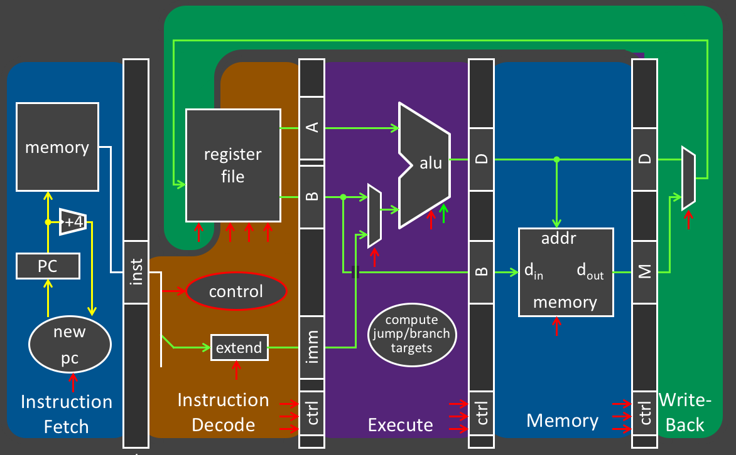
One Brain, Many Personalities
You are what you execute.
Personalities:
hailstone_recursive
Microsoft Word
Minecraft
Linux ← yes, this is just software like
every other program
that runs on the CPU
Are they all equal?
Brain

Slide 12
Trusted vs. Untrusted
Only trusted processes should access & change important things
Editing TLB, Page Tables, OS code, OS $sp, OS $fp…
If an untrusted process could change the OS’ $sp/$fp/$gp/etc., OS would crash!

Slide 13
Privileged Mode
CPU Mode Bit in Process Status Register
Many bits about the current process
Mode bit is just one of them
Mode bit:
0 = user mode = untrusted:
“Privileged” instructions and registers are
disabled by CPU
1 = kernel mode = trusted
All instructions and registers are enabled

Slide 14
Privileged Mode at Startup
Boot sequence
load first sector of disk (containing OS code) to predetermined address in memory
Mode ← 1; PC ← predetermined address
2. OS takes over
initializes devices, MMU, timers, etc.
loads programs from disk, sets up page tables, etc.
Mode ← 0; PC ← program entry point
User programs regularly yield control back to OS

Slide 15
Users need access to resources
If an untrusted process does not have privileges to use system resources, how can it
Use the screen to print?
Send message on the network?
Allocate pages?
Schedule processes?
Solution: System Calls

Slide 16
System Call Examples
putc(): Print character to screen
Need to multiplex screen between competing processes
send(): Send a packet on the network
Need to manipulate the internals of a device
sbrk(): Allocate a page
Needs to update page tables & MMU
sleep(): put current prog to sleep, wake other
Need to update page table base register

Slide 17
System Calls
System call: Not just a function call
Don’t let process jump just anywhere in OS code
OS can’t trust process’ registers (sp, fp, gp, etc.)
SYSCALL instruction: safe transfer of control to OS
MIPS system call convention:
Exception handler saves temp regs, saves ra, …
but: $v0 = system call number, which specifies the operation the application is requesting
Notes:
Mode ← 0; Cause ← syscall; PC ← exception vector

Slide 18
User Application
printf()
System Call Interface
User Mode
Privileged (Kernel) Mode
SYSCALL!
0xfffffffc
system reserved
top
printf.c
Implementation
of printf() syscall!
0x80000000
0x7ffffffc
stack
dynamic data (heap)
0x10000000
static data
.data
code (text)
.text
0x00400000
0x00000000
system reserved
bottom

Slide 19
Libraries and Wrappers
Compilers do not emit SYSCALL instructions
Compiler doesn’t know OS interface
Libraries implement standard API from system API
libc (standard C library):
getc() → syscall
sbrk() → syscall
write() → syscall
gets() → getc()
printf() → write()
malloc() → sbrk()
…

Slide 20
Invoking System Calls
char *gets(char *buf) {
while (...) {
buf[i] = getc();
}
}
int getc() {
asm("addiu $v0, $0, 4");
asm("syscall");
}
4 is number for getc syscall
Notes:
Inline assembly
4 is getc syscall name!

Slide 21
Anatomy of a Process, v1
0xfffffffc
system reserved
system reserved
0x80000000
0x7ffffffc
stack
(stack grows down)
(.stack)
(heap grows up)
(static) data
.data
dynamic data (heap)
text
.text
0x10000000
??
static data
code
(text)
(user) gets
0x00400000
reserved
(library) getc
0x00000000
system reserved

Slide 22
Where does the OS live?
In its own address space?
Syscall has to switch to a different address space
Hard to support syscall arguments passed as pointers
. . . So, NOPE
In the same address space as the user process?
Protection bits prevent user code from writing kernel
Higher part of virtual memory
Lower part of physical memory
. . . Yes, this is how we do it.

Slide 23
Anatomy of a Process
0xfffffffc
system reserved
top
system reserved
0x80000000
0x7ffffffc
stack
(stack grows down)
(.stack)
(heap grows up)
(static) data
.data
dynamic data (heap)
text
.text
0x10000000
static data
.data
code (text)
0x00400000
reserved
.text
0x00000000
bottom
system reserved

Slide 24
Full System Layout
All kernel text & most data:
At same virtual address in every address space
OS is omnipresent, available to help user-level applications
Typically in high memory
0xfffffffc
OS Stack
OS Heap
OS Data
0x80000000
OS Text
0x7ffffffc
stack
dynamic data (heap)
0x10000000
static data
code (text)
0x00400000
0x00000000
system reserved
Virtual Memory
Notes:
When an application needs to perform a privileged operation, it needs to invoke the OS

Slide 25
Full System Layout
0xfffffffc
OS Stack
OS Heap
OS Data
0x80000000
OS Text
0x7ffffffc
stack
dynamic data (heap)
OS Stack
0x10000000
static data
OS Heap
code (text)
OS Data
0x00400000
OS Text
0x00000000
system reserved
0x00...00
Virtual Memory
Physical Memory

Slide 26
Anatomy of a Process, v2
0xfffffffc
system reserved
system reserved
implementation of getc() syscall
0x80000000
0x7ffffffc
stack
(stack grows down)
(.stack)
(heap grows up)
(static) data
.data
dynamic data (heap)
text
.text
0x10000000
static data
code (text)
gets
0x00400000
reserved
getc
0x00000000
system reserved

Slide 27
Clicker Question
Which statement is FALSE?
OS manages the CPU, Memory, Devices, and Storage.
OS provides a consistent API to be used by other processes.
The OS kernel is always present on Disk.
The OS kernel is always present in Memory.
Any process can fetch and execute OS code in user mode.

Slide 28
Clicker Question
Which statement is FALSE?
OS manages the CPU, Memory, Devices, and Storage.
OS provides a consistent API to be used by other processes.
The OS kernel is always present on Disk.
The OS kernel is always present in Memory.
Any process can fetch and execute OS code in user mode.

Slide 29
Inside the SYSCALL instruction
SYSCALL instruction does an atomic jump to a controlled location (i.e. MIPS 0x8000 0180)
Switches the sp to the kernel stack
Saves the old (user) SP value
Saves the old (user) PC value (= return address)
Saves the old privilege mode
Sets the new privilege mode to 1
Sets the new PC to the kernel syscall handler

Slide 30
Inside the SYSCALL implementation
Kernel system call handler carries out the desired system call
Saves callee-save registers
Examines the syscall number
Checks arguments for sanity
Performs operation
Stores result in v0
Restores callee-save registers
Performs a “return from syscall” (ERET) instruction, which restores the privilege mode, SP and PC

Slide 31
Takeaway
It is necessary to have a privileged (kernel) mode to enable the Operating System (OS):
provides isolation between processes
protects shared resources
provides safe control transfer

Slide 32
Outline for Today
How do we protect processes from one another?
Skype should not crash Chrome.
How do we protect the operating system (OS) from other processes?
Chrome should not crash the computer!
How does the CPU and OS (software) handle exceptional conditions?
Division by 0, Page Fault, Syscall, etc.
Operating System
Privileged Mode
Traps, System calls, Exceptions, Interrupts

Slide 33
Exceptional Control Flow
Anything that isn’t a user program executing its own user-level instructions.
System Calls:
just one type of exceptional control flow
Process requesting a service from the OS
Intentional – it’s in the executable!

Slide 34
Software Exceptions
Trap
Intentional
Examples:
System call
(OS performs service)
Breakpoint traps
Privileged instructions
Fault
Unintentional but
Possibly recoverable
Examples:
Division by zero
Page fault
Abort
Unintentional
Not recoverable
Examples:
Parity error
One of many ontology / terminology trees.

Slide 35
Terminology
Trap: Any kind of a control transfer to the OS
Syscall: Synchronous and planned, process-to-kernel transfer
SYSCALL instruction in MIPS (various on x86)
Exception: Synchronous but unplanned, process-to-kernel transfer
exceptional events: div by zero, page fault, page protection err, …
Interrupt: Asynchronous, device-initiated transfer
e.g. Network packet arrived, keyboard event, timer ticks

Slide 36
Hardware support for exceptions
Exception program counter (EPC)
32-bit register, holds addr of affected instruction
Syscall case: Address of SYSCALL
Cause register
Register to hold the cause of the exception
Syscall case: 8, Sys
Special instructions to load TLB
Only do-able by kernel
Notes:
Precise and imprecise exceptions
In pipelined architecture
Have to correctly identify PC of exception
MIPS and modern processors support this

Slide 37
Hardware support for exceptions
Code Stored in Memory
(also, data and stack)
EPC
compute jump/branch targets
Cause
memory
$0 (zero)
$1 ($at)
$29 ($sp)
$31 ($ra)
register file
A
alu
D
D
B
+4
addr
PC
inst
control
B
d_{in}
d_{out}
M
memory
new pc
extend
imm
detect hazard
forward unit
Stack, Data, Code
Stored in Memory
Instruction Fetch
Instruction Decode
Write- Back
ctrl
ctrl
ctrl
Execute
Memory
IF/ID
ID/EX
EX/MEM
MEM/WB
Notes:
Precise and imprecise exceptions
In pipelined architecture
Have to correctly identify PC of exception
MIPS and modern processors support this

Slide 38
Hardware support for exceptions
Precise exceptions: Hardware guarantees
(similar to a branch)
Previous instructions complete
Later instructions are flushed
EPC and cause register are set
Jump to prearranged address in OS
When you come back, restart instruction
Disable exceptions while responding to one
Otherwise can overwrite EPC and cause
Notes:
Precise and imprecise exceptions
In pipelined architecture
Have to correctly identify PC of exception
MIPS and modern processors support this

Slide 39
Exceptional Control Flow
AKA Exceptions
Hardware interrupts
Asynchronous
= caused by events external to CPU
Software exceptions
Synchronous
= caused by CPU executing an instruction
Maskable
Can be turned off by CPU
Example: alert from network device that a packet just arrived, clock notifying CPU of clock tick
Unmaskable
Cannot be ignored
Example: alert from the power supply that electricity is about to go out

Slide 40
Interrupts & Unanticipated Exceptions
No SYSCALL instruction. Hardware steps in:
Saves PC of exception instruction (EPC)
Saves cause of the interrupt/privilege (Cause register)
Switches the sp to the kernel stack
Saves the old (user) SP value
Saves the old (user) PC value
Saves the old privilege mode
Sets the new privilege mode to 1
Sets the new PC to the kernel syscall hander interrupt/exception handler
SYSCALL

Slide 41
Inside Interrupts & Unanticipated Exceptions
interrupt/exception handler handles event
Kernel system call handler carries out system call
all
Saves callee-save registers
Examines the syscall number cause
Checks arguments for sanity
Performs operation
Stores result in v0
Restores callee-save registers
Performs a ERET instruction (restores the privilege mode, SP and PC)
all

Slide 42
Clicker Question
What else requires both Hardware and Software?
A) Virtual to Physical Address Translation
B) Branching and Jumping
C) Clearing the contents of a register
D) Pipelining instructions in the CPU
E) What are we even talking about?

Slide 43
Clicker Question
What else requires both Hardware and Software?
A) Virtual to Physical Address Translation
B) Branching and Jumping
C) Clearing the contents of a register
D) Pipelining instructions in the CPU
E) What are we even talking about?

Slide 44
Address Translation: HW/SW Division of Labor
Virtual → physical address translation!
Hardware
has a concept of operating in physical or virtual mode
helps manage the TLB
raises page faults
keeps Page Table Base Register (PTBR) and ProcessID
Software/OS
manages Page Table storage
handles Page Faults
updates Dirty and Reference bits in the Page Tables
keeps TLB valid on context switch:
Flush TLB when new process runs (x86)
Store process id (MIPS)

Slide 45
Demand Paging on MIPS
TLB miss
Trap to kernel
Walk Page Table
Find page is invalid
Convert virtual address to file + offset
Allocate page frame
Evict page if needed
Initiate disk block read into page frame
Disk interrupt when DMA complete
Mark page as valid
Load TLB entry
Resume process at faulting instruction
Execute instruction

Slide 46
November 1988: Internet Worm
Internet Worm attacks thousands of Internet hosts
Best Wikipedia quotes:
“According to its creator, the Morris worm was not written to cause damage, but to gauge the size of the Internet. The worm was released from MIT to disguise the fact that the worm originally came from Cornell.”
“The worm …determined whether to invade a new computer by asking whether there was already a copy running. But just doing this would have made it trivially easy to kill: everyone could run a process that would always answer "yes”. To compensate for this possibility, Morris directed the worm to copy itself even if the response is "yes" 1 out of 7 times. This level of replication proved excessive, and the worm spread rapidly, infecting some computers multiple times. Morris remarked, when he heard of the mistake, that he "should have tried it on a simulator first”.”
Computer Virus TV News Report 1988

Slide 47
Clicker Question
Which of the following is not a viable solution to protect against a buffer overflow attack?
(There are multiple answers, just pick one of them.)
Prohibit the execution of anything stored on the Stack.
Randomize the starting location of the Stack.
Use only library code that requires a buffer length to make sure it doesn’t overflow.
Write only to buffers on the OS Stack where they will be protected.
Compile the executable with the highest level of optimization flags.
Notes:
A B and C

Slide 48
Summary
Trap
Any kind of a control transfer to the OS
Syscall
Synchronous, process-initiated control transfer from user to the OS to obtain service from the OS
e.g. SYSCALL
Exception
Synchronous, process-initiated control transfer from user to the OS in response to an exceptional event
e.g. Divide by zero, TLB miss, Page fault
Interrupt
Asynchronous, device-initiated control transfer from user to the OS
e.g. Network packet, I/O complete

Slide 49
Example: Clock Interrupt
Example: Clock Interrupt*
Every N cycles, CPU causes exception with Cause = CLOCK_TICK
OS can select N to get e.g. 1000 TICKs per second
.ktext 0x8000 0180
# (step 1) save *everything* but $k0, $k1 to 0xB0000000
# (step 2) set up a usable OS context
# (step 3) examine Cause register, take action
if (Cause == PAGE_FAULT) handle_pfault(BadVaddr)
else if (Cause == SYSCALL) dispatch_syscall($v0)
else if (Cause == CLOCK_TICK) schedule()
# (step 4) restore registers and return to where process left off
* not the CPU clock, but a programmable timer clock

Slide 50
Scheduler
struct regs context[];
int ptbr[];
schedule() {
i = current_process;
j = pick_some_process();
if (i != j) {
current_process = j;
memcpy(context[i], 0xB0000000);
memcpy(0xB0000000, context[j]);
asm(“mtc0 Context, ptbr[j]”);
}
}

