Slide 1
Virtual Memory
Vishal Shrivastav
CS 3410
Computer System Organization & Programming
These slides are the product of many rounds of teaching CS 3410 by Professors Weatherspoon, Bala, Bracy, and Sirer.

Slide 2
Where are we now and where are we going?
How many programs do you run at once?
a) 1
b) 2
c) 3-5
d) 6-10
e) 11+
Notes:
Take a class poll
People often have many programs/application running at the same time such as a browser, Skype, Facetime, etc

Slide 3
Big Picture: Multiple Processes
How to run multiple processes?
Time-multiplex a single CPU core (multi-tasking)
Web browser, skype, office, … all must co-exist
Many cores per processor (multi-core) or many processors (multi-processor)
Multiple programs run simultaneously

Slide 4
Processor & Memory
CPU address/data bus...
… routed through caches
… to main memory
Simple, fast, but…
CPU
0xfff…f
0x7ff…f
Stack
$$
Heap
Data
Text
0x000…0
Memory
Notes:
Q: What happens for LW/SW to an invalid location?
0x000000000 (NULL)
uninitialized pointer
A: Need a memory management unit (MMU)
Throw (and/or handle) an exception

Slide 5
Multiple Processes
Q: What happens when another program is executed concurrently on another processor?
A: The addresses will conflict
Even though, CPUs may take
turns using memory bus
CPU
0xfff…f
0x7ff…f
Stack
$$
Stack
$$
Heap
Heap
CPU
Data
Data
Text
Text
0x000…0
Memory

Slide 6
Multiple Processes
Q: Can we relocate second program?
CPU
0xfff…f
0x7ff…f
Stack
Stack
Heap
Heap
CPU
Data
Data
Text
Text
0x000…0
Memory

Slide 7
Solution? Multiple processes/processors
Q: Can we relocate second program?
A: Yes, but…
What if they don’t fit?
What if not contiguous?
Need to recompile/relink?
…
Stack
CPU
Data
Stack
Heap
Heap
CPU
Data
Text
Text
Memory

Slide 8
Big Picture: (Virtual) Memory
Process 1
3
2
1
0
A
B
C
Give each process an illusion that it has exclusive access to entire main memory
D
Process 2
3
2
1
0
E
F
G
H

Slide 9
But In Reality…
14
D
13
12
Process 1
E
11
10
C
9
8
B
7
G
6
H
5
Process 2
4
A
3
2
F
1
0
Physical Memory

Slide 10
How do we create the illusion?
14
D
13
12
Process 1
3
2
1
0
A
E
11
B
10
C
D
C
9
8
B
7
G
6
H
5
Process 2
3
2
1
0
E
4
F
3
A
G
H
2
F
1
0
Physical Memory

Slide 11
How do we create the illusion?
14
D
13
12
Process 1
3
2
1
0
A
E
11
B
10
C
9
All problems in computer science can be solved by another level of indirection.
– David Wheeler
D
C
8
B
7
G
6
H
5
Process 2
3
2
1
0
E
4
F
3
A
G
H
2
F
1
0
Physical Memory

Slide 12
How do we create the illusion?
14
D
13
12
Process 1
3
2
1
0
A
E
11
B
10
Map virtual address to physical address
C
D
C
9
8
Virtual address
7
B
Physical address
Memory management unit (MMU) takes care of the mapping
6
G
H
5
Process 2
3
2
1
0
E
4
F
3
A
G
H
2
F
1
Virtual Memory
(just a concept; does not exist physically)
0
Physical Memory

Slide 13
How do we create the illusion?
14
Process 1 wants to access data C
D
13
12
Process 1
3
2
1
0
A
Process 1 thinks it is stored at addr 1
E
11
B
10
C
So CPU generates addr 1
D
C
9
This addr is intercepted by MMU
8
Virtual address
7
B
Physical address
G
6
MMU knows this is a virtual addr
H
5
Process 2
3
2
1
0
E
4
MMU looks at the mapping
F
3
A
G
Virtual addr 1 -> Physical addr 9
H
2
Data at Physical addr 9 is sent to CPU
F
1
Virtual Memory
(just a concept; does not exist physically)
0
And that data is indeed C!!!
Physical Memory

Slide 14
How do we create the illusion?
14
D
13
12
Process 1
3
2
1
0
A
E
11
B
10
Map virtual address to physical address
C
D
C
9
8
B
7
Memory management unit (MMU) takes care of the mapping
6
G
H
5
Process 2
3
2
1
0
E
4
F
3
G
H
2
1
Virtual Memory
0
A
F
Disk
Physical Memory

Slide 15
Big Picture: (Virtual) Memory
From a process’s perspective –
Process only sees the virtual memory
Contiguous memory
Process 1
3
2
1
0
A
Hidden from Process
B
C
C
D
Virtual Memory
Physical Memory

Slide 16
Big Picture: (Virtual) Memory
From a process’s perspective –
Process only sees the virtual memory
Contiguous memory
No need to recompile - only mappings need to be updated
Process 1
3
2
1
0
A
Hidden from Process
B
C
C
D
Virtual Memory
Physical Memory

Slide 17
Big Picture: (Virtual) Memory
From a process’s perspective –
Process only sees the virtual memory
Contiguous memory
No need to recompile - only mappings need to be updated
Process 1
C
3
2
1
0
A
Hidden from Process
B
C
D
Virtual Memory
Physical Memory

Slide 18
Big Picture: (Virtual) Memory
From a process’s perspective –
Process only sees the virtual memory
Contiguous memory
No need to recompile - only mappings need to be updated
When run out of memory, MMU maps data on disk in a transparent manner
Process 1
3
2
1
0
A
B
Hidden from Process
C
D
Virtual Memory
Physical Memory
C
Disk

Slide 19
Next Goal
How does Virtual Memory work?
i.e. How do we create the “map” that maps a virtual address generated by the CPU to a physical address used by main memory?

Slide 20
Virtual Memory Agenda
What is Virtual Memory?
How does Virtual memory Work?
Address Translation
Overhead
Paging
Performance

Slide 21
Picture Memory as… ?
Byte Array:
Segments:
New!
Page Array:
addr | data
0xffffffff | xaa
 | …
 | …
 | x00
 | x00
 | xef
 | xcd
 | xab
 | xff
0x00000000 | x00
0xfffffffc
system
reserved
page n
0xfffff000
0x80000000
0x7ffffffc
stack
0xffffe000
0xffffd000
. . .
each segment uses some # of pages
heap
0x00004000
0x10000000
data
. . .
0x00003000
text
page 2
0x00002000
0x00400000
page 1
system
reserved
0x00001000
page 0
0x00000000
0x00000000

Slide 22
A Little More About Pages
Page Array:
Memory size = depends on system
say 4GB
Page size = 4KB (by default)
Then, # of pages = 2^20
Any data in a page # 2 has address of the form: 0x00002xxx
Lower 12 bits specify which byte you are in the page:
0x00002200 = 0010 0000 0000
= byte 512
upper bits = page number (PPN)
lower bits = page offset
4KB
0xfffff000
0xffffe000
0xffffd000
…
0x00004000
0x00003000
0x00002000
0x00001000
0x00000000

Slide 23
Page Table:Datastructure to store mapping
1 Page Table per process
Lives in Memory, i.e. in a page (or more…)
Location stored in Page Table Base Register
Part of program state (like PC)
0x00008FFF
9
8
7
6
5
4
3
2
1
0
. . .
C
0x0000800c
00000001
B
0x00008008
00000004
0x00008004
00000005
0x00008000
00000000
A
Physical
Address
Space
PTBR
0x00008000
Assuming each page = 4KB

Slide 24
Address Translator: MMU
Programs use virtual addresses
Actual memory uses physical addresses
Memory Management Unit (MMU)
HW structure
Translates virtual → physical address on the fly
3
2
1
0
A
9
8
7
6
5
4
3
2
1
0
B
C
C
D
B
Program #1
C
B
MMU
D
A
3
2
1
0
A
B
Physical Address Space
Memory (DRAM)
C
D
Program #2
Notes:
each mmu has own mappings
Easy relocation
Higher memory utilization
Easy sharing

Slide 25
Simple Page Table Translation
0x00008FFF
0x10045
0xC20A3000
. . .
paddr
0x9000000c
0x4123B | 0xABC
0xC20A3
0x90000008
0x4123B
0x90000000
0x90000004
0x10044
0x90000000
0x00000
0x4123BABC
0x4123B000
31
12
11
0
vaddr
0x00002 | 0xABC
0x10045000
index into the page table
page offset
0x10044000
PTBR
0x90000000
0x00000000
Memory
Assuming each page = 4KB

Slide 26
General Address Translation
What if the page size is not 4KB?
→ Page offset is no longer 12 bits
Clicker Question:
Page size is 16KB → how many bits is page offset?
(a) 12 (b) 13 (c) 14 (d) 15 (e) 16
What if Main Memory is not 4GB?
→ Physical page number is no longer 20 bits
Clicker Question:
Page size 4KB, Main Memory 512 MB
→ how many bits is PPN?
(a) 15 (b) 16 (c) 17 (d) 18 (e) 19

Slide 27
Virtual Memory: Summary
Virtual Memory: a Solution for All Problems
Each process has its own virtual address space
Program/CPU can access any address from 0…2^{N}-1
(N=number of bits in address register)
A process is a program being executed
Programmer can code as if they own all of memory
On-the-fly at runtime, for each memory access
all accesses are indirect through a virtual address
translate fake virtual address to a real physical address
redirect load/store to the physical address
map

Slide 28
Advantages of Virtual Memory
Easy relocation
Loader puts code anywhere in physical memory
Virtual mappings to give illusion of correct layout
Higher memory utilization
Provide illusion of contiguous memory
Use all physical memory, even physical address 0x0
Easy sharing
Different mappings for different programs / cores
And more to come…

Slide 29
Takeaway
All problems in computer science can be solved by another level of indirection.
Need a map to translate a “fake” virtual address (generated by CPU) to a “real” physical Address (in memory)
Virtual memory is implemented via a “Map”, a PageTage, that maps a vaddr (a virtual address) to a paddr (physical address):
paddr = PageTable[vaddr]

Slide 30
Feedback
How much did you love today’s lecture?
A: As much as Melania loves Trump
B: As much as Kanye loves Kanye
C: Somewhere in between, but closer to A
D: Somewhere in between, but closer to B
E: I am incapable of loving anything ☹

Slide 31
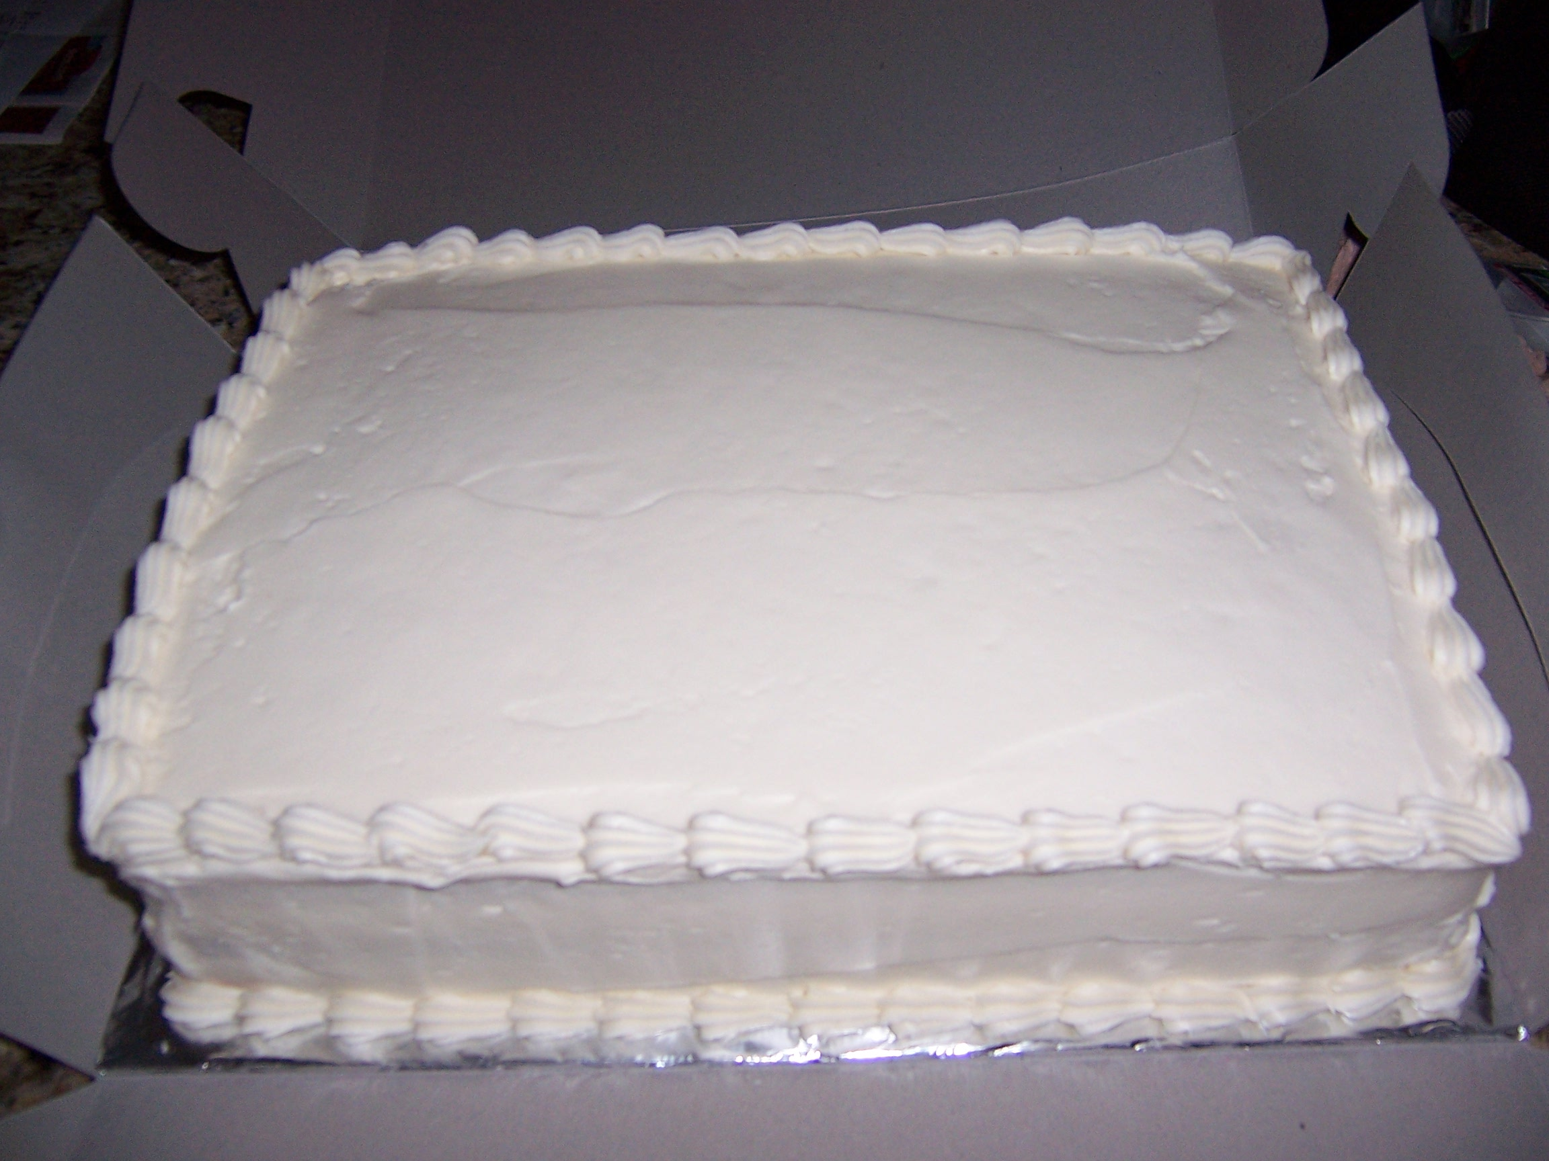
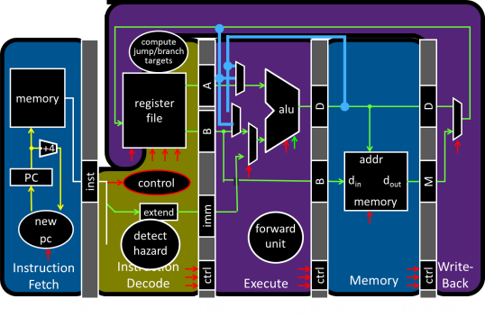
MIPS Processor Milestone Celebration!
Notes:
Need to finish project1!

Slide 32
Virtual Memory Agenda
What is Virtual Memory?
How does Virtual memory Work?
Address Translation
Overhead
Paging
Performance

Slide 33
Page Table Overhead
How large is PageTable?
Virtual address space (for each process):
Given: total virtual memory: 2³² bytes = 4GB
Given: page size: 2¹² bytes = 4KB
# entries in PageTable?
size of PageTable?
Physical address space:
total physical memory: 2²⁹ bytes = 512MB
overhead for 10 processes?
2²⁰ = 1 million entries
PTE size = 4 bytes
→PageTable size = 4 x 2²⁰ = 4MB
10 x 4MB = 40 MB of overhead!
40 MB /512 MB = 7.8% overhead,
space due to PageTable
Notes:
2²⁰ entries in pagetable, so 2²² bytes = 4MB (w/ 4byte entries), so 40MB (25% of total!)
Q: Can we possibly have a “full” pagetable?
A: Not enough physical memory pages – some pagetable entries will be duplicates!

Slide 34
But Wait... There’s more!
Page Table Entry won’t be just an integer
Meta-Data
Valid Bits
What PPN means “not mapped”? No such number…
At first: not all virtual pages will be in physical memory
Later: might not have enough physical memory to map all virtual pages
Page Permissions
R/W/X permission bits for each PTE
Code: read-only, executable
Data: writeable, not executable

Slide 35
Less Simple Page Table
V | R | W | X | Physical Page Number
0
1 | 1 | 1 | 0 | 0xC20A3
0
0
1 | 1 | 0 | 0 | 0xC20A3
1 |  |  |  | 0x4123B
1 |  |  |  | 0x10044
0
0xC20A3000
Aliasing: mapping several virtual addresses → same physical page
0x90000000
0x4123B000
Process tries to access a page without proper permissions
Segmentation Fault
Example:
Write to read-only? → process killed
0x10045000
0x10044000
0x00000000

Slide 36
Now how big is this Page Table?
struct pte_t page_table[2²⁰]
Each PTE = 8 bytes
How many pages in memory will the page table take up?
Clicker Question: (a) 4 million (2²²) pages
(b) 2048 (2¹¹) pages
(c) 1024 (2¹⁰) pages
(d) 4 billion (2³²) pages
(e) 4K (2¹²) pages
Assuming each page = 4KB

Slide 37
Now how big is this Page Table?
struct pte_t page_table[2²⁰]
Each PTE = 8 bytes
How many pages in memory will the page table take up?
Clicker Question: (a) 4 million (2²²) pages
(b) 2048 (2¹¹) pages
(c) 1024 (2¹⁰) pages
(d) 4 billion (2³²) pages
(e) 4K (2¹²) pages
Assuming each page = 4KB

Slide 38
Wait, how big is this Page Table?
page_table[2²⁰] = 8x2²⁰ =2²³ bytes
(Page Table = 8 MB in size)
How many pages in memory will the page table take up? 2²³ /2¹² =2¹¹ 2K pages!
Clicker Question: (a) 4 million (2²²) pages
(b) 2048 (2¹¹) pages
(c) 1024 (2¹⁰) pages
(d) 4 billion (2³²) pages
(e) 4K (2¹²) pages
Assuming each page = 4KB

Slide 39
Takeaway
All problems in computer science can be solved by another level of indirection.
Need a map to translate a “fake” virtual address (generated by CPU) to a “real” physical Address (in memory)
Virtual memory is implemented via a “Map”, a PageTage, that maps a vaddr (a virtual address) to a paddr (physical address):
paddr = PageTable[vaddr]
A page is constant size block of virtual memory. Often, the page size will be around 4kB to reduce the number of entries in a PageTable.
We can use the PageTable to set Read/Write/Execute permission on a per page basis. Can allocate memory on a per page basis. Need a valid bit, as well as Read/Write/Execute and other bits.
But, overhead due to PageTable is significant.

Slide 40
Next Goal
How do we reduce the size (overhead) of the PageTable?

Slide 41
Next Goal
How do we reduce the size (overhead) of the PageTable?
A: Another level of indirection!!

Slide 42
Single-Level Page Table
20 bits
12 bits
vaddr
31 12 11 0
Where is my physical page?
Total size = 2²⁰ * 4 bytes
= 4MB
PTEntry
PPN
PTBR
Page Table

Slide 43
Multi-Level Page Table
10 bits
10 bits
12 bits
vaddr
31 22 21 12 11 0
Where is my physical page?
Where is my translation?
PTEntry
PPN
PDEntry
Page Table
Also referred to as Level 1 and Level 2 Page Tables
PTBR
Page Directory
* Indirection to the Rescue, AGAIN!

Slide 44
Multi-Level Page Table
10 bits
10 bits
12 bits
vaddr
31 22 21 12 11 0
Assuming each entry is
4bytes,What is the size of
Page Directory?
A: 2KB B: 2MB
C: 4KB D: 4MB
Where is my physical page?
Where is my translation?
PTEntry
PPN
PDEntry
Page Table
Also referred to as Level 1 and Level 2 Page Tables
PTBR
Page Directory
* Indirection to the Rescue, AGAIN!

Slide 45
Multi-Level Page Table
10 bits
10 bits
12 bits
vaddr
31 22 21 12 11 0
Where is my physical page?
Assuming each entry is
4bytes,What is the total
size of ALL Page tables?
A: 2KB B: 2MB
C: 4KB D: 4MB
Where is my translation?
PTEntry
PPN
PDEntry
Page Table
Also referred to as Level 1 and Level 2 Page Tables
PTBR
Page Directory
* Indirection to the Rescue, AGAIN!

Slide 46
Multi-Level Page Table
10 bits
10 bits
12 bits
vaddr
31 22 21 12 11 0
Where is my physical page?
Where is my translation?
PTEntry
PPN
PDEntry
Page Table
Size = 2¹⁰ * 2¹⁰ *4 bytes = 4MB
PTBR
Page Directory
Size = 2¹⁰ * 4 bytes = 4KB
# page tables
# entries per page table

Slide 47
Multi-Level Page Table
Doesn’t this take up more memory than before?
- YES, but..
Benefits
Don’t need 4MB contiguous physical memory
Don’t need to allocate every PageTable, only those containing valid PTEs
Drawbacks
Performance: Longer lookups
Notes:
Q: Benefits?
A1: Don’t need 4MB contiguous physical memory
A2: Don’t need to allocate every PageTable, only those containing valid PTEs
Q: Drawbacks?
A: Longer lookups.

Slide 48
Virtual Memory Agenda
What is Virtual Memory?
How does Virtual memory Work?
Address Translation
Overhead
Paging
Performance

Slide 49
Paging
What if process requirements > physical memory?
Virtual starts earning its name
Memory acts as a cache for secondary storage (disk)
Swap memory pages out to disk when not in use
Page them back in when needed
Courtesy of Temporal & Spatial Locality (again!)
Pages used recently mostly likely to be used again
More Meta-Data:
Dirty Bit, Recently Used, etc.
OS may access this meta-data to choose a victim

Slide 50
Paging
V | R | W | X | D | Physical Page Number
0 |  |  |  |  | --
1 | 1 | 0 | 1 | 0 | 0x10045
0 |  |  |  |  | --
0 |  |  |  |  | --
0 |  |  |  | 0 | disk sector 200
0 |  |  |  | 0 | disk sector 25
1 | 1 | 1 | 0 | 1 | 0x00000
0 |  |  |  |  | --
0xC20A3000
0x90000000
0x4123B000
0x10045000
0x00000000
Example: accessing address beginning with 0x00003 (PageTable[3]) results in a Page Fault which will page the data in from disk sector 200
200
25
Notes:
A: can make code read-only, executable; make data read-write but not executable; etc.

Slide 51
Page Fault
Valid bit in Page Table = 0
→ means page is not in memory
OS takes over:
Choose a physical page to replace
“Working set”: refined LRU, tracks page usage
If dirty, write to disk
Read missing page from disk
Takes so long (~10ms), OS schedules another task
Performance-wise page faults are really bad!

Slide 52
Virtual Memory Agenda
What is Virtual Memory?
How does Virtual memory Work?
Address Translation
Overhead
Paging
Performance

Slide 53
Watch Your Performance Tank!
For every instruction:
MMU translates address (virtual → physical)
Uses PTBR to find Page Table in memory
Looks up entry for that virtual page
Fetch the instruction using physical address
Access Memory Hierarchy (I$ → L2 → Memory)
Repeat at Memory stage for load/store insns
Translate address
Now you perform the load/store

Slide 54
Performance
Virtual Memory Summary
PageTable for each process:
Page
Single-level (e.g. 4MB contiguous in physical memory)
or multi-level (e.g. less mem overhead due to page table),
…
every load/store translated to physical addresses
page table miss: load a swapped-out page and retry instruction, or kill program
Performance?
terrible: memory is already slow translation makes it slower
Solution?
A cache, of course
Notes:
4x slower!
Pipelining? No. Parallelization? No.

Slide 55
Next Goal
How do we speedup address translation?

Slide 56
Translation Lookaside Buffer (TLB)
Small, fast cache
Holds VPN→PPN translations
Exploits temporal locality in pagetable
TLB Hit: huge performance savings
TLB Miss: invoke TLB miss handler
Put translation in TLB for later
CPU
VA
“tag”
“data”
VA
VPN
PPN
VPN
PPN
VA
VPN
PPN
MMU
TLB
PA
PA

Slide 57
TLB Parameters
Typical
very small (64 – 256 entries) → very fast
fully associative, or at least set associative
Example: Intel Nehalem TLB
128-entry L1 Instruction TLB, 4-way LRU
64-entry L1 Data TLB, 4-way LRU
512-entry L2 Unified TLB, 4-way LRU

Slide 58
TLB to the Rescue!
For every instruction:
Translate the address (virtual → physical)
CPU checks TLB
That failing, walk the Page Table
Use PTBR to find Page Table in memory
Look up entry for that virtual page
Cache the result in the TLB
Fetch the instruction using physical address
Access Memory Hierarchy (I$ → L2 → Memory)
Repeat at Memory stage for load/store insns
CPU checks TLB, translate if necessary
Now perform load/store

Slide 59
Translation in Action
Virtual Address
deliver Data back to CPU
TLB Access
TLB miss handler
(HW or OS)
no
TLB Hit?
yes
$ Access
Physical Address
$
Hit?
yes
no
DRAM
Access
Next Topic:
Exceptional Control Flow
DRAM
Hit?
yes

Slide 60
Takeaways
Need a map to translate a “fake” virtual address (from process) to a “real” physical Address (in memory).
The map is a Page Table: ppn = PageTable[vpn]
A page is constant size block of virtual memory. Often ~4KB to reduce the number of entries in a PageTable.
Page Table can enforce Read/Write/Execute permissions on a per page basis. Can allocate memory on a per page basis. Also need a valid bit, and a few others.
Space overhead due to Page Table is significant.
Solution: another level of indirection!
Two-level of Page Table significantly reduces overhead.
Time overhead due to Address Translations also significant.
Solution: caching! Translation Lookaside Buffer (TLB) acts as a cache for the Page Table and significantly improves performance.

