Slide 1
Caches & Memory
CS 3410
Computer System Organization & Programming
These slides are the product of many rounds of teaching CS 3410 by Professors Weatherspoon, Bala, Bracy, and Sirer.

Slide 2
Programs 101
C Code
MIPS Assembly
int main (int argc, char* argv[ ]) {
int i;
int m = n;
int sum = 0;
for (i = 1; i <= m; i++) {
sum += i;
}
printf (“...”, n, sum);
}
main: addiu $sp,$sp,-48
sw $31,44($sp)
sw $fp,40($sp)
move $fp,$sp
sw $4,48($fp)
sw $5,52($fp)
la $2,n
lw $2,0($2)
sw $2,28($fp)
sw $0,32($fp)
li $2,1
sw $2,24($fp)
$L2: lw $2,24($fp)
lw $3,28($fp)
slt $2,$3,$2
bne $2,$0,$L3
. . .
Load/Store Architectures:
Read data from memory (put in registers)
Manipulate it
Store it back to memory
Instructions that read from
or write to memory…

Slide 3
1 Cycle Per Stage: the Biggest Lie (So Far)
Code Stored in Memory
(also, data and stack)
compute jump/branch targets
memory
register file
A
ALU
D
D
B
+4
addr
PC
inst
control
B
d_{in}
d_{out}
M
memory
new pc
extend
imm
forward unit
detect hazard
Stack, Data, Code
Stored in Memory
Instruction Fetch
Instruction Decode
Write- Back
ctrl
ctrl
ctrl
Execute
Memory
IF/ID
ID/EX
EX/MEM
MEM/WB

Slide 4
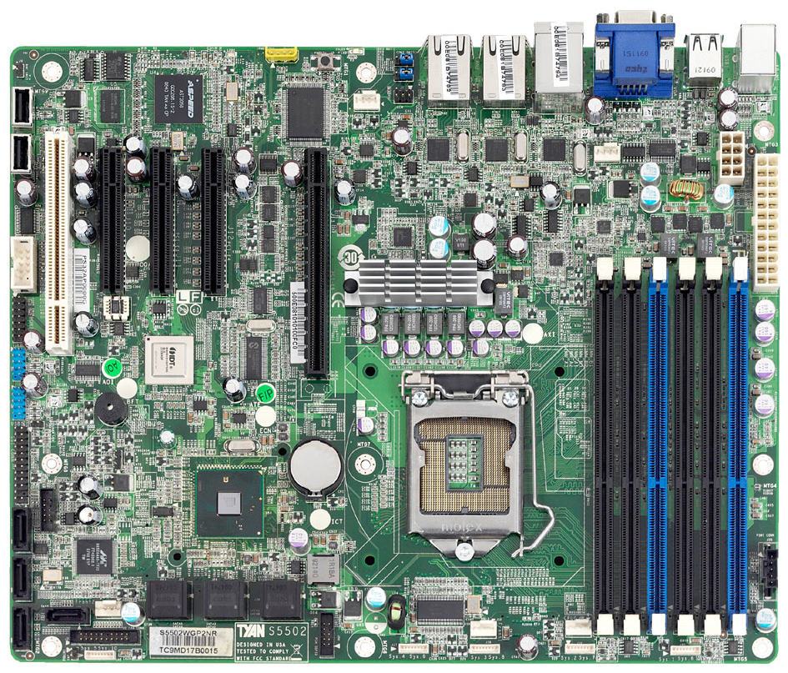
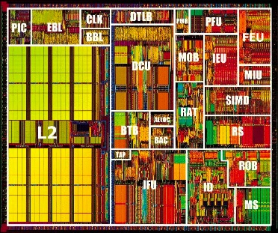
What’s the problem?
CPU
+ big
– slow
– far away
Main Memory
SandyBridge Motherboard, 2011
http://news.softpedia.com

Slide 5
The Need for Speed
CPU Pipeline
Notes:
I made these two slides to see if you can make everything Ampelmännchen instead of first rainbow then ampelmännchen.
Not sure if this captures what you want to say. Just wanted to throw it out there.
(Slides 7/8 would be an alternative for slides 4/5/6)

Slide 6
The Need for Speed
CPU Pipeline
Instruction speeds:
add,sub,shift: 1 cycle
mult: 3 cycles
load/store: 100 cycles
off-chip 50(-70)ns
2(-3) GHz processor → 0.5 ns clock
Notes:
This is great, but I would re-arrange it. First say that load/store requires 100 cycles (parallel to mult, add). This is your punch-line and probably surprising to the students.
Then explain why it is the case.

Slide 7
The Need for Speed
CPU Pipeline

Slide 8
What’s the solution?
Caches !
Level 1
Data $
Level 2 $
Level 1
Insn $
Intel Pentium 3, 1999

Slide 9
Aside
Go back to 04-state and look at how SRAM and DRAM are built.

Slide 10
What’s the solution?
Caches !
Level 1
Data $
Level 2 $
Level 1
Insn $
What lucky data gets to go here?
Intel Pentium 3, 1999

Slide 11
Locality Locality Locality
If you ask for something, you’re likely to ask for:
the same thing again soon
→ Temporal Locality
something near that thing, soon
→ Spatial Locality
^{total = 0;}
^{for (i = 0; i < n; i++)}
^{total += a[i];}
^{return total;}

Slide 12
Your life is full of Locality
Last Called
Speed Dial
Favorites
Contacts
Google/Facebook/email

Slide 13
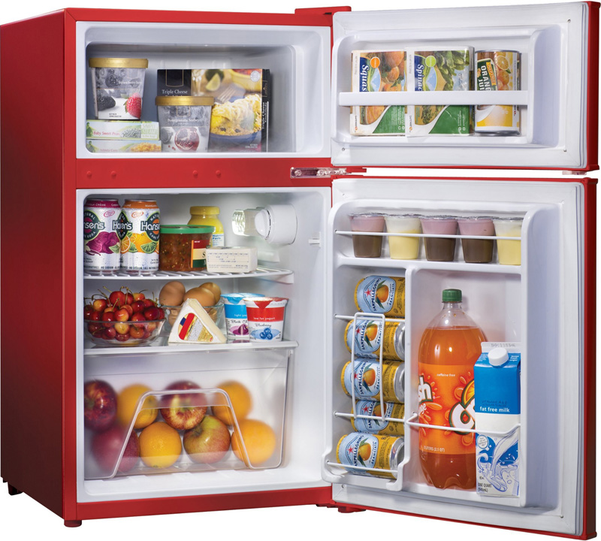
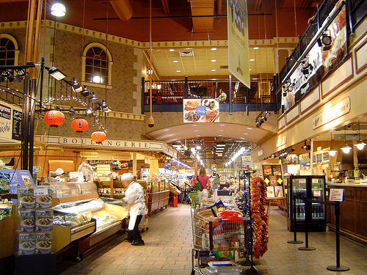
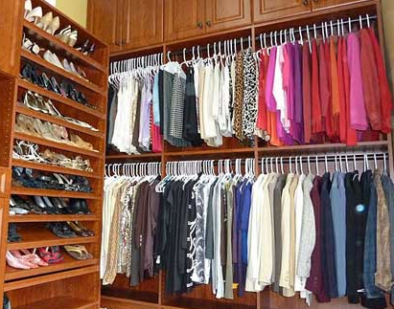
Your life is full of Locality

Slide 14
The Memory Hierarchy
Small, Fast
1 cycle,
128 bytes
Registers
4 cycles,
64 KB
L1 Caches
L2 Cache
12 cycles,
256 KB
L3 Cache
36 cycles,
2-20 MB
Main Memory
50-70 ns,
512 MB – 4 GB
Big, Slow
5-20 ms
16GB – 4 TB,
Disk
Intel Haswell Processor, 2013

Slide 15
Some Terminology
Cache hit
data is in the Cache
t_{hit} : time it takes to access the cache
Hit rate (%hit): # cache hits / # cache accesses
Cache miss
data is not in the Cache
t_{miss} : time it takes to get the data from below the $
Miss rate (%miss): # cache misses / # cache accesses

Slide 16
The Memory Hierarchy
1 cycle,
128 bytes
average access time
t_{avg} = t_{hit} + %_{miss}* t_{miss}
= 4 + 5% x 100
= 9 cycles
Registers
4 cycles,
64 KB
L1 Caches
L2 Cache
12 cycles,
256 KB
L3 Cache
36 cycles,
2-20 MB
Main Memory
50-70 ns,
512 MB – 4 GB
5-20 ms
16GB – 4 TB,
Disk
Intel Haswell Processor, 2013

Slide 17
Single Core Memory Hierarchy
ON CHIP
Processor
Registers
Regs
L1 Caches
I$
D$
L2 Cache
L2
L3 Cache
Main Memory
Main Memory
Disk
Disk

Slide 18
Multi-Core Memory Hierarchy
ON CHIP
Processor
Processor
Processor
Processor
Regs
Regs
Regs
Regs
I$
D$
I$
D$
I$
D$
I$
D$
L2
L2
L2
L2
L3
Main Memory
Disk
Notes:
This is my suggestion

Slide 19
Memory Hierarchy by the Numbers
CPU clock rates ~0.33ns – 2ns (3GHz-500MHz)
*Registers,D-Flip Flops: 10-100’s of registers
Memory technology | Transistor count* | Access time | Access time in cycles | $ per GIB in 2012 | Capacity
SRAM (on chip) | 6-8 transistors | 0.5-2.5 ns | 1-3 cycles | $4k | 256 KB
SRAM (off chip) |  | 1.5-30 ns | 5-15 cycles | $4k | 32 MB
DRAM | 1 transistor (needs refresh) | 50-70 ns | 150-200 cycles | $10-$20 | 8 GB
SSD (Flash) |  | 5k-50k ns | Tens of thousands | $0.75-$1 | 512 GB
Disk |  | 5M-20M ns | Millions | $0.05-$0.1 | 4 TB
Notes:
Capacity and latency are closely coupled
Cost is inversely proportional

Slide 20
Basic Cache Design
Direct Mapped Caches

Slide 21
16 Byte Memory
MEMORY
addr | data
0000 | A
0001 | B
0010 | C
0011 | D
0100 | E
0101 | F
0110 | G
0111 | H
1000 | J
1001 | K
1010 | L
1011 | M
1100 | N
1101 | O
1110 | P
1111 | Q
load 1100 → r1
Byte-addressable memory
4 address bits → 16 bytes total
b addr bits → 2^{b} bytes in memory

Slide 22
4-Byte, Direct Mapped Cache
MEMORY
addr | data
0000 | A
0001 | B
0010 | C
0011 | D
0100 | E
0101 | F
0110 | G
0111 | H
1000 | J
1001 | K
1010 | L
1011 | M
1100 | N
1101 | O
1110 | P
1111 | Q
CACHE
index
XXXX
data
A
B
C
D
index
00
01
10
11
Cache entry
= row
= (cache) line
= (cache) block
Block Size: 1 byte
Direct mapped:
Each address maps to 1 cache block
4 entries → 2 index bits (2^{n} → n bits)
Index with LSB:
Supports spatial locality

Slide 23
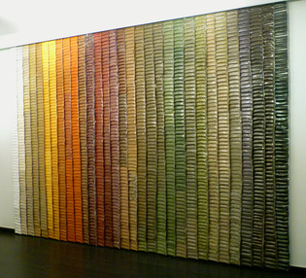
Analogy to a Spice Rack
Spice Rack
(Cache)
Spice Wall
(Memory)
index spice
A
B
C
D
E
F
…
Z
Compared to your spice wall
Smaller
Faster
More costly (per oz.)
http://www.bedbathandbeyond.com

Slide 24
Analogy to a Spice Rack
Spice Rack
(Cache)
Spice Wall
(Memory)
index spice
tag
A
B
C
D
E
F
…
Z
innamon
Cinnamon
How do you know what’s in the jar?
Need labels
Tag = Ultra-minimalist label

Slide 25
4-Byte, Direct Mapped Cache
MEMORY
addr | data
0000 | A
0001 | B
0010 | C
0011 | D
0100 | E
0101 | F
0110 | G
0111 | H
1000 | J
1001 | K
1010 | L
1011 | M
1100 | N
1101 | O
1110 | P
1111 | Q
tag|index
XXXX
CACHE
tag
00
00
00
00
index
00
01
10
11
 | data
 | A
 | B
 | C
 | D
Tag: minimalist label/address
address = tag + index

Slide 26
4-Byte, Direct Mapped Cache
MEMORY
addr | data
0000 | A
0001 | B
0010 | C
0011 | D
0100 | E
0101 | F
0110 | G
0111 | H
1000 | J
1001 | K
1010 | L
1011 | M
1100 | N
1101 | O
1110 | P
1111 | Q
CACHE
index
00
01
10
11
V | tag | data
0 | 00 | X
0 | 00 | X
0 | 00 | X
0 | 00 | X
One last tweak: valid bit

Slide 27
Simulation #1 of a 4-byte, DM Cache
MEMORY
addr | data
0000 | A
0001 | B
0010 | C
0011 | D
0100 | E
0101 | F
0110 | G
0111 | H
1000 | J
1001 | K
1010 | L
1011 | M
1100 | N
1101 | O
1110 | P
1111 | Q
tag|index
XXXX
CACHE
index
00
01
10
11
V | tag | data
0 | 11 | X
0 | 11 | X
0 | 11 | X
0 | 11 | X
load 1100
...
load 1100
Lookup:
Index into $
Check tag
Check valid bit

Slide 28
Block Diagram 4-entry, direct mapped Cache
tag|index
1101
CACHE
V | tag | data
1 | 00 | 1111 0000
1 | 11 | 1010 0101
0 | 01 | 1010 1010
1 | 11 | 0000 0000
2
2
2
8
=
1010 0101
data
Hit!

Slide 29
MEMORY
Simulation #2:
4-byte, DM Cache
addr | data
0000 | A
0001 | B
0010 | C
0011 | D
0100 | E
0101 | F
0110 | G
0111 | H
1000 | J
1001 | K
1010 | L
1011 | M
1100 | N
1101 | O
1110 | P
1111 | Q
CACHE
index
00
01
10
11
V | tag | data
0 | 11 | X
0 | 11 | X
0 | 11 | X
0 | 11 | X
load 1100
load 1101
load 0100
load 1100
Lookup:
Index into $
Check tag
Check valid bit

Slide 30
Reducing Cold Misses by Increasing Block Size
Leveraging Spatial Locality

Slide 31
Increasing Block Size
MEMORY
addr | data
0000 | A
0001 | B
0010 | C
0011 | D
0100 | E
0101 | F
0110 | G
0111 | H
1000 | J
1001 | K
1010 | L
1011 | M
1100 | N
1101 | O
1110 | P
1111 | Q
CACHE
offset
XXXX
index
00
01
10
11
V | tag | data
0 | x | A | B
0 | x | C | D
0 | x | E | F
0 | x | G | H
Block Size: 2 bytes
Block Offset: least significant bits indicate where you live in the block
Which bits are the index? tag?

Slide 32
Simulation #3: 8-byte, DM Cache
MEMORY
addr | data
0000 | A
0001 | B
0010 | C
0011 | D
0100 | E
0101 | F
0110 | G
0111 | H
1000 | J
1001 | K
1010 | L
1011 | M
1100 | N
1101 | O
1110 | P
1111 | Q
index
CACHE
tag| |offset
XXXX
index
00
01
10
11
V | tag | data
0 | x | X | X
0 | x | X | X
0 | x | X | X
0 | x | X | X
load 1100
load 1101
load 0100
load 1100
Lookup:
Index into $
Check tag
Check valid bit

Slide 33
Removing Conflict Misses with Fully-Associative Caches

Slide 34
Simulation #4: 8-byte, FA Cache
MEMORY
addr | data
0000 | A
0001 | B
0010 | C
0011 | D
0100 | E
0101 | F
0110 | G
0111 | H
1000 | J
1001 | K
1010 | L
1011 | M
1100 | N
1101 | O
1110 | P
1111 | Q
XXXX
tag|offset
CACHE
V | tag | data
0 | xxx | X | X
V | tag | data
0 | xxx | X | X
V | tag | data
0 | xxx | X | X
V | tag | data
0 | xxx | X | X
load 1100
load 1101
load 0100
load 1100
Lookup:
Index into $
Check tags
Check valid bits
LRU Pointer

Slide 35
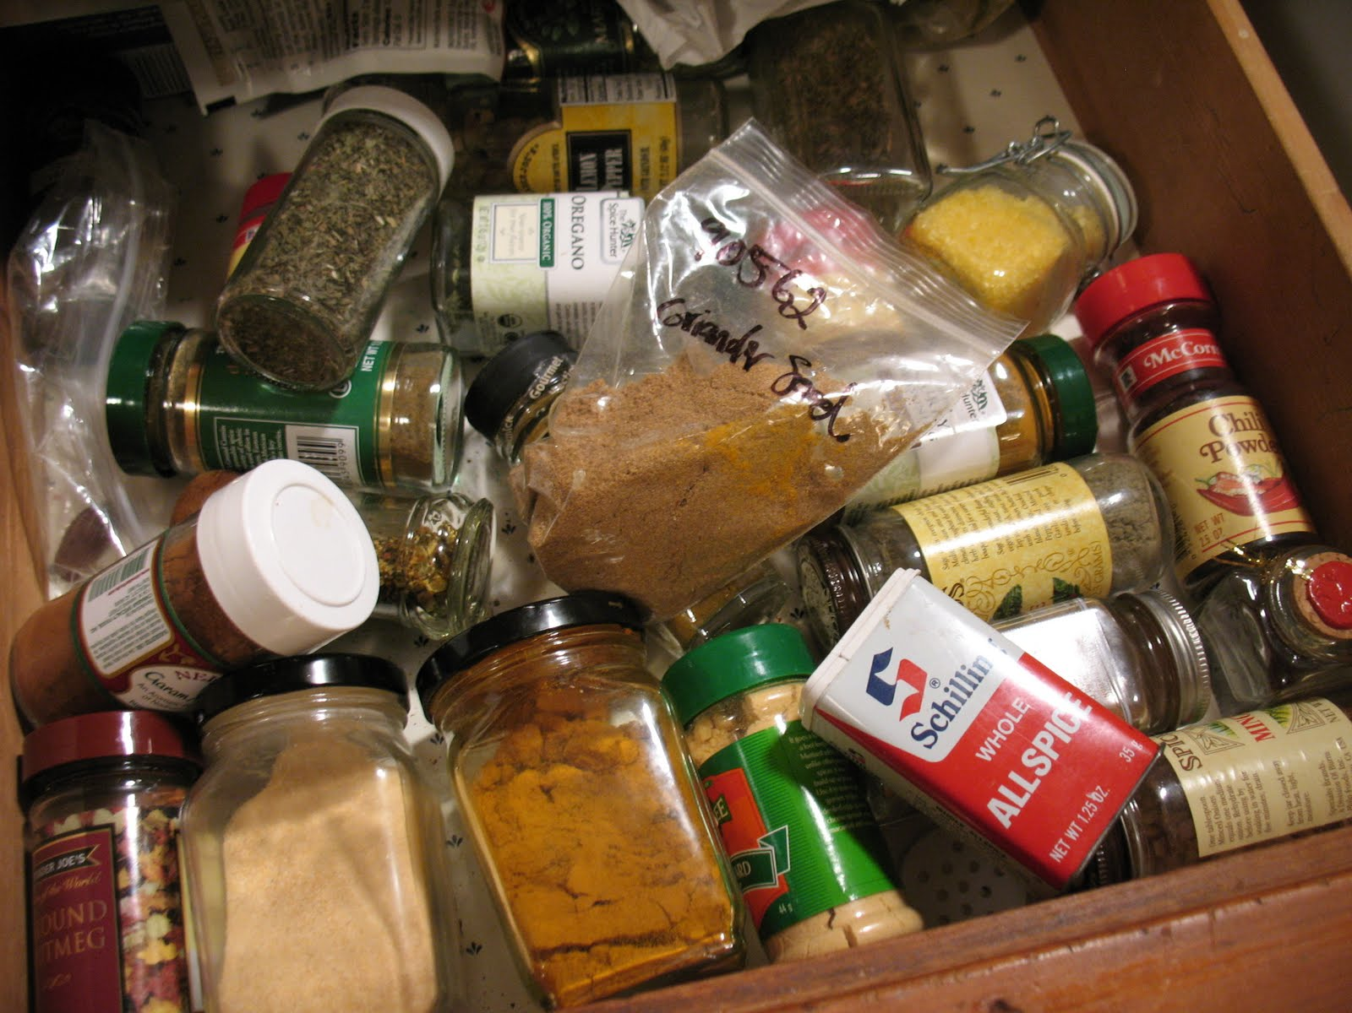
Pros and Cons of Full Associativity
+ No more conflicts!
+ Excellent utilization!
But either:
Parallel Reads
– lots of reading!
Serial Reads
– lots of waiting
t_{avg} = t_{hit} + %_{miss}* t_{miss}
= 4 + 5% x 100
= 9 cycles
= 6 + 3% x 100
= 9 cycles

Slide 36
Pros & Cons
 | Direct Mapped | Fully Associative
Tag Size | Smaller | Larger
SRAM Overhead | Less | More
Controller Logic | Less | More
Speed | Faster | Slower
Price | Less | More
Scalability | Very | Not Very
# of conflict misses | Lots | Zero
Hit Rate | Low | High
Pathological Cases | Common | ?

Slide 37
Reducing Conflict Misses with Set-Associative Caches
Not too conflict-y. Not too slow.
… Just Right!

Slide 38
8 byte, 2-way set associative Cache
MEMORY
addr | data
0000 | A
0001 | B
0010 | C
0011 | D
0100 | E
0101 | F
0110 | G
0111 | H
1000 | J
1001 | K
1010 | L
1011 | M
1100 | N
1101 | O
1110 | P
1111 | Q
XXXX
tag||offset
XXXX
XXXX
offset
index
CACHE
index
0
1
V | tag | data
0 | xx | E | F
0 | xx | C | D
V | tag | data
0 | xx | N | O
0 | xx | P | Q
What should the offset be?
What should the index be?
What should the tag be?

Slide 39
8 byte, 2-way set associative Cache
MEMORY
addr | data
0000 | A
0001 | B
0010 | C
0011 | D
0100 | E
0101 | F
0110 | G
0111 | H
1000 | J
1001 | K
1010 | L
1011 | M
1100 | N
1101 | O
1110 | P
1111 | Q
XXXX
tag||offset
index
CACHE
index
0
1
V | tag | data
0 | xx | X | X
0 | xx | X | X
V | tag | data
0 | xx | X | X
0 | xx | X | X
load 1100
load 1101
load 0100
load 1100
Miss
Lookup:
Index into $
Check tag
Check valid bit
LRU Pointer

Slide 40
Eviction Policies
Which cache line should be evicted from the cache to make room for a new line?
Direct-mapped: no choice, must evict line selected by index
Associative caches
Random: select one of the lines at random
Round-Robin: similar to random
FIFO: replace oldest line
LRU: replace line that has not been used in the longest time

Slide 41
Misses: the Three C’s
Cold (compulsory) Miss:
never seen this address before
Conflict Miss:
cache associativity is too low
Capacity Miss:
cache is too small

Slide 42
Miss Rate vs. Block Size

Slide 43
Block Size Tradeoffs
For a given total cache size,
Larger block sizes mean….
fewer lines
so fewer tags, less overhead
and fewer cold misses (within-block “prefetching”)
But also…
fewer blocks available (for scattered accesses!)
so more conflicts
can decrease performance if working set can’t fit in $
and larger miss penalty (time to fetch block)
Notes:
Same for other parameters: experimental mostly

Slide 44
Miss Rate vs. Associativity

Slide 45
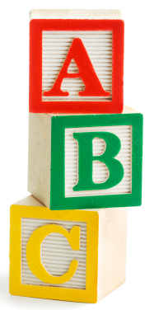
ABCs of Caches
t_{avg} = t_{hit} + %_{miss}* t_{miss}
+ Associativity:
⬇conflict misses ☺
⬆hit time ☹
+ Block Size:
⬇cold misses ☺
⬆conflict misses ☹
+ Capacity:
⬇capacity misses ☺
⬆hit time ☹

Slide 46
Which caches get what properties?
t_{avg} = t_{hit} + %_{miss}* t_{miss}
Design with speed in mind
Fast
L1 Caches
More Associative
Bigger Block Sizes
Larger Capacity
L2 Cache
L3 Cache
Design with miss rate in mind
Big

Slide 47
Roadmap
Things we have covered:
The Need for Speed
Locality to the Rescue!
Calculating average memory access time
$ Misses: Cold, Conflict, Capacity
$ Characteristics: Associativity, Block Size, Capacity
Things we will now cover:
Cache Figures
Cache Performance Examples
Writes

Slide 48
2-Way Set Associative Cache (Reading)
Tag Index Offset
V
Tag
Data
V
Tag
Data
=
=
line select
64bytes
word select
hit?
data
32bits

Slide 49
3-Way Set Associative Cache (Reading)
Tag Index Offset
=
=
=
line select
64bytes
word select
hit?
data
32bits

Slide 50
How Big is the Cache?
Tag Index Offset
n bit index, m bit offset, N-way Set Associative
Question: How big is cache?
Data only?
(what we usually mean when we ask “how big” is the cache)
Data + overhead?

Slide 51
Performance Calculation with $ Hierarchy
t_{avg} = t_{hit} + %_{miss}* t_{miss}
Parameters
Reference stream: all loads
D$: t_{hit} = 1ns, %_{miss} = 5%
L2: t_{hit} = 10ns, %_{miss} = 20% (local miss rate)
Main memory: t_{hit} = 50ns
What is t_{avgD$} without an L2?
t_{missD$} =
t_{avgD$} =
What is t_{avgD$} with an L2?
t_{missD$} =
t_{avgL2} =
t_{avgD$} =

Slide 52
Performance Summary
Average memory access time (AMAT) depends on:
cache architecture and size
Hit and miss rates
Access times and miss penalty
Cache design a very complex problem:
Cache size, block size (aka line size)
Number of ways of set-associativity (1, N, ∞)
Eviction policy
Number of levels of caching, parameters for each
Separate I-cache from D-cache, or Unified cache
Prefetching policies / instructions
Write policy

Slide 53
Takeaway
Direct Mapped → fast, but low hit rate
Fully Associative → higher hit cost, higher hit rate
Set Associative → middleground
Line size matters. Larger cache lines can increase performance due to prefetching. BUT, can also decrease performance is working set size cannot fit in cache.
Cache performance is measured by the average memory access time (AMAT), which depends cache architecture and size, but also the access time for hit, miss penalty, hit rate.

Slide 54
What about Stores?
We want to write to the cache.
If the data is not in the cache?
Bring it in. (Write allocate policy)
Should we also update memory?
Yes: write-through policy
No: write-back policy

Slide 55
Write-Through Cache
16 byte, byte-addressed memory
4 btye, fully-associative cache:
2-byte blocks, write-allocate
4 bit addresses:
3 bit tag, 1 bit offset
Memory
Instructions:
LB $1 ← M[ 1 ]
LB $2 ← M[ 7 ]
SB $2 → M[ 0 ]
SB $1 → M[ 5 ]
LB $2 ← M[ 10 ]
SB $1 → M[ 5 ]
SB $1 → M[ 10 ]
0
1
2
3
4
5
6
7
8
9
10
11
12
13
14
15
78
29
120
lru V tag data
123
71
1
0
150
162
0
0
173
18
Register File
Cache
21
33
$0
$1
$2
$3
28
Misses: 0
Hits: 0
Reads: 0
Writes: 0
19
200
210
225

Slide 56
Write-Through (REF 1)
Memory
Instructions:
LB $1 ← M[ 1 ]
LB $2 ← M[ 7 ]
SB $2 → M[ 0 ]
SB $1 → M[ 5 ]
LB $2 ← M[ 10 ]
SB $1 → M[ 5 ]
SB $1 → M[ 10 ]
0
1
2
3
4
5
6
7
8
9
10
11
12
13
14
15
78
29
120
lru V tag data
123
71
1
0
150
162
0
0
173
18
Register File
Cache
21
33
$0
$1
$2
$3
28
Misses: 0
Hits: 0
Reads: 0
Writes: 0
19
200
210
225

Slide 57
Summary: Write Through
Write-through policy with write allocate
Cache miss: read entire block from memory
Write: write only updated item to memory
Eviction: no need to write to memory

Slide 58
Next Goal: Write-Through vs. Write-Back
What if we DON’T to write stores immediately to memory?
Keep the current copy in cache, and update memory when data is evicted (write-back policy)
Write-back all evicted lines?
No, only written-to blocks

Slide 59
Write-Back Meta-Data (Valid, Dirty Bits)
V | D | Tag | Byte 1 | Byte 2 | … Byte N
V = 1 means the line has valid data
D = 1 means the bytes are newer than main memory
When allocating line:
Set V = 1, D = 0, fill in Tag and Data
When writing line:
Set D = 1
When evicting line:
If D = 0: just set V = 0
If D = 1: write-back Data, then set D = 0, V = 0

Slide 60
Write-back Example
Example: How does a write-back cache work?
Assume write-allocate

Slide 61
Handling Stores (Write-Back)
16 byte, byte-addressed memory
4 btye, fully-associative cache:
2-byte blocks, write-allocate
4 bit addresses:
3 bit tag, 1 bit offset
Memory
Instructions:
LB $1 ← M[ 1 ]
LB $2 ← M[ 7 ]
SB $2 → M[ 0 ]
SB $1 → M[ 5 ]
LB $2 ← M[ 10 ]
SB $1 → M[ 5 ]
SB $1 → M[ 10 ]
0
1
2
3
4
5
6
7
8
9
10
11
12
13
14
15
78
29
120
lru V d tag data
123
71
1
0
150
162
0
0
173
18
Register File
Cache
21
33
$0
$1
$2
$3
Misses: 0
Hits: 0
Reads: 0
Writes: 0
28
19
200
210
225

Slide 62
Write-Back (REF 1)
Memory
Instructions:
LB $1 ← M[ 1 ]
LB $2 ← M[ 7 ]
SB $2 → M[ 0 ]
SB $1 → M[ 5 ]
LB $2 ← M[ 10 ]
SB $1 → M[ 5 ]
SB $1 → M[ 10 ]
0
1
2
3
4
5
6
7
8
9
10
11
12
13
14
15
78
29
120
lru V d tag data
123
71
1
0
150
162
0
0
173
18
Register File
Cache
21
33
$0
$1
$2
$3
Misses: 0
Hits: 0
Reads: 0
Writes: 0
28
19
200
210
225

Slide 63
How Many Memory References?
Write-back performance
How many reads?
Each miss (read or write) reads a block from mem
4 misses → 8 mem reads
How many writes?
Some evictions write a block to mem
1 dirty eviction → 2 mem writes
(+ 2 dirty evictions later → +4 mem writes)

Slide 64
Write-back vs. Write-through Example
Assume: large associative cache, 16-byte lines
N 4-byte words
for (i=1; i<n; i++)
A[0] += A[i];
for (i=0; i<n; i++)
B[i] = A[i]
Notes:
Q: direct, or associative? A: associative definitely (w/ LRU or LFU, etc.)
A) reads: miss every W’th A[i]
A) writes: n for write-through, 1 eviction for write-back
B) reads: miss every W’th A[i] or B[i]
B) writes: n for write-through, n for write-back

Slide 65
So is write back just better?
Short Answer: Yes (fewer writes is a good thing)
Long Answer: It’s complicated.
Evictions require entire line be written back to memory (vs. just the data that was written)
Write-back can lead to incoherent caches on multi-core processors (later lecture)

Slide 66
Cache Conscious Programming
// H = 6, W = 10
int A[H][W];
for(x=0; x < W; x++)
for(y=0; y < H; y++)
sum += A[y][x];
1
2
3
4
5
6
W
1
2
3
4
5
6
YOUR MIND
CACHE
H
Every access a cache miss! (unless entire matrix fits in cache)
MEMORY

Slide 67
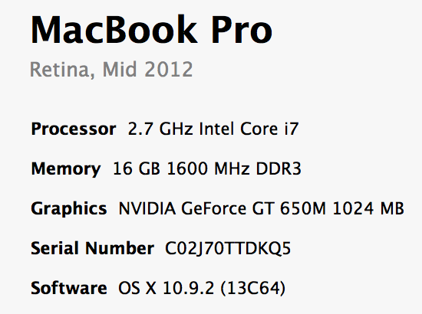
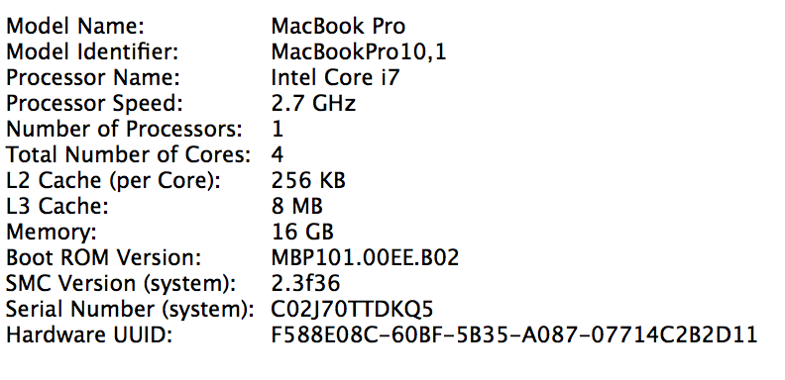
By the end of the cache lectures…

Slide 68
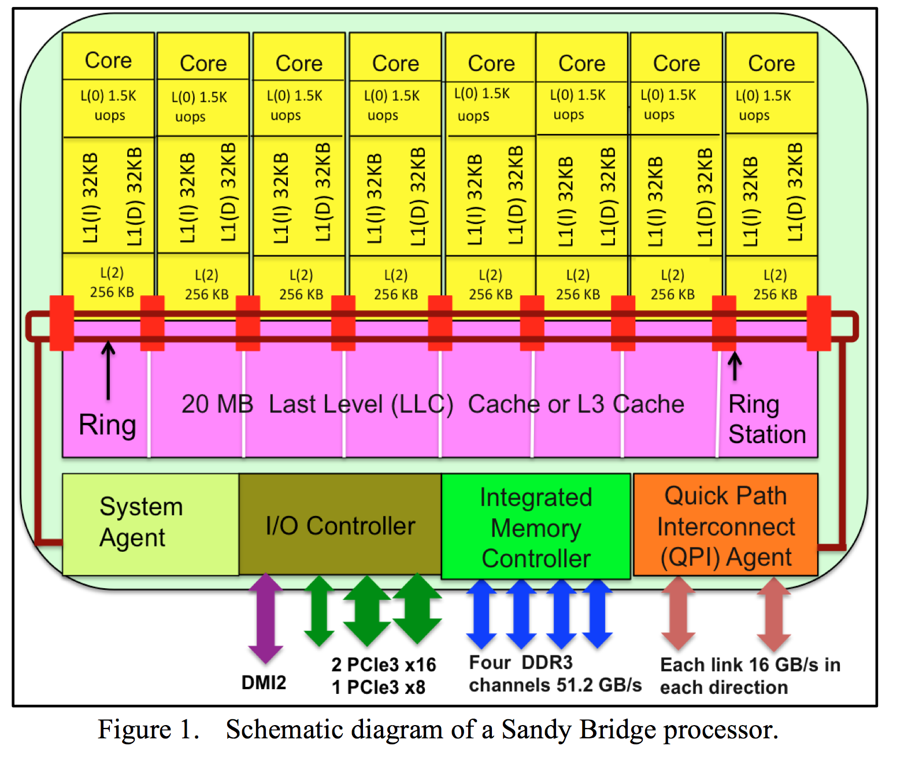

Slide 69
Summary
Memory performance matters!
often more than CPU performance
… because it is the bottleneck, and not improving much
… because most programs move a LOT of data
Design space is huge
Gambling against program behavior
Cuts across all layers: users → programs → os → hardware
NEXT: Multi-core processors are complicated
Inconsistent views of memory
Extremely complex protocols, very hard to get right

Slide 70
Have a great Spring Break!!

