Slide 1
Caches & Memory
CS 3410
Computer System Organization & Programming
These slides are the product of many rounds of teaching CS 3410 by Professors Weatherspoon, Bala, Bracy, and Sirer.

Slide 2
Programs 101
C Code
MIPS Assembly
int main (int argc, char* argv[ ]) {
int i;
int m = n;
int sum = 0;
for (i = 1; i <= m; i++) {
sum += i;
}
printf (“...”, n, sum);
}
main: addiu $sp,$sp,-48
sw $31,44($sp)
sw $fp,40($sp)
move $fp,$sp
sw $4,48($fp)
sw $5,52($fp)
la $2,n
lw $2,0($2)
sw $2,28($fp)
sw $0,32($fp)
li $2,1
sw $2,24($fp)
$L2: lw $2,24($fp)
lw $3,28($fp)
slt $2,$3,$2
bne $2,$0,$L3
. . .
Load/Store Architectures:
Read data from memory (put in registers)
Manipulate it
Store it back to memory
Instructions that read from
or write to memory…

Slide 3
1 Cycle Per Stage: the Biggest Lie (So Far)
Code Stored in Memory
(also, data and stack)
compute jump/branch targets
memory
register file
A
ALU
D
D
B
+4
addr
PC
inst
control
B
d_{in}
d_{out}
M
memory
new pc
extend
imm
forward unit
detect hazard
Stack, Data, Code
Stored in Memory
Instruction Fetch
Instruction Decode
Write- Back
ctrl
ctrl
ctrl
Execute
Memory
IF/ID
ID/EX
EX/MEM
MEM/WB

Slide 4
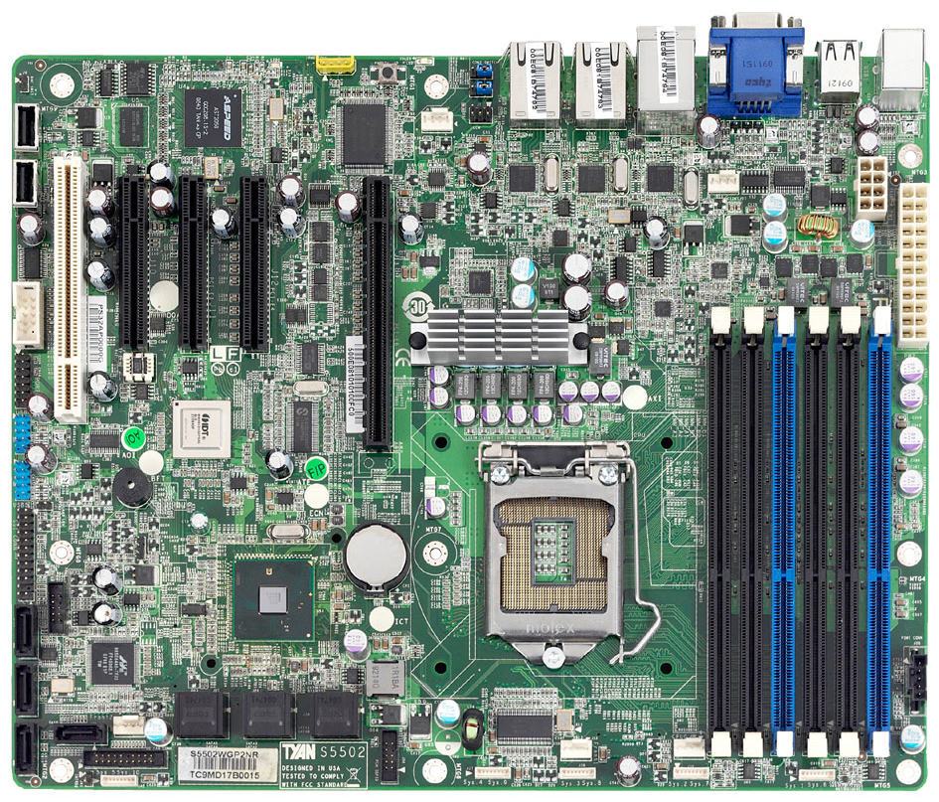
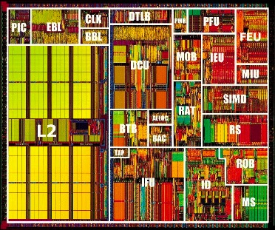
What’s the problem?
CPU
+ big
– slow
– far away
Main Memory
SandyBridge Motherboard, 2011
http://news.softpedia.com

Slide 5
The Need for Speed
CPU Pipeline
Notes:
I made these two slides to see if you can make everything Ampelmännchen instead of first rainbow then ampelmännchen.
Not sure if this captures what you want to say. Just wanted to throw it out there.
(Slides 7/8 would be an alternative for slides 4/5/6)

Slide 6
The Need for Speed
CPU Pipeline
Instruction speeds:
add,sub,shift: 1 cycle
mult: 3 cycles
load/store: 100 cycles
off-chip 50(-70)ns
2(-3) GHz processor → 0.5 ns clock
Notes:
This is great, but I would re-arrange it. First say that load/store requires 100 cycles (parallel to mult, add). This is your punch-line and probably surprising to the students.
Then explain why it is the case.

Slide 7
The Need for Speed
CPU Pipeline

Slide 8
What’s the solution?
Caches !
Level 1
Data $
Level 2 $
Level 1
Insn $
Intel Pentium 3, 1999

Slide 9
Aside
Go back to 04-state and 05-memory and look at how registers, SRAM and DRAM are built.

Slide 10
What’s the solution?
Caches !
Level 1
Data $
Level 2 $
Level 1
Insn $
What lucky data gets to go here?
Intel Pentium 3, 1999

Slide 11
Locality Locality Locality
If you ask for something, you’re likely to ask for:
the same thing again soon
→ Temporal Locality
something near that thing, soon
→ Spatial Locality
^{total = 0;}
^{for (i = 0; i < n; i++)}
^{total += a[i];}
^{return total;}

Slide 12
Clicker Questions
This highlights the temporal and spatial locality of data.
Q1: Which line of code exhibits good temporal locality?
^{1 total = 0;}
^{2 for (i = 0; i < n; i++) {}
^{3 n--;}
^{4 total += a[i];}
^{5 return total;}
1
2
3
4
5

Slide 13
Clicker Questions
This highlights the temporal and spatial locality of data.
Q1: Which line of code exhibits good temporal locality?
^{1 total = 0;}
^{2 for (i = 0; i < n; i++) {}
^{3 n--;}
^{4 total += a[i];}
^{5 return total;}
1
2
3
4
5

Slide 14
Clicker Questions
This highlights the temporal and spatial locality of data.
Q1: Which line of code exhibits good temporal locality?
^{1 total = 0;}
^{2 for (i = 0; i < n; i++) {}
^{3 n--;}
^{4 total += a[i];}
^{5 return total;}
1
2
3
4
5
Q2: Which line of code exhibits good spatial locality with the line after it?

Slide 15
Clicker Questions
This highlights the temporal and spatial locality of data.
Q1: Which line of code exhibits good temporal locality?
^{1 total = 0;}
^{2 for (i = 0; i < n; i++) {}
^{3 n--;}
^{4 total += a[i];}
^{5 return total;}
1
2
3
4
5
Q2: Which line of code exhibits good spatial locality with the line after it?

Slide 16
Your life is full of Locality
Last Called
Speed Dial
Favorites
Contacts
Google/Facebook/email

Slide 17
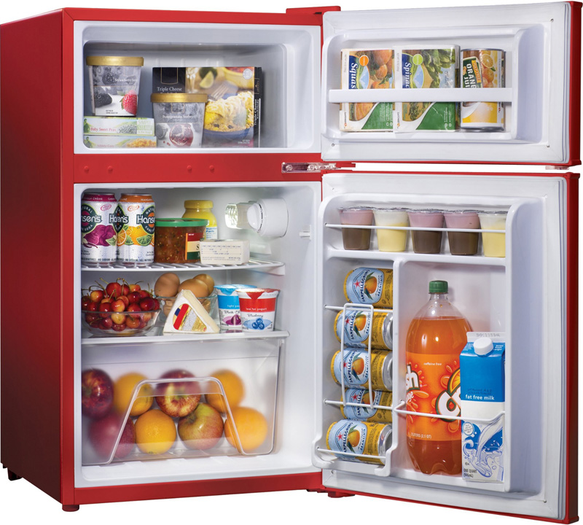
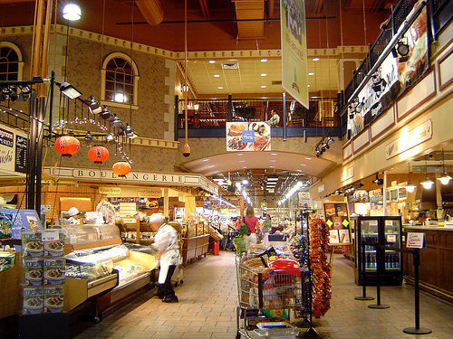
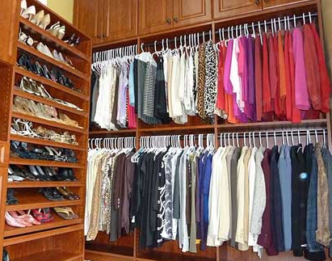
Your life is full of Locality

Slide 18
The Memory Hierarchy
Small, Fast
1 cycle,
128 bytes
Registers
4 cycles,
64 KB
L1 Caches
L2 Cache
12 cycles,
256 KB
L3 Cache
36 cycles,
2-20 MB
Main Memory
50-70 ns,
512 MB – 4 GB
Big, Slow
5-20 ms
16GB – 4 TB,
Disk
Intel Haswell Processor, 2013

Slide 19
Some Terminology
Cache hit
data is in the Cache
t_{hit} : time it takes to access the cache
Hit rate (%hit): # cache hits / # cache accesses
Cache miss
data is not in the Cache
t_{miss} : time it takes to get the data from below the $
Miss rate (%miss): # cache misses / # cache accesses
Cacheline or cacheblock or simply line or block
Minimum unit of info that is present/or not in the cache

Slide 20
The Memory Hierarchy
1 cycle,
128 bytes
average access time
t_{avg} = t_{hit} + %_{miss}* t_{miss}
= 4 + 5% x 100
= 9 cycles
Registers
4 cycles,
64 KB
L1 Caches
L2 Cache
12 cycles,
256 KB
L3 Cache
36 cycles,
2-20 MB
Main Memory
50-70 ns,
512 MB – 4 GB
5-20 ms
16GB – 4 TB,
Disk
Intel Haswell Processor, 2013
Notes:
There are two expressions for AMAT bolded below.
AMAT = %hit * hit time + %miss * miss time
where miss time = (hit time + miss penalty)
AMAT = %hit * hit time + %miss * (hit time + miss penalty)
AMAT = %hit * hit time + %miss * hit time + %miss * miss penalty
AMAT = hit time * (%hit + %miss) + % miss * miss penalty
AMAT = hit time + % miss * miss penalty

Slide 21
Single Core Memory Hierarchy
ON CHIP
Processor
Registers
Regs
L1 Caches
I$
D$
L2 Cache
L2
L3 Cache
Main Memory
Main Memory
Disk
Disk

Slide 22
Multi-Core Memory Hierarchy
ON CHIP
Processor
Processor
Processor
Processor
Regs
Regs
Regs
Regs
I$
D$
I$
D$
I$
D$
I$
D$
L2
L2
L2
L2
L3
Main Memory
Disk
Notes:
This is my suggestion

Slide 23
Memory Hierarchy by the Numbers
CPU clock rates ~0.33ns – 2ns (3GHz-500MHz)
*Registers,D-Flip Flops: 10-100’s of registers
Memory technology | Transistor count* | Access time | Access time in cycles | $ per GIB in 2012 | Capacity
SRAM (on chip) | 6-8 transistors | 0.5-2.5 ns | 1-3 cycles | $4k | 256 KB
SRAM (off chip) |  | 1.5-30 ns | 5-15 cycles | $4k | 32 MB
DRAM | 1 transistor (needs refresh) | 50-70 ns | 150-200 cycles | $10-$20 | 8 GB
SSD (Flash) |  | 5k-50k ns | Tens of thousands | $0.75-$1 | 512 GB
Disk |  | 5M-20M ns | Millions | $0.05-$0.1 | 4 TB
Notes:
Capacity and latency are closely coupled
Cost is inversely proportional

Slide 24
Basic Cache Design
Direct Mapped Caches

Slide 25
16 Byte Memory
MEMORY
addr | data
0000 | A
0001 | B
0010 | C
0011 | D
0100 | E
0101 | F
0110 | G
0111 | H
1000 | J
1001 | K
1010 | L
1011 | M
1100 | N
1101 | O
1110 | P
1111 | Q
load 1100 → r1
Byte-addressable memory
4 address bits → 16 bytes total
b addr bits → 2^{b} bytes in memory

Slide 26
4-Byte, Direct Mapped Cache
MEMORY
addr | data
0000 | A
0001 | B
0010 | C
0011 | D
0100 | E
0101 | F
0110 | G
0111 | H
1000 | J
1001 | K
1010 | L
1011 | M
1100 | N
1101 | O
1110 | P
1111 | Q
CACHE
index
XXXX
data
A
B
C
D
index
00
01
10
11
Cache entry
= row
= (cache) line
= (cache) block
Block Size: 1 byte
Direct mapped:
Each address maps to 1 cache block
4 entries → 2 index bits (2^{n} → n bits)
Index with LSB:
Supports spatial locality

Slide 27
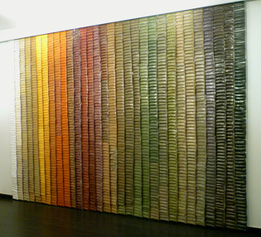
Analogy to a Spice Rack
Spice Rack
(Cache)
Spice Wall
(Memory)
index spice
A
B
C
D
E
F
…
Z
Compared to your spice wall
Smaller
Faster
More costly (per oz.)
http://www.bedbathandbeyond.com

Slide 28
Analogy to a Spice Rack
Spice Rack
(Cache)
Spice Wall
(Memory)
index spice
tag
A
B
C
D
E
F
…
Z
innamon
Cinnamon
How do you know what’s in the jar?
Need labels
Tag = Ultra-minimalist label

Slide 29
4-Byte, Direct Mapped Cache
MEMORY
addr | data
0000 | A
0001 | B
0010 | C
0011 | D
0100 | E
0101 | F
0110 | G
0111 | H
1000 | J
1001 | K
1010 | L
1011 | M
1100 | N
1101 | O
1110 | P
1111 | Q
tag|index
XXXX
CACHE
tag
00
00
00
00
index
00
01
10
11
 | data
 | A
 | B
 | C
 | D
Tag: minimalist label/address
address = tag + index

Slide 30
4-Byte, Direct Mapped Cache
MEMORY
addr | data
0000 | A
0001 | B
0010 | C
0011 | D
0100 | E
0101 | F
0110 | G
0111 | H
1000 | J
1001 | K
1010 | L
1011 | M
1100 | N
1101 | O
1110 | P
1111 | Q
CACHE
index
00
01
10
11
V | tag | data
0 | 00 | X
0 | 00 | X
0 | 00 | X
0 | 00 | X
One last tweak: valid bit

Slide 31
Simulation #1 of a 4-byte, DM Cache
MEMORY
addr | data
0000 | A
0001 | B
0010 | C
0011 | D
0100 | E
0101 | F
0110 | G
0111 | H
1000 | J
1001 | K
1010 | L
1011 | M
1100 | N
1101 | O
1110 | P
1111 | Q
tag|index
XXXX
CACHE
index
00
01
10
11
V | tag | data
0 | 11 | X
0 | 11 | X
0 | 11 | X
0 | 11 | X
load 1100
Miss
Lookup:
Index into $
Check tag
Check valid bit

Slide 32
Simulation #1 of a 4-byte, DM Cache
MEMORY
addr | data
0000 | A
0001 | B
0010 | C
0011 | D
0100 | E
0101 | F
0110 | G
0111 | H
1000 | J
1001 | K
1010 | L
1011 | M
1100 | N
1101 | O
1110 | P
1111 | Q
tag|index
XXXX
CACHE
index
00
01
10
11
V | tag | data
1 | 11 | N
0 | xx | X
0 | xx | X
0 | xx | X
load 1100
Miss
Lookup:
Index into $
Check tag
Check valid bit

Slide 33
Simulation #1 of a 4-byte, DM Cache
MEMORY
addr | data
0000 | A
0001 | B
0010 | C
0011 | D
0100 | E
0101 | F
0110 | G
0111 | H
1000 | J
1001 | K
1010 | L
1011 | M
1100 | N
1101 | O
1110 | P
1111 | Q
tag|index
XXXX
CACHE
index
00
01
10
11
V | tag | data
1 | 11 | N
0 | 11 | X
0 | 11 | X
0 | 11 | X
load 1100
...
load 1100
Miss
Lookup:
Index into $
Check tag
Check valid bit
Hit!
Awesome!

Slide 34
Clicker Questions
Processor A is a 1 GHz processor (1 cycle = 1 ns). There is an L1 cache with a 1 cycle access time and a 50% hit rate. There is an L2 cache with a 10 cycle access time and a 90% hit rate. It takes 100 ns to access memory.
Q1: What is the average memory access time of Processor A in ns? A: 5 B: 7 C: 9 D: 11 E: 13
Proc. B attempts to improve upon Proc. A by making the L1 cache larger. The new hit rate is 90%. To maintain a 1 cycle access time, Proc. B runs at 500 MHz (1 cycle = 2 ns).
Q2: What is the average memory access time of Processor B in ns? A: 5 B: 7 C: 9 D: 11 E: 13
Q3: Which processor should you buy?
A: Processor A B: Processor B C: They are equally good.
Notes:
Q1:
1 + 50% (10 + 10% x 100) =
1 + 5 + 5 = 11 ns
Q2:
2 + 10% (20 + 10% x 100) =
2 + 2 + 1 = 5 ns
Processor A. Although memory access times are over 2x faster on Processor B, the frequency of Processor B is 2x slower. Since most workloads are not more than 50% memory instructions, Processor A is still likely to be the faster processor for most work- loads. (If I did have workloads that were over 50% memory instructions, Processor B might be the better choice.)

Slide 35
Clicker Answers
Q1:
1 + 50% (10 + 10% x 100) =
1 + 5 + 5 = 11 ns
Q2:
2 + 10% (20 + 10% x 100) =
2 + 2 + 1 = 5 ns
Processor A. Although memory access times are over 2x faster on Processor B, the frequency of Processor B is 2x slower. Since most workloads are not more than 50% memory instructions, Processor A is still likely to be the faster processor for most work- loads. (If I did have workloads that were over 50% memory instructions, Processor B might be the better choice.)

Slide 36
Block Diagram 4-entry, direct mapped Cache
tag|index
1101
CACHE
V | tag | data
1 | 00 | 1111 0000
1 | 11 | 1010 0101
0 | 01 | 1010 1010
1 | 11 | 0000 0000
2
2
Great!
Are we done?
2
8
=
1010 0101
data
Hit!

Slide 37
Clicker: A) Hit B) Miss
MEMORY
Simulation #2:
4-byte, DM Cache
addr | data
0000 | A
0001 | B
0010 | C
0011 | D
0100 | E
0101 | F
0110 | G
0111 | H
1000 | J
1001 | K
1010 | L
1011 | M
1100 | N
1101 | O
1110 | P
1111 | Q
CACHE
index
00
01
10
11
V | tag | data
0 | 11 | X
0 | 11 | X
0 | 11 | X
0 | 11 | X
load 1100
load 1101
load 0100
load 1100
Miss
Lookup:
Index into $
Check tag
Check valid bit

Slide 38
Simulation #2: 4-byte, DM Cache
MEMORY
addr | data
0000 | A
0001 | B
0010 | C
0011 | D
0100 | E
0101 | F
0110 | G
0111 | H
1000 | J
1001 | K
1010 | L
1011 | M
1100 | N
1101 | O
1110 | P
1111 | Q
CACHE
index
00
01
10
11
V | tag | data
1 | 11 | N
0 | 11 | X
0 | 11 | X
0 | 11 | X
load 1100
load 1101
load 0100
load 1100
Miss
Lookup:
Index into $
Check tag
Check valid bit

Slide 39
Simulation #2: 4-byte, DM Cache
MEMORY
addr | data
0000 | A
0001 | B
0010 | C
0011 | D
0100 | E
0101 | F
0110 | G
0111 | H
1000 | J
1001 | K
1010 | L
1011 | M
1100 | N
1101 | O
1110 | P
1111 | Q
Clicker: A) Hit B) Miss
CACHE
index
00
01
10
11
V | tag | data
1 | 11 | N
0 | 11 | X
0 | 11 | X
0 | 11 | X
load 1100
load 1101
load 0100
load 1100
Miss
Lookup:
Index into $
Check tag
Check valid bit
Miss

Slide 40
Simulation #2: 4-byte, DM Cache
MEMORY
addr | data
0000 | A
0001 | B
0010 | C
0011 | D
0100 | E
0101 | F
0110 | G
0111 | H
1000 | J
1001 | K
1010 | L
1011 | M
1100 | N
1101 | O
1110 | P
1111 | Q
tag|index
XXXX
CACHE
index
00
01
10
11
V | tag | data
1 | 11 | N
1 | 11 | O
0 | 11 | X
0 | 11 | X
load 1100
load 1101
load 0100
load 1100
Miss
Lookup:
Index into $
Check tag
Check valid bit
Miss

Slide 41
Simulation #2: 4-byte, DM Cache
MEMORY
addr | data
0000 | A
0001 | B
0010 | C
0011 | D
0100 | E
0101 | F
0110 | G
0111 | H
1000 | J
1001 | K
1010 | L
1011 | M
1100 | N
1101 | O
1110 | P
1111 | Q
Clicker: A) Hit B) Miss
CACHE
index
00
01
10
11
V | tag | data
1 | 11 | N
1 | 11 | O
0 | xx | X
0 | xx | X
load 1100
load 1101
load 0100
load 1100
Miss
Lookup:
Index into $
Check tag
Check valid bit
Miss
Miss

Slide 42
Simulation #2: 4-byte, DM Cache
MEMORY
addr | data
0000 | A
0001 | B
0010 | C
0011 | D
0100 | E
0101 | F
0110 | G
0111 | H
1000 | J
1001 | K
1010 | L
1011 | M
1100 | N
1101 | O
1110 | P
1111 | Q
CACHE
index
00
01
10
11
V | tag | data
1 | 01 | E
1 | 11 | O
0 | 11 | X
0 | 11 | X
load 1100
load 1101
load 0100
load 1100
Miss
Lookup:
Index into $
Check tag
Check valid bit
Miss
Miss

Slide 43
Simulation #2: 4-byte, DM Cache
MEMORY
addr | data
0000 | A
0001 | B
0010 | C
0011 | D
0100 | E
0101 | F
0110 | G
0111 | H
1000 | J
1001 | K
1010 | L
1011 | M
1100 | N
1101 | O
1110 | P
1111 | Q
Clicker: A) Hit B) Miss
CACHE
index
00
01
10
11
V | tag | data
1 | 01 | E
1 | 11 | O
0 | 11 | X
0 | 11 | X
load 1100
load 1101
load 0100
load 1100
Miss
Lookup:
Index into $
Check tag
Check valid bit
Miss
Miss
Miss

Slide 44
Simulation #2: 4-byte, DM Cache
MEMORY
addr | data
0000 | A
0001 | B
0010 | C
0011 | D
0100 | E
0101 | F
0110 | G
0111 | H
1000 | J
1001 | K
1010 | L
1011 | M
1100 | N
1101 | O
1110 | P
1111 | Q
tag|index
XXXX
CACHE
index
00
01
10
11
V | tag | data
1 | 11 | N
1 | 11 | O
0 | 11 | X
0 | 11 | X
load 1100
load 1101
load 0100
load 1100
Miss
cold
Disappointed!
☹
Miss
cold
Miss
cold
Miss

Slide 45
Reducing Cold Misses by Increasing Block Size
Leveraging Spatial Locality

Slide 46
Increasing Block Size
MEMORY
addr | data
0000 | A
0001 | B
0010 | C
0011 | D
0100 | E
0101 | F
0110 | G
0111 | H
1000 | J
1001 | K
1010 | L
1011 | M
1100 | N
1101 | O
1110 | P
1111 | Q
CACHE
offset
XXXX
index
00
01
10
11
V | tag | data
0 | x | A | B
0 | x | C | D
0 | x | E | F
0 | x | G | H
Block Size: 2 bytes
Block Offset: least significant bits indicate where you live in the block
Which bits are the index? tag?

Slide 47
Simulation #3: 8-byte, DM Cache
MEMORY
addr | data
0000 | A
0001 | B
0010 | C
0011 | D
0100 | E
0101 | F
0110 | G
0111 | H
1000 | J
1001 | K
1010 | L
1011 | M
1100 | N
1101 | O
1110 | P
1111 | Q
index
CACHE
tag| |offset
XXXX
index
00
01
10
11
V | tag | data
0 | x | X | X
0 | x | X | X
0 | x | X | X
0 | x | X | X
load 1100
load 1101
load 0100
load 1100
Miss
Lookup:
Index into $
Check tag
Check valid bit

Slide 48
Simulation #3: 8-byte, DM Cache
MEMORY
addr | data
0000 | A
0001 | B
0010 | C
0011 | D
0100 | E
0101 | F
0110 | G
0111 | H
1000 | J
1001 | K
1010 | L
1011 | M
1100 | N
1101 | O
1110 | P
1111 | Q
index
CACHE
tag| |offset
XXXX
index
00
01
10
11
V | tag | data
0 | x | X | X
0 | x | X | X
1 | 1 | N | O
0 | x | X | X
load 1100
load 1101
load 0100
load 1100
Miss
Lookup:
Index into $
Check tag
Check valid bit

Slide 49
Simulation #3: 8-byte, DM Cache
MEMORY
addr | data
0000 | A
0001 | B
0010 | C
0011 | D
0100 | E
0101 | F
0110 | G
0111 | H
1000 | J
1001 | K
1010 | L
1011 | M
1100 | N
1101 | O
1110 | P
1111 | Q
index
CACHE
tag| |offset
XXXX
index
00
01
10
11
V | tag | data
0 | x | X | X
0 | x | X | X
1 | 1 | N | O
0 | x | X | X
load 1100
load 1101
load 0100
load 1100
Miss
Lookup:
Index into $
Check tag
Check valid bit
Hit!

Slide 50
Simulation #3: 8-byte, DM Cache
MEMORY
addr | data
0000 | A
0001 | B
0010 | C
0011 | D
0100 | E
0101 | F
0110 | G
0111 | H
1000 | J
1001 | K
1010 | L
1011 | M
1100 | N
1101 | O
1110 | P
1111 | Q
index
CACHE
tag| |offset
XXXX
index
00
01
10
11
V | tag | data
0 | x | X | X
0 | x | X | X
1 | 1 | N | O
0 | x | X | X
load 1100
load 1101
load 0100
load 1100
Miss
Lookup:
Index into $
Check tag
Check valid bit
Hit!
Miss

Slide 51
Simulation #3: 8-byte, DM Cache
MEMORY
addr | data
0000 | A
0001 | B
0010 | C
0011 | D
0100 | E
0101 | F
0110 | G
0111 | H
1000 | J
1001 | K
1010 | L
1011 | M
1100 | N
1101 | O
1110 | P
1111 | Q
index
CACHE
tag| |offset
XXXX
index
00
01
10
11
V | tag | data
0 | x | X | X
0 | x | X | X
1 | 0 | E | F
0 | x | X | X
load 1100
load 1101
load 0100
load 1100
Miss
Lookup:
Index into $
Check tag
Check valid bit
Hit!
Miss

Slide 52
Simulation #3: 8-byte, DM Cache
MEMORY
addr | data
0000 | A
0001 | B
0010 | C
0011 | D
0100 | E
0101 | F
0110 | G
0111 | H
1000 | J
1001 | K
1010 | L
1011 | M
1100 | N
1101 | O
1110 | P
1111 | Q
index
CACHE
tag| |offset
XXXX
index
00
01
10
11
V | tag | data
0 | x | X | X
0 | x | X | X
1 | 0 | E | F
0 | x | X | X
load 1100
load 1101
load 0100
load 1100
Miss
Lookup:
Index into $
Check tag
Check valid bit
Hit!
Miss
Miss

Slide 53
Simulation #3: 8-byte, DM Cache
MEMORY
addr | data
0000 | A
0001 | B
0010 | C
0011 | D
0100 | E
0101 | F
0110 | G
0111 | H
1000 | J
1001 | K
1010 | L
1011 | M
1100 | N
1101 | O
1110 | P
1111 | Q
CACHE
index
00
01
10
11
V | tag | data
0 | x | X | X
0 | x | X | X
1 | 0 | E | F
0 | x | X | X
load 1100
load 1101
load 0100
load 1100
Miss
cold
1 hit, 3 misses
3 bytes don’t fit in a 4 entry cache?
Hit!
Miss
cold
Miss
conflict

Slide 54
Removing Conflict Misses with Fully-Associative Caches

Slide 55
8 byte, fully-associative Cache
MEMORY
addr | data
0000 | A
0001 | B
0010 | C
0011 | D
0100 | E
0101 | F
0110 | G
0111 | H
1000 | J
1001 | K
1010 | L
1011 | M
1100 | N
1101 | O
1110 | P
1111 | Q
XXXX
tag|offset
XXXX
XXXX
offset
CACHE
V | tag | data
0 | xxx | X | X
V | tag | data
0 | xxx | X | X
V | tag | data
0 | xxx | X | X
V | tag | data
0 | xxx | X | X
What should the offset be?
What should the index be?
What should the tag be?
Clicker: A) xxxx
B) xxxx
C) xxxx
D) xxxx
E) None
Notes:
Offset = A
Index = E
Tag = D

Slide 56
Simulation #4: 8-byte, FA Cache
MEMORY
addr | data
0000 | A
0001 | B
0010 | C
0011 | D
0100 | E
0101 | F
0110 | G
0111 | H
1000 | J
1001 | K
1010 | L
1011 | M
1100 | N
1101 | O
1110 | P
1111 | Q
XXXX
tag|offset
CACHE
V | tag | data
0 | xxx | X | X
V | tag | data
0 | xxx | X | X
V | tag | data
0 | xxx | X | X
V | tag | data
0 | xxx | X | X
load 1100
load 1101
load 0100
load 1100
Miss
Lookup:
Index into $
Check tags
Check valid bits
LRU Pointer

Slide 57
Simulation #4: 8-byte, FA Cache
MEMORY
addr | data
0000 | A
0001 | B
0010 | C
0011 | D
0100 | E
0101 | F
0110 | G
0111 | H
1000 | J
1001 | K
1010 | L
1011 | M
1100 | N
1101 | O
1110 | P
1111 | Q
XXXX
tag|offset
CACHE
V | tag | data
1 | 110 | N | O
V | tag | data
0 | xxx | X | X
V | tag | data
0 | xxx | X | X
V | tag | data
0 | xxx | X | X
load 1100
load 1101
load 0100
load 1100
Miss
Lookup:
Index into $
Check tags
Check valid bits
Hit!

Slide 58
Simulation #4: 8-byte, FA Cache
MEMORY
addr | data
0000 | A
0001 | B
0010 | C
0011 | D
0100 | E
0101 | F
0110 | G
0111 | H
1000 | J
1001 | K
1010 | L
1011 | M
1100 | N
1101 | O
1110 | P
1111 | Q
XXXX
tag|offset
CACHE
V | tag | data
1 | 110 | N | O
V | tag | data
0 | xxx | X | X
V | tag | data
0 | xxx | X | X
V | tag | data
0 | xxx | X | X
load 1100
load 1101
load 0100
load 1100
Miss
Lookup:
Index into $
Check tags
Check valid bits
Hit!
Miss
LRU Pointer

Slide 59
Simulation #4: 8-byte, FA Cache
MEMORY
addr | data
0000 | A
0001 | B
0010 | C
0011 | D
0100 | E
0101 | F
0110 | G
0111 | H
1000 | J
1001 | K
1010 | L
1011 | M
1100 | N
1101 | O
1110 | P
1111 | Q
XXXX
tag|offset
CACHE
V | tag | data
1 | 110 | N | O
V | tag | data
1 | 010 | E | F
V | tag | data
0 | xxx | X | X
V | tag | data
0 | xxx | X | X
load 1100
load 1101
load 0100
load 1100
Miss
Lookup:
Index into $
Check tags
Check valid bits
Hit!
Miss
Hit!
LRU Pointer

Slide 60
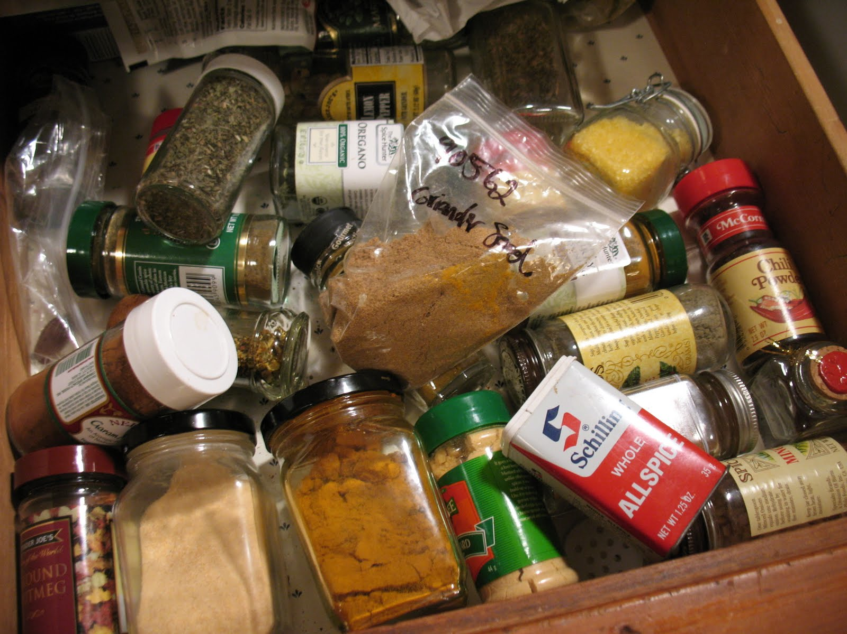
Pros and Cons of Full Associativity
+ No more conflicts!
+ Excellent utilization!
But either:
Parallel Reads
– lots of reading!
Serial Reads
– lots of waiting
t_{avg} = t_{hit} + %_{miss}* t_{miss}
= 4 + 5% x 100
= 9 cycles
= 6 + 3% x 100
= 9 cycles

Slide 61
Pros & Cons
 | Direct Mapped | Fully Associative
Tag Size | Smaller | Larger
SRAM Overhead | Less | More
Controller Logic | Less | More
Speed | Faster | Slower
Price | Less | More
Scalability | Very | Not Very
# of conflict misses | Lots | Zero
Hit Rate | Low | High
Pathological Cases | Common | ?

Slide 62
Reducing Conflict Misses with Set-Associative Caches
Not too conflict-y. Not too slow.
… Just Right!

Slide 63
8 byte, 2-way set associative Cache
MEMORY
addr | data
0000 | A
0001 | B
0010 | C
0011 | D
0100 | E
0101 | F
0110 | G
0111 | H
1000 | J
1001 | K
1010 | L
1011 | M
1100 | N
1101 | O
1110 | P
1111 | Q
XXXX
tag||offset
XXXX
XXXX
offset
index
CACHE
index
0
1
V | tag | data
0 | xx | E | F
0 | xx | C | D
V | tag | data
0 | xx | N | O
0 | xx | P | Q
What should the offset be?
What should the index be?
What should the tag be?

Slide 64
Clicker Question
5 bit address
2 byte block size
24 byte, 3-Way Set Associative CACHE
XXXXX
index
00
01
10
11
V | tag | data
0 | ? | X | Y
0 | ? | X | Y
0 | ? | X | Y
0 | ? | X | Y
V | tag | data
0 | ? | X’ | Y’
0 | ? | X’ | Y’
0 | ? | X’ | Y’
0 | ? | X’ | Y’
V | tag | data
0 | ? | X’’ | Y’’
0 | ? | X’’ | Y’’
0 | ? | X’’ | Y’’
0 | ? | X’’ | Y’’
0
1
2
3
4
How many tag bits?

Slide 65
Clicker Question
5 bit address
2 byte block size
24 byte, 3-Way Set Associative CACHE
XXXXX
index
00
01
10
11
V | tag | data
0 | ? | X | Y
0 | ? | X | Y
0 | ? | X | Y
0 | ? | X | Y
V | tag | data
0 | ? | X’ | Y’
0 | ? | X’ | Y’
0 | ? | X’ | Y’
0 | ? | X’ | Y’
V | tag | data
0 | ? | X’’ | Y’’
0 | ? | X’’ | Y’’
0 | ? | X’’ | Y’’
0 | ? | X’’ | Y’’
0
1
2
3
4
How many tag bits?

Slide 66
8 byte, 2-way set associative Cache
MEMORY
addr | data
0000 | A
0001 | B
0010 | C
0011 | D
0100 | E
0101 | F
0110 | G
0111 | H
1000 | J
1001 | K
1010 | L
1011 | M
1100 | N
1101 | O
1110 | P
1111 | Q
XXXX
tag||offset
index
CACHE
index
0
1
V | tag | data
0 | xx | X | X
0 | xx | X | X
V | tag | data
0 | xx | X | X
0 | xx | X | X
load 1100
load 1101
load 0100
load 1100
Miss
Lookup:
Index into $
Check tag
Check valid bit
LRU Pointer

Slide 67
8 byte, 2-way set associative Cache
MEMORY
addr | data
0000 | A
0001 | B
0010 | C
0011 | D
0100 | E
0101 | F
0110 | G
0111 | H
1000 | J
1001 | K
1010 | L
1011 | M
1100 | N
1101 | O
1110 | P
1111 | Q
XXXX
tag||offset
index
CACHE
index
0
1
V | tag | data
1 | 11 | N | O
0 | xx | X | X
V | tag | data
0 | xx | X | X
0 | xx | X | X
load 1100
load 1101
load 0100
load 1100
Miss
Lookup:
Index into $
Check tag
Check valid bit
Hit!
LRU Pointer

Slide 68
8 byte, 2-way set associative Cache
MEMORY
addr | data
0000 | A
0001 | B
0010 | C
0011 | D
0100 | E
0101 | F
0110 | G
0111 | H
1000 | J
1001 | K
1010 | L
1011 | M
1100 | N
1101 | O
1110 | P
1111 | Q
XXXX
tag||offset
index
CACHE
index
0
1
V | tag | data
1 | 11 | N | O
0 | xx | X | X
V | tag | data
0 | xx | X | X
0 | xx | X | X
load 1100
load 1101
load 0100
load 1100
Miss
Lookup:
Index into $
Check tag
Check valid bit
Hit!
Miss
LRU Pointer

Slide 69
8 byte, 2-way set associative Cache
MEMORY
addr | data
0000 | A
0001 | B
0010 | C
0011 | D
0100 | E
0101 | F
0110 | G
0111 | H
1000 | J
1001 | K
1010 | L
1011 | M
1100 | N
1101 | O
1110 | P
1111 | Q
XXXX
tag||offset
index
CACHE
index
0
1
V | tag | data
1 | 11 | N | O
0 | xx | X | X
V | tag | data
1 | 01 | E | F
0 | xx | X | X
load 1100
load 1101
load 0100
load 1100
Miss
Lookup:
Index into $
Check tag
Check valid bit
Hit!
Miss
Hit!
LRU Pointer

Slide 70
Eviction Policies
Which cache line should be evicted from the cache to make room for a new line?
Direct-mapped: no choice, must evict line selected by index
Associative caches
Random: select one of the lines at random
Round-Robin: similar to random
FIFO: replace oldest line
LRU: replace line that has not been used in the longest time

Slide 71
Misses: the Three C’s
Cold (compulsory) Miss:
never seen this address before
Conflict Miss:
cache associativity is too low
Capacity Miss:
cache is too small

Slide 72
Miss Rate vs. Block Size

Slide 73
Block Size Tradeoffs
For a given total cache size,
Larger block sizes mean….
fewer lines
so fewer tags, less overhead
and fewer cold misses (within-block “prefetching”)
But also…
fewer blocks available (for scattered accesses!)
so more conflicts
can decrease performance if working set can’t fit in $
and larger miss penalty (time to fetch block)
Notes:
Same for other parameters: experimental mostly

Slide 74
Miss Rate vs. Associativity

Slide 75
Clicker Question
What does NOT happen when you increase the associativity of the cache?
Conflict misses decrease
Tag overhead decreases
Hit time increases
Cache stays the same size

Slide 76
Clicker Question
What does NOT happen when you increase the associativity of the cache?
Conflict misses decrease
Tag overhead decreases
Hit time increases
Cache stays the same size

Slide 77
ABCs of Caches
t_{avg} = t_{hit} + %_{miss}* t_{miss}
+ Associativity:
⬇conflict misses ☺
⬆hit time ☹
+ Block Size:
⬇cold misses ☺
⬆conflict misses ☹
+ Capacity:
⬇capacity misses ☺
⬆hit time ☹

Slide 78
Which caches get what properties?
t_{avg} = t_{hit} + %_{miss}* t_{miss}
Design with speed in mind
Fast
L1 Caches
More Associative
Bigger Block Sizes
Larger Capacity
L2 Cache
L3 Cache
Design with miss rate in mind
Big

Slide 79
Roadmap
Things we have covered:
The Need for Speed
Locality to the Rescue!
Calculating average memory access time
$ Misses: Cold, Conflict, Capacity
$ Characteristics: Associativity, Block Size, Capacity
Things we will now cover:
Cache Figures
Cache Performance Examples
Writes

Slide 80
2-Way Set Associative Cache (Reading)
Tag Index Offset
V
Tag
Data
V
Tag
Data
=
=
line select
64bytes
word select
hit?
data
32bits

Slide 81
3-Way Set Associative Cache (Reading)
Tag Index Offset
=
=
=
line select
64bytes
word select
hit?
data
32bits

Slide 82
How Big is the Cache?
Tag Index Offset
n bit index, m bit offset, N-way Set Associative
Question: How big is cache?
Data only?
(what we usually mean when we ask “how big” is the cache)
Data + overhead?

Slide 83
How Big is the Cache?
Tag Index Offset
n bit index, m bit offset, N-way Set Associative
Question: How big is cache?
How big is the cache (Data only)?
Cache of size 2^{n} sets
Block size of 2^{m} bytes, N-way set associative
Cache Size: 2^{m} bytes-per-block x (2^{n} sets x N-way-per-set)
= N x 2^{n+m} bytes

Slide 84
How Big is the Cache?
Tag Index Offset
n bit index, m bit offset, N-way Set Associative
Question: How big is cache?
How big is the cache (Data + overhead)?
Cache of size 2^{n} sets
Block size of 2^{m} bytes, N-way set associative
Tag field: 32 – (n + m), Valid bit: 1
SRAM Size: 2^{n} sets x N-way-per-set x (block size + tag size + valid bit size)
= 2^{n} x N-way x (2^{m} bytes x 8 bits-per-byte + (32–n–m) + 1)

Slide 85
Performance Calculation with $ Hierarchy
t_{avg} = t_{hit} + %_{miss}* t_{miss}
Parameters
Reference stream: all loads
D$: t_{hit} = 1ns, %_{miss} = 5%
L2: t_{hit} = 10ns, %_{miss} = 20% (local miss rate)
Main memory: t_{hit} = 50ns
What is t_{avgD$} without an L2?
t_{missD$} =
t_{avgD$} =
What is t_{avgD$} with an L2?
t_{missD$} =
t_{avgL2} =
t_{avgD$} =

Slide 86
Performance Calculation with $ Hierarchy
Parameters
Reference stream: all loads
D$: t_{hit} = 1ns, %_{miss} = 5%
L2: t_{hit} = 10ns, %_{miss} = 20% (local miss rate)
Main memory: t_{hit} = 50ns
What is t_{avgD$} without an L2?
t_{missD$} =
t_{avgD$} =
What is t_{avgD$} with an L2?
t_{missD$} =
t_{avgL2} =
t_{avgD$} =
t_{avg} = t_{hit} + %_{miss}* t_{miss}
t_{hitM}
t_{hitD$} + %_{missD$}*t_{hitM} = 1ns+(0.05*50ns) = 3.5ns
t_{avgL2}
t_{hitL2}+%_{missL2}*t_{hitM} = 10ns+(0.2*50ns) = 20ns
t_{hitD$} + %_{missD$}*t_{avgL2} = 1ns+(0.05*20ns) = 2ns

Slide 87
Performance Summary
Average memory access time (AMAT) depends on:
cache architecture and size
Hit and miss rates
Access times and miss penalty
Cache design a very complex problem:
Cache size, block size (aka line size)
Number of ways of set-associativity (1, N, ∞)
Eviction policy
Number of levels of caching, parameters for each
Separate I-cache from D-cache, or Unified cache
Prefetching policies / instructions
Write policy

Slide 88
Takeaway
Direct Mapped → fast, but low hit rate
Fully Associative → higher hit cost, higher hit rate
Set Associative → middleground
Line size matters. Larger cache lines can increase performance due to prefetching. BUT, can also decrease performance is working set size cannot fit in cache.
Cache performance is measured by the average memory access time (AMAT), which depends cache architecture and size, but also the access time for hit, miss penalty, hit rate.

Slide 89
What about Stores?
We want to write to the cache.
If the data is not in the cache?
Bring it in. (Write allocate policy)
Should we also update memory?
Yes: write-through policy
No: write-back policy

Slide 90
Write-Through Cache
16 byte, byte-addressed memory
4 btye, fully-associative cache:
2-byte blocks, write-allocate
4 bit addresses:
3 bit tag, 1 bit offset
Memory
Instructions:
LB $1 ← M[ 1 ]
LB $2 ← M[ 7 ]
SB $2 → M[ 0 ]
SB $1 → M[ 5 ]
LB $2 ← M[ 10 ]
SB $1 → M[ 5 ]
SB $1 → M[ 10 ]
0
1
2
3
4
5
6
7
8
9
10
11
12
13
14
15
78
29
120
lru V tag data
123
71
1
0
150
162
0
0
173
18
Register File
Cache
21
33
$0
$1
$2
$3
28
Misses: 0
Hits: 0
Reads: 0
Writes: 0
19
200
210
225

Slide 91
Write-Through (REF 1)
Memory
Instructions:
LB $1 ← M[ 1 ]
LB $2 ← M[ 7 ]
SB $2 → M[ 0 ]
SB $1 → M[ 5 ]
LB $2 ← M[ 10 ]
SB $1 → M[ 5 ]
SB $1 → M[ 10 ]
0
1
2
3
4
5
6
7
8
9
10
11
12
13
14
15
78
29
120
lru V tag data
123
71
1
0
150
162
0
0
173
18
Register File
Cache
21
33
$0
$1
$2
$3
28
Misses: 0
Hits: 0
Reads: 0
Writes: 0
19
200
210
225

Slide 92
Write-Through (REF 1)
Memory
Instructions:
LB $1 ← M[ 1 ]
LB $2 ← M[ 7 ]
SB $2 → M[ 0 ]
SB $1 → M[ 5 ]
LB $2 ← M[ 10 ]
SB $1 → M[ 5 ]
SB $1 → M[ 10 ]
0
1
2
3
4
5
6
7
8
9
10
11
12
13
14
15
78
M
29
120
lru V tag data
123
71
0
1
000
78
150
29
162
1
0
173
18
Register File
Cache
21
33
$0
$1
$2
$3
28
29
Misses: 1
Hits: 0
Reads: 2
Writes: 0
19
200
210
225

Slide 93
Write-Through (REF 2)
Memory
Instructions:
LB $1 ← M[ 1 ]
LB $2 ← M[ 7 ]
SB $2 → M[ 0 ]
SB $1 → M[ 5 ]
LB $2 ← M[ 10 ]
SB $1 → M[ 5 ]
SB $1 → M[ 10 ]
0
1
2
3
4
5
6
7
8
9
10
11
12
13
14
15
78
M
29
120
lru V tag data
123
71
0
1
000
78
150
29
162
1
0
173
18
Register File
Cache
21
33
$0
$1
$2
$3
28
29
Misses: 1
Hits: 0
Reads: 2
Writes: 0
19
200
210
225

Slide 94
Write-Through (REF 2)
Memory
Instructions:
LB $1 ← M[ 1 ]
LB $2 ← M[ 7 ]
SB $2 → M[ 0 ]
SB $1 → M[ 5 ]
LB $2 ← M[ 10 ]
SB $1 → M[ 5 ]
SB $1 → M[ 10 ]
0
1
2
3
4
5
6
7
8
9
10
11
12
13
14
15
78
M
M
29
120
lru V tag data
123
71
0
1
000
78
150
29
162
1
1
011
162
173
173
18
Register File
Cache
21
33
$0
$1
$2
$3
28
29
Misses: 2
Hits: 0
Reads: 4
Writes: 0
19
173
200
210
225

Slide 95
Write-Through (REF 3)
CLICKER:
HIT
MISS
Memory
Instructions:
LB $1 ← M[ 1 ]
LB $2 ← M[ 7 ]
SB $2 → M[ 0 ]
SB $1 → M[ 5 ]
LB $2 ← M[ 10 ]
SB $1 → M[ 5 ]
SB $1 → M[ 10 ]
0
1
2
3
4
5
6
7
8
9
10
11
12
13
14
15
78
M
M
29
120
lru V tag data
123
71
1
1
000
78
150
29
162
0
1
011
162
173
173
18
Register File
Cache
21
33
$0
$1
$2
$3
28
29
Misses: 2
Hits: 0
Reads: 4
Writes: 0
19
173
200
210
225

Slide 96
Write-Through (REF 3)
Memory
Instructions:
LB $1 ← M[ 1 ]
LB $2 ← M[ 7 ]
SB $2 → M[ 0 ]
SB $1 → M[ 5 ]
LB $2 ← M[ 10 ]
SB $1 → M[ 5 ]
SB $1 → M[ 10 ]
0
1
2
3
4
5
6
7
8
9
10
11
12
13
14
15
173
M
M
Hit
29
120
lru V tag data
123
71
0
1
000
173
150
29
162
1
1
011
162
173
173
18
Register File
Cache
21
33
$0
$1
$2
$3
28
29
Misses: 2
Hits: 1
Reads: 4
Writes: 1
19
173
200
210
225

Slide 97
Write-Through (REF 4)
write-allocate
Memory
Instructions:
LB $1 ← M[ 1 ]
LB $2 ← M[ 7 ]
SB $2 → M[ 0 ]
SB $1 → M[ 5 ]
LB $2 ← M[ 10 ]
SB $1 → M[ 5 ]
SB $1 → M[ 10 ]
0
1
2
3
4
5
6
7
8
9
10
11
12
13
14
15
173
M
M
Hit
M
29
120
lru V tag data
123
71
0
1
000
173
150
29
162
1
1
011
011
010
162
71
173
150
173
18
Register File
Cache
21
33
$0
$1
$2
$3
28
29
Misses: 2
Hits: 1
Reads: 4
Writes: 1
19
173
200
210
225

Slide 98
Write-Through (REF 4)
Memory
Instructions:
LB $1 ← M[ 1 ]
LB $2 ← M[ 7 ]
SB $2 → M[ 0 ]
SB $1 → M[ 5 ]
LB $2 ← M[ 10 ]
SB $1 → M[ 5 ]
SB $1 → M[ 10 ]
0
1
2
3
4
5
6
7
8
9
10
11
12
13
14
15
173
M
M
Hit
M
29
120
lru V tag data
123
71
1
1
000
173
150
29
29
162
0
1
010
71
173
150
29
150
18
Register File
Cache
21
33
$0
$1
$2
$3
28
29
Misses: 3
Hits: 1
Reads: 6
Writes: 2
19
173
200
210
225

Slide 99
Write-Through (REF 5)
CLICKER:
HIT
MISS
Memory
Instructions:
LB $1 ← M[ 1 ]
LB $2 ← M[ 7 ]
SB $2 → M[ 0 ]
SB $1 → M[ 5 ]
LB $2 ← M[ 10 ]
SB $1 → M[ 5 ]
SB $1 → M[ 10 ]
0
1
2
3
4
5
6
7
8
9
10
11
12
13
14
15
173
M
M
Hit
M
29
120
lru V tag data
123
71
1
1
000
173
29
29
162
0
1
010
71
173
29
18
Register File
Cache
21
33
$0
$1
$2
$3
28
29
Misses: 3
Hits: 1
Reads: 6
Writes: 2
19
173
200
210
225

Slide 100
Write-Through (REF 5)
Memory
Instructions:
LB $1 ← M[ 1 ]
LB $2 ← M[ 7 ]
SB $2 → M[ 0 ]
SB $1 → M[ 5 ]
LB $2 ← M[ 10 ]
SB $1 → M[ 5 ]
SB $1 → M[ 10 ]
0
1
2
3
4
5
6
7
8
9
10
11
12
13
14
15
173
M
M
Hit
M
M
29
120
lru V tag data
123
71
0
1
101
33
29
28
162
1
1
010
71
173
29
18
Register File
Cache
21
33
$0
$1
$2
$3
28
29
Misses: 4
Hits: 1
Reads: 8
Writes: 2
19
33
200
210
225

Slide 101
Write-Through (REF 6)
Memory
Instructions:
LB $1 ← M[ 1 ]
LB $2 ← M[ 7 ]
SB $2 → M[ 0 ]
SB $1 → M[ 5 ]
LB $2 ← M[ 10 ]
SB $1 → M[ 5 ]
SB $1 → M[ 10 ]
0
1
2
3
4
5
6
7
8
9
10
11
12
13
14
15
173
M
M
Hit
M
M
29
120
lru V tag data
123
71
0
1
101
33
29
29
28
162
1
1
010
71
173
29
29
18
Register File
Cache
21
33
$0
$1
$2
$3
28
29
Misses: 4
Hits: 1
Reads: 8
Writes: 2
19
33
200
210
225

Slide 102
Write-Through (REF 6)
Memory
Instructions:
LB $1 ← M[ 1 ]
LB $2 ← M[ 7 ]
SB $2 → M[ 0 ]
SB $1 → M[ 5 ]
LB $2 ← M[ 10 ]
SB $1 → M[ 5 ]
SB $1 → M[ 10 ]
0
1
2
3
4
5
6
7
8
9
10
11
12
13
14
15
173
M
M
Hit
M
M
Hit
29
120
lru V tag data
123
71
0
1
101
33
29
29
28
162
1
1
010
71
173
29
29
18
Register File
Cache
21
33
$0
$1
$2
$3
28
29
Misses: 4
Hits: 2
Reads: 8
Writes: 3
19
33
200
210
225

Slide 103
Write-Through (REF 7)
Memory
Instructions:
LB $1 ← M[ 1 ]
LB $2 ← M[ 7 ]
SB $2 → M[ 0 ]
SB $1 → M[ 5 ]
LB $2 ← M[ 10 ]
SB $1 → M[ 5 ]
SB $1 → M[ 10 ]
0
1
2
3
4
5
6
7
8
9
10
11
12
13
14
15
173
M
M
Hit
M
M
Hit
29
120
lru V tag data
123
71
0
1
101
33
29
29
28
162
1
1
010
71
173
29
29
18
Register File
Cache
21
33
$0
$1
$2
$3
28
29
Misses: 4
Hits: 2
Reads: 8
Writes: 3
19
33
200
210
225

Slide 104
Write-Through (REF 7)
Memory
Instructions:
LB $1 ← M[ 1 ]
LB $2 ← M[ 7 ]
SB $2 → M[ 0 ]
SB $1 → M[ 5 ]
LB $2 ← M[ 10 ]
SB $1 → M[ 5 ]
SB $1 → M[ 10 ]
0
1
2
3
4
5
6
7
8
9
10
11
12
13
14
15
173
M
M
Hit
M
M
Hit
Hit
29
120
lru V tag data
123
71
0
1
101
33
29
29
29
28
162
1
1
010
71
173
29
29
18
Register File
Cache
21
33
29
$0
$1
$2
$3
28
29
Misses: 4
Hits: 3
Reads: 8
Writes: 4
19
33
200
210
225

Slide 105
Summary: Write Through
Write-through policy with write allocate
Cache miss: read entire block from memory
Write: write only updated item to memory
Eviction: no need to write to memory

Slide 106
Next Goal: Write-Through vs. Write-Back
What if we DON’T to write stores immediately to memory?
Keep the current copy in cache, and update memory when data is evicted (write-back policy)
Write-back all evicted lines?
No, only written-to blocks

Slide 107
Write-Back Meta-Data (Valid, Dirty Bits)
V | D | Tag | Byte 1 | Byte 2 | … Byte N
V = 1 means the line has valid data
D = 1 means the bytes are newer than main memory
When allocating line:
Set V = 1, D = 0, fill in Tag and Data
When writing line:
Set D = 1
When evicting line:
If D = 0: just set V = 0
If D = 1: write-back Data, then set D = 0, V = 0

Slide 108
Write-back Example
Example: How does a write-back cache work?
Assume write-allocate

Slide 109
Handling Stores (Write-Back)
16 byte, byte-addressed memory
4 btye, fully-associative cache:
2-byte blocks, write-allocate
4 bit addresses:
3 bit tag, 1 bit offset
Memory
Instructions:
LB $1 ← M[ 1 ]
LB $2 ← M[ 7 ]
SB $2 → M[ 0 ]
SB $1 → M[ 5 ]
LB $2 ← M[ 10 ]
SB $1 → M[ 5 ]
SB $1 → M[ 10 ]
0
1
2
3
4
5
6
7
8
9
10
11
12
13
14
15
78
29
120
lru V d tag data
123
71
1
0
150
162
0
0
173
18
Register File
Cache
21
33
$0
$1
$2
$3
Misses: 0
Hits: 0
Reads: 0
Writes: 0
28
19
200
210
225

Slide 110
Write-Back (REF 1)
Memory
Instructions:
LB $1 ← M[ 1 ]
LB $2 ← M[ 7 ]
SB $2 → M[ 0 ]
SB $1 → M[ 5 ]
LB $2 ← M[ 10 ]
SB $1 → M[ 5 ]
SB $1 → M[ 10 ]
0
1
2
3
4
5
6
7
8
9
10
11
12
13
14
15
78
29
120
lru V d tag data
123
71
1
0
150
162
0
0
173
18
Register File
Cache
21
33
$0
$1
$2
$3
Misses: 0
Hits: 0
Reads: 0
Writes: 0
28
19
200
210
225

Slide 111
Write-Back (REF 1)
Memory
Instructions:
LB $1 ← M[ 1 ]
LB $2 ← M[ 7 ]
SB $2 → M[ 0 ]
SB $1 → M[ 5 ]
LB $2 ← M[ 10 ]
SB $1 → M[ 5 ]
SB $1 → M[ 10 ]
M
0
1
2
3
4
5
6
7
8
9
10
11
12
13
14
15
78
29
120
lru V d tag data
123
71
0
1
0
000
78
150
29
162
1
0
173
18
Register File
Cache
21
33
$0
$1
$2
$3
Misses: 1
Hits: 0
Reads: 2
Writes: 0
28
29
19
200
210
225

Slide 112
Write-Back (REF 2)
Memory
Instructions:
LB $1 ← M[ 1 ]
LB $2 ← M[ 7 ]
SB $2 → M[ 0 ]
SB $1 → M[ 5 ]
LB $2 ← M[ 10 ]
SB $1 → M[ 5 ]
SB $1 → M[ 10 ]
M
0
1
2
3
4
5
6
7
8
9
10
11
12
13
14
15
78
29
120
lru V d tag data
123
71
0
1
0
000
78
150
29
162
1
0
173
18
Register File
Cache
21
33
$0
$1
$2
$3
Misses: 1
Hits: 0
Reads: 2
Writes: 0
28
29
19
200
210
225

Slide 113
Write-Back (REF 2)
Memory
Instructions:
LB $1 ← M[ 1 ]
LB $2 ← M[ 7 ]
SB $2 → M[ 0 ]
SB $1 → M[ 5 ]
LB $2 ← M[ 10 ]
SB $1 → M[ 5 ]
SB $1 → M[ 10 ]
M
M
0
1
2
3
4
5
6
7
8
9
10
11
12
13
14
15
78
29
120
lru V d tag data
123
71
1
1
0
000
78
150
29
162
0
1
0
011
162
173
173
18
Register File
Cache
21
33
$0
$1
$2
$3
Misses: 2
Hits: 0
Reads: 4
Writes: 0
28
29
19
173
200
210
225

Slide 114
Write-Back (REF 3)
Memory
Instructions:
LB $1 ← M[ 1 ]
LB $2 ← M[ 7 ]
SB $2 → M[ 0 ]
SB $1 → M[ 5 ]
LB $2 ← M[ 10 ]
SB $1 → M[ 5 ]
SB $1 → M[ 10 ]
M
M
0
1
2
3
4
5
6
7
8
9
10
11
12
13
14
15
78
29
120
lru V d tag data
123
71
1
1
0
000
78
150
29
162
0
1
0
011
162
173
173
18
Register File
Cache
21
33
$0
$1
$2
$3
Misses: 2
Hits: 0
Reads: 4
Writes: 0
28
29
19
173
200
210
225

Slide 115
Write-Back (REF 3)
Memory
Instructions:
LB $1 ← M[ 1 ]
LB $2 ← M[ 7 ]
SB $2 → M[ 0 ]
SB $1 → M[ 5 ]
LB $2 ← M[ 10 ]
SB $1 → M[ 5 ]
SB $1 → M[ 10 ]
M
M
Hit
0
1
2
3
4
5
6
7
8
9
10
11
12
13
14
15
78
29
120
lru V d tag data
123
71
0
1
1
000
173
150
29
162
1
1
0
011
162
173
173
18
Register File
Cache
21
33
$0
$1
$2
$3
Misses: 2
Hits: 1
Reads: 4
Writes: 0
28
29
19
173
200
210
225

Slide 116
Write-Back (REF 4)
Memory
Instructions:
LB $1 ← M[ 1 ]
LB $2 ← M[ 7 ]
SB $2 → M[ 0 ]
SB $1 → M[ 5 ]
LB $2 ← M[ 10 ]
SB $1 → M[ 5 ]
SB $1 → M[ 10 ]
M
M
Hit
0
1
2
3
4
5
6
7
8
9
10
11
12
13
14
15
78
29
120
lru V d tag data
123
71
0
1
1
000
173
150
29
162
1
1
0
011
162
173
173
18
Register File
Cache
21
33
$0
$1
$2
$3
Misses: 2
Hits: 1
Reads: 4
Writes: 0
28
29
19
173
200
210
225

Slide 117
Write-Back (REF 4)
Memory
Instructions:
LB $1 ← M[ 1 ]
LB $2 ← M[ 7 ]
SB $2 → M[ 0 ]
SB $1 → M[ 5 ]
LB $2 ← M[ 10 ]
SB $1 → M[ 5 ]
SB $1 → M[ 10 ]
M
M
Hit
0
1
2
3
4
5
6
7
8
9
10
11
12
13
14
15
78
29
120
lru V d tag data
123
71
0
1
1
000
173
150
29
162
1
1
0
011
162
173
173
18
Register File
Cache
21
33
$0
$1
$2
$3
Misses: 3
Hits: 1
Reads: 6
Writes: 0
28
29
19
173
200
210
225

Slide 118
Write-Back (REF 4)
Memory
Instructions:
LB $1 ← M[ 1 ]
LB $2 ← M[ 7 ]
SB $2 → M[ 0 ]
SB $1 → M[ 5 ]
LB $2 ← M[ 10 ]
SB $1 → M[ 5 ]
SB $1 → M[ 10 ]
M
M
Hit
M
0
1
2
3
4
5
6
7
8
9
10
11
12
13
14
15
78
29
120
lru V d tag data
123
71
1
1
1
000
173
150
29
162
0
1
1
010
71
173
150
29
18
Register File
Cache
21
33
$0
$1
$2
$3
Misses: 3
Hits: 1
Reads: 6
Writes: 0
28
29
19
173
200
210
225

Slide 119
Write-Back (REF 5)
Memory
Instructions:
LB $1 ← M[ 1 ]
LB $2 ← M[ 7 ]
SB $2 → M[ 0 ]
SB $1 → M[ 5 ]
LB $2 ← M[ 10 ]
SB $1 → M[ 5 ]
SB $1 → M[ 10 ]
M
M
Hit
M
0
1
2
3
4
5
6
7
8
9
10
11
12
13
14
15
78
29
120
lru V d tag data
123
71
1
1
1
000
173
150
29
162
0
1
1
010
71
173
29
18
Register File
Cache
21
33
$0
$1
$2
$3
Misses: 3
Hits: 1
Reads: 6
Writes: 0
28
29
19
173
200
210
225

Slide 120
Write-Back (REF 5)
Eviction, WB dirty block
Memory
Instructions:
LB $1 ← M[ 1 ]
LB $2 ← M[ 7 ]
SB $2 → M[ 0 ]
SB $1 → M[ 5 ]
LB $2 ← M[ 10 ]
SB $1 → M[ 5 ]
SB $1 → M[ 10 ]
0
1
2
3
4
5
6
7
8
9
10
11
12
13
14
15
78
M
M
Hit
M
173
29
120
lru V d tag data
123
71
1
1
1
000
173
150
29
162
0
1
1
010
71
173
29
18
Register File
Cache
21
33
$0
$1
$2
$3
Misses: 3
Hits: 1
Reads: 6
Writes: 2
28
29
19
173
200
210
225

Slide 121
Write-Back (REF 5)
Memory
Instructions:
LB $1 ← M[ 1 ]
LB $2 ← M[ 7 ]
SB $2 → M[ 0 ]
SB $1 → M[ 5 ]
LB $2 ← M[ 10 ]
SB $1 → M[ 5 ]
SB $1 → M[ 10 ]
M
M
Hit
M
M
0
1
2
3
4
5
6
7
8
9
10
11
12
13
14
15
173
29
120
lru V d tag data
123
71
0
1
0
101
33
150
28
162
1
1
1
010
71
173
29
18
Register File
Cache
21
33
$0
$1
$2
$3
Misses: 4
Hits: 1
Reads: 8
Writes: 2
28
29
19
33
200
210
225

Slide 122
Write-Back (REF 6)
CLICKER:
HIT
MISS
Memory
Instructions:
LB $1 ← M[ 1 ]
LB $2 ← M[ 7 ]
SB $2 → M[ 0 ]
SB $1 → M[ 5 ]
LB $2 ← M[ 10 ]
SB $1 → M[ 5 ]
SB $1 → M[ 10 ]
M
M
Hit
M
M
0
1
2
3
4
5
6
7
8
9
10
11
12
13
14
15
173
29
120
lru V d tag data
123
71
0
1
0
101
33
150
28
162
1
1
1
010
71
173
29
18
Register File
Cache
21
33
$0
$1
$2
$3
Misses: 4
Hits: 1
Reads: 8
Writes: 2
28
29
19
33
200
210
225

Slide 123
Write-Back (REF 6)
Memory
Instructions:
LB $1 ← M[ 1 ]
LB $2 ← M[ 7 ]
SB $2 → M[ 0 ]
SB $1 → M[ 5 ]
LB $2 ← M[ 10 ]
SB $1 → M[ 5 ]
SB $1 → M[ 10 ]
M
M
Hit
M
M
Hit
0
1
2
3
4
5
6
7
8
9
10
11
12
13
14
15
173
29
120
lru V d tag data
123
71
1
1
0
101
33
150
28
162
0
1
1
010
71
173
29
18
Register File
Cache
21
33
$0
$1
$2
$3
Misses: 4
Hits: 2
Reads: 8
Writes: 2
28
29
19
33
200
210
225

Slide 124
Write-Back (REF 7)
Memory
Instructions:
LB $1 ← M[ 1 ]
LB $2 ← M[ 7 ]
SB $2 → M[ 0 ]
SB $1 → M[ 5 ]
LB $2 ← M[ 10 ]
SB $1 → M[ 5 ]
SB $1 → M[ 10 ]
M
M
Hit
M
M
Hit
0
1
2
3
4
5
6
7
8
9
10
11
12
13
14
15
173
29
120
lru V d tag data
123
71
1
1
0
101
33
150
28
162
0
1
1
010
71
173
29
18
Register File
Cache
21
33
$0
$1
$2
$3
Misses: 4
Hits: 2
Reads: 8
Writes: 2
28
29
19
33
200
210
225

Slide 125
Write-Back (REF 7)
Memory
Instructions:
LB $1 ← M[ 1 ]
LB $2 ← M[ 7 ]
SB $2 → M[ 0 ]
SB $1 → M[ 5 ]
LB $2 ← M[ 10 ]
SB $1 → M[ 5 ]
SB $1 → M[ 10 ]
M
M
Hit
M
M
Hit
Hit
0
1
2
3
4
5
6
7
8
9
10
11
12
13
14
15
173
29
120
lru V d tag data
123
71
0
1
1
101
29
150
28
162
1
1
1
010
71
173
29
18
Register File
Cache
21
33
$0
$1
$2
$3
Misses: 4
Hits: 3
Reads: 8
Writes: 2
28
29
19
33
200
210
225

Slide 126
Write-Back (REF 8,9)
Cheap subsequent updates!
M
M
Hit
M
M
Hit
Hit
Memory
Instructions:
...
SB $1 → M[ 5 ]
LB $2 ← M[ 10 ]
SB $1 → M[ 5 ]
SB $1 → M[ 10 ]
SB $1 → M[ 5 ]
SB $1 → M[ 10 ]
0
1
2
3
4
5
6
7
8
9
10
11
12
13
14
15
173
29
120
lru V d tag data
123
71
0
1
1
101
29
150
28
162
1
1
1
010
71
173
29
18
Register File
Cache
21
33
$0
$1
$2
$3
Misses: 4
Hits: 3
Reads: 8
Writes: 2
28
29
19
33
200
210
225

Slide 127
Write-Back (REF 8,9)
M
M
Hit
M
M
Hit
Hit
Hit
Hit
Memory
Instructions:
...
SB $1 → M[ 5 ]
LB $2 ← M[ 10 ]
SB $1 → M[ 5 ]
SB $1 → M[ 10 ]
SB $1 → M[ 5 ]
SB $1 → M[ 10 ]
0
1
2
3
4
5
6
7
8
9
10
11
12
13
14
15
173
29
120
lru V d tag data
123
71
0
1
1
101
29
150
28
162
1
1
1
010
71
173
29
18
Register File
Cache
21
33
$0
$1
$2
$3
Misses: 4
Hits: 3
Reads: 8
Writes: 2
28
29
19
33
200
210
225

Slide 128
How Many Memory References?
Write-back performance
How many reads?
Each miss (read or write) reads a block from mem
4 misses → 8 mem reads
How many writes?
Some evictions write a block to mem
1 dirty eviction → 2 mem writes
(+ 2 dirty evictions later → +4 mem writes)

Slide 129
Write-back vs. Write-through Example
Assume: large associative cache, 16-byte lines
N 4-byte words
for (i=1; i<n; i++)
A[0] += A[i];
for (i=0; i<n; i++)
B[i] = A[i]
Write-thru: n/4 reads
n writes
Write-back: n/4 reads
1 write
Write-thru: 2 x n/4 reads
n writes
Write-back: 2 x n/4 reads
n/4 writes
Notes:
Q: direct, or associative? A: associative definitely (w/ LRU or LFU, etc.)
A) reads: miss every W’th A[i]
A) writes: n for write-through, 1 eviction for write-back
B) reads: miss every W’th A[i] or B[i]
B) writes: n for write-through, n for write-back

Slide 130
So is write back just better?
Short Answer: Yes (fewer writes is a good thing)
Long Answer: It’s complicated.
Evictions require entire line be written back to memory (vs. just the data that was written)
Write-back can lead to incoherent caches on multi-core processors (later lecture)

Slide 131
Optimization: Write Buffering
Q: Writes to main memory are slow!
A: Use a write-back buffer
A small queue holding dirty lines
Add to end upon eviction
Remove from front upon completion
Q: When does it help?
A: short bursts of writes (but not sustained writes)
A: fast eviction reduces miss penalty

Slide 132
Write-through vs. Write-back
Write-through is slower
But simpler (memory always consistent)
Write-back is almost always faster
write-back buffer hides large eviction cost
But what about multiple cores with separate caches but sharing memory?
Write-back requires a cache coherency protocol
Inconsistent views of memory
Need to “snoop” in each other’s caches
Extremely complex protocols, very hard to get right

Slide 133
Cache-coherency
Q: Multiple readers and writers?
A: Potentially inconsistent views of memory
A’
CPU
CPU
CPU
CPU
A
L1
L1
A
A
L1
L1
L1
L1
L1
L1
A
L2
L2
A
disk
net
Mem
Cache coherency protocol
May need to snoop on other CPU’s cache activity
Invalidate cache line when other CPU writes
Flush write-back caches before other CPU reads
Or the reverse: Before writing/reading…
Extremely complex protocols, very hard to get right

Slide 134
Takeaway
Write-through policy with write allocate
Cache miss: read entire block from memory
Write: write only updated item to memory
Eviction: no need to write to memory
Slower, but cleaner
Write-back policy with write allocate
Cache miss: read entire block from memory
**But may need to write dirty cacheline first**
Write: nothing to memory
Eviction: have to write to memory entire cacheline because don’t know what is dirty (only 1 dirty bit)
Faster, but more complicated, especially with multicore

Slide 135
Cache Conscious Programming
// H = 6, W = 10
int A[H][W];
for(x=0; x < W; x++)
for(y=0; y < H; y++)
sum += A[y][x];
1
2
3
4
5
6
W
1
2
3
4
5
6
YOUR MIND
CACHE
H
Every access a cache miss! (unless entire matrix fits in cache)
MEMORY

Slide 136
Cache Conscious Programming
// H = 6, W = 10
int A[H][W];
for(x=0; x < H; x++)
for(y=0; y < W; y++)
sum += A[x][y];
1 | 2 | 3 | 4
5 | 6 | 7 | 8
W
1 | 2 | 3 | 4 | 5 | 6 | 7 | 8
YOUR MIND
CACHE
H
Block size = 4 → 75% hit rate
Block size = 8 → 87.5% hit rate
Block size = 16 → 93.75% hit rate
And you can easily prefetch to warm the cache
MEMORY

Slide 137
Clicker Question
Choose the best block size for your cache among the choices given. Assume that integers and pointers are all 4 bytes each and that the scores array is 4-byte aligned.
(a) 1 byte (b) 4 bytes (c) 8 bytes (d) 16 bytes (e) 32 bytes
int scores[NUM STUDENTS] = 0;
int sum = 0; for (i = 0; i < NUM STUDENTS; i++) {
sum += scores[i];
}
Notes:
Answer: E

Slide 138
Clicker Question
Choose the best block size for your cache among the choices given. Assume that integers and pointers are all 4 bytes each and that the scores array is 4-byte aligned.
(a) 1 byte (b) 4 bytes (c) 8 bytes (d) 16 bytes (e) 32 bytes
int scores[NUM STUDENTS] = 0;
int sum = 0; for (i = 0; i < NUM STUDENTS; i++) {
sum += scores[i];
}
Notes:
Answer: E

Slide 139
Clicker Question
Choose the best block size for your cache among the choices given. Assume integers and pointers are 4 bytes.
(a) 1 byte (b) 4 bytes (c) 8 bytes (d) 16 bytes (e) 32 bytes
typedef struct item_t {
int value;
struct item_t *next;
char *name;
} item_t;
int sum = 0;
item_t *curr = list_head; while (curr != NULL) {
sum += curr->value;
curr = curr->next;
}
Notes:
Answer: C

Slide 140
Clicker Question
Choose the best block size for your cache among the choices given. Assume integers and pointers are 4 bytes.
(a) 1 byte (b) 4 bytes (c) 8 bytes (d) 16 bytes (e) 32 bytes
typedef struct item_t {
int value;
struct item_t *next;
char *name;
} item_t;
int sum = 0;
item_t *curr = list_head; while (curr != NULL) {
sum += curr->value;
curr = curr->next;
}
Notes:
Answer: C

Slide 141
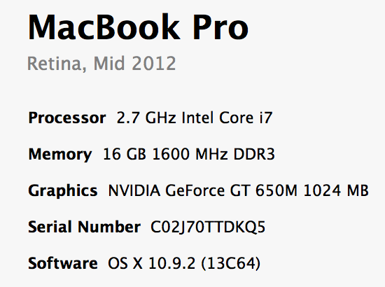
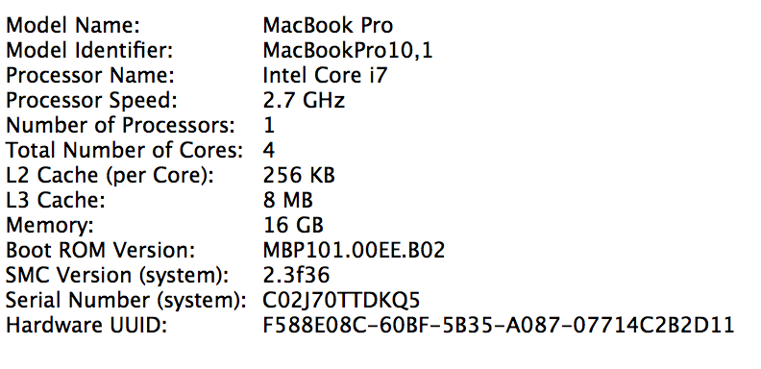
By the end of the cache lectures…

Slide 142
A Real Example
> dmidecode -t cache
Cache Information
Socket Designation: L1 Cache
Configuration: Enabled, Not Socketed, Level 1
Operational Mode: Write Back
Location: Internal
Installed Size: 128 kB
Maximum Size: 128 kB
Supported SRAM Types:
Synchronous
Installed SRAM Type: Synchronous
Speed: Unknown
Error Correction Type: Parity
System Type: Unified
Associativity: 8-way Set-associative
Cache Information
Socket Designation: L2 Cache
Configuration: Enabled, Not Socketed,
Level 2
Operational Mode: Write Back
Location: Internal
Installed Size: 512 kB
Maximum Size: 512 kB
Supported SRAM Types:
Synchronous
Installed SRAM Type: Synchronous
Speed: Unknown
Error Correction Type: Single-bit ECC
System Type: Unified
Associativity: 4-way Set-associative
Microsoft Surfacebook
Dual core
Intel i7-6600 CPU @ 2.6 GHz (purchased in 2016)
Cache Information
Socket Designation: L3 Cache
Configuration: Enabled, Not Socketed,
Level 3
Operational Mode: Write Back
Location: Internal
Installed Size: 4096 kB
Maximum Size: 4096 kB
Supported SRAM Types:
Synchronous
Installed SRAM Type: Synchronous
Speed: Unknown
Error Correction Type: Multi-bit ECC
System Type: Unified
Associativity: 16-way Set-associative

Slide 143
A Real Example
> sudo dmidecode -t cache
Cache Information
Configuration: Enabled, Not Socketed, Level 1
Operational Mode: Write Back
Installed Size: 128 KB
Error Correction Type: None
Cache Information
Configuration: Enabled, Not Socketed, Level 2
Operational Mode: Varies With Memory Address
Installed Size: 6144 KB
Error Correction Type: Single-bit ECC
> cd /sys/devices/system/cpu/cpu0; grep cache/*/*
cache/index0/level:1
cache/index0/type:Data
cache/index0/ways_of_associativity:8
cache/index0/number_of_sets:64
cache/index0/coherency_line_size:64
cache/index0/size:32K
cache/index1/level:1
cache/index1/type:Instruction
cache/index1/ways_of_associativity:8
cache/index1/number_of_sets:64
cache/index1/coherency_line_size:64
cache/index1/size:32K
cache/index2/level:2
cache/index2/type:Unified
cache/index2/shared_cpu_list:0-1
cache/index2/ways_of_associativity:24
cache/index2/number_of_sets:4096
cache/index2/coherency_line_size:64
cache/index2/size:6144K
Dual-core 3.16GHz Intel (purchased in 2011)

Slide 144
A Real Example
Dual 32K L1 Instruction caches
8-way set associative
64 sets
64 byte line size
Dual 32K L1 Data caches
Same as above
Single 6M L2 Unified cache
24-way set associative (!!!)
4096 sets
64 byte line size
4GB Main memory
1TB Disk
Dual-core 3.16GHz Intel (purchased in 2009)

Slide 145
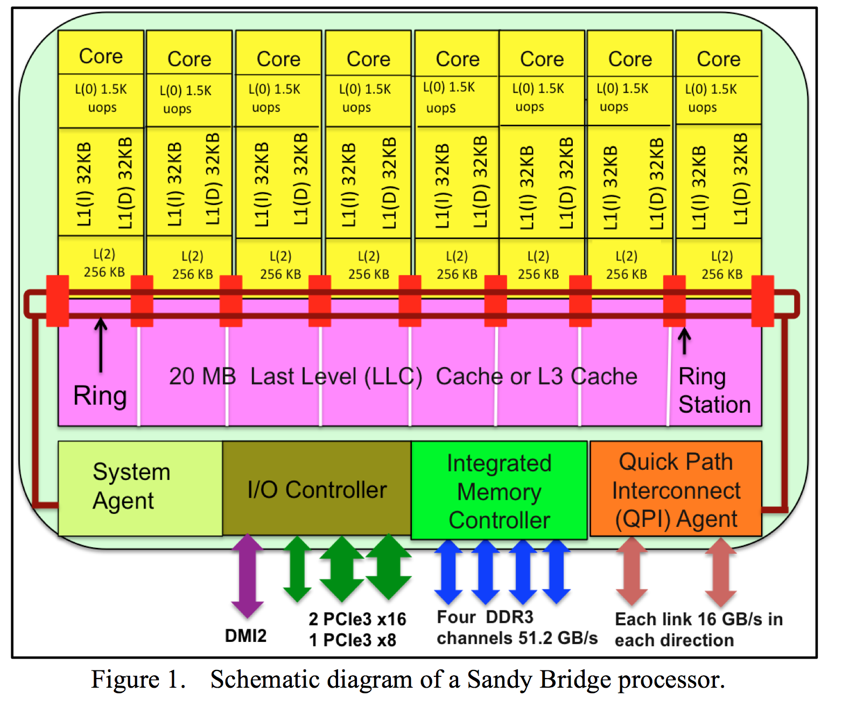

Slide 146
Summary
Memory performance matters!
often more than CPU performance
… because it is the bottleneck, and not improving much
… because most programs move a LOT of data
Design space is huge
Gambling against program behavior
Cuts across all layers: users → programs → os → hardware
NEXT: Multi-core processors are complicated
Inconsistent views of memory
Extremely complex protocols, very hard to get right

