Slide 1
Gates and Logic: From Transistors to Logic Gates and Logic Circuits
Prof. Hakim Weatherspoon
CS 3410
Computer Science
Cornell University
The slides are the product of many rounds of teaching CS 3410 by Professors Weatherspoon, Bala, Bracy, and Sirer.

Slide 2
Goals for Today
From Switches to Logic Gates to Logic Circuits
Logic Gates
From switches
Truth Tables
Logic Circuits
Identity Laws
From Truth Tables to Circuits (Sum of Products)
Logic Circuit Minimization
Algebraic Manipulations
Truth Tables (Karnaugh Maps)
Transistors (electronic switch)

Slide 3
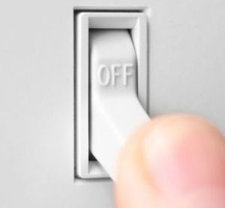
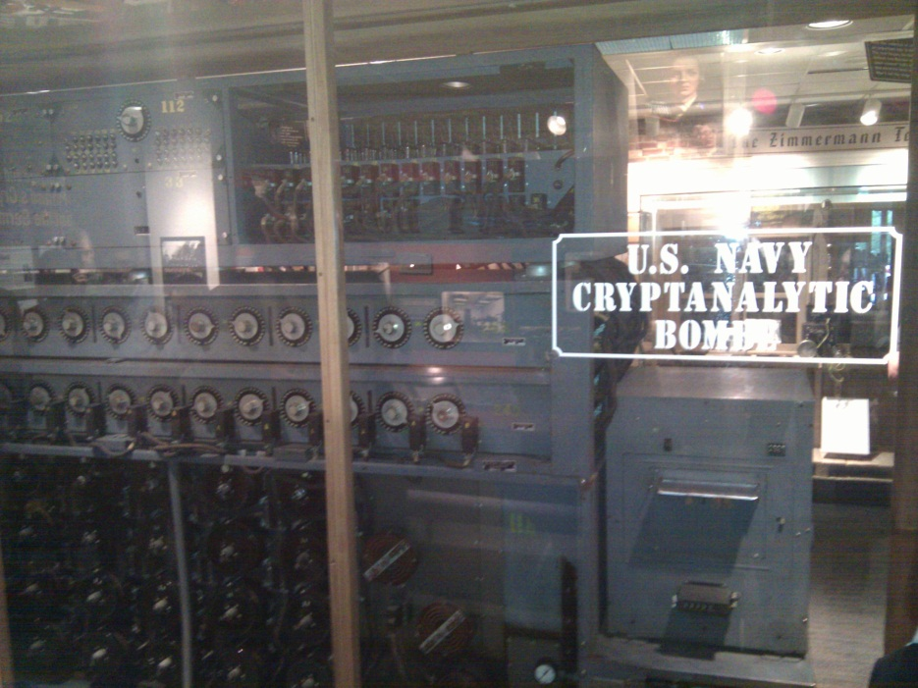
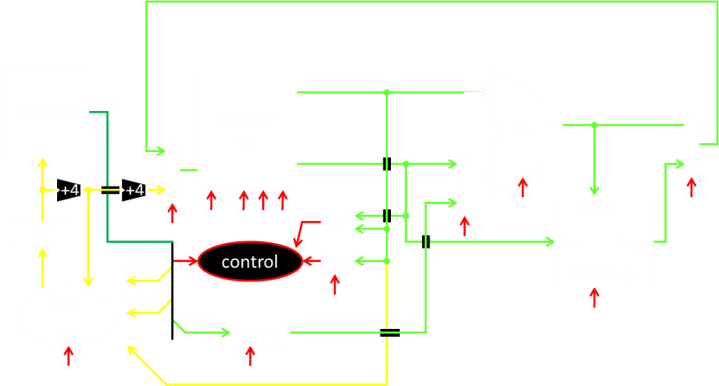
A switch
Acts as a conductor or insulator
Can be used to build amazing things…
The Bombe used to break the German
Enigma machine during World War II
Notes:
Pictures show the Bombe built by Alan Turing to break the enigma machine ciphers.
They were Fixed-Program Computers came before stored-program computers (general purpose)
The former required re-wiring (e.g. ENIAC took 3 weeks to “re-wire”).

Slide 4
Basic Building Blocks: Switches to Logic Gates
+
A
Truth Table
A | B | Light
OFF | OFF
A | B | Light
OFF | OFF
OFF | ON
A | B | Light
OFF | OFF
OFF | ON
ON | OFF
ON | ON
A | B | Light
-
A | B | Light
OFF | OFF
OFF | ON
ON | OFF
B
+
A
-
A | B | Light
OFF | OFF
A | B | Light
OFF | OFF
OFF | ON
A | B | Light
OFF | OFF
OFF | ON
ON | OFF
A | B | Light
OFF | OFF
OFF | ON
ON | OFF
ON | ON
A | B | Light
B
Notes:
Speed and size of a mechanical switch

Slide 5
Basic Building Blocks: Switches to Logic Gates
Either (OR)
Both (AND)
A
Truth Table
-
A | B | Light
OFF | OFF
OFF | ON
ON | OFF
ON | ON
OR
B
A
-
A | B | Light
OFF | OFF
OFF | ON
ON | OFF
ON | ON
AND
B
Notes:
Speed and size of a mechanical switch

Slide 6
Basic Building Blocks: Switches to Logic Gates
Either (OR)
Both (AND)
A
Truth Table
-
A | B | Light
0 | 0
0 | 1
1 | 0
1 | 1
OR
0 = OFF
1 = ON
B
A
-
A | B | Light
0 | 0
0 | 1
1 | 0
1 | 1
AND
B
Notes:
Speed and size of a mechanical switch

Slide 7
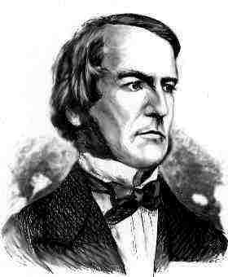
Basic Building Blocks: Switches to Logic Gates
A
OR
B
George Boole,(1815-1864)
A
Did you know?
George Boole Inventor of the idea of logic gates. He was born in Lincoln, England and he was the son of a shoemaker in a low class family.
AND
B
Notes:
E.g. logic statements:
“Jane will only go to the cinema tonight if a good film is on AND she has enough money.”
“Stuart will only go to the birthday party on Sunday if Katie OR Sujit is going too.”

Slide 8
Takeaway
Binary (two symbols: true and false) is the basis of Logic Design
Notes:
Add takeways at end of a block. Possibly build on takeaways throughout lecture

Slide 9
Building Functions: Logic Gates
NOT:
AND:
OR:
Logic Gates
digital circuit that either allows a signal to pass through it or not.
Used to build logic functions
There are seven basic logic gates:
AND, OR, NOT,
NAND (not AND), NOR (not OR), XOR, and XNOR (not XOR) [later]
A | Out
0 | 1
1 | 0
A
A | B | Out
0 | 0 | 0
0 | 1 | 0
1 | 0 | 0
1 | 1 | 1
A | B | Out
0 | 0 | 1
0 | 1 | 1
1 | 0 | 1
1 | 1 | 0
NAND:
A
A
B
B
NOR:
A | B | Out
0 | 0 | 0
0 | 1 | 1
1 | 0 | 1
1 | 1 | 1
A | B | Out
0 | 0 | 1
0 | 1 | 0
1 | 0 | 0
1 | 1 | 0
A
A
B
B
Notes:
Flash Drives
Create truth table of AND or OR: state what they do
Did you know? Logic gates allow the computer to do things such as add, divide, multiply, do simple yes and no reasoning in certain situations along with other things.

Slide 10
Goals for Today
From Switches to Logic Gates to Logic Circuits
Logic Gates
From switches
Truth Tables
Logic Circuits
Identity Laws
From Truth Tables to Circuits (Sum of Products)
Logic Circuit Minimization
Algebraic Manipulations
Truth Tables (Karnaugh Maps)
Transistors (electronic switch)

Slide 11
Next Goal
Given a Logic function, create a Logic Circuit that implements the Logic Function…
…and, with the minimum number of logic gates
Fewer gates: A cheaper ($$$) circuit!
Notes:
Can get logic circuit from truth table
Minimize logic circuit through algebraic reductions or Karnaugh Maps

Slide 12
Logic Gates
A | Out
0 | 1
1 | 0
NOT:
AND:
OR:
XOR:
.
A
A | B | Out
0 | 0 | 0
0 | 1 | 0
1 | 0 | 0
1 | 1 | 1
A | B | Out
0 | 0 | 1
0 | 1 | 1
1 | 0 | 1
1 | 1 | 0
NAND:
A
A
B
B
NOR:
A | B | Out
0 | 0 | 0
0 | 1 | 1
1 | 0 | 1
1 | 1 | 1
A | B | Out
0 | 0 | 1
0 | 1 | 0
1 | 0 | 0
1 | 1 | 0
A
A
B
B
XNOR:
A | B | Out
0 | 0 | 0
0 | 1 | 1
1 | 0 | 1
1 | 1 | 0
A | B | Out
0 | 0 | 1
0 | 1 | 0
1 | 0 | 0
1 | 1 | 1
A
A
B
B
Notes:
XOR is not a basic Logic Gate since it can be created from AND and OR gates, but it is often used as a basic Logic Operator

Slide 13
Logic Implementation
How to implement a desired logic function?
a | b | c | out
0 | 0 | 0 | 0
0 | 0 | 1 | 1
0 | 1 | 0 | 0
0 | 1 | 1 | 1
1 | 0 | 0 | 0
1 | 0 | 1 | 1
1 | 1 | 0 | 0
1 | 1 | 1 | 0
Notes:
Draw circuit and go through out=true cases
Have not done cheaply yet

Slide 14
Logic Implementation
How to implement a desired logic function?
Write minterms
sum of products:
OR of all minterms where out=1
a | b | c | out
0 | 0 | 0 | 0
0 | 0 | 1 | 1
0 | 1 | 0 | 0
0 | 1 | 1 | 1
1 | 0 | 0 | 0
1 | 0 | 1 | 1
1 | 1 | 0 | 0
1 | 1 | 1 | 0
minterm
a b c
a b c
a b c
a b c
a b c
a b c
a b c
a b c
Notes:
Show what out equals

Slide 15
Logic Equations
NOT:
out = ā = !a = ¬a
AND:
out = a ∙ b = a & b = a ∧ b
OR:
out = a + b = a | b = a ∨ b
XOR:
out = a ⊕ b = a$\overline{b}$ + āb
Logic Equations
Constants: true = 1, false = 0
Variables: a, b, out, …
Operators (above): AND, OR, NOT, etc.
NAND:
out = $\overline{a \text{∙} b}$ = !(a & b) = ¬ (a ∧ b)
NOR:
out = $\overline{a+b}$ = !(a | b) = ¬ (a ∨ b)
XNOR:
out = $\overline{a \text{⊕} b}$ = ab + $\overline{ab}$
.
Notes:
Apologize that there are three ways to represent the same logic equation
XOR is not a basic Logic Gate since it can be created from AND and OR gates, but it is often used as a basic Logic Operator
AND is “product”
OR is “sum”
Read outloud

Slide 16
Identities
Identities useful for manipulating logic equations
For optimization & ease of implementation
a + 0 =
a + 1 =
a + ā =
a ∙ 0 =
a ∙ 1 =
a ∙ ā =
Notes:
Minimization activity
Maybe use picture to go through
Complement a+ā=1 and aā=0

Slide 17
Identities
Identities useful for manipulating logic equations
For optimization & ease of implementation
$\overline{(a+b)}$ =
$\overline{(a ∙b)}$ =
a + a b =
a(b+c) =
$\overline{a(b+c)}$ =
Notes:
Minimization activity
Maybe use picture to go through
De Morgan’s Law: $\overline{(a+b)}$ = $\overline{a}$ ∙ $\overline{b}$ and $\overline{(a ∙b)}$ = $\overline{a}$ + $\overline{b}$

Slide 18
Goals for Today
From Switches to Logic Gates to Logic Circuits
Logic Gates
From switches
Truth Tables
Logic Circuits
From Truth Tables to Circuits (Sum of Products)
Identity Laws
Logic Circuit Minimization – why?
Algebraic Manipulations
Truth Tables (Karnaugh Maps)
Transistors (electronic switch)

Slide 19
Checking Equality w/Truth Tables
circuits ↔ truth tables ↔ equations
Example: (a+b)(a+c) = a + bc
a | b | c
0 | 0 | 0
0 | 0 | 1
0 | 1 | 0
0 | 1 | 1
1 | 0 | 0
1 | 0 | 1
1 | 1 | 0
1 | 1 | 1
Notes:
(a+b)(a+c)
= aa + ab + ac + bc
= a + a(b+c) + bc
= a(1 + (b+c)) + bc
= a + bc

Slide 20
Takeaway
Binary (two symbols: true and false) is the basis of Logic Design
More than one Logic Circuit can implement same Logic function. Use Algebra (Identities) or Truth Tables to show equivalence.
Notes:
Add takeways at end of a block. Possibly build on takeaways throughout lecture

Slide 21
Goals for Today
From Switches to Logic Gates to Logic Circuits
Logic Gates
From switches
Truth Tables
Logic Circuits
From Truth Tables to Circuits (Sum of Products)
Identity Laws
Logic Circuit Minimization
Algebraic Manipulations
Truth Tables (Karnaugh Maps)
Transistors (electronic switch)

Slide 22
Next Goal
How to standardize minimizing logic circuits?

Slide 23
Karnaugh Maps
How does one find the most efficient equation?
Manipulate algebraically until…?
Use Karnaugh Maps (optimize visually)
Use a software optimizer
For large circuits
Decomposition & reuse of building blocks

Slide 24
Minimization with Karnaugh maps (1)
Sum of minterms yields
out = $\overline{ab}$c + $\overline{a}$bc + a$\overline{bc}$ + a$\overline{b}$c
a | b | c | out
0 | 0 | 0 | 0
0 | 0 | 1 | 1
0 | 1 | 0 | 0
0 | 1 | 1 | 1
1 | 0 | 0 | 1
1 | 0 | 1 | 1
1 | 1 | 0 | 0
1 | 1 | 1 | 0

Slide 25
Minimization with Karnaugh maps (2)
Sum of minterms yields
out = $\overline{ab}$c + $\overline{a}$bc + a$\overline{bc}$ + a$\overline{b}$c
Karnaugh map minimization
Cover all 1’s
Group adjacent blocks of 2^{n} 1’s that yield a rectangular shape
Encode the common features of the rectangle
out = a$\overline{b}$ + $\overline{a}$c
a | b | c | out
0 | 0 | 0 | 0
0 | 0 | 1 | 1
0 | 1 | 0 | 0
0 | 1 | 1 | 1
1 | 0 | 0 | 1
1 | 0 | 1 | 1
1 | 1 | 0 | 0
1 | 1 | 1 | 0
ab
c
00 01 11 10
0
0 | 0 | 0 | 1
1 | 1 | 0 | 1
1

Slide 26
Karnaugh Minimization Tricks (1)
ab
c
00 01 11 10
Minterms can overlap
out = b$\overline{c}$ + a$\overline{c}$ + ab
Minterms can span 2, 4, 8 or more cells
out = $\overline{c}$ + ab
0
0 | 1 | 1 | 1
0 | 0 | 1 | 0
1
ab
c
00 01 11 10
0
1 | 1 | 1 | 1
0 | 0 | 1 | 0
1

Slide 27
Karnaugh Minimization Tricks (2)
ab
cd
00 01 11 10
00
0 | 0 | 0 | 0
1 | 0 | 0 | 1
1 | 0 | 0 | 1
0 | 0 | 0 | 0
The map wraps around
out =
out =
01
11
10
ab
cd
00 01 11 10
00
1 | 0 | 0 | 1
0 | 0 | 0 | 0
0 | 0 | 0 | 0
1 | 0 | 0 | 1
01
11
10

Slide 28
Karnaugh Minimization Tricks (3)
ab
cd
00 01 11 10
00
0 | 0 | 0 | 0
1 | x | x | x
1 | x | x | 1
0 | 0 | 0 | 0
“Don’t care” values can be interpreted individually in whatever way is convenient
assume all x’s = 1
out =
assume middle x’s = 0
assume 4th column x = 1
out =
01
11
10
ab
cd
00 01 11 10
00
1 | 0 | 0 | x
0 | x | x | 0
0 | x | x | 0
1 | 0 | 0 | 1
01
11
10

Slide 29
Minimization with K-Maps
(1) Circle the 1’s (see below)
(2) Each circle is a logical component of the final equation
= a$\overline{b}$ + $\overline{a}$c
ab
c
00 01 11 10
0
0 | 0 | 0 | 1
1 | 1 | 0 | 1
1
Rules:
Use fewest circles necessary to cover all 1’s
Circles must cover only 1’s
Circles span rectangles of size power of 2 (1, 2, 4, 8…)
Circles should be as large as possible (all circles of 1?)
Circles may wrap around edges of K-Map
1 may be circled multiple times if that means fewer circles

Slide 30
Multiplexer
A multiplexer selects between multiple inputs
out = a, if d = 0
out = b, if d = 1
Build truth table
Minimize diagram
Derive logic diagram
a
b
d
a | b | d | out
0 | 0 | 0
0 | 0 | 1
0 | 1 | 0
0 | 1 | 1
1 | 0 | 0
1 | 0 | 1
1 | 1 | 0
1 | 1 | 1
Notes:
What is the truth table

Slide 31
Takeaway
Binary (two symbols: true and false) is the basis of Logic Design
More than one Logic Circuit can implement same Logic function. Use Algebra (Identities) or Truth Tables to show equivalence.
Any logic function can be implemented as “sum of products”. Karnaugh Maps minimize number of gates.
Notes:
Add takeways at end of a block. Possibly build on takeaways throughout lecture

Slide 32
Goals for Today
From Transistors to Gates to Logic Circuits
Logic Gates
From transistors
Truth Tables
Logic Circuits
From Truth Tables to Circuits (Sum of Products)
Identity Laws
Logic Circuit Minimization
Algebraic Manipulations
Truth Tables (Karnaugh Maps)
Transistors (electronic switch)

Slide 33
Silicon Valley & the Semiconductor Industry
Transistors:
Youtube video “How does a transistor work”
https://www.youtube.com/watch?v=IcrBqCFLHIY
Break: show some Transistor, Fab, Wafer photos
Notes:
Everything that we have shown them can be constructed in silicon.

Slide 34
Transistors 101
Source
Gate
Drain
Source
Gate
Drain
—
-
+
Insulator
+
+
+
Insulator
+
+
+
+
+
-
-
+
+
+
+
+
+
+
N-type
P-type
P-type
P-type channel created
-
N-type
-
-
-
-
-
P-type
+
-
-
P-type
+
+
+
+
+
+
-
+
+
-
+
+
+
+
-
-
-
-
-
-
-
-
-
-
-
-
-
-
-
-
-
-
-
-
-
-
-
-
-
-
-
-
-
-
-
-
-
-
-
-
-
-
-
-
-
Off
On
N-Type Silicon: negative free-carriers (electrons)
P-Type Silicon: positive free-carriers (holes)
P-Transistor: negative charge on gate generates electric field that creates a (+ charged) p-channel connecting source & drain
N-Transistor: works the opposite way
Metal-Oxide Semiconductor (Gate-Insulator-Silicon)
Complementary MOS = CMOS technology uses both p- & n-type transistors
Notes:
Negative charge on the gate generates an electric field that creates a positively-charged path between the source and the drain.
Transistors made from semiconductor materials:
MOSFET – Metal Oxide Semiconductor Field Effect Transistor
NMOS, PMOS – Negative MOS and Positive MOS
CMOS – complementary MOS made from PMOS and NMOS transistors

Slide 35
CMOS Notation
N-type
P-type
Gate input controls whether current can flow between the other two terminals or not.
Hint: the “o” bubble of the p-type tells you that this gate wants a 0 to be turned on
Off/Open
On/Closed
0
1
gate
Off/Open
On/Closed
1
0
gate

Slide 36
2-Transistor Combination: NOT
Logic gates are constructed by combining transistors in complementary arrangements
Combine p&n transistors to make a NOT gate:
CMOS Inverter :
power source (1)
power source (1)
power source (1)
p-gate
—
p-gate
closes
+
p-gate
stays open
output
0
1
1
0
input
n-gate
stays open
n-gate
closes
n-gate
—
+
ground (0)
ground (0)
ground (0)

Slide 37
Inverter
V_{supply} (aka logic 1)
Function: NOT
Symbol:
Truth Table:
in
out
in
out
(ground is logic 0)
In | Out
0 | 1
1 | 0

Slide 38
NOR Gate
V_{supply}
Function: NOR
Symbol:
Truth Table:
A
a
B
out
b
out
A
B
A | B | out
0 | 0 | 1
0 | 1 | 0
1 | 0 | 0
1 | 1 | 0
38
Notes:
Example

Slide 39
Building Functions (Revisited)
NOT:
AND:
OR:
NAND and NOR are universal
Can implement any function with NAND or just NOR gates
useful for manufacturing
a
a
b
a
b
Notes:
Flash Drives
Create truth table of AND or OR: state what they do

Slide 40
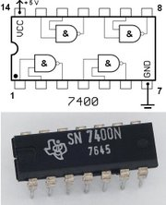
Logic Gates
One can buy gates separately
ex. 74xxx series of integrated circuits
cost ~$1 per chip, mostly for packaging and testing
Cumbersome, but possible to build devices using gates put together manually

Slide 41
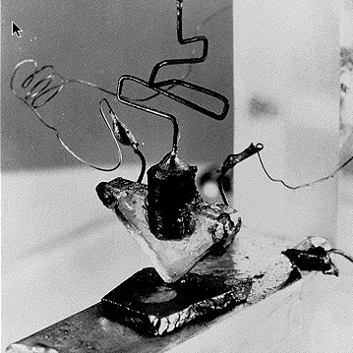
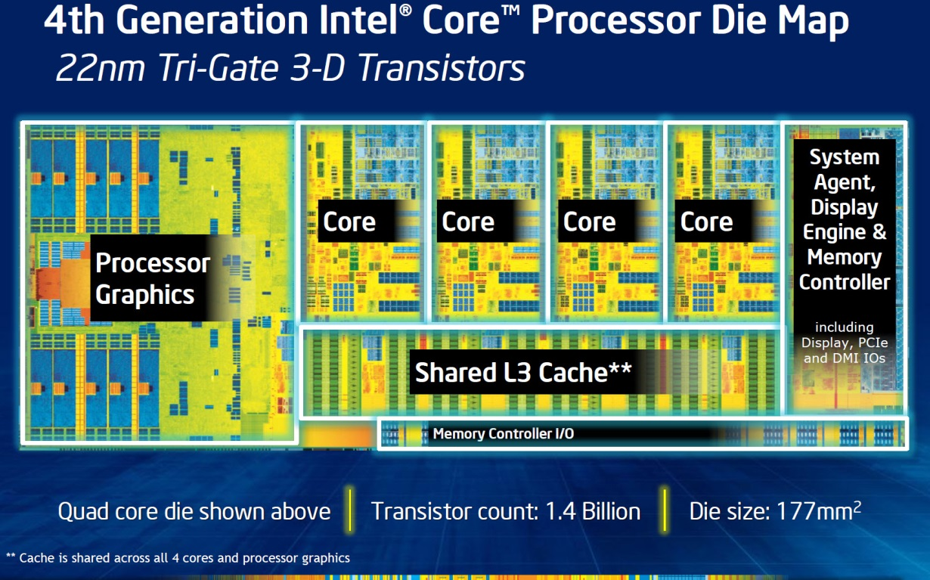
Then and Now
http://techguru3d.com/4th-gen-intel-haswell-processors-architecture-and-lineup/
The first transistor
One workbench at AT&T Bell Labs
1947
Bardeen, Brattain, and Shockley
Intel Haswell
1.4 billion transistors, 22nm
177 square millimeters
Four processing cores
https://en.wikipedia.org/wiki/Transistor_count
Notes:
John Bardeen
Walter Brattain
William Shockley

Slide 42
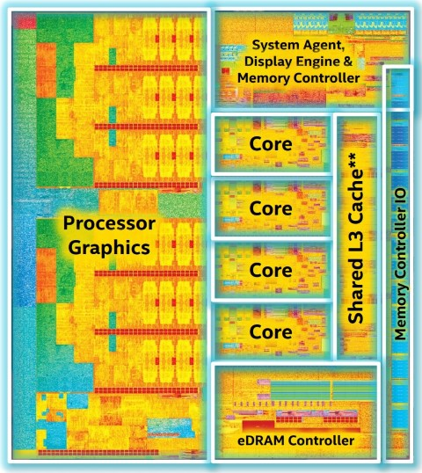
Then and Now
https://www.computershopper.com/computex-2015/performance-preview-desktop-broadwell-at-computex-2015
The first transistor
One workbench at AT&T Bell Labs
1947
Bardeen, Brattain, and Shockley
Intel Broadwell
7.2 billion transistors, 14nm
456 square millimeters
Up to 22 processing cores
https://en.wikipedia.org/wiki/Transistor_count
Notes:
John Bardeen
Walter Brattain
William Shockley

Slide 43
Big Picture: Abstraction
Hide complexity through simple abstractions
Simplicity
Box diagram represents inputs and outputs
Complexity
Hides underlying NMOS- and PMOS-transistors and atomic interactions
Vdd
a
in
out
d
out
Vss
b
a
d
out
in
out
b

Slide 44
Summary
Most modern devices made of billions of transistors
You will build a processor in this course!
Modern transistors made from semiconductor materials
Transistors used to make logic gates and logic circuits
We can now implement any logic circuit
Use P- & N-transistors to implement NAND/NOR gates
Use NAND or NOR gates to implement the logic circuit
Efficiently: use K-maps to find required minimal terms

