Slide 1
Gates and Logic:
From Transistors to Logic Gates and Logic Circuits
Prof. Hakim Weatherspoon
CS 3410
Computer Science
Cornell University
The slides are the product of many rounds of teaching CS 3410 by Professors Weatherspoon, Bala, Bracy, and Sirer.

Slide 2

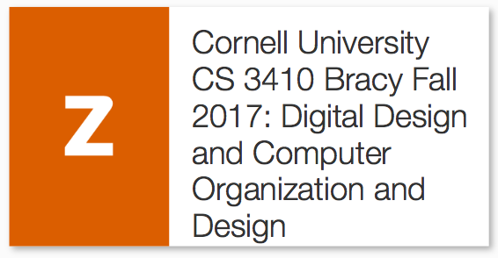
Goals for Today
From Switches to Logic Gates to Logic Circuits
Understanding the foundations of
Computer Systems Organization and Programming
Digital Design
+
=
Notes:
How does my laptop work? How does my phone work? What is the underlying principles and design for these electronics?

Slide 3
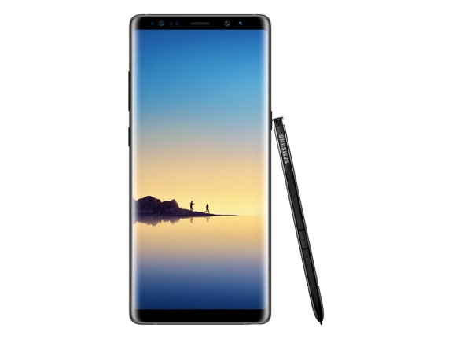
Goals for Today
From Switches to Logic Gates to Logic Circuits
Understanding the foundations of
Computer Systems Organization and Programming
e.g. Galaxy Note 8
Notes:
How does my laptop work? How does my phone work? What is the underlying principles and design for these electronics?
Galaxy note 3 picture: http://www.anandtech.com/show/6768/samsung-details-exynos-5-octa-architecture-power-at-isscc-13

Slide 4
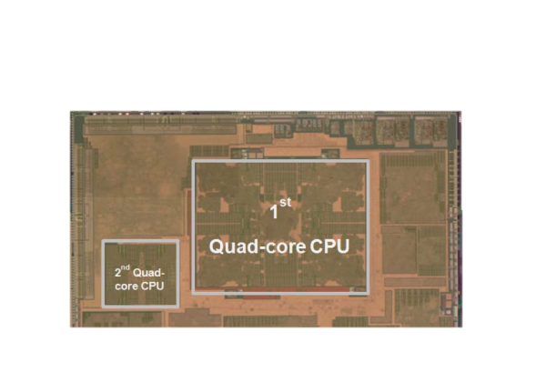
Goals for Today
From Switches to Logic Gates to Logic Circuits
Understanding the foundations of
Computer Systems Organization and Programming
e.g. Galaxy Note 8
with the big.LITTLE 8-core ARM processor
Notes:
How does my laptop work? How does my phone work? What is the underlying principles and design for these electronics?
Galaxy note 3 picture: http://www.anandtech.com/show/6768/samsung-details-exynos-5-octa-architecture-power-at-isscc-13

Slide 5
Goals for Today
From Switches to Logic Gates to Logic Circuits
Understanding the foundations of
Computer Systems Organization and Programming
e.g. Galaxy Note 8
with the big.LITTLE 8-core ARM processor
 | big Quad Core | LITTLE Quad Core
Architecture | ARM v7a | ARM v7a
Process | Samsung 28nm | Samsung 28nm
Frequency | 200MHz~1.8GHz+ | 200MHz~1.2GHz
Area | 19mm2 | 3.8mm2
Power-ratio | 1 | 0.17
L1 Cache Size | 32 KB I/D Cache | 32 KB I/D Cache
L2 Cache Size | 2 MB Data Cache | 512 KB Data Cache
Notes:
How does my laptop work? How does my phone work? What is the underlying principles and design for these electronics?
Galaxy note 3 picture: http://www.anandtech.com/show/6768/samsung-details-exynos-5-octa-architecture-power-at-isscc-13

Slide 6
Goals for Today
From Switches to Logic Gates to Logic Circuits
Logic Gates
  From switches
  Truth Tables
Logic Circuits
  Identity Laws
  From Truth Tables to Circuits (Sum of Products)
Logic Circuit Minimization
  Algebraic Manipulations
  Truth Tables (Karnaugh Maps)
Transistors (electronic switch)

Slide 7
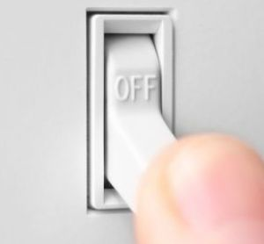
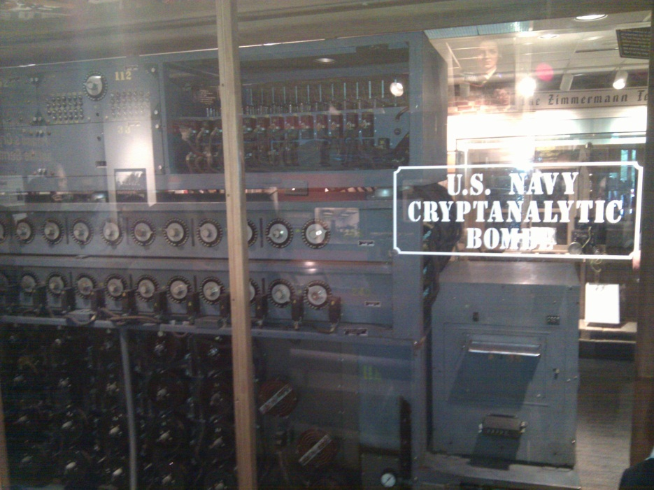

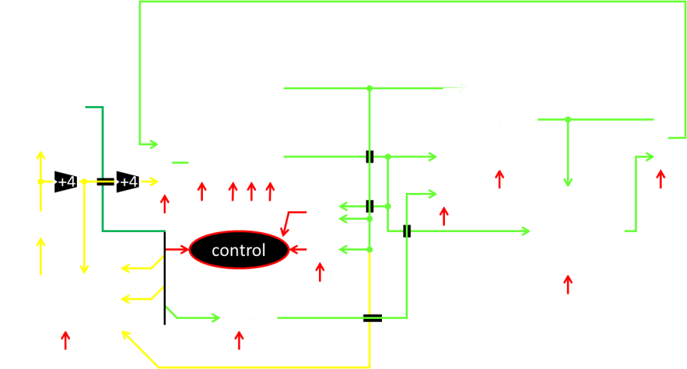
A switch
Acts as a conductor or insulator
Can be used to build amazing things…
The Bombe used to break the German
Enigma machine during World War II
Notes:
Pictures show the Bombe built by Alan Turing to break the enigma machine ciphers.
They were Fixed-Program Computers came before stored-program computers (general purpose)
The former required re-wiring (e.g. ENIAC took 3 weeks to “re-wire”).

Slide 8
Basic Building Blocks: Switches to Logic Gates
+
A
Truth Table
A | B | Light
OFF | OFF
A | B | Light
OFF | OFF
OFF | ON
A | B | Light
OFF | OFF
OFF | ON
ON | OFF
ON | ON
A | B | Light
-
A | B | Light
OFF | OFF
OFF | ON
ON | OFF
B
Notes:
Speed and size of a mechanical switch
Truth Table: defines the output for all possible combinations of values for input

Slide 9
Basic Building Blocks: Switches to Logic Gates
+
A
Truth Table
A | B | Light
OFF | OFF
A | B | Light
OFF | OFF
OFF | ON
A | B | Light
OFF | OFF
OFF | ON
ON | OFF
ON | ON
A | B | Light
-
A | B | Light
OFF | OFF | OFF
OFF | ON | ON
ON | OFF | ON
 |  | ON
B
+
A
-
A | B | Light
OFF | OFF
A | B | Light
OFF | OFF
OFF | ON
A | B | Light
OFF | OFF
OFF | ON
ON | OFF
A | B | Light
OFF | OFF
OFF | ON
ON | OFF
ON | ON
A | B | Light
B
Notes:
Speed and size of a mechanical switch

Slide 10
Basic Building Blocks: Switches to Logic Gates
+
A
Truth Table
A | B | Light
OFF | OFF
A | B | Light
OFF | OFF
OFF | ON
A | B | Light
OFF | OFF
OFF | ON
ON | OFF
ON | ON
A | B | Light
-
A | B | Light
OFF | OFF | OFF
OFF | ON | ON
ON | OFF | ON
 |  | ON
B
+
A
-
A | B | Light
OFF | OFF
A | B | Light
OFF | OFF
OFF | ON
A | B | Light
OFF | OFF
OFF | ON
ON | OFF
A | B | Light
OFF | OFF
OFF | ON
ON | OFF
ON | ON
A | B | Light
B
Notes:
Speed and size of a mechanical switch

Slide 11
Basic Building Blocks: Switches to Logic Gates
+
Either (OR)
Both (AND)
A
Truth Table
-
A | B | Light
OFF | OFF | OFF
OFF | ON | ON
ON | OFF | ON
ON | ON | ON
B
+
A
-
A | B | Light
OFF | OFF | OFF
OFF | ON | OFF
ON | OFF | OFF
ON | ON | ON
B
Notes:
Speed and size of a mechanical switch

Slide 12
Basic Building Blocks: Switches to Logic Gates
Either (OR)
Both (AND)
A
Truth Table
-
A | B | Light
OFF | OFF | OFF
OFF | ON | ON
ON | OFF | ON
ON | ON | ON
OR
B
A
-
A | B | Light
OFF | OFF | OFF
OFF | ON | OFF
ON | OFF | OFF
ON | ON | ON
AND
B
Notes:
Speed and size of a mechanical switch

Slide 13
Basic Building Blocks: Switches to Logic Gates
Either (OR)
Both (AND)
A
Truth Table
-
A | B | Light
0 | 0 | 0
0 | 1 | 1
1 | 0 | 1
1 | 1 | 1
OR
0 = OFF
1 = ON
B
A
-
A | B | Light
0 | 0 | 0
0 | 1 | 0
1 | 0 | 0
1 | 1 | 1
AND
B
Notes:
Speed and size of a mechanical switch

Slide 14
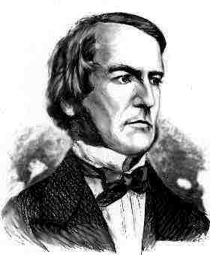
Basic Building Blocks: Switches to Logic Gates
A
OR
B
George Boole,(1815-1864)
A
Did you know?
George Boole Inventor of the idea of logic gates. He was born in Lincoln, England and he was the son of a shoemaker in a low class family.
AND
B
Notes:
E.g. logic statements:
“Jane will only go to the cinema tonight if a good film is on AND she has enough money.”
“Stuart will only go to the birthday party on Sunday if Katie OR Sujit is going too.”

Slide 15
Takeaway
Binary (two symbols: true and false) is the basis of Logic Design
Notes:
Add takeways at end of a block. Possibly build on takeaways throughout lecture

Slide 16
Building Functions: Logic Gates
NOT:
AND:
OR:
Logic Gates
  digital circuit that either allows a signal to pass through it or not.
  Used to build logic functions
  There are seven basic logic gates:
  AND, OR, NOT
A | Out
A
A | B | Out
0 | 0 | 0
0 | 1 | 0
1 | 0 | 0
1 | 1 | 1
A
B
A | B | Out
0 | 0 | 0
0 | 1 | 1
1 | 0 | 1
1 | 1 | 1
A
B
Notes:
Flash Drives
Create truth table of AND or OR: state what they do

Slide 17
Building Functions: Logic Gates
NOT:
AND:
OR:
Logic Gates
  digital circuit that either allows a signal to pass through it or not.
  Used to build logic functions
  There are seven basic logic gates:
  AND, OR, NOT,
  NAND (not AND), NOR (not OR), XOR, and XNOR (not XOR) [later]
A | Out
0 | 1
1 | 0
A
A | B | Out
0 | 0 | 0
0 | 1 | 0
1 | 0 | 0
1 | 1 | 1
A
B
A | B | Out
0 | 0 | 0
0 | 1 | 1
1 | 0 | 1
1 | 1 | 1
A
B
Notes:
Flash Drives
Create truth table of AND or OR: state what they do
Did you know? Logic gates allow the computer to do things such as add, divide, multiply, do simple yes and no reasoning in certain situations along with other things.

Slide 18
Building Functions: Logic Gates
NOT:
AND:
OR:
Logic Gates
  digital circuit that either allows a signal to pass through it or not.
  Used to build logic functions
  There are seven basic logic gates:
  AND, OR, NOT,
  NAND (not AND), NOR (not OR), XOR, and XNOR (not XOR) [later]
A | Out
0 | 1
1 | 0
A
A | B | Out
0 | 0 | 0
0 | 1 | 0
1 | 0 | 0
1 | 1 | 1
A | B | Out
0 | 0 | 1
0 | 1 | 1
1 | 0 | 1
1 | 1 | 0
NAND:
A
A
B
B
NOR:
A | B | Out
0 | 0 | 0
0 | 1 | 1
1 | 0 | 1
1 | 1 | 1
A | B | Out
0 | 0 | 1
0 | 1 | 0
1 | 0 | 0
1 | 1 | 0
A
A
B
B
Notes:
Flash Drives
Create truth table of AND or OR: state what they do
Did you know? Logic gates allow the computer to do things such as add, divide, multiply, do simple yes and no reasoning in certain situations along with other things.

Slide 19
Which Gate is this?
iClicker Question
Function:
Symbol:
Truth Table:
a | b | Out
a
NOT
OR
XOR
AND
NAND
b
Out
Notes:
Fill out table
Put, NOT, AND, OR labels in box

Slide 20
Which Gate is this?
iClicker Question
XOR: out = 1 if a or b is 1, but not both;
out = 0 otherwise.
out = 1, only if a = 1 AND b = 0
OR a = 0 AND b = 1
a | b | Out
0 | 0 | 0
0 | 1 | 1
1 | 0 | 1
1 | 1 | 0
a
NOT
OR
XOR
AND
NAND
b
Out
Notes:
Fill out table

Slide 21
Which Gate is this?
iClicker Question
XOR: out = 1 if a or b is 1, but not both;
out = 0 otherwise.
out = 1, only if a = 1 AND b = 0
OR a = 0 AND b = 1
a | b | Out
0 | 0 | 0
0 | 1 | 1
1 | 0 | 1
1 | 1 | 0
a
Out
NOT
OR
XOR
AND
NAND
b
Notes:
Fill out table
Remove instructions

Slide 22
Activity#2: Logic Gates
Fill in the truth table, given the following Logic Circuit made from Logic AND, OR, and NOT gates.
What does the logic circuit do?
a | b | d | Out
0 | 0 | 0
0 | 0 | 1
0 | 1 | 0
0 | 1 | 1
1 | 0 | 0
1 | 0 | 1
1 | 1 | 0
1 | 1 | 1
a
d
Out
b
Notes:
Fill out table

Slide 23
Activity#2: Logic Gates
Multiplexor: select (d) between two inputs (a and b) and set one as the output (out)?
out = a, if d = 0
out = b, if d = 1
a | b | d | Out
0 | 0 | 0 | 0
0 | 0 | 1 | 0
0 | 1 | 0 | 0
0 | 1 | 1 | 1
1 | 0 | 0 | 1
1 | 0 | 1 | 0
1 | 1 | 0 | 1
1 | 1 | 1 | 1
a
d
Out
b
Notes:
Fill out table
Ask rows in audience to fill in different rows of tabel

Slide 24
Goals for Today
From Switches to Logic Gates to Logic Circuits
Logic Gates
  From switches
  Truth Tables
Logic Circuits
  Identity Laws
  From Truth Tables to Circuits (Sum of Products)
Logic Circuit Minimization
  Algebraic Manipulations
  Truth Tables (Karnaugh Maps)
Transistors (electronic switch)

Slide 25
Next Goal
Given a Logic function, create a Logic Circuit that implements the Logic Function…
…and, with the minimum number of logic gates
Fewer gates: A cheaper ($$$) circuit!
Notes:
Can get logic circuit from truth table
Minimize logic circuit through algebraic reductions or Karnaugh Maps

Slide 26
Logic Gates
A | Out
0 | 1
1 | 0
NOT:
AND:
OR:
XOR:
  .
A
A | B | Out
0 | 0 | 0
0 | 1 | 0
1 | 0 | 0
1 | 1 | 1
A
B
A | B | Out
0 | 0 | 0
0 | 1 | 1
1 | 0 | 1
1 | 1 | 1
A
B
A | B | Out
0 | 0 | 0
0 | 1 | 1
1 | 0 | 1
1 | 1 | 0
A
B
Notes:
XOR is not a basic Logic Gate since it can be created from AND and OR gates, but it is often used as a basic Logic Operator

Slide 27
Logic Gates
A | Out
0 | 1
1 | 0
NOT:
AND:
OR:
XOR:
  .
A
A | B | Out
0 | 0 | 0
0 | 1 | 0
1 | 0 | 0
1 | 1 | 1
A | B | Out
0 | 0 | 1
0 | 1 | 1
1 | 0 | 1
1 | 1 | 0
NAND:
A
A
B
B
NOR:
A | B | Out
0 | 0 | 0
0 | 1 | 1
1 | 0 | 1
1 | 1 | 1
A | B | Out
0 | 0 | 1
0 | 1 | 0
1 | 0 | 0
1 | 1 | 0
A
A
B
B
XNOR:
A | B | Out
0 | 0 | 0
0 | 1 | 1
1 | 0 | 1
1 | 1 | 0
A | B | Out
0 | 0 | 1
0 | 1 | 0
1 | 0 | 0
1 | 1 | 1
A
A
B
B
Notes:
XOR is not a basic Logic Gate since it can be created from AND and OR gates, but it is often used as a basic Logic Operator

Slide 28
Logic Implementation
How to implement a desired logic function?
a | b | c | out
0 | 0 | 0 | 0
0 | 0 | 1 | 1
0 | 1 | 0 | 0
0 | 1 | 1 | 1
1 | 0 | 0 | 0
1 | 0 | 1 | 1
1 | 1 | 0 | 0
1 | 1 | 1 | 0
Notes:
Draw circuit and go through out=true cases
Have not done cheaply yet

Slide 29
Logic Implementation
How to implement a desired logic function?
Write minterms
sum of products:
OR of all minterms where out=1
a | b | c | out
0 | 0 | 0 | 0
0 | 0 | 1 | 1
0 | 1 | 0 | 0
0 | 1 | 1 | 1
1 | 0 | 0 | 0
1 | 0 | 1 | 1
1 | 1 | 0 | 0
1 | 1 | 1 | 0
minterm
a b c
a b c
a b c
a b c
a b c
a b c
a b c
a b c
Notes:
Show what out equals

Slide 30
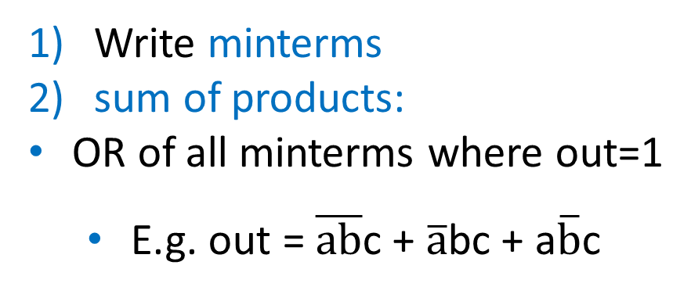
Logic Implementation
How to implement a desired logic function?
Write minterms
sum of products:
OR of all minterms where out=1
  E.g. out = $\overline{ab}$c + $\overline{a}$bc + a$\overline{b}$c
a | b | c | out
0 | 0 | 0 | 0
0 | 0 | 1 | 1
0 | 1 | 0 | 0
0 | 1 | 1 | 1
1 | 0 | 0 | 0
1 | 0 | 1 | 1
1 | 1 | 0 | 0
1 | 1 | 1 | 0
minterm
a b c
a b c
a b c
a b c
a b c
a b c
a b c
a b c
a
b
c
out
corollary: any combinational circuit can be implemented in two levels of logic (ignoring inverters)
Notes:
Show what out equals

Slide 31
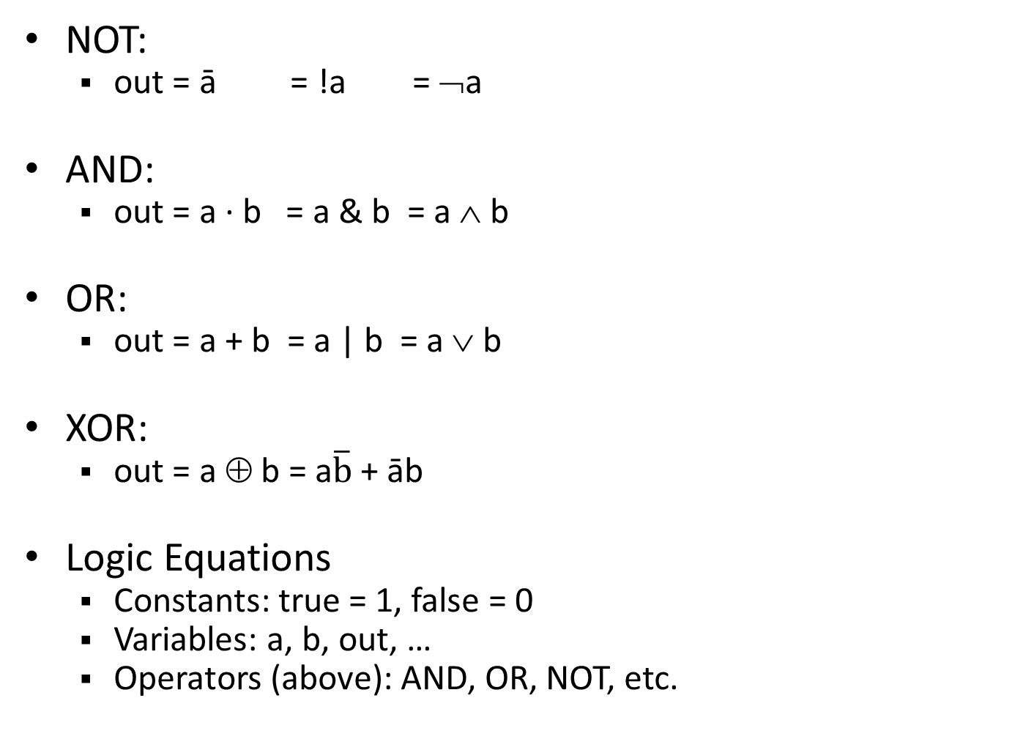
Logic Equations
NOT:
  out = ā = !a = ¬a
AND:
  out = a ∙ b = a & b = a ∧ b
OR:
  out = a + b = a | b = a ∨ b
XOR:
  out = a ⊕ b = a$\overline{b}$ + āb
Logic Equations
  Constants: true = 1, false = 0
  Variables: a, b, out, …
  Operators (above): AND, OR, NOT, etc.
Notes:
Apologize that there are three ways to represent the same logic equation
XOR is not a basic Logic Gate since it can be created from AND and OR gates, but it is often used as a basic Logic Operator
AND is “product”
OR is “sum”
Read outloud

Slide 32

Logic Equations
NOT:
  out = ā = !a = ¬a
AND:
  out = a ∙ b = a & b = a ∧ b
OR:
  out = a + b = a | b = a ∨ b
XOR:
  out = a ⊕ b = a$\overline{b}$ + āb
Logic Equations
  Constants: true = 1, false = 0
  Variables: a, b, out, …
  Operators (above): AND, OR, NOT, etc.
NAND:
  out = $\overline{a \text{∙} b}$ = !(a & b) = ¬ (a ∧ b)
NOR:
  out = $\overline{a+b}$ = !(a | b) = ¬ (a ∨ b)
XNOR:
  out = $\overline{a \text{⊕} b}$ = ab + $\overline{ab}$
  .
Notes:
Apologize that there are three ways to represent the same logic equation
XOR is not a basic Logic Gate since it can be created from AND and OR gates, but it is often used as a basic Logic Operator
AND is “product”
OR is “sum”
Read outloud

Slide 33
Identities
Identities useful for manipulating logic equations
  For optimization & ease of implementation
  a + 0 =
  a + 1 =
  a + ā =
  a ∙ 0 =
  a ∙ 1 =
  a ∙ ā =
Notes:
Minimization activity
Maybe use picture to go through
Complement a+ā=1 and aā=0

Slide 34
Identities
Identities useful for manipulating logic equations
  For optimization & ease of implementation
  a + 0 =
  a + 1 =
  a + ā =
  a ∙ 0 =
  a ∙ 1 =
  a ∙ ā =
  a
  1
  1
  0
  a
  0
a
b
a
b
Notes:
Minimization activity
Maybe use picture to go through
Complement a+ā=1 and aā=0

Slide 35

Identities
Identities useful for manipulating logic equations
  For optimization & ease of implementation
  $\overline{(a+b)}$ =
  $\overline{(a ∙b)}$ =
  a + a b =
  a(b+c) =
  $\overline{a(b+c)}$ =
Notes:
Minimization activity
Maybe use picture to go through
De Morgan’s Law: $\overline{(a+b)}$ = $\overline{a}$ ∙ $\overline{b}$ and $\overline{(a ∙b)}$ = $\overline{a}$ + $\overline{b}$

Slide 36

Identities
Identities useful for manipulating logic equations
  For optimization & ease of implementation
  $\overline{(a+b)}$ =
  $\overline{(a ∙b)}$ =
  a + a b =
  a(b+c) =
  $\overline{a(b+c)}$ =
A
↔
A
  $\overline{a}$ ∙ $\overline{b}$
  $\overline{a}$ + $\overline{b}$
  a
  ab + ac
  $\overline{a}$ + $\overline{b}$∙$\overline{c}$
B
B
A
↔
A
B
B
Notes:
Minimization activity
Maybe use picture to go through
De Morgan’s Law: $\overline{(a+b)}$ = $\overline{a}$ ∙ $\overline{b}$ and $\overline{(a ∙b)}$ = $\overline{a}$ + $\overline{b}$

Slide 37
Goals for Today
From Switches to Logic Gates to Logic Circuits
Logic Gates
  From switches
  Truth Tables
Logic Circuits
  From Truth Tables to Circuits (Sum of Products)
  Identity Laws
Logic Circuit Minimization – why?
  Algebraic Manipulations
  Truth Tables (Karnaugh Maps)
Transistors (electronic switch)

Slide 38
Minimization Example
a + 0 = a
a + 1 = 1
a + ā = 1
a · 0 = 0
a · 1 = a
a · ā = 0
a + a b = a
a (b+c) = ab + ac
Minimize this logic equation:
(a+b)(a+c) =
(a+b)a + (a+b)c
= aa + ba + ac + bc
= a + a(b+c) + bc
= a + bc
Notes:
Minimization activity

Slide 39
iClicker Question
a + 0 = a
a + 1 = 1
a + ā = 1
a · 0 = 0
a · 1 = a
a · ā = 0
a + a b = a
a (b+c) = ab + ac
(a+b)(a+c) → a + bc
How many gates were required before and after?
BEFORE AFTER
2 OR 1 OR
2 OR, 1 AND 2 OR
2 OR, 1 AND 1 OR, 1 AND
2 OR, 2 AND 2 OR
2 OR, 2 AND 2 OR, 1 AND
Notes:
Before: 2 OR gates, 1 AND
After: 1 OR gate, 1 AND

Slide 40
iClicker Question
a + 0 = a
a + 1 = 1
a + ā = 1
a · 0 = 0
a · 1 = a
a · ā = 0
a + a b = a
a (b+c) = ab + ac
(a+b)(a+c) → a + bc
How many gates were required before and after?
BEFORE AFTER
2 OR 1 OR
2 OR, 1 AND 2 OR
2 OR, 1 AND 1 OR, 1 AND
2 OR, 2 AND 2 OR
2 OR, 2 AND 2 OR, 1 AND
Notes:
Before: 2 OR gates, 1 AND
After: 1 OR gate, 1 AND

Slide 41
Checking Equality w/Truth Tables
circuits ↔ truth tables ↔ equations
Example: (a+b)(a+c) = a + bc
a | b | c
0 | 0 | 0
0 | 0 | 1
0 | 1 | 0
0 | 1 | 1
1 | 0 | 0
1 | 0 | 1
1 | 1 | 0
1 | 1 | 1
Notes:
(a+b)(a+c)
= aa + ab + ac + bc
= a + a(b+c) + bc
= a(1 + (b+c)) + bc
= a + bc

Slide 42
Checking Equality w/Truth Tables
circuits ↔ truth tables ↔ equations
Example: (a+b)(a+c) = a + bc
a | b | c
0 | 0 | 0
0 | 0 | 1
0 | 1 | 0
0 | 1 | 1
1 | 0 | 0
1 | 0 | 1
1 | 1 | 0
1 | 1 | 1
 |  |  | a+b | a+c | LHS
 |  |  | 0 | 0 | 0
 |  |  | 0 | 1 | 0
 |  |  | 1 | 0 | 0
 |  |  | 1 | 1 | 1
 |  |  | 1 | 1 | 1
 |  |  | 1 | 1 | 1
 |  |  | 1 | 1 | 1
 |  |  | 1 | 1 | 1
 |  |  |  |  |  | bc | RHS
 |  |  |  |  |  | 0 | 0
 |  |  |  |  |  | 0 | 0
 |  |  |  |  |  | 0 | 0
 |  |  |  |  |  | 1 | 1
 |  |  |  |  |  | 0 | 1
 |  |  |  |  |  | 0 | 1
 |  |  |  |  |  | 0 | 1
 |  |  |  |  |  | 1 | 1
Notes:
(a+b)(a+c)
= aa + ab + ac + bc
= a + a(b+c) + bc
= a(1 + (b+c)) + bc
= a + bc

Slide 43
Takeaway
Binary (two symbols: true and false) is the basis of Logic Design
More than one Logic Circuit can implement same Logic function. Use Algebra (Identities) or Truth Tables to show equivalence.
Notes:
Add takeways at end of a block. Possibly build on takeaways throughout lecture

Slide 44
Goals for Today
From Switches to Logic Gates to Logic Circuits
Logic Gates
  From switches
  Truth Tables
Logic Circuits
  From Truth Tables to Circuits (Sum of Products)
  Identity Laws
Logic Circuit Minimization
  Algebraic Manipulations
  Truth Tables (Karnaugh Maps)
Transistors (electronic switch)

Slide 45
Next Goal
How to standardize minimizing logic circuits?

Slide 46
Karnaugh Maps
        How does one find the most efficient equation?
          Manipulate algebraically until…?
          Use Karnaugh Maps (optimize visually)
          Use a software optimizer
          For large circuits
          Decomposition & reuse of building blocks

Slide 47
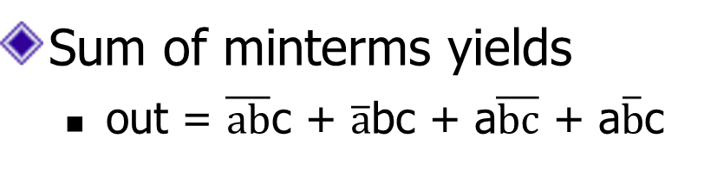
Minimization with Karnaugh maps (1)
Sum of minterms yields
  out = $\overline{ab}$c + $\overline{a}$bc + a$\overline{bc}$ + a$\overline{b}$c
a | b | c | out
0 | 0 | 0 | 0
0 | 0 | 1 | 1
0 | 1 | 0 | 0
0 | 1 | 1 | 1
1 | 0 | 0 | 1
1 | 0 | 1 | 1
1 | 1 | 0 | 0
1 | 1 | 1 | 0

Slide 48
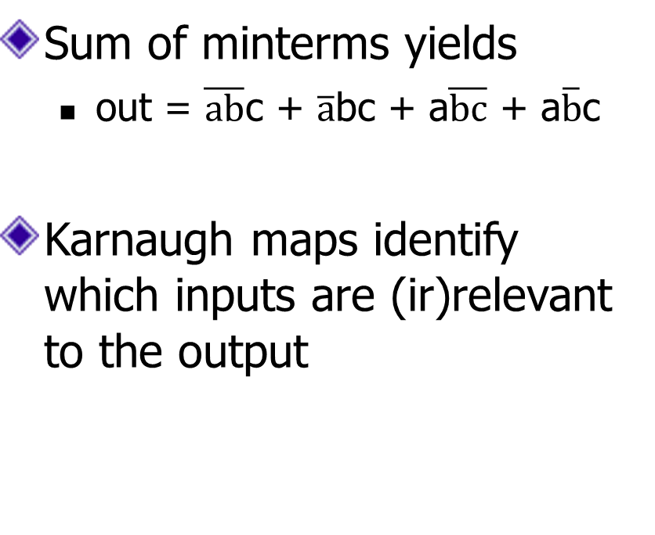
Minimization with Karnaugh maps (2)
Sum of minterms yields
  out = $\overline{ab}$c + $\overline{a}$bc + a$\overline{bc}$ + a$\overline{b}$c
Karnaugh maps identify which inputs are (ir)relevant to the output
a | b | c | out
0 | 0 | 0 | 0
0 | 0 | 1 | 1
0 | 1 | 0 | 0
0 | 1 | 1 | 1
1 | 0 | 0 | 1
1 | 0 | 1 | 1
1 | 1 | 0 | 0
1 | 1 | 1 | 0
ab
c
00 01 11 10
0
0 | 0 | 0 | 1
1 | 1 | 0 | 1
1

Slide 49
Minimization with Karnaugh maps (2)
Sum of minterms yields
  out = $\overline{ab}$c + $\overline{a}$bc + a$\overline{bc}$ + a$\overline{b}$c
Karnaugh maps identify which inputs are (ir)relevant to the output
a | b | c | out
0 | 0 | 0 | 0
0 | 0 | 1 | 1
0 | 1 | 0 | 0
0 | 1 | 1 | 1
1 | 0 | 0 | 1
1 | 0 | 1 | 1
1 | 1 | 0 | 0
1 | 1 | 1 | 0
ab
c
00 01 11 10
0
0 | 0 | 0 | 1
1 | 1 | 0 | 1
1

Slide 50
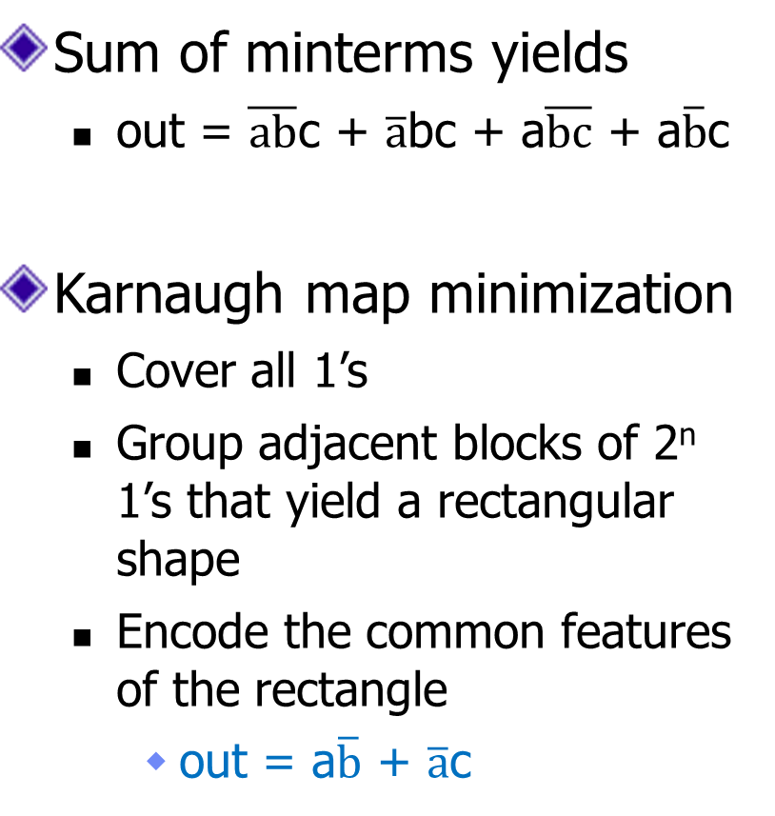
Minimization with Karnaugh maps (2)
Sum of minterms yields
  out = $\overline{ab}$c + $\overline{a}$bc + a$\overline{bc}$ + a$\overline{b}$c
Karnaugh map minimization
  Cover all 1’s
  Group adjacent blocks of 2^{n} 1’s that yield a rectangular shape
  Encode the common features of the rectangle
    out = a$\overline{b}$ + $\overline{a}$c
a | b | c | out
0 | 0 | 0 | 0
0 | 0 | 1 | 1
0 | 1 | 0 | 0
0 | 1 | 1 | 1
1 | 0 | 0 | 1
1 | 0 | 1 | 1
1 | 1 | 0 | 0
1 | 1 | 1 | 0
ab
c
00 01 11 10
0
0 | 0 | 0 | 1
1 | 1 | 0 | 1
1

Slide 51
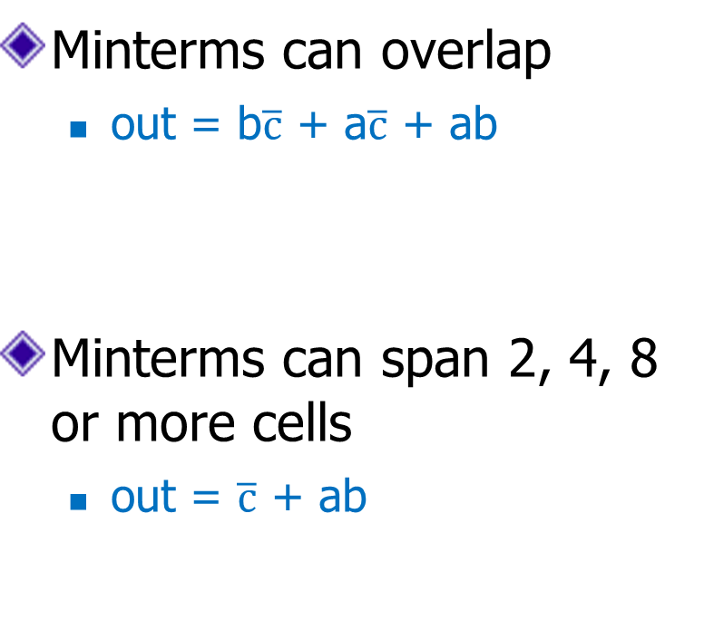
Karnaugh Minimization Tricks (1)
ab
c
00 01 11 10
Minterms can overlap
  out = b$\overline{c}$ + a$\overline{c}$ + ab
Minterms can span 2, 4, 8 or more cells
  out = $\overline{c}$ + ab
0
0 | 1 | 1 | 1
0 | 0 | 1 | 0
1
ab
c
00 01 11 10
0
1 | 1 | 1 | 1
0 | 0 | 1 | 0
1

Slide 52
Karnaugh Minimization Tricks (1)
ab
c
00 01 11 10
Minterms can overlap
  out = b$\overline{c}$ + a$\overline{c}$ + ab
Minterms can span 2, 4, 8 or more cells
  out = $\overline{c}$ + ab
0
0 | 1 | 1 | 1
0 | 0 | 1 | 0
1
ab
c
00 01 11 10
0
1 | 1 | 1 | 1
0 | 0 | 1 | 0
1

Slide 53

Karnaugh Minimization Tricks (2)
ab
cd
00 01 11 10
00
0 | 0 | 0 | 0
1 | 0 | 0 | 1
1 | 0 | 0 | 1
0 | 0 | 0 | 0
The map wraps around
  out = $\overline{b}$d
  out = $\overline{b}$ $\overline{d}$
01
11
10
ab
cd
00 01 11 10
00
1 | 0 | 0 | 1
0 | 0 | 0 | 0
0 | 0 | 0 | 0
1 | 0 | 0 | 1
01
11
10

Slide 54
Karnaugh Minimization Tricks (2)
ab
cd
00 01 11 10
00
0 | 0 | 0 | 0
1 | 0 | 0 | 1
1 | 0 | 0 | 1
0 | 0 | 0 | 0
The map wraps around
  out = $\overline{b}$d
  out = $\overline{b}$ $\overline{d}$
01
11
10
ab
cd
00 01 11 10
00
1 | 0 | 0 | 1
0 | 0 | 0 | 0
0 | 0 | 0 | 0
1 | 0 | 0 | 1
01
11
10

Slide 55
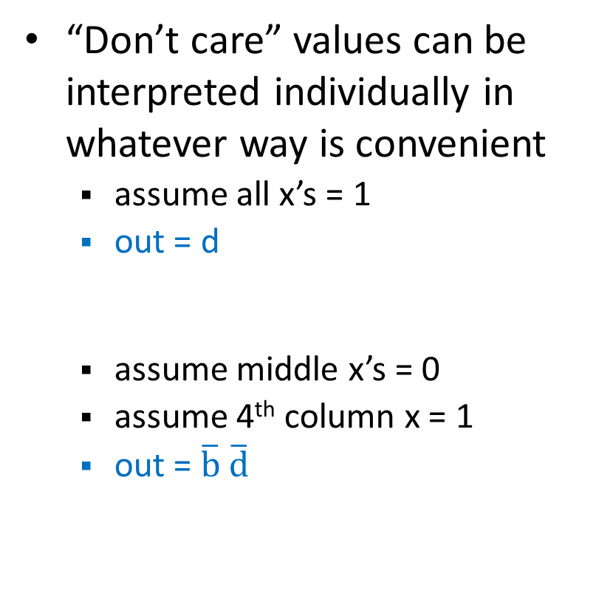
Karnaugh Minimization Tricks (3)
ab
cd
00 01 11 10
00
0 | 0 | 0 | 0
1 | x | x | x
1 | x | x | 1
0 | 0 | 0 | 0
“Don’t care” values can be interpreted individually in whatever way is convenient
  assume all x’s = 1
  out = d
  assume middle x’s = 0
  assume 4th column x = 1
  out = $\overline{b}$ $\overline{d}$
01
11
10
ab
cd
00 01 11 10
00
1 | 0 | 0 | x
0 | x | x | 0
0 | x | x | 0
1 | 0 | 0 | 1
01
11
10

Slide 56
Karnaugh Minimization Tricks (3)
ab
cd
00 01 11 10
00
0 | 0 | 0 | 0
1 | x | x | x
1 | x | x | 1
0 | 0 | 0 | 0
“Don’t care” values can be interpreted individually in whatever way is convenient
  assume all x’s = 1
  out = d
  assume middle x’s = 0
  assume 4th column x = 1
  out = $\overline{b}$ $\overline{d}$
01
11
10
ab
cd
00 01 11 10
00
1 | 0 | 0 | x
0 | x | x | 0
0 | x | x | 0
1 | 0 | 0 | 1
01
11
10

Slide 57
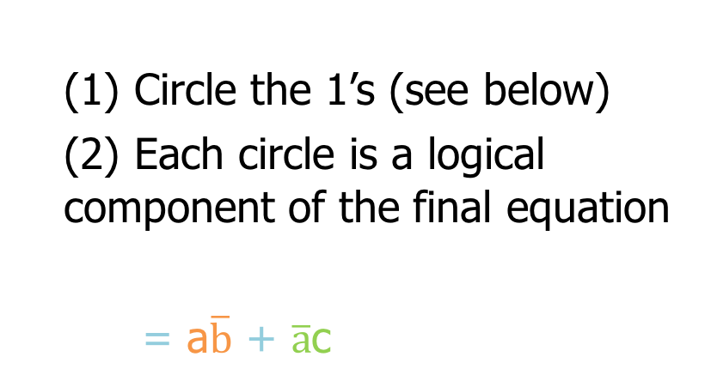
Minimization with K-Maps
  (1) Circle the 1’s (see below)
  (2) Each circle is a logical component of the final equation
  = a$\overline{b}$ + $\overline{a}$c
ab
c
00 01 11 10
0
0 | 0 | 0 | 1
1 | 1 | 0 | 1
1
Rules:
Use fewest circles necessary to cover all 1’s
Circles must cover only 1’s
Circles span rectangles of size power of 2 (1, 2, 4, 8…)
Circles should be as large as possible (all circles of 1?)
Circles may wrap around edges of K-Map
1 may be circled multiple times if that means fewer circles

Slide 58
Multiplexer
A multiplexer selects between multiple inputs
  out = a, if d = 0
  out = b, if d = 1
Build truth table
Minimize diagram
Derive logic diagram
a
b
d
a | b | d | out
0 | 0 | 0
0 | 0 | 1
0 | 1 | 0
0 | 1 | 1
1 | 0 | 0
1 | 0 | 1
1 | 1 | 0
1 | 1 | 1
Notes:
What is the truth table

Slide 59
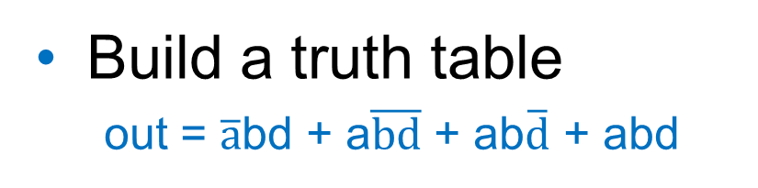
Multiplexer Implementation
a
Build a truth table
  out = $\overline{a}$bd + a$\overline{bd}$ + ab$\overline{d}$ + abd
b
d
a | b | d | out
0 | 0 | 0 | 0
0 | 0 | 1 | 0
0 | 1 | 0 | 0
0 | 1 | 1 | 1
1 | 0 | 0 | 1
1 | 0 | 1 | 0
1 | 1 | 0 | 1
1 | 1 | 1 | 1

Slide 60
Multiplexer Implementation
a
Build the Karnaugh map
b
d
ab
d
00 01 11 10
a | b | d | out
0 | 0 | 0 | 0
0 | 0 | 1 | 0
0 | 1 | 0 | 0
0 | 1 | 1 | 1
1 | 0 | 0 | 1
1 | 0 | 1 | 0
1 | 1 | 0 | 1
1 | 1 | 1 | 1
0
1

Slide 61
Multiplexer Implementation
a
Build the Karnaugh map
b
d
ab
d
00 01 11 10
a | b | d | out
0 | 0 | 0 | 0
0 | 0 | 1 | 0
0 | 1 | 0 | 0
0 | 1 | 1 | 1
1 | 0 | 0 | 1
1 | 0 | 1 | 0
1 | 1 | 0 | 1
1 | 1 | 1 | 1
0
0 | 0 | 1 | 1
0 | 1 | 1 | 0
1

Slide 62
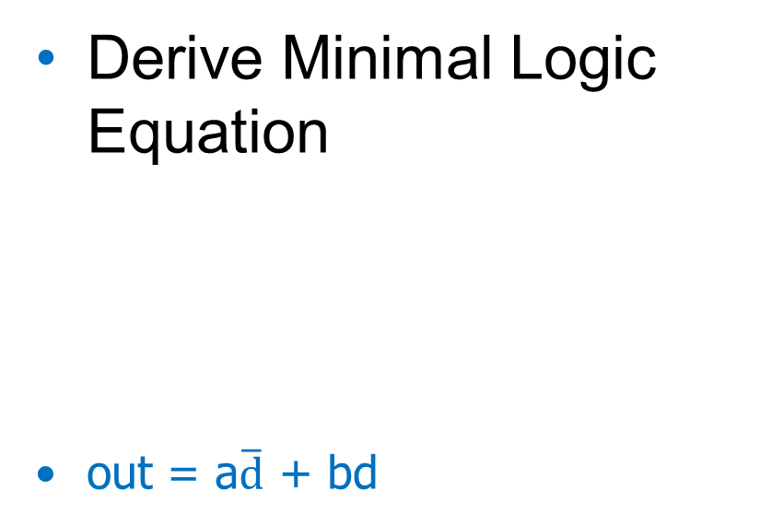
Multiplexer Implementation
a
Derive Minimal Logic Equation
  out = a$\overline{d}$ + bd
b
d
ab
d
00 01 11 10
a | b | d | out
0 | 0 | 0 | 0
0 | 0 | 1 | 0
0 | 1 | 0 | 0
0 | 1 | 1 | 1
1 | 0 | 0 | 1
1 | 0 | 1 | 0
1 | 1 | 0 | 1
1 | 1 | 1 | 1
0
0 | 0 | 1 | 1
0 | 1 | 1 | 0
1
a
d
out
b

Slide 63
Takeaway
Binary (two symbols: true and false) is the basis of Logic Design
More than one Logic Circuit can implement same Logic function. Use Algebra (Identities) or Truth Tables to show equivalence.
Any logic function can be implemented as “sum of products”. Karnaugh Maps minimize number of gates.
Notes:
Add takeways at end of a block. Possibly build on takeaways throughout lecture

Slide 64
Administrivia
Dates to keep in Mind
  Prelims: Thur Mar 15th and Thur May 3rd
  Proj 1: Due Fri Feb 16th before Winter break
  Proj2: Due Fri Mar 6th before Spring break
  Final Project: Due Tue May 15th

Slide 65
iClicker
Attempt to balance the iClicker graph
Register iClicker
  http://atcsupport.cit.cornell.edu/pollsrvc/

Slide 66
Goals for Today
From Transistors to Gates to Logic Circuits
Logic Gates
  From transistors
  Truth Tables
Logic Circuits
  From Truth Tables to Circuits (Sum of Products)
  Identity Laws
Logic Circuit Minimization
  Algebraic Manipulations
  Truth Tables (Karnaugh Maps)
Transistors (electronic switch)

Slide 67
Silicon Valley & the Semiconductor Industry
Transistors:
Youtube video “How does a transistor work”
  https://www.youtube.com/watch?v=IcrBqCFLHIY
Break: show some Transistor, Fab, Wafer photos
Notes:
Everything that we have shown them can be constructed in silicon.

Slide 68
Transistors 101
Source
Gate
Drain
Source
Gate
Drain
—
-
+
Insulator
+
+
+
Insulator
+
+
+
+
+
-
-
+
+
+
+
+
+
+
N-type
P-type
P-type
P-type channel created
-
N-type
-
-
-
-
-
P-type
+
-
-
P-type
+
+
+
+
+
+
-
+
+
-
+
+
+
+
-
-
-
-
-
-
-
-
-
-
-
-
-
-
-
-
-
-
-
-
-
-
-
-
-
-
-
-
-
-
-
-
-
-
-
-
-
-
-
-
-
P-Transistor
Off
P-Transistor
On
N-Type Silicon: negative free-carriers (electrons)
P-Type Silicon: positive free-carriers (holes)
P-Transistor: negative charge on gate generates electric field that creates a (+ charged) p-channel connecting source & drain
N-Transistor: works the opposite way
Metal-Oxide Semiconductor (Gate-Insulator-Silicon)
Complementary MOS = CMOS technology uses both p- & n-type transistors
Notes:
Negative charge on the gate generates an electric field that creates a positively-charged path between the source and the drain.
Transistors made from semiconductor materials:
MOSFET – Metal Oxide Semiconductor Field Effect Transistor
NMOS, PMOS – Negative MOS and Positive MOS
CMOS – complementary MOS made from PMOS and NMOS transistors

Slide 69
CMOS Notation
N-type
P-type
Gate input controls whether current can flow between the other two terminals or not.
Hint: the “o” bubble of the p-type tells you that this gate wants a 0 to be turned on
Off/Open
On/Closed
0
1
gate
Off/Open
On/Closed
1
0
gate

Slide 70
iClicker Question
Which of the following statements is false?
P- and N-type transistors are both used in CMOS designs.
As transistors get smaller, the frequency of your processor will keep getting faster.
As transistors get smaller, you can fit more and more of them on a single chip.
Pure silicon is a semi conductor.
Experts believe that Moore’s Law will soon end.

Slide 71
2-Transistor Combination: NOT
Logic gates are constructed by combining transistors in complementary arrangements
Combine p&n transistors to make a NOT gate:
CMOS Inverter :
power source (1)
power source (1)
power source (1)
p-gate
—
p-gate
closes
+
p-gate
stays open
output
0
1
1
0
input
n-gate
stays open
n-gate
closes
n-gate
—
+
ground (0)
ground (0)
ground (0)

Slide 72
Inverter
V_{supply} (aka logic 1)
Function: NOT
Symbol:
Truth Table:
in
out
in
out
(ground is logic 0)
In | Out
0 | 1
1 | 0

Slide 73
NOR Gate
V_{supply}
Function: NOR
Symbol:
Truth Table:
A
a
B
out
b
out
A
B
A | B | out
0 | 0 | 1
0 | 1 | 0
1 | 0 | 0
1 | 1 | 0
73
Notes:
Example

Slide 74
Which Gate is this?
iClicker Question
Function:
Symbol:
Truth Table:
V_{supply}
V_{supply}
A
B
out
B
A
A | B | out
0 | 0
0 | 1
1 | 0
1 | 1
NOT
OR
XOR
AND
NAND
Notes:
This is a NAND gate:
A B out
0 0 1
0 1 1
1 0 1
1 1 0

Slide 75
Which Gate is this?
iClicker Question
Function:
Symbol:
Truth Table:
V_{supply}
V_{supply}
A
B
out
B
A
A | B | out
0 | 0 | 1
0 | 1 | 1
1 | 0 | 1
1 | 1 | 0
NOT
OR
XOR
AND
NAND
Notes:
This is a NAND gate:
A B out
0 0 1
0 1 1
1 0 1
1 1 0

Slide 76
Building Functions (Revisited)
NOT:
AND:
OR:
NAND and NOR are universal
  Can implement any function with NAND or just NOR gates
  useful for manufacturing
Notes:
Flash Drives
Create truth table of AND or OR: state what they do

Slide 77
Building Functions (Revisited)
NOT:
AND:
OR:
NAND and NOR are universal
  Can implement any function with NAND or just NOR gates
  useful for manufacturing
a
a
b
a
b
Notes:
Flash Drives
Create truth table of AND or OR: state what they do

Slide 78
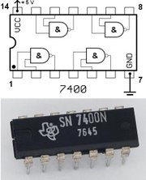
Logic Gates
One can buy gates separately
  ex. 74xxx series of integrated circuits
  cost ~$1 per chip, mostly for packaging and testing
Cumbersome, but possible to build devices using gates put together manually

Slide 79

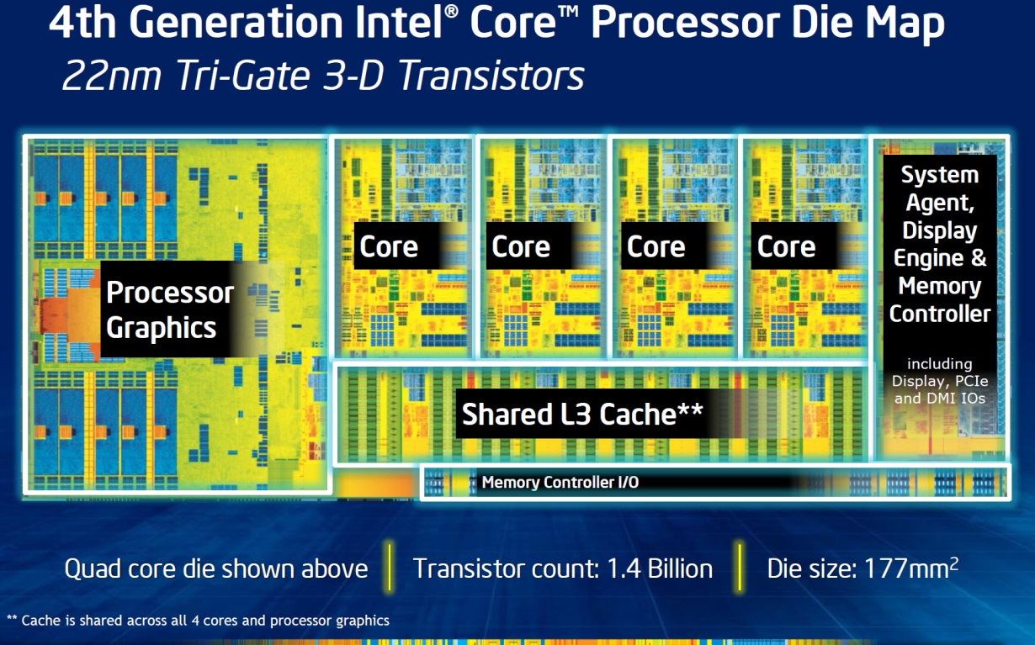
Then and Now
http://techguru3d.com/4th-gen-intel-haswell-processors-architecture-and-lineup/
The first transistor
  One workbench at AT&T Bell Labs
  1947
  Bardeen, Brattain, and Shockley
Intel Haswell
  1.4 billion transistors, 22nm
  177 square millimeters
  Four processing cores
https://en.wikipedia.org/wiki/Transistor_count
Notes:
John Bardeen
Walter Brattain
William Shockley

Slide 80
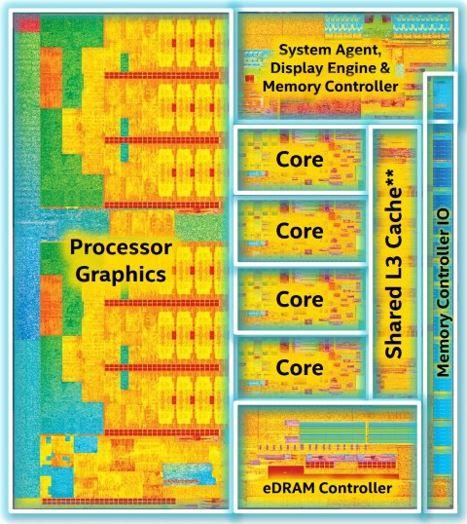
Then and Now
https://www.computershopper.com/computex-2015/performance-preview-desktop-broadwell-at-computex-2015
The first transistor
  One workbench at AT&T Bell Labs
  1947
  Bardeen, Brattain, and Shockley
Intel Broadwell
  7.2 billion transistors, 14nm
  456 square millimeters
  Up to 22 processing cores
https://en.wikipedia.org/wiki/Transistor_count
Notes:
John Bardeen
Walter Brattain
William Shockley

Slide 81
Big Picture: Abstraction
Hide complexity through simple abstractions
  Simplicity
    Box diagram represents inputs and outputs
  Complexity
    Hides underlying NMOS- and PMOS-transistors and atomic interactions
Vdd
a
in
out
d
out
Vss
b
a
d
out
in
out
b

Slide 82
Summary
Most modern devices made of billions of transistors
  You will build a processor in this course!
  Modern transistors made from semiconductor materials
  Transistors used to make logic gates and logic circuits
We can now implement any logic circuit
  Use P- & N-transistors to implement NAND/NOR gates
  Use NAND or NOR gates to implement the logic circuit
  Efficiently: use K-maps to find required minimal terms

