Slide 1
CS 3410: Computer System Organization and Programming
Hakim Weatherspoon
Computer Science
Cornell University
The slides are the product of many rounds of teaching CS 3410 by Professors Weatherspoon, Bala, Bracy, and Sirer.

Slide 2
The Analytical Engine
Designed by Charles Babbage from 1834 – 1871
Considered to be the first digital computer
Built from mechanical gears, where each gear represented a discrete value (0-9)
Babbage died before it was finished
http://history-computer.com
http://wikimedia.com

Slide 3
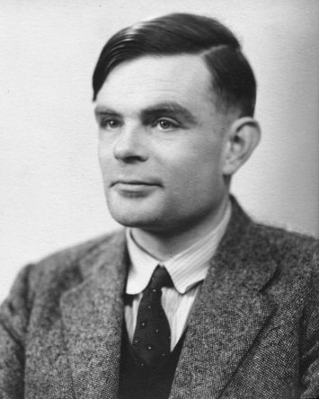
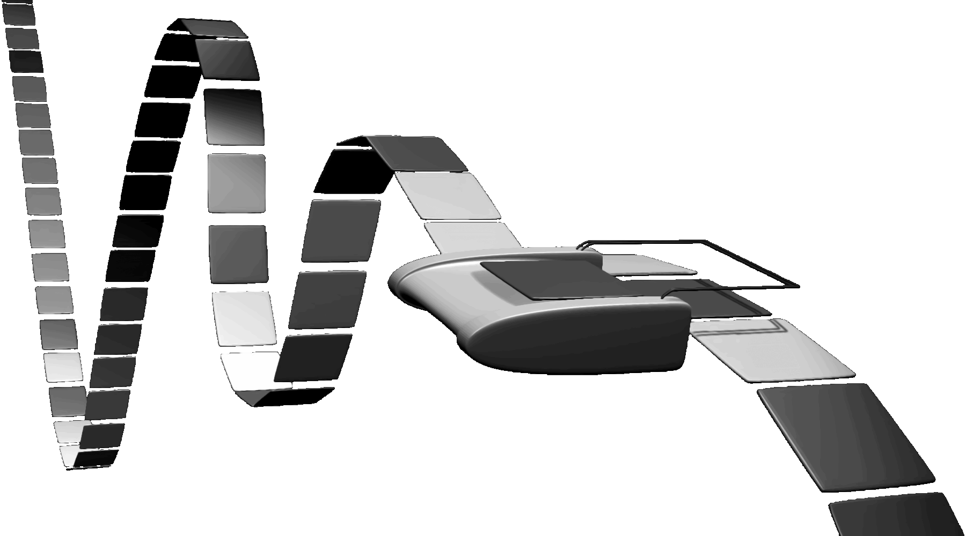
Turing Machine
1936
Alan Turing
= abstract model for CPU that can simulate any algorithm
Notes:
How does The Imitation Game, Engima/Bombe, Turing relate to you and this course?!
Alan Turing thesis in 1936 came up with an abstract model for a CPU that can simulate any algorithm, a Turing Machine. You will build a CPU and understand it and its organization
http://en.wikipedia.org/wiki/Turing_machine
A Turing machine is a hypothetical device that manipulates symbols on a strip of tape according to a table of rules. Despite its simplicity, a Turing machine can be adapted to simulate the logic of any computer algorithm, and is particularly useful in explaining the functions of a CPU inside a computer.
Note that every part of the machine (i.e. its state, symbol-collections, and used tape at any given time) and its actions (such as printing, erasing and tape motion) is finite, discrete and distinguishable; it is the unlimited amount of tape and runtime that gives it an unbounded amount of storage space.

Slide 4
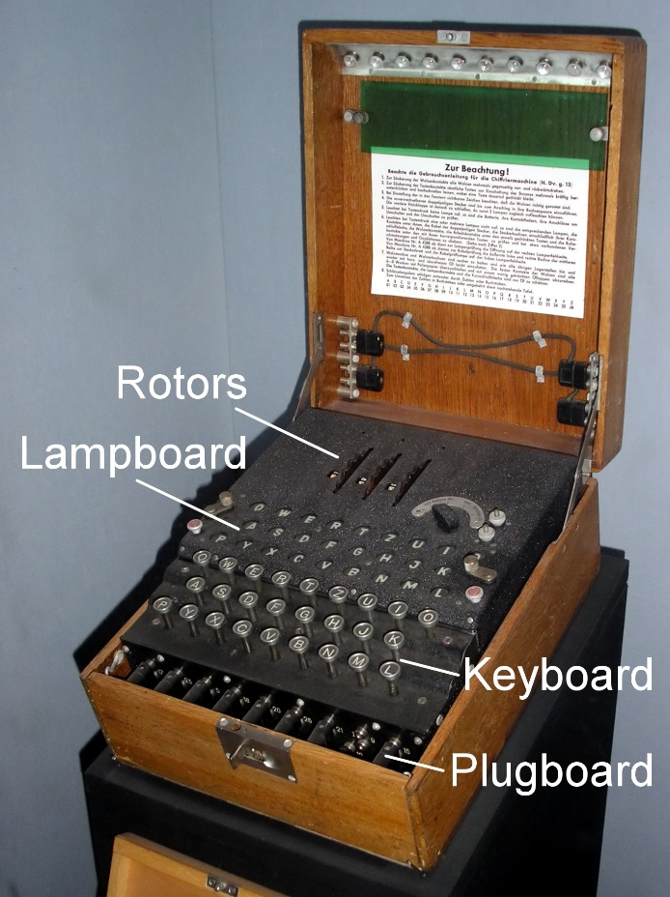
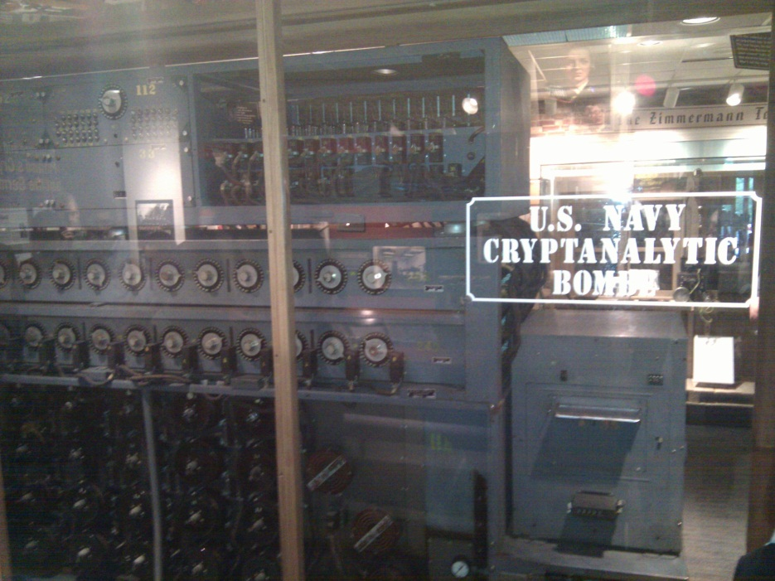
The Bombe
used by the Allies to
break the German
Enigma machine during
World War II
Enigma machine
Used by the Germans during
World War II to encrypt and
exchange secret messages
Notes:
http://en.wikipedia.org/wiki/Bombe
How many possible combinations to break an Enigma cipher text (msg encrypted by the Enigma machine)?
Rotors x Rotor posititions x plugboard combinations with 10 pairs = 159 quintillion = 1.59 x 10^20 158,962,555,217,826,360,000
Rotors (3 of 5 rotors): 5 x 4 x 3 = 60
Rotor positions: 26 x 26 x 26 = 17,526
plugboard: 26! / (6!10!2^10)
Numberphile on Enigma/Bombe
For those who want to learn more about the mechanism of the Bombe and how it exploited the flaw in the Enigma, Numberphile has recently done an excellent episode on it. Enjoy!
Flaw in the Enigma: http://www.youtube.com/watch?v=V4V2bpZlqx8
Previous episode on Enigma: http://www.youtube.com/watch?v=G2_Q9FoD-oQ

Slide 5
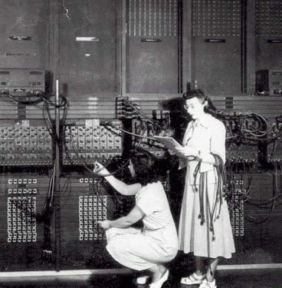
ENIAC Electronic Numerical Integrator And Computer
1946
John Mauchly
J. Presper Eckert

Slide 6
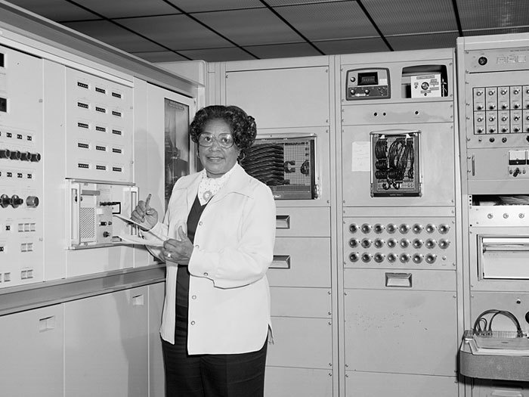
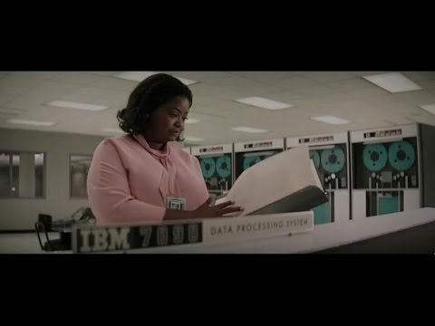
IBM 7090 Human Computers programming the IBM 7090
Mary Jackson
Hidden Figures

Slide 7
Who are you?
“Sometimes it is the people that no one imagines anything of who do the things that no one can imagine.” – Alan Turing
Turing Award Winners?
Eckert Mauchly Award Winners?

Slide 8
Course Objective
Understand the HW / SW interface software
How a processor works
How a computer is organized
Establish a foundation for building applications
How to write a good program
Good = correct, fast, and secure
How to understand where the world is going
Understand technology (past, present, future)

Slide 9
What is this?
#include <stdio.h>
int main() {
printf("Hello world!\n");
return 0;
}
How does it work?
I’m glad you asked…
15 weeks later and you’ll know!
“I know Kung Fu.”

Slide 10
Compilers & Assemblers
C
int x = 10;
x = 2 * x + 15;
compiler
r0 = 0
r5 = r0 + 10
r5 = r5 * 2
r5 = r5 + 15
MIPS
assembly
language
addi r5, r0, 10
muli r5, r5, 2
addi r5, r5, 15
assembler
op = addi r0 r5 10
MIPS
machine
language
00100000000001010000000000001010
00000000000001010010100001000000
00100000101001010000000000001111
op = addi r5 r5 15
Everything is a number!
Notes:
32 bits, 4 bytes
What time is it?

Slide 11
How to Design a Simple Processor
0
inst
alu
10
memory
register file
32
r5
r0
2
10
32
00
5 5 5
pc
new pc
calculation
control
00: addi r5, r0, 10
04: muli r5, r5, 2
08: addi r5, r5, 15

Slide 12
Instruction Set Architecture (ISA)
abstract interface between hardware and the lowest level software
user portion of the instruction set plus the operating system interfaces used by application programmers

Slide 13
Basic Computer System
A processor executes instructions
Processor has some internal state in storage elements (registers)
A memory holds instructions and data
von Neumann architecture: combined inst and data
A bus connects the two
01010000
10010100
…
bus
regs
addr, data,
r/w
processor
memory

Slide 14
Overview
Application
Operating
System
Compiler
Firmware
Instruction Set
Architecture
Memory
system
Instr. Set Proc.
I/O system
Datapath & Control
Digital Design
Circuit Design
Notes:
For class handout

Slide 15
Covered in this course
Application
Operating
System
Compiler
Firmware
Instruction Set
Architecture
Memory
system
I/O system
CPU
Datapath & Control
Digital Design
Circuit Design
Notes:
For class handout

Slide 16
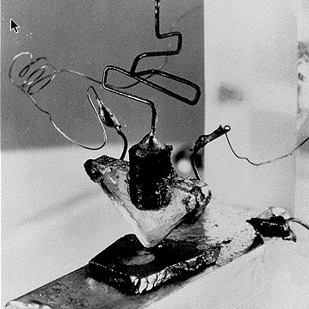
Where did it begin?
Electrical Switch
On/Off
Binary
Transistor
The first transistor on a workbench at AT&T Bell Labs in 1947
Transistors
Notes:
John Bardeen
Walter Brattain
William Shockley

Slide 17
Moore’s Law
1965
# of transistors integrated on a die doubles every 18-24 months (i.e., grows exponentially with time)
Amazingly visionary
2300 transistors, 1 MHz clock (Intel 4004) - 1971
16 Million transistors (Ultra Sparc III)
42 Million transistors, 2 GHz clock (Intel Xeon) – 2001
55 Million transistors, 3 GHz, 130nm technology, 250mm² die (Intel Pentium 4) – 2004
290+ Million transistors, 3 GHz (Intel Core 2 Duo) – 2007
721 Million transistors, 2 GHz (Nehalem) - 2009
1.4 Billion transistors, 3.4 GHz Intel Haswell (Quad core) – 2013
7.2 Billion transistors, 3-3.9 GHz Intel Broadwell (22-core) – 2016
Notes:
Tbyte = 2^40 bytes (or 10^12 bytes)
Note that Moore’s law is not about speed predictions but about chip complexity

Slide 18
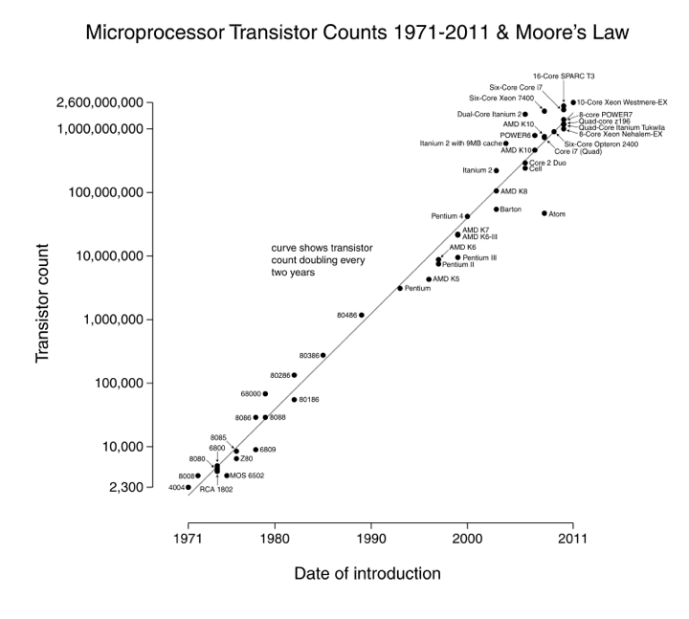

Slide 19
Processor Performance Increase
Intel Pentium 4/3000
Intel Xeon/2000
DEC Alpha 21264A/667
DEC Alpha 5/500
DEC Alpha 21264/600
DEC Alpha 5/300
DEC Alpha 4/266
IBM POWER 100
DEC AXP/500
HP 9000/750
IBM RS6000
MIPS M2000
SUN-4/260
MIPS M/120
Notes:
Another powerpoint “comic” – note that the y axis is log !
x/y where x is the model number and y is the speed in MHz
Rate of performance improvement has been between 1.5 and 1.6 times per year – how much longer will Moore’s Law hold?

Slide 20
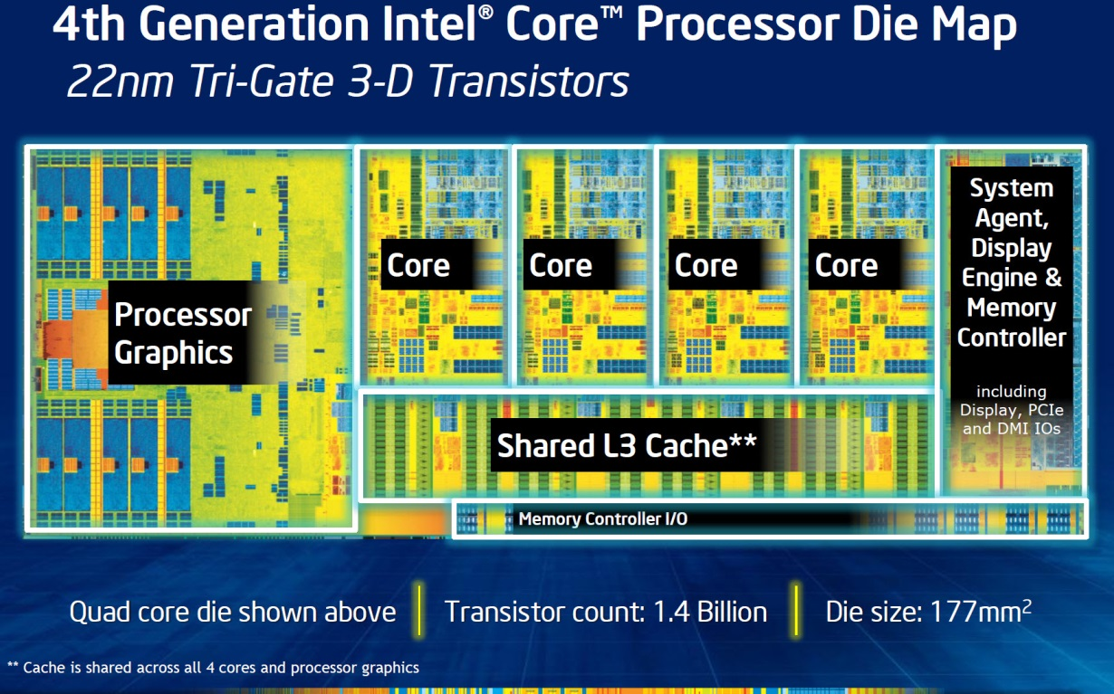
Then and Now
http://techguru3d.com/4th-gen-intel-haswell-processors-architecture-and-lineup/
The first transistor
One workbench at AT&T Bell Labs
1947
Bardeen, Brattain, and Shockley
Intel Haswell
1.4 billion transistors, 22nm
177 square millimeters
Four processing cores
What are we doing with all these transistors?
https://en.wikipedia.org/wiki/Transistor_count
Notes:
John Bardeen
Walter Brattain
William Shockley

Slide 21
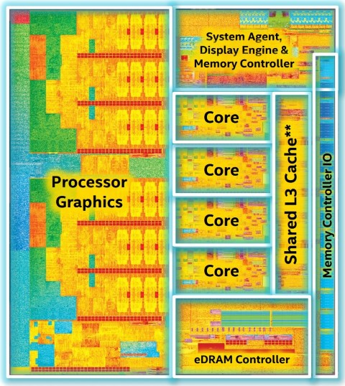
Then and Now
https://www.computershopper.com/computex-2015/performance-preview-desktop-broadwell-at-computex-2015
The first transistor
One workbench at AT&T Bell Labs
1947
Bardeen, Brattain, and Shockley
Intel Broadwell
7.2 billion transistors, 14nm
456 square millimeters
Up to 22 processing cores
What are we doing with all these transistors?
https://en.wikipedia.org/wiki/Transistor_count
Notes:
John Bardeen
Walter Brattain
William Shockley

Slide 22
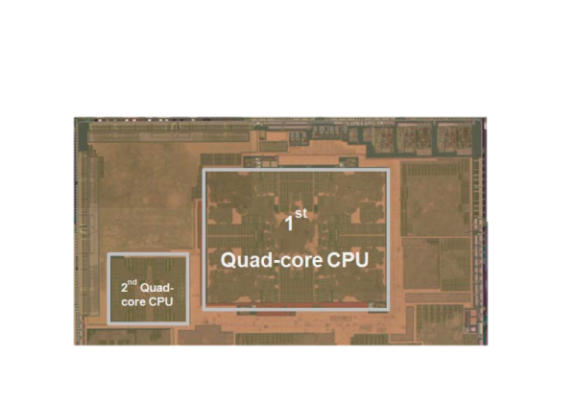
Then and Now
The first transistor
One workbench at AT&T Bell Labs
1947
Bardeen, Brattain, and Shockley
Galaxy Note 8
8 processing cores
Exynos 9 Octa 8895 processor
What are we doing with all these transistors?
https://en.wikipedia.org/wiki/Exynos
Notes:
John Bardeen
Walter Brattain
William Shockley

Slide 23
What are we doing with all these transistors?
Everything these days!
Phones, cars, televisions, games, computers,…

Slide 24
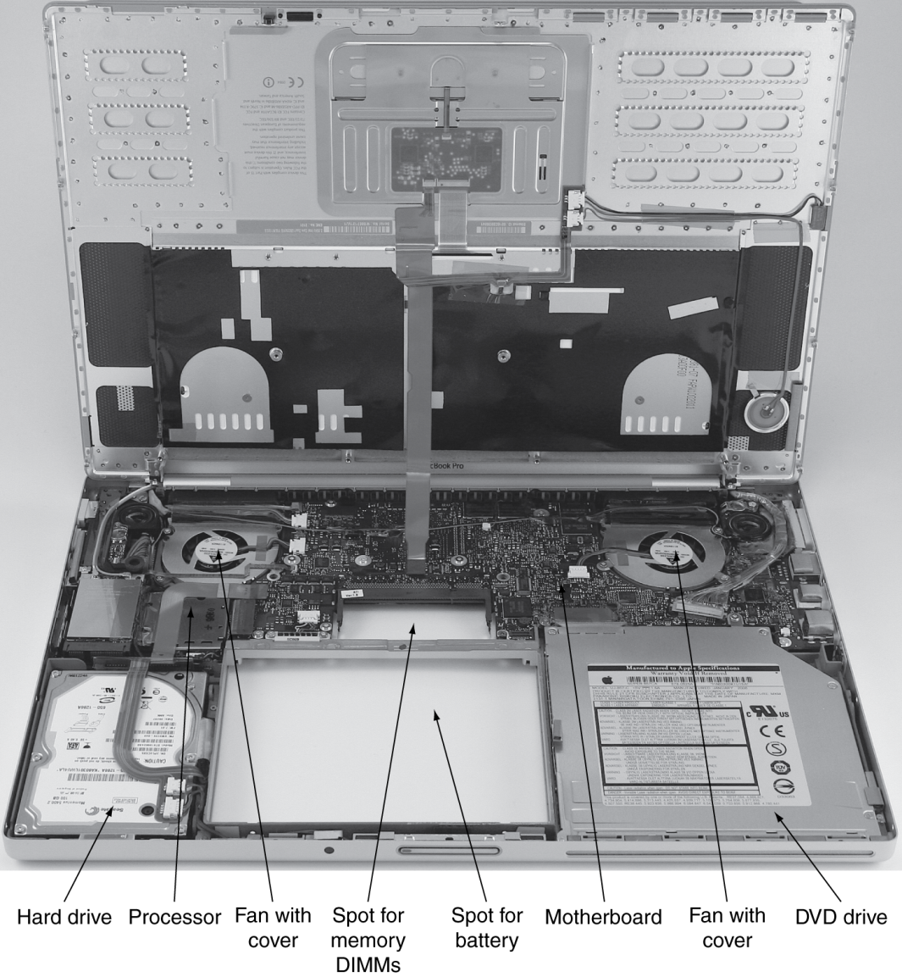
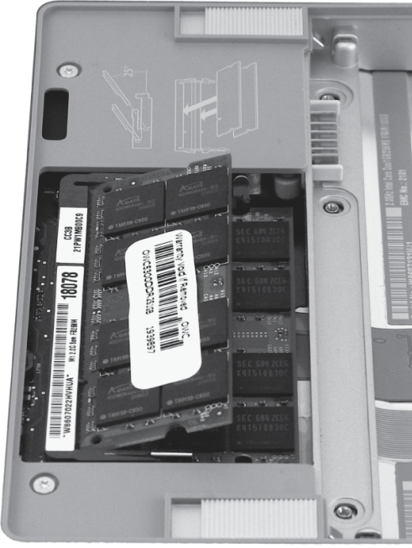
Computer System Organization

Slide 25
Reflect
Why take this course?
Basic knowledge needed for all other areas of CS:
operating systems, compilers, ...
Levels are not independent
hardware design ↔ software design ↔ performance
Crossing boundaries is hard but important
device drivers
Good design techniques
abstraction, layering, pipelining, parallel vs. serial, ...
Understand where the world is going
The Mysteries of Computing will be revealed!

