Slide 1
CS 3410: Computer System Organization and Programming
Hakim Weatherspoon
Computer Science
Cornell University
The slides are the product of many rounds of teaching CS 3410 by Professors Weatherspoon, Bala, Bracy, and Sirer.

Slide 2
First Clicker Question!
How excited are you to take this class??
I’ve been waiting my whole life to take 3410. I couldn’t sleep last night I’m so excited.
I’m excited.
I’ve heard good things, but my excitement is on hold.
Excited, not sure. Anxious? Yes.
Help! I’m a CS minor trapped in this class. Please rescue me. (Seriously.)

Slide 3
Who am I?
Hakim Weatherspoon
Undergrad: Computer Engineering
@ U. of Washington
PhD: Computer Science, Distributed Systems
@ U. of California, Berkeley
Academia: Cornell
  Taught 3410 and 4410 more than 10 times over 10 years!

Slide 4
Second Clicker Question!
Who are you?
Freshman
Sophomore
Junior
Senior
Other

Slide 5
“Sometimes it is the people that no one imagines anything of
who do the things that no one can imagine”
--quote from the movie The Imitation Game

Slide 6
“Can machines think?”
-- Alan Turing, 1950
Computing Machinery and Intelligence
Notes:
http://en.wikipedia.org/wiki/The_Imitation_Game
The film's title [The Imitation Game] refers to Turing's proposed test of the same name, which he discussed in his 1950 paper on artificial intelligence entitled "Computing Machinery and Intelligence".[29] The paper opens: "I propose to consider the question, 'Can machines think?' This should begin with definitions of the meaning of the terms 'machine' and 'think'.“

Slide 7
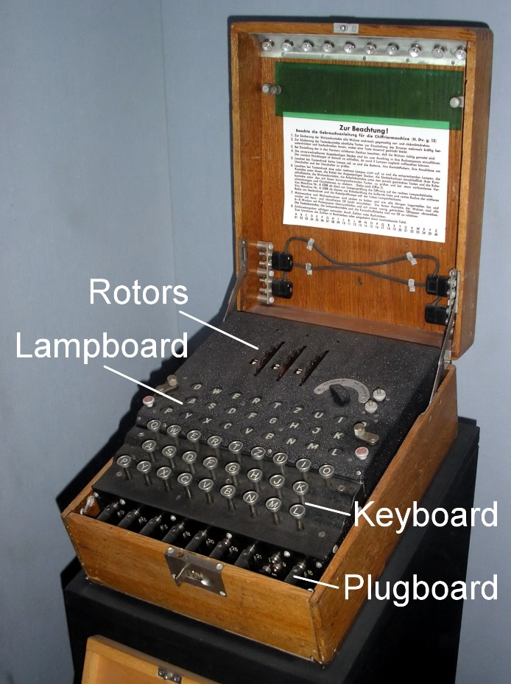
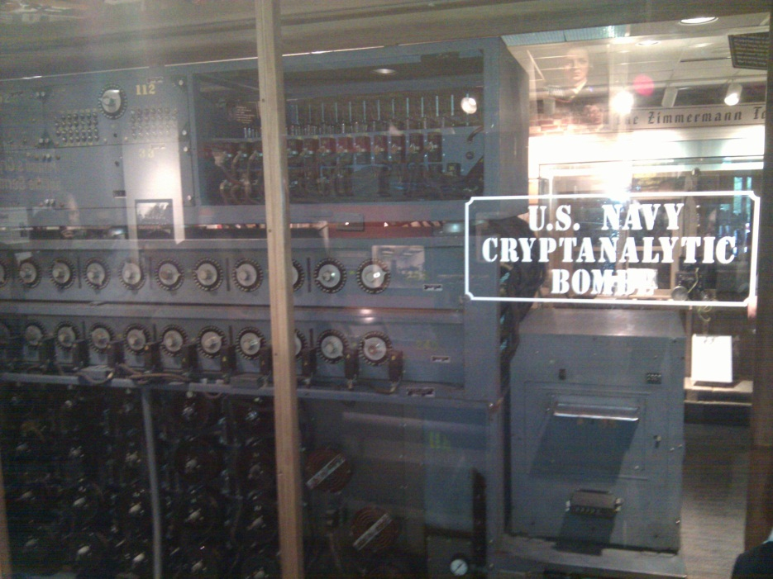
The Bombe
used by the Allies to
break the German
Enigma machine during
World War II
Enigma machine
Used by the Germans during
World War II to encrypt and
exchange secret messages
Notes:
http://en.wikipedia.org/wiki/Bombe
How many possible combinations to break an Enigma cipher text (msg encrypted by the Enigma machine)?
Rotors x Rotor posititions x plugboard combinations with 10 pairs = 159 quintillion = 1.59 x 10^20 158,962,555,217,826,360,000
Rotors (3 of 5 rotors): 5 x 4 x 3 = 60
Rotor positions: 26 x 26 x 26 = 17,526
plugboard: 26! / (6!10!2^10)
Numberphile on Enigma/Bombe
For those who want to learn more about the mechanism of the Bombe and how it exploited the flaw in the Enigma, Numberphile has recently done an excellent episode on it. Enjoy!
Flaw in the Enigma: http://www.youtube.com/watch?v=V4V2bpZlqx8
Previous episode on Enigma: http://www.youtube.com/watch?v=G2_Q9FoD-oQ

Slide 8
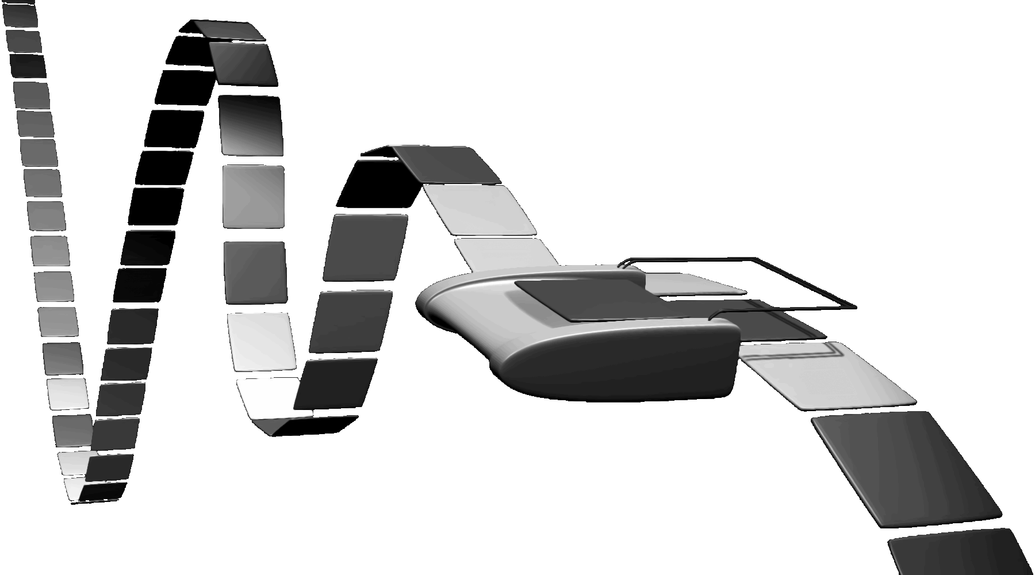

Turing Machine
1936
Alan Turing
Notes:
How does The Imitation Game, Engima/Bombe, Turing relate to you and this course?!
Alan Turing thesis in 1936 came up with an abstract model for a CPU that can simulate any algorithm, a Turing Machine. You will build a CPU and understand it and its organization
http://en.wikipedia.org/wiki/Turing_machine
A Turing machine is a hypothetical device that manipulates symbols on a strip of tape according to a table of rules. Despite its simplicity, a Turing machine can be adapted to simulate the logic of any computer algorithm, and is particularly useful in explaining the functions of a CPU inside a computer.
Note that every part of the machine (i.e. its state, symbol-collections, and used tape at any given time) and its actions (such as printing, erasing and tape motion) is finite, discrete and distinguishable; it is the unlimited amount of tape and runtime that gives it an unbounded amount of storage space.

Slide 9
Course Objective
Bridge the gap between hardware and software
  How a processor works
  How a computer is organized
Establish a foundation for building higher-level applications
  How to understand program performance
  How to understand where the world is going

Slide 10
How class is organized
Before you take this class…
Lecture
Lab Sections
Office Hours
Online Tools
Grading
Who’s Who

Slide 11
Pre-requisites and scheduling (1)
CS 2110 required (OO Programming & Data Structures)
  Must have satisfactorily completed CS 2110
  Cannot take CS 2110 concurrently with CS 3410
CS 3420 (ECE 3140) (Embedded Systems)
  Take either CS 3410 or CS 3420
    both satisfy CS and ECE requirements
  However, Need ENGRD 2300 to take CS 3420
CS 3110 (Data Structures and Functional Programming)
  Not advised to take CS 3110 and 3410 together
  Lectures scheduled at the same time so you can’t

Slide 12
Pre-requisites and scheduling (2)
CS 2043 (UNIX Tools and Scripting)
  2-credit course will greatly help with CS 3410.
  Spring only
CS 2024 (C++)
  1 to 2-credit course will greatly help with CS 3410
ECE 2400 (Computer Systems Programming)
  New course started last semester
  Lot of overlap with 2110, 2043, 2024, and 3410

Slide 13

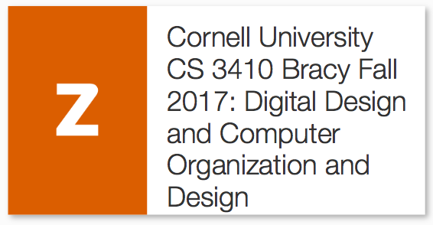
Required Textbook
Digital Design
+ =
Participation Activities due by midnight before class (soft) or 10 am day of class (hard).
(Starts next Tuesday.)
Challenge Activities not required unless you are told otherwise for Lab Section.

Slide 14
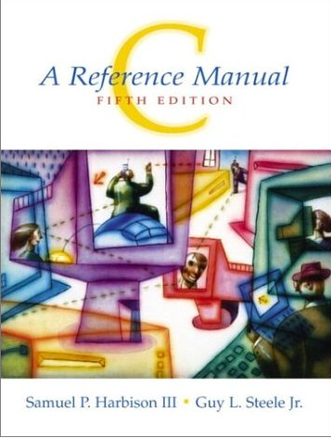

C Resources (optional)

Slide 15
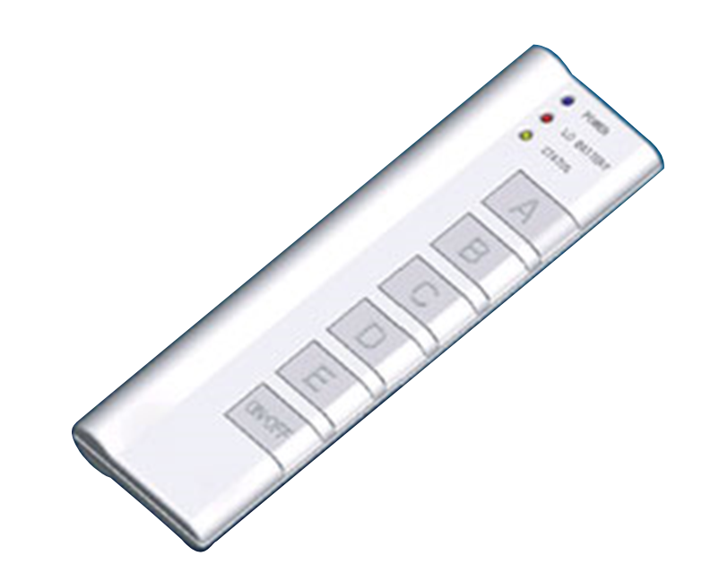
Lectures
Tuesday & Thursday 10:10-11:25
Klarman Hall KG70
iClicker: Bring to every Lecture
(starting today!)
missing a few times is okay
No cell phones (except for Reef Polling)
No Laptops

Slide 16
Active Learning
Interactive Textbook
Clickers
Activity Sheets
Classroom DJ, Breaks
Autograders
Lab Sections
You ask Questions
I ask Questions

Slide 17
How class is organized
Before you take this class…
Lecture
Lab Sections
Office Hours
Online Tools
Grading
Who’s Who

Slide 18
Lab Sections
  Labs Start This Week!

Slide 19
Office Hours
My Office Hours:
Mondays 10:30-11:30am, Tuesday 1:15-2:15pm
TA Office Hours:
Always in Rhodes Hall, Rooms 400 & 402
Every day of the week
See Google Calendar on course website
Start Sunday
Awesome Course Staff on the website

Slide 20
Communication
Website
  http://www.cs.cornell.edu/courses/cs3410/2018sp
Email
  cs3410-prof@cornell.edu
  The email alias goes to me, or come to my office hours
Assignments
  CMS: http://cmsx.csuglab.cornell.edu
Newsgroup
  http://www.piazza.com/cornell/spring2018/cs3410
  For students
iClicker
  http://atcsupport.cit.cornell.edu/pollsrvc/

Slide 21
Personal Emergencies
Please email cs3410-prof@cornell.edu
Get Help
Get Documentation
The earlier the better

Slide 22
Online Tools: Website
http://www.cs.cornell.edu/courses/cs3410/2018sp
Office Hours / Consulting Hours
Lecture slides, schedule, and Logisim
CSUG lab access (esp. second half of course)
Finalized Schedule will be up by next lecture (readings by Friday)
Submit to CMS.
This class is relentless.
Stay on top of it!

Slide 23
Course Management
Github for assignment dissemination
CMS for submissions & grades
Notes:
iclickers not using blackboard

Slide 24
Labs & Projects
Labs Assignments
  Weekly
  To be done in lab
Projects
  2 Individual Projects: you work alone
  6 Pair Projects: you work in pairs
  Ideally, find partner in same section
Notes:
We will pair you up if you don’t have a preferred partner
Design document due one week after handout
Start early, time management is key
Manage the team effort

Slide 25
Exams
2 Prelims
  March 15 and May 3
  Administrative Assistant:
  Jenna Edwards <jls478@cornell.edu>, Gates 401
  Please give accommodation letters to her within the first 2 weeks

Slide 26
Grading
Approximately:
Practicum ~50%
  Labs 10%
  Projects 40%
Lecture ~50%
  Prelims 35%
  Zybook 10%
  Participation 5%

Slide 27
Grading
Regrade policy
  Within 1 week of the assignment (or exam)’s return
Late Policy
  Each person has a total of 4 “Slip days”
  Max of 2 slip days for any project
  Cannot ever submit later than 48 hours late
  Handled by CMS, need to check implementation
    For pair projects, slip days deducted from all partners
    25% deducted per day late after slip days are exhausted
  Cannot use on Labs. (Lowest 2 lab scores will be dropped.)

Slide 28
Who am I, Revisited
Nice and a vertebrate:
Piazza posts about course material very welcome
Visits to my office hours very welcome
Correspondence about use of slip days, your alarm clock, your all-nighters, your alcohol intake, your car battery, etc. etc. not welcome
No exceptions
Deadlines are firm

Slide 29
Academic Integrity
All submitted work must be your own
  OK to study together, but do not share solultions
  Cite your sources
Project groups submit joint work
  Same rules apply to projects at the group level
  Cannot use someone else’s solution
  Stressed? Tempted? Lost?
    Come see us before due date!
Plagiarism in any form will not be tolerated

Slide 30
Academic Integrity Rules of Thumb
Looking at code that we didn’t give you?
STOP
  Protect yourself. Solutions are hard to un-see
White board rule of collaboration
  Work on white board, take no notes
  Erase, go home, watch an episode of Stranger Things
  Code up by yourself

Slide 31
Questions so far?

