Slide 1
Project 2
CS 3410

Slide 2
New Instructions (Table B)
Jumps - J, JR, JAL, JALR
Branches - BEQ, BNE, BLEZ, BGTZ, BLTZ, BGEZ
Memory - LW, LB, LBU, SW, SB
However, Project 2 is cumulative.

Slide 3
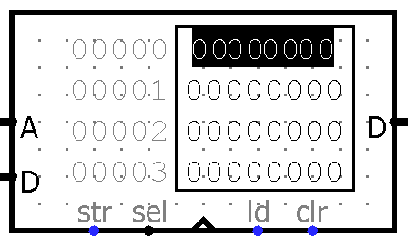
Logisim RAM

Slide 4
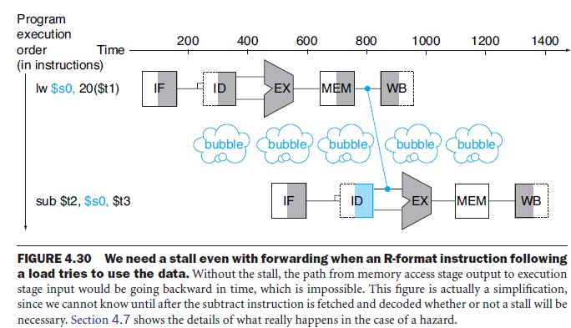
Load-Use Hazard

Slide 5
Load-Use Hazard
Load-use Stall = ID/Ex.MemRead &&
(IF/ID.Ra == ID/Ex.Rd || IF/ID.Rb == ID/Ex.Rd)

Slide 6
Delay Slot
Branch and Jump instructions have 1 delay slot.

Slide 7
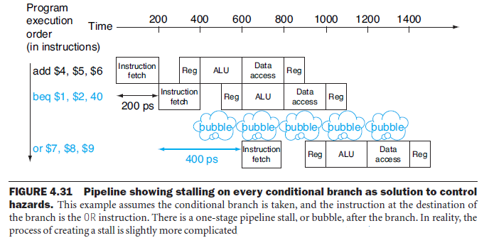
Control Hazards

Slide 8
Control Hazards
Simple Solution:
Stall
More Complex Solution (Not required):
Branch Prediction + Zap/Flush

Slide 9
Data Hazards
Data hazards can occur on branches and jumps!

Slide 10
Relative vs. Absolute PC
Branches use relative addressing.
Ex: Array indices, A[0], A[1]......A[N].
Jumps use absolute addresses.
Ex: Goto statements

Slide 11
Hailstone Programs
Three hailstone MIPS programs required.
An exercise of converting from C to MIPS.
In these you must follow calling conventions.
Do not include a main method!

