Slide 1
PA1 Introduction

Slide 2
PA1 Introduction
We’re making a miniature MIPS microprocessor!
  MIPS is a RISC instruction set that is easy to understand and implement.
  This + PA2 is a really cool project that will teach you the basics of what is happening on the machine level when you run some arbitrary code.

Slide 3
Design Docs!
Will help put you ideas into words and help others understand your design decisions/control signals.
Approach top-down – break everything into modules and decide the interface between them
Design doc meetings
Example Design Doc

Slide 4
Implementation
We’ll go over a few things in this section
  A few details about the processor
  A few details about the ISA
  Review of different types of instructions
    R-type
    I-Type
    J-Type
  Logisim Details
  Decoding Tips
  Go through the PA1 docs

Slide 5
Processor Details
You will need 5-stages: fetch, decode, execute, writeback, and memory.
  This is the most common organization to MIPS and most similar to book/class
Needs a program counter, a read-only program memory, a register file, the provided ALU, and any other components needed.
Should fetch instructions to execute from ROM, increment PC by 4, decode, select args from register file, compute results, do nothing in MEM stage, and store results back in register file.

Slide 6
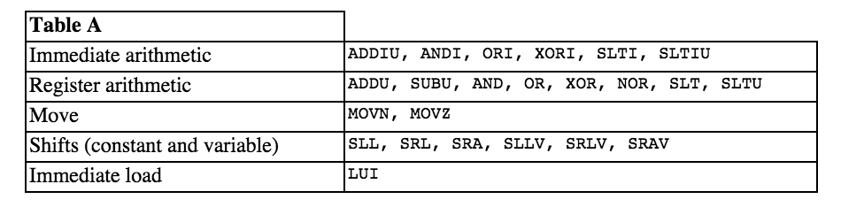
What to Implement/Not to Implement
Memory Stage for P1 – just make this a pass-through to the next stage that does nothing for now.
Delay Slots for P1 – Will not be implemented for now.

Slide 7
Continued
Decode all instructions in Table B (but don’t need to implement them yet.
  Can do anything you want as long as execution of instructions in Table A are not interfered with and no value in the register file changes.
Data Hazards: Implement forwarding to handle them. No-op/stalls are easy but incur a performance overhead.

Slide 8
ISA Details
The ISA exposes 31 32-bit registers that can hold values
  Actually 32 but $0 is always 0 – (actually this is kind of like dev/null … might be useful for no-ops).
But if registers aren’t enough, we also have the ability to load/store to 32-bit memory.
All instructions are 32-bits – the first six bits are the opcode
Instructions are layed out in instruction memory with a 32-bit program counter
  We use a modified Harvard Architecture – separate.

Slide 9
Instructions
Every instruction starts with a 6-bit opcode.
  R-Type specifies three registers, a SA field, and a function field
  I-Type specifies two registers and a 16-bit immediate value that is either sign/zero extended
  J-Type use a 26-bit jump target after opcode

Slide 10
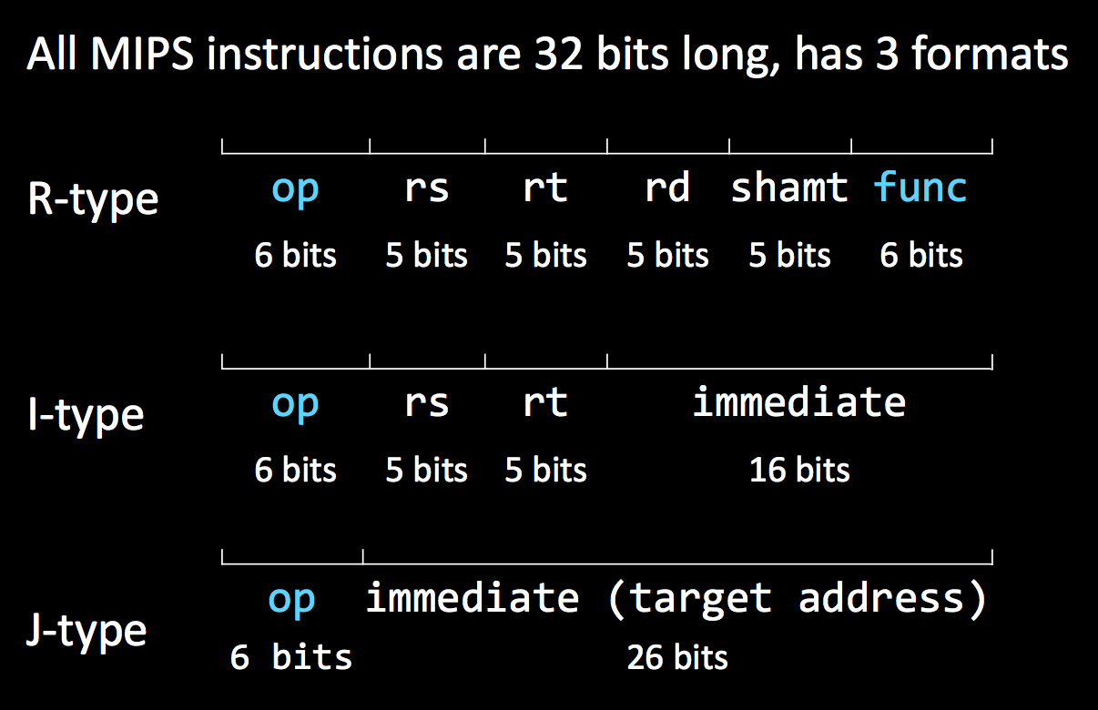

Slide 11
R-Type Instruction
Result and two source registers with shift amount
Opcode is always 0 (use this knowledge to decode them)
All R-Type instructions will do something to two registers and store the answer in the result register
The last 6 function bits will determine what you do (ADDU, SUBU, AND, OR, XOR, NOR …)

Slide 12
I-Type Instruction
  Specifies two registers and a 16-bit immediate value that is either sign/zero extended
  Do something to the register and the immediate value in the instruction – then store in the result register.
  Opcode can be anything other than 000000, 00001x, 0100xx (specifies other types of instructions)
  ADDIU, ANDI, ORI, XORI

Slide 13
J-Type Instruction
Just J and JAL
Jumping is used to go to other parts of instruction memory – usually used to execute new procedures
Opcodes are 000010 and 000011
But the target in the instruction is only 26 bits!
  Pad the LSB with 2 empty bits so we go from word to word
  The remaining 4 bits use bits 28-31 PC=PC+4
    Jump targets are computed with PC+4 not PC

Slide 14
Logisim Details
Download the latest version of Logisim
Program ROM
ALU
Register File

Slide 15
Decoding Tips
Find common ground between different types of instructions/opcodes just like Lab 1
Try to figure out what components to use and what control signals might be necessary
Tip: Make a chart of all the instructions and what the control signals need to be.

