Slide 1
Unix Lab
Fall 2016

Slide 2
Shell Scripting
Through the shell (LXTerminal) you can:
Run programs.
Interact with the file system.
Change settings.
Send/receive e-mails.

Slide 3
Bash
Bash Unix shell is the default shell on Linux and Mac OS X.
There are many (many, many) commands. Here we will present the most common/useful.

Slide 4
The File System
Every file and directory has a path!
Path: Where the file or directory is located in the file system.
Unix paths are delimited by forward slashes “ / ”
e.g. /home/username/cs3410/pa1

Slide 5
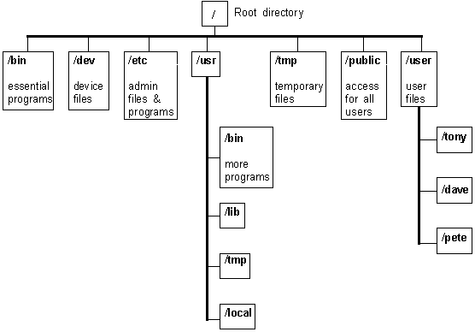
Special Directories
Root Directory
The Top-Most dir!
“ / ”
Home Directory
Current User’s dir!
“ ~ ”
Current Directory
The dir you’re in!
“ . ”
Parent Directory
The dir above!
“ .. ”

Slide 6
Special Directories
Absolute paths
start with “ / ”, i.e the root directory
Relative paths
start from your current directory

Slide 7
File System Commands
cd <dirpath> : Change Directory
pwd : Print Working Directory
ls : List Directory contents
mkdir <dirname> : Make Directory
When you log in to VM you are in your Home Directory!
You can always access it using “ ~ ”

Slide 8
File System Commands
$ pwd
/home/username
$ ls
dir1 file1
dir2 file2
$ mkdir mydir
$ ls
dir1 mydir file1
dir2 file1
$ cd ..
$ pwd
/home
$ cd ~/mydir
$ pwd
/home/username/mydir
$ cd /home
$ pwd
/home

Slide 9
Create & Delete Commands
mkdir <dirname>: Make Directory
touch <filename>: Create an empty file
rm <filename>: Remove the file
rm –r <dirname>: Remove dir and files in it recursively
WARNING: There is no Trash in the Unix File System.
If you delete a file or directory, it is gone forever!

Slide 10
Create & Delete Commands
$ pwd
/home/username
$ ls
dir1 mydir file2
dir2 file1
$ touch myfile
$ ls
dir1 mydir file2
dir2 file1 myfile
$ rm myfile
$ ls
dir1 mydir file2
dir2 file1
$ rm –r mydir
$ ls
dir1 file1
dir2 file2

Slide 11
Command Options
rm –r <dirname>
-r makes the rm command run recursively!
-r is an option that changes the command!
How to know the command options and how to use them?

Slide 12
The most helpful command
man <cmd>
Opens the manual page for the command cmd
Man page includes: Usage, Description, Explanation
If the man page is confusing, you can always try googling the problem!

Slide 13
Command History
All commands you run are saved!
$ history
Cycle through previous commands with the arrow keys
Very helpful when executing a small set of commands frequently (e.g. “nano arraylist.c” “gcc arraylist.c”)

Slide 14
Tab completion
Pressing the tab key will automatically complete whatever you are typing
If there is more than one thing you could be typing (so tab completion will not work), press tab twice to see the list of possibilities

Slide 15
Redirection
$ command > file
Send the output of the command to that file.
Creates the file if it does not exist.
$ ls ~ > homefiles.txt
Writes list of files under Home Directory to homefiles.txt

Slide 16
Redirection
$ command > file
Will overwrite the contents of file
$ command >> file
Will append the output of command to file

Slide 17
Shell scripting
You can write programs to do all the things you want in the Unix shell!
A Shell script is a bunch of commands saved in one executable file.
Uses extension .sh

Slide 18
Count files in Directory
#!/bin/bash
COUNTER=0
for i in $( ls ); do
COUNTER=$[$COUNTER+1];
done
echo $COUNTER
Use bash interpreter
Initialize Counter
Count
Print

Slide 19
Shell scripting
The Shell file has to be executable!
Write script, name filename.sh
Make it executable and execute!
$ chmod +x filename.sh
will make file executable
$ ./filename.sh
execute that file
requires “.” to be used explicitly! (You should google why!)

