Slide 1
ALU Design
CS3410

Slide 2
ALU Overview
Arithmetic Logic Unit
  Core of integer data path
  2 operands, 32-bits wide, plus control signals

Slide 3
Mechanism
Implements add, sub, or, and, shift-left, right-shift…
Computes many results in parallel
Control mux selects desired output from among all potential results
+/–
A
B

Slide 4
Requirements
You can only use the following Logisim elements:
  Anything in the Wiring folder (pins, splitters, probes, tunnels, etc.)
  Anything in the Base folder (wires, text, etc.)
  Anything in the Gates folder except for the even parity, odd parity, and controlled buffer elements.
  Anything in the Plexers folder.

Slide 5
Bit Shifts
Logical Shift (4-bit)
  Left logical shift
    0b1101 << 2 = ?
    0b1100 << 2 = ?
  Right logical shift
    0b1101 >> 2 = ?
    0b0101 >> 2 = ?

Slide 6
Bit Shifts
Logical Shift (4-bit)
  Left logical shift
    0b1101 << 2 = 0b0100
    0b1100 << 2 = 0b0000
  Right logical shift
    0b1101 >> 2 = 0b0011
    0b0101 >> 2 = 0b0001

Slide 7
Bit Shifts
Arithmetic Shift (4-bit)
  Right arithmetic shift
    0b1101 >> 2 = ?
    0b0101 >> 2 = ?

Slide 8
Bit Shifts
Arithmetic Shift (4-bit)
  Right arithmetic shift
    0b1101 >> 2 = 0b1111
    0b0101 >> 2 = 0b0001

Slide 9
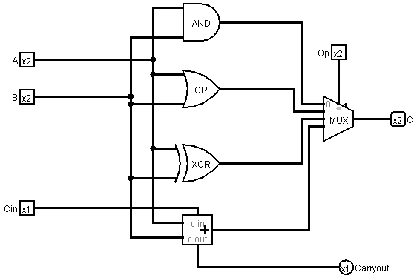
Basic ALU(2-bit)
Note: the two inputs to the adder here for the ALU are NOT signed two's complement numbers. This is different from the requirements listed on the webpage of Lab1.
Logisim Example

Slide 10
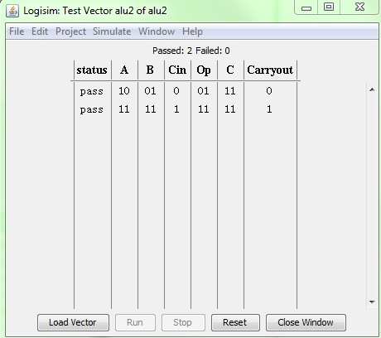
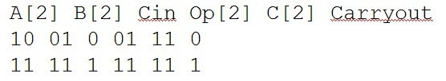
Test Vectors
Note: the two inputs to the adder here for the ALU are NOT signed two's complement numbers. This is different from the requirements listed on the webpage of Lab1.
Logisim Example

Slide 11
What to Submit?
README file
Logisim Project file
Three ascii text files containing test vectors
Design documentation
Please read the webpage of Lab1 for detailed information.

Slide 12
Re-download Logisim
We made some improvements/bug fixes. You should re-download the 3410 logisim from the course webpage

Slide 13
Lab 1 Dos
Best Practices: http://www.cs.cornell.edu/Courses/cs3410/2015fa/labs/logisim_design.html
DO get started early.
DO write your test cases first.
DO use labels to make your circuit readable and executable.
  Using labels in the correct way is very very very important. Do not use text boxes to label elements, use the Label option to label them.
DO make sure that the inputs and outputs are positioned correctly.
  Data flows left-to-right.
  Inputs on the left, outputs on the right.
DO test each component independently.
DO use version control and backup your circuit.

Slide 14
Lab 1 Don’ts
Points will be take off for DON’Ts
DON’T use tunnels excessively.
DON’T forget to label your inputs and outputs correctly.
  The labels are case-sensitive.
DON’T use gates with more number of inputs than necessary.
DON’T forget to test.
DON’T include circuits from different files.
  Use subcircuits like we did in Lab0.
  Ensure that you do not have external file dependencies.

Slide 15
Version Control
You can use Git and Github to keep track of revisions of your circuit file.
If using an online repository you MUST make it private. Github (https://education.github.com) and Bitbucket (https://bitbucket.org) allow for free repos.
To learn how to use Git see http://git-scm.com/docs/gittutorial
Logisim and Git sometimes don’t work well together when merging, be careful and check files carefully while merging.

