Slide 1
GPUs
Prof. Hakim Weatherspoon
CS 3410, Spring 2015
Computer Science
Cornell University

Slide 2
Announcements
Project3 Cache Race Games night Monday, May 4th, 5pm
Come, eat, drink, have fun and be merry!
Location: B17 Upson Hall
Prelim2: Thursday, April 30th in evening
Time and Location: 7:30pm sharp in Statler Auditorium
Old prelims are online in CMS
Prelim Review Session:
TODAY, Tuesday, April 28, 7-9pm in B14 Hollister Hall
Project4:
Design Doc due May 5th, bring design doc to mtg May 4-6
Demos: May 12 and 13
Will not be able to use slip days

Slide 3
Announcements
Prelim2 Topics
Lecture: Lectures 10 to 24
Data and Control Hazards (Chapters 4.7-4.8)
RISC/CISC (Chapters 2.16-2.18, 2.21)
Calling conventions and linkers (Chapters 2.8, 2.12, Appendix A.1-6)
Caching and Virtual Memory (Chapter 5)
Multicore/parallelism (Chapter 6)
Synchronization (Chapter 2.11)
Traps, Exceptions, OS (Chapter 4.9, Appendix A.7, pp 445-452)
HW2, Labs 3/4, C-Labs 2/3, PA2/3
Topics from Prelim1 (not the focus, but some possible questions)

Slide 4
GPUs

Slide 5
The supercomputer in your laptop
GPU: Graphics processing unit
Very basic till about 1999
Specialized device to accelerate display
Then started changing into a full processor
2000-…: Frontier times

Slide 6
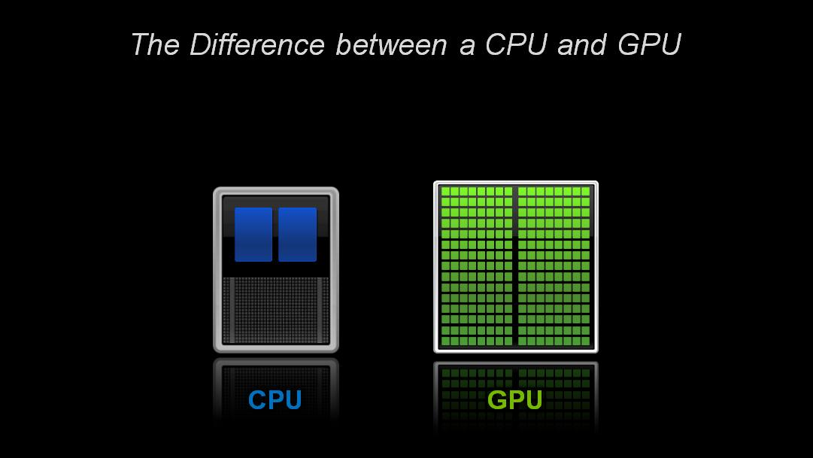
Parallelism
CPU: Central Processing Unit
GPU: Graphics Processing Unit

Slide 7
Parallelism
GPU parallelism is similar to multicore parallelism
Key: How to gang schedule thousands of threads on thousands of cores?
Hardware multithreading with thousands of register sets
GPU Hardware multithreads (like multicore Hyperthreads)
MultiIssue + extra PCs and registers – dependency logic
Illusion of thousands of cores
Fine grain hardware multithreading - Easier to keep pipelines full
Notes:
HT = MultiIssue + extra PCs and registers – dependency logic
HT = MultiCore – redundant functional units + hazard avoidance

Slide 8
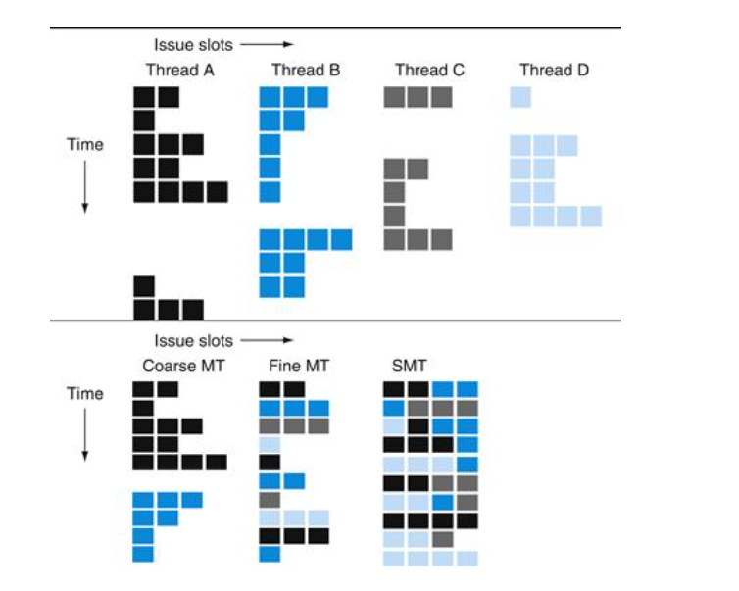

Slide 9
GPU Architectures
Processing is highly data-parallel
GPUs are highly multithreaded
Use thread switching to hide memory latency
Less reliance on multi-level caches
Graphics memory is wide and high-bandwidth
Trend toward general purpose GPUs
Heterogeneous CPU/GPU systems
CPU for sequential code, GPU for parallel code
Programming languages/APIs
DirectX, OpenGL
C for Graphics (Cg), High Level Shader Language (HLSL)
Compute Unified Device Architecture (CUDA)

Slide 10
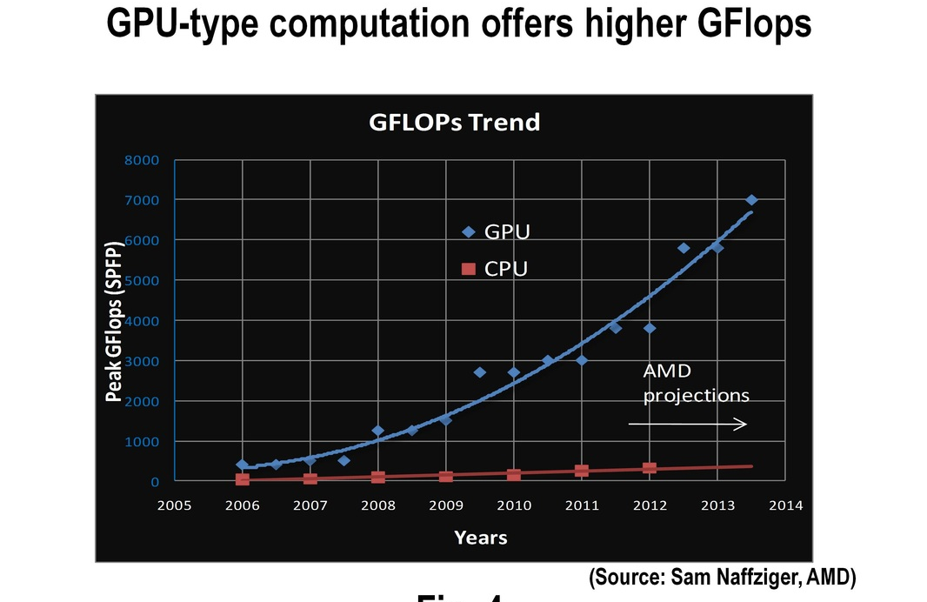

Slide 11
GPUs: Faster than Moore’s Law Moore’s Law is for Wimps?!
nVidia
G70
10
9
10
9
One-pixel polygons (~10M polygons @ 30Hz)
10
8
10
8
Slope ~2.4x/year
UNC/HP PixelFlow
ATI
Radeon 256
SGI
(Moore's Law ~ 1.7x/year)
R-Monster
Peak
7
SGI
GeForce
10
7
Performance
10
Division
Pxpl6
IR
E&S
Nvidia TNT
(polygons’s/sec)
Harmony
3DLabs
SGI
Cobalt
UNC Pxpl5
Glint
SGI SkyWriter
Accel/VSIS
Voodoo
6
10
6
Megatek
10
SGI VGX
SGI
E&S Freedom
HP VRX
HP TVRX
RE1
SGI
RE2
PC Graphics
Flat
shading
10
5
E&S
Textures
Division VPX
10
5
Stellar GS1000
F300
UNC Pxpl4
SGI GT
Gouraud
shading
Antialiasing
HP CRX
10
4
SGI Iris
10
4
86
88
90
92
94
96
98
00
Year
Graph courtesy of Professor John Poulton (from Eric Haines)

Slide 12
Programmable Hardware
Started in 1999
Flexible, programmable
Vertex, Geometry, Fragment Shaders
And much faster, of course
1999 GeForce256: 0.35 Gigapixel peak fill rate
2001 GeForce3: 0.8 Gigapixel peak fill rate
2003 GeForceFX Ultra: 2.0 Gigapixel peak fill rate
ATI Radeon 9800 Pro : 3.0 Gigapixel peak fill rate
2006 NV60: ... Gigapixel peak fill rate
2009 GeForce GTX 285: 10 Gigapixel peak fill rate
2011
GeForce GTC 590: 56 Gigapixel peak fill rate
Radeon HD 6990: 2x26.5
2012
GeForce GTC 690: 62 Gigapixel/s peak fill rate

Slide 13
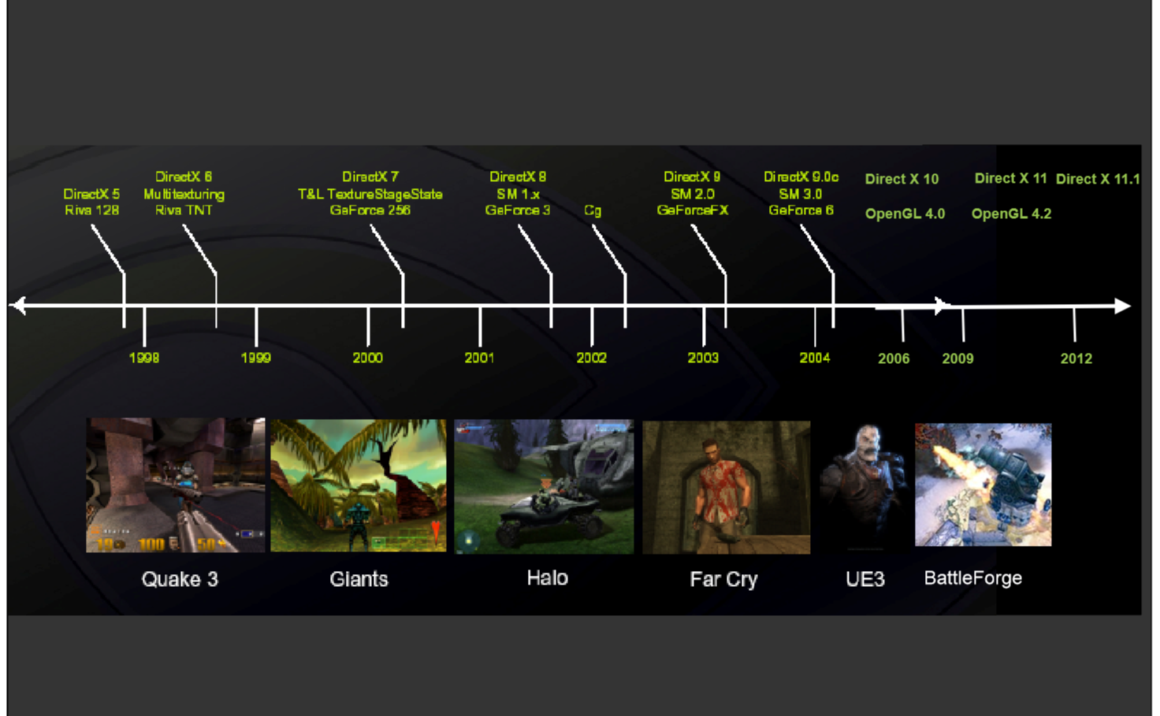
Evolution of GPU

Slide 14
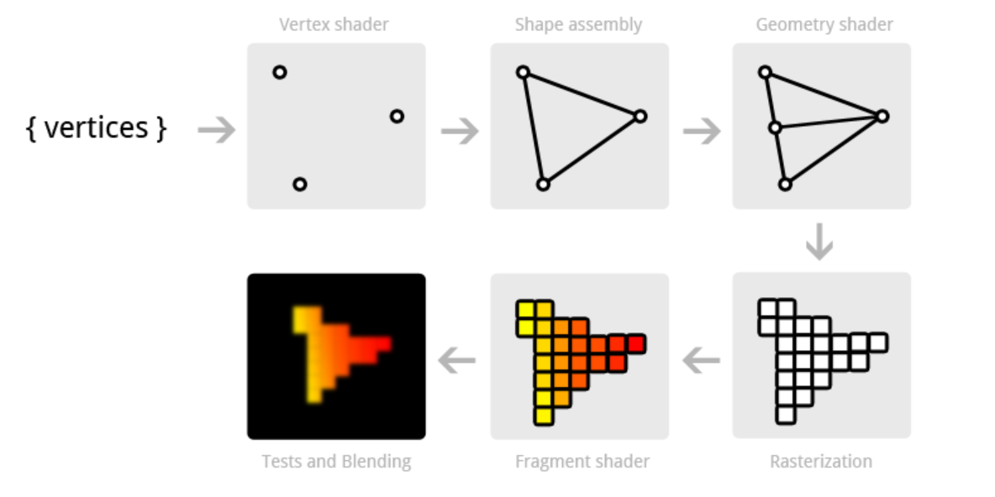
Around 2000
Fixed function pipeline

Slide 15
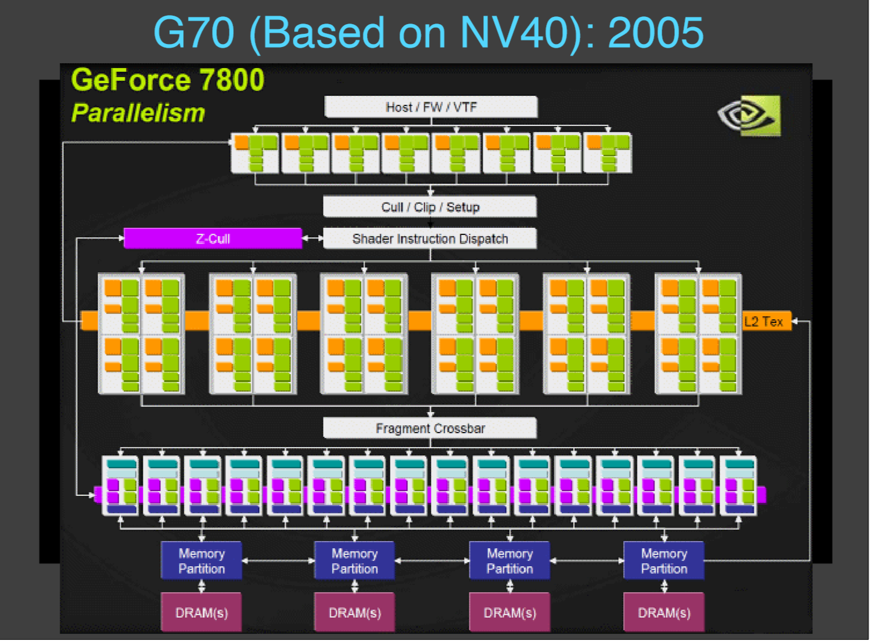
Around 2005
Programmable vertex and pixel processors

Slide 16
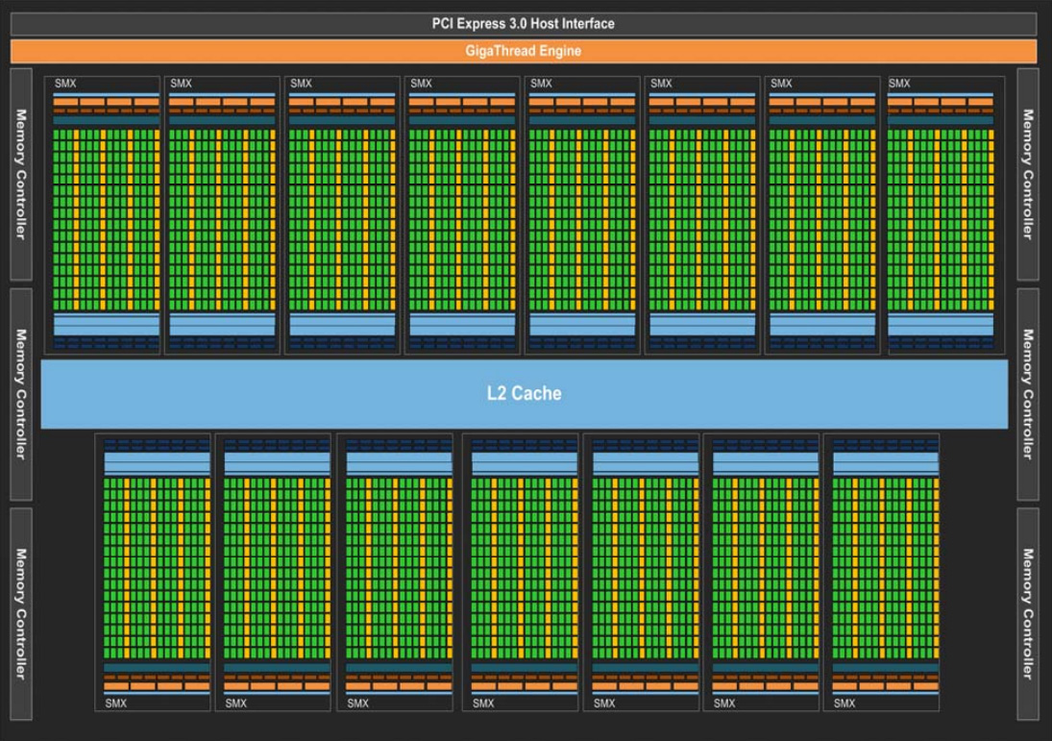
Post 2006: Unified Architecture
nVIDIA Kepler

Slide 17
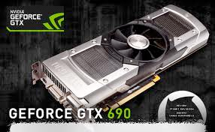
Why?
Parallelism: thousands of cores
Pipelining
Hardware multithreading
Not multiscale caching
Streaming caches
Throughput, not latency

Slide 18
Flynn’s Taxonomy
Single Instruction Single Data (SISD) | Multiple Instruction Single Data (MISD)
Single Instruction Multiple Data (SIMD) | Multiple Instruction Multiple Data (MIMD)

Slide 19
MIMD array of SIMD procs
nVIDIA Kepler

Slide 20
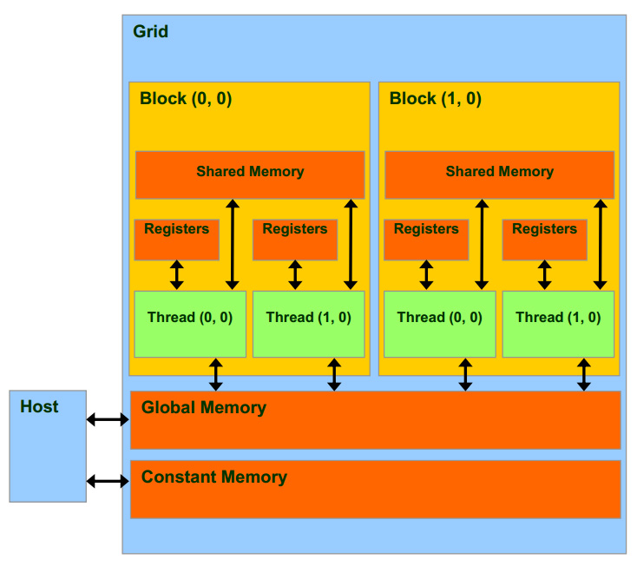
Grids, Blocks, and Threads

Slide 21
CUDA Memory
Faster, per-block
Fastest, per-thread
Slower, global
Read-only, cached

Slide 22
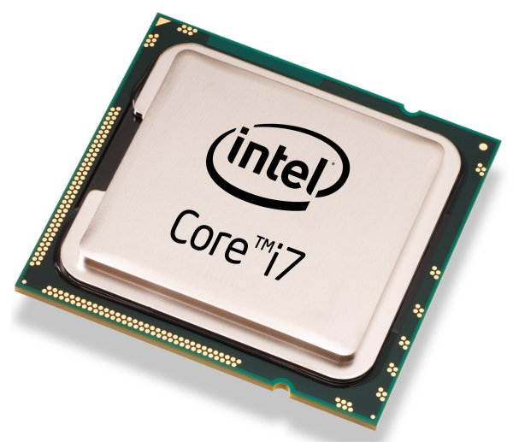
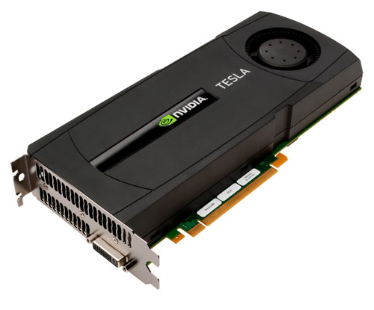
Heterogeneous Computing
Host: the CPU and its memory
Device: the GPU and its memory

Slide 23
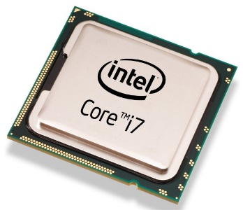

Programming using CUDA
Compute Unified Device Architecture
do_something_on_host();
kernel<<<nBlk, nTid>>>(args);
cudaDeviceSynchronize();
do_something_else_on_host();
…
Highly parallel

Slide 24
Hardware Thread Organization
Threads in a block are partitioned into warps
All threads in a warp execute in a Single Instruction Multiple Data, or SIMD, fashion
All paths of conditional branches will be taken
Warp size varies, many graphics cards have 32
NO guaranteed execution ordering between warps

Slide 25
Branch Divergence
Threads in one warp execute very different branches
Significantly harms the performance!
Simple solution:
Reordering the threads so that all threads in each block are more likely to take the same branch
Not always possible

Slide 26
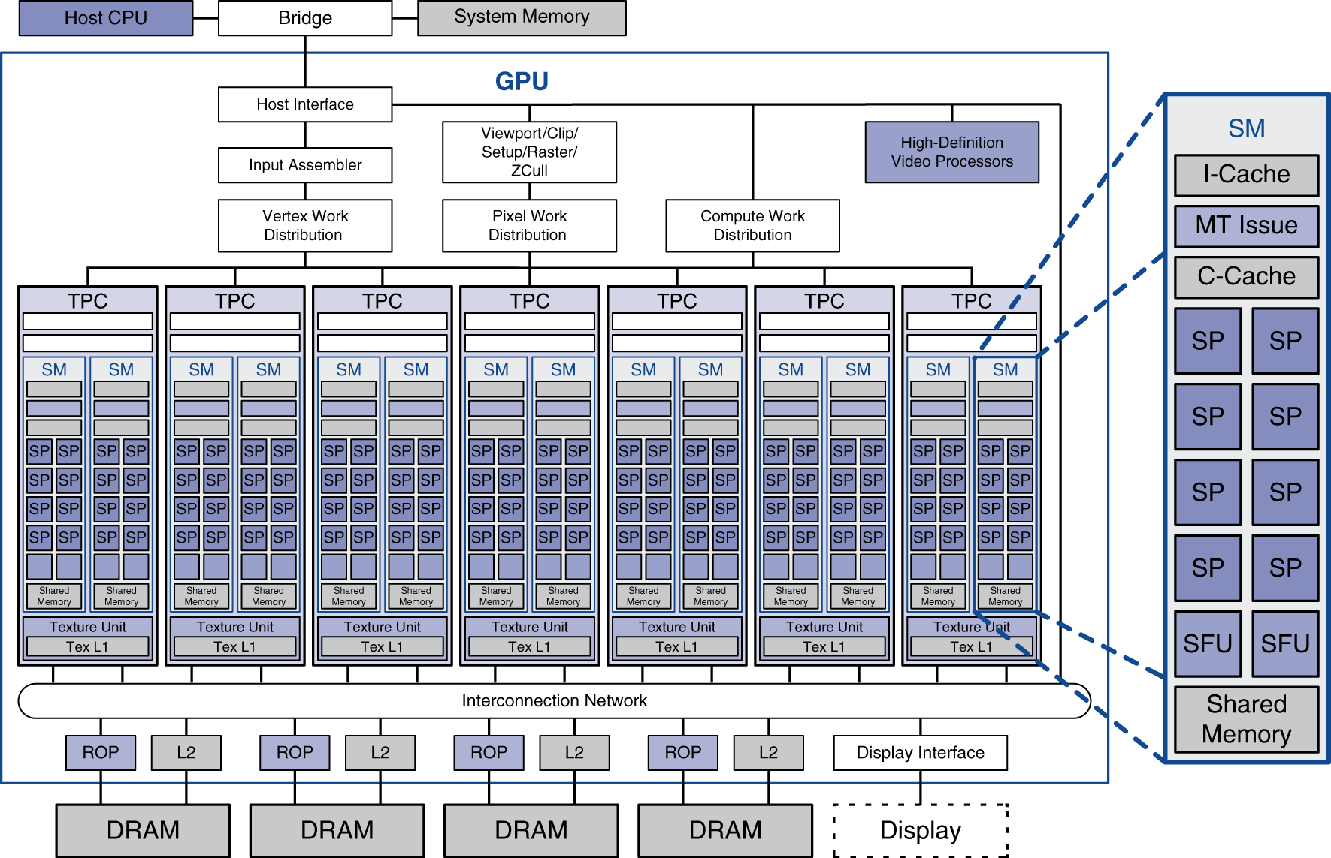
Example: NVIDIA Tesla
Streaming multiprocessor
8 × Streaming processors

Slide 27
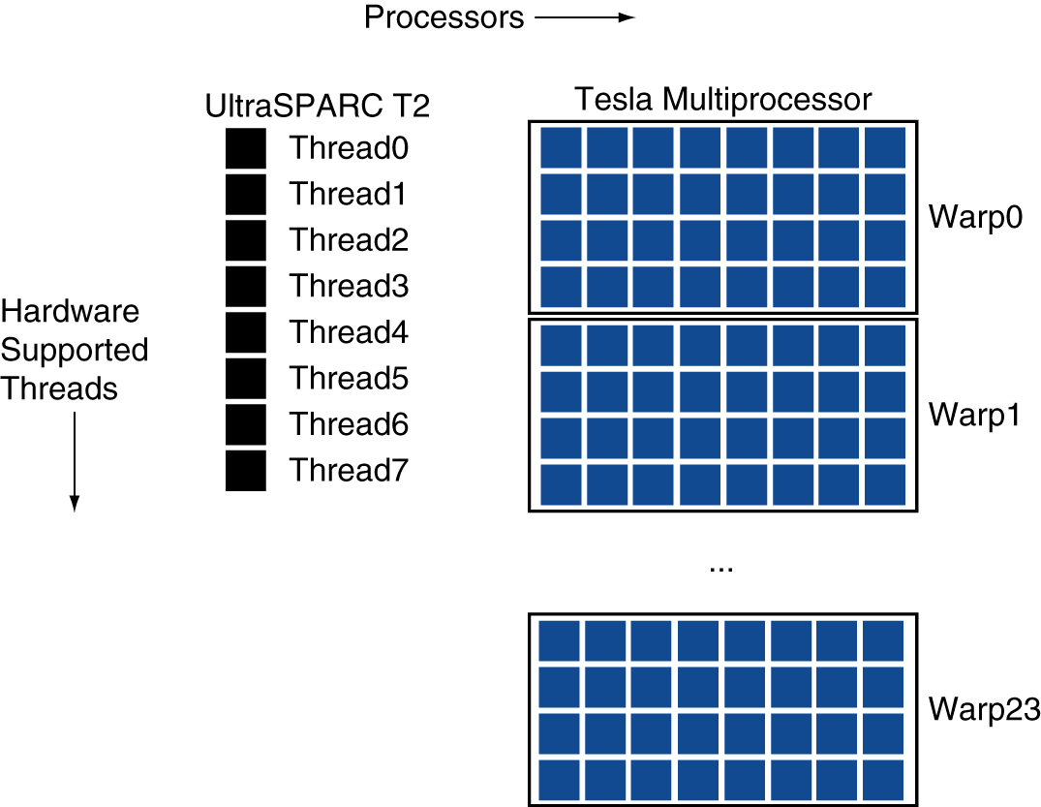
Example: NVIDIA Tesla
Streaming Processors
Single-precision FP and integer units
Each SP is fine-grained multithreaded
Warp: group of 32 threads
Executed in parallel, SIMD style
8 SPs × 4 clock cycles
Hardware contexts for 24 warps
Registers, PCs, …

Slide 28
