Slide 1
Multicore, Parallelism, and Synchronization
Hakim Weatherspoon
CS 3410, Spring 2015
Computer Science
Cornell University
P&H Chapter 2.11, 5.10, and 6.5

Slide 2
Announcements
HW2 Review Sessions!
TODAY, Tue, April 21st, Hollister B14@7pm
HW2-P5 (Pre-Lab4) was due yesterday!
PA3 due Friday, April 24th
The Lord of the Cache!
Tournament, Monday, May 4, 5-7pm

Slide 3
Announcements
Prelim 2 is next week on April 30th at 7 PM at Statler Hall!
If you have a conflict e-mail me:
deniz@cs.cornell.edu

Slide 4
Announcements
Next three weeks
Week 12 (Apr 21): Lab4 due in-class, Proj3 due Fri, HW2 due Sat
Week 13 (Apr 28): Proj4 release, Prelim2
Week 14 (May 5): Proj3 tournament Mon, Proj4 design doc due
Final Project for class
Week 15 (May 12): Proj4 due Wed

Slide 5
Big Picture: Parallelism and Synchronization
How do I take advantage of parallelism?
How do I write (correct) parallel programs?
What primitives do I need to implement correct parallel programs?

Slide 6
Topics: Goals for Today
Understand Cache Coherency
Synchronizing parallel programs
Atomic Instructions
HW support for synchronization
How to write parallel programs
Threads and processes
Critical sections, race conditions, and mutexes

Slide 7
Parallelism and Synchronization
Cache Coherency Problem: What happens when to two or more processors cache shared data?

Slide 8
Parallelism and Synchronization
Cache Coherency Problem: What happens when to two or more processors cache shared data?
i.e. the view of memory held by two different processors is through their individual caches.
As a result, processors can see different (incoherent) values to the same memory location.

Slide 9
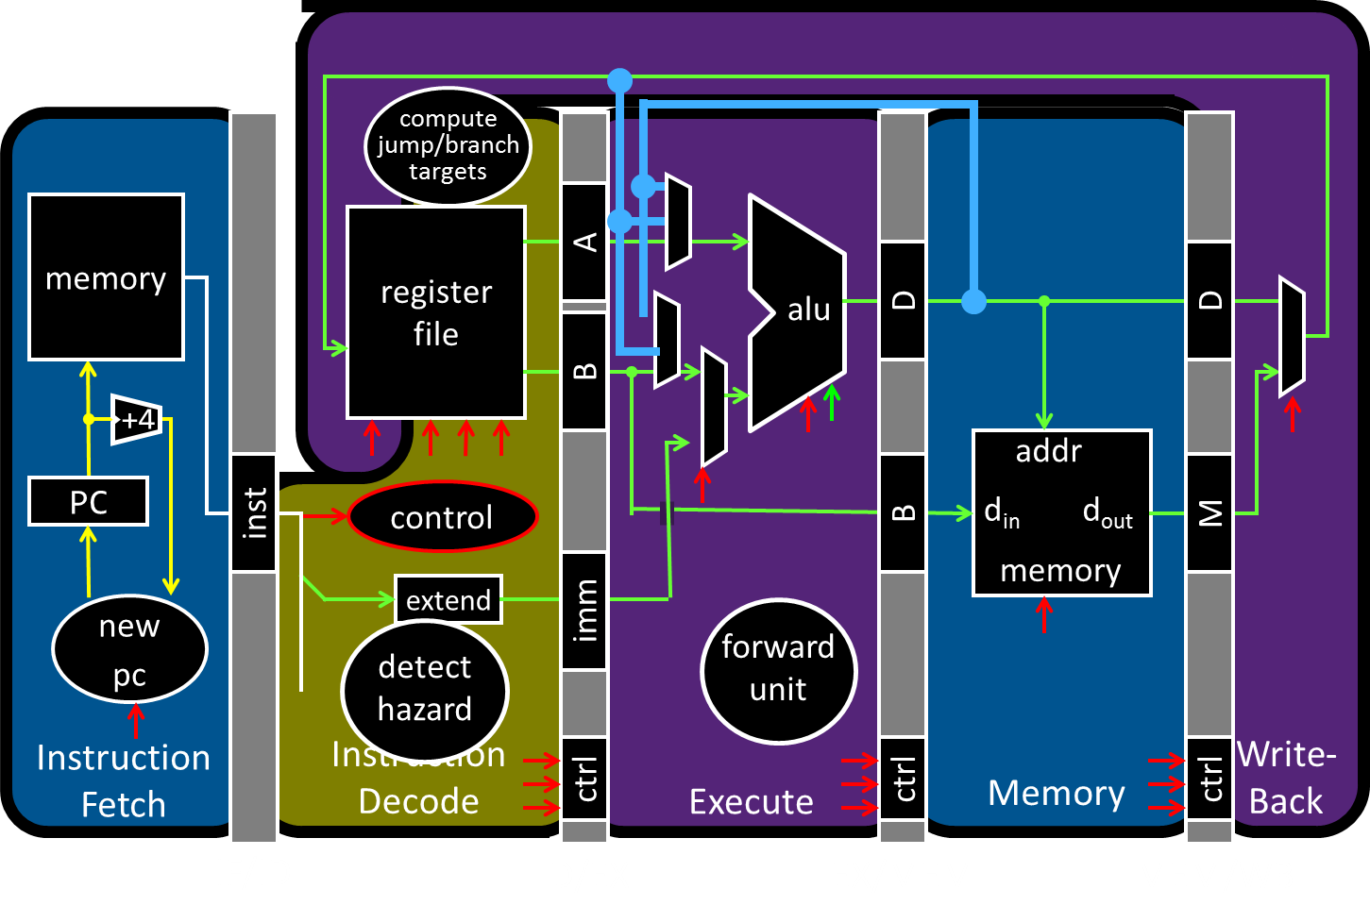
Parallelism and Synchronization

Slide 10
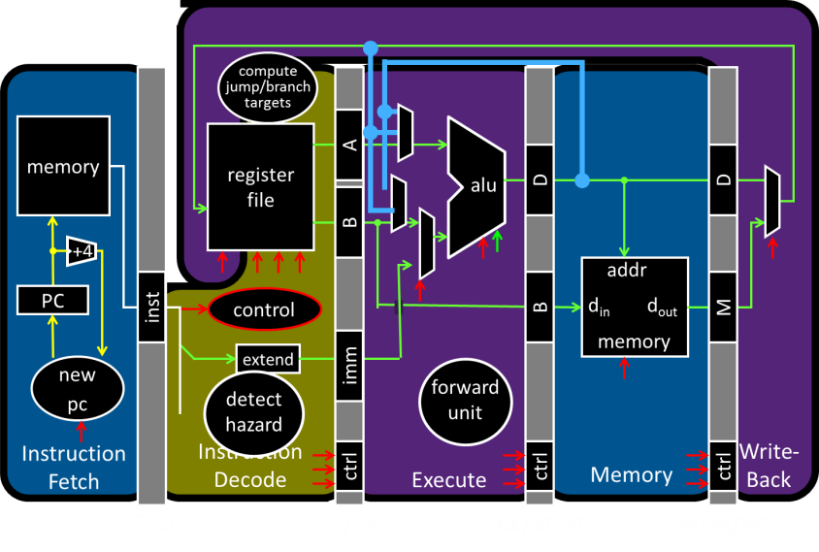
Parallelism and Synchronization
Each processor core has its own L1 cache

Slide 11
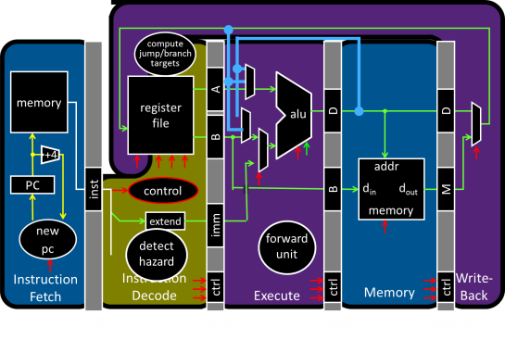
Parallelism and Synchronization
Each processor core has its own L1 cache

Slide 12
Parallelism and Synchronization
Each processor core has its own L1 cache
Core0
Core1
Core2
Core3
Cache
Cache
Cache
Cache
Interconnect
Memory
I/O

Slide 13
Shared Memory Multiprocessors
Shared Memory Multiprocessor (SMP)
Typical (today): 2 – 4 processor dies, 2 – 8 cores each
HW provides single physical address space for all processors
Assume physical addresses (ignore virtual memory)
Assume uniform memory access (ignore NUMA)
Core0
Core1
Core2
Core3
Cache
Cache
Cache
Cache
Interconnect
Memory
I/O
Notes:
How do they share data? How do they coordinate? How do they scale?

Slide 14
Shared Memory Multiprocessors
Shared Memory Multiprocessor (SMP)
Typical (today): 2 – 4 processor dies, 2 – 8 cores each
HW provides single physical address space for all processors
Assume physical addresses (ignore virtual memory)
Assume uniform memory access (ignore NUMA)
Core0
Core1
...
...
...
CoreN
Cache
Cache
Cache
Interconnect
Memory
I/O
Notes:
How do they share data? How do they coordinate? How do they scale?

Slide 15
Cache Coherency Problem
Thread A (on Core0) Thread B (on Core1) for(int i = 0, i < 5; i++) { for(int j = 0; j < 5; j++) { x = x + 1; x = x + 1; } }
What will the value of x be after both loops finish?
Core0
Core1
...
...
...
CoreN
Cache
Cache
Cache
Interconnect
Memory
I/O
Notes:
How do they share data? How do they coordinate? How do they scale?

Slide 16
Cache Coherency Problem
Thread A (on Core0) Thread B (on Core1) for(int i = 0, i < 5; i++) { for(int j = 0; j < 5; j++) { x = x + 1; x = x + 1; } }
What will the value of x be after both loops finish?
6
8
10
All of the above
None of the above
Notes:
How do they share data? How do they coordinate? How do they scale?

Slide 17
Cache Coherency Problem
Thread A (on Core0) Thread B (on Core1) for(int i = 0, i < 5; i++) { for(int j = 0; j < 5; j++) { LW $t0, addr(x) LW $t0, addr(x)
ADDIU $t0, $t0, 1 ADDIU $t0, $t0, 1
SW $t0, addr(x) SW $t0, addr(x) } }
$t0=0
$t0=0
$t0=1
$t0=1
x=1
x=1
x should be greater than 1 after both threads loop at least once!
Core0
Core1
...
...
...
CoreN
Cache
Cache
Cache
Interconnect
Memory
I/O
Notes:
How do they share data? How do they coordinate? How do they scale?

Slide 18
Cache Coherence Problem
Suppose two CPU cores share a physical address space
Write-through caches
Time step | Event | CPU A’s cache | CPU B’s cache | Memory
0 |  |  |  | 0
Time step | Event | CPU A’s cache | CPU B’s cache | Memory
0 |  |  |  | 0
1 | CPU A reads X | 0 |  | 0
Time step | Event | CPU A’s cache | CPU B’s cache | Memory
0 |  |  |  | 0
1 | CPU A reads X | 0 |  | 0
2 | CPU B reads X | 0 | 0 | 0
Time step | Event | CPU A’s cache | CPU B’s cache | Memory
0 |  |  |  | 0
1 | CPU A reads X | 0 |  | 0
2 | CPU B reads X | 0 | 0 | 0
3 | CPU A writes 1 to X | 1 | 0 | 1
Core0
Core1
...
...
...
CoreN
Cache
Cache
Cache
Interconnect
Memory
I/O

Slide 19
Two issues
Coherence
What values can be returned by a read
Consistency
When a written value will be returned by a read

Slide 20
Coherence Defined
Informal: Reads return most recently written value
Formal: For concurrent processes P₁ and P₂
P writes X before P reads X (with no intervening writes) ⇒ read returns written value
(preserve program order)
P₁ writes X before P₂ reads X ⇒ read returns written value
(coherent memory view, can’t read old value forever)
P₁ writes X and P₂ writes X ⇒ all processors see writes in the same order
all see the same final value for X
Aka write serialization
(else P_{A} can see P₂’s write before P₁’s and P_{B} can see the opposite; their final understanding of state is wrong)
Notes:
second case: for some definition of “before”
third case: see relativity
complication: clocks are not synchronized across cores
1 light nanosecond = 30cm, so 3GHz can do 1 instruction per 10cm

Slide 21
Cache Coherence Protocols
Operations performed by caches in multiprocessors to ensure coherence
Migration of data to local caches
Reduces bandwidth for shared memory
Replication of read-shared data
Reduces contention for access
Snooping protocols
Each cache monitors bus reads/writes

Slide 22
Snooping
Snooping for Hardware Cache Coherence
All caches monitor bus and all other caches
Bus read: respond if you have dirty data
Bus write: update/invalidate your copy of data
Snoop
Snoop
...
Snoop
Core0
Core1
...
...
CoreN
Snoop
Cache
Snoop
Cache
Snoop
Cache
Interconnect
Memory
I/O
Notes:
In reality: very complicated, lots of corner cases

Slide 23
Invalidating Snooping Protocols
Cache gets exclusive access to a block when it is to be written
Broadcasts an invalidate message on the bus
Subsequent read in another cache misses
Owning cache supplies updated value
Time Step | CPU activity | Bus activity | CPU A’s cache | CPU B’s cache | Memory
0 |  |  |  |  | 0
1 | CPU A reads X | Cache miss for X | 0 |  | 0
Time Step | CPU activity | Bus activity | CPU A’s cache | CPU B’s cache | Memory
0 |  |  |  |  | 0
1 | CPU A reads X | Cache miss for X | 0 |  | 0
2 | CPU B reads X | Cache miss for X | 0 | 0 | 0
Time Step | CPU activity | Bus activity | CPU A’s cache | CPU B’s cache | Memory
0 |  |  |  |  | 0
1 | CPU A reads X | Cache miss for X | 0 |  | 0
2 | CPU B reads X | Cache miss for X | 0 | 0 | 0
3 | CPU A writes 1 to X | Invalidate for X | 1 |  | 0
Time Step | CPU activity | Bus activity | CPU A’s cache | CPU B’s cache | Memory
0 |  |  |  |  | 0
1 | CPU A reads X | Cache miss for X | 0 |  | 0
2 | CPU B reads X | Cache miss for X | 0 | 0 | 0
3 | CPU A writes 1 to X | Invalidate for X | 1 |  | 0
4 | CPU B read X | Cache miss for X | 1 | 1 | 1
Time Step | CPU activity | Bus activity | CPU A’s cache | CPU B’s cache | Memory
0 |  |  |  |  | 0

Slide 24
Writing
Write-back policies for bandwidth
Write-invalidate coherence policy
First invalidate all other copies of data
Then write it in cache line
Anybody else can read it
Permits one writer, multiple readers
In reality: many coherence protocols
Snooping doesn’t scale
Directory-based protocols
Caches and memory record sharing status of blocks in a directory

Slide 25
Takeaway: Summary of cache coherence
Informally, Cache Coherency requires that reads return most recently written value
Cache coherence hard problem
Snooping protocols are one approach

Slide 26
Next Goal: Synchronization
Is cache coherency sufficient?
i.e. Is cache coherency (what values are read) sufficient to maintain consistency (when a written value will be returned to a read). Both coherency and consistency are required to maintain consistency in shared memory programs.

Slide 27
Is Cache Coherency Sufficient?
Thread A (on Core0) Thread B (on Core1) for(int i = 0, i < 5; i++) { for(int j = 0; j < 5; j++) { LW $t0, addr(x) LW $t0, addr(x)
ADDIU $t0, $t0, 1 ADDIU $t0, $t0, 1
SW $t0, addr(x) SW $t0, addr(x) } }
Very expensive and difficult to maintain consistency
Core0
Core1
...
...
...
CoreN
Cache
Cache
Cache
Interconnect
Memory
I/O
Notes:
Is cache coherence enough? Maybe?
read (1) 40 read (3) 40
Inc (2) 41 inc (4) 41
Write (5) 41 write (6) 41
second case: for some definition of “before”
third case: see relativity
complication: clocks are not synchronized across cores
1 light nanosecond = 30cm, so 3GHz can do 1 instruction per 10cm

Slide 28
Synchronization
Threads
Critical sections, race conditions, and mutexes
Atomic Instructions
HW support for synchronization
Using sync primitives to build concurrency-safe data structures
Example: thread-safe data structures
Language level synchronization
Threads and processes

Slide 29
Programming with Threads
Need it to exploit multiple processing units
…to parallelize for multicore
…to write servers that handle many clients
Problem: hard even for experienced programmers
Behavior can depend on subtle timing differences
Bugs may be impossible to reproduce
Needed: synchronization of threads

Slide 30
Programming with threads
Within a thread: execution is sequential
Between threads?
No ordering or timing guarantees
Might even run on different cores at the same time
Problem: hard to program, hard to reason about
Behavior can depend on subtle timing differences
Bugs may be impossible to reproduce
Cache coherency is not sufficient…
Need explicit synchronization to make sense of concurrency!

Slide 31
Programming with Threads
Concurrency poses challenges for:
Correctness
Threads accessing shared memory should not interfere with each other
Liveness
Threads should not get stuck, should make forward progress
Efficiency
Program should make good use of available computing resources (e.g., processors).
Fairness
Resources apportioned fairly between threads

Slide 32
Example: Multi-Threaded Program
Apache web server
void main() { setup();
while (c = accept_connection()) {
req = read_request(c);
hits[req]++; send_response(c, req);
}
cleanup();
}
Notes:
Use fork
Use threads

Slide 33
Example: web server
Each client request handled by a separate thread (in parallel)
Some shared state: hit counter, ...
(look familiar?)
Timing-dependent failure ⇒ race condition
hard to reproduce ⇒ hard to debug
Thread 52
read hits
addiu
write hits
Thread 205
read hits
addiu
write hits
Thread 52
...
hits = hits + 1;
...
Thread 205
...
hits = hits + 1;
...
Notes:
What happens when two threads execute concurrently?
sequential with threads
between threads is unsynchronized

Slide 34
Two threads, one counter
Possible result: lost update!
Timing-dependent failure ⇒ race condition
Very hard to reproduce ⇒ Difficult to debug
hits = 0
T1
T2
time
LW (0)
LW (0)
ADDIU/SW: hits = 0 + 1
ADDIU/SW: hits = 0 + 1
hits = 1

Slide 35
Race conditions
Def: timing-dependent error involving access to shared state
Whether a race condition happens depends on
how threads scheduled
i.e. who wins “races” to instruction that updates state vs. instruction that accesses state
Challenges about Race conditions
Races are intermittent, may occur rarely
Timing dependent = small changes can hide bug
A program is correct only if all possible schedules are safe
Number of possible schedule permutations is huge
Need to imagine an adversary who switches contexts at the worst possible time

Slide 36
Critical sections
What if we can designate parts of the execution as critical sections
Rule: only one thread can be “inside” a critical section
Thread 52
read hits
addi
write hits
Thread 52
CSEnter()
read hits
addi
write hits
CSExit()
Thread 205
read hits
addi
write hits
Thread 205
CSEnter()
read hits
addi
write hits
CSExit()
Notes:
Show picture

Slide 37
Critical Sections
To eliminate races: use critical sections that only one thread can be in
Contending threads must wait to enter
T1
T2
time
CSEnter();
Critical section
CSExit();
CSEnter();
# wait
# wait
Critical section
CSExit();
T1
T2

Slide 38
Mutexes
Q: How to implement critical sections in code?
A: Lots of approaches….
Mutual Exclusion Lock (mutex)
lock(m): wait till it becomes free, then lock it
unlock(m): unlock it
safe_increment() {
pthread_mutex_lock(&m);
hits = hits + 1;
pthread_mutex_unlock(&m);
}

Slide 39
Mutexes
Only one thread can hold a given mutex at a time
Acquire (lock) mutex on entry to critical section
Or block if another thread already holds it
Release (unlock) mutex on exit
Allow one waiting thread (if any) to acquire & proceed
pthread_mutex_init(&m);
pthread_mutex_lock(&m);
# wait
# wait
hits = hits+1;
pthread_mutex_unlock(&m);
pthread_mutex_lock(&m);
hits = hits+1;
pthread_mutex_unlock(&m);
T1
T2

Slide 40
Next Goal
How to implement mutex locks?
What are the hardware primitives?
Then, use these mutex locks to implement critical sections, and use critical sections to write parallel safe programs

Slide 41
Synchronization
Synchronization requires hardware support
Atomic read/write memory operation
No other access to the location allowed between the read and write
Could be a single instruction
E.g., atomic swap of register ↔ memory (e.g. ATS, BTS; x86)
Or an atomic pair of instructions (e.g. LL and SC; MIPS)

Slide 43
Synchronization in MIPS
Load linked: LL rt, offset(rs)
Store conditional: SC rt, offset(rs)
Succeeds if location not changed since the LL
Returns 1 in rt
Fails if location is changed
Returns 0 in rt
Any time a processor intervenes and modifies the value in memory between the LL and SC instruction, the SC returns 0 in $t0, causing the code to try again.
i.e. use this value 0 in $t0 to try again.

Slide 44
Synchronization in MIPS
Load linked: LL rt, offset(rs)
Store conditional: SC rt, offset(rs)
Succeeds if location not changed since the LL
Returns 1 in rt
Fails if location is changed
Returns 0 in rt
Example: atomic incrementor
Time Step | Thread A | Thread B | Thread A $t0 | Thread B $t0 | Memory M[$s0]
0 |  |  |  |  | 0
1 | try: LL $t0, 0($s0) | try: LL $t0, 0($s0)
2 | ADDIU $t0, $t0, 1 | ADDIU $t0, $t0, 1
3 | SC $t0, 0($s0) | SC $t0, 0 ($s0)
4 | BEQZ $t0, try | BEQZ $t0, try

Slide 45
Synchronization in MIPS
Load linked: LL rt, offset(rs)
Store conditional: SC rt, offset(rs)
Succeeds if location not changed since the LL
Returns 1 in rt
Fails if location is changed
Returns 0 in rt
Example: atomic incrementor
Time Step | Thread A | Thread B | Thread A $t0 | Thread B $t0 | Memory M[$s0]
0 |  |  |  |  | 0
1 | try: LL $t0, 0($s0) | try: LL $t0, 0($s0) | 0 | 0 | 0
2 | ADDIU $t0, $t0, 1 | ADDIU $t0, $t0, 1 | 1 | 1 | 0
3 | SC $t0, 0($s0) | SC $t0, 0 ($s0) | 0 | 1 | 1
4 | BEQZ $t0, try | BEQZ $t0, try | 0 | 1 | 1
Failure – try again
Success!

Slide 46
Mutex from LL and SC
Linked load / Store Conditional
m = 0; // m=0 means lock is free; otherwise, if m=1, then lock locked
mutex_lock(int *m) {
while(test_and_set(m)){}
}
int test_and_set(int *m) {
old = *m;
*m = 1;
return old;
}
LL Atomic
SC
Notes:
LL just like LW
SC jus like SW, but overwrites src register with 1 “success” or 0 “fail”

Slide 47
Mutex from LL and SC
Linked load / Store Conditional
m = 0; // m=0 means lock is free; otherwise, if m=1, then lock locked
mutex_lock(int *m) {
while(test_and_set(m)){}
}
int test_and_set(int *m) {
LI $t0, 1
LL $t1, 0($a0)
SC $t0, 0($a0)
MOVE $v0, $t1
}
try:
BEQZ $t0, try
Notes:
LL just like LW
SC jus like SW, but overwrites src register with 1 “success” or 0 “fail”

Slide 48
Mutex from LL and SC
Linked load / Store Conditional
m = 0; // m=0 means lock is free; otherwise, if m=1, then lock locked
mutex_lock(int *m) {
while(test_and_set(m)){}
}
int test_and_set(int *m) {
try:
LI $t0, 1
LL $t1, 0($a0)
SC $t0, 0($a0)
BEQZ $t0, try
MOVE $v0, $t1
}
Notes:
LL just like LW
SC jus like SW, but overwrites src register with 1 “success” or 0 “fail”

Slide 49
Mutex from LL and SC
Linked load / Store Conditional
m = 0;
mutex_lock(int *m) {
test_and_set:
LI $t0, 1
LL $t1, 0($a0)
BNEZ $t1, test_and_set
SC $t0, 0($a0)
BEQZ $t0, test_and_set
}
mutex_unlock(int *m) {
*m = 0;
}
Notes:
LL just like LW
SC jus like SW, but overwrites src register with 1 “success” or 0 “fail”

Slide 50
Mutex from LL and SC
Linked load / Store Conditional
m = 0;
mutex_lock(int *m) {
test_and_set:
LI $t0, 1
LL $t1, 0($a0)
BNEZ $t1, test_and_set
SC $t0, 0($a0)
BEQZ $t0, test_and_set
}
mutex_unlock(int *m) {
SW $zero, 0($a0)
}
This is called a
Spin lock
Aka spin waiting
Notes:
LL just like LW
SC jus like SW, but overwrites src register with 1 “success” or 0 “fail”

Slide 51
Mutex from LL and SC
Linked load / Store Conditional
m = 0;
mutex_lock(int *m) {
Time Step | Thread A | Thread B | ThreadA $t0 | ThreadA $t1 | ThreadB $t0 | ThreadB $t1 | Mem M[$a0]
0 |  |  |  |  |  |  | 0
1 | try: LI $t0, 1 | try: LI $t0, 1
2 | LL $t1, 0($a0) | LL $t1, 0($a0)
3 | BNEZ $t1, try | BNEZ $t1, try
4 | SC $t0, 0($a0) | SC $t0, 0 ($a0)
5 | BEQZ $t0, try | BEQZ $t0, try
6
Notes:
LL just like LW
SC jus like SW, but overwrites src register with 1 “success” or 0 “fail”

Slide 52
Mutex from LL and SC
Linked load / Store Conditional
m = 0;
mutex_lock(int *m) {
Time Step | Thread A | Thread B | ThreadA $t0 | ThreadA $t1 | ThreadB $t0 | ThreadB $t1 | Mem M[$a0]
0 |  |  |  |  |  |  | 0
1 | try: LI $t0, 1 | try: LI $t0, 1 | 1 |  | 1 |  | 0
2 | LL $t1, 0($a0) | LL $t1, 0($a0) | 1 | 0 | 1 | 0 | 0
3 | BNEZ $t1, try | BNEZ $t1, try | 1 | 0 | 1 | 0 | 0
4 | SC $t0, 0($a0) | SC $t0, 0 ($a0) | 0 | 0 | 1 | 0 | 1
5 | BEQZ $t0, try | BEQZ $t0, try | 0 | 0 | 1 | 0 | 1
6
Notes:
LL just like LW
SC jus like SW, but overwrites src register with 1 “success” or 0 “fail”

Slide 53
Mutex from LL and SC
Linked load / Store Conditional
m = 0;
mutex_lock(int *m) {
Time Step | Thread A | Thread B | ThreadA $t0 | ThreadA $t1 | ThreadB $t0 | ThreadB $t1 | Mem M[$a0]
0 |  |  |  |  |  |  | 0
1 | try: LI $t0, 1 | try: LI $t0, 1 | 1 |  | 1 |  | 0
2 | LL $t1, 0($a0) | LL $t1, 0($a0) | 1 | 0 | 1 | 0 | 0
3 | BNEZ $t1, try | BNEZ $t1, try | 1 | 0 | 1 | 0 | 0
4 | SC $t0, 0($a0) | SC $t0, 0 ($a0) | 0 | 0 | 1 | 0 | 1
5 | BEQZ $t0, try | BEQZ $t0, try | 0 | 0 | 1 | 0 | 1
6 | try: LI $t0, 1 | Critical section
Failed to get mutex lock – try again
Success grabbing mutex lock!
Inside Critical section
Notes:
LL just like LW
SC jus like SW, but overwrites src register with 1 “success” or 0 “fail”

Slide 54
Mutex from LL and SC
Linked load / Store Conditional
m = 0;
mutex_lock(int *m) {
test_and_set:
LI $t0, 1
LL $t1, 0($a0)
BNEZ $t1, test_and_set
SC $t0, 0($a0)
BEQZ $t0, test_and_set
}
mutex_unlock(int *m) {
SW $zero, 0($a0)
}
This is called a
Spin lock
Aka spin waiting
Notes:
LL just like LW
SC jus like SW, but overwrites src register with 1 “success” or 0 “fail”

Slide 55
Mutex from LL and SC
Linked load / Store Conditional
m = 0;
mutex_lock(int *m) {
Time Step | Thread A | Thread B | ThreadA $t0 | ThreadA $t1 | ThreadB $t0 | ThreadB $t1 | Mem M[$a0]
0 |  |  |  |  |  |  | 1
1 | try: LI $t0, 1 | try: LI $t0, 1
2
3
4
5
6
7
8
9
Notes:
LL just like LW
SC jus like SW, but overwrites src register with 1 “success” or 0 “fail”

Slide 56
Mutex from LL and SC
Linked load / Store Conditional
m = 0;
mutex_lock(int *m) {
Time Step | Thread A | Thread B | ThreadA $t0 | ThreadA $t1 | ThreadB $t0 | ThreadB $t1 | Mem M[$a0]
0 |  |  |  |  |  |  | 1
1 | try: LI $t0, 1 | try: LI $t0, 1 | 1 |  | 1 |  | 1
2 | LL $t1, 0($a0) | LL $t1, 0($a0) | 1 | 1 | 1 | 1 | 1
3 | BNEZ $t1, try | BNEZ $t1, try | 1 | 1 | 1 | 1 | 1
4 | try: LI $t0, 1 | try: LI $t0, 1 | 1 | 1 | 1 | 1 | 1
5 | LL $t1, 0($a0) | LL $t1, 0($a0) | 1 | 1 | 1 | 1 | 1
6 | BNEZ $t1, try | BNEZ $t1, try | 1 | 1 | 1 | 1 | 1
7 | try: LI $t0, 1 | try: LI $t0, 1 | 1 | 1 | 1 | 1 | 1
8 | LL $t1, 0($a0) | LL $t1, 0($a0) | 1 | 1 | 1 | 1 | 1
9 | BNEZ $t1, try | BNEZ $t1, try | 1 | 1 | 1 | 1 | 1
Notes:
LL just like LW
SC jus like SW, but overwrites src register with 1 “success” or 0 “fail”

Slide 57
Now we can write parallel and correct programs
Thread A Thread B for(int i = 0, i < 5; i++) { for(int j = 0; j < 5; j++) {
x = x + 1; x = x + 1;
} }
mutex_lock(m); mutex_lock(m);
mutex_unlock(m); mutex_unlock(m);
Notes:
Can be done using lock,
Also can be done using atomic increment.

Slide 58
Alternative Atomic Instructions
Other atomic hardware primitives
- test and set (x86)
- atomic increment (x86)
- bus lock prefix (x86)
- compare and exchange (x86, ARM deprecated)
- linked load / store conditional (MIPS, ARM, PowerPC, DEC Alpha, …)
Notes:
hardware implementation: lock bus while read-modify-write cycle happens, very expensive

Slide 59
Synchronization
Synchronization techniques
clever code
must work despite adversarial scheduler/interrupts
used by: hackers
also: noobs
disable interrupts
used by: exception handler, scheduler, device drivers, …
disable preemption
dangerous for user code, but okay for some kernel code
mutual exclusion locks (mutex)
general purpose, except for some interrupt-related cases
Notes:
device drivers if interrupts always go to same core

Slide 60
Summary
Need parallel abstractions, especially for multicore
Writing correct programs is hard
Need to prevent data races
Need critical sections to prevent data races
Mutex, mutual exclusion, implements critical section
Mutex often implemented using a lock abstraction
Hardware provides synchronization primitives such as LL and SC (load linked and store conditional) instructions to efficiently implement locks

