Slide 1
Caches 3
Prof. Hakim Weatherspoon
CS 3410, Spring 2015
Computer Science
Cornell University
See P&H Chapter: 5.1-5.4, 5.8, 5.10, 5.15; Also, 5.13 & 5.17

Slide 2
Overview
Writing to caches: policies, performance
Cache tradeoffs and performance

Slide 3
What about Stores?
Where should you write the result of a store?
If that memory location is in the cache?
Send it to the cache
Should we also send it to memory right away?
(write-through policy)
Wait until we evict the block (write-back policy)
If it is not in the cache?
Allocate the line (put it in the cache)?
(write allocate policy)
Write it directly to memory without allocation?
(no write allocate policy)

Slide 4
Cache Write Policies
Q: How to write data?
Memory
DRAM
CPU
addr
Cache
SRAM
data
If data is already in the cache…
No-Write
writes invalidate the cache and go directly to memory
Write-Through
writes go to main memory and cache
Write-Back
CPU writes only to cache
cache writes to main memory later (when block is evicted)

Slide 5
Write Allocation Policies
Q: How to write data?
Memory
DRAM
CPU
addr
Cache
SRAM
data
If data is not in the cache…
Write-Allocate
allocate a cache line for new data (and maybe write-through)
No-Write-Allocate
ignore cache, just go to main memory

Slide 6
Next Goal
How does a write-through cache work?
Assume write-allocate

Slide 7
Handling Stores (Write-Through)
Using byte addresses in this example! Addr Bus = 5 bits
Processor
Cache
Memory
Fully Associative Cache
2 cache lines
2 word block
4 bit tag field
1 bit block offset field
Assume write-allocate
policy
0
1
2
3
4
5
6
7
8
9
10
11
12
13
14
15
78
29
120
123
LB $1 ← M[ 1 ]
LB $2 ← M[ 7 ]
SB $2 → M[ 0 ]
SB $1 → M[ 5 ]
LB $2 ← M[ 10 ]
SB $1 → M[ 5 ]
SB $1 → M[ 10 ]
V tag data
71
0
150
162
0
173
18
21
33
$0
$1
$2
$3
28
Misses: 0
Hits: 0
19
200
210
225

Slide 8
Write-Through (REF 1)
Processor
Cache
Memory
0
1
2
3
4
5
6
7
8
9
10
11
12
13
14
15
78
29
120
V tag data
123
LB $1 ← M[ 1 ]
LB $2 ← M[ 7 ]
SB $2 → M[ 0 ]
SB $1 → M[ 5 ]
LB $2 ← M[ 10 ]
SB $1 → M[ 5 ]
SB $1 → M[ 10 ]
71
0
150
162
0
173
18
21
33
$0
$1
$2
$3
28
Misses: 0
Hits: 0
19
200
210
225

Slide 9
How Many Memory References?
Write-through performance
Each miss (read or write) reads a block from mem
Each store writes an item to mem
Evictions don’t need to write to mem

Slide 10
Summary: Write Through
Write-through policy with write allocate
Cache miss: read entire block from memory
Write: write only updated item to memory
Eviction: no need to write to memory

Slide 11
Write-Through vs. Write-Back
Can we also design the cache NOT to write all stores immediately to memory?
Keep the most current copy in cache, and update memory when that data is evicted (write-back policy)
Do we need to write-back all evicted lines?
No, only blocks that have been stored into (written)

Slide 12
Write-Back Meta-Data
V | D | Tag | Byte 1 | Byte 2 | … Byte N
V = 1 means the line has valid data
D = 1 means the bytes are newer than main memory
When allocating line:
Set V = 1, D = 0, fill in Tag and Data
When writing line:
Set D = 1
When evicting line:
If D = 0: just set V = 0
If D = 1: write-back Data, then set D = 0, V = 0

Slide 13
Write-back Example
Example: How does a write-back cache work?
Assume write-allocate

Slide 14
Handling Stores (Write-Back)
Using byte addresses in this example! Addr Bus = 5 bits
Processor
Cache
Memory
Fully Associative Cache
2 cache lines
2 word block
3 bit tag field
1 bit block offset field
Assume write-allocate
policy
0
1
2
3
4
5
6
7
8
9
10
11
12
13
14
15
78
29
120
123
LB $1 ← M[ 1 ]
LB $2 ← M[ 7 ]
SB $2 → M[ 0 ]
SB $1 → M[ 5 ]
LB $2 ← M[ 10 ]
V d tag data
LB $1 ← M[ 1 ]
LB $2 ← M[ 7 ]
SB $2 → M[ 0 ]
SB $1 → M[ 5 ]
LB $2 ← M[ 10 ]
SB $1 → M[ 5 ]
SB $1 → M[ 10 ]
71
0
150
162
0
173
18
21
33
$0
$1
$2
$3
28
Misses: 0
Hits: 0
19
200
210
225

Slide 15
Write-Back (REF 1)
Processor
Cache
Memory
0
1
2
3
4
5
6
7
8
9
10
11
12
13
14
15
78
29
120
123
LB $1 ← M[ 1 ]
LB $2 ← M[ 7 ]
SB $2 → M[ 0 ]
SB $1 → M[ 5 ]
LB $2 ← M[ 10 ]
V d tag data
LB $1 ← M[ 1 ]
LB $2 ← M[ 7 ]
SB $2 → M[ 0 ]
SB $1 → M[ 5 ]
LB $2 ← M[ 10 ]
SB $1 → M[ 5 ]
SB $1 → M[ 10 ]
71
0
150
162
0
173
18
21
33
$0
$1
$2
$3
28
Misses: 0
Hits: 0
19
200
210
225

Slide 16
How Many Memory References?
Write-back performance
Each miss (read or write) reads a block from mem
Some evictions write a block to mem

Slide 17
So is write back just better?
What are other performance tradeoffs between write-through and write-back?
How can we further reduce penalty for cost of writes to memory?

Slide 18
Performance: An Example
Performance: Write-back versus Write-through
Assume: large associative cache, 16-byte lines
for (i=1; i<n; i++)
A[0] += A[i];
for (i=0; i<n; i++)
B[i] = A[i]
Notes:
Q: direct, or associative? A: associative definitely (w/ LRU or LFU, etc.)
A) reads: miss every W’th A[i]
A) writes: n for write-through, 1 eviction for write-back
B) reads: miss every W’th A[i] or B[i]
B) writes: n for write-through, n for write-back

Slide 19
Performance Tradeoffs
Q: Hit time: write-through vs. write-back?
Q: Miss penalty: write-through vs. write-back?

Slide 20
Write Buffering
Q: Writes to main memory are slow!
Q: When does it help?

Slide 21
Write-through vs. Write-back
Write-through is slower
But simpler (memory always consistent)
Write-back is almost always faster
write-back buffer hides large eviction cost
But what about multiple cores with separate caches but sharing memory?
Write-back requires a cache coherency protocol
Inconsistent views of memory
Need to “snoop” in each other’s caches
Extremely complex protocols, very hard to get right

Slide 22
Cache-coherency
Q: Multiple readers and writers?
A: Potentially inconsistent views of memory
A’
CPU
CPU
CPU
CPU
A
L1
L1
A
A
L1
L1
L1
L1
L1
L1
A
L2
L2
A
disk
net
Mem
Cache coherency protocol
May need to snoop on other CPU’s cache activity
Invalidate cache line when other CPU writes
Flush write-back caches before other CPU reads
Or the reverse: Before writing/reading…
Extremely complex protocols, very hard to get right

Slide 23
Summary: Write Through
Write-through policy with write allocate
Cache miss: read entire block from memory
Write: write only updated item to memory
Eviction: no need to write to memory
Slower, but cleaner
Write-back policy with write allocate
Cache miss: read entire block from memory
But may need to write dirty cacheline first
Write: nothing to memory
Eviction: have to write to memory, entire cacheline because don’t know what is dirty (only 1 dirty bit)
Faster, but complicated with multicore

Slide 24
Next Goal
Performance: What is the average memory access time (AMAT) for a cache?
AMAT = %hit x hit time + % miss x miss time

Slide 25
Cache Performance Example
Average Memory Access Time (AMAT)
Cache Performance (very simplified):
L1 (SRAM): 512 x 64 byte cache lines, direct mapped
Data cost: 3 cycle per word access
Lookup cost: 2 cycle
Mem (DRAM): 4GB
Data cost: 50 cycle for first word, plus 3 cycles per subsequent word
16 words (i.e. 64 / 4 = 16)
Notes:
Hit rate 90%
.90 *5 + .10*(2+50+16*3) = 4.5 + 10.0 = 14.5 cycles on average
Hit rate 95 % → 9.5 cycles on average

Slide 26
Cache Performance Example
Average Memory Access Time (AMAT)
Cache Performance (very simplified):
L1 (SRAM): 512 x 64 byte cache lines, direct mapped
Data cost: 3 cycle per word access
Lookup cost: 2 cycle
Mem (DRAM): 4GB
Data cost: 50 cycle for first word, plus 3 cycles per subsequent word
16 words (i.e. 64 / 4 = 16)
Notes:
Hit rate 90%
.90 *5 + .10*(2+50+16*3) = 4.5 + 10.0 = 14.5 cycles on average
Hit rate 95 % → 9.5 cycles on average

Slide 27
Multi Level Caching
Cache Performance (very simplified):
L1 (SRAM): 512 x 64 byte cache lines, direct mapped
Hit time: 5 cycles
L2 cache: bigger
Hit time = 20 cycles
Mem (DRAM): 4GB
Hit rate: 90% in L1, 90% in L2
Often: L1 fast and direct mapped, L2 bigger and higher associativity

Slide 28
Performance Summary
Average memory access time (AMAT)
depends on cache architecture and size
access time for hit,
miss penalty, miss rate
Cache design a very complex problem:
Cache size, block size (aka line size)
Number of ways of set-associativity (1, N, ∞)
Eviction policy
Number of levels of caching, parameters for each
Separate I-cache from D-cache, or Unified cache
Prefetching policies / instructions
Write policy

Slide 29
Cache Conscious Programming
// H = 12, W = 10
int A[H][W];
for(x=0; x < W; x++)
for(y=0; y < H; y++)
sum += A[y][x];

Slide 30
Cache Conscious Programming
// H = 12, W = 10
int A[H][W];
for(y=0; y < H; y++)
for(x=0; x < W; x++)
sum += A[y][x];

Slide 31
A Real Example
> dmidecode -t cache
Cache Information
Configuration: Enabled, Not Socketed, Level 1
Operational Mode: Write Back
Installed Size: 128 KB
Error Correction Type: None
Cache Information
Configuration: Enabled, Not Socketed, Level 2
Operational Mode: Varies With Memory Address
Installed Size: 6144 KB
Error Correction Type: Single-bit ECC
> cd /sys/devices/system/cpu/cpu0; grep cache/*/*
cache/index0/level:1
cache/index0/type:Data
cache/index0/ways_of_associativity:8
cache/index0/number_of_sets:64
cache/index0/coherency_line_size:64
cache/index0/size:32K
cache/index1/level:1
cache/index1/type:Instruction
cache/index1/ways_of_associativity:8
cache/index1/number_of_sets:64
cache/index1/coherency_line_size:64
cache/index1/size:32K
cache/index2/level:2
cache/index2/type:Unified
cache/index2/shared_cpu_list:0-1
cache/index2/ways_of_associativity:24
cache/index2/number_of_sets:4096
cache/index2/coherency_line_size:64
cache/index2/size:6144K
Dual-core 3.16GHz Intel (purchased in 2011)

Slide 32
A Real Example
Dual-core 3.16GHz Intel (purchased in 2009)
Dual 32K L1 Instruction caches
8-way set associative
64 sets
64 byte line size
Dual 32K L1 Data caches
Same as above
Single 6M L2 Unified cache
24-way set associative (!!!)
4096 sets
64 byte line size
4GB Main memory
1TB Disk

Slide 33
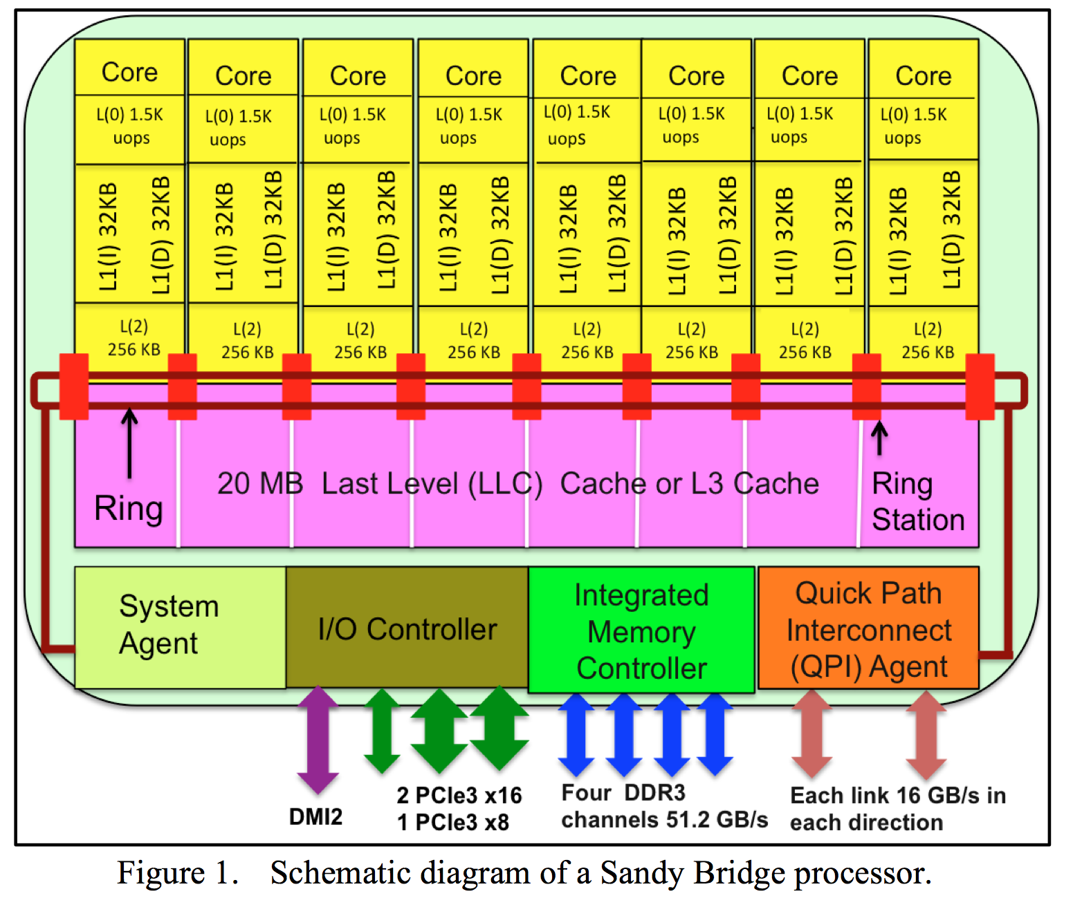

Slide 34
Summary
Memory performance matters!
often more than CPU performance
… because it is the bottleneck, and not improving much
… because most programs move a LOT of data
Design space is huge
Gambling against program behavior
Cuts across all layers: users → programs → os → hardware
Multi-core / Multi-Processor is complicated
Inconsistent views of memory
Extremely complex protocols, very hard to get right

