Slide 1
State and Finite State Machines
Prof. Hakim Weatherspoon
CS 3410, Spring 2015
Computer Science
Cornell University
See P&H Appendix B.7. B.8, B.10, B.11

Slide 2
Announcements
Make sure you are
Registered for class, can access CMS
Have a Section you can go to.
Lab Sections are required.
  “Make up” lab sections only 8:40am Wed, Thur, or Fri
  Bring laptop to Labs
Project partners are required for projects.
  Have project partner in same Lab Section, if possible
HW1 and Lab1 available today, after lecture
Do HW1 problems with lecture, i.e. finish part1 and 2 this week
Work alone on both
But, use your resources
  Lab Section, Piazza.com, Office Hours, Homework Help Session,
  Class notes, book, Sections, CSUGLab

Slide 3
Announcements
Make sure to go to your Lab Section this week
Completed Lab1 due before winter break, Friday, Feb 13th
Note, a Design Document is due when you submit Lab1 final circuit
Work alone
Homework1 is available, after lecture
Due a week before prelim1, Monday, February 23rd
Work on problems incrementally, as we cover them in lecture
Office Hours for help
Work alone
Work alone, BUT use your resources
  Lab Section, Piazza.com, Office Hours
  Class notes, book, Sections, CSUGLab

Slide 4
Announcements
Check online syllabus/schedule
  http://www.cs.cornell.edu/Courses/CS3410/2015sp/schedule.html
Slides and Reading for lectures
Office Hours
Pictures of all TAs
Homework and Programming Assignments
Dates to keep in Mind
  Prelims: Tue Mar 3rd and Thur April 30th
  Lab 1: Due next Friday, Feb 13th before Winter break
  Proj2: Due Thur Mar 26th before Spring break
  Final Project: Due when final would be (not known until Feb 14th)
Schedule is subject to change

Slide 5
Collaboration, Late, Re-grading Policies
“Black Board” Collaboration Policy
  Can discuss approach together on a “black board”
  Leave and write up solution independently
  Do not copy solutions
  Late Policy
  Each person has a total of four “slip days”
  Max of two slip days for any individual assignment
  Slip days deducted first for any late assignment,
  cannot selectively apply slip days
  For projects, slip days are deducted from all partners
  25% deducted per day late after slip days are exhausted
  Regrade policy
  Submit written request to lead PhD TA (Deniz, Vishal, Adam, Praveen),
  and lead TA will pick a different grader
  Submit another written request,
  lead TA will regrade directly
  Submit yet another written request for professor to regrade.

Slide 6
Big Picture: Building a Processor
memory
register
file
inst
alu
+4
+4
addr
=?
PC
d_{in}
d_{out}
control
cmp
offset
memory
new
pc
target
imm
extend
A Single cycle processor

Slide 7
Review
  We can generalize 1-bit Full Adders to 32 bits, 64 bits …
A₃ B₃
A₂ B₂
A₁ B₁
A₀ B₀
C₀
S₃
S₂
S₁
S₀

Slide 8
Review
  We can generalize 1-bit Full Adders to 32 bits, 64 bits …
B₃
B₂
B₁
B₀
A₃
mux
A₂
mux
A₁
mux
A₀
mux
0=add
1=sub
over
flow
S₃
S₂
S₁
S₀

Slide 9
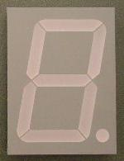
Example: A Calculator
8
A
8
decoder
8
B
S
0=add
1=sub
Notes:
red herring? constants into mux

Slide 10
Example: A Calculator
8
A
8
8
adder
decoder
8
8
B
mux
8
S
0=add
1=sub
Notes:
red herring? constants into mux

Slide 11
Example: A Calculator
8
128
A
0b1000 0000
8
8
adder
decoder
8
8
128
B
mux
0b1000 0000
8
S
0=add
1=sub
Notes:
red herring? constants into mux

Slide 12
Example: A Calculator
8
128
A
0b1000 0000
8
8
adder
decoder
8
8
128
B
mux
0b1000 0000
8
S
0=add
1=sub
Notes:
red herring? constants into mux

Slide 13
Review: Efficiency and Generality
  We can generalize 1-bit Full Adders to 32 bits, 64 bits …
  How long does it take to compute a result?
B₃
B₂
B₁
B₀
A₃
mux
A₂
mux
A₁
mux
A₀
mux
0=add
1=sub
over
flow
S₃
S₂
S₁
S₀

Slide 14
Review: Efficiency and Generality
  We can generalize 1-bit Full Adders to 32 bits, 64 bits …
  How long does it take to compute a result?
  A) 2 ns
  B) 2 gate delays
  C) 10 ns
  D) 10 gate delays
  E) 8 gate delays

Slide 15
Review: Efficiency and Generality
  We can generalize 1-bit Full Adders to 32 bits, 64 bits …
  How long does it take to compute a result?
B₃
B₂
B₁
B₀
A₃
mux
A₂
mux
A₁
mux
A₀
mux
0=add
1=sub
over
flow
t=10
t=8
S₃
t=6
S₂
t=4
S₁
t=2
S₀
t=0

Slide 16
Review: Efficiency and Generality
  We can generalize 1-bit Full Adders to 32 bits, 64 bits …
  How long does it take to compute a result?
  Can we store the result?
B₃
B₂
B₁
B₀
A₃
mux
A₂
mux
A₁
mux
A₀
mux
0=add
1=sub
over
flow
t=10
t=8
S₃
t=6
S₂
t=4
S₁
t=2
S₀
t=0

Slide 17
Performance
Speed of a circuit is affected by the number of gates in series (on the critical path or the deepest level of logic)
inputs
arrive
Combinational
Logic
outputs
expected
t_{combinational}

Slide 18
4-bit Ripple Carry Adder
A₃
B₃
A₂
B₂
A₁
B₁
A₀
B₀
C₃
C₂
C₁
C₄
C₀
S₃
S₂
S₁
S₀
Carry ripples from lsb to msb
First full adder, 2 gate delay
Second full adder, 2 gate delay
…
Notes:
Carry-lookahead adders would be more efficient performance wise (i.e. lower gate delay), but more expense hardware wise (i.e. more logic gates)

Slide 19
Stateful Components
Until now is combinationial logic
  Output is computed when inputs are present
  System has no internal state
  Nothing computed in the present can depend on what happened in the past!
Need a way to record data
Need a way to build stateful circuits
Need a state-holding device
Finite State Machines
Inputs
Combinational
circuit
Outputs
N
M
Notes:
How are we going to stably store state

Slide 20
Goals for Today
State
  How do we store one bit?
  Attempts at storing (and changing) one bit
    Set-Reset Latch
    D Latch
    D Flip-Flops
    Master-Slave Flip-Flops
  Register: storing more than one bit, N-bits
Basic Building Blocks
  Decoders and Encoders
Finite State Machines (FSM)
  How do we design logic circuits with state?
  Types of FSMs: Mealy and Moore Machines
  Examples: Serial Adder and a Digital Door Lock

Slide 21
Goal
How do we store store one bit?

Slide 22
First Attempt: Unstable Devices
B
C
A

Slide 23
First Attempt: Unstable Devices
B
0
1
C
0
1
0
1
A
Does not work!
  Unstable
  Oscillates wildly!

Slide 24
Second Attempt: Bistable Devices
Stable and unstable equilibria?
A
B
A Simple Device
In stable state, A = B
How do we change the state?
0
1
1
0
A
B
A
B
Notes:
How to create state? Feedback.
Show how the signal works

Slide 25

Third Attempt: Set-Reset Latch
S
A
$$\overline{Q}$$
Q
B
R
Notes:
Can you store a value (with this circuit)?
Can you change its value?
Q is comes from Latin language "quiscens" or "the present particle" or "what is present available" or "present output"
How to create state? Feedback.
Show how the signal works

Slide 26


Third Attempt: Set-Reset Latch
S
$$\overline{Q}$$
A | B | OR | NOR
0 | 0 | 0 | 1
0 | 1 | 1 | 0
1 | 0 | 1 | 0
1 | 1 | 1 | 0
Q
R
S | R | Q | $$\overline{Q}$$
0 | 0
0 | 1
1 | 0
1 | 1
Set-Reset (S-R) Latch
Stores a value Q and its complement

Slide 27
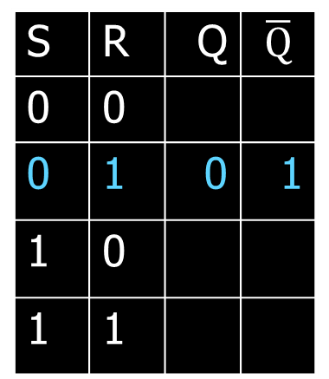

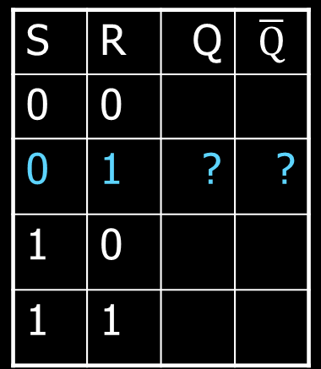
Third Attempt: Set-Reset Latch
0
S
$$\overline{Q}$$
A | B | OR | NOR
0 | 0 | 0 | 1
0 | 1 | 1 | 0
1 | 0 | 1 | 0
1 | 1 | 1 | 0
0
1
Q will be 0 if R is 1
Q
R
$\overline{Q}$will be 1
1
S | R | Q | $$\overline{Q}$$
0 | 0
0 | 1 | ? | ?
1 | 0
1 | 1
S | R | Q | $$\overline{Q}$$
0 | 0
0 | 1 | 0 | 1
1 | 0
1 | 1
Set-Reset (S-R) Latch
Stores a value Q and its complement

Slide 28
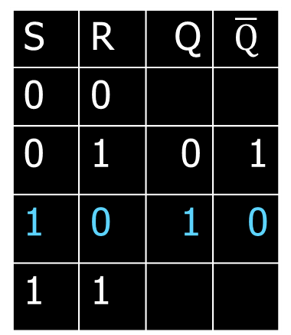

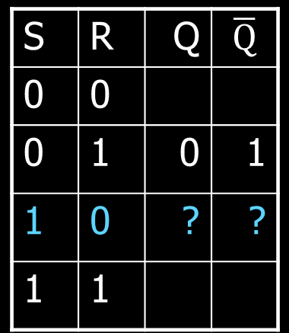
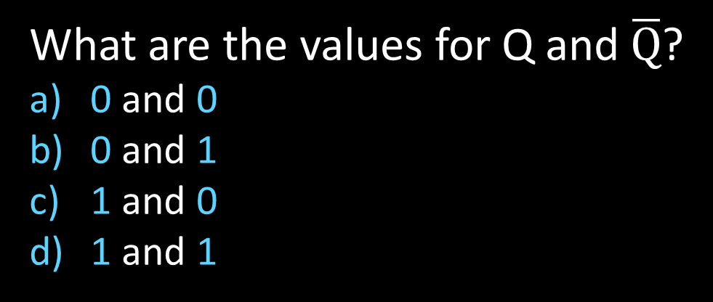
Third Attempt: Set-Reset Latch
1
S
$$\overline{Q}$$
A | B | OR | NOR
0 | 0 | 0 | 1
0 | 1 | 1 | 0
1 | 0 | 1 | 0
1 | 1 | 1 | 0
1
0
Q will be 1
Q
R
$\overline{Q}$will be 0 if S is 1
0
S | R | Q | $$\overline{Q}$$
0 | 0
0 | 1 | 0 | 1
1 | 0 | ? | ?
1 | 1
S | R | Q | $$\overline{Q}$$
0 | 0
0 | 1 | 0 | 1
1 | 0 | 1 | 0
1 | 1
Set-Reset (S-R) Latch
Stores a value Q and its complement
What are the values for Q and $\overline{Q}$?
0 and 0
0 and 1
1 and 0
1 and 1
Notes:
Ask a clicker question about Q and !Q

Slide 29
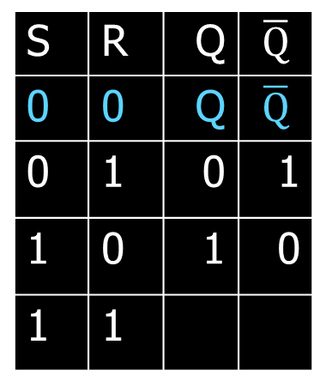
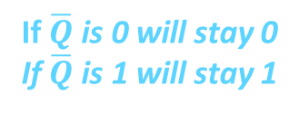

Third Attempt: Set-Reset Latch
1
→
S
0
$$\overline{Q}$$
A | B | OR | NOR
0 | 0 | 0 | 1
0 | 1 | 1 | 0
1 | 0 | 1 | 0
1 | 1 | 1 | 0
1
0
If Q is 1, will stay 1
if Q is 0, will stay 0
Q
R
If $\overline{Q}$ is 0 will stay 0
If $\overline{Q}$ is 1 will stay 1
0
S | R | Q | $$\overline{Q}$$
0 | 0 | ? | ?
0 | 1 | 0 | 1
1 | 0 | 1 | 0
1 | 1
S | R | Q | $$\overline{Q}$$
0 | 0 | Q | $$\overline{Q}$$
0 | 1 | 0 | 1
1 | 0 | 1 | 0
1 | 1
Set-Reset (S-R) Latch
Stores a value Q and its complement
Notes:
Since the set and reset input are both 0, the Q and !Q determine the output, which will hold.

Slide 30

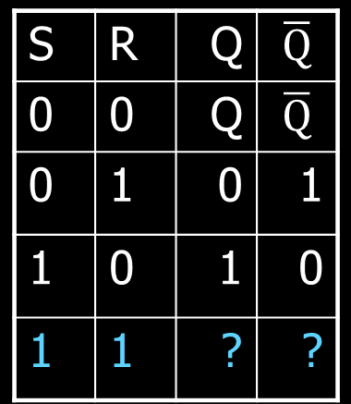
Third Attempt: Set-Reset Latch
S
1
$$\overline{Q}$$
A | B | OR | NOR
0 | 0 | 0 | 1
0 | 1 | 1 | 0
1 | 0 | 1 | 0
1 | 1 | 1 | 0
0
0
Q will be 0 since R is 1
R
$\overline{Q}$ will be 0 since S is 1
Q
1
S | R | Q | $$\overline{Q}$$
0 | 0 | Q | $$\overline{Q}$$
0 | 1 | 0 | 1
1 | 0 | 1 | 0
1 | 1 | ? | ?
Set-Reset (S-R) Latch
Stores a value Q and its complement
What happens when S,R changes from 1,1 to 0,0?
Notes:
Start with 0, 1 => 0, 1
then 0, 0 => 0, 1
then 1, 0 => 1, 0
then 0, 0 => 1, 0, better yet “stay”
1, 1 is forbidden, b/c going to 0, 0 after goes haywire
i.e.
Start 1,1 => 0,0
Alright. Now change S,R to 0, 0, what happens.
1, 1=>0, 0 -> 0, 0=> 0, 0 -> 0, 0=>1, 1 -> 0, 0=> 0, 0 -> oscillations.
S R=>Q,!Q -> S,R=>Q,!Q -> S, R=>Q,!Q -> S,R => Q,!Q

Slide 31
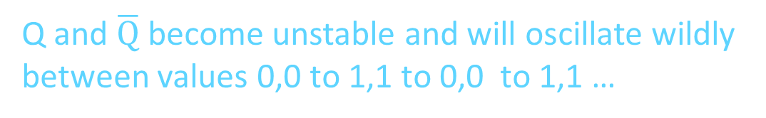
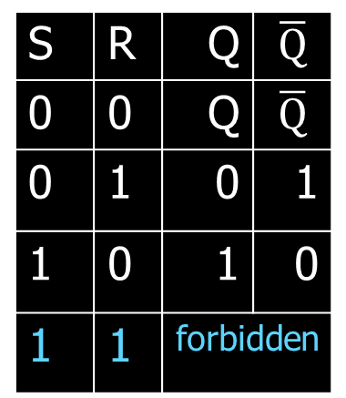
Third Attempt: Set-Reset Latch
S
1→0
$$\overline{Q}$$
A | B | OR | NOR
0 | 0 | 0 | 1
0 | 1 | 1 | 0
1 | 0 | 1 | 0
1 | 1 | 1 | 0
0 →1
0 →1 →0
0 →1 →0 →1
0→1
0
0→1 →0
0→1 →0 →1
0
Q
R
1 →0
S | R | Q | $$\overline{Q}$$
0 | 0 | Q | $$\overline{Q}$$
0 | 1 | 0 | 1
1 | 0 | 1 | 0
1 | 1 | ? | ?
S | R | Q | $$\overline{Q}$$
0 | 0 | Q | $$\overline{Q}$$
0 | 1 | 0 | 1
1 | 0 | 1 | 0
1 | 1 | forbidden
Set-Reset (S-R) Latch
Stores a value Q and its complement
What happens when S,R changes from 1,1 to 0,0?
Q and $\overline{Q}$ become unstable and will oscillate wildly
between values 0,0 to 1,1 to 0,0 to 1,1 …
Notes:
Start with 0, 1 => 0, 1
then 0, 0 => 0, 1
then 1, 0 => 1, 0
then 0, 0 => 1, 0, better yet “stay”
1, 1 is forbidden, b/c going to 0, 0 after goes haywire
i.e.
Start 1,1 => 0,0
Alright. Now change S,R to 0, 0, what happens.
1, 1=>0, 0 -> 0, 0=> 0, 0 -> 0, 0=>1, 1 -> 0, 0=> 0, 0 -> oscillations.
S R=>Q,!Q -> S,R=>Q,!Q -> S, R=>Q,!Q -> S,R => Q,!Q

Slide 32

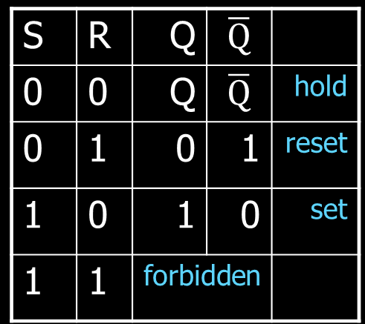

Third Attempt: Set-Reset Latch
S
Q
S
R
$$\overline{Q}$$
$$\overline{Q}$$
Q
R
S | R | Q | $$\overline{Q}$$
0 | 0 | Q | $$\overline{Q}$$
0 | 1 | 0 | 1
1 | 0 | 1 | 0
1 | 1 | forbidden
S | R | Q | $$\overline{Q}$$
0 | 0 | Q | $$\overline{Q}$$ | hold
0 | 1 | 0 | 1 | reset
1 | 0 | 1 | 0 | set
1 | 1 | forbidden
Set-Reset (S-R) Latch
Stores a value Q and its complement
Notes:
Start with 0, 1 => 0, 1
then 0, 0 => 0, 1
then 1, 0 => 1, 0
then 0, 0 => 1, 0, better yet “stay”
1, 1 is forbidden, b/c going to 0, 0 after goes haywire
i.e.
Start 1,1 => 0,0
Alright. Now change S,R to 0, 0, what happens.
1, 1=>0, 0 -> 0, 0=> 0, 0 -> 0, 0=>1, 1 -> 0, 0=> 0, 0 -> oscillations.
S R=>Q,!Q -> S,R=>Q,!Q -> S, R=>Q,!Q -> S,R => Q,!Q

Slide 33
Takeaway
Set-Reset (SR) Latch can store one bit and we can change the value of the stored bit. But, SR Latch has a forbidden state.

Slide 34
Next Goal
How do we avoid the forbidden state of S-R Latch?

Slide 35

Fourth Attempt: (Unclocked) D Latch
D
S
Q
D
S
R
Q
$$\overline{Q}$$
R
Q
D | Q | $$\overline{Q}$$
0
1
Fill in the truth table?
A | B | OR | NOR
0 | 0 | 0 | 1
0 | 1 | 1 | 0
1 | 0 | 1 | 0
1 | 1 | 1 | 0
Notes:
Start in 0, 0, 1
Change to D = 1
After NOT gate, R = 0
After OR+NOT gates, /Q = 0 (R is already ready then), Q goes to 1
Problem: No way to hold state

Slide 36
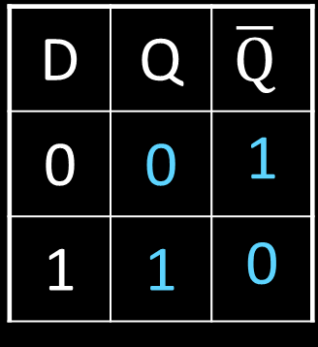
Fourth Attempt: (Unclocked) D Latch
D
S
Q
D
S
R
Q
$$\overline{Q}$$
R
Q
D | Q | $$\overline{Q}$$
0 | 0 | 1
1 | 1 | 0
Fill in the truth table?
Data (D) Latch
  Easier to use than an SR latch
  No possibility of entering an undefined state
When D changes, Q changes
    … immediately (…after a delay of 2 Ors and 2 NOTs)
Need to control when the output changes
A | B | OR | NOR
0 | 0 | 0 | 1
0 | 1 | 1 | 0
1 | 0 | 1 | 0
1 | 1 | 1 | 0
Notes:
Start in 0, 0, 1
Change to D = 1
After NOT gate, R = 0
After OR+NOT gates, /Q = 0 (R is already ready then), Q goes to 1
Problem: No way to hold state

Slide 37
Takeaway
Set-Reset (SR) Latch can store one bit and we can change the value of the stored bit. But, SR Latch has a forbidden state.
(Unclocked) D Latch can store and change a bit like an SR Latch while avoiding the forbidden state.

Slide 38
Next Goal
How do we coordinate state changes to a D Latch?

Slide 39
Clocks
Clock helps coordinate state changes
  Usually generated by an oscillating crystal
  Fixed period; frequency = 1/period
clock
high
falling
edge
rising
edge
rising
edge
falling
edge
1
0
period
low
high
clock
period
clock
low

Slide 40
Clock Disciplines
Level sensitive
  State changes when clock is high (or low)
Edge triggered
  State changes at clock edge
positive edge-triggered
negative edge-triggered

Slide 41
Clock Methodology
Clock Methodology
Negative edge, synchronous
    Edge-Triggered: Signals must be stable near falling clock edge
Positive edge synchronous
clk
t_{combinational}
t_{setup}
t_{hold}
compute
save
compute
save
compute

Slide 42

Fifth Attempt: D Latch with Clock
D
S
Q
R
$$\overline{Q}$$
Notes:
Any forbidden S=R=1 inputs? No
Need both truth tables

Slide 43

Fifth Attempt: D Latch with Clock
D
S
Q
clk
R
$$\overline{Q}$$
Fill in the truth table
clk | D | Q | $$\overline{Q}$$
0 | 0
0 | 1
1 | 0
1 | 1
Notes:
Any forbidden S=R=1 inputs? No
Need both truth tables

Slide 44


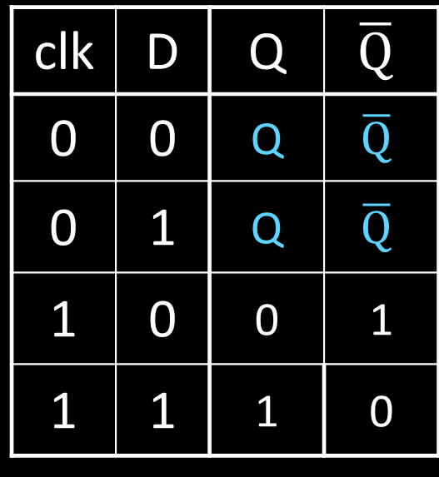
Fifth Attempt: D Latch with Clock
D
S
Q
clk
R
$$\overline{Q}$$
Fill in the truth table
clk | D | Q | $$\overline{Q}$$
0 | 0
0 | 1
1 | 0
1 | 1
S | R | Q | $$\overline{Q}$$
0 | 0 | Q | $$\overline{Q}$$ | hold
0 | 1 | 0 | 1 | reset
1 | 0 | 1 | 0 | set
1 | 1 | forbidden
clk | D | Q | $$\overline{Q}$$
0 | 0 | Q | $$\overline{Q}$$
0 | 1 | Q | $$\overline{Q}$$
1 | 0 | 0 | 1
1 | 1 | 1 | 0
Notes:
Any forbidden S=R=1 inputs? No
Need both truth tables

Slide 45
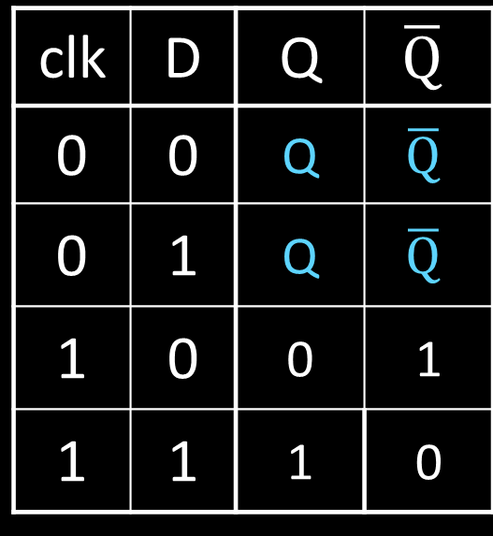
Fifth Attempt: D Latch with Clock
Level Sensitive D Latch
Clock high:
set/reset (according to D)
Clock low:
keep state (ignore D)
D
S
Q
clk
R
$$\overline{Q}$$
clk | D | Q | $$\overline{Q}$$
0 | 0 | Q | $$\overline{Q}$$
0 | 1 | Q | $$\overline{Q}$$
1 | 0 | 0 | 1
1 | 1 | 1 | 0
clk
D
Q
Notes:
Any forbidden S=R=1 inputs? No
Need both truth tables

Slide 46



Sixth Attempt: Edge-Triggered D Flip-Flop
D Flip-Flop
Edge-Triggered
Data captured when clock is high
Output changes only on falling edges
D
1
D
Q
0
D
Q
0
Q
X
clk
0
L
$$\overline{Q}$$
1
L
$$\overline{Q}$$
$$\overline{Q}$$
c
c
Activity#1: Fill in timing graph and values for X and Q
clk
D
X
Q
Notes:
Master-Slave Flip Flop
- Outputs change only on falling edges
- Data is captured on rising edges
1 cycle delay
but works out perfectly – data for the next stage is ready 1 cycle ahead of time

Slide 47
Sixth Attempt: Edge-Triggered D Flip-Flop
D Flip-Flop
Edge-Triggered
Data captured when clock is high
Output changes only on falling edges
1
0
0
1
0
D
D
Q
D
Q
1
Q
X
0
1
L
$$\overline{Q}$$
0
L
$$\overline{Q}$$
clk
1
$$\overline{Q}$$
c
c
clk
D
X
Q
Notes:
Master-Slave Flip Flop
- Outputs change only on falling edges
- Data is captured on rising edges
1 cycle delay
but works out perfectly – data for the next stage is ready 1 cycle ahead of time

Slide 48
Takeaway
Set-Reset (SR) Latch can store one bit and we can change the value of the stored bit. But, SR Latch has a forbidden state.
(Unclocked) D Latch can store and change a bit like an SR Latch while avoiding a forbidden state.
An Edge-Triggered D Flip-Flip (aka Master-Slave D Flip-Flip) stores one bit. The bit can be changed in a synchronized fashion on the edge of a clock signal.

Slide 49
Next Goal
How do we store more than one bit, N bits?

Slide 50
Registers
D0
Register
D flip-flops in parallel
shared clock
extra clocked inputs:
write_enable, reset, …
D1
D2
D3
4-bit
reg
4
4
clk
clk

Slide 51
Takeaway
Set-Reset (SR) Latch can store one bit and we can change the value of the stored bit. But, SR Latch has a forbidden state.
(Unclocked) D Latch can store and change a bit like an SR Latch while avoiding a forbidden state.
An Edge-Triggered D Flip-Flip (aka Master-Slave D Flip-Flip) stores one bit. The bit can be changed in a synchronized fashion on the edge of a clock signal.
An N-bit register stores N-bits. It is created with N D-Flip-Flops in parallel along with a shared clock.

Slide 52
An Example: What will this circuit do?
4
16
Decoder
4
4
4-bit
reg
+1
Clk
4

Slide 53
An Example: What will this circuit do?
Reset
Run
WE
R
4
16
Decoder
4
4
A[4]
1 = 0001 =B[4]
4-bit
reg
C_{out}
+1
S[4]
Clk
4

Slide 54
Decoder Example: 7-Segment LED
d7
d6
d5
d4
7-Segment LED
  photons emitted when electrons fall into holes
d3
d2
d1
d0
Notes:
Previous slide would need to display up to 16, so would need a 16-segment LED decoder

Slide 55
Decoder Example: 7-Segment LED
d7
d6
d5
d4
7-Segment LED
  photons emitted when electrons fall into holes
d3
d2
d1
d0

Slide 56
Decoder Example: 7-Segment LED Decoder
3 inputs
encode 0 – 7 in binary
7 outputs
one for each LED
7LED decode

Slide 57
7 Segment LED Decoder Implementation
b2 | b1 | b0 | d6 | d5 | d4 | d3 | d2 | d1 | d0
0 | 0 | 0
0 | 0 | 1
0 | 1 | 0
0 | 1 | 1
1 | 0 | 0
1 | 0 | 1
1 | 1 | 0
1 | 1 | 1
b2 | b1 | b0 | d6 | d5 | d4 | d3 | d2 | d1 | d0
0 | 0 | 0
0 | 0 | 1
0 | 1 | 0
0 | 1 | 1
1 | 0 | 0
1 | 0 | 1
1 | 1 | 0
1 | 1 | 1 | 1 | 0 | 0 | 0 | 0 | 1 | 1
d1
d2
d0
d3
d4
d6
d5

Slide 58
7 Segment LED Decoder Implementation
b2 | b1 | b0 | d6 | d5 | d4 | d3 | d2 | d1 | d0
0 | 0 | 0
0 | 0 | 1
0 | 1 | 0
0 | 1 | 1
1 | 0 | 0
1 | 0 | 1
1 | 1 | 0
1 | 1 | 1
1 | 1 | 1 | 0 | 1 | 1 | 1
1 | 0 | 0 | 0 | 0 | 0 | 1
0 | 1 | 1 | 1 | 0 | 1 | 1
1 | 1 | 0 | 1 | 0 | 1 | 1
1 | 0 | 0 | 1 | 1 | 0 | 1
1 | 1 | 0 | 1 | 1 | 1 | 0
1 | 1 | 1 | 1 | 1 | 1 | 0
1 | 0 | 0 | 0 | 0 | 1 | 1
d1
d2
d0
d3
d4
d6
d5

Slide 59
Basic Building Blocks We have Seen
N
2^{N}
0
N
binary
encoder
1
N
N
2
N
N
Multiplexor
binary
decoder
. . .
2^{N}
N
2^{M}-1
M

Slide 60
Encoders
0
1
2
3
N Input wires
4
Log₂(N) outputs wires
encoder
5
. . .
6
7
e.g. Voting:
Can only vote for one out of N
candidates, so N inputs.
But can encode vote efficiently
with binary encoding.
. . .
N
Notes:
N possible inputs -> log2(N) wires to encode

Slide 61
Example Encoder Truth Table
a | b | c | d
0 | 0 | 0 | 0
1 | 0 | 0 | 0
0 | 1 | 0 | 0
0 | 0 | 1 | 0
0 | 0 | 0 | 1
a
1
o₀
b
2
o₁
o₁
c
3
o₂
d
4
A 3-bit
encoder
with 4 inputs
for simplicity
Notes:
Implementation . . .
assume 8 choices, exactly one mark detected

Slide 62
Example Encoder Truth Table
a | b | c | d |  | o₂ | o₁ | o₀
0 | 0 | 0 | 0 |  | 0 | 0 | 0
1 | 0 | 0 | 0 |  | 0 | 0 | 1
0 | 1 | 0 | 0 |  | 0 | 1 | 0
0 | 0 | 1 | 0 |  | 0 | 1 | 1
0 | 0 | 0 | 1 |  | 1 | 0 | 0
a
1
o₀
b
2
o₁
o₁
c
3
o₂
d
4
o₂ = abcd
o₁ = abcd + abcd
o₀ = abcd + abcd
A 3-bit
encoder
with 4 inputs
for simplicity
Notes:
Implementation . . .
assume 8 choices, exactly one mark detected

Slide 63
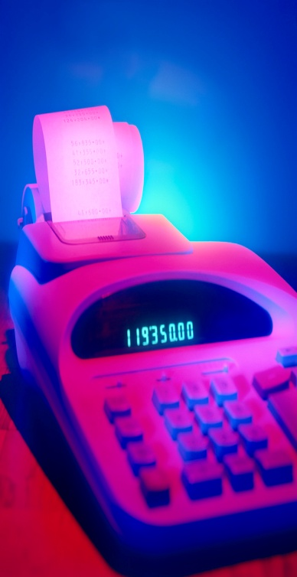
Basic Building Blocks Example: Voting
enc
7LED
decode
detect
8
3
7
Ballots
The 3410 optical scan
vote reader
machine

Slide 64
Basic Building Blocks We have Seen
N
2^{N}
0
N
binary
encoder
1
N
N
2
N
N
Multiplexor
binary
decoder
. . .
2^{N}
N
2^{M}-1
M

Slide 65
Recap
We can now build interesting devices with sensors
  Using combinationial logic
We can also store data values (aka Sequential Logic)
  In state-holding elements
  Coupled with clocks

Slide 66
Goals for Today
State
  How do we store one bit?
  Attempts at storing (and changing) one bit
    Set-Reset Latch
    D Latch
    D Flip-Flops
    Master-Slave Flip-Flops
  Register: storing more than one bit, N-bits
Basic Building Blocks
  Decoders and Encoders
Finite State Machines (FSM)
  How do we design logic circuits with state?
  Types of FSMs: Mealy and Moore Machines
  Examples: Serial Adder and a Digital Door Lock

Slide 67
Goals for Today
State
  How do we store one bit?
  Attempts at storing (and changing) one bit
    Set-Reset Latch
    D Latch
    D Flip-Flops
    Master-Slave Flip-Flops
  Register: storing more than one bit, N-bits
Basic Building Blocks
  Decoders and Encoders
Finite State Machines (FSM)
  How do we design logic circuits with state?
  Types of FSMs: Mealy and Moore Machines
  Examples: Serial Adder and a Digital Door Lock

Slide 68
Finite State Machines

Slide 69
Next Goal
How do we design logic circuits with state?

Slide 70
Finite State Machines
An electronic machine which has
  external inputs
  externally visible outputs
  internal state
Output and next state depend on
  inputs
  current state

Slide 71
Abstract Model of FSM
Machine is
M = ( S, I, O, δ )
S: Finite set of states
I: Finite set of inputs
O: Finite set of outputs
δ: State transition function
Next state depends on present input and present state

Slide 72
Automata Model
Finite State Machine
  inputs from external world
  outputs to external world
  internal state
  combinational logic
Registers
Current State
Comb.
Logic
Output
Input
Next State
Notes:
Put sequential logic term on slide

Slide 73
FSM Example
down/on
input/output
up/off
down/on
A
B
state
start
state
up/off
up/off
Legend
up/off
C
D
down/off
Input: up or down
Output: on or off
States: A, B, C, or D
down/off

Slide 74
FSM Example
down/on
input/output
up/off
down/on
A
B
state
start
state
up/off
up/off
Legend
up/off
C
D
down/off
Input: = up or = down
Output: = on or = off
States: = A, = B, = C, or = D
down/off
Notes:
Say left of slash is input and right is output

Slide 75
FSM Example
1/1
1/1
i₀i₁i₂…/o₀o₁o₂…
0/0
00
01
S₁S₀
S₁S₀
0/0
0/0
Legend
0/0
10
11
1/0
Input: 0=up or 1=down
Output: 1=on or 0=off
States: 00=A, 01=B, 10=C, or 11=D
1/0

Slide 76
Mealy Machine
General Case: Mealy Machine
Outputs and next state depend on both
current state and input
Registers
Current State
Comb.
Logic
Output
Input
Next State

Slide 77
Moore Machine
Special Case: Moore Machine
Outputs depend only on current state
Registers
Current State
Comb.
Logic
Output
Comb.
Logic
Input
Next State

Slide 78
Moore Machine FSM Example
down
input
up
down
A off
B
on
state
out
startout
up
down
Legend
up
C off
D off
up
Input: up or down
Output: on or off
States: A, B, C, or D
down
Notes:
Also show a mealy machine

Slide 79
Mealy Machine FSM Example
down/on
input/output
up/off
down/on
A
B
state
start
state
up/off
down/off
Legend
up/off
C
D
up/off
Input: up or down
Output: on or off
States: A, B, C, or D
down/off

Slide 80
Activity#2: Create a Logic Circuit for a Serial Adder
Add two infinite input bit streams
  streams are sent with least-significant-bit (lsb) first
…10110
Sum: output
…00101
…01111
Notes:
Ask as a clicker question

Slide 81
Activity#2: Create a Logic Circuit for a Serial Adder
Add two infinite input bit streams
  streams are sent with least-significant-bit (lsb) first
Carry-out
1
…10110
Sum: output
…00101
…01111
Notes:
Ask as a clicker question

Slide 82
Activity#2: Create a Logic Circuit for a Serial Adder
Add two infinite input bit streams
  streams are sent with least-significant-bit (lsb) first
Carry-in
1
…10110
Sum: output
…00101
…01111
Notes:
Ask as a clicker question

Slide 83
Activity#2: Create a Logic Circuit for a Serial Adder
Add two infinite input bit streams
  streams are sent with least-significant-bit (lsb) first
Carry-out
1
1
…10110
Sum: output
…00101
…01111
Notes:
Ask as a clicker question

Slide 84
Activity#2: Create a Logic Circuit for a Serial Adder
Add two infinite input bit streams
  streams are sent with least-significant-bit (lsb) first
  How many states are needed to represent FSM?
  Draw and Fill in FSM diagram
…10110
Sum: output
…00101
…01111
Strategy:
(1) Draw a state diagram (e.g. Mealy Machine)
(2) Write output and next-state tables
(3) Encode states, inputs, and outputs as bits
(4) Determine logic equations for next state and outputs
Notes:
Ask as a clicker question

Slide 85
FSM: State Diagram
…10110
…00101
…01111
states:
Inputs: ??? and ???
Output: ???
  .
Notes:
Is this a mealy or moore machine, maybe clicker

Slide 86
FSM: State Diagram
a
…10110
…00101
z
b
…01111
Two states: S0 (no carry in), S1 (carry in)
Inputs: a and b
Output: z
  z is the sum of inputs a, b, and carry-in (one bit at a time)
  A carry-out is the next carry-in state.
  .

Slide 87
FSM: State Diagram
__/_
__/_
__/_
S0
__/_
S1
__/_
__/_
__/_
__/_
a
…10110
…00101
z
b
…01111
Two states: S0 (no carry in), S1 (carry in)
Inputs: a and b
Output: z
  z is the sum of inputs a, b, and carry-in (one bit at a time)
  A carry-out is the next carry-in state.
  Arcs labeled with input bits a and b, and output z
Notes:
Is this a mealy or moore machine, maybe clicker

Slide 88
FSM: State Diagram
11/0
00/0
11/1
S0
00/1
S1
10/1
01/1
10/0
01/0
a
…10110
…00101
z
b
…01111
Two states: S0 (no carry in), S1 (carry in)
Inputs: a and b
Output: z
  z is the sum of inputs a, b, and carry-in (one bit at a time)
  A carry-out is the next carry-in state.
  Arcs labeled with input bits a and b, and output z (Mealy Machine)

Slide 89
Serial Adder: State Table
11/0
00/0
11/1
S0
00/1
S1
10/1
01/1
10/0
01/0
a | b | Current state | z | Next state
(2) Write down all input and state combinations

Slide 90
Serial Adder: State Table
11/0
00/0
11/1
S0
00/1
S1
10/1
01/1
10/0
01/0
a | b | Current state | z | Next state
0 | 0 | S0 | 0 | S0
0 | 1 | S0 | 1 | S0
1 | 0 | S0 | 1 | S0
1 | 1 | S0 | 0 | S1
0 | 0 | S1 | 1 | S0
0 | 1 | S1 | 0 | S1
1 | 0 | S1 | 0 | S1
1 | 1 | S1 | 1 | S1
(2) Write down all input and state combinations

Slide 91
Serial Adder: State Assignment
11/0
00/0
11/1
0
00/1
1
10/1
01/1
10/0
01/0
a | b | s | z | s'
0 | 0 | 0 | 0 | 0
0 | 1 | 0 | 1 | 0
1 | 0 | 0 | 1 | 0
1 | 1 | 0 | 0 | 1
0 | 0 | 1 | 1 | 0
0 | 1 | 1 | 0 | 1
1 | 0 | 1 | 0 | 1
1 | 1 | 1 | 1 | 1
(3) Encode states, inputs, and outputs as bits
Two states, so 1-bit is sufficient
  A single flip-flop will encode the state

Slide 92

Serial Adder: Circuit
Next State
Current State
Output
Comb.
Logic
z
s'
s
D
Q
a
Next State
b
Input
s'
a | b | s | z | s'
0 | 0 | 0 | 0 | 0
0 | 1 | 0 | 1 | 0
1 | 0 | 0 | 1 | 0
1 | 1 | 0 | 0 | 1
0 | 0 | 1 | 1 | 0
0 | 1 | 1 | 0 | 1
1 | 0 | 1 | 0 | 1
1 | 1 | 1 | 1 | 1
(4) Determine logic equations for next state and outputs
Combinational Logic Equations
  z = $\overline{a}$b$\overline{s}$ + a$\overline{bs}$ + $\overline{ab}$s + abs
  s’ = ab$\overline{s}$ + $\overline{a}$bs + a$\overline{b}$s + abs
Notes:
Practice minimizing circuit w/a Karnaugh map

Slide 93

Sequential Logic Circuits
Next State
Current State
Output
Comb.
Logic
z
s'
s
D
Q
a
Next State
b
Input
s'
  z = $\overline{a}$b$\overline{s}$ + a$\overline{bs}$ + $\overline{ab}$s + abs
  s’ = ab$\overline{s}$ + $\overline{a}$bs + a$\overline{b}$s + abs
  .
  .
  .
Strategy:
(1) Draw a state diagram (e.g. Mealy Machine)
(2) Write output and next-state tables
(3) Encode states, inputs, and outputs as bits
(4) Determine logic equations for next state and outputs

Slide 94
Summary
We can now build interesting devices with sensors
  Using combinational logic
We can also store data values
  Stateful circuit elements (D Flip Flops, Registers, …)
  Clock to synchronize state changes
  State Machines or Ad-Hoc Circuits

