Slide 1
Gates and Logic: From switches to Transistors, Logic Gates and Logic Circuits
Prof. Hakim Weatherspoon
CS 3410, Spring 2015
Computer Science
Cornell University
See: P&H Appendix B.2 and B.3 (Also, see B.1)

Slide 2
Goals for Today
From Switches to Logic Gates to Logic Circuits
Logic Gates
From switches
Truth Tables
Logic Circuits
Identity Laws
From Truth Tables to Circuits (Sum of Products)
Logic Circuit Minimization
Algebraic Manipulations
Truth Tables (Karnaugh Maps)
Transistors (electronic switch)

Slide 3
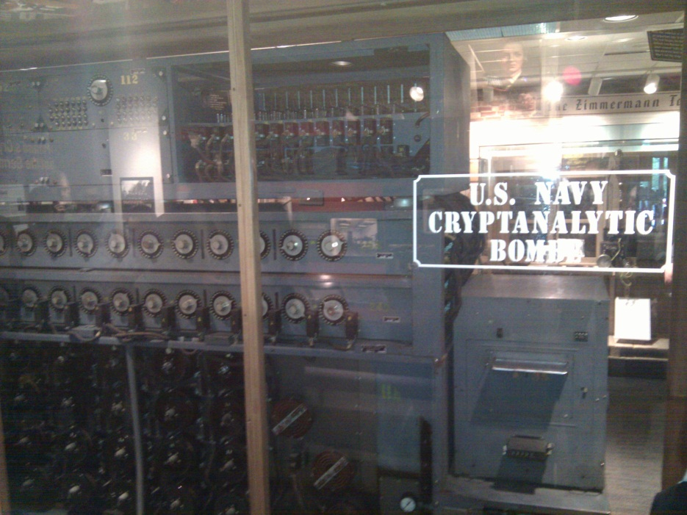
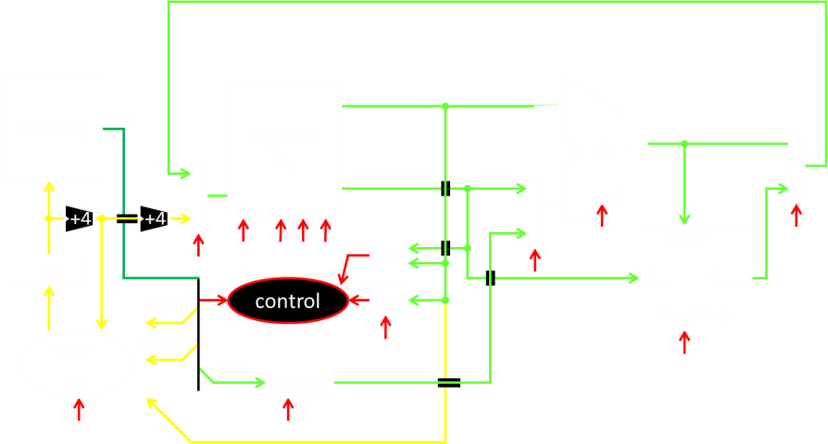
A switch
Acts as a conductor or insulator
Can be used to build amazing things…
The Bombe used to break the German
Enigma machine during World War II
Notes:
Pictures show the Bombe built by Alan Turing to break the enigma machine ciphers.
They were Fixed-Program Computers came before stored-program computers (general purpose)
The former required re-wiring (e.g. ENIAC took 3 weeks to “re-wire”).

Slide 4
Basic Building Blocks: Switches to Logic Gates
Either (OR)
Both (AND)
+
A
Truth Table
-
A | B | Light
OFF | OFF
OFF | ON
ON | OFF
ON | ON
B
+
A
-
A | B | Light
OFF | OFF
OFF | ON
ON | OFF
ON | ON
B
Notes:
Speed and size of a mechanical switch

Slide 5
Basic Building Blocks: Switches to Logic Gates
Either (OR)
Both (AND)
A
Truth Table
-
A | B | Light
OFF | OFF
OFF | ON
ON | OFF
ON | ON
OR
B
A
-
A | B | Light
OFF | OFF
OFF | ON
ON | OFF
ON | ON
AND
B
Notes:
Speed and size of a mechanical switch

Slide 6
Basic Building Blocks: Switches to Logic Gates
Either (OR)
Both (AND)
A
Truth Table
-
A | B | Light
0 | 0
0 | 1
1 | 0
1 | 1
OR
0 = OFF
1 = ON
B
A
-
A | B | Light
0 | 0
0 | 1
1 | 0
1 | 1
AND
B
Notes:
Speed and size of a mechanical switch

Slide 7
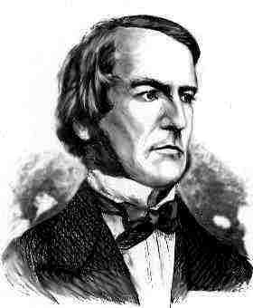
Basic Building Blocks: Switches to Logic Gates
A
OR
B
George Boole,(1815-1864)
A
Did you know?
George Boole Inventor of the idea of logic gates. He was born in Lincoln, England and he was the son of a shoemaker in a low class family.
AND
B
Notes:
E.g. logic statements:
“Jane will only go to the cinema tonight if a good film is on AND she has enough money.”
“Stuart will only go to the birthday party on Sunday if Katie OR Sujit is going too.”

Slide 8
Takeaway
Binary (two symbols: true and false) is the basis of Logic Design
Notes:
Add takeways at end of a block. Possibly build on takeaways throughout lecture

Slide 9
Building Functions: Logic Gates
A | Out
NOT:
AND:
OR:
Logic Gates
digital circuit that either allows a signal to pass through it or not.
Used to build logic functions
There are seven basic logic gates:
AND, OR, NOT,
NAND (not AND), NOR (not OR), XOR, and XNOR (not XOR) [later]
A
A | B | Out
0 | 0 | 0
0 | 1 | 0
1 | 0 | 0
1 | 1 | 1
A
B
A | B | Out
0 | 0 | 0
0 | 1 | 1
1 | 0 | 1
1 | 1 | 1
A
B
Notes:
Flash Drives
Create truth table of AND or OR: state what they do

Slide 10
Building Functions: Logic Gates
A | Out
0 | 1
1 | 0
NOT:
AND:
OR:
Logic Gates
digital circuit that either allows a signal to pass through it or not.
Used to build logic functions
There are seven basic logic gates:
AND, OR, NOT,
NAND (not AND), NOR (not OR), XOR, and XNOR (not XOR) [later]
A
A | B | Out
0 | 0 | 0
0 | 1 | 0
1 | 0 | 0
1 | 1 | 1
A
B
A | B | Out
0 | 0 | 0
0 | 1 | 1
1 | 0 | 1
1 | 1 | 1
A
B
Notes:
Flash Drives
Create truth table of AND or OR: state what they do
Did you know? Logic gates allow the computer to do things such as add, divide, multiply, do simple yes and no reasoning in certain situations along with other things.

Slide 11
Building Functions: Logic Gates
A | Out
0 | 1
1 | 0
NOT:
AND:
OR:
Logic Gates
digital circuit that either allows a signal to pass through it or not.
Used to build logic functions
There are seven basic logic gates:
AND, OR, NOT,
NAND (not AND), NOR (not OR), XOR, and XNOR (not XOR) [later]
A
A | B | Out
0 | 0 | 0
0 | 1 | 0
1 | 0 | 0
1 | 1 | 1
A | B | Out
0 | 0 | 1
0 | 1 | 1
1 | 0 | 1
1 | 1 | 0
NAND:
A
A
B
B
NOR:
A | B | Out
0 | 0 | 0
0 | 1 | 1
1 | 0 | 1
1 | 1 | 1
A | B | Out
0 | 0 | 1
0 | 1 | 0
1 | 0 | 0
1 | 1 | 0
A
A
B
B
Notes:
Flash Drives
Create truth table of AND or OR: state what they do
Did you know? Logic gates allow the computer to do things such as add, divide, multiply, do simple yes and no reasoning in certain situations along with other things.

Slide 12
Goals for Today
From Switches to Logic Gates to Logic Circuits
Logic Gates
From switches
Truth Tables
Logic Circuits
Identity Laws
From Truth Tables to Circuits (Sum of Products)
Logic Circuit Minimization
Algebraic Manipulations
Truth Tables (Karnaugh Maps)
Transistors (electronic switch)

Slide 13
Next Goal
Given a Logic function, create a Logic Circuit that implements the Logic Function…
…and, with the minimum number of logic gates
Fewer gates: A cheaper ($$$) circuit!
Notes:
Can get logic circuit from truth table
Minimize logic circuit through algebraic reductions or Karnaugh Maps

Slide 14
Logic Gates
A | Out
0 | 1
1 | 0
NOT:
AND:
OR:
XOR:
.
A
A | B | Out
0 | 0 | 0
0 | 1 | 0
1 | 0 | 0
1 | 1 | 1
A
B
A | B | Out
0 | 0 | 0
0 | 1 | 1
1 | 0 | 1
1 | 1 | 1
A
B
A | B | Out
0 | 0 | 0
0 | 1 | 1
1 | 0 | 1
1 | 1 | 0
A
B
Notes:
XOR is not a basic Logic Gate since it can be created from AND and OR gates, but it is often used as a basic Logic Operator

Slide 15
Logic Gates
A | Out
0 | 1
1 | 0
NOT:
AND:
OR:
XOR:
.
A
A | B | Out
0 | 0 | 0
0 | 1 | 0
1 | 0 | 0
1 | 1 | 1
A | B | Out
0 | 0 | 1
0 | 1 | 1
1 | 0 | 1
1 | 1 | 0
NAND:
A
A
B
B
NOR:
A | B | Out
0 | 0 | 0
0 | 1 | 1
1 | 0 | 1
1 | 1 | 1
A | B | Out
0 | 0 | 1
0 | 1 | 0
1 | 0 | 0
1 | 1 | 0
A
A
B
B
XNOR:
A | B | Out
0 | 0 | 0
0 | 1 | 1
1 | 0 | 1
1 | 1 | 0
A | B | Out
0 | 0 | 1
0 | 1 | 0
1 | 0 | 0
1 | 1 | 1
A
A
B
B
Notes:
XOR is not a basic Logic Gate since it can be created from AND and OR gates, but it is often used as a basic Logic Operator

Slide 16
Logic Equations
NOT:
out = ā = !a = ¬a
AND:
out = a ∙ b = a & b = a ∧ b
OR:
out = a + b = a | b = a ∨ b
XOR:
out = a ⊕ b = a$\overline{b}$ + āb
Logic Equations
Constants: true = 1, false = 0
Variables: a, b, out, …
Operators (above): AND, OR, NOT, etc.
Notes:
Apologize that there are three ways to represent the same logic equation
XOR is not a basic Logic Gate since it can be created from AND and OR gates, but it is often used as a basic Logic Operator
AND is “product”
OR is “sum”
Read outloud

Slide 17
Logic Equations
NOT:
out = ā = !a = ¬a
AND:
out = a ∙ b = a & b = a ∧ b
OR:
out = a + b = a | b = a ∨ b
XOR:
out = a ⊕ b = a$\overline{b}$ + āb
Logic Equations
Constants: true = 1, false = 0
Variables: a, b, out, …
Operators (above): AND, OR, NOT, etc.
NAND:
out = $\overline{a \text{∙} b}$ = !(a & b) = ¬ (a ∧ b)
NOR:
out = $\overline{a+b}$ = !(a | b) = ¬ (a ∨ b)
XNOR:
out = $\overline{a \text{⊕} b}$ = ab + $\overline{ab}$
.
Notes:
Apologize that there are three ways to represent the same logic equation
XOR is not a basic Logic Gate since it can be created from AND and OR gates, but it is often used as a basic Logic Operator
AND is “product”
OR is “sum”
Read outloud

Slide 18
Identities
Identities useful for manipulating logic equations
For optimization & ease of implementation
a + 0 =
a + 1 =
a + ā =
a ∙ 0 =
a ∙ 1 =
a ∙ ā =
Notes:
Minimization activity
Maybe use picture to go through
Complement a+ā=1 and aā=0

Slide 19
Identities
Identities useful for manipulating logic equations
For optimization & ease of implementation
$\overline{(a+b)}$ =
$\overline{(a ∙b)}$ =
a + a b =
a(b+c) =
$\overline{a(b+c)}$ =
Notes:
Minimization activity
Maybe use picture to go through
De Morgan’s Law: $\overline{(a+b)}$ = $\overline{a}$ ∙ $\overline{b}$ and $\overline{(a ∙b)}$ = $\overline{a}$ + $\overline{b}$

Slide 20
Logic Manipulation
functions: gates ↔ truth tables ↔ equations
Example: (a+b)(a+c) = a + bc
a | b | c
0 | 0 | 0
0 | 0 | 1
0 | 1 | 0
0 | 1 | 1
1 | 0 | 0
1 | 0 | 1
1 | 1 | 0
1 | 1 | 1
Notes:
(a+b)(a+c)
= aa + ab + ac + bc
= a + a(b+c) + bc
= a(1 + (b+c)) + bc
= a + bc

Slide 21
Takeaway
Binary (two symbols: true and false) is the basis of Logic Design
More than one Logic Circuit can implement same Logic function. Use Algebra (Identities) or Truth Tables to show equivalence.
Notes:
Add takeways at end of a block. Possibly build on takeaways throughout lecture

Slide 22
Notes:
Think-Pair-Share: Why does minimization matter

Slide 23
Goals for Today
From Switches to Logic Gates to Logic Circuits
Logic Gates
From switches
Truth Tables
Logic Circuits
Identity Laws
From Truth Tables to Circuits (Sum of Products)
Logic Circuit Minimization
Algebraic Manipulations
Truth Tables (Karnaugh Maps)
Transistors (electronic switch)

Slide 24
Next Goal
How to standardize minimizing logic circuits?

Slide 25
Logic Minimization
How to implement a desired logic function?
a | b | c | out
0 | 0 | 0 | 0
0 | 0 | 1 | 1
0 | 1 | 0 | 0
0 | 1 | 1 | 1
1 | 0 | 0 | 0
1 | 0 | 1 | 1
1 | 1 | 0 | 0
1 | 1 | 1 | 0
Notes:
Draw circuit and go through out=true cases
Have not done cheaply yet

Slide 26
Logic Minimization
How to implement a desired logic function?
Write minterms
sum of products:
OR of all minterms where out=1
a | b | c | out
0 | 0 | 0 | 0
0 | 0 | 1 | 1
0 | 1 | 0 | 0
0 | 1 | 1 | 1
1 | 0 | 0 | 0
1 | 0 | 1 | 1
1 | 1 | 0 | 0
1 | 1 | 1 | 0
minterm
a b c
a b c
a b c
a b c
a b c
a b c
a b c
a b c
Notes:
Show what out equals

Slide 27
Logic Minimization
How to implement a desired logic function?
Write minterms
sum of products:
OR of all minterms where out=1
a | b | c | out
0 | 0 | 0 | 0
0 | 0 | 1 | 1
0 | 1 | 0 | 0
0 | 1 | 1 | 1
1 | 0 | 0 | 0
1 | 0 | 1 | 1
1 | 1 | 0 | 0
1 | 1 | 1 | 0
minterm
a b c
a b c
a b c
a b c
a b c
a b c
a b c
a b c
Notes:
Show what out equals

Slide 28
Karnaugh Maps
How does one find the most efficient equation?
Manipulate algebraically until…?
Use Karnaugh maps (optimize visually)
Use a software optimizer
For large circuits
Decomposition & reuse of building blocks

Slide 29
Minimization with Karnaugh maps (1)
Sum of minterms yields
out = $\overline{ab}$c + $\overline{a}$bc + a$\overline{bc}$ + a$\overline{b}$c
a | b | c | out
0 | 0 | 0 | 0
0 | 0 | 1 | 1
0 | 1 | 0 | 0
0 | 1 | 1 | 1
1 | 0 | 0 | 1
1 | 0 | 1 | 1
1 | 1 | 0 | 0
1 | 1 | 1 | 0

Slide 30
Minimization with Karnaugh maps (2)
Sum of minterms yields
out =
Karnaugh maps identify which inputs are (ir)relevant to the output
a | b | c | out
0 | 0 | 0 | 0
0 | 0 | 1 | 1
0 | 1 | 0 | 0
0 | 1 | 1 | 1
1 | 0 | 0 | 1
1 | 0 | 1 | 1
1 | 1 | 0 | 0
1 | 1 | 1 | 0
ab
c
00 01 11 10
0
0 | 0 | 0 | 1
1 | 1 | 0 | 1
1

Slide 31
Minimization with Karnaugh maps (2)
Sum of minterms yields
out = $\overline{ab}$c + $\overline{a}$bc + a$\overline{bc}$ + a$\overline{b}$c
Karnaugh map minimization
Cover all 1’s
Group adjacent blocks of 2^{n} 1’s that yield a rectangular shape
Encode the common features of the rectangle
out = a$\overline{b}$ + $\overline{a}$c
a | b | c | out
0 | 0 | 0 | 0
0 | 0 | 1 | 1
0 | 1 | 0 | 0
0 | 1 | 1 | 1
1 | 0 | 0 | 1
1 | 0 | 1 | 1
1 | 1 | 0 | 0
1 | 1 | 1 | 0
ab
c
00 01 11 10
0
0 | 0 | 0 | 1
1 | 1 | 0 | 1
1

Slide 32
Karnaugh Minimization Tricks (1)
ab
c
00 01 11 10
Minterms can overlap
out = b$\overline{c}$ + a$\overline{c}$ + ab
Minterms can span 2, 4, 8 or more cells
out = $\overline{c}$ + ab
0
0 | 1 | 1 | 1
0 | 0 | 1 | 0
1
ab
c
00 01 11 10
0
1 | 1 | 1 | 1
0 | 0 | 1 | 0
1

Slide 33
Karnaugh Minimization Tricks (2)
ab
cd
00 01 11 10
00
0 | 0 | 0 | 0
1 | 0 | 0 | 1
1 | 0 | 0 | 1
0 | 0 | 0 | 0
The map wraps around
out = $\overline{b}$d
out =
01
11
10
ab
cd
00 01 11 10
00
1 | 0 | 0 | 1
0 | 0 | 0 | 0
0 | 0 | 0 | 0
1 | 0 | 0 | 1
01
11
10

Slide 34
Karnaugh Minimization Tricks (3)
ab
cd
00 01 11 10
00
0 | 0 | 0 | 0
1 | x | x | x
1 | x | x | 1
0 | 0 | 0 | 0
“Don’t care” values can be interpreted individually in whatever way is convenient
assume all x’s = 1
out = d
assume middle x’s = 0
assume 4th column x = 1
out =
01
11
10
ab
cd
00 01 11 10
00
1 | 0 | 0 | x
0 | x | x | 0
0 | x | x | 0
1 | 0 | 0 | 1
01
11
10

Slide 35
Multiplexer
A multiplexer selects between multiple inputs
out = a, if d = 0
out = b, if d = 1
Build truth table
Minimize diagram
Derive logic diagram
a
b
d
a | b | d | out
0 | 0 | 0
0 | 0 | 1
0 | 1 | 0
0 | 1 | 1
1 | 0 | 0
1 | 0 | 1
1 | 1 | 0
1 | 1 | 1
Notes:
What is the truth table

Slide 36
Takeaway
Binary (two symbols: true and false) is the basis of Logic Design
More than one Logic Circuit can implement same Logic function. Use Algebra (Identities) or Truth Tables to show equivalence.
Any logic function can be implemented as “sum of products”. Karnaugh Maps minimize number of gates.
Notes:
Add takeways at end of a block. Possibly build on takeaways throughout lecture

Slide 37
Goals for Today
From Transistors to Gates to Logic Circuits
Logic Gates
From transistors
Truth Tables
Logic Circuits
Identity Laws
From Truth Tables to Circuits (Sum of Products)
Logic Circuit Minimization
Algebraic Manipulations
Truth Tables (Karnaugh Maps)
Transistors (electronic switch)

Slide 38
Activity#4 How do we build electronic switches?
Transistors:
6:10 minutes (watch from from 41s to 7:00)
http://www.youtube.com/watch?v=QO5FgM7MLGg
Fill our Transistor Worksheet with info from Video
Notes:
Everything that we have shown them can be constructed in silicon.

Slide 39
NMOS and PMOS Transistors
NMOS Transistor
Connect source to drain when gate = 1
N-channel
PMOS Transistor
Connect source to drain when gate = 0
P-channel
V_{D}
V_{S}
V_{G}
V_{G} = V_{S}
V_{G}
V_{G} = V_{S}
V_{G} = 0 V
V_{G} = 0 V
V_{S} = 0 V
V_{D} = 0 V

Slide 40
NMOS and PMOS Transistors
NMOS Transistor
Connect source to drain when gate = 1
N-channel
PMOS Transistor
Connect source to drain when gate = 0
P-channel
V_{D}
V_{S}
V_{G}
V_{G} = 1
V_{G}
V_{G} = 1
V_{G} = 0
V_{G} = 0
V_{S} = 0 V
V_{D} = 0 V

Slide 41
Inverter
V_{supply} (aka logic 1)
Function: NOT
Called an inverter
Symbol:
Useful for taking the inverse of an input
CMOS: complementary-symmetry metal–oxide–semiconductor
in
out
in
out
(ground is logic 0)
In | Out
0 | 1
1 | 0
Truth table

Slide 42
NAND Gate
V_{supply}
V_{supply}
Function: NAND
Symbol:
A
B
out
a
out
B
b
A
A | B | out
0 | 0 | 1
1 | 0 | 1
0 | 1 | 1
1 | 1 | 0

Slide 43
NOR Gate
V_{supply}
Function: NOR
Symbol:
A
a
B
out
b
out
A
B
A | B | out
0 | 0 | 1
1 | 0 | 0
0 | 1 | 0
1 | 1 | 0
Notes:
Example

Slide 44
Building Functions (Revisited)
NOT:
AND:
OR:
NAND and NOR are universal
Can implement any function with NAND or just NOR gates
useful for manufacturing
Notes:
Flash Drives
Create truth table of AND or OR: state what they do

Slide 45
Building Functions (Revisited)
NOT:
AND:
OR:
NAND and NOR are universal
Can implement any function with NAND or just NOR gates
useful for manufacturing
a
a
b
a
b
Notes:
Flash Drives
Create truth table of AND or OR: state what they do

Slide 46
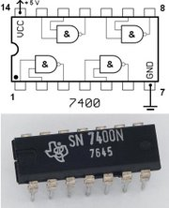
Logic Gates
One can buy gates separately
ex. 74xxx series of integrated circuits
cost ~$1 per chip, mostly for packaging and testing
Cumbersome, but possible to build devices using gates put together manually

Slide 47
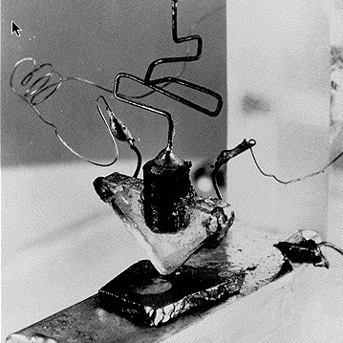
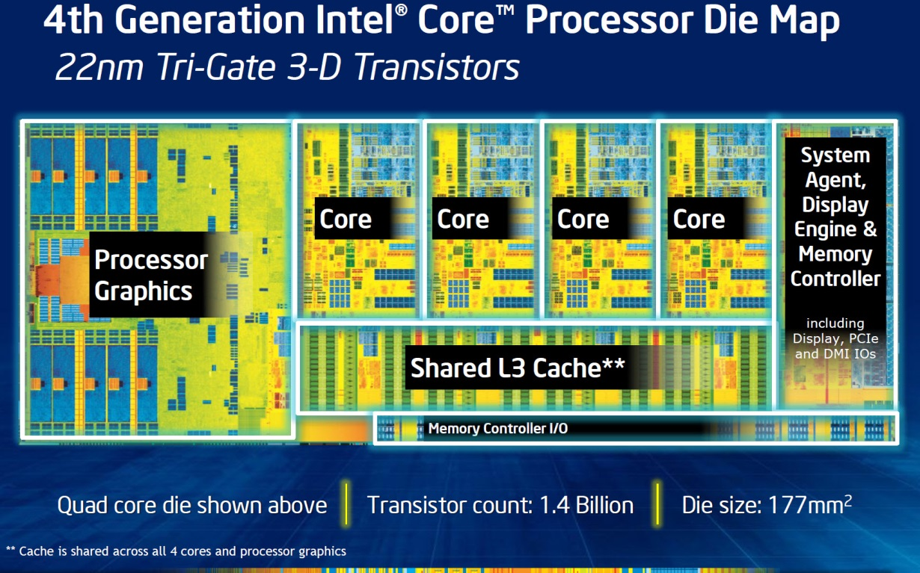
Then and Now
http://techguru3d.com/4th-gen-intel-haswell-processors-architecture-and-lineup/
The first transistor
on a workbench at
AT&T Bell Labs in 1947
Bardeen, Brattain, and Shockley
An Intel Haswell
1.4 billion transistors
177 square millimeters
Four processing cores
Notes:
John Bardeen
Walter Brattain
William Shockley

Slide 48
Big Picture: Abstraction
Hide complexity through simple abstractions
Simplicity
Box diagram represents inputs and outputs
Complexity
Hides underlying NMOS- and PMOS-transistors and atomic interactions
Vdd
a
in
out
d
out
Vss
b
a
d
out
in
out
b

Slide 49
Summary
Most modern devices are made from billions of on /off switches called transistors
We will build a processor in this course!
Transistors made from semiconductor materials:
MOSFET – Metal Oxide Semiconductor Field Effect Transistor
NMOS, PMOS – Negative MOS and Positive MOS
CMOS – complementary MOS made from PMOS and NMOS transistors
Transistors used to make logic gates and logic circuits
We can now implement any logic circuit
Can do it efficiently, using Karnaugh maps to find the minimal terms required
Can use either NAND or NOR gates to implement the logic circuit
Can use P- and N-transistors to implement NAND or NOR gates

