Slide 1
Gates and Logic: From switches to Transistors, Logic Gates and Logic Circuits
Prof. Hakim Weatherspoon
CS 3410, Spring 2015
Computer Science
Cornell University
See: P&H Appendix B.2 and B.3 (Also, see B.1)

Slide 2
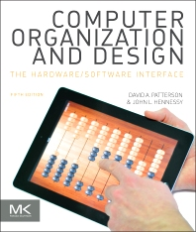
Goals for Today
From Switches to Logic Gates to Logic Circuits
Understanding the foundations of
Computer Systems Organization and Programming
Notes:
How does my laptop work? How does my phone work? What is the underlying principles and design for these electronics?

Slide 3
Goals for Today
From Switches to Logic Gates to Logic Circuits
Understanding the foundations of
Computer Systems Organization and Programming
e.g. Galaxy Note 3
Notes:
How does my laptop work? How does my phone work? What is the underlying principles and design for these electronics?
Galaxy note 3 picture: http://www.anandtech.com/show/6768/samsung-details-exynos-5-octa-architecture-power-at-isscc-13

Slide 4
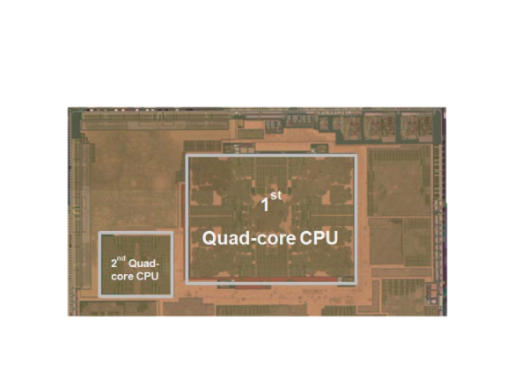
Goals for Today
From Switches to Logic Gates to Logic Circuits
Understanding the foundations of
Computer Systems Organization and Programming
e.g. Galaxy Note 3
with the big.LITTLE 8-core ARM processor
Notes:
How does my laptop work? How does my phone work? What is the underlying principles and design for these electronics?
Galaxy note 3 picture: http://www.anandtech.com/show/6768/samsung-details-exynos-5-octa-architecture-power-at-isscc-13

Slide 5
Goals for Today
From Switches to Logic Gates to Logic Circuits
Understanding the foundations of
Computer Systems Organization and Programming
e.g. Galaxy Note 3
with the big.LITTLE 8-core ARM processor
 | big Quad Core | LITTLE Quad Core
Architecture | ARM v7a | ARM v7a
Process | Samsung 28nm | Samsung 28nm
Frequency | 200MHz~1.8GHz+ | 200MHz~1.2GHz
Area | 19mm2 | 3.8mm2
Power-ratio | 1 | 0.17
L1 Cache Size | 32 KB I/D Cache | 32 KB I/D Cache
L2 Cache Size | 2 MB Data Cache | 512 KB Data Cache
Notes:
How does my laptop work? How does my phone work? What is the underlying principles and design for these electronics?
Galaxy note 3 picture: http://www.anandtech.com/show/6768/samsung-details-exynos-5-octa-architecture-power-at-isscc-13

Slide 6
Goals for Today
From Switches to Logic Gates to Logic Circuits
Logic Gates
From switches
Truth Tables
Logic Circuits
Identity Laws
From Truth Tables to Circuits (Sum of Products)
Logic Circuit Minimization
Algebraic Manipulations
Truth Tables (Karnaugh Maps)
Transistors (electronic switch)

Slide 7
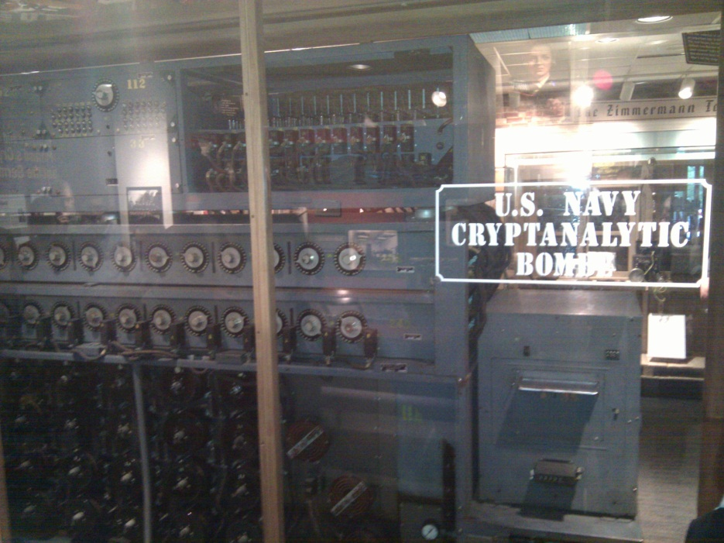
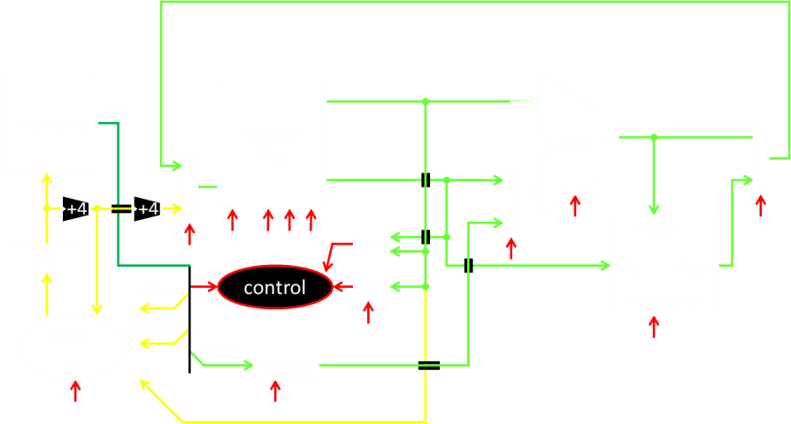
A switch
Acts as a conductor or insulator
Can be used to build amazing things…
The Bombe used to break the German
Enigma machine during World War II
Notes:
Pictures show the Bombe built by Alan Turing to break the enigma machine ciphers.
They were Fixed-Program Computers came before stored-program computers (general purpose)
The former required re-wiring (e.g. ENIAC took 3 weeks to “re-wire”).

Slide 8
Basic Building Blocks: Switches to Logic Gates
+
A
Truth Table
A | B | Light
OFF | OFF
A | B | Light
OFF | OFF
OFF | ON
A | B | Light
OFF | OFF
OFF | ON
ON | OFF
ON | ON
A | B | Light
-
A | B | Light
OFF | OFF
OFF | ON
ON | OFF
B
Notes:
Speed and size of a mechanical switch
Truth Table: defines the output for all possible combinations of values for input

Slide 9
Basic Building Blocks: Switches to Logic Gates
+
A
Truth Table
A | B | Light
OFF | OFF
A | B | Light
OFF | OFF
OFF | ON
A | B | Light
OFF | OFF
OFF | ON
ON | OFF
ON | ON
A | B | Light
-
A | B | Light
OFF | OFF | OFF
OFF | ON | ON
ON | OFF | ON
 |  | ON
B
+
A
-
A | B | Light
OFF | OFF
A | B | Light
OFF | OFF
OFF | ON
A | B | Light
OFF | OFF
OFF | ON
ON | OFF
A | B | Light
OFF | OFF
OFF | ON
ON | OFF
ON | ON
A | B | Light
B
Notes:
Speed and size of a mechanical switch

Slide 10
Basic Building Blocks: Switches to Logic Gates
+
A
Truth Table
A | B | Light
OFF | OFF
A | B | Light
OFF | OFF
OFF | ON
A | B | Light
OFF | OFF
OFF | ON
ON | OFF
ON | ON
A | B | Light
-
A | B | Light
OFF | OFF | OFF
OFF | ON | ON
ON | OFF | ON
 |  | ON
B
+
A
-
A | B | Light
OFF | OFF
A | B | Light
OFF | OFF
OFF | ON
A | B | Light
OFF | OFF
OFF | ON
ON | OFF
A | B | Light
OFF | OFF
OFF | ON
ON | OFF
ON | ON
A | B | Light
B
Notes:
Speed and size of a mechanical switch

Slide 11
Basic Building Blocks: Switches to Logic Gates
Either (OR)
Both (AND)
+
A
Truth Table
-
A | B | Light
OFF | OFF | OFF
OFF | ON | ON
ON | OFF | ON
ON | ON | ON
B
+
A
-
A | B | Light
OFF | OFF | OFF
OFF | ON | OFF
ON | OFF | OFF
ON | ON | ON
B
Notes:
Speed and size of a mechanical switch

Slide 12
Basic Building Blocks: Switches to Logic Gates
Either (OR)
Both (AND)
A
Truth Table
-
A | B | Light
OFF | OFF | OFF
OFF | ON | ON
ON | OFF | ON
ON | ON | ON
OR
B
A
-
A | B | Light
OFF | OFF | OFF
OFF | ON | OFF
ON | OFF | OFF
ON | ON | ON
AND
B
Notes:
Speed and size of a mechanical switch

Slide 13
Basic Building Blocks: Switches to Logic Gates
Either (OR)
Both (AND)
A
Truth Table
-
A | B | Light
0 | 0 | 0
0 | 1 | 1
1 | 0 | 1
1 | 1 | 1
OR
0 = OFF
1 = ON
B
A
-
A | B | Light
0 | 0 | 0
0 | 1 | 0
1 | 0 | 0
1 | 1 | 1
AND
B
Notes:
Speed and size of a mechanical switch

Slide 14
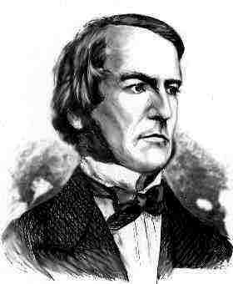
Basic Building Blocks: Switches to Logic Gates
A
OR
B
George Boole,(1815-1864)
A
Did you know?
George Boole Inventor of the idea of logic gates. He was born in Lincoln, England and he was the son of a shoemaker in a low class family.
AND
B
Notes:
E.g. logic statements:
“Jane will only go to the cinema tonight if a good film is on AND she has enough money.”
“Stuart will only go to the birthday party on Sunday if Katie OR Sujit is going too.”

Slide 15
Takeaway
Binary (two symbols: true and false) is the basis of Logic Design
Notes:
Add takeways at end of a block. Possibly build on takeaways throughout lecture

Slide 16
Building Functions: Logic Gates
A | Out
NOT:
AND:
OR:
Logic Gates
digital circuit that either allows a signal to pass through it or not.
Used to build logic functions
There are seven basic logic gates:
AND, OR, NOT
A
A | B | Out
0 | 0 | 0
0 | 1 | 0
1 | 0 | 0
1 | 1 | 1
A
B
A | B | Out
0 | 0 | 0
0 | 1 | 1
1 | 0 | 1
1 | 1 | 1
A
B
Notes:
Flash Drives
Create truth table of AND or OR: state what they do

Slide 17
Building Functions: Logic Gates
A | Out
0 | 1
1 | 0
NOT:
AND:
OR:
Logic Gates
digital circuit that either allows a signal to pass through it or not.
Used to build logic functions
There are seven basic logic gates:
AND, OR, NOT,
NAND (not AND), NOR (not OR), XOR, and XNOR (not XOR) [later]
A
A | B | Out
0 | 0 | 0
0 | 1 | 0
1 | 0 | 0
1 | 1 | 1
A
B
A | B | Out
0 | 0 | 0
0 | 1 | 1
1 | 0 | 1
1 | 1 | 1
A
B
Notes:
Flash Drives
Create truth table of AND or OR: state what they do
Did you know? Logic gates allow the computer to do things such as add, divide, multiply, do simple yes and no reasoning in certain situations along with other things.

Slide 18
Building Functions: Logic Gates
A | Out
0 | 1
1 | 0
NOT:
AND:
OR:
Logic Gates
digital circuit that either allows a signal to pass through it or not.
Used to build logic functions
There are seven basic logic gates:
AND, OR, NOT,
NAND (not AND), NOR (not OR), XOR, and XNOR (not XOR) [later]
A
A | B | Out
0 | 0 | 0
0 | 1 | 0
1 | 0 | 0
1 | 1 | 1
A | B | Out
0 | 0 | 1
0 | 1 | 1
1 | 0 | 1
1 | 1 | 0
NAND:
A
A
B
B
NOR:
A | B | Out
0 | 0 | 0
0 | 1 | 1
1 | 0 | 1
1 | 1 | 1
A | B | Out
0 | 0 | 1
0 | 1 | 0
1 | 0 | 0
1 | 1 | 0
A
A
B
B
Notes:
Flash Drives
Create truth table of AND or OR: state what they do
Did you know? Logic gates allow the computer to do things such as add, divide, multiply, do simple yes and no reasoning in certain situations along with other things.

Slide 19
Activity#1: Logic Gates
Fill in the truth table, given the following Logic Circuit made from Logic AND, OR, and NOT gates.
What does the logic circuit do?
a | b | Out
a
b
Out
Notes:
Fill out table
Put, NOT, AND, OR labels in box

Slide 20
Activity#1: Logic Gates
XOR: out = 1 if a or b is 1, but not both;
out = 0 otherwise.
out = 1, only if a = 1 AND b = 0
OR a = 0 AND b = 1
a | b | Out
0 | 0 | 0
0 | 1 | 1
1 | 0 | 1
1 | 1 | 0
a
b
Out
Notes:
Fill out table

Slide 21
Activity#1: Logic Gates
XOR: out = 1 if a or b is 1, but not both;
out = 0 otherwise.
out = 1, only if a = 1 AND b = 0
OR a = 0 AND b = 1
a | b | Out
0 | 0 | 0
0 | 1 | 1
1 | 0 | 1
1 | 1 | 0
a
Out
b
Notes:
Fill out table
Remove instructions

Slide 22
Activity#2: Logic Gates
Fill in the truth table, given the following Logic Circuit made from Logic AND, OR, and NOT gates.
What does the logic circuit do?
a | b | d | Out
0 | 0 | 0
0 | 0 | 1
0 | 1 | 0
0 | 1 | 1
1 | 0 | 0
1 | 0 | 1
1 | 1 | 0
1 | 1 | 1
a
d
Out
b
Notes:
Fill out table

Slide 23
Activity#2: Logic Gates
Multiplexor: select (d) between two inputs (a and b) and set one as the output (out)?
out = a, if d = 0
out = b, if d = 1
a | b | d | Out
0 | 0 | 0 | 0
0 | 0 | 1 | 0
0 | 1 | 0 | 0
0 | 1 | 1 | 1
1 | 0 | 0 | 1
1 | 0 | 1 | 0
1 | 1 | 0 | 1
1 | 1 | 1 | 1
a
d
Out
b
Notes:
Fill out table
Ask rows in audience to fill in different rows of tabel

Slide 24
Goals for Today
From Switches to Logic Gates to Logic Circuits
Logic Gates
From switches
Truth Tables
Logic Circuits
Identity Laws
From Truth Tables to Circuits (Sum of Products)
Logic Circuit Minimization
Algebraic Manipulations
Truth Tables (Karnaugh Maps)
Transistors (electronic switch)

Slide 25
Next Goal
Given a Logic function, create a Logic Circuit that implements the Logic Function…
…and, with the minimum number of logic gates
Fewer gates: A cheaper ($$$) circuit!
Notes:
Can get logic circuit from truth table
Minimize logic circuit through algebraic reductions or Karnaugh Maps

Slide 26
Logic Gates
A | Out
0 | 1
1 | 0
NOT:
AND:
OR:
XOR:
.
A
A | B | Out
0 | 0 | 0
0 | 1 | 0
1 | 0 | 0
1 | 1 | 1
A
B
A | B | Out
0 | 0 | 0
0 | 1 | 1
1 | 0 | 1
1 | 1 | 1
A
B
A | B | Out
0 | 0 | 0
0 | 1 | 1
1 | 0 | 1
1 | 1 | 0
A
B
Notes:
XOR is not a basic Logic Gate since it can be created from AND and OR gates, but it is often used as a basic Logic Operator

Slide 27
Logic Gates
A | Out
0 | 1
1 | 0
NOT:
AND:
OR:
XOR:
.
A
A | B | Out
0 | 0 | 0
0 | 1 | 0
1 | 0 | 0
1 | 1 | 1
A | B | Out
0 | 0 | 1
0 | 1 | 1
1 | 0 | 1
1 | 1 | 0
NAND:
A
A
B
B
NOR:
A | B | Out
0 | 0 | 0
0 | 1 | 1
1 | 0 | 1
1 | 1 | 1
A | B | Out
0 | 0 | 1
0 | 1 | 0
1 | 0 | 0
1 | 1 | 0
A
A
B
B
XNOR:
A | B | Out
0 | 0 | 0
0 | 1 | 1
1 | 0 | 1
1 | 1 | 0
A | B | Out
0 | 0 | 1
0 | 1 | 0
1 | 0 | 0
1 | 1 | 1
A
A
B
B
Notes:
XOR is not a basic Logic Gate since it can be created from AND and OR gates, but it is often used as a basic Logic Operator

Slide 28
Logic Equations
NOT:
out = ā = !a = ¬a
AND:
out = a ∙ b = a & b = a ∧ b
OR:
out = a + b = a | b = a ∨ b
XOR:
out = a ⊕ b = a$\overline{b}$ + āb
Logic Equations
Constants: true = 1, false = 0
Variables: a, b, out, …
Operators (above): AND, OR, NOT, etc.
Notes:
Apologize that there are three ways to represent the same logic equation
XOR is not a basic Logic Gate since it can be created from AND and OR gates, but it is often used as a basic Logic Operator
AND is “product”
OR is “sum”
Read outloud

Slide 29
Logic Equations
NOT:
out = ā = !a = ¬a
AND:
out = a ∙ b = a & b = a ∧ b
OR:
out = a + b = a | b = a ∨ b
XOR:
out = a ⊕ b = a$\overline{b}$ + āb
Logic Equations
Constants: true = 1, false = 0
Variables: a, b, out, …
Operators (above): AND, OR, NOT, etc.
NAND:
out = $\overline{a \text{∙} b}$ = !(a & b) = ¬ (a ∧ b)
NOR:
out = $\overline{a+b}$ = !(a | b) = ¬ (a ∨ b)
XNOR:
out = $\overline{a \text{⊕} b}$ = ab + $\overline{ab}$
.
Notes:
Apologize that there are three ways to represent the same logic equation
XOR is not a basic Logic Gate since it can be created from AND and OR gates, but it is often used as a basic Logic Operator
AND is “product”
OR is “sum”
Read outloud

Slide 30
Identities
Identities useful for manipulating logic equations
For optimization & ease of implementation
a + 0 =
a + 1 =
a + ā =
a ∙ 0 =
a ∙ 1 =
a ∙ ā =
Notes:
Minimization activity
Maybe use picture to go through
Complement a+ā=1 and aā=0

Slide 31
Identities
Identities useful for manipulating logic equations
For optimization & ease of implementation
a + 0 =
a + 1 =
a + ā =
a ∙ 0 =
a ∙ 1 =
a ∙ ā =
a
1
1
0
a
0
a
b
a
b
Notes:
Minimization activity
Maybe use picture to go through
Complement a+ā=1 and aā=0

Slide 32
Identities
Identities useful for manipulating logic equations
For optimization & ease of implementation
$\overline{(a+b)}$ =
$\overline{(a ∙b)}$ =
a + a b =
a(b+c) =
$\overline{a(b+c)}$ =
Notes:
Minimization activity
Maybe use picture to go through
De Morgan’s Law: $\overline{(a+b)}$ = $\overline{a}$ ∙ $\overline{b}$ and $\overline{(a ∙b)}$ = $\overline{a}$ + $\overline{b}$

Slide 33
Identities
Identities useful for manipulating logic equations
For optimization & ease of implementation
$\overline{(a+b)}$ =
$\overline{(a ∙b)}$ =
a + a b =
a(b+c) =
$\overline{a(b+c)}$ =
A
↔
A
$\overline{a}$ ∙ $\overline{b}$
$\overline{a}$ + $\overline{b}$
a
ab + ac
$\overline{a}$ + $\overline{b}$∙$\overline{c}$
B
B
A
↔
A
B
B
Notes:
Minimization activity
Maybe use picture to go through
De Morgan’s Law: $\overline{(a+b)}$ = $\overline{a}$ ∙ $\overline{b}$ and $\overline{(a ∙b)}$ = $\overline{a}$ + $\overline{b}$

Slide 34
Activity #3: Identities
a + 0 =
a + 1 =
a + ā =
a 0 =
a 1 =
a ā =
$\overline{(a+b)}$ =
$\overline{(a b)}$ =
a + a b =
a(b+c) =
$\overline{a(b+c)}$ =
a
1
1
0
a
0
$\overline{a}$ $\overline{b}$
$\overline{a}$ + $\overline{b}$
a
ab + ac
$\overline{a}$ + $\overline{b}$∙$\overline{c}$
Show that the Logic equations
below are equivalent.
(a+b)(a+c) = a + bc
(a+b)(a+c) =
Notes:
Minimization activity

Slide 35
Activity #3: Identities
a + 0 =
a + 1 =
a + ā =
a 0 =
a 1 =
a ā =
$\overline{(a+b)}$ =
$\overline{(a b)}$ =
a + a b =
a(b+c) =
$\overline{a(b+c)}$ =
a
1
1
0
a
0
$\overline{a}$ $\overline{b}$
$\overline{a}$ + $\overline{b}$
a
ab + ac
$\overline{a}$ + $\overline{bc}$
Show that the Logic equations
below are equivalent.
(a+b)(a+c) = a + bc
(a+b)(a+c) = aa + ab + ac + bc
= a + a(b+c) + bc
= a(1 + (b+c)) + bc
= a + bc
Notes:
Minimization activity

Slide 36
Logic Manipulation
functions: gates ↔ truth tables ↔ equations
Example: (a+b)(a+c) = a + bc
a | b | c
0 | 0 | 0
0 | 0 | 1
0 | 1 | 0
0 | 1 | 1
1 | 0 | 0
1 | 0 | 1
1 | 1 | 0
1 | 1 | 1
Notes:
(a+b)(a+c)
= aa + ab + ac + bc
= a + a(b+c) + bc
= a(1 + (b+c)) + bc
= a + bc

Slide 37
Logic Manipulation
functions: gates ↔ truth tables ↔ equations
Example: (a+b)(a+c) = a + bc
a | b | c
0 | 0 | 0
0 | 0 | 1
0 | 1 | 0
0 | 1 | 1
1 | 0 | 0
1 | 0 | 1
1 | 1 | 0
1 | 1 | 1
 |  |  | a+b | a+c | LHS
 |  |  | 0 | 0 | 0
 |  |  | 0 | 1 | 0
 |  |  | 1 | 0 | 0
 |  |  | 1 | 1 | 1
 |  |  | 1 | 1 | 1
 |  |  | 1 | 1 | 1
 |  |  | 1 | 1 | 1
 |  |  | 1 | 1 | 1
 |  |  |  |  |  | bc | RHS
 |  |  |  |  |  | 0 | 0
 |  |  |  |  |  | 0 | 0
 |  |  |  |  |  | 0 | 0
 |  |  |  |  |  | 1 | 1
 |  |  |  |  |  | 0 | 1
 |  |  |  |  |  | 0 | 1
 |  |  |  |  |  | 0 | 1
 |  |  |  |  |  | 1 | 1
Notes:
(a+b)(a+c)
= aa + ab + ac + bc
= a + a(b+c) + bc
= a(1 + (b+c)) + bc
= a + bc

Slide 38
Takeaway
Binary (two symbols: true and false) is the basis of Logic Design
More than one Logic Circuit can implement same Logic function. Use Algebra (Identities) or Truth Tables to show equivalence.
Notes:
Add takeways at end of a block. Possibly build on takeaways throughout lecture

Slide 39
Notes:
Think-Pair-Share: Why does minimization matter

Slide 40
Goals for Today
From Switches to Logic Gates to Logic Circuits
Logic Gates
From switches
Truth Tables
Logic Circuits
Identity Laws
From Truth Tables to Circuits (Sum of Products)
Logic Circuit Minimization
Algebraic Manipulations
Truth Tables (Karnaugh Maps)
Transistors (electronic switch)

Slide 41
Next Goal
How to standardize minimizing logic circuits?

Slide 42
Logic Minimization
How to implement a desired logic function?
a | b | c | out
0 | 0 | 0 | 0
0 | 0 | 1 | 1
0 | 1 | 0 | 0
0 | 1 | 1 | 1
1 | 0 | 0 | 0
1 | 0 | 1 | 1
1 | 1 | 0 | 0
1 | 1 | 1 | 0
Notes:
Draw circuit and go through out=true cases
Have not done cheaply yet

Slide 43
Logic Minimization
How to implement a desired logic function?
Write minterms
sum of products:
OR of all minterms where out=1
a | b | c | out
0 | 0 | 0 | 0
0 | 0 | 1 | 1
0 | 1 | 0 | 0
0 | 1 | 1 | 1
1 | 0 | 0 | 0
1 | 0 | 1 | 1
1 | 1 | 0 | 0
1 | 1 | 1 | 0
minterm
a b c
a b c
a b c
a b c
a b c
a b c
a b c
a b c
Notes:
Show what out equals

Slide 44
Logic Minimization
How to implement a desired logic function?
Write minterms
sum of products:
OR of all minterms where out=1
E.g. out = $\overline{ab}$c + $\overline{a}$bc + a$\overline{b}$c
a | b | c | out
0 | 0 | 0 | 0
0 | 0 | 1 | 1
0 | 1 | 0 | 0
0 | 1 | 1 | 1
1 | 0 | 0 | 0
1 | 0 | 1 | 1
1 | 1 | 0 | 0
1 | 1 | 1 | 0
minterm
a b c
a b c
a b c
a b c
a b c
a b c
a b c
a b c
a
b
c
out
corollary: any combinational circuit can be implemented in two levels of logic (ignoring inverters)
Notes:
Show what out equals

Slide 45
Karnaugh Maps
How does one find the most efficient equation?
Manipulate algebraically until…?
Use Karnaugh maps (optimize visually)
Use a software optimizer
For large circuits
Decomposition & reuse of building blocks

Slide 46
Minimization with Karnaugh maps (1)
Sum of minterms yields
out = $\overline{ab}$c + $\overline{a}$bc + a$\overline{bc}$ + a$\overline{b}$c
a | b | c | out
0 | 0 | 0 | 0
0 | 0 | 1 | 1
0 | 1 | 0 | 0
0 | 1 | 1 | 1
1 | 0 | 0 | 1
1 | 0 | 1 | 1
1 | 1 | 0 | 0
1 | 1 | 1 | 0

Slide 47
Minimization with Karnaugh maps (2)
Sum of minterms yields
out = $\overline{ab}$c + $\overline{a}$bc + a$\overline{bc}$ + a$\overline{b}$c
Karnaugh maps identify which inputs are (ir)relevant to the output
a | b | c | out
0 | 0 | 0 | 0
0 | 0 | 1 | 1
0 | 1 | 0 | 0
0 | 1 | 1 | 1
1 | 0 | 0 | 1
1 | 0 | 1 | 1
1 | 1 | 0 | 0
1 | 1 | 1 | 0
ab
c
00 01 11 10
0
0 | 0 | 0 | 1
1 | 1 | 0 | 1
1

Slide 48
Minimization with Karnaugh maps (2)
Sum of minterms yields
out = $\overline{ab}$c + $\overline{a}$bc + a$\overline{bc}$ + a$\overline{b}$c
Karnaugh maps identify which inputs are (ir)relevant to the output
a | b | c | out
0 | 0 | 0 | 0
0 | 0 | 1 | 1
0 | 1 | 0 | 0
0 | 1 | 1 | 1
1 | 0 | 0 | 1
1 | 0 | 1 | 1
1 | 1 | 0 | 0
1 | 1 | 1 | 0
ab
c
00 01 11 10
0
0 | 0 | 0 | 1
1 | 1 | 0 | 1
1

Slide 49
Minimization with Karnaugh maps (2)
Sum of minterms yields
out = $\overline{ab}$c + $\overline{a}$bc + a$\overline{bc}$ + a$\overline{b}$c
Karnaugh map minimization
Cover all 1’s
Group adjacent blocks of 2^{n} 1’s that yield a rectangular shape
Encode the common features of the rectangle
out = a$\overline{b}$ + $\overline{a}$c
a | b | c | out
0 | 0 | 0 | 0
0 | 0 | 1 | 1
0 | 1 | 0 | 0
0 | 1 | 1 | 1
1 | 0 | 0 | 1
1 | 0 | 1 | 1
1 | 1 | 0 | 0
1 | 1 | 1 | 0
ab
c
00 01 11 10
0
0 | 0 | 0 | 1
1 | 1 | 0 | 1
1

Slide 50
Karnaugh Minimization Tricks (1)
ab
c
00 01 11 10
Minterms can overlap
out = b$\overline{c}$ + a$\overline{c}$ + ab
Minterms can span 2, 4, 8 or more cells
out = $\overline{c}$ + ab
0
0 | 1 | 1 | 1
0 | 0 | 1 | 0
1
ab
c
00 01 11 10
0
1 | 1 | 1 | 1
0 | 0 | 1 | 0
1

Slide 51
Karnaugh Minimization Tricks (1)
ab
c
00 01 11 10
Minterms can overlap
out = b$\overline{c}$ + a$\overline{c}$ + ab
Minterms can span 2, 4, 8 or more cells
out = $\overline{c}$ + ab
0
0 | 1 | 1 | 1
0 | 0 | 1 | 0
1
ab
c
00 01 11 10
0
1 | 1 | 1 | 1
0 | 0 | 1 | 0
1

Slide 52
Karnaugh Minimization Tricks (2)
ab
cd
00 01 11 10
00
0 | 0 | 0 | 0
1 | 0 | 0 | 1
1 | 0 | 0 | 1
0 | 0 | 0 | 0
The map wraps around
out = $\overline{b}$d
out = $\overline{b}$ $\overline{d}$
01
11
10
ab
cd
00 01 11 10
00
1 | 0 | 0 | 1
0 | 0 | 0 | 0
0 | 0 | 0 | 0
1 | 0 | 0 | 1
01
11
10

Slide 53
Karnaugh Minimization Tricks (2)
ab
cd
00 01 11 10
00
0 | 0 | 0 | 0
1 | 0 | 0 | 1
1 | 0 | 0 | 1
0 | 0 | 0 | 0
The map wraps around
out = $\overline{b}$d
out = $\overline{b}$ $\overline{d}$
01
11
10
ab
cd
00 01 11 10
00
1 | 0 | 0 | 1
0 | 0 | 0 | 0
0 | 0 | 0 | 0
1 | 0 | 0 | 1
01
11
10

Slide 54
Karnaugh Minimization Tricks (3)
ab
cd
00 01 11 10
00
0 | 0 | 0 | 0
1 | x | x | x
1 | x | x | 1
0 | 0 | 0 | 0
“Don’t care” values can be interpreted individually in whatever way is convenient
assume all x’s = 1
out = d
assume middle x’s = 0
assume 4th column x = 1
out = $\overline{b}$ $\overline{d}$
01
11
10
ab
cd
00 01 11 10
00
1 | 0 | 0 | x
0 | x | x | 0
0 | x | x | 0
1 | 0 | 0 | 1
01
11
10

Slide 55
Karnaugh Minimization Tricks (3)
ab
cd
00 01 11 10
00
0 | 0 | 0 | 0
1 | x | x | x
1 | x | x | 1
0 | 0 | 0 | 0
“Don’t care” values can be interpreted individually in whatever way is convenient
assume all x’s = 1
out = d
assume middle x’s = 0
assume 4th column x = 1
out = $\overline{b}$ $\overline{d}$
01
11
10
ab
cd
00 01 11 10
00
1 | 0 | 0 | x
0 | x | x | 0
0 | x | x | 0
1 | 0 | 0 | 1
01
11
10

Slide 56
Multiplexer
A multiplexer selects between multiple inputs
out = a, if d = 0
out = b, if d = 1
Build truth table
Minimize diagram
Derive logic diagram
a
b
d
a | b | d | out
0 | 0 | 0
0 | 0 | 1
0 | 1 | 0
0 | 1 | 1
1 | 0 | 0
1 | 0 | 1
1 | 1 | 0
1 | 1 | 1
Notes:
What is the truth table

Slide 57
Multiplexer Implementation
a
Build a truth table
out = $\overline{a}$bd + a$\overline{bd}$ + ab$\overline{d}$ + abd
b
d
a | b | d | out
0 | 0 | 0 | 0
0 | 0 | 1 | 0
0 | 1 | 0 | 0
0 | 1 | 1 | 1
1 | 0 | 0 | 1
1 | 0 | 1 | 0
1 | 1 | 0 | 1
1 | 1 | 1 | 1

Slide 58
Multiplexer Implementation
a
Build the Karnaugh map
b
d
ab
d
00 01 11 10
a | b | d | out
0 | 0 | 0 | 0
0 | 0 | 1 | 0
0 | 1 | 0 | 0
0 | 1 | 1 | 1
1 | 0 | 0 | 1
1 | 0 | 1 | 0
1 | 1 | 0 | 1
1 | 1 | 1 | 1
0
1

Slide 59
Multiplexer Implementation
a
Build the Karnaugh map
b
d
ab
d
00 01 11 10
a | b | d | out
0 | 0 | 0 | 0
0 | 0 | 1 | 0
0 | 1 | 0 | 0
0 | 1 | 1 | 1
1 | 0 | 0 | 1
1 | 0 | 1 | 0
1 | 1 | 0 | 1
1 | 1 | 1 | 1
0
0 | 0 | 1 | 1
0 | 1 | 1 | 0
1

Slide 60
Multiplexer Implementation
a
Derive Minimal Logic Equation
out = a$\overline{d}$ + bd
b
d
ab
d
00 01 11 10
a | b | d | out
0 | 0 | 0 | 0
0 | 0 | 1 | 0
0 | 1 | 0 | 0
0 | 1 | 1 | 1
1 | 0 | 0 | 1
1 | 0 | 1 | 0
1 | 1 | 0 | 1
1 | 1 | 1 | 1
0
0 | 0 | 1 | 1
0 | 1 | 1 | 0
1
a
d
out
b

Slide 61
Takeaway
Binary (two symbols: true and false) is the basis of Logic Design
More than one Logic Circuit can implement same Logic function. Use Algebra (Identities) or Truth Tables to show equivalence.
Any logic function can be implemented as “sum of products”. Karnaugh Maps minimize number of gates.
Notes:
Add takeways at end of a block. Possibly build on takeaways throughout lecture

Slide 62
Administrivia
Dates to keep in Mind
Prelims: Tue Mar 3rd and Thur April 30th
Lab 1: Due Fri Feb 13th before Winter break
Proj2: Due Thur Mar 26th before Spring break
Final Project: Due when final would be (not known until Feb 14th)

Slide 63
Administrivia
Lab Sections (required)
Labs sections are required.
Separate than lecture and homework
Bring laptop to Labs
“Make up” lab sections only 8:40am Wed, Thur, or Fri
This week: intro to logisim and building an adder
T 2:55 – 4:10pm Carpenter Hall 104 (Blue Room)
W 8:40—9:55am Carpenter Hall 104 (Blue Room)
W 11:40am – 12:55pm Carpenter Hall 104 (BlueRoom) W 1:25 – 2:40pm Carpenter Hall 104 (BlueRoom)
W 3:35 – 4:50pm Carpenter Hall 104 (Blue Room) W 7:30—8:45pm Phillips 318
R 8:40 – 9:55pm Carpenter Hall 104 (Blue Room) R 11:40 – 12:55pm Carpenter Hall 104 (Blue Room) R 2:55 – 4:10pm Carpenter Hall 104 (Blue Room) F 8:40 – 9:55am Carpenter Hall 104 (Blue Room)
F 11:40am – 12:55pm Carpenter Hall 104 (Blue Room)
F 1:25 – 2:40pm Carpenter Hall 104 (Blue Room)
F 2:55 – 4:10pm Carpenter Hall 104 (Blue Room)

Slide 64
iClicker
Attempt to balance the iClicker graph
Register iClicker
http://atcsupport.cit.cornell.edu/pollsrvc/
iClicker GO
http://pollinghelp.cit.cornell.edu/iclicker-go/#students

Slide 65
Goals for Today
From Transistors to Gates to Logic Circuits
Logic Gates
From transistors
Truth Tables
Logic Circuits
Identity Laws
From Truth Tables to Circuits (Sum of Products)
Logic Circuit Minimization
Algebraic Manipulations
Truth Tables (Karnaugh Maps)
Transistors (electronic switch)

Slide 66
Activity#4 How do we build electronic switches?
Transistors:
6:10 minutes (watch from from 41s to 7:00)
http://www.youtube.com/watch?v=QO5FgM7MLGg
Fill our Transistor Worksheet with info from Video
Notes:
Everything that we have shown them can be constructed in silicon.

Slide 67
NMOS and PMOS Transistors
NMOS Transistor
Connect source to drain when gate = 1
N-channel
PMOS Transistor
Connect source to drain when gate = 0
P-channel
V_{D}
V_{S}= 0 V
V_{G}
V_{G} = V_{S}
V_{G}
V_{G} = V_{S}
V_{G} = 0 V
V_{G} = 0 V
V_{S} = 0 V
V_{D}

Slide 68
NMOS and PMOS Transistors
NMOS Transistor
Connect source to drain when gate = 1
N-channel
PMOS Transistor
Connect source to drain when gate = 0
P-channel
V_{D}
V_{S}= 0 V
V_{G}
V_{G} = 1
V_{G}
V_{G} = 1
V_{G} = 0
V_{G} = 0
V_{S} = 0 V
V_{D}

Slide 69
Inverter
V_{supply} (aka logic 1)
Function: NOT
Called an inverter
Symbol:
Useful for taking the inverse of an input
CMOS: complementary-symmetry metal–oxide–semiconductor
0
1
in
out
in
out
(ground is logic 0)
In | Out
0 | 1
1 | 0
Truth table

Slide 70
Inverter
V_{supply}
V_{supply} (aka logic 1)
Function: NOT
Called an inverter
Symbol:
Useful for taking the inverse of an input
CMOS: complementary-symmetry metal–oxide–semiconductor
1
0
in
out
in
out
(ground is logic 0)
In | Out
0 | 1
1 | 0
Truth table

Slide 71
Inverter
V_{supply}
V_{supply} (aka logic 1)
Function: NOT
Called an inverter
Symbol:
Useful for taking the inverse of an input
CMOS: complementary-symmetry metal–oxide–semiconductor
in
out
A = 0
Out = 1
A = 1
Out = 0
in
out
(ground is logic 0)
A | Out
0 | 1
1 | 0
Truth table

Slide 72
NAND Gate
V_{supply}
V_{supply}
Function: NAND
Symbol:
1
1
A
B
0
a
out
out
1
b
B
1
A
A | B | out
0 | 0 | 1
1 | 0 | 1
0 | 1 | 1
1 | 1 | 0

Slide 73
NOR Gate
V_{supply}
Function: NOR
Symbol:
A
0
0
a
B
out
1
b
out
0
0
A
B
A | B | out
0 | 0 | 1
1 | 0 | 0
0 | 1 | 0
1 | 1 | 0
Notes:
Example

Slide 74
Building Functions (Revisited)
NOT:
AND:
OR:
NAND and NOR are universal
Can implement any function with NAND or just NOR gates
useful for manufacturing
Notes:
Flash Drives
Create truth table of AND or OR: state what they do

Slide 75
Building Functions (Revisited)
NOT:
AND:
OR:
NAND and NOR are universal
Can implement any function with NAND or just NOR gates
useful for manufacturing
a
a
b
a
b
Notes:
Flash Drives
Create truth table of AND or OR: state what they do

Slide 76
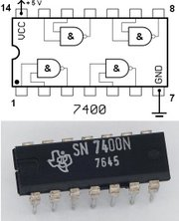
Logic Gates
One can buy gates separately
ex. 74xxx series of integrated circuits
cost ~$1 per chip, mostly for packaging and testing
Cumbersome, but possible to build devices using gates put together manually

Slide 77
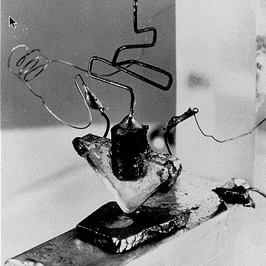
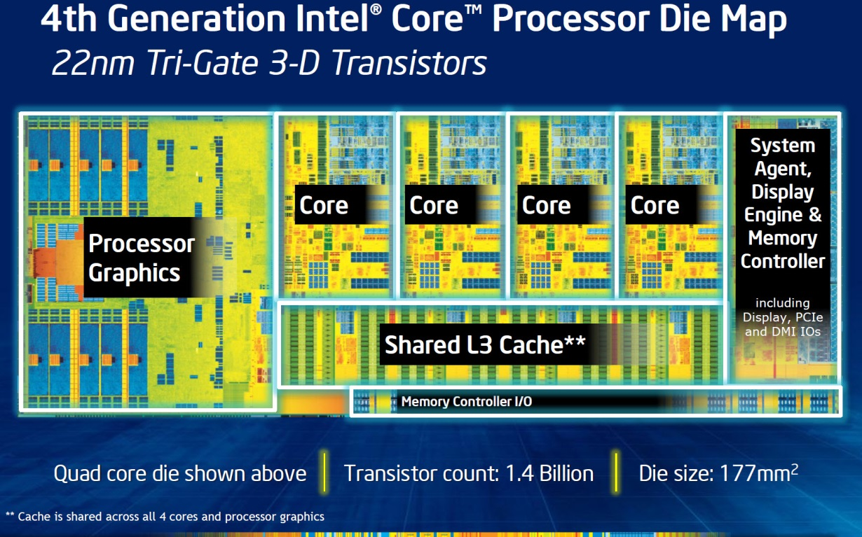
Then and Now
http://techguru3d.com/4th-gen-intel-haswell-processors-architecture-and-lineup/
The first transistor
on a workbench at
AT&T Bell Labs in 1947
Bardeen, Brattain, and Shockley
An Intel Haswell
1.4 billion transistors
177 square millimeters
Four processing cores
Notes:
John Bardeen
Walter Brattain
William Shockley

Slide 78
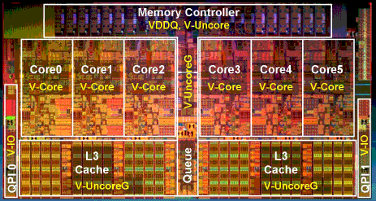
Then and Now
http://www.theregister.co.uk/2010/02/03/intel_westmere_ep_preview/
The first transistor
on a workbench at
AT&T Bell Labs in 1947
Bardeen, Brattain, and Shockley
An Intel Westmere
1.17 billion transistors
240 square millimeters
Six processing cores
Notes:
John Bardeen
Walter Brattain
William Shockley

Slide 79
Big Picture: Abstraction
Hide complexity through simple abstractions
Simplicity
Box diagram represents inputs and outputs
Complexity
Hides underlying NMOS- and PMOS-transistors and atomic interactions
Vdd
a
in
out
d
out
Vss
b
a
d
out
in
out
b

Slide 80
Summary
Most modern devices are made from billions of on /off switches called transistors
We will build a processor in this course!
Transistors made from semiconductor materials:
MOSFET – Metal Oxide Semiconductor Field Effect Transistor
NMOS, PMOS – Negative MOS and Positive MOS
CMOS – complementary MOS made from PMOS and NMOS transistors
Transistors used to make logic gates and logic circuits
We can now implement any logic circuit
Can do it efficiently, using Karnaugh maps to find the minimal terms required
Can use either NAND or NOR gates to implement the logic circuit
Can use P- and N-transistors to implement NAND or NOR gates

