Slide 1
Homework 2 Review
Cornell CS 3410

Slide 2
Calling Conventions
How many caller/callee-saved registers would you expect this C code to use? For each variable, would it make more sense to use a caller- or callee-saved register?
int gcd(int x, int y) {
int t, a = x, b = y;
while(b != 0) {
t = b;
b = mod(a, b);
a = t;
}
return a;
}

Slide 3
Calling Conventions
How many caller/callee-saved registers would you expect this C code to use? For each variable, would it make more sense to use a caller- or callee-saved register?
int gcd(int x, int y) {
int t, a = x, b = y;
while(b != 0) {
t = b;
b = mod(a, b);
a = t;
}
return a;
}
3 registers:
1 callee-saved register for t
t is needed after the call to mod
2 caller-saved registers for a and b

Slide 4
Calling Conventions
Write the prologue for gcd().
int gcd(int x, int y) {
int t, a = x, b = y;
while(b != 0) {
t = b;
b = mod(a, b);
a = t;
}
return a;
}

Slide 5
Calling Conventions
Write the prologue for gcd().
int gcd(int x, int y) {
int t, a = x, b = y;
while(b != 0) {
t = b;
b = mod(a, b);
a = t;
}
return a;
}
addiu $sp, $sp, -28
sw $ra, 24($sp)
sw $fp, 20($sp)
sw $s0, 16($sp)
addiu $fp, $sp, 24
addiu $t0, $a0, 0
addiu $t1, $a1, 0

Slide 6
Calling Conventions
Write the epilogue for gcd().
int gcd(int x, int y) {
int t, a = x, b = y;
while(b != 0) {
t = b;
b = mod(a, b);
a = t;
}
return a;
}

Slide 7
Calling Conventions
Write the epilogue for gcd().
int gcd(int x, int y) {
int t, a = x, b = y;
while(b != 0) {
t = b;
b = mod(a, b);
a = t;
}
return a;
}
lw $s0, 16($sp)
lw $fp, 20($sp)
lw $ra, 24($sp)
addiu $sp, $sp, 28
jr $ra
nop

Slide 8
Calling Conventions
Write the function call for mod().
int gcd(int x, int y) {
int t, a = x, b = y;
while(b != 0) {
t = b;
b = mod(a, b);
a = t;
}
return a;
}

Slide 9
Calling Conventions
Write the function call for mod().
int gcd(int x, int y) {
int t, a = x, b = y;
while(b != 0) {
t = b;
b = mod(a, b);
a = t;
}
return a;
}
addiu $a0, $t0, 0
addiu $a1, $t1, 0
jal MOD
nop

Slide 10
Virtual Memory
Consider a byte-addressable virtual memory system with 32-bit virtual addresses, 32-bit physical addresses, and 1 KB pages.
Can we run a program that requires 16 GB of memory?

Slide 11
Virtual Memory
Consider a byte-addressable virtual memory system with 32-bit virtual addresses, 32-bit physical addresses, and 1 KB pages.
Can we run a program that requires 16 GB of memory?
No:
The amount of virtual memory is 2^32 bytes = 4 GB. Since only 4 GB are addressable, we cannot run a program that needs to address 16 GB.

Slide 12
Virtual Memory
Consider a byte-addressable virtual memory system with 32-bit virtual addresses, 32-bit physical addresses, and 1 KB pages.
If each entry in the single-level page table is 4 bytes long, how much space does the page-table occupy in memory?

Slide 13
Virtual Memory
Consider a byte-addressable virtual memory system with 32-bit virtual addresses, 32-bit physical addresses, and 1 KB pages.
If each entry in the single-level page table is 4 bytes long, how much space does the page-table occupy in memory?
The page size is 1 KB = 2^10 bytes, so the page-offset is 10 bits.
The VPN field is 32 – 10 = 22 bits long.
The page table thus has 2^22 entries.
Thus, the table takes up 4 * (2^22) bytes = 16 MB of memory.

Slide 14
Virtual Memory
Consider a byte-addressable virtual memory system with 32-bit virtual addresses, 32-bit physical addresses, and 1 KB pages.
If each entry in the single-level page table is 4 bytes long, how much total physical memory does a 32 MB process occupy?

Slide 15
Virtual Memory
Consider a byte-addressable virtual memory system with 32-bit virtual addresses, 32-bit physical addresses, and 1 KB pages.
If each entry in the single-level page table is 4 bytes long, how much total physical memory does a 32 MB process occupy?
16 MB page table + 32 MB process = 48 MB total

Slide 16
Multicore Performance
Consider a program with 3 sequential parts:
The first 10% can be parallelized to any extent.
The next 30% can be run on up to 10 processors.
The last 60% can’t be parallelized at all.
The program takes 70 seconds on a single processor.
How long will it take on 2 processors?
On n processors, as n goes to infinity?

Slide 17
Multicore Performance
Consider a program with 3 sequential parts:
The first 10% can be parallelized to any extent.
The next 30% can be run on up to 10 processors.
The last 60% can’t be parallelized at all.
The program takes 70 seconds on a single processor.
How long will it take on 2 processors?
On n processors, as n goes to infinity?
(70*.1)/2 + (70*.3)/2 + (70*.6) s = 3.5 + 10.5 + 42 s = 56 s

Slide 18
Multicore Performance
Consider a program with 3 sequential parts:
The first 10% can be parallelized to any extent.
The next 30% can be run on up to 10 processors.
The last 60% can’t be parallelized at all.
The program takes 70 seconds on a single processor.
How long will it take on 2 processors?
On n processors, as n goes to infinity?
(70*.1)/2 + (70*.3)/2 + (70*.6) s = 3.5 + 10.5 + 42 s = 56 s
lim n→∞ (70*.1)/n + (70*.3)/10 + (70*.6) s = 0 + 2.1 + 42 s = 44.1 s

Slide 19
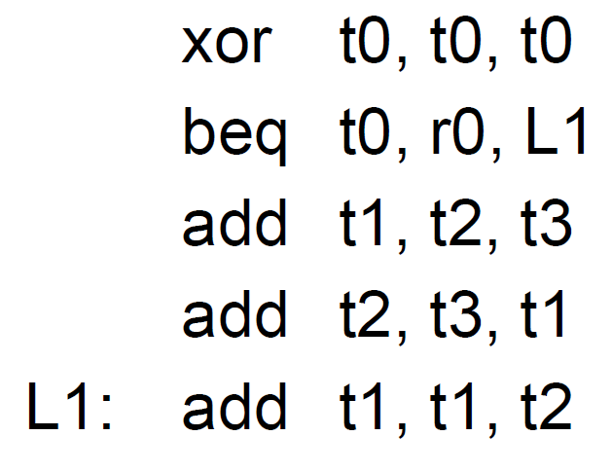
Hazards, Branches, & Cycle charts
Is the branch taken?
Where are the data hazards?

Slide 20
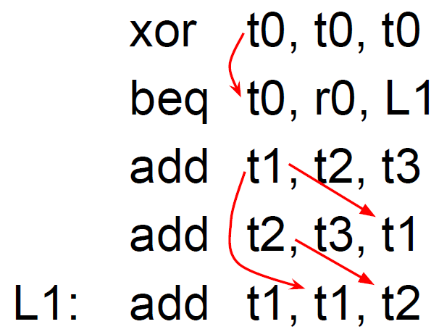
Hazards, Branches, & Cycle charts
Is the branch taken?
Where are the data hazards?
Yes

Slide 21
Hazards, Branches, & Cycle charts
Fill in the chart.
Assume 1 delay slot, predict not-taken, no bypasses, and branches resolved in EXE.

Slide 22
Hazards, Branches, & Cycle charts
Fill in the chart.
Assume 1 delay slot, predict not-taken, no bypasses, and branches resolved in EXE.

Slide 23
Hazards, Branches, & Cycle charts
Fill in the chart.
Assume 1 delay slot, predict not-taken, fully bypassed, and branches resolved in EXE.

Slide 24
Hazards, Branches, & Cycle charts
Fill in the chart.
Assume 1 delay slot, predict not-taken, fully bypassed, and branches resolved in EXE.

Slide 25
Cache
Consider a 32-bit machine with 1024 different 16-byte direct-mapped cache lines.
How many tag bits, index bits, and offset bits would you expect?

Slide 26
Cache
Consider a 32-bit machine with 1024 different 16-byte direct-mapped cache lines.
How many tag bits, index bits, and offset bits would you expect?
Offset: 16 bytes = 2^4 bytes, so 4 bits
Index: 1024 lines = 2^10 lines, so 10 bits
Tag: 32 – 4 – 10 = 18, so 18 bits

Slide 27
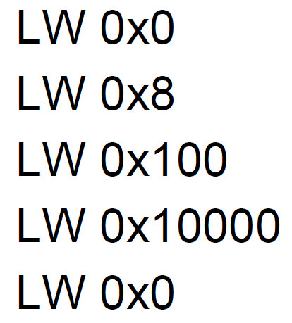
Cache
Consider a 32-bit machine with 1024 different 16-byte direct-mapped cache lines.
For each of the following memory accesses, specify the tag, index, and whether it would be a miss or hit.

Slide 28
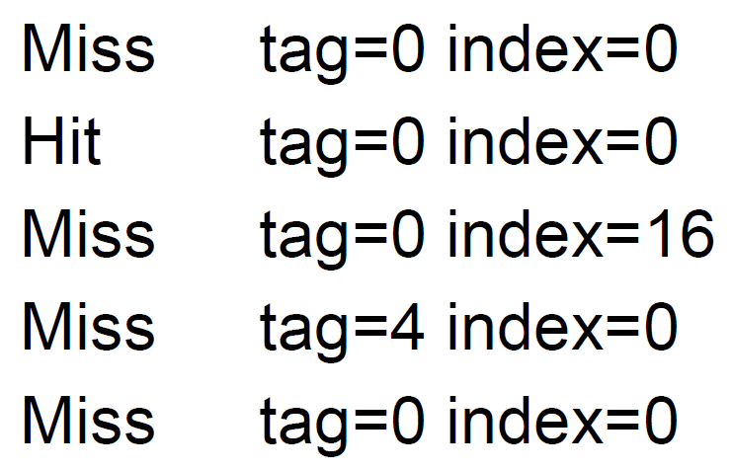
Cache
Consider a 32-bit machine with 1024 different 16-byte direct-mapped cache lines.
For each of the following memory accesses, specify the tag, index, and whether it would be a miss or hit.

