Slide 1
CS 3410 - Spring 2014 Prelim 2 Review

Slide 2
Prelim 2 Coverage
Calling Conventions
Linkers
Caches
Virtual Memory
Traps
Multicore Architectures
Synchronization

Slide 3
Calling Convention
Prelim 2, 2013sp, Q5:
Translate the following C code to MIPS assembly:
int foo(int a, int b, int c, int d, int e) {
int tmp = (a|b) – (d&e);
int q = littlefoo(tmp);
int z = bigfoo(q,tmp,a,b,c);
return tmp + q – z;
}

Slide 4
Calling Convention (cont.)
int foo(int a, int b, int c, int d, int e) {
int tmp = (a|b) – (d&e);
int q = littlefoo(tmp);
int z = bigfoo(q,tmp,a,b,c);
return tmp + q – z;
}
Question 1: how many caller/callee save registers for which variables?
Callee save (need the original value after a function call):
a, b, c, tmp, q
Caller save (do not need to preserve in a function call):
d ($a3), e, z ($v0)
Question 2: how many outgoing arguments we should leave space for?
5: bigfoo(q, tmp, a, b, c)
Question 3: what is the stack frame size?
ra + fp + 5 callee-save + 5 outgoing args = 12 words = 48 bytes

Slide 5
Calling Convention (cont.)
int foo(int a, int b, int c, int d, int e) {
int tmp = (a|b) – (d&e);
int q = littlefoo(tmp);
int z = bigfoo(q,tmp,a,b,c);
return tmp + q – z;
}
#prolog
ADDIU $sp, $sp, -48 # (== 5x outgoing args, 5x $sxx, $ra, $fp)
SW $ra, 44($sp)
SW $fp, 40($sp)
SW $s0, 36($sp) # store, then $s0 = a
SW $s1, 32($sp) # store, then $s1 = b
SW $s2, 28($sp) # store, then $s2 = c
SW $s3, 24($sp) # store, then $s3 = tmp = (a|b) – (d&e)
SW $s4, 20($sp) # store, then $s4 = q = littlefoo(tmp)
ADDIU $fp, $sp, 44

Slide 6
Calling Convention (cont.)
int foo(int a, int b, int c, int d, int e) {
int tmp = (a|b) – (d&e);
int q = littlefoo(tmp);
int z = bigfoo(q,tmp,a,b,c);
return tmp + q – z;
}
#Initializing local variables
MOVE $s0, $a0
MOVE $s1, $a1
MOVE $s2, $a2
OR $t0, $s0, $s1 # $t0 = (a|b)
LW $t1, 64($sp) # 64 = 48(own stack) + 16(5th arg in parent)
AND $t1, $a3, $t1 # $t1 = (d&e)
SUB $s3, $t0, $t1 # $s3 = tmp = (a|b) – (d&e)

Slide 7
Calling Convention (cont.)
int foo(int a, int b, int c, int d, int e) {
int tmp = (a|b) – (d&e);
int q = littlefoo(tmp);
int z = bigfoo(q,tmp,a,b,c);
return tmp + q – z;
}
#Calling littlefoo
MOVE $a0, $s3 # $a0 = tmp
JAL littlefoo
NOP
#Calling bigfoo
MOVE $s4, $v0 # $s4 = q = littlefoo(tmp)
MOVE $a0, $s4 # $a0 = $s4 = q
MOVE $a1, $s3 # $a1 = $s3 = tmp
MOVE $a2, $s0 # $a2 = $s0 = a
MOVE $a3, $s2 # $a3 = $s1 = b
SW $s2, 16($sp) # 5th arg = $s2 = c
JAL bigfoo # bigfoo(q,tmp,a,b,c)
NOP

Slide 8
Calling Convention (cont.)
int foo(int a, int b, int c, int d, int e) {
int tmp = (a|b) – (d&e);
int q = littlefoo(tmp);
int z = bigfoo(q,tmp,a,b,c);
return tmp + q – z;
}
#Generating return value
ADD $t0, $s3, $s4 # $t0 = tmp + q
SUB $v0, $t0, $v0 # $v0 = $t0 – z = (tmp + q) – z
#epilog
LW $s4, 20($sp)
LW $s3, 24($sp)
LW $s2, 28($sp)
LW $s1, 32($sp)
LW $s0, 36($sp)
LW $fp, 40($sp)
LW $ra, 44($sp)
ADDIU $sp, $sp, 48
JR $ra
NOP

Slide 9
Linkers and Program Layout
Prelim 2, 2012sp, Q2b:
The global pointer, $gp, is usually initialized to the middle of the global data segment. Why the middle?
Load and store instructions use signed offsets. Having $gp point to the middle of the data segment allows a full 2^16 byte range of memory to be accessed using positive and negative offsets from $gp.

Slide 10
Linkers and Program Layout
Prelim 2, 2012sp, Q2c:
Bob links his Hello World program against 9001 static libraries. Amazingly, this works without any collisions. Why?
The linker chooses addresses for each library and fills in all the absolute addresses in each with the numbers that it chose.

Slide 11
Caches
Prelim 2, 2013sp, Q4:
Assume that we have a byte-addressed 32-bit processor with 32-bit words (i.e. a word is 4 bytes). Assume further that we have a cache consisting of eight 16-byte lines

Slide 12
Caches (cont.)
How many bits are needed for the tag, index, and offset for the following cache architectures?
Direct Mapped
Tag: 25, Index: 3, Offset: 4
2-way Set Associative
Tag: 26, Index: 2, Offset: 4
4-way Set Associative
Tag: 27, Index: 1, Offset: 4
Fully Associative
Tag: 28, Index: 0, Offset: 4
Offset is only determined by the size of the cache line.
Index is determined by how caches are organized.
Tag = 32 – index - offset

Slide 13
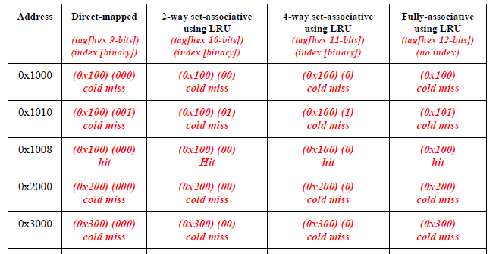
Caches (cont.)
For each access and for each specified cache organization, indicate whether there is a cache hit, a cold (compulsory) miss, conflict miss, or capacity miss.

Slide 14
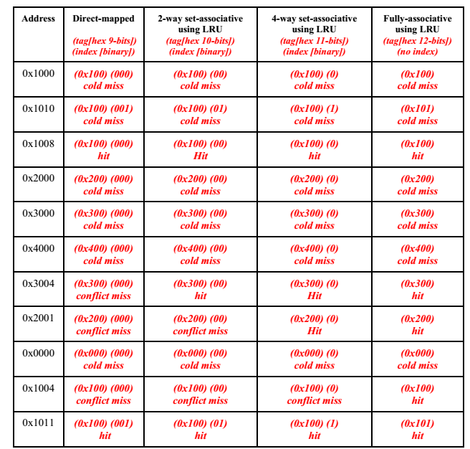

Slide 15
Virtual Memory (2012 Prelim3, Q4)
Virtual Address: 32-bit
Page Size: 16 kB
Single level page table
Each page table entry is 4 bytes.
Each process segment requires a separate physical page.
Stack
8 kB
Heap
8 kB
16 kB = 2^14 B
So we need 14 bits
Bits for page Offset?
Data
8 kB
Bits for page table index?
32-14 bits = 18 bits
Code
8 kB
Physical memory?
Each segment size < one page size
4*16 kB = 64 kB
2^18 (PTE’s) * 4 bytes = 1 MB
Total: 64kB + 1MB
Memory layout of a single process

Slide 16
Virtual Memory (2012 Prelim3, Q4)
Two level page table
Assume there are enough page table entries to fill a second-level page table.
(which means every entry in a second level page table will be used)
Bits for page offset?
14 bits
Bits for second level page table?
16kB/4B=2^12
So we need 12 bits
Bits for page directory?
32-14-12 bits=6 bits
Physical memory(each process segment requires a separate second-level page table)?
1st: 2^6 * 4B < 2^14B=> 16 kB
2nd: 4 * 16 kB
Pages: 4 * 16 kB
Total: 16kB+4*16kB+4*16kB
……

Slide 17
Syscall
User Program
Kernel
main(){
…
syscall(arg1,arg2);
…
}
syscall(arg1,arg2){
do operation
}
User Stub
Kernel Stub
syscall(arg1,arg2){
trap
return
}
handler(){
copy arguments from user memory
check arguments
syscall(arg1,arg2);
copy return value into user memory
return
}
Hardware Trap
Trap Return

Slide 18
Exceptions
On an interrupt or exception
CPU saves PC of exception instruction (EPC)
CPU Saves cause of the interrupt/privilege (Cause register)
Switches the sp to the kernel stack
Saves the old (user) SP value
Saves the old (user) PC value
Saves the old privilege mode
Sets the new privilege mode to 1
Sets the new PC to the kernel interrupt/exception handler
Kernel interrupt/exception handler handles the event
Saves all registers
Examines the cause
Performs operation required
Restores all registers
Performs a “return from interrupt” instruction, which restores the privilege mode, SP and PC

Slide 19
Syscall V.S. Exceptions

Slide 20
Concurrency (2012 Prelim3, Q5)
mutex_lock(&m)
operation
mutex_unlock(&m)
mutex_lock
try:
LI $t1, 1
LL $t0, 0($a0)
BNEZ $t0, try
SC $t1, 0($a0)
BEQZ $t1, try
Load-link returns the current value of a memory location, while a subsequent store-conditional to the same memory location will store a new value only if no updates have occurred to that location since the load-link. Together, this implements a lock-free atomic read-modify-write operation.
mutex_unlock
SW $zero, 0($a0)

Slide 21
Concurrency (2012 Prelim3, Q5)
Critical Section:x = max(x, y)
x: global variable, shared; y: local variable
&x: $a1
y: $a2
Implement critical section using LL/SC without using mutex_lock and mutex_unlock
try:
LL $t0, 0($a1)
BGE $t0, $a2, next
NOP
MOVE $t0, $a2
next:
SC $t0, 0($a1)
BEQZ $t0, try
NOP

Slide 22
Concurrency(Homework2 Q8)
c[0]?
A: LW $t0, 0($s0)
ADDIU $t0, $t0, 2
SW $t0, 0($s0)
B: SW $zero, 0($s0)
=>0
B: SW $zero, 0($s0)
A: LW $t0, 0($s0)
ADDIU $t0, $t0, 2
SW $t0, 0($s0)
=>2
A: LW $t0, 0($s0)
ADDIU $t0, $t0, 2
B: SW $zero, 0($s0)
A: SW $t0, 0($s0)
=>3

Slide 23
Concurrency(Homework2 Q8)

