Slide 1
C Lab 1
Introduction to C

Slide 2
Basics of C
C was developed by Dennis Ritchie working at AT&T Bell Labs in the 1970’s.
C maps very easily to machine instructions (even allows inline assembly!)
Unlike Java or Python, the programmer is in charge of memory management. There is no garbage collector.
C is not Object Oriented (no inheritance or interfaces)

Slide 3
Terminology
Compiler—program that converts source code into object code (assembly/machine code)
You will be using GCC to compile your source before you can run it
Debugger—Program that allows you to inspect a program while it is running.
You will be using gdb
A good alternative to print statements everywhere!
Header—A file of function and variable declarations
If you want to use functions defined in other files, you must include a corresponding header (.h) file

Slide 4
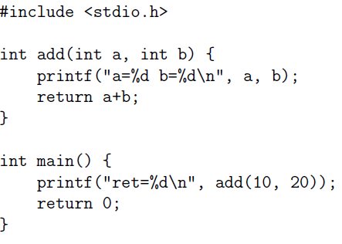
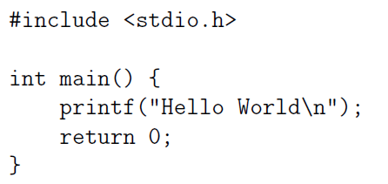
Structure of a C Program
Which lines are preprocessor directives? Function declarations?

Slide 5
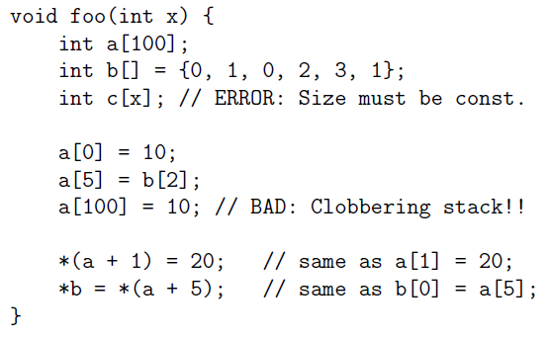
Basics: Arrays

Slide 6
Common Array Problems
C has no array-bound checks. You won’t even get a warning! At best you’ll get a segfault when you try to run it.
Do not use sizeof(array) or any pointer in general. It will return the size of the pointer, not the underlying memory size.
SEGFAULT

Slide 7
Strings in C… are just null terminated char arrays
<string.h> has common string functions.
For example: “CS3410” is equivalent to:
Char str[] = {‘C’, ‘S’, ‘3’, ‘4’, ‘1’, ‘0’, ‘\0’}
Things to note:
Strlen(s) does not include the terminal character. Be careful when using memory operations (ie. Memcpy) which does include the character!

Slide 8
What are Pointers?
A pointer is an integer that represents a memory location either on the stack or on the heap.
The type of a pointer tells the compiler what kind of object to expect when it is dereferenced.
For example, a “double*” is an integer representing the memory location of a double.
A pointer does not actually create the data it points to. For the pointer to contain data, some other function must create the data it will point to. This is typically a call to malloc.

Slide 9
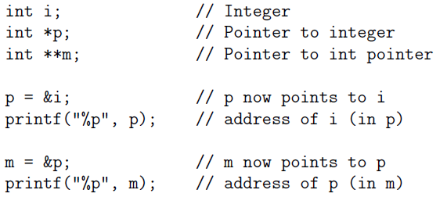
Pointers

Slide 10
Heap
The heap persists across function calls. If you wish to return something that is not a primitive from a function, must use the heap.
In C, this is managed by the programmer through calls to (defined in stdlib.h):
Malloc(size)
Free(ptr)
You should always check the result of malloc since it can fail (you ran out of memory)
You must explicitly call free when the variable is no longer in use.
See cplusplus.com or your C reference manual for detailed information about library functions.
http://www.cplusplus.com/reference/cstdlib/malloc/

Slide 11
Pointers: A visual representation
char* d1;
d1 = “CS3410”;
char* d2;
Stack
d2 = d1+1;
Memory
//d2[0]==‘S’;
float* d1
“CS3410”
float* d2
d2[6]=?

Slide 12
Pointers to stack variables
float* d1;
float local = 42.42;
d1 = &local;
Stack
*d1 = 25;
Heap
float* d1
local = 25
local = 42.42

