Slide 1
Back to the Future:
A Historical Perspective
Hakim Weatherspoon
CS 3410, Spring 2013
Computer Science
Cornell University

Slide 2
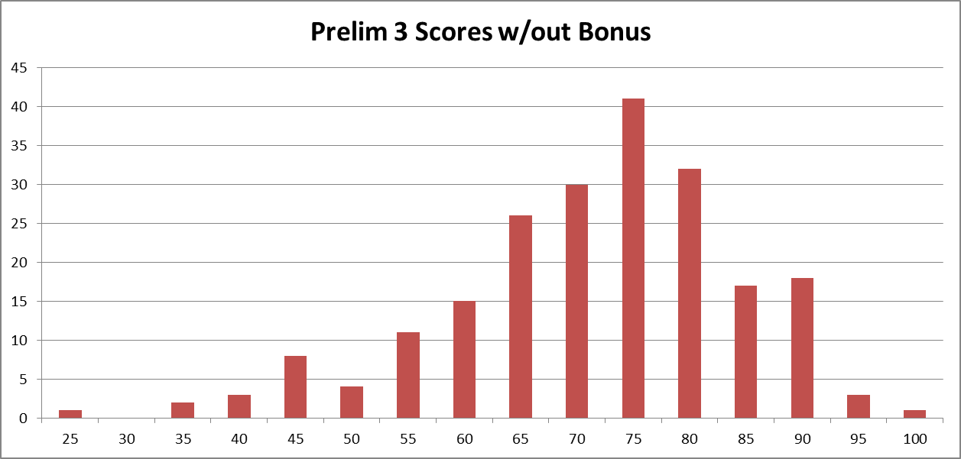
Announcements
Prelim3 Results (w/out bonus)
  Mean 69.5 ± 12.9 (median 71.5), Max 95.5, out of 98
  Pickup in Homework Passback Room (305 Upson)

Slide 3
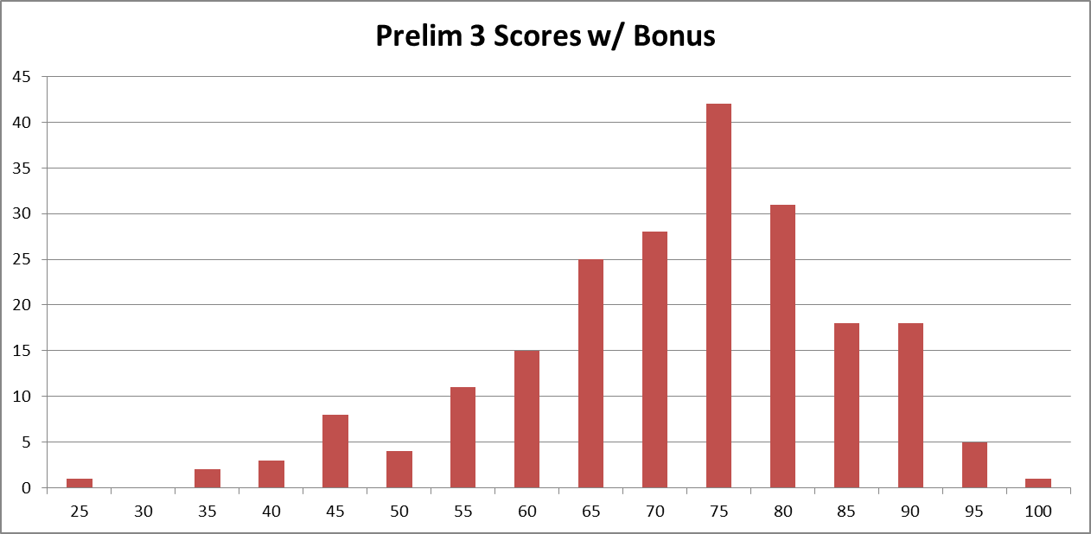
Announcements
Prelim3 Results (w/ bonus)
  Mean 69.8 ± 13.1 (median 72.3), Max 95.5, out of 98
  Pickup in Homework Passback Room (305 Upson)

Slide 4
Announcements
How to improve your grade?
Submit a course evaluation and drop lowest homework score
  To receive credit, Submit before Tuesday, May 7th

Slide 5
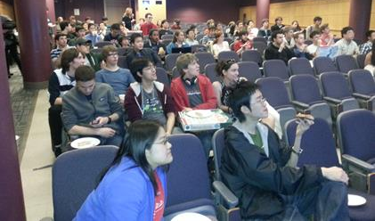
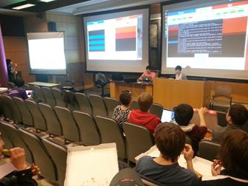
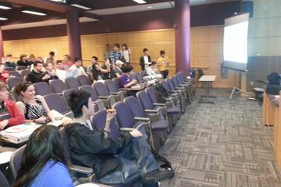
Announcements
CacheRace Games Night was great!
  Winner: Team Brycebits
Bryce Evans and Dominick Twitty

Slide 6
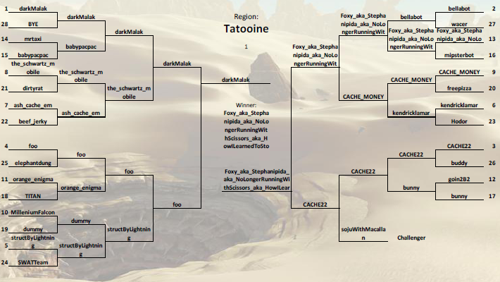
Announcements
CacheRace Games Night was great!
  Winner: Team Brycebits
Bryce Evans and Dominick Twitty

Slide 7
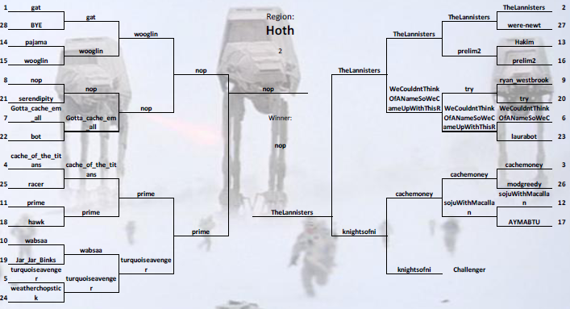
Announcements
CacheRace Games Night was great!
  Winner: Team Brycebits
Bryce Evans and Dominick Twitty

Slide 8
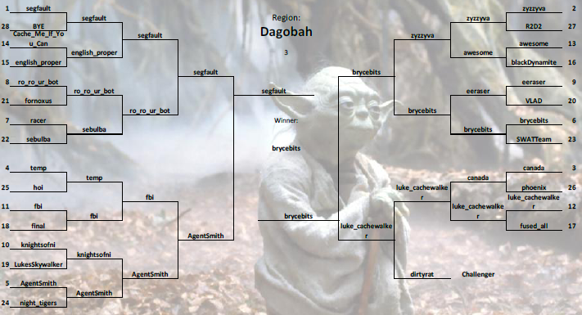
Announcements
CacheRace Games Night was great!
  Winner: Team Brycebits
Bryce Evans and Dominick Twitty

Slide 9
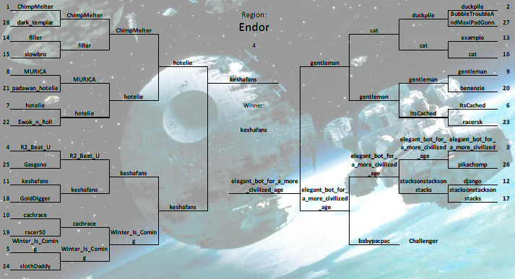
Announcements
CacheRace Games Night was great!
  Winner: Team Brycebits
Bryce Evans and Dominick Twitty

Slide 10
Announcements
Final Project
Design Doc sign-up via CMS
sign up Sunday, Monday, or Tuesday
May 5th, 6th, or 7th
Demo Sign-Up via CMS.
sign up Tuesday, May 14th
or Wednesday, May 15th
CMS submission due:
  Due 6:30pm Wednesday, May 15th

Slide 11
Goal for Today: Back to the Future
Can multiple entities interact with processor at once?

Slide 12
Back to the Future: Timesharing
Can multiple entities interact with processor at once?
compute
jump/branch
targets
memory
register
file
A
alu
D
D
B
+4
addr
PC
inst
control
B
d_{in}
d_{out}
M
memory
new
pc
extend
imm
detect
hazard
forward
unit
Instruction
Fetch
Instruction
Decode
Write-
Back
ctrl
ctrl
ctrl
Execute
Memory
IF/ID
ID/EX
EX/MEM
MEM/WB

Slide 13
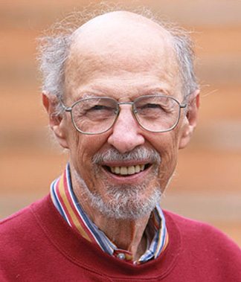
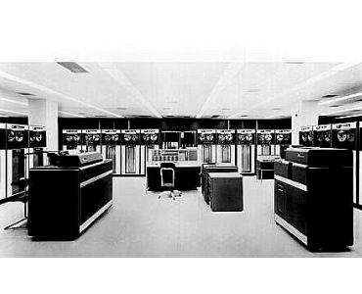
Back to the Future: Timesharing
Fernando J. Corbató (MIT)
  Known for pioneering time sharing systems and MULTICS operating system (later influence UNIX)
  Influences: Turing Award Recipient (1990).
    "for his pioneering work in organizing the concepts and leading the development of the general-purpose, large-scale, time-sharing and resource-sharing computer systems“
        Corbató's Law: "Regardless of whether one is dealing with assembly language or compiler language, the number of debugged lines of source code per day is about the same!"
IBM 7090

Slide 14
Back to the Future: Timesharing
1963 Timesharing: A Solution to Computer Bottlenecks
http://www.youtube.com/watch?v=3IkP7gZIprk&feature=youtu.be (cc)
  http://www.youtube.com/watch?v=Q07PhW5sCEk&feature=youtu.be
  Reporter John Fitch at the MIT Computation Center in an extended interview with MIT professor of computer science Fernando J. Corbato
  The prime focus of the film is timesharing, one of the most important developments in computing
IBM 7090
Notes:
http://www.youtube.com/watch?v=Q07PhW5sCEk&feature=youtu.be
[Recorded: May 9, 1963]
This vintage film features MIT Science Reporter John Fitch at the MIT Computation Center in an extended interview with MIT professor of computer science Fernando J. Corbato. The film was co-produced by WGBH (Boston) and MIT.
The prime focus of the film is timesharing, one of the most important developments in computing, and one which has come in and out of favor several times over the last several decades as the dichotomy between remote and centrally-managed computing resources played out; the latest incarnation for centrally-managed computing resources is known as cloud computing.
Timesharing as shown in this film, was a novel concept in the early 1960s. Driven by a desire to more efficiently use expensive computer resources while increasing the interactivity between user and computer (man and machine), timesharing was eventually taken up by industry in the form of special timesharing hardware for mainframe and minicomputer computer systems as well as in sophisticated operating systems to manage multiple users and resources.
Corbato describes how after the mid-1950s, when computers began to become reliable, the next big challenge to improve productivity and efficiency was the development of computer languages, FORTRAN being an example. One of the next bottlenecks in computing, according to Corabto, was the traditional batch processing method of combining many peoples computer jobs into one large single job for the computer to process at one time. He compares batch processing to a group of people catching a bus, all being moved at once.
Timesharing, on the other hand, involves attaching a large number of consoles to the central computer, each of which is given a time-slice of the computers time. While the computer is rapidly switching among user applications and problems, it appears to the user that s/he has complete access to the central computer.
Corbato then describes in technical detail a complex description of timesharing before showing some examples of timesharing from a terminal using a simple program to calculate a simple geometric problem (Pythagorean theorem).
In the long run, Corbato says, timesharing will help address the increasing need for computer time and ease-of-use.

