Slide 1
I/O
Hakim Weatherspoon
CS 3410, Spring 2013
Computer Science
Cornell University
See: P&H Chapter 6.5-6

Slide 2
Goals for Today
Computer System Organization
How does a processor interact with its environment?
  I/O Overview
How to talk to device?
  Programmed I/O or Memory-Mapped I/O
How to get events?
  Polling or Interrupts
How to transfer lots of data?
  Direct Memory Access (DMA)

Slide 3
Next Goal
How does a processor interact with its environment?

Slide 4
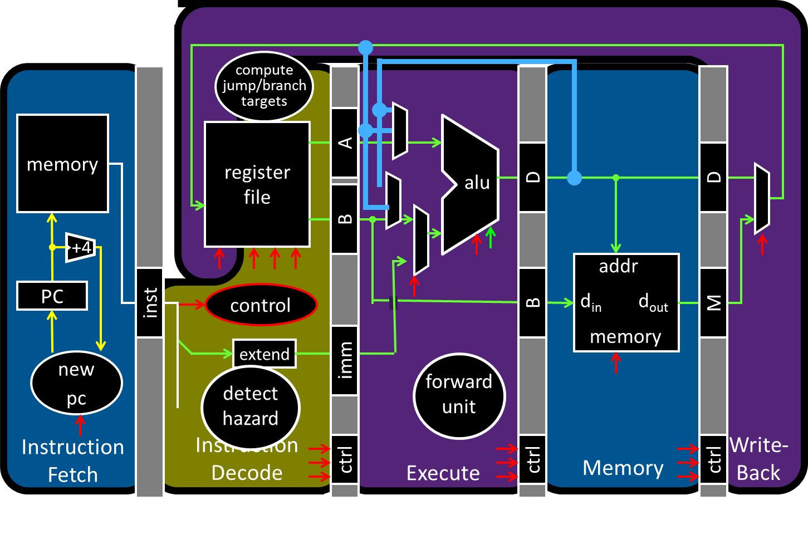
Big Picture: Input/Output (I/O)
How does a processor interact with its environment?

Slide 5
Big Picture: Input/Output (I/O)
How does a processor interact with its environment?
Computer System Organization =
Memory +
Datapath +
Control +
Input +
Output

Slide 6
I/O Devices Enables Interacting with Environment
Device | Behavior | Partner | Data Rate (b/sec)
Keyboard | Input | Human | 100
Mouse | Input | Human | 3.8k
Sound Input | Input | Machine | 3M
Voice Output | Output | Human | 264k
Sound Output | Output | Human | 8M
Laser Printer | Output | Human | 3.2M
Graphics Display | Output | Human | 800M – 8G
Network/LAN | Input/Output | Machine | 100M – 10G
Network/Wireless LAN | Input/Output | Machine | 11 – 54M
Optical Disk | Storage | Machine | 5 – 120M
Flash memory | Storage | Machine | 32 – 200M
Magnetic Disk | Storage | Machine | 800M – 3G

Slide 7
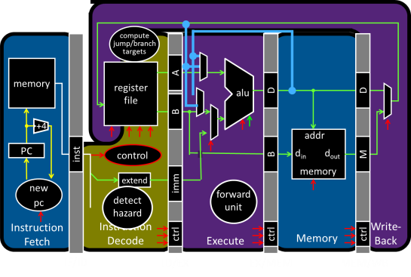
Attempt#1: All devices on one interconnect
Replace all devices as the interconnect changes
e.g. keyboard speed == main memory speed ?!
Unified Memory and I/O Interconnect
Memory
Display
Disk
Keyboard
Network
Notes:
- All devices run at same speed, but performance requirements vary significantly across I/O devices
- Difficult to evolve interconnect due to legacy compatibility

Slide 8
Attempt#2: I/O Controllers
Decouple I/O devices from Interconnect
Enable smarter I/O interfaces
Core0
Core1
Cache
Cache
Unified Memory and I/O Interconnect
Memory
Controller
I/O
Controller
I/O
Controller
I/O
Controller
I/O
Controller
Memory
Display
Disk
Keyboard
Network
Notes:
- Decouple I/O devices from interconnect
- Enable smarter I/O interfaces

Slide 9
Attempt#3: I/O Controllers + Bridge
Separate high-performance processor, memory, display interconnect from lower-performance interconnect
Core0
Core1
Cache
Cache
High Performance
Interconnect
Bridge
Lower Performance
Legacy Interconnect
Memory
Controller
I/O
Controller
I/O
Controller
I/O
Controller
I/O
Controller
Memory
Display
Disk
Keyboard
Network
Notes:
- Use bridge to separate high-performance processor, memory, display interconnect from lower-performance interconnect
- High-performance interconnect can evolve more quickly
fast/expensive busses when needed; slow/cheap elsewhere
I/O controllers to connect end devices

Slide 10
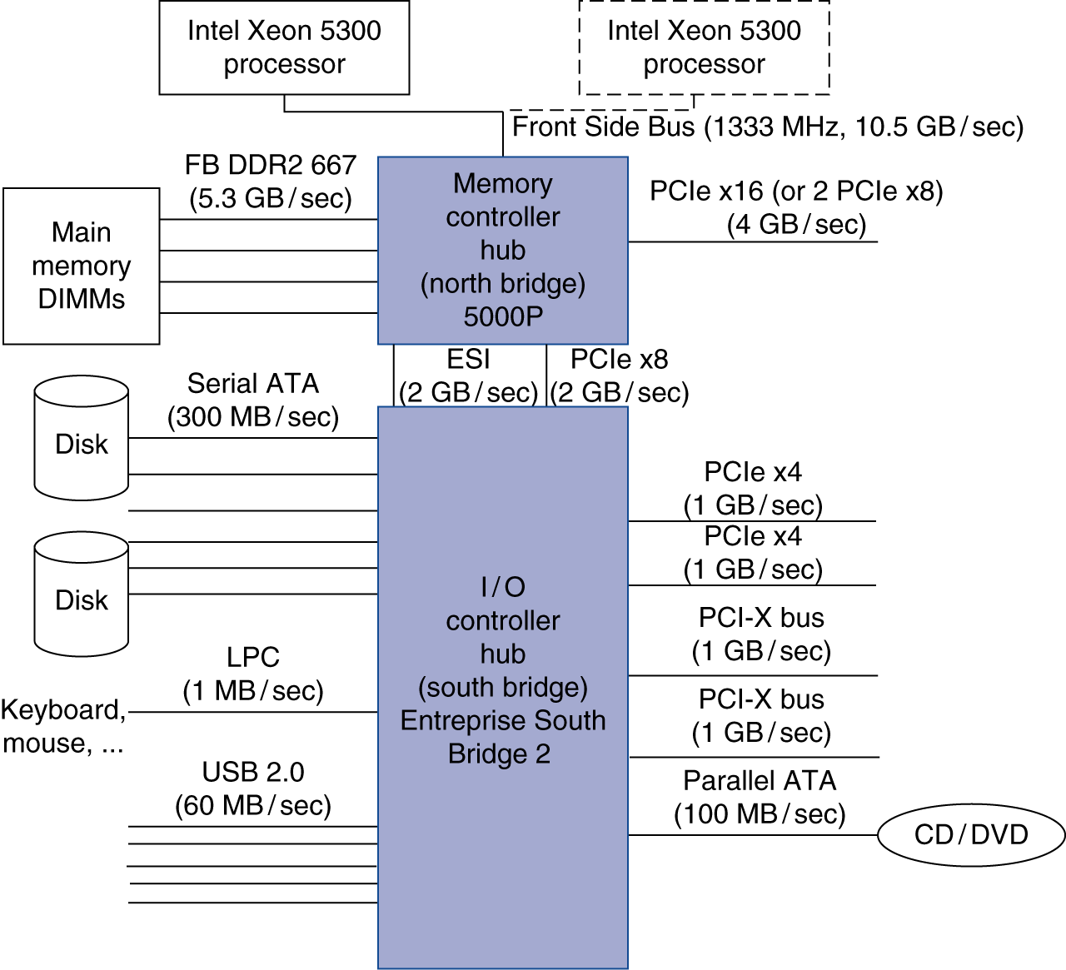
Attempt#3: I/O Controllers + Bridge
Separate high-performance processor, memory, display interconnect from lower-performance interconnect
Notes:
- Use bridge to separate high-performance processor, memory, display interconnect from lower-performance interconnect
- High-performance interconnect can evolve more quickly
fast/expensive busses when needed; slow/cheap elsewhere
I/O controllers to connect end devices

Slide 11
Bus Parameters
Width = number of wires
Transfer size = data words per bus transaction
Synchronous (with a bus clock)
or asynchronous (no bus clock / “self clocking”)

Slide 12
Bus Types
Processor – Memory (“Front Side Bus”. Also QPI)
  Short, fast, & wide
  Mostly fixed topology, designed as a “chipset”
    CPU + Caches + Interconnect + Memory Controller
I/O and Peripheral busses (PCI, SCSI, USB, LPC, …)
  Longer, slower, & narrower
  Flexible topology, multiple/varied connections
  Interoperability standards for devices
  Connect to processor-memory bus through a bridge
Notes:
Note: USB is not really a bus, it is really a network.

Slide 13
Example Interconnects
Name | Use | Devics per channel | Channel Width | Data Rate (B/sec)
Firewire 800 | External | 63 | 4 | 100M
USB 2.0 | External | 127 | 2 | 60M
Parallel ATA | Internal | 1 | 16 | 133M
Serial ATA (SATA) | Internal | 1 | 4 | 300M
PCI 66MHz | Internal | 1 | 32-64 | 533M
PCI Express v2.x | Internal | 1 | 2-64 | 16G/dir
Hypertransport v2.x | Internal | 1 | 2-64 | 25G/dir
QuickPath (QPI) | Internal | 1 | 40 | 12G/dir

Slide 14
Interconnecting Components
Interconnects are (were?) busses
  parallel set of wires for data and control
  shared channel
    multiple senders/receivers
    everyone can see all bus transactions
  bus protocol: rules for using the bus wires
Alternative (and increasingly common):
  dedicated point-to-point channels
e.g. Intel
Xeon
e.g. Intel
Nehalem
Notes:
CPU – North Bridge / Memory Controller
North Bridge – South Bridge / SuperIO

Slide 15
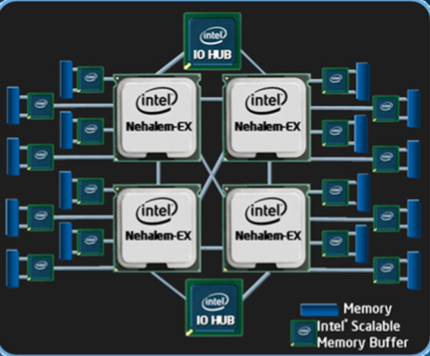
Attempt#4: I/O Controllers+Bridge+ NUMA
Remove bridge as bottleneck with Point-to-point interconnects
E.g. Non-Uniform Memory Access (NUMA)
Notes:
- Use bridge to separate high-performance processor, memory, display interconnect from lower-performance interconnect
- High-performance interconnect can evolve more quickly
fast/expensive busses when needed; slow/cheap elsewhere
I/O controllers to connect end devices

Slide 16
Takeaways
Diverse I/O devices require hierarchical interconnect which is more recently transitioning to point-to-point topologies.

Slide 17
Next Goal
How does the processor interact with I/O devices?

Slide 18
I/O Device Driver Software Interface
Set of methods to write/read data to/from device and control device
Example: Linux Character Devices
// Open a toy " echo " character device
int fd = open("/dev/echo", O_RDWR);
// Write to the device
char write_buf[] = "Hello World!";
write(fd, write_buf, sizeof(write_buf));
// Read from the device
char read_buf [32];
read(fd, read_buf, sizeof(read_buf));
// Close the device
close(fd);
// Verify the result
assert(strcmp(write_buf, read_buf)==0);
Notes:
Set of methods to write/read data to/from device and control device-
Example: Linux Character Devices

Slide 19
I/O Device API
Typical I/O Device API
  a set of read-only or read/write registers
Command registers
  writing causes device to do something
Status registers
  reading indicates what device is doing, error codes, …
Data registers
  Write: transfer data to a device
  Read: transfer data from a device
Every device uses this API

Slide 20
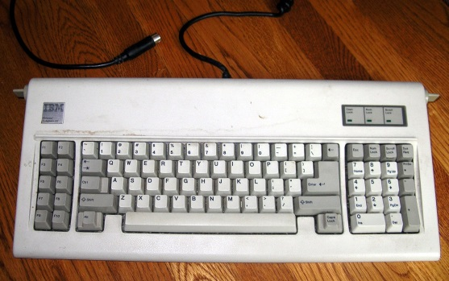
I/O Device API
Simple (old) example: AT Keyboard Device
8-bit Status:
8-bit Command:
0xAA = “self test”
0xAE = “enable kbd”
0xED = “set LEDs”
…
8-bit Data:
scancode (when reading)
LED state (when writing) or …
PE | TO | AUXB | LOCK | AL2 | SYSF | IBS | OBS
Notes:
IBS = input buffer status: 0 = waiting for commands, 1 = busy
OBS = output buffer status: 0 = waiting for data, 1 = data is available
http://en.wikipedia.org/wiki/IBM_PC/AT
The IBM Personal Computer AT, more commonly known as the IBM AT and also sometimes called the PC AT or PC/AT, was IBM's second-generation PC, designed around the 6 MHz Intel 80286 microprocessor and released in 1984 as machine type 5170. The name AT stood for "Advanced Technology", and was chosen because the AT offered various technologies that were then new in personal computers; one such advancement was that the 80286 processor supported protected mode. IBM later released an 8 MHz version of the AT.
http://en.wikipedia.org/wiki/AT_keyboard
The AT keyboard was a keyboard with 84 keys introduced with the IBM PC/AT computer. It succeeded the 83-key PC/XT keyboard and therefore did not have many of the features seen on modern keyboards such as inverted-T arrow keys and dual ctrl and alt keys. It was later replaced with the 101-key Enhanced keyboard. Nonetheless, "AT keyboard" remains a popular name for any keyboard that uses the five-pin DIN connector. This connector is often considered a Legacy port. Many Enhanced keyboards used this, though it was eventually superseded by the PS/2 connector, which is mechanically different but electrically and protocol-wise identical; thus, the AT keyboard protocol remained the most common standard on PC keyboards well into the 2000s. Many modern computers now use Universal Serial Bus (USB) connectors instead of, or in addition to, PS/2 connectors. The USB connector is electrically and protocol-wise quite different.
Compared to the 83-key XT keyboard, the AT keyboard uses a different communication protocol and a different set of scancodes. Despite having the same connector, the two are not interchangeable. Some PC-compatible mid-to-late 1980s keyboards not made by IBM were switchable between the two protocols and scancode sets, usually with a slider type switch on the underside.

Slide 21
Communication Interface
Q: How does program OS code talk to device?
A: special instructions to talk over special busses
Programmed I/O
  inb $a, 0x64
  outb $a, 0x60
  Specifies: device, data, direction
  Protection: only allowed in kernel mode
Interact with cmd, status, and
data device registers directly
kbd status register
kbd data register
Kernel boundary crossinging is expensive
*x86: $a implicit; also inw, outw, inh, outh, …

Slide 22
Communication Interface
Q: How does program OS code talk to device?
A: Map registers into virtual address space
Memory-mapped I/O
  Accesses to certain addresses redirected to I/O devices
  Data goes over the memory bus
  Protection: via bits in pagetable entries
  OS+MMU+devices configure mappings
Faster. Less boundary crossing

Slide 23
Memory-Mapped I/O
0xFFFF FFFF
Virtual
Address
Space
I/O
Controller
0x00FF FFFF
Display
Physical
Address
Space
I/O
Controller
Disk
I/O
Controller
Keyboard
I/O
Controller
Network
0x0000 0000
0x0000 0000

Slide 24
Device Drivers
Programmed I/O
char read_kbd()
{
do {
sleep();
status = inb(0x64);
} while(!(status & 1));
return inb(0x60);
}
Memory Mapped I/O
struct kbd {
char status, pad[3];
char data, pad[3];
};
kbd *k = mmap(...);
char read_kbd()
{
do {
sleep();
status = k->status;
} while(!(status & 1));
return k->data;
}
Polling examples,
But mmap I/O more
efficient
syscall
NO
syscall
syscall
Notes:
Polling example, but MMAP I/O more efficient than programmed I/O

Slide 25
Comparing Programmed I/O vs Memory Mapped I/O
Programmed I/O
  Requires special instructions
  Can require dedicated hardware interface to devices
  Protection enforced via kernel mode access to instructions
  Virtualization can be difficult
Memory-Mapped I/O
  Re-uses standard load/store instructions
  Re-uses standard memory hardware interface
  Protection enforced with normal memory protection scheme
  Virtualization enabled with normal memory virtualization scheme

Slide 26
Takeaways
Diverse I/O devices require hierarchical interconnect which is more recently transitioning to point-to-point topologies.
Memory-mapped I/O is an elegant technique to read/write device registers with standard load/stores.

Slide 27
Next Goal
How does the processor know device is ready/done?

Slide 28
Communication Method
Q: How does program learn device is ready/done?

Slide 29
Takeaways
Diverse I/O devices require hierarchical interconnect which is more recently transitioning to point-to-point topologies.
Memory-mapped I/O is an elegant technique to read/write device registers with standard load/stores.
Interrupt-based I/O avoids the wasted work in
polling-based I/O and is usually more efficient

Slide 30
Next Goal
How do we transfer a lot of data efficiently?

Slide 31
I/O Data Transfer
How to talk to device?
  Programmed I/O or Memory-Mapped I/O
How to get events?
  Polling or Interrupts
How to transfer lots of data?
disk->cmd = READ_4K_SECTOR;
disk->data = 12;
while (!(disk->status & 1) { }
for (i = 0..4k)
buf[i] = disk->data;
Very
Expensive

Slide 32
I/O Data Transfer
Programmed I/O xfer: Device ←→ CPU ←→ RAM
  for (i = 1 .. n)
  CPU issues read request
  Device puts data on bus
  & CPU reads into registers
  CPU writes data to memory
CPU
RAM
DISK
Read from Disk
Write to Memory
Everything interrupts CPU
Wastes CPU

Slide 33
I/O Data Transfer
Q: How to transfer lots of data efficiently?

Slide 34
DMA: Direct Memory Access
Programmed I/O xfer: Device ←→ CPU ←→ RAM
  for (i = 1 .. n)
  CPU issues read request
  Device puts data on bus
  & CPU reads into registers
  CPU writes data to memory
DMA xfer: Device ←→ RAM
  CPU sets up DMA request
  for (i = 1 ... n)
  Device puts data on bus
  & RAM accepts it
  Device interrupts CPU after done
CPU
RAM
DISK
3) Interrupt after done
CPU
RAM
1) Setup
2) Transfer
DISK
Notes:
Question: Virtual vs Physical memory
If physical cannot cross page boundary b/c device does not know where next virtual page is in physical memory.
If virtual, need a small page table to map virtual to physical address, but can cross page boundaries
(if physical, coherency/consistency issue between cache and memory)

Slide 35
DMA Example
DMA example: reading from audio (mic) input
  DMA engine on audio device… or I/O controller … or …
int dma_size = 4*PAGE_SIZE;
int *buf = alloc_dma(dma_size);
...
dev->mic_dma_baseaddr = (int)buf;
dev->mic_dma_count = dma_len;
dev->cmd = DEV_MIC_INPUT |
DEV_INTERRUPT_ENABLE | DEV_DMA_ENABLE;

Slide 36
DMA Issues (1): Addressing
Issue #1: DMA meets Virtual Memory
RAM: physical addresses
Programs: virtual addresses
CPU
MMU
RAM
DISK

Slide 37
DMA Example
DMA example: reading from audio (mic) input
  DMA engine on audio device… or I/O controller … or …
int dma_size = 4*PAGE_SIZE;
void *buf = alloc_dma(dma_size);
...
dev->mic_dma_baseaddr = virt_to_phys(buf);
dev->mic_dma_count = dma_len;
dev->cmd = DEV_MIC_INPUT |
DEV_INTERRUPT_ENABLE | DEV_DMA_ENABLE;

Slide 38
DMA Issues (1): Addressing
Issue #1: DMA meets Virtual Memory
RAM: physical addresses
Programs: virtual addresses
CPU
MMU
RAM
DISK

Slide 39
DMA Issues (2): Virtual Mem
Issue #2: DMA meets Paged Virtual Memory
DMA destination page
may get swapped out
CPU
RAM
DISK

Slide 40
DMA Issues (4): Caches
Issue #4: DMA meets Caching
DMA-related data could
be cached in L1/L2
  DMA to Mem: cache is now stale
  DMA from Mem: dev gets stale data
CPU
L2
RAM
DISK

Slide 41
Takeaways
Diverse I/O devices require hierarchical interconnect which is more recently transitioning to point-to-point topologies.
Memory-mapped I/O is an elegant technique to read/write device registers with standard load/stores.
Interrupt-based I/O avoids the wasted work in
polling-based I/O and is usually more efficient.
Modern systems combine memory-mapped I/O,
interrupt-based I/O, and direct-memory access
to create sophisticated I/O device subsystems.

Slide 42
I/O Summary
How to talk to device?
Programmed I/O or Memory-Mapped I/O
How to get events?
Polling or Interrupts
How to transfer lots of data?
DMA

Slide 43
Administrivia
No Lab section this week
Project3 extended to tonight Tuesday, April 23rd
Project3 Cache Race Games night Friday, Apr 26th, 5pm
  Come, eat, drink, have fun and be merry!
  Location: B17 Upson Hall
Prelim3: Thursday, April 25th in evening
  Time: We will start at 7:30pm sharp, so come early
  Two Locations: PHL101 and UPSB17
    If NetID begins with ‘a’ to ‘j’, then go to PHL101 (Phillips Hall rm 101)
    If NetID begins with ‘k’ to ‘z’, then go to UPSB17 (Upson Hall rm B17)
  Prelim Review: Today, Tue, at 6:00pm in Phillips Hall rm 101
Project4: Final project out next week
  Demos: May 14 and 15
  Will not be able to use slip days

Slide 44
Administrivia
Next two weeks
  Week 13 (Apr 22): Project3 Games Night and Prelim3
  Week 14 (Apr 29): Project4 handout
Final Project for class
  Week 15 (May 6): Project4 design doc due
  Week 16 (May 13): Project4 due by May 15th

