Slide 1
Synchronization
Hakim Weatherspoon
CS 3410, Spring 2013
Computer Science
Cornell University
P&H Chapter 2.11 and 5.8

Slide 2
Big Picture: Parallelism and Synchronization
How do I take advantage of multiple processors; parallelism?
How do I write (correct) parallel programs, cache cohrency and synchronization?
What primitives do I need to implement correct parallel programs?

Slide 3
Goals for Today
Understand Cache Coherency Problem
Define Cache coherency problem
Synchronizing parallel programs
Atomic Instructions
HW support for synchronization
How to write parallel programs
Threads and processes
Critical sections, race conditions, and mutexes

Slide 4
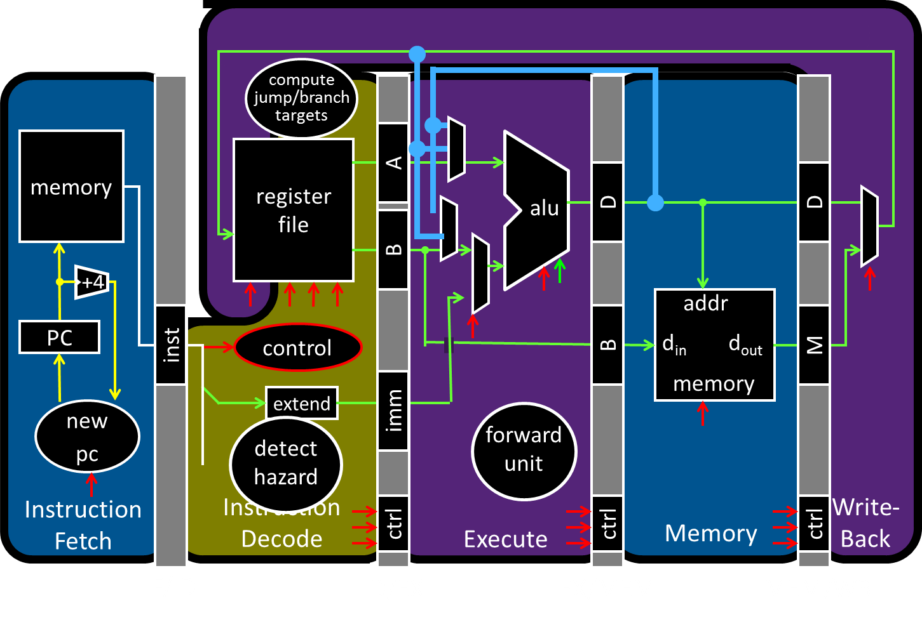
Big Picture: Parallelism and Synchronization

Slide 5
Next Goal: Parallelism and Synchronization
Cache Coherency Problem: What happens when to two or more processors cache shared data?

Slide 6
Next Goal: Parallelism and Synchronization
Cache Coherency Problem: What happens when to two or more processors cache shared data?
i.e. the view of memory held by two different processors is through their individual caches.
As a result, processors can see different (incoherent) values to the same memory location.

Slide 7
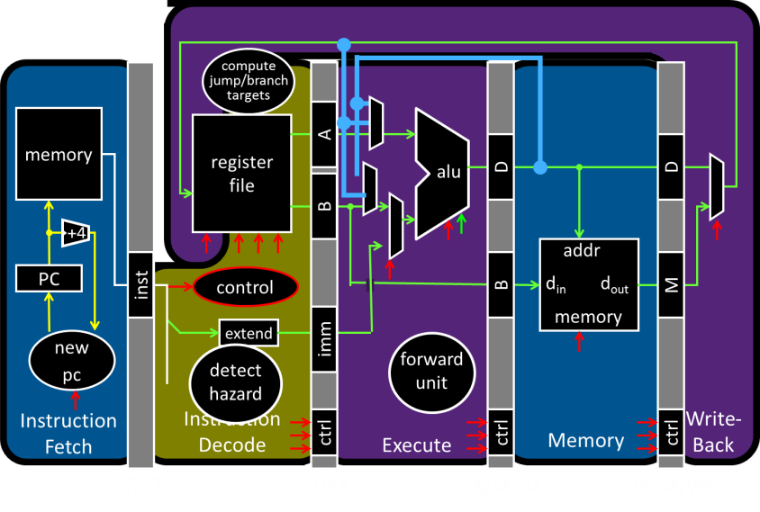
Big Picture: Parallelism and Synchronization
Each processor core has its own L1 cache

Slide 8
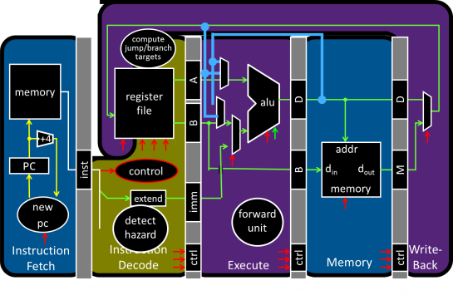
Big Picture: Parallelism and Synchronization
Each processor core has its own L1 cache

Slide 9
Big Picture: Parallelism and Synchronization
Each processor core has its own L1 cache
Core0
Core1
Core2
Core3
Cache
Cache
Cache
Cache
Interconnect
Memory
I/O

Slide 10
Shared Memory Multiprocessors
Shared Memory Multiprocessor (SMP)
Typical (today): 2 – 4 processor dies, 2 – 8 cores each
HW provides single physical address space for all processors
Assume physical addresses (ignore virtual memory)
Assume uniform memory access (ignore NUMA)
Core0
Core1
Core2
Core3
Cache
Cache
Cache
Cache
Interconnect
Memory
I/O
Notes:
How do they share data? How do they coordinate? How do they scale?

Slide 11
Shared Memory Multiprocessors
Shared Memory Multiprocessor (SMP)
Typical (today): 2 – 4 processor dies, 2 – 8 cores each
HW provides single physical address space for all processors
Assume physical addresses (ignore virtual memory)
Assume uniform memory access (ignore NUMA)
Core0
Core1
...
...
...
CoreN
Cache
Cache
Cache
Interconnect
Memory
I/O
Notes:
How do they share data? How do they coordinate? How do they scale?

Slide 12
Cache Coherency Problem
Thread A (on Core0) Thread B (on Core1) for(int i = 0, i < 5; i++) { for(int j = 0; j < 5; j++) { x = x + 1; x = x + 1; } }
What will the value of x be after both loops finish?
Core0
Core1
...
...
...
CoreN
Cache
Cache
Cache
Interconnect
Memory
I/O
Notes:
How do they share data? How do they coordinate? How do they scale?

Slide 13
Cache Coherency Problem
Thread A (on Core0) Thread B (on Core1) for(int i = 0, i < 5; i++) { for(int j = 0; j < 5; j++) { x = x + 1; x = x + 1; } }
What will the value of x be after both loops finish?
6
8
10
All of the above
None of the above
Notes:
How do they share data? How do they coordinate? How do they scale?

Slide 14
Cache Coherency Problem
Thread A (on Core0) Thread B (on Core1) for(int i = 0, i < 5; i++) { for(int j = 0; j < 5; j++) { LW $t0, addr(x) LW $t0, addr(x)
ADDIU $t0, $t0, 1 ADDIU $t0, $t0, 1
SW $t0, addr(x) SW $t0, addr(x) } }
$t0=0
$t0=0
$t0=1
$t0=1
x=1
x=1
x should be greater than 1 after both threads loop at least once!
Core0
Core1
...
...
...
CoreN
Cache
Cache
Cache
Interconnect
Memory
I/O
Notes:
How do they share data? How do they coordinate? How do they scale?

Slide 15
Cache Coherence Problem
Suppose two CPU cores share a physical address space
Write-through caches
Time step | Event | CPU A’s cache | CPU B’s cache | Memory
0 |  |  |  | 0
Time step | Event | CPU A’s cache | CPU B’s cache | Memory
0 |  |  |  | 0
1 | CPU A reads X | 0 |  | 0
Time step | Event | CPU A’s cache | CPU B’s cache | Memory
0 |  |  |  | 0
1 | CPU A reads X | 0 |  | 0
2 | CPU B reads X | 0 | 0 | 0
Time step | Event | CPU A’s cache | CPU B’s cache | Memory
0 |  |  |  | 0
1 | CPU A reads X | 0 |  | 0
2 | CPU B reads X | 0 | 0 | 0
3 | CPU A writes 1 to X | 1 | 0 | 1
Core0
Core1
...
...
...
CoreN
Cache
Cache
Cache
Interconnect
Memory
I/O

Slide 16
Coherence Defined
Cache coherence defined...
Informal: Reads return most recently written value
Formal: For concurrent processes P₁ and P₂
P writes X before P reads X (with no intervening writes) ⇒ read returns written value
P₁ writes X before P₂ reads X ⇒ read returns written value
P₁ writes X and P₂ writes X ⇒ all processors see writes in the same order
all see the same final value for X
Aka write serialization
Notes:
second case: for some definition of “before”
third case: see relativity
complication: clocks are not synchronized across cores
1 light nanosecond = 30cm, so 3GHz can do 1 instruction per 10cm

Slide 17
Cache Coherence Protocols
Operations performed by caches in multiprocessors to ensure coherence
Migration of data to local caches
Reduces bandwidth for shared memory
Replication of read-shared data
Reduces contention for access
Snooping protocols
Each cache monitors bus reads/writes

Slide 18
Snooping
Snooping for Hardware Cache Coherence
All caches monitor bus and all other caches
Bus read: respond if you have dirty data
Bus write: update/invalidate your copy of data
Snoop
Snoop
...
Snoop
Core0
Core1
...
...
CoreN
Snoop
Cache
Snoop
Cache
Snoop
Cache
Interconnect
Memory
I/O
Notes:
In reality: very complicated, lots of corner cases

Slide 19
Invalidating Snooping Protocols
Cache gets exclusive access to a block when it is to be written
Broadcasts an invalidate message on the bus
Subsequent read in another cache misses
Owning cache supplies updated value
Time Step | CPU activity | Bus activity | CPU A’s cache | CPU B’s cache | Memory
0 |  |  |  |  | 0
1 | CPU A reads X | Cache miss for X | 0 |  | 0
Time Step | CPU activity | Bus activity | CPU A’s cache | CPU B’s cache | Memory
0 |  |  |  |  | 0
1 | CPU A reads X | Cache miss for X | 0 |  | 0
2 | CPU B reads X | Cache miss for X | 0 | 0 | 0
Time Step | CPU activity | Bus activity | CPU A’s cache | CPU B’s cache | Memory
0 |  |  |  |  | 0
1 | CPU A reads X | Cache miss for X | 0 |  | 0
2 | CPU B reads X | Cache miss for X | 0 | 0 | 0
3 | CPU A writes 1 to X | Invalidate for X | 1 |  | 0
Time Step | CPU activity | Bus activity | CPU A’s cache | CPU B’s cache | Memory
0 |  |  |  |  | 0
1 | CPU A reads X | Cache miss for X | 0 |  | 0
2 | CPU B reads X | Cache miss for X | 0 | 0 | 0
3 | CPU A writes 1 to X | Invalidate for X | 1 |  | 0
4 | CPU B read X | Cache miss for X | 1 | 1 | 1
Time Step | CPU activity | Bus activity | CPU A’s cache | CPU B’s cache | Memory
0 |  |  |  |  | 0

Slide 20
Writing
Write-back policies for bandwidth
Write-invalidate coherence policy
First invalidate all other copies of data
Then write it in cache line
Anybody else can read it
Permits one writer, multiple readers
In reality: many coherence protocols
Snooping doesn’t scale
Directory-based protocols
Caches and memory record sharing status of blocks in a directory

Slide 21
Takeaway
Informally, Cache Coherency requires that reads return most recently written value.
With multiprocessors maintaining cache coherency can be difficult and requires cache coherency protocols like Snooping cache coherency protocols.

Slide 22
Next Goal: Synchronization
Is cache coherency sufficient?
i.e. Is cache coherency (what values are read) sufficient to maintain consistency (when a written value will be returned to a read). Both coherency and consistency are required to maintain consistency in shared memory programs.

Slide 23
Is Cache Coherency Sufficient?
Thread A (on Core0) Thread B (on Core1) for(int i = 0, i < 5; i++) { for(int j = 0; j < 5; j++) { LW $t0, addr(x) LW $t0, addr(x)
ADDIU $t0, $t0, 1 ADDIU $t0, $t0, 1
SW $t0, addr(x) SW $t0, addr(x) } }
Very expensive and difficult to maintain consistency
Core0
Core1
...
...
...
CoreN
Cache
Cache
Cache
Interconnect
Memory
I/O
Notes:
Is cache coherence enough? Maybe?
read (1) 40 read (3) 40
Inc (2) 41 inc (4) 41
Write (5) 41 write (6) 41
second case: for some definition of “before”
third case: see relativity
complication: clocks are not synchronized across cores
1 light nanosecond = 30cm, so 3GHz can do 1 instruction per 10cm

Slide 24
Synchronization
Two processors sharing an area of memory
P1 writes, then P2 reads
Data race if P1 and P2 don’t synchronize
Result depends of order of accesses
Hardware support required
Atomic read/write memory operation
No other access to the location allowed between the read and write
Could be a single instruction
E.g., atomic swap of register ↔ memory (e.g. ATS, BTS; x86)
Or an atomic pair of instructions (e.g. LL and SC; MIPS)

Slide 25
Synchronization in MIPS
Load linked: LL rt, offset(rs)
Store conditional: SC rt, offset(rs)
Succeeds if location not changed since the LL
Returns 1 in rt
Fails if location is changed
Returns 0 in rt
Example: atomic swap (to test/set lock variable)
try: MOVE $t0,$s4 ;copy exchange value
LL $t1,0($s1) ;load linked
SC $t0,0($s1) ;store conditional
BEQZ $t0,try ;branch store fails
MOVE $s4,$t1 ;put load value in $s4
Any time a processor intervenes and modifies the value in memory between the LL and SC instruction, the SC returns 0 in $t0, causing the code to try again.

Slide 26
Mutex from LL and SC
Linked load / Store Conditional
m = 0; // m=0 means lock is free; otherwise, if m=1, then lock locked
mutex_lock(int *m) {
while(test_and_test(m)){}
}
int test_and_set(int *m) {
old = *m;
*m = 1;
return old;
}
LL Atomic
SC
Notes:
LL just like LW
SC jus like SW, but overwrites src register with 1 “success” or 0 “fail”

Slide 27
Mutex from LL and SC
Linked load / Store Conditional
m =0;
mutex_lock(int *m) {
while(test_and_test(m)){}
}
int test_and_set(int *m) {
LI $t0, 1
LL $t1, 0($a0)
SC $t0, 0($a0)
MOVE $v0, $t1
}
try:
BEQZ $t0, try
Notes:
LL just like LW
SC jus like SW, but overwrites src register with 1 “success” or 0 “fail”

Slide 28
Mutex from LL and SC
Linked load / Store Conditional
mutex_lock(int *m) {
while(test_and_test(m)){}
}
int test_and_set(int *m) {
try:
LI $t0, 1
LL $t1, 0($a0)
SC $t0, 0($a0)
BEQZ $t0, try
MOVE $v0, $t1
}
Notes:
LL just like LW
SC jus like SW, but overwrites src register with 1 “success” or 0 “fail”

Slide 29
Mutex from LL and SC
Linked load / Store Conditional
mutex_lock(int *m) {
test_and_set:
LI $t0, 1
LL $t1, 0($a0)
BNEZ $t1, test_and_set
SC $t0, 0($a0)
BEQZ $t0, test_and_set
}
mutex_unlock(int *m) {
*m = 0;
}
Notes:
LL just like LW
SC jus like SW, but overwrites src register with 1 “success” or 0 “fail”

Slide 30
Mutex from LL and SC
Linked load / Store Conditional
mutex_lock(int *m) {
test_and_set:
LI $t0, 1
LL $t1, 0($a0)
BNEZ $t1, test_and_set
SC $t0, 0($a0)
BEQZ $t0, test_and_set
}
mutex_unlock(int *m) {
SW $zero, 0($a0)
}
This is called a
Spin lock
Aka spin waiting
Notes:
LL just like LW
SC jus like SW, but overwrites src register with 1 “success” or 0 “fail”

Slide 31
Alternative Atomic Instructions
Other atomic hardware primitives
- test and set (x86)
- atomic increment (x86)
- bus lock prefix (x86)
- compare and exchange (x86, ARM deprecated)
- linked load / store conditional (MIPS, ARM, PowerPC, DEC Alpha, …)
Notes:
hardware implementation: lock bus while read-modify-write cycle happens, very expensive

Slide 32
Now we can write parallel and correct programs
Thread A Thread B for(int i = 0, i < 5; i++) { for(int j = 0; j < 5; j++) {
x = x + 1; x = x + 1;
} }
mutex_lock(m); mutex_lock(m);
mutex_unlock(m); mutex_unlock(m);
Notes:
Can be done using lock,
Also can be done using atomic increment.

Slide 33
Takeaway
Informally, Cache Coherency requires that reads return most recently written value.
With multiprocessors maintaining cache coherency can be difficult and requires cache coherency protocols like Snooping cache coherency protocols.
Cache coherency controls what values are read, but may be insufficient or very expensive to maintain consistency (when a written value will be returned to a read). We need synchronization primitives to more efficiently implement parallel and correct programs.

Slide 34
Next Goal
How do we write parallel programs?

Slide 35
Processes
How do we cope with lots of activity?
Simplicity? Separation into processes
Reliability? Isolation
Speed? Program-level parallelism
OS
ls
www
emacs
gcc
nfsd
emacs
nfsd
lpr
ls
www
lpr
OS
Notes:
(isolation e.g. virtual memory)
(parallelism e.g. during I/O)

Slide 36
Process and Program
Process
OS abstraction of a running computation
The unit of execution
The unit of scheduling
Execution state + address space
From process perspective
a virtual CPU
some virtual memory
a virtual keyboard, screen, …
Program
“Blueprint” for a process
Passive entity (bits on disk)
Code + static data
Header
Code
Initialized data
BSS
Symbol table
Line numbers
Ext. refs
Notes:
A virtual machine of sorts
Draw saved PTBR and Registers table

Slide 37
Process and Program
Process
Program
mapped segments
DLL’s
Stack
Header
Code
Heap
Initialized data
BSS
BSS
Symbol table
Initialized data
Line numbers
Ext. refs
Code

Slide 38
Role of the OS
Role of the OS
Context Switching
Provides illusion that every process owns a CPU
Virtual Memory
Provides illusion that process owns some memory
Device drivers & system calls
Provides illusion that process owns a keyboard, …
To do:
How to start a process?
How do processes communicate / coordinate?
Notes:
Draw OS on next slide

Slide 39
How to create a process?
Q: How to create a process?
A: Double click
After boot, OS starts the first process
…which in turn creates other processes
parent / child → the process tree
Notes:
1st process = init

Slide 40
pstree example
$ pstree | view -
init-+-NetworkManager-+-dhclient
|-apache2
|-chrome-+-chrome
| `-chrome
|-chrome---chrome
|-clementine
|-clock-applet
|-cron
|-cupsd
|-firefox---run-mozilla.sh---firefox-bin-+-plugin-cont
|-gnome-screensaver
|-grep
|-in.tftpd
|-ntpd
`-sshd---sshd---sshd---bash-+-gcc---gcc---cc1
|-pstree
|-vim
`-view

Slide 41
Processes Under UNIX
Init is a special case. For others…
Q: How does parent process create child process?
A: fork() system call
Wait. what? int fork() returns TWICE!
Notes:
1. creates new address space (Copy-On-Write duplicate of parent’s)
2. creates new execution state in OS process table (Exact copy of parent’s)
3. returns child’s id to parent (context[parent_id]->v0 = child_id)
4. returns zero to child (context[child_id]->v0 = 0)

Slide 42
Example
main(int ac, char **av) {
int x = getpid(); // get current process ID from OS
char *hi = av[1]; // get greeting from command line
printf(“I’m process %d\n”, x);
int id = fork();
if (id == 0)
printf(“%s from %d\n”, hi, getpid());
else
printf(“%s from %d, child is %d\n”, hi, getpid(), id);
}
$ gcc -o strange strange.c
$ ./strange “Hey”
I’m process 23511
Hey from 23512
Hey from 23511, child is 23512
Notes:
Draw OS state

Slide 43
Inter-process Communication
Parent can pass information to child
In fact, all parent data is passed to child
But isolated after (C-O-W ensures changes are invisible)
Q: How to continue communicating?
A: Invent OS “IPC channels” : send(msg), recv(), …
Notes:
IPC = inter-process communication
sockets, RMI, ipc, unix-domain sockets, pipes

Slide 44
Inter-process Communication
Parent can pass information to child
In fact, all parent data is passed to child
But isolated after (C-O-W ensures changes are invisible)
Q: How to continue communicating?
A: Shared (Virtual) Memory!
Notes:
Before fork: allocate pages, mark as “shared”
During fork: don’t set copy-on-write for these pages
After fork: either can read/write

Slide 45
Processes and Threads

Slide 46
Processes are heavyweight
Parallel programming with processes:
They share almost everything code, shared mem, open files, filesystem privileges, …
Pagetables will be almost identical
Differences: PC, registers, stack
Recall: process = execution context + address space
Notes:
pstree example: Firefox downloader, renderer, toolbar, etc.
Idea: multiple execution contexts sharing a single address space!

Slide 47
Processes and Threads
Process
OS abstraction of a running computation
The unit of execution
The unit of scheduling
Execution state + address space
From process perspective
a virtual CPU
some virtual memory
a virtual keyboard, screen, …
Thread
OS abstraction of a single thread of control
The unit of scheduling
Lives in one single process
From thread perspective
one virtual CPU core on a virtual multi-core machine
Notes:
d/Unit of scheduling/
s/execution state/one or more threads/
s/virtual CPU/virtual multi-core machine/

Slide 48
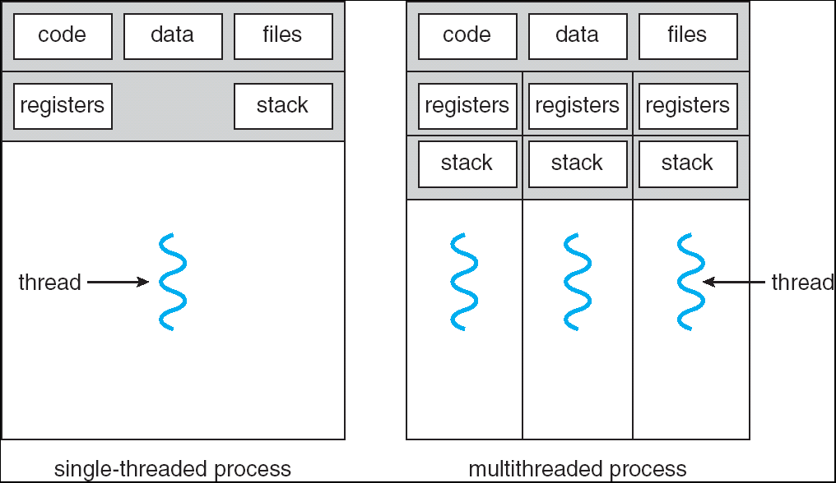
Multithreaded Processes

Slide 49
Threads
#include <pthread.h>
int counter = 0;
void PrintHello(int arg) {
printf(“I’m thread %d, counter is %d\n”, arg, counter++);
... do some work ...
pthread_exit(NULL);
}
int main () {
for (t = 0; t < 4; t++) {
printf(“in main: creating thread %d\n", t);
pthread_create(NULL, NULL, PrintHello, t);
}
pthread_exit(NULL);
}

Slide 50
Threads versus Fork
in main: creating thread 0
I’m thread 0, counter is 0
in main: creating thread 1
I’m thread 1, counter is 1
in main: creating thread 2
in main: creating thread 3
I’m thread 3, counter is 2
I’m thread 2, counter is 3
If processes?

Slide 51
Example Multi-Threaded Program
Example: Apache web server
void main() { setup();
while (c = accept_connection()) {
req = read_request(c);
hits[req]++; send_response(c, req);
}
cleanup();
}
Notes:
Use fork
Use threads

Slide 52
Race Conditions
Example: Apache web server
Each client request handled by a separate thread (in parallel)
Some shared state: hit counter, ...
(look familiar?)
Timing-dependent failure ⇒ race condition
hard to reproduce ⇒ hard to debug
Thread 52
read hits
addi
write hits
Thread 205
read hits
addi
write hits
Thread 52
...
hits = hits + 1;
...
Thread 205
...
hits = hits + 1;
...
Notes:
What happens when two threads execute concurrently?
sequential with threads
between threads is unsynchronized

Slide 53
Programming with threads
Within a thread: execution is sequential
Between threads?
No ordering or timing guarantees
Might even run on different cores at the same time
Problem: hard to program, hard to reason about
Behavior can depend on subtle timing differences
Bugs may be impossible to reproduce
Cache coherency isn’t sufficient…
Need explicit synchronization to make sense of concurrency!

Slide 54
Race conditions
Race Condition
Timing-dependent error when accessing shared state
Depends on scheduling happenstance … e.g. who wins “race” to the store instruction?
Concurrent Program Correctness = all possible schedules are safe
Must consider every possible permutation
In other words…
… the scheduler is your adversary

Slide 55
Critical sections
What if we can designate parts of the execution as critical sections
Rule: only one thread can be “inside”
Thread 52
read hits
addi
write hits
Thread 205
read hits
addi
write hits
Notes:
Show picture

Slide 56
Mutexes
Q: How to implement critical section in code?
A: Lots of approaches….
Mutual Exclusion Lock (mutex)
acquire(m): wait till it becomes free, then lock it
release(m): unlock it
apache_got_hit() {
pthread_mutex_lock(m);
hits = hits + 1;
pthread_mutex_unlock(m)
}

Slide 57
Takeaway
Informally, Cache Coherency requires that reads return most recently written value.
With multiprocessors maintaining cache coherency can be difficult and requires cache coherency protocols like Snooping cache coherency protocols.
Cache coherency controls what values are read, but may be insufficient or very expensive to maintain consistency (when a written value will be returned to a read). We need synchronization primitives to more efficiently implement parallel and correct programs.
Processes and Threads are the abstraction that we use to write parallel programs? Fork and Joint and Interprocesses communication (IPC) can be used to coordinate processes. Threads are used to coordinate use of shared memory within a process.

Slide 58
Next time
Next time. Higher level synchronization primitives (other abstractions to implement a critical section beyond mutexes)?
Notes:
A: next time…

Slide 59
Administrivia
Project3 due next week, Monday, April 22nd
Design Doc due yesterday, Monday, April 15th
Games night Friday, April 26th, 5-7pm.
Location: B17 Upson
Homework4 is due tomorrow, Wednesday, April 17th
Work alone
Question1 on Virtual Memory is pre-lab question for Lab4
Prelim3 is next week, Thursday, April 25th
Time and Location: 7:30pm in Phillips 101 and Upson B17
Old prelims are online in CMS

Slide 60
Administrivia
Next three weeks
Week 12 (Apr 15): Project3 design doc due and HW4 due
Week 13 (Apr 22): Project3 due and Prelim3
Week 14 (Apr 29): Project4 handout
Final Project for class
Week 15 (May 6): Project4 design doc due
Week 16 (May 13): Project4 due

