Slide 1
Virtual Memory
Hakim Weatherspoon
CS 3410, Spring 2013
Computer Science
Cornell University
P & H Chapter 5.4 (up to TLBs)

Slide 2
Big Picture: (Virtual) Memory
0xfffffffc
system reserved
top
system reserved
0x80000000
0x7ffffffc
stack
(stack grows down)
(.stack)
(heap grows up)
(static) data
.data
dynamic data (heap)
text
.text
0x10000000
static data
.data
code (text)
0x00400000
reserved
.text
0x00000000
bottom
system reserved

Slide 3
Big Picture: (Virtual) Memory
Code Stored in Memory
(also, data and stack)
compute jump/branch targets
$$
memory
$0 (zero)
$1 ($at)
$29 ($sp)
$31 ($ra)
register file
A
alu
D
D
B
+4
$$
addr
PC
inst
control
B
d_{in}
d_{out}
M
memory
new pc
extend
imm
detect hazard
forward unit
Stack, Data, Code
Stored in Memory
Instruction Fetch
Instruction Decode
Write- Back
ctrl
ctrl
ctrl
Execute
Memory
IF/ID
ID/EX
EX/MEM
MEM/WB

Slide 4
Big Picture: (Virtual) Memory
How do we execute more than one program at a time?

Slide 5
Big Picture: Virtual Memory
How do we execute more than one program at a time?
A: Abstraction – Virtual Memory
Memory that appears to exist as main memory (although most of it is supported by data held in secondary storage, transfer between the two being made automatically as required—i.e. ”paging”)
Abstraction that supports multi-tasking---the ability to run more than one process at a time

Slide 6
Goals for Today: Virtual Memory
What is Virtual Memory?
How does Virtual memory Work?
Address Translation
Pages, page tables, and memory mgmt unit
Paging
Role of Operating System
Context switches, working set, shared memory
Performance
How slow is it
Making virtual memory fast
Translation lookaside buffer (TLB)
Virtual Memory Meets Caching

Slide 7
Virtual Memory

Slide 8
Big Picture: Multiple Processes
How to Run multiple processes?
Time-multiplex a single CPU core (multi-tasking)
Web browser, skype, office, … all must co-exist
Many cores per processor (multi-core) or many processors (multi-processor)
Multiple programs run simultaneously

Slide 9
Big Picture: (Virtual) Memory
Memory: big & slow vs Caches: small & fast
Processor
Cache
Memory
0xfff…f
0x7ff…f
Stack
LB $1 ← M[ 1 ]
LB $2 ← M[ 5 ]
LB $3 ← M[ 1 ]
LB $3 ← M[ 4 ]
LB $2 ← M[ 0 ]
LB $2 ← M[ 12 ]
LB $2 ← M[ 5 ]
LB $2 ← M[ 12 ]
LB $2 ← M[ 5 ]
LB $2 ← M[ 12 ]
LB $2 ← M[ 5 ]
tag data
100
110
1
2
140
Heap
150
Data
0
Text
0
Misses:
Hits:
0x000…0

Slide 10
Processor & Memory
CPU address/data bus...
… routed through caches
… to main memory
Simple, fast, but…
Q: What happens for LW/SW to an invalid location?
0x000000000 (NULL)
uninitialized pointer
A: Need a memory management unit (MMU)
Throw (and/or handle) an exception
Memory
CPU
0xfff…f
0x7ff…f
Stack
$$
Heap
Data
Text
0x000…0
Memory

Slide 11
Multiple Processes
Q: What happens when another program is executed concurrently on another processor?
A: The addresses will conflict
Even though, CPUs may take
turns using memory bus
CPU
0xfff…f
0x7ff…f
Stack
$$
Stack
$$
Heap
Heap
CPU
Data
Data
Text
Text
0x000…0
Memory

Slide 12
Multiple Processes
Q: Can we relocate second program?
CPU
0xfff…f
0x7ff…f
Stack
Stack
Heap
Heap
CPU
Data
Data
Text
Text
0x000…0
Memory

Slide 13
Solution? Multiple processes/processors
Q: Can we relocate second program?
A: Yes, but…
What if they don’t fit?
What if not contiguous?
Need to recompile/relink?
…
Stack
CPU
Data
Stack
Heap
Heap
CPU
Data
Text
Text
Memory

Slide 14
Takeaway
All problems in computer science can be solved by another level of indirection.
– David Wheeler
– or, Butler Lampson
– or, Leslie Lamport
– or, Steve Bellovin

Slide 15
Takeaway
All problems in computer science can be solved by another level of indirection.
– David Wheeler
– or, Butler Lampson
– or, Leslie Lamport
– or, Steve Bellovin
Solution: Need a MAP
To map a Virtual Address (generated by CPU)
to a Physical Address (in memory)

Slide 16
Next Goal
How does Virtual Memory work?
i.e. How do we create that “map” that maps a virtual address generated by the CPU to a physical address used by main memory?

Slide 17
Virtual Memory
Virtual Memory: A Solution for All Problems
Program/CPU can access any address from 0…2^{N}
(e.g. N=32)
Each process has its own virtual address space
A process is a program being executed
Programmer can code as if they own all of memory
On-the-fly at runtime, for each memory access
all access is indirect through a virtual address
translate fake virtual address to a real physical address
redirect load/store to the physical address
map

Slide 18
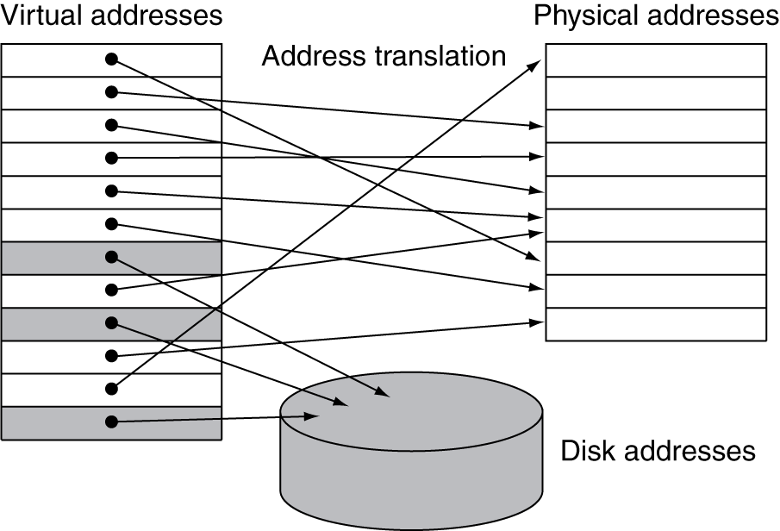
Address Space
wikipedia

Slide 19
Address Space
X
CPU
CPU
0x1000
C
0x1000
A
X
B
B
Y
C
Z
Z
MMU
MMU
Y
Virtual Address
Space
A
Virtual Address
Space
Physical Address Space
Programs load/store to virtual addresses
Actual memory uses physical addresses
Memory Management Unit (MMU)
Responsible for translating on the fly
Essentially, just a big array of integers: paddr = PageTable[vaddr];
Notes:
each mmu has own mappings
Easy relocation
Higher memory utilization
Easy sharing

Slide 20
Virtual Memory Advantages
Advantages
Easy relocation
Loader puts code anywhere in physical memory
Creates virtual mappings to give illusion of correct layout
Higher memory utilization
Provide illusion of contiguous memory
Use all physical memory, even physical address 0x0
Easy sharing
Different mappings for different programs / cores
And more to come…

Slide 21
Takeaway
All problems in computer science can be solved by another level of indirection.
Need a map to translate a “fake” virtual address (generated by CPU) to a “real” physical Address (in memory)
Virtual memory is implemented via a “Map”, a PageTage, that maps a vaddr (a virtual address) to a paddr (physical address):
paddr = PageTable[vaddr]

Slide 22
Next Goal
How do we implement that translation from a virtual address (vaddr) to a physical address (paddr)?
paddr = PageTable[vaddr]
i.e. How do we implement the PageTable??

Slide 23
Address Translation
Pages, Page Tables, and
the Memory Management Unit (MMU)

Slide 24
Attempt#1: Address Translation
How large should a PageTable be for a MMU?
paddr = PageTable[vaddr];
Granularity?
Per word…
Per block…
Variable..…
Typical:
4KB – 16KB pages
4MB – 256MB jumbo pages
2³² = 4GB
4 bytes per word -> Need 1 billion entry PageTable!
2³² / 4 = 1 billion
e.g. 2³² / 4 kB = 2³² / 2¹² = 2²⁰
2²⁰ -> 1 million entry PageTable is better
e.g. 2³² / 256 MB = 2³² / 2²⁸ = 2⁴
2⁴ -> 16 entry PageTable!
Notes:
per word … too expensive: 4GB PageTable arrray
per block… ?
Variable … complicated hardware
We will stick to 4kb pages

Slide 25
Attempt #1: Address Translation
CPU
generated
Virtual page number
Page Offset
vaddr
31 12 11 0
e.g. Page size
4 kB = 2¹²
Lookup in PageTable
Main
Memory
Physical page number
Page offset
paddr
12 11 0
Attempt #1: For any access to virtual address:
Calculate virtual page number and page offset
Lookup physical page number at PageTable[vpn]
Calculate physical address as ppn:offset
Notes:
4kb pages = 12 bits for page offset, 20 bits for VPN

Slide 26
Takeaway
All problems in computer science can be solved by another level of indirection.
Need a map to translate a “fake” virtual address (generated by CPU) to a “real” physical Address (in memory)
Virtual memory is implemented via a “Map”, a PageTage, that maps a vaddr (a virtual address) to a paddr (physical address):
paddr = PageTable[vaddr]
A page is constant size block of virtual memory. Often, the page size will be around 4kB to reduce the number of entries in a PageTable.

Slide 27
Next Goal
Example
How to translate a vaddr (virtual address) generated by the CPU to a paddr (physical address) used by main memory using the PageTable managed by the memory management unit (MMU).

Slide 28
Next Goal
Example
How to translate a vaddr (virtual address) generated by the CPU to a paddr (physical address) used by main memory using the PageTable managed by the memory management unit (MMU).
Q: Where is the PageTable stored??

Slide 29
Simple PageTable
Read Mem[0x4123B538]
PageOffset
VPN: virtual page number
Data
CPU
0xC20A3000
MMU
Q: Where to store page tables?
A: In memory, of course… Special page table base register (CR3:PTBR on x86) (Cop0:ContextRegister on MIPS)
0x90000000
PTBR
0x4123B000
0x10045000
0x10044000
0x00000000
Notes:
VADDR = 0x00401538
PFN = VADDR/4kb = VADDR>>12 = 0x401
PageTableEntry at 0x90000804 contains 0x4123B000
Data at 0x4123B538

Slide 30
Simple PageTable
 | Physical Page Number
 | 0x10045
 | 0xC20A3
 | 0x4123B
 | 0x10044
0xC20A3000
0x90000000
0x4123B000
vpn | pgoff
vaddr
0x10045000
0x10044000
0x00000000
PTBR

Slide 31
Invalid Pages
V |  | Physical Page Number
0
1 |  | 0x10045
0
0
1 |  | 0xC20A3
1 |  | 0x4123B
1 |  | 0x10044
0
0xC20A3000
0x90000000
0x4123B000
Cool Trick #1: Don’t map all pages
Need valid bit for each page table entry
Q: Why?
A: now access to NULL will fail
A: we might not have that much physical memory
0x10045000
0x10044000
0x00000000
Notes:
A: now access to NULL will fail
A: we might not have that much physical memory

Slide 32
Page Permissions
V | R | W | X |  | Physical Page Number
0
1 |  |  |  |  | 0x10045
0
0
1 |  |  |  |  | 0xC20A3
1 |  |  |  |  | 0x4123B
1 |  |  |  |  | 0x10044
0
0xC20A3000
0x90000000
0x4123B000
Cool Trick #2: Page permissions!
Keep R, W, X permission bits for each page table entry
Q: Why?
A: can make code read-only, executable;
make data read-write but not executable; etc.
0x10045000
0x10044000
0x00000000
Notes:
A: can make code read-only, executable; make data read-write but not executable; etc.

Slide 33
Aliasing
V | R | W | X |  | Physical Page Number
0
1 |  |  |  |  | 0xC20A3
0
0
1 |  |  |  |  | 0xC20A3
1 |  |  |  |  | 0x4123B
1 |  |  |  |  | 0x10044
0
0xC20A3000
0x90000000
0x4123B000
Cool Trick #3: Aliasing
Map the same physical page at several virtual addresses
Q: Why?
A: can make different views of same
data with different permissions
0x10045000
0x10044000
0x00000000
Notes:
A: can make different views of same data with different permissions

Slide 34
Page Size Example
Overhead for VM Attempt #1 (example)
Virtual address space (for each process):
total memory: 2³² bytes = 4GB
page size: 2¹² bytes = 4KB
entries in PageTable?
size of PageTable?
Physical address space:
total memory: 2²⁹ bytes = 512MB
overhead for 10 processes?
2²⁰ = 1 million entries in PageTable
PageTable Entry (PTE) size = 4 bytes
So, PageTable size = 4 x 2²⁰ = 4MB
10 x 4MB = 40 MB of overhead!
40 MB /512 MB = 7.8% overhead,
space due to PageTable
Notes:
2²⁰ entries in pagetable, so 2²² bytes = 4MB (w/ 4byte entries), so 40MB (25% of total!)
Q: Can we possibly have a “full” pagetable?
A: Not enough physical memory pages – some pagetable entries will be duplicates!

Slide 35
Takeaway
All problems in computer science can be solved by another level of indirection.
Need a map to translate a “fake” virtual address (generated by CPU) to a “real” physical Address (in memory)
Virtual memory is implemented via a “Map”, a PageTage, that maps a vaddr (a virtual address) to a paddr (physical address):
paddr = PageTable[vaddr]
A page is constant size block of virtual memory. Often, the page size will be around 4kB to reduce the number of entries in a PageTable.
We can use the PageTable to set Read/Write/Execute permission on a per page basis. Can allocate memory on a per page basis. Need a valid bit, as well as Read/Write/Execute and other bits.
But, overhead due to PageTable is significant.

Slide 36
Next Goal
How do we reduce the size (overhead) of the PageTable?

Slide 37
Next Goal
How do we reduce the size (overhead) of the PageTable?
A: Another level of indirection!!

Slide 38
Beyond Flat Page Tables
Assume most of PageTable is empty
How to translate addresses?
Multi-level PageTable
10 bits
10 bits
10 bits
2
vaddr
Word
PTEntry
Page
PDEntry
Page Table
PTBR
Page Directory
* x86 does exactly this
Notes:
Q: Benefits?
A1: Don’t need 4MB contiguous physical memory
A2: Don’t need to allocate every PageTable, only those containing valid PTEs
Q: Drawbacks?
A: Longer lookups.

Slide 39
Beyond Flat Page Tables
Assume most of PageTable is empty
How to translate addresses? Multi-level PageTable
Q: Benefits?
A: Don’t need 4MB contiguous physical memory
A: Don’t need to allocate every PageTable, only those containing valid PTEs
Q: Drawbacks
A: Performance: Longer lookups
Notes:
Q: Benefits?
A1: Don’t need 4MB contiguous physical memory
A2: Don’t need to allocate every PageTable, only those containing valid PTEs
Q: Drawbacks?
A: Longer lookups.

Slide 40
Takeaway
All problems in computer science can be solved by another level of indirection.
Need a map to translate a “fake” virtual address (generated by CPU) to a “real” physical Address (in memory)
Virtual memory is implemented via a “Map”, a PageTage, that maps a vaddr (a virtual address) to a paddr (physical address):
paddr = PageTable[vaddr]
A page is constant size block of virtual memory. Often, the page size will be around 4kB to reduce the number of entries in a PageTable.
We can use the PageTable to set Read/Write/Execute permission on a per page basis. Can allocate memory on a per page basis. Need a valid bit, as well as Read/Write/Execute and other bits.
But, overhead due to PageTable is significant.
Another level of indirection, two levels of PageTables and significantly reduce the overhead due to PageTables.

Slide 41
Next Goal
Can we run process larger than physical memory?

Slide 42
Paging

Slide 43
Paging
Can we run process larger than physical memory?
The “virtual” in “virtual memory”
View memory as a “cache” for secondary storage
Swap memory pages out to disk when not in use
Page them back in when needed
Assumes Temporal/Spatial Locality
Pages used recently most likely to be used again soon

Slide 44
Paging
V | R | W | X | D | Physical Page Number
0 |  |  |  |  | invalid
1 |  |  |  | 0 | 0x10045
0 |  |  |  |  | invalid
0 |  |  |  |  | invalid
0 |  |  |  | 0 | disk sector 200
0 |  |  |  | 0 | disk sector 25
1 |  |  |  | 1 | 0x00000
0 |  |  |  |  | invalid
0xC20A3000
0x90000000
0x4123B000
0x10045000
Cool Trick #4: Paging/Swapping
Need more bits:
Dirty, RecentlyUsed, …
0x00000000
200
25
Notes:
A: can make code read-only, executable; make data read-write but not executable; etc.

Slide 45
Summary
Virtual Memory
Address Translation
Pages, page tables, and memory mgmt unit
Paging
Next time
Role of Operating System
Context switches, working set, shared memory
Performance
How slow is it
Making virtual memory fast
Translation lookaside buffer (TLB)
Virtual Memory Meets Caching

Slide 46
Administrivia
Lab3 is out due next Thursday

Slide 47
Administrivia
Next five weeks
Week 10 (Apr 1): Project2 due and Lab3 handout
Week 11 (Apr 8): Lab3 due and Project3/HW4 handout
Week 12 (Apr 15): Project3 design doc due and HW4 due
Week 13 (Apr 22): Project3 due and Prelim3
Week 14 (Apr 29): Project4 handout
Final Project for class
Week 15 (May 6): Project4 design doc due
Week 16 (May 13): Project4 due

Slide 48
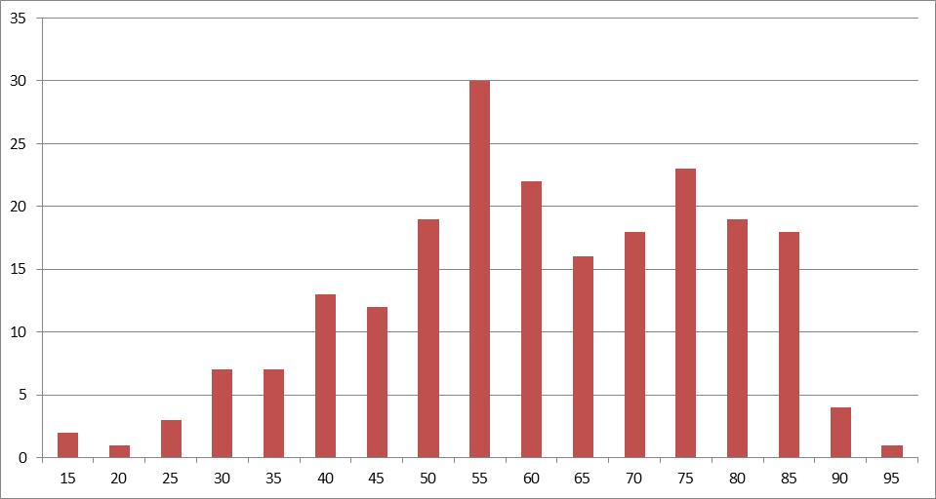
Administrivia
Prelim2 results
Mean 58.8 (median 58), standard deviation 16.8
Prelims available in Upson 305 after today
Regrade requires written request
Whole test is regraded

