Slide 1
State and Finite State Machines
Hakim Weatherspoon
CS 3410, Spring 2013
Computer Science
Cornell University
See P&H Appendix C.7. C.8, C.10, C.11

Slide 2
Stateful Components
Until now is combinatorial logic
  Output is computed when inputs are present
  System has no internal state
  Nothing computed in the present can depend on what happened in the past!
Need a way to record data
Need a way to build stateful circuits
Need a state-holding device
Finite State Machines
Inputs
Combinational
circuit
Outputs
N
M
Notes:
How are we going to stably store state

Slide 3
Goals for Today
State
  How do we store one bit?
  Attempts at storing (and changing) one bit
    Set-Reset Latch
    D Latch
    D Flip-Flops
    Master-Slave Flip-Flops
  Register: storing more than one bit, N-bits
Finite State Machines (FSM)
  How do we design logic circuits with state?
  Types of FSMs: Mealy and Moore Machines
  Examples: Serial Adder and a Digital Door Lock

Slide 4
Goal
How do we store store one bit?

Slide 5
First Attempt: Unstable Devices
B
C
A

Slide 6
Second Attempt: Bistable Devices
Stable and unstable equilibria?
A
B
A Simple Device
Notes:
How to create state? Feedback.
Show how the signal works

Slide 7

Third Attempt: Set-Reset Latch
S
A
$$\overline{Q}$$
Q
B
R
Can you store a value (with this circuit)?
Can you change its value?
Notes:
How to create state? Feedback.
Show how the signal works

Slide 8


Third Attempt: Set-Reset Latch
S
$$\overline{Q}$$
Q
R
S | R | Q | $$\overline{Q}$$
0 | 0
0 | 1
1 | 0
1 | 1
Set-Reset (S-R) Latch
Stores a value Q and its complement

Slide 9
Third Attempt: Set-Reset Latch
S
$$\overline{Q}$$
Q
R
S | R | Q | $$\overline{Q}$$
0 | 0
0 | 1
1 | 0
1 | 1
Set-Reset (S-R) Latch
Stores a value Q and its complement
A | B | OR | NOR
0 | 0 | 0 | 1
0 | 1 | 1 | 0
1 | 0 | 1 | 0
1 | 1 | 1 | 0

Slide 10

Third Attempt: Set-Reset Latch
S
Q
S
R
$$\overline{Q}$$
$$\overline{Q}$$
Q
R
S | R | Q | $$\overline{Q}$$
0 | 0
0 | 1
1 | 0
1 | 1
Set-Reset (S-R) Latch
Stores a value Q and its complement

Slide 11
Takeaway
Set-Reset (SR) Latch can store one bit and we can change the value of the stored bit. But, SR Latch has a forbidden state.

Slide 12
Next Goal
How do we avoid the forbidden state of S-R Latch?

Slide 13

Fourth Attempt: (Unclocked) D Latch
D
S
Q
D
S
R
Q
$$\overline{Q}$$
R
Q
D | Q | $$\overline{Q}$$
0
1
Fill in the truth table?
A | B | OR | NOR
0 | 0 | 0 | 1
0 | 1 | 1 | 0
1 | 0 | 1 | 0
1 | 1 | 1 | 0
Notes:
Start in 0, 0, 1
Change to D = 1
After NOT gate, R = 0
After OR+NOT gates, /Q = 0 (R is already ready then), Q goes to 1
Problem: No way to hold state

Slide 14
Takeaway
Set-Reset (SR) Latch can store one bit and we can change the value of the stored bit. But, SR Latch has a forbidden state.
(Unclocked) D Latch can store and change a bit like an SR Latch while avoiding the forbidden state.

Slide 15
Next Goal
How do we coordinate state changes to a D Latch?

Slide 16
Clocks
Clock helps coordinate state changes
  Usually generated by an oscillating crystal
  Fixed period; frequency = 1/period
clock
high
falling
edge
rising
edge
falling
edge
rising
edge
1
0
period
low
high
clock
period
clock
low

Slide 17
Edge-triggering
Can design circuits to change on the rising or falling edge
Trigger on rising edge = positive edge-triggered
Trigger on falling edge = negative edge-triggered
Inputs must be stable just before the triggering edge
input
clock

Slide 18
Clock Disciplines
Level sensitive
  State changes when clock is high (or low)
Edge triggered
  State changes at clock edge
positive edge-triggered
negative edge-triggered

Slide 19


Fifth Attempt: D Latch with Clock
D
S
Q
clk
R
$$\overline{Q}$$
Fill in the truth table
clk | D | Q | $$\overline{Q}$$
0 | 0
0 | 1
1 | 0
1 | 1
Notes:
Any forbidden S=R=1 inputs? No
Need both truth tables

Slide 20
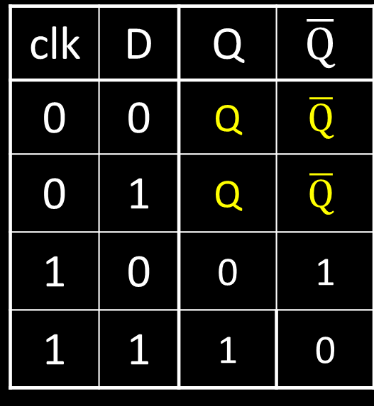
Fifth Attempt: D Latch with Clock
Level Sensitive D Latch
Clock high:
set/reset (according to D)
Clock low:
keep state (ignore D)
D
S
Q
clk
R
$$\overline{Q}$$
clk | D | Q | $$\overline{Q}$$
0 | 0 | Q | $$\overline{Q}$$
0 | 1 | Q | $$\overline{Q}$$
1 | 0 | 0 | 1
1 | 1 | 1 | 0
clk
D
Q
Notes:
Any forbidden S=R=1 inputs? No
Need both truth tables

Slide 21



Sixth Attempt: Edge-Triggered D Flip-Flop
D Flip-Flop
Edge-Triggered
Data captured when clock is high
Output changes only on falling edges
D
1
D
Q
0
D
Q
0
Q
X
clk
0
L
$$\overline{Q}$$
1
L
$$\overline{Q}$$
$$\overline{Q}$$
c
c
Activity#1: Fill in timing graph and values for X and Q
clk
D
X
Q
Notes:
Master-Slave Flip Flop
- Outputs change only on falling edges
- Data is captured on rising edges
1 cycle delay
but works out perfectly – data for the next stage is ready 1 cycle ahead of time

Slide 22
Takeaway
Set-Reset (SR) Latch can store one bit and we can change the value of the stored bit. But, SR Latch has a forbidden state.
(Unclocked) D Latch can store and change a bit like an SR Latch while avoiding a forbidden state.
An Edge-Triggered D Flip-Flip (aka Master-Slave D Flip-Flip) stores one bit. The bit can be changed in a synchronized fashion on the edge of a clock signal.

Slide 23
Next Goal
How do we store more than one bit, N bits?

Slide 24
Registers
D0
Register
D flip-flops in parallel
shared clock
extra clocked inputs:
write_enable, reset, …
D1
D2
D3
4-bit
reg
4
4
clk
clk

Slide 25
Takeaway
Set-Reset (SR) Latch can store one bit and we can change the value of the stored bit. But, SR Latch has a forbidden state.
(Unclocked) D Latch can store and change a bit like an SR Latch while avoiding a forbidden state.
An Edge-Triggered D Flip-Flip (aka Master-Slave D Flip-Flip) stores one bit. The bit can be changed in a synchronized fashion on the edge of a clock signal.
An N-bit register stores N-bits. It is be created with N D-Flip-Flops in parallel along with a shared clock.

Slide 26
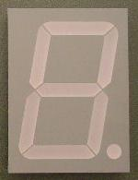
An Example: What will this circuit do?
Reset
Run
WE
R
Decoder
32-bit
reg
+1
Clk

Slide 27
Recap
We can now build interesting devices with sensors
  Using combinatorial logic
We can also store data values
  In state-holding elements
  Coupled with clocks

Slide 28
Administrivia
Make sure to go to your Lab Section this week
Design Doc for Lab1 due in one week, next Monday, Feb 4th
Completed Lab1 due in two weeks, Monday, Feb 11th
Work alone
Homework1 is out
Due in one week, next Wednesday, start early
Work alone
But, use your resources
  Lab Section, Piazza.com, Office Hours, Homework Help Session,
  Class notes, book, Sections, CSUGLab

Slide 29
Administrivia
Check online syllabus/schedule
  http://www.cs.cornell.edu/Courses/CS3410/2013sp/schedule.html
Slides and Reading for lectures
Office Hours
Homework and Programming Assignments
Prelims (in evenings):
  Tuesday, February 26th
  Thursday, March 28th
  Thursday, April 25th
Schedule is subject to change

Slide 30
Collaboration, Late, Re-grading Policies
“Black Board” Collaboration Policy
  Can discuss approach together on a “black board”
  Leave and write up solution independently
  Do not copy solutions
  Late Policy
  Each person has a total of four “slip days”
  Max of two slip days for any individual assignment
  Slip days deducted first for any late assignment,
  cannot selectively apply slip days
  For projects, slip days are deducted from all partners
  20% deducted per day late after slip days are exhausted
  Regrade policy
  Submit written request to lead TA,
  and lead TA will pick a different grader
  Submit another written request,
  lead TA will regrade directly
  Submit yet another written request for professor to regrade.

Slide 31
Goals for Today
State
  How do we store one bit?
  Attempts at storing (and changing) one bit
    Set-Reset Latch
    D Latch
    D Flip-Flops
    Master-Slave Flip-Flops
  Register: storing more than one bit, N-bits
Finite State Machines (FSM)
  How do we design logic circuits with state?
  Types of FSMs: Mealy and Moore Machines
  Examples: Serial Adder and a Digital Door Lock

Slide 32
Finite State Machines

Slide 33
Next Goal
How do we design logic circuits with state?

Slide 34
Finite State Machines
An electronic machine which has
  external inputs
  externally visible outputs
  internal state
Output and next state depend on
  inputs
  current state

Slide 35
Abstract Model of FSM
Machine is
M = ( S, I, O, δ )
S: Finite set of states
I: Finite set of inputs
O: Finite set of outputs
δ: State transition function
Next state depends on present input and present state

Slide 36
Automata Model
Finite State Machine
  inputs from external world
  outputs to external world
  internal state
  combinational logic
Registers
Current State
Comb.
Logic
Output
Input
Next State
Notes:
Put sequential logic term on slide

Slide 37
FSM Example
down/on
input/output
up/off
down/on
A
B
state
start
state
up/off
up/off
Legend
up/off
C
D
down/off
Input: up or down
Output: on or off
States: A, B, C, or D
down/off

Slide 38
FSM Example
down/on
input/output
up/off
down/on
A
B
state
start
state
up/off
up/off
Legend
up/off
C
D
down/on
Input: = up or = down
Output: = on or = off
States: = A, = B, = C, or = D
down/on
Notes:
Say left of slash is input and right is output

Slide 39
FSM Example
1/1
1/1
i₀i₁i₂…/o₀o₁o₂…
0/0
00
01
S₁S₀
S₁S₀
0/0
0/0
Legend
0/0
10
11
1/0
Input: 0=up or 1=down
Output: 1=on or 1=off
States: 00=A, 01=B, 10=C, or 11=D
1/0

Slide 40
Mealy Machine
General Case: Mealy Machine
Outputs and next state depend on both
current state and input
Registers
Current State
Comb.
Logic
Output
Input
Next State

Slide 41
Moore Machine
Special Case: Moore Machine
Outputs depend only on current state
Registers
Current State
Comb.
Logic
Output
Comb.
Logic
Input
Next State

Slide 42
Moore Machine Example
down
input
up
down
A off
B
on
state
out
startout
up
up
Legend
up
C off
D on
down
Input: up or down
Output: on or off
States: A, B, C, or D
down
Notes:
Also show a mealy machine

Slide 43
Activity #2: Create a Mealy FSM for a Serial Adder
Add two infinite input bit streams
  streams are sent with least-significant-bit (lsb) first
  How many states are needed to represent FSM?
  Draw and Fill in FSM diagram
…10110
…00101
…01111
Strategy:
(1) Draw a state diagram (e.g. Mealy Machine)
(2) Write output and next-state tables
(3) Encode states, inputs, and outputs as bits
(4) Determine logic equations for next state and outputs
Notes:
Ask as a clicker question

Slide 44
FSM: State Diagram
__/_
__/_
__/_
S0
__/_
S1
__/_
__/_
__/_
__/_
a
…10110
…00101
z
b
…01111
Two states: S0 (no carry in), S1 (carry in)
Inputs: a and b
Output: z
  z is the sum of inputs a, b, and carry-in (one bit at a time)
  A carry-out is the next carry-in state.
  Arcs labeled with input bits a and b, and output z
Notes:
Is this a mealy or moore machine, maybe clicker

Slide 45
Serial Adder: State Table
__/_
__/_
__/_
S0
__/_
S1
__/_
__/_
__/_
__/_
a | b | Current state | z | Next state
(2) Write down all input and state combinations

Slide 46
Serial Adder: State Table
__/_
__/_
__/_
S0
__/_
S1
__/_
__/_
__/_
__/_
a | b | Current state | z | Next state
(3) Encode states, inputs, and outputs as bits

Slide 47
Serial Adder: Circuit
Next State
Current State
Output
Comb.
Logic
z
s'
s
D
Q
a
Next State
b
Input
s'
a | b | s | z | s'
(4) Determine logic equations for next state and outputs
Combinational Logic Equations
  .
Notes:
Practice minimizing circuit w/a Karnaugh map

Slide 48
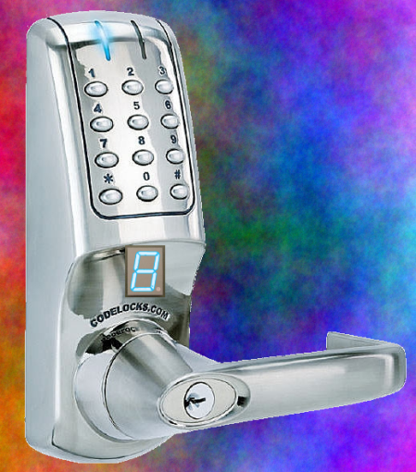
Example: Digital Door Lock
Digital Door Lock
Inputs:
  keycodes from keypad
  clock
Outputs:
  “unlock” signal
  display how many keys pressed so far

Slide 49
Door Lock: Inputs
Assumptions:
  signals are synchronized to clock
  Password is B-A-B
K | A | B | Meaning
0 | 0 | 0 | Ø (no key)
1 | 1 | 0 | ‘A’ pressed
1 | 0 | 1 | ‘B’ pressed
K
A
B
Notes:
How many states, another clicker question

Slide 50
Door Lock: Outputs
Assumptions:
  High pulse on U unlocks door
4
LED
dec
8
D₃D₂D₁D₀
U
Strategy:
(1) Draw a state diagram (e.g. Moore Machine)
(2) Write output and next-state tables
(3) Encode states, inputs, and outputs as bits
(4) Determine logic equations for next state and outputs

Slide 51
Door Lock: Simplified State Diagram
Ø
Ø
“A”
“B”
G3
G1
G2
”3”, U
”1”
”2”
“B”
else
else
any
Idle
”0”
Ø
else
any
B1
else
B2
else
B3
”1”
”2”
”3”
Ø
Ø
(1) Draw a state diagram (e.g. Moore Machine)

Slide 52
Door Lock: Simplified State Diagram
Ø
Ø
“A”
“B”
G3
G1
G2
”3”, U
”1”
”2”
“B”
else
else
any
Idle
”0”
else
Ø
else
B1
else
B2
”1”
”2”
Ø
Ø
(1) Draw a state diagram (e.g. Moore Machine)
Notes:
Works, but gives extra information revealing a secret

Slide 53
Door Lock: Simplified State Diagram
Ø
Ø
“A”
“B”
G3
G1
G2
”3”, U
”1”
”2”
“B”
else
else
any
Cur. State | Output
Idle
”0”
else
Ø
else
B1
else
B2
”1”
”2”
Ø
Ø
(2) Write output and next-state tables

Slide 54
Door Lock: Simplified State Diagram
Ø
Ø
“A”
“B”
G3
G1
G2
”3”, U
”1”
”2”
“B”
else
else
any
Cur. State | Output
Cur. State | Output
Idle | “0”
G1 | “1”
G2 | “2”
G3 | “3”, U
B1 | “1”
B2 | “2”
Idle
”0”
else
Ø
else
B1
else
B2
”1”
”2”
Ø
Ø
(2) Write output and next-state tables

Slide 55
Door Lock: Simplified State Diagram
Cur. State | Input | Next State
Ø
Ø
Cur. State | Input | Next State
“A”
“B”
G3
G1
G2
”3”, U
”1”
”2”
“B”
else
else
any
Idle
”0”
else
Ø
else
B1
else
B2
”1”
”2”
Ø
Ø
(2) Write output and next-state tables

Slide 56
Door Lock: Simplified State Diagram
Cur. State | Input | Next State
Ø
Ø
Cur. State | Input | Next State
Idle | Ø | Idle
Idle | “B” | G1
Idle | “A” | B1
G1 | Ø | G1
G1 | “A” | G2
G1 | “B” | B2
G2 | Ø | B2
G2 | “B” | G3
G2 | “A” | Idle
G3 | any | Idle
B1 | Ø | B1
B1 | K | B2
B2 | Ø | B2
B2 | K | Idle
“A”
“B”
G3
G1
G2
”3”, U
”1”
”2”
“B”
else
else
any
Idle
”0”
else
Ø
else
B1
else
B2
”1”
”2”
Ø
Ø
(2) Write output and next-state tables

Slide 57
State Table Encoding
Cur. State | Output
Idle | “0”
G1 | “1”
G2 | “2”
G3 | “3”, U
B1 | “1”
B2 | “2”
S₂ | S₁ | S₀
0 | 0 | 0
0 | 0 | 1
0 | 1 | 0
0 | 1 | 1
1 | 0 | 0
1 | 0 | 1
D₃ | D₂ | D₁ | D₀ | U
0 | 0 | 0 | 0 | 0
0 | 0 | 0 | 1 | 0
0 | 0 | 1 | 0 | 0
0 | 0 | 1 | 1 | 1
0 | 0 | 0 | 1 | 0
0 | 0 | 1 | 0 | 0
Cur. State | Input | Next State
Idle | Ø | Idle
Idle | “B” | G1
Idle | “A” | B1
G1 | Ø | G1
G1 | “A” | G2
G1 | “B” | B2
G2 | Ø | B2
G2 | “B” | G3
G2 | “A” | Idle
G3 | any | Idle
B1 | Ø | B1
B1 | K | B2
B2 | Ø | B2
B2 | K | Idle
K | A | B
0 | 0 | 0
1 | 0 | 1
1 | 1 | 0
0 | 0 | 0
1 | 1 | 0
1 | 0 | 1
0 | 0 | 0
1 | 0 | 1
1 | 1 | 0
x | x | x
0 | 0 | 0
1 | x | x
0 | 0 | 0
1 | x | x
S₂ | S₁ | S₀ |  | S’₂ | S’₁ | S’₀
0 | 0 | 0 |  | 0 | 0 | 0
0 | 0 | 0 |  | 0 | 0 | 1
0 | 0 | 0 |  | 1 | 0 | 0
0 | 0 | 1 |  | 0 | 0 | 1
0 | 0 | 1 |  | 0 | 1 | 0
0 | 0 | 1 |  | 1 | 0 | 1
0 | 1 | 0 |  | 0 | 1 | 0
0 | 1 | 0 |  | 0 | 1 | 1
0 | 1 | 0 |  | 0 | 0 | 0
0 | 1 | 1 |  | 0 | 0 | 0
1 | 0 | 0 |  | 1 | 0 | 0
1 | 0 | 0 |  | 1 | 0 | 1
1 | 0 | 1 |  | 1 | 0 | 1
1 | 0 | 1 |  | 0 | 0 | 0
State | S₂ | S₁ | S₀
Idle | 0 | 0 | 0
G1 | 0 | 0 | 1
G2 | 0 | 1 | 0
G3 | 0 | 1 | 1
B1 | 1 | 0 | 0
B2 | 1 | 0 | 1
4
8
K | A | B | Meaning
0 | 0 | 0 | Ø (no key)
1 | 1 | 0 | ‘A’ pressed
1 | 0 | 1 | ‘B’ pressed
D₃D₂D₁D₀
dec
U
K
A
B
(3) Encode states, inputs, and outputs as bits

Slide 58
Door Lock: Implementation
4
D₃₋₀
dec
3bit
Reg
S₂₋₀
U
clk
S₂₋₀
K
S’₂₋₀
A
B
Strategy:
(1) Draw a state diagram (e.g. Moore Machine)
(2) Write output and next-state tables
(3) Encode states, inputs, and outputs as bits
(4) Determine logic equations for next state and outputs

Slide 59
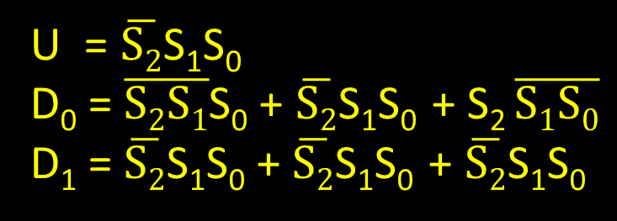
Door Lock: Implementation
4
D₃₋₀
dec
3bit
Reg
S₂₋₀
U
clk
S₂₋₀
K
S’₂₋₀
S₂ | S₁ | S₀
0 | 0 | 0
0 | 0 | 1
0 | 1 | 0
0 | 1 | 1
1 | 0 | 0
1 | 0 | 1
D₃ | D₂ | D₁ | D₀ | U
0 | 0 | 0 | 0 | 0
0 | 0 | 0 | 1 | 0
0 | 0 | 1 | 0 | 0
0 | 0 | 1 | 1 | 1
0 | 0 | 0 | 1 | 0
0 | 0 | 1 | 0 | 0
A
B
U = $\overline{S2}$S₁S₀
D₀ = $\overline{S2S1}$S₀ + $\overline{S2}$S₁S₀ + S₂ $\overline{S1S0}$
D₁ = $\overline{S2}$S₁S₀ + $\overline{S2}$S₁S₀ + $\overline{S2}$S₁S₀
(4) Determine logic equations for next state and outputs

Slide 60
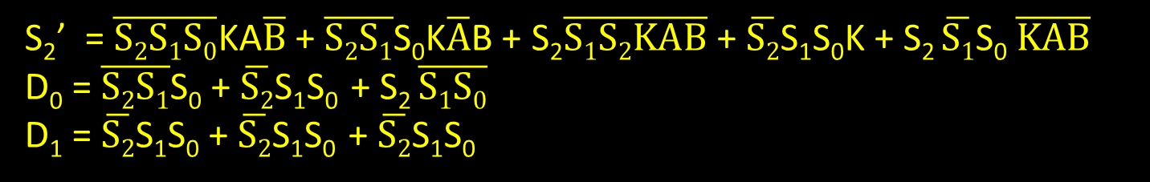
Door Lock: Implementation
K | A | B
0 | 0 | 0
1 | 0 | 1
1 | 1 | 0
0 | 0 | 0
1 | 1 | 0
1 | 0 | 1
0 | 0 | 0
1 | 0 | 1
1 | 1 | 0
x | x | x
0 | 0 | 0
1 | x | x
0 | 0 | 0
1 | x | x
S₂ | S₁ | S₀ |  | S’₂ | S’₁ | S’₀
0 | 0 | 0 |  | 0 | 0 | 0
0 | 0 | 0 |  | 0 | 0 | 1
0 | 0 | 0 |  | 1 | 0 | 0
0 | 0 | 1 |  | 0 | 0 | 1
0 | 0 | 1 |  | 0 | 1 | 0
0 | 0 | 1 |  | 1 | 0 | 1
0 | 1 | 0 |  | 0 | 1 | 0
0 | 1 | 0 |  | 0 | 1 | 1
0 | 1 | 0 |  | 0 | 0 | 0
0 | 1 | 1 |  | 0 | 0 | 0
1 | 0 | 0 |  | 1 | 0 | 0
1 | 0 | 0 |  | 1 | 0 | 1
1 | 0 | 1 |  | 1 | 0 | 1
1 | 0 | 1 |  | 0 | 0 | 0
4
D₃₋₀
dec
3bit
Reg
S₂₋₀
U
clk
S₂₋₀
K
S’₂₋₀
A
B
S₂’ = $\overline{S2S1S0}$KA$\overline{B}$ + $\overline{S2S1}$S₀K$\overline{A}$B + S₂$\overline{S1S2KAB}$ + $\overline{S2}$S₁S₀K + S₂ $\overline{S1}$S₀ $\overline{KAB}$
D₀ = $\overline{S2S1}$S₀ + $\overline{S2}$S₁S₀ + S₂ $\overline{S1S0}$
D₁ = $\overline{S2}$S₁S₀ + $\overline{S2}$S₁S₀ + $\overline{S2}$S₁S₀
(4) Determine logic equations for next state and outputs
Notes:
Write down and compare S₂’

Slide 61
Summary
We can now build interesting devices with sensors
  Using combinational logic
We can also store data values
  Stateful circuit elements (D Flip Flops, Registers, …)
  Clock to synchronize state changes
  State Machines or Ad-Hoc Circuits

