Slide 1
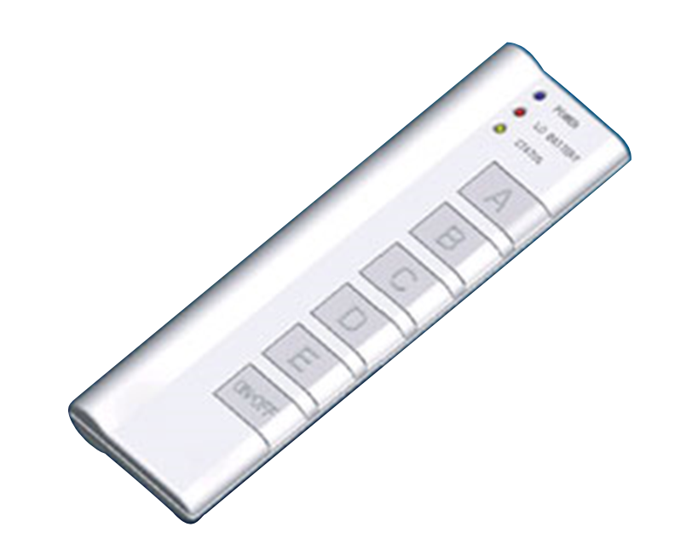



State and Finite State Machines
Hakim Weatherspoon
CS 3410, Spring 2013
Computer Science
Cornell University
See P&H Appendix C.7. C.8, C.10, C.11

Slide 2
Big Picture: Building a Processor
memory
register
file
inst
alu
+4
+4
addr
=?
PC
d_{in}
d_{out}
control
cmp
offset
memory
new
pc
target
imm
extend
A Single cycle processor

Slide 3
Review: Efficiency and Generality
  We can generalize 1-bit Full Adders to 32 bits, 64 bits …
A₃ B₃
A₂ B₂
A₁ B₁
A₀ B₀
C₀
S₃
S₂
S₁
S₀

Slide 4
Review: Efficiency and Generality
  We can generalize 1-bit Full Adders to 32 bits, 64 bits …
  How long does it take to compute a result?
  Can we store the result?
B₃
B₂
B₁
B₀
A₃
mux
A₂
mux
A₁
mux
A₀
mux
0=add
1=sub
over
flow
S₃
S₂
S₁
S₀

Slide 5
Performance
Speed of a circuit is affected by the number of gates in series (on the critical path or the deepest level of logic)
inputs
arrive
Combinational
Logic
outputs
expected
t_{combinational}

Slide 6
4-bit Ripple Carry Adder
A₃
B₃
A₂
B₂
A₁
B₁
A₀
B₀
C₃
C₂
C₁
C₄
C₀
S₃
S₂
S₁
S₀
Carry ripples from lsb to msb
First full adder, 2 gate delay
Second full adder, 2 gate delay
…
Notes:
Carry-lookahead adders would be more efficient performance wise (i.e. lower gate delay), but more expense hardware wise (i.e. more logic gates)

Slide 7
Stateful Components
Until now is combinatorial logic
  Output is computed when inputs are present
  System has no internal state
  Nothing computed in the present can depend on what happened in the past!
Need a way to record data
Need a way to build stateful circuits
Need a state-holding device
Finite State Machines
Inputs
Combinational
circuit
Outputs
N
M
Notes:
How are we going to stably store state

Slide 8
Goals for Today
State
  How do we store one bit?
  Attempts at storing (and changing) one bit
    Set-Reset Latch
    D Latch
    D Flip-Flops
    Master-Slave Flip-Flops
  Register: storing more than one bit, N-bits
Basic Building Blocks
  Decoders and Encoders
Finite State Machines (FSM)
  How do we design logic circuits with state?
  Types of FSMs: Mealy and Moore Machines
  Examples: Serial Adder and a Digital Door Lock

Slide 9
Goal
How do we store store one bit?

Slide 10
First Attempt: Unstable Devices
B
C
A

Slide 11
First Attempt: Unstable Devices
B
0
1
C
0
1
0
1
A
Does not work!
  Unstable
  Oscillates wildly!

Slide 12
Second Attempt: Bistable Devices
Stable and unstable equilibria?
A
B
A Simple Device
In stable state, A = B
How do we change the state?
0
1
1
0
A
B
A
B
Notes:
How to create state? Feedback.
Show how the signal works

Slide 13

Third Attempt: Set-Reset Latch
S
A
$$\overline{Q}$$
Q
B
R
Notes:
Can you store a value (with this circuit)?
Can you change its value?
Q is comes from Latin language "quiscens" or "the present particle" or "what is present available" or "present output"
How to create state? Feedback.
Show how the signal works

Slide 14


Third Attempt: Set-Reset Latch
S
$$\overline{Q}$$
Q
R
S | R | Q | $$\overline{Q}$$
0 | 0
0 | 1
1 | 0
1 | 1
Set-Reset (S-R) Latch
Stores a value Q and its complement

Slide 15
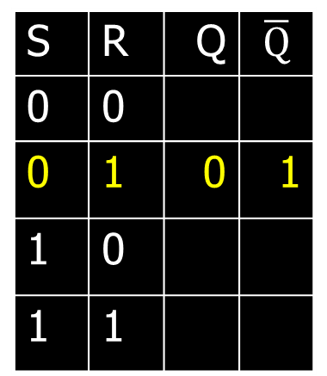


Third Attempt: Set-Reset Latch
0
S
$$\overline{Q}$$
A | B | OR | NOR
0 | 0 | 0 | 1
0 | 1 | 1 | 0
1 | 0 | 1 | 0
1 | 1 | 1 | 0
0
1
Q will be 0 if R is 1
Q
R
$\overline{Q}$will be 1
1
S | R | Q | $$\overline{Q}$$
0 | 0
0 | 1 | ? | ?
1 | 0
1 | 1
S | R | Q | $$\overline{Q}$$
0 | 0
0 | 1 | 0 | 1
1 | 0
1 | 1
Set-Reset (S-R) Latch
Stores a value Q and its complement

Slide 16
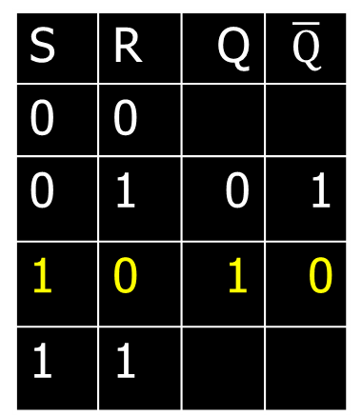


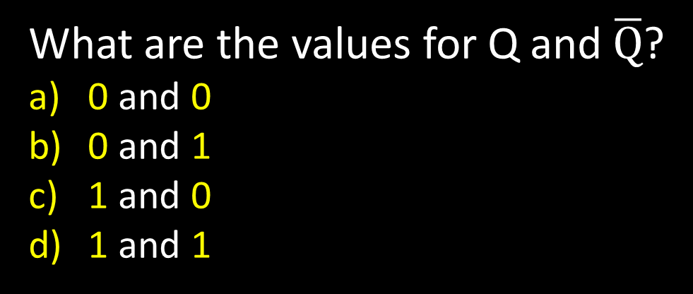
Third Attempt: Set-Reset Latch
1
S
$$\overline{Q}$$
A | B | OR | NOR
0 | 0 | 0 | 1
0 | 1 | 1 | 0
1 | 0 | 1 | 0
1 | 1 | 1 | 0
1
0
Q will be 1
Q
R
$\overline{Q}$will be 0 if S is 1
0
S | R | Q | $$\overline{Q}$$
0 | 0
0 | 1 | 0 | 1
1 | 0 | ? | ?
1 | 1
S | R | Q | $$\overline{Q}$$
0 | 0
0 | 1 | 0 | 1
1 | 0 | 1 | 0
1 | 1
Set-Reset (S-R) Latch
Stores a value Q and its complement
What are the values for Q and $\overline{Q}$?
0 and 0
0 and 1
1 and 0
1 and 1
Notes:
Ask a clicker question about Q and !Q

Slide 17
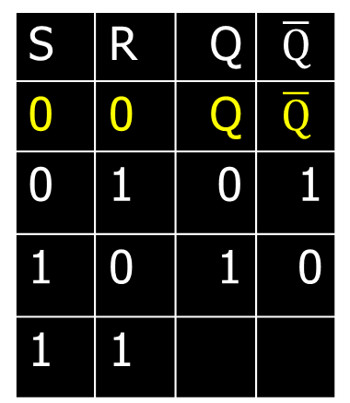
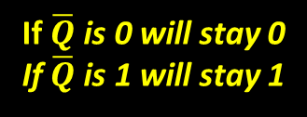

Third Attempt: Set-Reset Latch
1
→
S
0
$$\overline{Q}$$
A | B | OR | NOR
0 | 0 | 0 | 1
0 | 1 | 1 | 0
1 | 0 | 1 | 0
1 | 1 | 1 | 0
1
0
If Q is 1, will stay 1
if Q is 0, will stay 0
Q
R
If $\overline{Q}$ is 0 will stay 0
If $\overline{Q}$ is 1 will stay 1
0
S | R | Q | $$\overline{Q}$$
0 | 0 | ? | ?
0 | 1 | 0 | 1
1 | 0 | 1 | 0
1 | 1
S | R | Q | $$\overline{Q}$$
0 | 0 | Q | $$\overline{Q}$$
0 | 1 | 0 | 1
1 | 0 | 1 | 0
1 | 1
Set-Reset (S-R) Latch
Stores a value Q and its complement
Notes:
Since the set and reset input are both 0, the Q and !Q determine the output, which will hold.

Slide 18


Third Attempt: Set-Reset Latch
S
1
$$\overline{Q}$$
A | B | OR | NOR
0 | 0 | 0 | 1
0 | 1 | 1 | 0
1 | 0 | 1 | 0
1 | 1 | 1 | 0
0
0
Q will be 0 since R is 1
R
$\overline{Q}$ will be 0 since S is 1
Q
1
S | R | Q | $$\overline{Q}$$
0 | 0 | Q | $$\overline{Q}$$
0 | 1 | 0 | 1
1 | 0 | 1 | 0
1 | 1 | ? | ?
Set-Reset (S-R) Latch
Stores a value Q and its complement
What happens when S,R changes from 1,1 to 0,0?
Notes:
Start with 0, 1 => 0, 1
then 0, 0 => 0, 1
then 1, 0 => 1, 0
then 0, 0 => 1, 0, better yet “stay”
1, 1 is forbidden, b/c going to 0, 0 after goes haywire
i.e.
Start 1,1 => 0,0
Alright. Now change S,R to 0, 0, what happens.
1, 1=>0, 0 -> 0, 0=> 0, 0 -> 0, 0=>1, 1 -> 0, 0=> 0, 0 -> oscillations.
S R=>Q,!Q -> S,R=>Q,!Q -> S, R=>Q,!Q -> S,R => Q,!Q

Slide 19

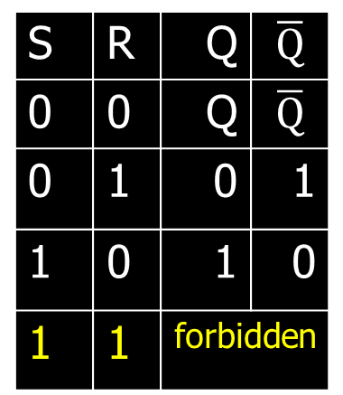
Third Attempt: Set-Reset Latch
S
1→0
$$\overline{Q}$$
A | B | OR | NOR
0 | 0 | 0 | 1
0 | 1 | 1 | 0
1 | 0 | 1 | 0
1 | 1 | 1 | 0
0 →1 →0
0→1 →0
0 →1 →0 →1
0→1 →0 →1
0 →1
0→1
0
0
Q
R
1 →0
S | R | Q | $$\overline{Q}$$
0 | 0 | Q | $$\overline{Q}$$
0 | 1 | 0 | 1
1 | 0 | 1 | 0
1 | 1 | ? | ?
S | R | Q | $$\overline{Q}$$
0 | 0 | Q | $$\overline{Q}$$
0 | 1 | 0 | 1
1 | 0 | 1 | 0
1 | 1 | forbidden
Set-Reset (S-R) Latch
Stores a value Q and its complement
What happens when S,R changes from 1,1 to 0,0?
Q and $\overline{Q}$ become unstable and will oscillate wildly
between values 0,0 to 1,1 to 0,0 to 1,1 …
Notes:
Start with 0, 1 => 0, 1
then 0, 0 => 0, 1
then 1, 0 => 1, 0
then 0, 0 => 1, 0, better yet “stay”
1, 1 is forbidden, b/c going to 0, 0 after goes haywire
i.e.
Start 1,1 => 0,0
Alright. Now change S,R to 0, 0, what happens.
1, 1=>0, 0 -> 0, 0=> 0, 0 -> 0, 0=>1, 1 -> 0, 0=> 0, 0 -> oscillations.
S R=>Q,!Q -> S,R=>Q,!Q -> S, R=>Q,!Q -> S,R => Q,!Q

Slide 20

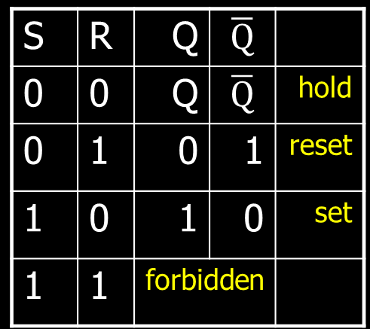

Third Attempt: Set-Reset Latch
S
Q
S
R
$$\overline{Q}$$
$$\overline{Q}$$
Q
R
S | R | Q | $$\overline{Q}$$
0 | 0 | Q | $$\overline{Q}$$
0 | 1 | 0 | 1
1 | 0 | 1 | 0
1 | 1 | forbidden
S | R | Q | $$\overline{Q}$$
0 | 0 | Q | $$\overline{Q}$$ | hold
0 | 1 | 0 | 1 | reset
1 | 0 | 1 | 0 | set
1 | 1 | forbidden
Set-Reset (S-R) Latch
Stores a value Q and its complement
Notes:
Start with 0, 1 => 0, 1
then 0, 0 => 0, 1
then 1, 0 => 1, 0
then 0, 0 => 1, 0, better yet “stay”
1, 1 is forbidden, b/c going to 0, 0 after goes haywire
i.e.
Start 1,1 => 0,0
Alright. Now change S,R to 0, 0, what happens.
1, 1=>0, 0 -> 0, 0=> 0, 0 -> 0, 0=>1, 1 -> 0, 0=> 0, 0 -> oscillations.
S R=>Q,!Q -> S,R=>Q,!Q -> S, R=>Q,!Q -> S,R => Q,!Q

Slide 21
Takeaway
Set-Reset (SR) Latch can store one bit and we can change the value of the stored bit. But, SR Latch has a forbidden state.

Slide 22
Next Goal
How do we avoid the forbidden state of S-R Latch?

Slide 23

Fourth Attempt: (Unclocked) D Latch
D
S
Q
D
S
R
Q
$$\overline{Q}$$
R
Q
D | Q | $$\overline{Q}$$
0
1
Fill in the truth table?
A | B | OR | NOR
0 | 0 | 0 | 1
0 | 1 | 1 | 0
1 | 0 | 1 | 0
1 | 1 | 1 | 0
Notes:
Start in 0, 0, 1
Change to D = 1
After NOT gate, R = 0
After OR+NOT gates, /Q = 0 (R is already ready then), Q goes to 1
Problem: No way to hold state

Slide 24
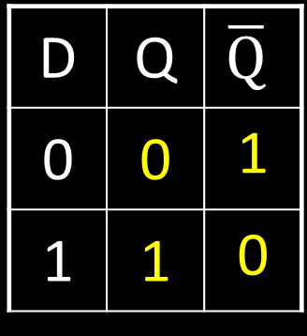
Fourth Attempt: (Unclocked) D Latch
D
S
Q
D
S
R
Q
$$\overline{Q}$$
R
Q
D | Q | $$\overline{Q}$$
0 | 0 | 1
1 | 1 | 0
Fill in the truth table?
Data (D) Latch
  Easier to use than an SR latch
  No possibility of entering an undefined state
When D changes, Q changes
    … immediately (…after a delay of 2 Ors and 2 NOTs)
Need to control when the output changes
A | B | OR | NOR
0 | 0 | 0 | 1
0 | 1 | 1 | 0
1 | 0 | 1 | 0
1 | 1 | 1 | 0
Notes:
Start in 0, 0, 1
Change to D = 1
After NOT gate, R = 0
After OR+NOT gates, /Q = 0 (R is already ready then), Q goes to 1
Problem: No way to hold state

Slide 25
Takeaway
Set-Reset (SR) Latch can store one bit and we can change the value of the stored bit. But, SR Latch has a forbidden state.
(Unclocked) D Latch can store and change a bit like an SR Latch while avoiding the forbidden state.

Slide 26
Next Goal
How do we coordinate state changes to a D Latch?

Slide 27
Clocks
Clock helps coordinate state changes
  Usually generated by an oscillating crystal
  Fixed period; frequency = 1/period
clock
high
falling
edge
rising
edge
rising
edge
falling
edge
1
0
period
low
high
clock
period
clock
low

Slide 28
Clock Disciplines
Level sensitive
  State changes when clock is high (or low)
Edge triggered
  State changes at clock edge
positive edge-triggered
negative edge-triggered

Slide 29
Clock Methodology
Clock Methodology
Negative edge, synchronous
    Edge-Triggered: Signals must be stable near falling clock edge
Positive edge synchronous
clk
t_{combinational}
t_{setup}
t_{hold}
compute
save
compute
save
compute

Slide 30

Fifth Attempt: D Latch with Clock
D
S
Q
R
$$\overline{Q}$$
Notes:
Any forbidden S=R=1 inputs? No
Need both truth tables

Slide 31

Fifth Attempt: D Latch with Clock
D
S
Q
clk
R
$$\overline{Q}$$
Fill in the truth table
clk | D | Q | $$\overline{Q}$$
0 | 0
0 | 1
1 | 0
1 | 1
Notes:
Any forbidden S=R=1 inputs? No
Need both truth tables

Slide 32


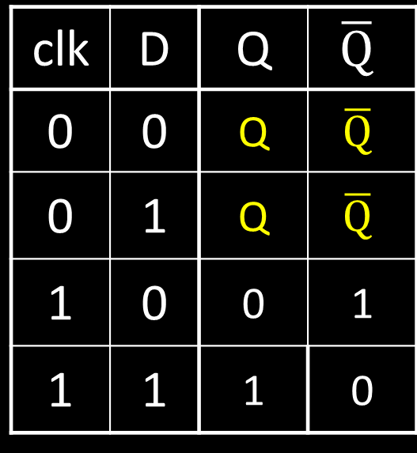
Fifth Attempt: D Latch with Clock
D
S
Q
clk
R
$$\overline{Q}$$
Fill in the truth table
clk | D | Q | $$\overline{Q}$$
0 | 0
0 | 1
1 | 0
1 | 1
S | R | Q | $$\overline{Q}$$
0 | 0 | Q | $$\overline{Q}$$ | hold
0 | 1 | 0 | 1 | reset
1 | 0 | 1 | 0 | set
1 | 1 | forbidden
clk | D | Q | $$\overline{Q}$$
0 | 0 | Q | $$\overline{Q}$$
0 | 1 | Q | $$\overline{Q}$$
1 | 0 | 0 | 1
1 | 1 | 1 | 0
Notes:
Any forbidden S=R=1 inputs? No
Need both truth tables

Slide 33
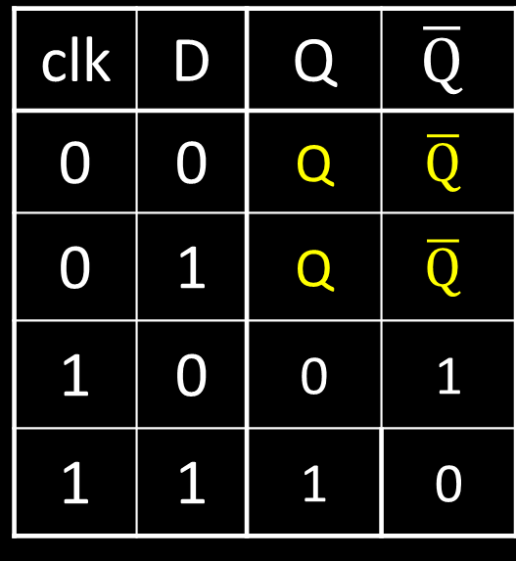
Fifth Attempt: D Latch with Clock
Level Sensitive D Latch
Clock high:
set/reset (according to D)
Clock low:
keep state (ignore D)
D
S
Q
clk
R
$$\overline{Q}$$
clk | D | Q | $$\overline{Q}$$
0 | 0 | Q | $$\overline{Q}$$
0 | 1 | Q | $$\overline{Q}$$
1 | 0 | 0 | 1
1 | 1 | 1 | 0
clk
D
Q
Notes:
Any forbidden S=R=1 inputs? No
Need both truth tables

Slide 34



Sixth Attempt: Edge-Triggered D Flip-Flop
D Flip-Flop
Edge-Triggered
Data captured when clock is high
Output changes only on falling edges
D
1
D
Q
0
D
Q
0
Q
X
clk
0
L
$$\overline{Q}$$
1
L
$$\overline{Q}$$
$$\overline{Q}$$
c
c
Activity#1: Fill in timing graph and values for X and Q
clk
D
X
Q
Notes:
Master-Slave Flip Flop
- Outputs change only on falling edges
- Data is captured on rising edges
1 cycle delay
but works out perfectly – data for the next stage is ready 1 cycle ahead of time

Slide 35
Sixth Attempt: Edge-Triggered D Flip-Flop
D Flip-Flop
Edge-Triggered
Data captured when clock is high
Output changes only on falling edges
1
0
0
1
0
D
D
Q
D
Q
1
Q
X
0
1
L
$$\overline{Q}$$
0
L
$$\overline{Q}$$
clk
1
$$\overline{Q}$$
c
c
clk
D
X
Q
Notes:
Master-Slave Flip Flop
- Outputs change only on falling edges
- Data is captured on rising edges
1 cycle delay
but works out perfectly – data for the next stage is ready 1 cycle ahead of time

Slide 36
Takeaway
Set-Reset (SR) Latch can store one bit and we can change the value of the stored bit. But, SR Latch has a forbidden state.
(Unclocked) D Latch can store and change a bit like an SR Latch while avoiding a forbidden state.
An Edge-Triggered D Flip-Flip (aka Master-Slave D Flip-Flip) stores one bit. The bit can be changed in a synchronized fashion on the edge of a clock signal.

Slide 37
Next Goal
How do we store more than one bit, N bits?

Slide 38
Registers
D0
Register
D flip-flops in parallel
shared clock
extra clocked inputs:
write_enable, reset, …
D1
D2
D3
4-bit
reg
4
4
clk
clk

Slide 39
Takeaway
Set-Reset (SR) Latch can store one bit and we can change the value of the stored bit. But, SR Latch has a forbidden state.
(Unclocked) D Latch can store and change a bit like an SR Latch while avoiding a forbidden state.
An Edge-Triggered D Flip-Flip (aka Master-Slave D Flip-Flip) stores one bit. The bit can be changed in a synchronized fashion on the edge of a clock signal.
An N-bit register stores N-bits. It is be created with N D-Flip-Flops in parallel along with a shared clock.

Slide 40
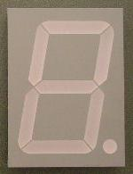
An Example: What will this circuit do?
4
16
Decoder
4
4
4-bit
reg
+1
Clk
4

Slide 41
An Example: What will this circuit do?
Reset
Run
WE
R
4
16
Decoder
4
4
A[4]
1 = 0001 =B[4]
4-bit
reg
C_{out}
+1
S[4]
Clk
4

Slide 42
Decoder Example: 7-Segment LED
d7
d6
d5
d4
7-Segment LED
  photons emitted when electrons fall into holes
d3
d2
d1
d0
Notes:
Previous slide would need to display up to 16, so would need a 16-segment LED decoder

Slide 43
Decoder Example: 7-Segment LED
d7
d6
d5
d4
7-Segment LED
  photons emitted when electrons fall into holes
d3
d2
d1
d0

Slide 44
Decoder Example: 7-Segment LED Decoder
3 inputs
encode 0 – 7 in binary
7 outputs
one for each LED
7LED decode

Slide 45
7 Segment LED Decoder Implementation
b2 | b1 | b0 | d6 | d5 | d4 | d3 | d2 | d1 | d0
0 | 0 | 0
0 | 0 | 1
0 | 1 | 0
0 | 1 | 1
1 | 0 | 0
1 | 0 | 1
1 | 1 | 0
1 | 1 | 1
b2 | b1 | b0 | d6 | d5 | d4 | d3 | d2 | d1 | d0
0 | 0 | 0
0 | 0 | 1
0 | 1 | 0
0 | 1 | 1
1 | 0 | 0
1 | 0 | 1
1 | 1 | 0
1 | 1 | 1 | 1 | 0 | 0 | 0 | 0 | 1 | 1
d1
d2
d0
d3
d4
d6
d5

Slide 46
7 Segment LED Decoder Implementation
b2 | b1 | b0 | d6 | d5 | d4 | d3 | d2 | d1 | d0
0 | 0 | 0
0 | 0 | 1
0 | 1 | 0
0 | 1 | 1
1 | 0 | 0
1 | 0 | 1
1 | 1 | 0
1 | 1 | 1
1 | 1 | 1 | 0 | 1 | 1 | 1
1 | 0 | 0 | 0 | 0 | 0 | 1
0 | 1 | 1 | 1 | 0 | 1 | 1
1 | 1 | 0 | 1 | 0 | 1 | 1
1 | 0 | 0 | 1 | 1 | 0 | 1
1 | 1 | 0 | 1 | 1 | 1 | 0
1 | 1 | 1 | 1 | 1 | 1 | 0
1 | 0 | 0 | 0 | 0 | 1 | 1
d1
d2
d0
d3
d4
d6
d5

Slide 47
Basic Building Blocks We have Seen
N
2^{N}
0
N
binary
encoder
1
N
N
2
N
N
Multiplexor
binary
decoder
. . .
2^{N}
N
2^{M}-1
M

Slide 48
Encoders
0
1
2
3
N Input wires
4
Log₂(N) outputs wires
encoder
5
. . .
6
7
e.g. Voting:
Can only vote for one out of N
candidates, so N inputs.
But can encode vote efficiently
with binary encoding.
. . .
N
Notes:
N possible inputs -> log2(N) wires to encode

Slide 49
Example Encoder Truth Table
a | b | c | d
0 | 0 | 0 | 0
1 | 0 | 0 | 0
0 | 1 | 0 | 0
0 | 0 | 1 | 0
0 | 0 | 0 | 1
a
1
o₀
b
2
o₁
o₁
c
3
o₂
d
4
A 3-bit
encoder
with 4 inputs
for simplicity
Notes:
Implementation . . .
assume 8 choices, exactly one mark detected

Slide 50
Example Encoder Truth Table
a | b | c | d |  | o2 | o1 | o0
0 | 0 | 0 | 0 |  | 0 | 0 | 0
1 | 0 | 0 | 0 |  | 0 | 0 | 1
0 | 1 | 0 | 0 |  | 0 | 1 | 0
0 | 0 | 1 | 0 |  | 0 | 1 | 1
0 | 0 | 0 | 1 |  | 1 | 0 | 0
a
1
o₀
b
2
o₁
o₁
c
3
o₂
d
4
o2 = abcd
o1 = abcd + abcd
o0 = abcd + abcd
A 3-bit
encoder
with 4 inputs
for simplicity
Notes:
Implementation . . .
assume 8 choices, exactly one mark detected

Slide 51
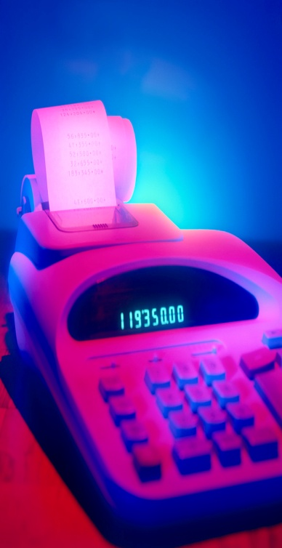
Basic Building Blocks Example: Voting
enc
7LED
decode
detect
8
3
7
Ballots
The 3410 optical scan
vote reader
machine

Slide 52
Recap
We can now build interesting devices with sensors
  Using combinatorial logic
We can also store data values (aka Sequential Logic)
  In state-holding elements
  Coupled with clocks

Slide 53
Administrivia
Make sure to go to your Lab Section this week
Design Doc for Lab1 due Monday, Feb 4th
Completed Lab1 due in two weeks, Monday, Feb 11th
Work alone
Homework1 is out
Due in one week, next Wednesday, start early
Homework Help Session: Thursday and Monday, B14 HLN, 6-8pm
Work alone
BUT, use your resources
  Lab Section, Piazza.com, Office Hours, Homework Help Session,
  Class notes, book, Sections, CSUGLab

Slide 54
Administrivia
Check online syllabus/schedule
  http://www.cs.cornell.edu/Courses/CS3410/2013sp/schedule.html
Slides and Reading for lectures
Office Hours
Homework and Programming Assignments
Prelims (in evenings):
  Tuesday, February 26th
  Thursday, March 28th
  Thursday, April 25th
Schedule is subject to change

Slide 55
Collaboration, Late, Re-grading Policies
“Black Board” Collaboration Policy
  Can discuss approach together on a “black board”
  Leave and write up solution independently
  Do not copy solutions
  Late Policy
  Each person has a total of four “slip days”
  Max of two slip days for any individual assignment
  Slip days deducted first for any late assignment,
  cannot selectively apply slip days
  For projects, slip days are deducted from all partners
  25% deducted per day late after slip days are exhausted
  Regrade policy
  Submit written request to lead TA,
  and lead TA will pick a different grader
  Submit another written request,
  lead TA will regrade directly
  Submit yet another written request for professor to regrade.

Slide 56
Goals for Today
State
  How do we store one bit?
  Attempts at storing (and changing) one bit
    Set-Reset Latch
    D Latch
    D Flip-Flops
    Master-Slave Flip-Flops
  Register: storing more than one bit, N-bits
Basic Building Blocks
  Decoders and Encoders
Finite State Machines (FSM)
  How do we design logic circuits with state?
  Types of FSMs: Mealy and Moore Machines
  Examples: Serial Adder and a Digital Door Lock

Slide 57
Finite State Machines

Slide 58
Next Goal
How do we design logic circuits with state?

Slide 59
Finite State Machines
An electronic machine which has
  external inputs
  externally visible outputs
  internal state
Output and next state depend on
  inputs
  current state

Slide 60
Abstract Model of FSM
Machine is
M = ( S, I, O, δ )
S: Finite set of states
I: Finite set of inputs
O: Finite set of outputs
δ: State transition function
Next state depends on present input and present state

Slide 61
Automata Model
Finite State Machine
  inputs from external world
  outputs to external world
  internal state
  combinational logic
Registers
Current State
Comb.
Logic
Output
Input
Next State
Notes:
Put sequential logic term on slide

Slide 62
FSM Example
down/on
input/output
up/off
down/on
A
B
state
start
state
up/off
down/off
Legend
up/off
C
D
up/off
Input: up or down
Output: on or off
States: A, B, C, or D
up/off

Slide 63
FSM Example
down/on
input/output
up/off
down/on
A
B
state
start
state
up/off
down/off
Legend
up/off
C
D
up/off
Input: = up or = down
Output: = on or = off
States: = A, = B, = C, or = D
up/off
Notes:
Say left of slash is input and right is output

Slide 64
FSM Example
1/1
1/1
i₀i₁i₂…/o₀o₁o₂…
0/0
00
01
S₁S₀
S₁S₀
0/0
0/0
Legend
0/0
10
11
1/0
Input: 0=up or 1=down
Output: 1=on or 1=off
States: 00=A, 01=B, 10=C, or 11=D
1/0

Slide 65
Mealy Machine
General Case: Mealy Machine
Outputs and next state depend on both
current state and input
Registers
Current State
Comb.
Logic
Output
Input
Next State

Slide 66
Moore Machine
Special Case: Moore Machine
Outputs depend only on current state
Registers
Current State
Comb.
Logic
Output
Comb.
Logic
Input
Next State

Slide 67
Moore Machine FSM Example
down
input
up
down
A off
B
on
state
out
startout
up
down
Legend
up
C off
D off
up
Input: up or down
Output: on or off
States: A, B, C, or D
up
Notes:
Also show a mealy machine

Slide 68
Mealy Machine FSM Example
down/on
input/output
up/off
down/on
A
B
state
start
state
up/off
down/off
Legend
up/off
C
D
up/off
Input: up or down
Output: on or off
States: A, B, C, or D
up/off

Slide 69
Activity#2: Create a Logic Circuit for a Serial Adder
Add two infinite input bit streams
  streams are sent with least-significant-bit (lsb) first
  How many states are needed to represent FSM?
  Draw and Fill in FSM diagram
…10110
…00101
…01111
Strategy:
(1) Draw a state diagram (e.g. Mealy Machine)
(2) Write output and next-state tables
(3) Encode states, inputs, and outputs as bits
(4) Determine logic equations for next state and outputs
Notes:
Ask as a clicker question

Slide 70
FSM: State Diagram
a
…10110
…00101
z
b
…01111
Two states: S0 (no carry in), S1 (carry in)
Inputs: a and b
Output: z
  z is the sum of inputs a, b, and carry-in (one bit at a time)
  A carry-out is the next carry-in state.
  .

Slide 71
FSM: State Diagram
__/_
__/_
__/_
S0
__/_
S1
__/_
__/_
__/_
__/_
a
…10110
…00101
z
b
…01111
Two states: S0 (no carry in), S1 (carry in)
Inputs: a and b
Output: z
  z is the sum of inputs a, b, and carry-in (one bit at a time)
  A carry-out is the next carry-in state.
  Arcs labeled with input bits a and b, and output z
Notes:
Is this a mealy or moore machine, maybe clicker

Slide 72
FSM: State Diagram
11/0
00/0
11/1
S0
00/1
S1
10/1
01/1
10/0
01/0
a
…10110
…00101
z
b
…01111
Two states: S0 (no carry in), S1 (carry in)
Inputs: a and b
Output: z
  z is the sum of inputs a, b, and carry-in (one bit at a time)
  A carry-out is the next carry-in state.
  Arcs labeled with input bits a and b, and output z (Mealy Machine)

Slide 73
Serial Adder: State Table
11/0
00/0
11/1
S0
00/1
S1
10/1
01/1
10/0
01/0
a | b | Current state | z | Next state
(2) Write down all input and state combinations

Slide 74
Serial Adder: State Table
11/0
00/0
11/1
S0
00/1
S1
10/1
01/1
10/0
01/0
a | b | Current state | z | Next state
0 | 0 | S0 | 0 | S0
0 | 1 | S0 | 1 | S0
1 | 0 | S0 | 1 | S0
1 | 1 | S0 | 0 | S1
0 | 0 | S1 | 1 | S0
0 | 1 | S1 | 0 | S1
1 | 0 | S1 | 0 | S1
1 | 1 | S1 | 1 | S1
(2) Write down all input and state combinations

Slide 75
Serial Adder: State Assignment
11/0
00/0
11/1
0
00/1
1
10/1
01/1
10/0
01/0
a | b | s | z | s'
0 | 0 | 0 | 0 | 0
0 | 1 | 0 | 1 | 0
1 | 0 | 0 | 1 | 0
1 | 1 | 0 | 0 | 1
0 | 0 | 1 | 1 | 0
0 | 1 | 1 | 0 | 1
1 | 0 | 1 | 0 | 1
1 | 1 | 1 | 1 | 1
(3) Encode states, inputs, and outputs as bits
Two states, so 1-bit is sufficient
  A single flip-flop will encode the state

Slide 76

Serial Adder: Circuit
Next State
Current State
Output
Comb.
Logic
z
s'
s
D
Q
a
Next State
b
Input
s'
a | b | s | z | s'
0 | 0 | 0 | 0 | 0
0 | 1 | 0 | 1 | 0
1 | 0 | 0 | 1 | 0
1 | 1 | 0 | 0 | 1
0 | 0 | 1 | 1 | 0
0 | 1 | 1 | 0 | 1
1 | 0 | 1 | 0 | 1
1 | 1 | 1 | 1 | 1
(4) Determine logic equations for next state and outputs
Combinational Logic Equations
  z = $\overline{a}$b$\overline{s}$ + a$\overline{bs}$ + $\overline{ab}$s + abs
  s’ = ab$\overline{s}$ + $\overline{a}$bs + a$\overline{b}$s + abs
Notes:
Practice minimizing circuit w/a Karnaugh map

Slide 77

Sequential Logic Circuits
Next State
Current State
Output
Comb.
Logic
z
s'
s
D
Q
a
Next State
b
Input
s'
  z = $\overline{a}$b$\overline{s}$ + a$\overline{bs}$ + $\overline{ab}$s + abs
  s’ = ab$\overline{s}$ + $\overline{a}$bs + a$\overline{b}$s + abs
  .
  .
  .
Strategy:
(1) Draw a state diagram (e.g. Mealy Machine)
(2) Write output and next-state tables
(3) Encode states, inputs, and outputs as bits
(4) Determine logic equations for next state and outputs

Slide 78
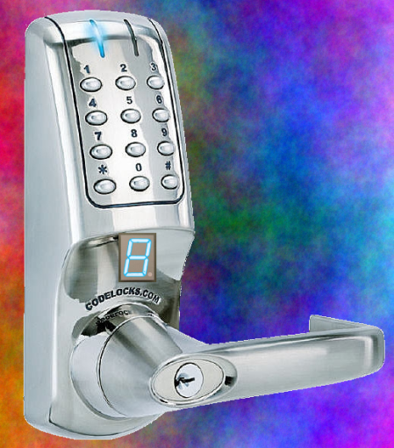
Example #2: Digital Door Lock
Digital Door Lock
Inputs:
  keycodes from keypad
  clock
Outputs:
  “unlock” signal
  display how many keys pressed so far

Slide 79
Door Lock: Inputs
Assumptions:
  signals are synchronized to clock
  Password is B-A-B
K | A | B | Meaning
0 | 0 | 0 | Ø (no key)
1 | 1 | 0 | ‘A’ pressed
1 | 0 | 1 | ‘B’ pressed
K
A
B
Notes:
How many states, another clicker question

Slide 80
Door Lock: Outputs
Assumptions:
  High pulse on U unlocks door
4
LED
dec
8
D₃D₂D₁D₀
U
Strategy:
(1) Draw a state diagram (e.g. Moore Machine)
(2) Write output and next-state tables
(3) Encode states, inputs, and outputs as bits
(4) Determine logic equations for next state and outputs

Slide 81
Door Lock: Simplified State Diagram
Ø
Ø
“A”
“B”
G3
G1
G2
”3”, U
”1”
”2”
“B”
else
else
any
Idle
”0”
Ø
else
any
B1
else
B2
else
B3
”1”
”2”
”3”
Ø
Ø
(1) Draw a state diagram (e.g. Moore Machine)

Slide 82
Door Lock: Simplified State Diagram
Ø
Ø
“A”
“B”
G3
G1
G2
”3”, U
”1”
”2”
“B”
else
else
any
Idle
”0”
else
Ø
else
B1
else
B2
”1”
”2”
Ø
Ø
(1) Draw a state diagram (e.g. Moore Machine)
Notes:
Works, but gives extra information revealing a secret

Slide 83
Door Lock: Simplified State Diagram
Ø
Ø
“A”
“B”
G3
G1
G2
”3”, U
”1”
”2”
“B”
else
else
any
Cur. State | Output
Idle
”0”
else
Ø
else
B1
else
B2
”1”
”2”
Ø
Ø
(2) Write output and next-state tables

Slide 84
Door Lock: Simplified State Diagram
Ø
Ø
“A”
“B”
G3
G1
G2
”3”, U
”1”
”2”
“B”
else
else
any
Cur. State | Output
Cur. State | Output
Idle | “0”
G1 | “1”
G2 | “2”
G3 | “3”, U
B1 | “1”
B2 | “2”
Idle
”0”
else
Ø
else
B1
else
B2
”1”
”2”
Ø
Ø
(2) Write output and next-state tables

Slide 85
Door Lock: Simplified State Diagram
Cur. State | Input | Next State
Ø
Ø
Cur. State | Input | Next State
“A”
“B”
G3
G1
G2
”3”, U
”1”
”2”
“B”
else
else
any
Idle
”0”
else
Ø
else
B1
else
B2
”1”
”2”
Ø
Ø
(2) Write output and next-state tables

Slide 86
Door Lock: Simplified State Diagram
Cur. State | Input | Next State
Ø
Ø
Cur. State | Input | Next State
Idle | Ø | Idle
Idle | “B” | G1
Idle | “A” | B1
G1 | Ø | G1
G1 | “A” | G2
G1 | “B” | B2
G2 | Ø | B2
G2 | “B” | G3
G2 | “A” | Idle
G3 | any | Idle
B1 | Ø | B1
B1 | K | B2
B2 | Ø | B2
B2 | K | Idle
“A”
“B”
G3
G1
G2
”3”, U
”1”
”2”
“B”
else
else
any
Idle
”0”
else
Ø
else
B1
else
B2
”1”
”2”
Ø
Ø
(2) Write output and next-state tables

Slide 87
State Table Encoding
Cur. State | Output
Idle | “0”
G1 | “1”
G2 | “2”
G3 | “3”, U
B1 | “1”
B2 | “2”
S₂ | S₁ | S₀
0 | 0 | 0
0 | 0 | 1
0 | 1 | 0
0 | 1 | 1
1 | 0 | 0
1 | 0 | 1
D₃ | D₂ | D₁ | D₀ | U
0 | 0 | 0 | 0 | 0
0 | 0 | 0 | 1 | 0
0 | 0 | 1 | 0 | 0
0 | 0 | 1 | 1 | 1
0 | 0 | 0 | 1 | 0
0 | 0 | 1 | 0 | 0
Cur. State | Input | Next State
Idle | Ø | Idle
Idle | “B” | G1
Idle | “A” | B1
G1 | Ø | G1
G1 | “A” | G2
G1 | “B” | B2
G2 | Ø | B2
G2 | “B” | G3
G2 | “A” | Idle
G3 | any | Idle
B1 | Ø | B1
B1 | K | B2
B2 | Ø | B2
B2 | K | Idle
K | A | B
0 | 0 | 0
1 | 0 | 1
1 | 1 | 0
0 | 0 | 0
1 | 1 | 0
1 | 0 | 1
0 | 0 | 0
1 | 0 | 1
1 | 1 | 0
x | x | x
0 | 0 | 0
1 | x | x
0 | 0 | 0
1 | x | x
S₂ | S₁ | S₀ |  | S’₂ | S’₁ | S’₀
0 | 0 | 0 |  | 0 | 0 | 0
0 | 0 | 0 |  | 0 | 0 | 1
0 | 0 | 0 |  | 1 | 0 | 0
0 | 0 | 1 |  | 0 | 0 | 1
0 | 0 | 1 |  | 0 | 1 | 0
0 | 0 | 1 |  | 1 | 0 | 1
0 | 1 | 0 |  | 0 | 1 | 0
0 | 1 | 0 |  | 0 | 1 | 1
0 | 1 | 0 |  | 0 | 0 | 0
0 | 1 | 1 |  | 0 | 0 | 0
1 | 0 | 0 |  | 1 | 0 | 0
1 | 0 | 0 |  | 1 | 0 | 1
1 | 0 | 1 |  | 1 | 0 | 1
1 | 0 | 1 |  | 0 | 0 | 0
State | S₂ | S₁ | S₀
Idle | 0 | 0 | 0
G1 | 0 | 0 | 1
G2 | 0 | 1 | 0
G3 | 0 | 1 | 1
B1 | 1 | 0 | 0
B2 | 1 | 0 | 1
4
8
K | A | B | Meaning
0 | 0 | 0 | Ø (no key)
1 | 1 | 0 | ‘A’ pressed
1 | 0 | 1 | ‘B’ pressed
D₃D₂D₁D₀
dec
U
K
A
B
(3) Encode states, inputs, and outputs as bits

Slide 88
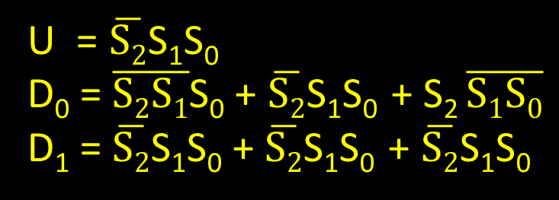
Door Lock: Implementation
4
D₃₋₀
dec
3bit
Reg
S₂₋₀
U
clk
S₂₋₀
K
S’₂₋₀
S₂ | S₁ | S₀
0 | 0 | 0
0 | 0 | 1
0 | 1 | 0
0 | 1 | 1
1 | 0 | 0
1 | 0 | 1
D₃ | D₂ | D₁ | D₀ | U
0 | 0 | 0 | 0 | 0
0 | 0 | 0 | 1 | 0
0 | 0 | 1 | 0 | 0
0 | 0 | 1 | 1 | 1
0 | 0 | 0 | 1 | 0
0 | 0 | 1 | 0 | 0
A
B
U = $\overline{S2}$S₁S₀
D₀ = $\overline{S2S1}$S₀ + $\overline{S2}$S₁S₀ + S₂ $\overline{S1S0}$
D₁ = $\overline{S2}$S₁S₀ + $\overline{S2}$S₁S₀ + $\overline{S2}$S₁S₀
(4) Determine logic equations for next state and outputs

Slide 89
Door Lock: Implementation
K | A | B
0 | 0 | 0
1 | 0 | 1
1 | 1 | 0
0 | 0 | 0
1 | 1 | 0
1 | 0 | 1
0 | 0 | 0
1 | 0 | 1
1 | 1 | 0
x | x | x
0 | 0 | 0
1 | x | x
0 | 0 | 0
1 | x | x
S₂ | S₁ | S₀ |  | S’₂ | S’₁ | S’₀
0 | 0 | 0 |  | 0 | 0 | 0
0 | 0 | 0 |  | 0 | 0 | 1
0 | 0 | 0 |  | 1 | 0 | 0
0 | 0 | 1 |  | 0 | 0 | 1
0 | 0 | 1 |  | 0 | 1 | 0
0 | 0 | 1 |  | 1 | 0 | 1
0 | 1 | 0 |  | 0 | 1 | 0
0 | 1 | 0 |  | 0 | 1 | 1
0 | 1 | 0 |  | 0 | 0 | 0
0 | 1 | 1 |  | 0 | 0 | 0
1 | 0 | 0 |  | 1 | 0 | 0
1 | 0 | 0 |  | 1 | 0 | 1
1 | 0 | 1 |  | 1 | 0 | 1
1 | 0 | 1 |  | 0 | 0 | 0
4
D₃₋₀
dec
3bit
Reg
S₂₋₀
U
clk
S₂₋₀
K
S’₂₋₀
A
B
S₂’ = $\overline{S2S1S0}$KA$\overline{B}$ + $\overline{S2S1}$S₀K$\overline{A}$B + S₂$\overline{S1S2KAB}$ + $\overline{S2}$S₁S₀K + S₂ $\overline{S1}$S₀ $\overline{KAB}$
Notes:
Write down and compare S₂’

Slide 90
Door Lock: Implementation
4
D₃₋₀
dec
3bit
Reg
S₂₋₀
U
clk
S₂₋₀
K
S’₂₋₀
A
B
Strategy:
(1) Draw a state diagram (e.g. Moore Machine)
(2) Write output and next-state tables
(3) Encode states, inputs, and outputs as bits
(4) Determine logic equations for next state and outputs

Slide 91
Summary
We can now build interesting devices with sensors
  Using combinational logic
We can also store data values
  Stateful circuit elements (D Flip Flops, Registers, …)
  Clock to synchronize state changes
  State Machines or Ad-Hoc Circuits

