Slide 1
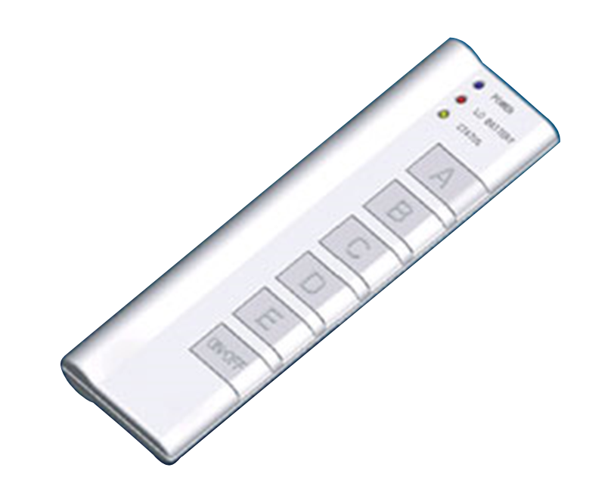
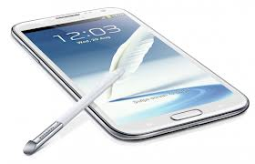


Numbers and Arithmetic
Hakim Weatherspoon
CS 3410, Spring 2013
Computer Science
Cornell University
See: P&H Chapter 2.4 - 2.6, 3.2, C.5 – C.6

Slide 2
Big Picture: Building a Processor
memory
register
file
inst
alu
+4
+4
addr
=?
PC
d_{in}
d_{out}
control
cmp
offset
memory
new
pc
target
imm
extend
A Single cycle processor

Slide 3
Goals for Today
Binary Operations
  Number representations
  One-bit and four-bit adders
  Negative numbers and two’s compliment
  Addition (two’s compliment)
  Subtraction (two’s compliment)
  Performance

Slide 4
Number Representations
Recall: Binary
  Two symbols (base 2): true and false; 1 and 0
  Basis of Logic Circuits and all digital computers
So, how do we represent numbers in Binary (base 2)?
Notes:
Add takeways at end of a block. Possibly build on takeaways throughout lecture

Slide 5
Number Representations
Recall: Binary
  Two symbols (base 2): true and false; 1 and 0
  Basis of Logic Circuits and all digital computers
So, how do we represent numbers in Binary (base 2)?
  We know represent numbers in Decimal (base 10).
    E.g. 6 3 7
  Can just as easily use other bases
    Base 2 — Binary
    Base 8 — Octal
    Base 16 — Hexadecimal
10² 10¹ 10⁰
1 0 0 1 1 1 1 1 0 1
2⁹ 2⁸ 2⁷ 2⁶ 2⁵ 2⁴ 2³ 2² 2¹ 2⁰
0o 1 1 7 5
0x 2 7 d
8³ 8² 8¹ 8⁰
16²16¹16⁰
Notes:
637 has a 1’s place , 10’s place and 100’s place
Show how to go from

Slide 6
Number Representations
Recall: Binary
  Two symbols (base 2): true and false; 1 and 0
  Basis of Logic Circuits and all digital computers
So, how do we represent numbers in Binary (base 2)?
  We know represent numbers in Decimal (base 10).
    E.g. 6 3 7
  Can just as easily use other bases
    Base 2 — Binary
    Base 8 — Octal
    Base 16 — Hexadecimal
6∙10² + 3∙10¹ + 7∙10⁰ = 637
10² 10¹ 10⁰
1∙2⁹+1∙2⁶+1∙2⁵+1∙2⁴+1∙2³+1∙2²+1∙2⁰ = 637
1∙8³ + 1∙8² + 7∙8¹ + 5∙8⁰ = 637
2∙16² + 7∙16¹ + d∙16⁰ = 637
2∙16² + 7∙16¹ + 13∙16⁰ = 637
Notes:
637 has a 1’s place , 10’s place and 100’s place
Show how to go from

Slide 7
Number Representations: Activity #1 Counting
How do we count in different bases?
  Dec (base 10) Bin (base 2) Oct (base 8) Hex (base 16)
0
1
2
3
4
5
6
7
8
9
10
11
12
13
14
15
16
17
18
.
.
99
100
0
1
10
11
100
101
110
111
1000
1001
1010
1011
1100
1101
1110
1111
1 0000
1 0001
1 0010
.
.
0
1
2
3
4
5
6
7
10
11
12
13
14
15
16
17
20
21
22
.
.
0
1
2
3
4
5
6
7
8
9
a
b
c
d
e
f
10
11
12
.
.
0
1
2
3
4
5
6
7
8
9
a
b
c
d
e
f
0b 1111 1111 = ?
0b 1 0000 0000 = ?
0o 77 = ?
0o 100 = ?
0x ff = ?
0x 100 = ?
Notes:
Place location of question better in slide
The base represents the number of unique symbols (decimal has 10, octal has 8, hexadecimal has 16, and binary has 2 unique symbols)
Every group of four bits is called a nibble, every group of 8 bits is a byte

Slide 8
Number Representations: Activity #1 Counting
How do we count in different bases?
  Dec (base 10) Bin (base 2) Oct (base 8) Hex (base 16)
0
1
2
3
4
5
6
7
8
9
10
11
12
13
14
15
16
17
18
.
.
99
100
0
1
10
11
100
101
110
111
1000
1001
1010
1011
1100
1101
1110
1111
1 0000
1 0001
1 0010
.
.
0
1
2
3
4
5
6
7
10
11
12
13
14
15
16
17
20
21
22
.
.
0
1
2
3
4
5
6
7
8
9
a
b
c
d
e
f
10
11
12
.
.
0b 1111 1111 = 255
0b 1 0000 0000 = 256
0o 77 = 63
0o 100 = 64
0x ff = 255
0x 100 = 256
Notes:
Every group of four bits is called a nibble, every group of 8 bits is a byte

Slide 9
Number Representations
How to convert a number between different bases?
Base conversion via repetitive division
  Divide by base, write remainder, move left with quotient
  637 ÷ 8 = 79 remainder 5
  79 ÷ 8 = 9 remainder 7
  9 ÷ 8 = 1 remainder 1
  1 ÷ 8 = 0 remainder 1
637 = 0o 1175
lsb (least significant bit)
msb (most significant bit)
msb
lsb
Notes:
**Convert to a different base instead of same base**
637 = 0o1175 = 0b1001111101 = 0x27D
oct: 637 : 79 : 9 : 1 : 0
bin: 637 : 318 : 159 : 79 : 39 : 19 : 9 : 4 : 2 : 1 : 0
hex: 637 : 39 : 2 : 0

Slide 10
Number Representations
Convert a base 10 number to a base 2 number
Base conversion via repetitive division
  Divide by base, write remainder, move left with quotient
  637 ÷ 2 = 318 remainder 1
  318 ÷ 2 = 159 remainder 0
  159 ÷ 2 = 79 remainder 1
  79 ÷ 2 = 39 remainder 1
  39 ÷ 2 = 19 remainder 1
  19 ÷ 2 = 9 remainder 1
  9 ÷ 2 = 4 remainder 1
  4 ÷ 2 = 2 remainder 0
  2 ÷ 2 = 1 remainder 0
  1 ÷ 2 = 0 remainder 1
637 = 10 0111 1101 (can also be written as 0b10 0111 1101)
lsb (least significant bit)
msb (most significant bit)
msb
lsb
Notes:
Ask students to write down binary number after we figure it out. The question is did they writ the MSB on the left?
637 = 0o1175 = 0b10 0111 1101 = 0x27D
oct: 637 : 79 : 9 : 1 : 0
bin: 637 : 318 : 159 : 79 : 39 : 19 : 9 : 4 : 2 : 1 : 0
hex: 637 : 39 : 2 : 0

Slide 11
Number Representations
Convert a base 10 number to a base 16 number
Base conversion via repetitive division
  Divide by base, write remainder, move left with quotient
  637 ÷ 16 = 39 remainder 13
  39 ÷ 16 = 2 remainder 7
  2 ÷ 16 = 0 remainder 2
637 = 0x 2 7 13 = 0x 2 7 d
Thus, 637 = 0x27d
lsb
dec = hex
10 = 0xa
11 = 0xb
12 = 0xc
13 = 0xd
14 = 0xe
15 = 0xf
= bin
= 1010
= 1011
= 1100
= 1101
= 1110
= 1111
msb
?
Notes:
Is 637 same as 0x 637 ?
637 = 0o1175 = 0b10 0111 1101 = 0x27D
oct: 637 : 79 : 9 : 1 : 0
bin: 637 : 318 : 159 : 79 : 39 : 19 : 9 : 4 : 2 : 1 : 0
hex: 637 : 39 : 2 : 0

Slide 12
Number Representations
How to convert a number between different bases?
Base conversion via repetitive division
  Divide by base, write remainder, move left with quotient
  637 ÷ 10 = 63 remainder 7
  63 ÷ 10 = 6 remainder 3
  6 ÷ 10 = 0 remainder 6
lsb (least significant bit)
msb (most significant bit)
Notes:
**Convert to a different base instead of same base**
637 = 0o1175 = 0b1001111101 = 0x27D
oct: 637 : 79 : 9 : 1 : 0
bin: 637 : 318 : 159 : 79 : 39 : 19 : 9 : 4 : 2 : 1 : 0
hex: 637 : 39 : 2 : 0

Slide 13
Number Representations
Convert a base 2 number to base 8 (oct) or 16 (hex)
Binary to Hexadecimal
  Convert each nibble (group of four bits) from binary to hex
  A nibble (four bits) ranges in value from 0…15, which is one hex digit
    Range: 0000…1111 (binary) => 0x0 …0xF (hex) => 0…15 (decimal)
  E.g. 0b10 0111 1101
    0b10 = 0x2
    0b0111 = 0x7
    0b1101 = 0xd
    Thus, 637 = 0x27d = 0b10 0111 1101
Binary to Octal
  Convert each group of three bits from binary to oct
  Three bits range in value from 0…7, which is one octal digit
    Range: 0000…1111 (binary) => 0x0 …0xF (hex) => 0…15 (decimal)
  E.g. 0b1 001 111 101
    0b1 = 0x1
    0b001 = 0x1
    0b111 = 0x7
    0b101 = 0x5
    Thus, 637 = 0o1175 = 0b10 0111 1101
Notes:
Ask class to convert from binary to octal
637 = 0o1175 = 0b10 0111 1101 = 0x27D
oct: 637 : 79 : 9 : 1 : 0
bin: 637 : 318 : 159 : 79 : 39 : 19 : 9 : 4 : 2 : 1 : 0
hex: 637 : 39 : 2 : 0

Slide 14
Number Representations Summary
We can represent any number in any base
  Base 10 – Decimal
  Base 2 — Binary
  Base 8 — Octal
  Base 16 — Hexadecimal
6 3 7
6∙10² + 3∙10¹ + 7∙10⁰ = 637
10² 10¹ 10⁰
1 0 0 1 1 1 1 1 0 1
1∙2⁹+1∙2⁶+1∙2⁵+1∙2⁴+1∙2³+1∙2²+1∙2⁰ = 637
2⁹ 2⁸ 2⁷ 2⁶ 2⁵ 2⁴ 2³ 2² 2¹ 2⁰
0o 1 1 7 5
1∙8³ + 1∙8² + 7∙8¹ + 5∙8⁰ = 637
8³ 8² 8¹ 8⁰
0x 2 7 d
2∙16² + 7∙16¹ + d∙16⁰ = 637
16²16¹16⁰
2∙16² + 7∙16¹ + 13∙16⁰ = 637
Notes:
637 has a 1’s place , 10’s place and 100’s place

Slide 15
Takeaway
Digital computers are implemented via logic circuits and thus represent all numbers in binary (base 2).
We (humans) often write numbers as decimal and hexadecimal for convenience, so need to be able to convert to binary and back (to understand what computer is doing!).
Notes:
We can write any number in any base we like. The most natural base for computers is binary, which is hard to read, which is the reason we use hex and octal. Decimal..

Slide 16
Next Goal
Binary Arithmetic: Add and Subtract two binary numbers

Slide 17
Binary Addition
How do we do arithmetic in binary?
1
Addition works the same way regardless of base
  Add the digits in each position
  Propagate the carry
  Unsigned binary addition is pretty easy
  Combine two bits at a time
  Along with a carry
183
+ 254
4
3
7
Carry-out
Carry-in
1
1
1
001110
+ 011100
1
0
1
0
1
0
Notes:
Talk about Cin (carry in) and Cout (carry out)
Animate this better
Add another slide
So we need two numbers, the sum, carry in, and carry out

Slide 18
Binary Addition
How do we do arithmetic in binary?
1
Addition works the same way regardless of base
  Add the digits in each position
  Propagate the carry
  Unsigned binary addition is pretty easy
  Combine two bits at a time
  Along with a carry
183
+ 254
437
111
001110
+ 011100
101010
Notes:
Talk about Cin (carry in) and Cout (carry out)
Animate this better
Add another slide
So we need two numbers, the sum, carry in, and carry out

Slide 19
Binary Addition
Binary addition requires
  Add of two bits PLUS carry-in
  Also, carry-out if necessary
Notes:
Talk about Cin (carry in) and Cout (carry out)
Animate this better
Add another slide
So we need two numbers, the sum, carry in, and carry out

Slide 20
1-bit Adder
A
B
Half Adder
Adds two 1-bit numbers
Computes 1-bit result and 1-bit carry
No carry-in
C_{out}
S
A | B | C_{out} | S
0 | 0
0 | 1
1 | 0
1 | 1
Notes:
Adds two 1-bit numbers,
computes 1-bit result and carry out
Useful for the rightmost binary digit, not much else

Slide 21

1-bit Adder
A
B
Half Adder
Adds two 1-bit numbers
Computes 1-bit result and 1-bit carry
No carry-in
S = $\overline{A}$B + A$\overline{B}$
C_{out} = AB
C_{out}
S
A | B | C_{out} | S
0 | 0 | 0 | 0
0 | 1 | 0 | 1
1 | 0 | 0 | 1
1 | 1 | 1 | 0
A
B
C_{out}
S
Notes:
Adds two 1-bit numbers,
computes 1-bit result and carry out
Useful for the rightmost binary digit, not much else

Slide 22
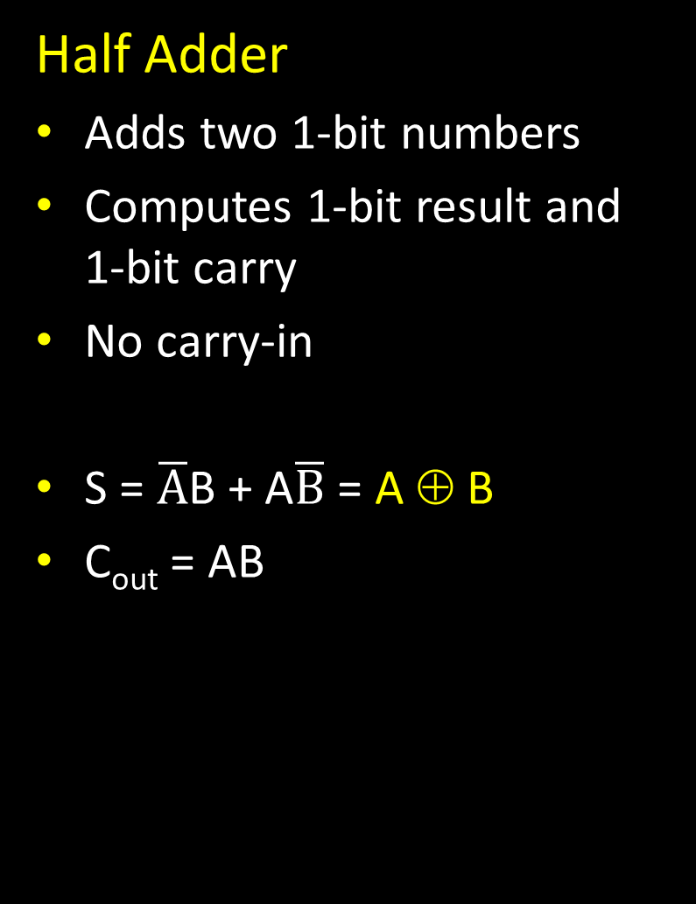
1-bit Adder
A
B
Half Adder
Adds two 1-bit numbers
Computes 1-bit result and 1-bit carry
No carry-in
S = $\overline{A}$B + A$\overline{B}$ = A ⊕ B
C_{out} = AB
C_{out}
S
A | B | C_{out} | S
0 | 0 | 0 | 0
0 | 1 | 0 | 1
1 | 0 | 0 | 1
1 | 1 | 1 | 0
A
B
C_{out}
S
Notes:
Adds two 1-bit numbers,
computes 1-bit result and carry out
Useful for the rightmost binary digit, not much else

Slide 23
1-bit Adder with Carry
A
B
Full Adder
Adds three 1-bit numbers
Computes 1-bit result and 1-bit carry
Can be cascaded
Activity: Truth Table and Sum-of-Product.
Logic minimization via Karnaugh Maps and algebraic minimization.
Draw Logic Circuits
C_{out}
C_{in}
S
A | B | C_{in} | C_{out} | S
0 | 0 | 0
0 | 0 | 1
0 | 1 | 0
0 | 1 | 1
1 | 0 | 0
1 | 0 | 1
1 | 1 | 0
1 | 1 | 1

Slide 24
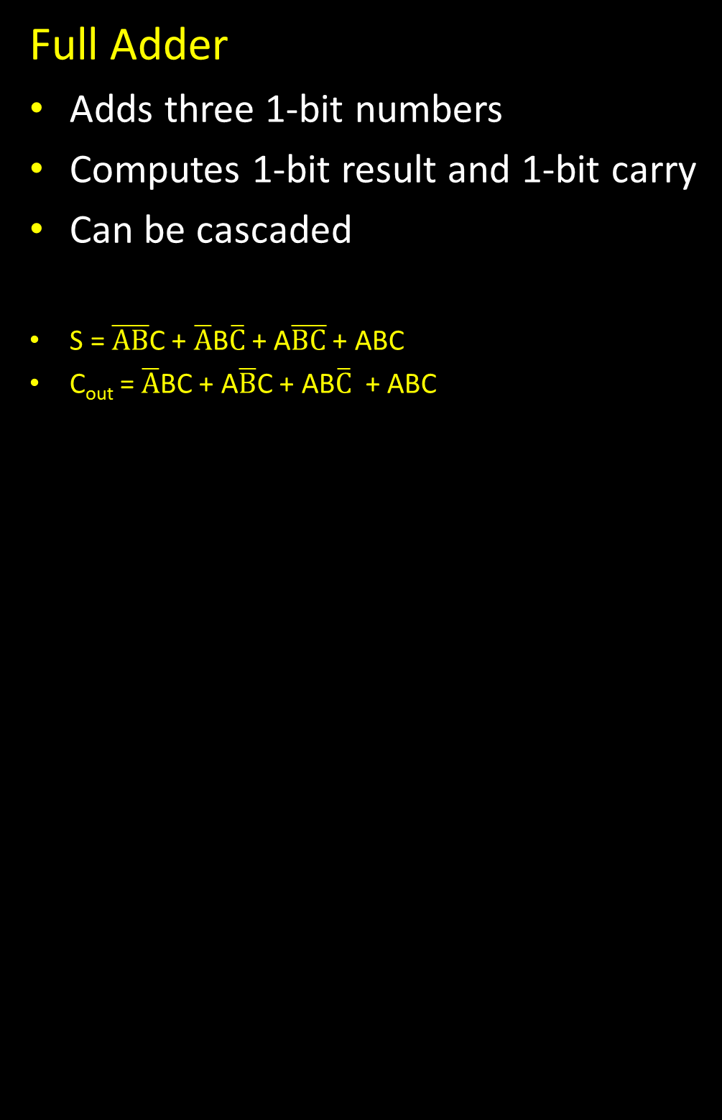
1-bit Adder with Carry
A
B
Full Adder
Adds three 1-bit numbers
Computes 1-bit result and 1-bit carry
Can be cascaded
S = $\overline{AB}$C + $\overline{A}$B$\overline{C}$ + A$\overline{BC}$ + ABC
C_{out} = $\overline{A}$BC + A$\overline{B}$C + AB$\overline{C}$ + ABC
C_{out}
C_{in}
A
B
C_{out}
C_{in}
S
A | B | C_{in} | C_{out} | S
0 | 0 | 0 | 0 | 0
0 | 0 | 1 | 0 | 1
0 | 1 | 0 | 0 | 1
0 | 1 | 1 | 1 | 0
1 | 0 | 0 | 0 | 1
1 | 0 | 1 | 1 | 0
1 | 1 | 0 | 1 | 0
1 | 1 | 1 | 1 | 1
S
Notes:
Draw circuits

Slide 25
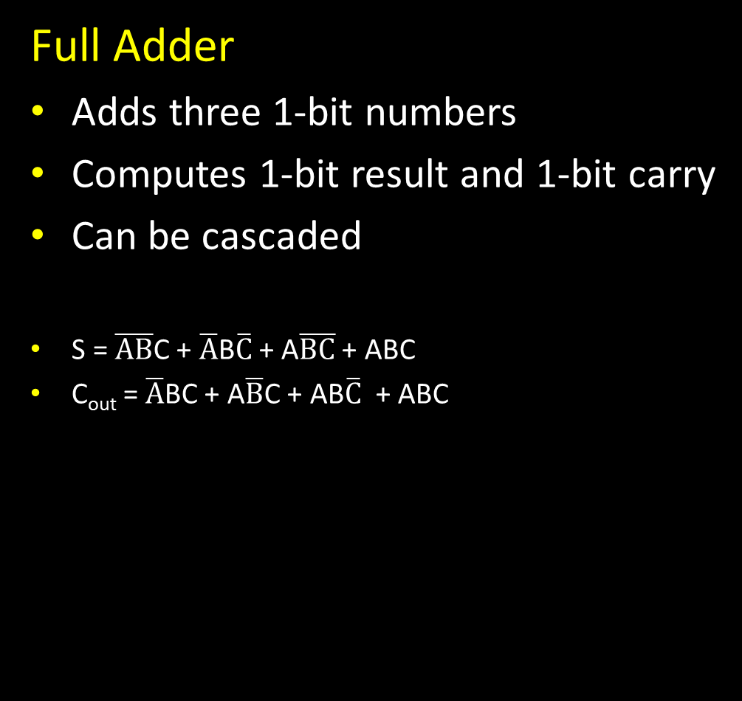
1-bit Adder with Carry
A
B
Full Adder
Adds three 1-bit numbers
Computes 1-bit result and 1-bit carry
Can be cascaded
S = $\overline{AB}$C + $\overline{A}$B$\overline{C}$ + A$\overline{BC}$ + ABC
C_{out} = $\overline{A}$BC + A$\overline{B}$C + AB$\overline{C}$ + ABC
C_{out}
C_{in}
A
B
C_{out}
C_{in}
S
A | B | C_{in} | C_{out} | S
0 | 0 | 0 | 0 | 0
0 | 0 | 1 | 0 | 1
0 | 1 | 0 | 0 | 1
0 | 1 | 1 | 1 | 0
1 | 0 | 0 | 0 | 1
1 | 0 | 1 | 1 | 0
1 | 1 | 0 | 1 | 0
1 | 1 | 1 | 1 | 1
AB
S
AB
C_{out}
C_{in}
C_{in}
00 01 11 10
00 01 11 10
0
0
S
1
1

Slide 26
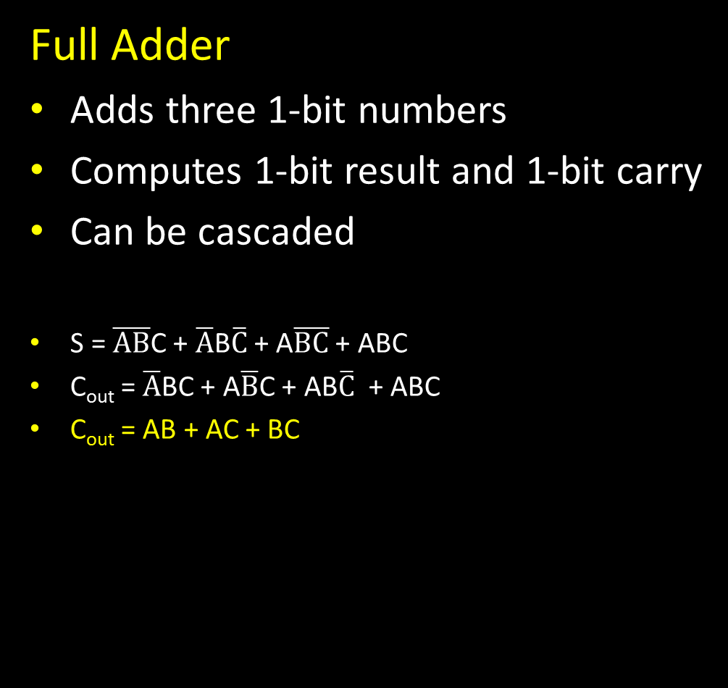
1-bit Adder with Carry
A
B
Full Adder
Adds three 1-bit numbers
Computes 1-bit result and 1-bit carry
Can be cascaded
S = $\overline{AB}$C + $\overline{A}$B$\overline{C}$ + A$\overline{BC}$ + ABC
C_{out} = $\overline{A}$BC + A$\overline{B}$C + AB$\overline{C}$ + ABC
C_{out} = AB + AC + BC
C_{out}
C_{in}
A
B
C_{out}
C_{in}
S
A | B | C_{in} | C_{out} | S
0 | 0 | 0 | 0 | 0
0 | 0 | 1 | 0 | 1
0 | 1 | 0 | 0 | 1
0 | 1 | 1 | 1 | 0
1 | 0 | 0 | 0 | 1
1 | 0 | 1 | 1 | 0
1 | 1 | 0 | 1 | 0
1 | 1 | 1 | 1 | 1
AB
S
AB
C_{out}
C_{in}
C_{in}
00 01 11 10
00 01 11 10
0
0 | 1 | 0 | 1
1 | 0 | 1 | 0
0
0 | 0 | 1 | 0
0 | 1 | 1 | 1
S
1
1

Slide 27
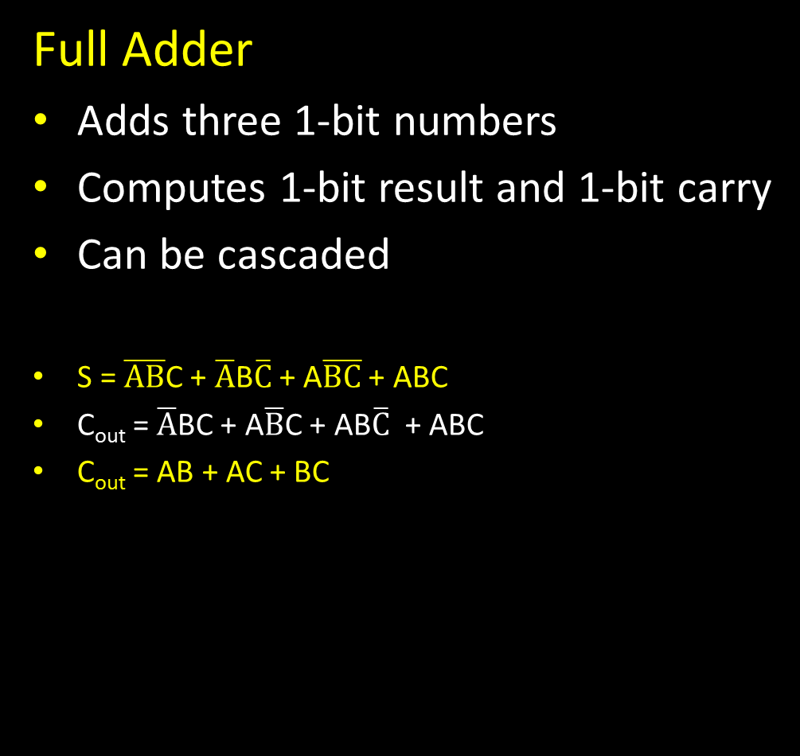
1-bit Adder with Carry
A
B
Full Adder
Adds three 1-bit numbers
Computes 1-bit result and 1-bit carry
Can be cascaded
S = $\overline{AB}$C + $\overline{A}$B$\overline{C}$ + A$\overline{BC}$ + ABC
C_{out} = $\overline{A}$BC + A$\overline{B}$C + AB$\overline{C}$ + ABC
C_{out} = AB + AC + BC
C_{out}
C_{in}
A
B
C_{out}
C_{in}
S
A | B | C_{in} | C_{out} | S
0 | 0 | 0 | 0 | 0
0 | 0 | 1 | 0 | 1
0 | 1 | 0 | 0 | 1
0 | 1 | 1 | 1 | 0
1 | 0 | 0 | 0 | 1
1 | 0 | 1 | 1 | 0
1 | 1 | 0 | 1 | 0
1 | 1 | 1 | 1 | 1
AB
S
AB
C_{out}
C_{in}
C_{in}
00 01 11 10
00 01 11 10
0
0 | 1 | 0 | 1
1 | 0 | 1 | 0
0
0 | 0 | 1 | 0
0 | 1 | 1 | 1
S
1
1

Slide 28
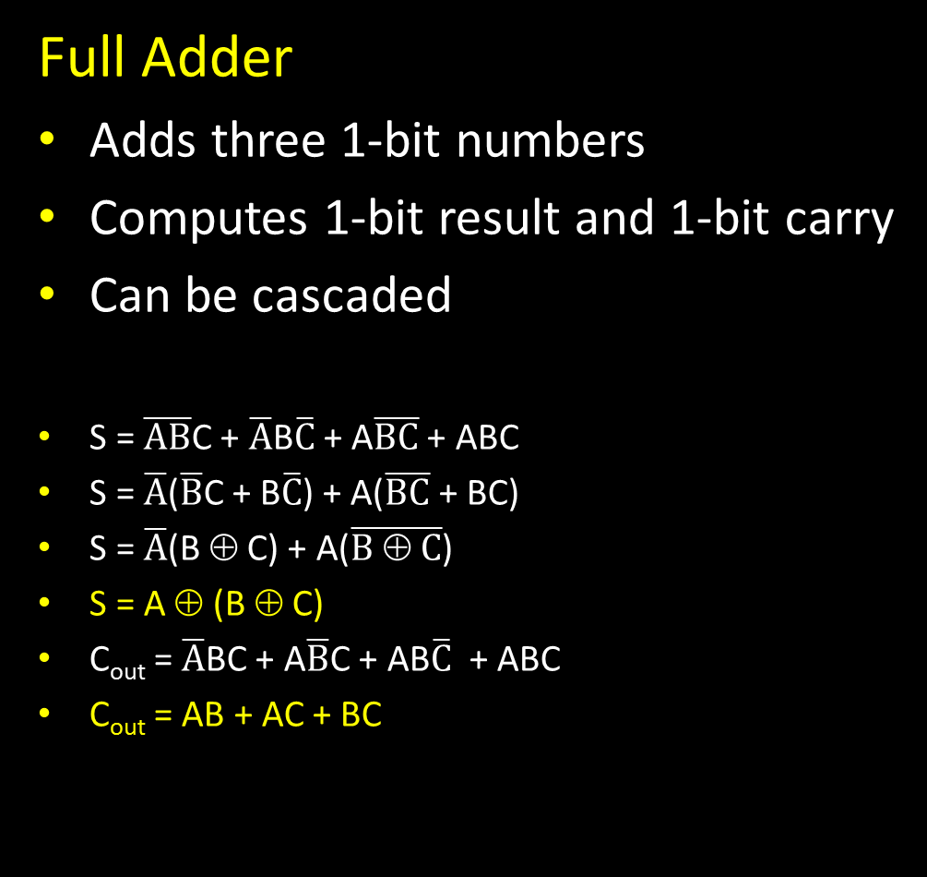
1-bit Adder with Carry
A
B
Full Adder
Adds three 1-bit numbers
Computes 1-bit result and 1-bit carry
Can be cascaded
S = $\overline{AB}$C + $\overline{A}$B$\overline{C}$ + A$\overline{BC}$ + ABC
S = $\overline{A}$($\overline{B}$C + B$\overline{C}$) + A($\overline{BC}$ + BC)
S = $\overline{A}$(B ⊕ C) + A($\overline{B ⊕ C}$)
S = A ⊕ (B ⊕ C)
C_{out} = $\overline{A}$BC + A$\overline{B}$C + AB$\overline{C}$ + ABC
C_{out} = AB + AC + BC
C_{out}
C_{in}
A
B
C_{out}
C_{in}
S
A | B | C_{in} | C_{out} | S
0 | 0 | 0 | 0 | 0
0 | 0 | 1 | 0 | 1
0 | 1 | 0 | 0 | 1
0 | 1 | 1 | 1 | 0
1 | 0 | 0 | 0 | 1
1 | 0 | 1 | 1 | 0
1 | 1 | 0 | 1 | 0
1 | 1 | 1 | 1 | 1
AB
S
AB
C_{out}
C_{in}
C_{in}
00 01 11 10
00 01 11 10
0
0 | 1 | 0 | 1
1 | 0 | 1 | 0
0
0 | 0 | 1 | 0
0 | 1 | 1 | 1
S
1
1
Notes:
Point out lab0

Slide 29
1-bit Adder with Carry
A
B
Full Adder
Adds three 1-bit numbers
Computes 1-bit result and 1-bit carry
Can be cascaded
S = $\overline{AB}$C + $\overline{A}$B$\overline{C}$ + A$\overline{BC}$ + ABC
S = $\overline{A}$($\overline{B}$C + B$\overline{C}$) + A($\overline{BC}$ + BC)
S = $\overline{A}$(B ⊕ C) + A($\overline{B ⊕ C}$)
S = A ⊕ (B ⊕ C)
C_{out} = $\overline{A}$BC + A$\overline{B}$C + AB$\overline{C}$ + ABC
C_{out} = AB + AC + BC
C_{out}
C_{in}
A
B
C_{out}
C_{in}
S
A | B | C_{in} | C_{out} | S
0 | 0 | 0 | 0 | 0
0 | 0 | 1 | 0 | 1
0 | 1 | 0 | 0 | 1
0 | 1 | 1 | 1 | 0
1 | 0 | 0 | 0 | 1
1 | 0 | 1 | 1 | 0
1 | 1 | 0 | 1 | 0
1 | 1 | 1 | 1 | 1
S
AB
S
AB
C_{out}
C_{in}
C_{in}
00 01 11 10
00 01 11 10
0
0 | 1 | 0 | 1
1 | 0 | 1 | 0
0
0 | 0 | 1 | 0
0 | 1 | 1 | 1
1
1
Notes:
Point out lab0

Slide 30
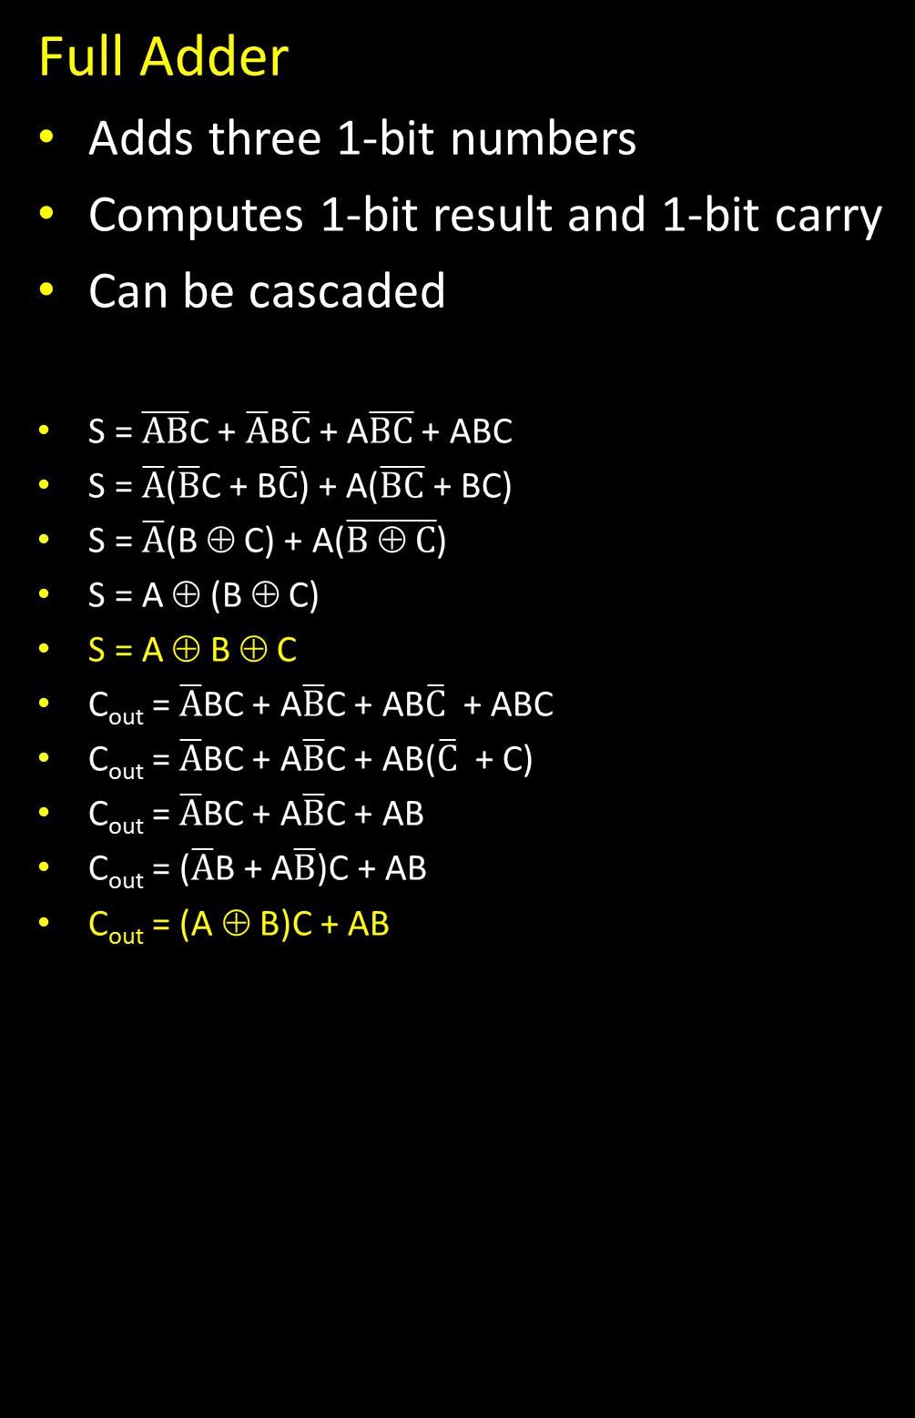
1-bit Adder with Carry
A
B
Full Adder
Adds three 1-bit numbers
Computes 1-bit result and 1-bit carry
Can be cascaded
S = $\overline{AB}$C + $\overline{A}$B$\overline{C}$ + A$\overline{BC}$ + ABC
S = $\overline{A}$($\overline{B}$C + B$\overline{C}$) + A($\overline{BC}$ + BC)
S = $\overline{A}$(B ⊕ C) + A($\overline{B ⊕ C}$)
S = A ⊕ (B ⊕ C)
S = A ⊕ B ⊕ C
C_{out} = $\overline{A}$BC + A$\overline{B}$C + AB$\overline{C}$ + ABC
C_{out} = $\overline{A}$BC + A$\overline{B}$C + AB($\overline{C}$ + C)
C_{out} = $\overline{A}$BC + A$\overline{B}$C + AB
C_{out} = ($\overline{A}$B + A$\overline{B}$)C + AB
C_{out} = (A ⊕ B)C + AB
C_{out}
C_{in}
A
B
C_{out}
C_{in}
S
A | B | C_{in} | C_{out} | S
0 | 0 | 0 | 0 | 0
0 | 0 | 1 | 0 | 1
0 | 1 | 0 | 0 | 1
0 | 1 | 1 | 1 | 0
1 | 0 | 0 | 0 | 1
1 | 0 | 1 | 1 | 0
1 | 1 | 0 | 1 | 0
1 | 1 | 1 | 1 | 1
S
Notes:
Point out lab0

Slide 31
4-bit Adder
A[4]
B[4]
4-Bit Full Adder
Adds two 4-bit numbers and carry in
Computes 4-bit result and carry out
Can be cascaded
C_{out}
C_{in}
S[4]
Notes:
Adds two 1-bit numbers, along with carry-in, computes 1-bit result and carry out
Can be cascaded to add N-bit numbers

Slide 32
4-bit Adder
0 0 1 1
0 0 1 0
A₃ B₃
A₂ B₂
A₁ B₁
A₀ B₀
0 0 1 0 0
C_{in}
C_{out}
S₃
S₂
S₁
S₀
0 1 0 1
Adds two 4-bit numbers, along with carry-in
Computes 4-bit result and carry out
Carry-out = overflow indicates result does not fit in 4 bits
Notes:
Transition: to do subtraction, just add, but negate one number

Slide 33
4-bit Adder
A₃ B₃
A₂ B₂
A₁ B₁
A₀ B₀
C_{out}
S₃
S₂
S₁
S₀
Adds two 4-bit numbers, along with carry-in
Computes 4-bit result and carry out
Carry-out = overflow indicates result does not fit in 4 bits
Notes:
Transition: to do subtraction, just add, but negate one number

Slide 34
Takeaway
Digital computers are implemented via logic circuits and thus represent all numbers in binary (base 2).
We (humans) often write numbers as decimal and hexadecimal for convenience, so need to be able to convert to binary and back (to understand what computer is doing!).
Adding two 1-bit numbers generalizes to adding two numbers of any size since 1-bit full adders can be cascaded.

Slide 35
Next Goal
How do we subtract two binary numbers?
Equivalent to adding with a negative number
How do we represent negative numbers?

Slide 36
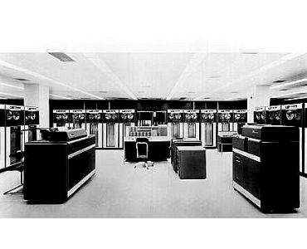
First Attempt: Sign/Magnitude Representation
First Attempt: Sign/Magnitude Representation
  1 bit for sign (0=positive, 1=negative)
  N-1 bits for magnitude
Problem?
  Two zero’s: +0 different than -0
  Complicated circuits
0111 = 7
1000 = -7
0111 =
1000 =
0000 = +0
1111 = -0
IBM 7090
Notes:
problems? two zeros, circuit still complicated
e.g. the existence of two forms of the same value (-0 and +0) necessitates two rather than a single comparison when checking for equality with zero.
The CDC 6000 series and UNIVAC 1100 series computers were based on ones' complement.
Also, in addition to two zero’s, there is a crazy phenomenon called "end-around carry“: If the carry extends past the end of the word it is said to have "wrapped" around, a condition called an "end-around carry". When this occurs, the bit must be added back in at the right-most bit. This phenomenon does not occur in two's complement arithmetic.
Subtraction is similar, except that borrows are propagated to the left instead of carries. If the borrow extends past the end of the word it is said to have "wrapped" around, a condition called an "end-around borrow". When this occurs, the bit must be subtracted back in at the right-most bit. This phenomenon does not occur in two's complement arithmetic.
The CDC 6000 series and UNIVAC 1100 series computers were based on ones' complement.

Slide 37
Two’s Complement Representation
Better: Two’s Complement Representation
Nonnegative numbers are represented as usual
  0 = 0000
  1 = 0001
  3 = 0011
  7 = 0111
Leading 1’s for negative numbers
To negate any number:
  complement all the bits (i.e. flip all the bits)
  then add 1
  -1: 1 ⇒ 0001 ⇒ 1110 ⇒ 1111
  -3: 3 ⇒ 0011 ⇒ 1100 ⇒ 1101
  -7: 7 ⇒ 0111 ⇒ 1000 ⇒ 1001
  -8: 8 ⇒ 1000 ⇒ 0111 ⇒ 1000
  -0: 0 ⇒ 0000 ⇒ 1111 ⇒ 0000 (this is good, -0 = +0)
Notes:
add 1 and *discard carry*
Add a “Did you know box”
The two's complement of an N-bit number is defined as the *complement* with respect to 2^N, in other words the result of subtracting the number from 2^N. This is also equivalent to taking the *ones' complement* and then adding one, since the sum of a number and its ones' complement is all 1 bits. The two's complement of a number behaves like the negative of the original number in most arithmetic, and positive and negative numbers can coexist in a natural way.
Two's complement is the easiest to implement in hardware, which may be the ultimate reason for its widespread popularity[citation needed]. Remember that processors on the early mainframes often consisted of thousands of transistors – eliminating a significant number of transistors was a significant cost savings. The architects of the early integrated circuit based CPUs (Intel 8080, etc.) chose to use two's complement math. As IC technology advanced, virtually all adopted two's complement technology. Intel, AMD, and IBM POWER chips are all two's complement.[

Slide 38
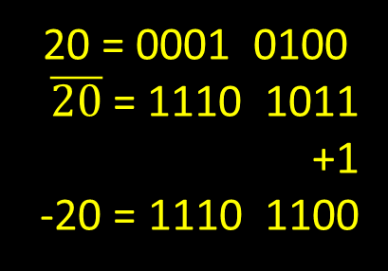

Two’s Complement Representation
0 = 0000
$\overline{0}$ = 1111
+1
0 = 0000
Is there only one zero!
One more example. How do we represent -20?
20 = 0001 0100
$\overline{20}$ = 1110 1011
+1
-20 = 1110 1100
Notes:
Add and subtract the same number to show that two’s complement works

Slide 39

Two’s Complement
Non-negatives
(as usual):
+0 = 0000
+1 = 0001
+2 = 0010
+3 = 0011
+4 = 0100
+5 = 0101
+6 = 0110
+7 = 0111
+8 = 1000
Negatives
(two’s complement: flip then add 1):
$\overline{0}$ = 1111 -0 = 0000
$\overline{1}$ = 1110 -1 = 1111
$\overline{2}$ = 1101 -2 = 1110
$\overline{3}$ = 1100 -3 = 1101
$\overline{4}$ = 1011 -4 = 1100
$\overline{5}$ = 1010 -5 = 1011
$\overline{6}$ = 1001 -6 = 1010
$\overline{7}$ = 1000 -7 = 1001
$\overline{8}$ = 0111 -8 = 1000
Notes:
choose -8 so we have a sign bit
+0 = -0
wraps from +7 to -8
asymmetric: no +8

Slide 40
Two’s Complement
Non-negatives
(as usual):
+0 = 0000
+1 = 0001
+2 = 0010
+3 = 0011
+4 = 0100
+5 = 0101
+6 = 0110
+7 = 0111
+8 = 1000
Negatives
(two’s complement: flip then add 1):
$\overline{0}$ = 1111 -0 = 0000
$\overline{1}$ = 1110 -1 = 1111
$\overline{2}$ = 1101 -2 = 1110
$\overline{3}$ = 1100 -3 = 1101
$\overline{4}$ = 1011 -4 = 1100
$\overline{5}$ = 1010 -5 = 1011
$\overline{6}$ = 1001 -6 = 1010
$\overline{7}$ = 1000 -7 = 1001
$\overline{8}$ = 0111 -8 = 1000
Notes:
choose -8 so we have a sign bit
+0 = -0
wraps from +7 to -8
asymmetric: no +8

Slide 41
Two’s Complement Facts
Signed two’s complement
  Negative numbers have leading 1’s
  zero is unique: +0 = - 0
  wraps from largest positive to largest negative
N bits can be used to represent
  unsigned: range 0…2^{N}-1
    eg: 8 bits ⇒ 0…255
  signed (two’s complement): -(2^{N-1})…(2^{N-1} - 1)
    ex: 8 bits ⇒ (1000 000) … (0111 1111)
    -128 … 127
Notes:
Why two’s complement works:
Given a set of all possible N-bit values, we can assign the lower (by binary value) half to be the integers from 0 to (2^[N−1]−1) inclusive and the upper half to be −2^[N−1] to −1 inclusive. The upper half can be used to represent negative integers from −2^[N−1] to −1 because, under addition modulo 2^N they behave the same way as those negative integers. That is to say that because i + j mod 2^N = i + (j + 2^N) mod 2^N any value in the set { j + k2^N | k is an integer } can be used in place of j.
For example, with eight bits, the unsigned bytes are 0 to 255. Subtracting 256 from the top half (128 to 255) yields the signed bytes −128 to −1.
The relationship to two's complement is realised by noting that 256 = 255 + 1, and (255 − x) is the ones' complement of x.
http://en.wikipedia.org/wiki/Two%27s_complement

Slide 42
Sign Extension & Truncation
  Copy the leftmost bit into new leading bits
    For positive number, put 0’s in new leading bits
    For negative number, put 1’s in new leading bits
  Drop leading bits so long as sign doesn’t change
Extending to larger size
  1111 = -1
  1111 1111 = -1
  0111 = 7
  0000 0111 = 7
Truncate to smaller size
  0000 1111 = 15
  BUT, 0000 1111 = 1111 = -1

Slide 43
Two’s Complement Addition
Addition with two’s complement signed numbers
Perform addition as usual, regardless of sign
(it just works)
Examples
  1 + -1 =
  -3 + -1 =
  -7 + 3 =
  7 + (-3) =
Notes:
1 + (-1)
(-3) + (-1)
(-7) + 3
7 + (-3)
7 + 1 : overflow
(-7) + (-3) : overflow
(-7) + (-1)
7 + 1 = 0111+0001 = 1000 = -8 (OVERFLOW)! (Had a carry in to the MSB!) Sign of out != sign of in
7 + (-3) 0111+ 1101 = 1100 = -4
-7+-3 = 1001 + 1101 = 0110 (cout = 1) (Did not have a carry in to the MSB)
-7+-1 = 1001 + 1111 = 1000 (cout = 1)

Slide 44
Two’s Complement Addition
Addition with two’s complement signed numbers
Perform addition as usual, regardless of sign
(it just works)
Examples
  1 + -1 = 0001 + 1111 =
  -3 + -1 = 1101 + 1111 =
  -7 + 3 = 1001 + 0011 =
  7 + (-3) = 0111 + 1101 =
Notes:
1 + (-1)
(-3) + (-1)
(-7) + 3
7 + (-3)
7 + 1 : overflow
(-7) + (-3) : overflow
(-7) + (-1)
7 + 1 = 0111+0001 = 1000 = -8 (OVERFLOW)! (Had a carry in to the MSB!) Sign of out != sign of in
7 + (-3) 0111+ 1101 = 1100 = -4
-7+-3 = 1001 + 1101 = 0110 (cout = 1) (Did not have a carry in to the MSB)
-7+-1 = 1001 + 1111 = 1000 (cout = 1)

Slide 45
Two’s Complement Addition
Addition with two’s complement signed numbers
Perform addition as usual, regardless of sign
(it just works)
Examples
  1 + -1 = 0001 + 1111 = 0000 (0)
  -3 + -1 = 1101 + 1111 = 1100 (-4)
  -7 + 3 = 1001 + 0011 = 1100 (-4)
  7 + (-3) = 0111 + 1101 = 0100 (4)
  What is wrong with the following additions?
  7 + 1, -7 + -3, -7 + -1
  1000 overflow, 1 0110 overflow, 1000 fine
Notes:
1 + (-1)
(-3) + (-1)
(-7) + 3
7 + (-3)
7 + 1 : overflow
(-7) + (-3) : overflow
(-7) + (-1)
7 + 1 = 0111+0001 = 1000 = -8 (OVERFLOW)! (Had a carry in to the MSB!) Sign of out != sign of in
7 + (-3) 0111+ 1101 = 1100 = -4
-7+-3 = 1001 + 1101 = 0110 (cout = 1) (Did not have a carry in to the MSB)
-7+-1 = 1001 + 1111 = 1000 (cout = 1)

Slide 46
Binary Subtraction
Two’s Complement Subtraction
Why create a new circuit?
Just use addition
  How?
Notes:
a – b, where b is so large that –B overflows
B must be -8, so that –B = -8
last bit will change
if a >= 0, will correctly signal overflow
if a < 0, will correctly subtract and not signal overflow

Slide 47

Binary Subtraction
Two’s Complement Subtraction
  Subtraction is simply addition,
  where one of the operands has been negated
    Negation is done by inverting all bits and adding one
    A – B = A + (-B) = A + ($\overline{B}$ + 1)
B₃
B₂
B₁
B₀
0 0 1 1
0 1 0 0
A₃
A₂
A₁
A₀
1 1 0 0
C_{out}
1
1 1 0 0
S₃
S₂
S₁
S₀
0 0 0 1
Notes:
a – b, where b is so large that –B overflows
B must be -8, so that –B = -8
last bit will change
if a >= 0, will correctly signal overflow
if a < 0, will correctly subtract and not signal overflow

Slide 48
Binary Subtraction
Two’s Complement Subtraction
  Subtraction is simply addition,
  where one of the operands has been negated
    Negation is done by inverting all bits and adding one
    A – B = A + (-B) = A + ($\overline{B}$ + 1)
B₃
B₂
B₁
B₀
A₃
A₂
A₁
A₀
C_{out}
1
S₃
S₂
S₁
S₀
Q: How do we detect and handle overflows?
Q: What if (-B) overflows?
Notes:
a – b, where b is so large that –B overflows
B must be -8, so that –B = -8
last bit will change
if a >= 0, will correctly signal overflow
if a < 0, will correctly subtract and not signal overflow

Slide 49
Takeaway
Digital computers are implemented via logic circuits and thus represent all numbers in binary (base 2).
We (humans) often write numbers as decimal and hexadecimal for convenience, so need to be able to convert to binary and back (to understand what computer is doing!).
Adding two 1-bit numbers generalizes to adding two numbers of any size since 1-bit full adders can be cascaded.
Using Two’s complement number representation simplifies adder Logic circuit design (0 is unique, easy to negate). Subtraction is simply adding, where one operand is negated (two’s complement; to negate just flip the bits and add 1).
.

Slide 50
Next Goal
How do we detect and handle overflow?

Slide 51
Overflow
When can overflow occur?
  adding a negative and a positive?
  adding two positives?
  adding two negatives?

Slide 52
Overflow
When can overflow occur?
  adding a negative and a positive?
    Overflow cannot occur (Why?)
    Always subtract larger magnitude from smaller
  adding two positives?
    Overflow can occur (Why?)
    Precision: Add two positives, and get a negative number!
  adding two negatives?
    Overflow can occur (Why?)
    Precision: add two negatives, get a positive number!
Rule of thumb:
  Overflow happens iff
  carry into msb != carry out of msb
Notes:
Overflow occurs because there are not enough bits to represent the precision/magnitude of the result of the add
MSB
0
0
Cout = 0 0 Cin = 0
0
0
Cout = 0 1 Cin = 1 (Overflow!)
1
1
Cout = 1 0 Cin = 0 (Overflow!)
1
1
Cout = 1 1 Cin = 1

Slide 53
Overflow
When can overflow occur?
Rule of thumb:
  Overflow happened iff
  carry into msb != carry out of msb
MSB
A | B | C_{in} | C_{out} | S
0 | 0 | 0 | 0 | 0
0 | 0 | 1 | 0 | 1
0 | 1 | 0 | 0 | 1
0 | 1 | 1 | 1 | 0
1 | 0 | 0 | 0 | 1
1 | 0 | 1 | 1 | 0
1 | 1 | 0 | 1 | 0
1 | 1 | 1 | 1 | 1
Wrong
Sign
A_{MSB} B_{MSB}
over
flow
C_{out_MSB}
C_{in_MSB}
Wrong
Sign
S_{MSB}
Notes:
Outgoing sign of result (S) does match in coming sign of operands, A and B. This only happens when Cin != Cout
MSB!!
0
0
Cout = 0 0 Cin = 0
0
0
Cout = 0 1 Cin = 1 (Overflow!)
1
1
Cout = 1 0 Cin = 0 (Overflow!)
1
1
Cout = 1 1 Cin = 1

Slide 54
Two’s Complement Adder
Two’s Complement Adder with overflow detection
A₃ B₃
A₂ B₂
A₁ B₁
A₀ B₀
over
flow
0
S₃
S₂
S₁
S₀

Slide 55
Two’s Complement Adder
Two’s Complement Subtraction with overflow detection
B₃
B₂
B₁
B₀
A₃
A₂
A₁
A₀
over
flow
1
S₃
S₂
S₁
S₀

Slide 56
Two’s Complement Adder
Two’s Complement Adder with overflow detection
B₃
B₂
B₁
B₀
A₃
mux
A₂
mux
A₁
mux
A₀
mux
over
flow
0=add
1=sub
S₃
S₂
S₁
S₀

Slide 57
Takeaway
Digital computers are implemented via logic circuits and thus represent all numbers in binary (base 2).
We (humans) often write numbers as decimal and hexadecimal for convenience, so need to be able to convert to binary and back (to understand what computer is doing!).
Adding two 1-bit numbers generalizes to adding two numbers of any size since 1-bit full adders can be cascaded.
Using Two’s complement number representation simplifies adder Logic circuit design (0 is unique, easy to negate). Subtraction is simply adding, where one operand is negated (two’s complement; to negate just flip the bits and add 1).
Overflow if sign of operands A and B != sign of result S. Can detect overflow by testing C_{in} != C_{out} of the most significant bit (msb), which only occurs when previous statement is true.

Slide 58
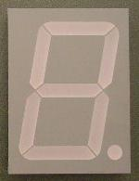
A Calculator
8
A
8
B
8
decoder
S
0=add
1=sub
Notes:
User enters the numbers to be added or subtracted using toggle switches
User selects ADD or SUBTRACT
Muxes feed A and B,
or A and –B, to the 8-bit adder
The 8-bit decoder for the hex display is straightforward (but not shown in detail)

Slide 59
A Calculator
8
A
8
8
adder
decoder
8
8
B
mux
8
S
0=add
1=sub
Notes:
red herring? constants into mux

Slide 60
Next Goal
Performance

Slide 61
Efficiency and Generality
  Is this design fast enough?
  Can we generalize to 32 bits? 64? more?
A₃ B₃
A₂ B₂
A₁ B₁
A₀ B₀
C₀
S₃
S₂
S₁
S₀

Slide 62
Performance
Speed of a circuit is affected by the number of gates in series (on the critical path or the deepest level of logic)
inputs
arrive
Combinational
Logic
outputs
expected
t_{combinational}

Slide 63
4-bit Ripple Carry Adder
A₃
B₃
A₂
B₂
A₁
B₁
A₀
B₀
C₃
C₂
C₁
C₄
C₀
S₃
S₂
S₁
S₀
Carry ripples from lsb to msb
First full adder, 2 gate delay
Second full adder, 2 gate delay
…

Slide 64
Goals for Today
Binary Operations
  Number representations
  One-bit and four-bit adders
  Negative numbers and two’s compliment
  Addition (two’s compliment)
  Subtraction (two’s compliment)
  Performance

Slide 65
Administrivia
Make sure you are
Registered for class, can access CMS
Have a Section you can go to
Have project partner in same Lab Section
Lab1 and HW1 are out
Both due in one week, next Monday, start early
Work alone
But, use your resources
  Lab Section, Piazza.com, Office Hours, Homework Help Session,
  Class notes, book, Sections, CSUGLab
Homework Help Session
Wednesday and Friday from 3:30-5:30pm
Location: 203 Thurston

Slide 66
Administrivia
Check online syllabus/schedule
  http://www.cs.cornell.edu/Courses/CS3410/2012sp/schedule.html
Slides and Reading for lectures
Office Hours
Homework and Programming Assignments
Prelims (in evenings):
  Tuesday, February 28th
  Thursday, March 29th
  April 26th
Schedule is subject to change

Slide 67
Summary
We can now implement combinational (combinatorial) logic circuit
  Design each block
    Binary encoded numbers for compactness
  Decompose large circuit into manageable blocks
    1-bit Half Adders, 1-bit Full Adders,
    n-bit Adders via cascaded 1-bit Full Adders, ...
  Can implement circuits using NAND or NOR gates
  Can implement gates using use PMOS and NMOS-transistors
  And can add and subtract numbers (in two’s compliment)!
  Next time, state and finite state machines…

