Slide 1
Gates and Logic: From switches to Transistors, Logic Gates and Logic Circuits
Hakim Weatherspoon
CS 3410, Spring 2013
Computer Science
Cornell University
See: P&H Appendix C.2 and C.3 (Also, see C.0 and C.1)

Slide 2
Goals for Today
From Switches to Logic Gates to Logic Circuits
Logic Gates
From switches
Truth Tables
Logic Circuits
Identity Laws
From Truth Tables to Circuits (Sum of Products)
Logic Circuit Minimization
Algebraic Manipulations
Truth Tables (Karnaugh Maps)
Transistors (electronic switch)

Slide 3
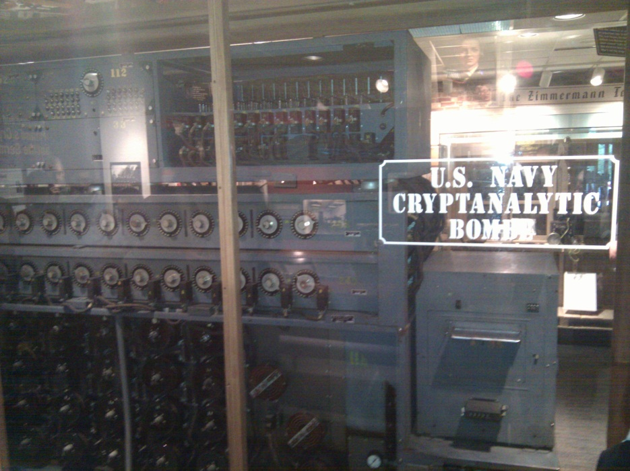
A switch
Acts as a conductor or insulator
Can be used to build amazing things…
The Bombe used to break the German
Enigma machine during World War II
Notes:
Pictures show the Bombe built by Alan Turing to break the enigma machine ciphers.
They were Fixed-Program Computers came before stored-program computers (general purpose)
The former required re-wiring (e.g. ENIAC took 3 weeks to “re-wire”).

Slide 4
Basic Building Blocks: Switches to Logic Gates
Either (OR)
Both (AND)
+
A
Truth Table
-
A | B | Light
OFF | OFF
OFF | ON
ON | OFF
ON | ON
B
+
A
-
A | B | Light
OFF | OFF
OFF | ON
ON | OFF
ON | ON
B
Notes:
Speed and size of a mechanical switch

Slide 5
Basic Building Blocks: Switches to Logic Gates
Either (OR)
Both (AND)
A
Truth Table
-
A | B | Light
OFF | OFF
OFF | ON
ON | OFF
ON | ON
OR
B
A
-
A | B | Light
OFF | OFF
OFF | ON
ON | OFF
ON | ON
AND
B
Notes:
Speed and size of a mechanical switch

Slide 6
Basic Building Blocks: Switches to Logic Gates
Either (OR)
Both (AND)
A
Truth Table
-
A | B | Light
0 | 0
0 | 1
1 | 0
1 | 1
OR
0 = OFF
1 = ON
B
A
-
A | B | Light
0 | 0
0 | 1
1 | 0
1 | 1
AND
B
Notes:
Speed and size of a mechanical switch

Slide 7
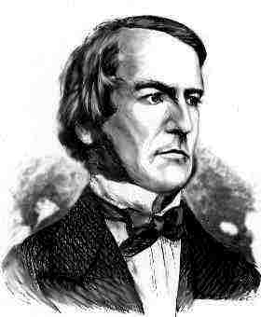
Basic Building Blocks: Switches to Logic Gates
A
OR
B
George Boole,(1815-1864)
A
Did you know?
George Boole Inventor of the idea of logic gates. He was born in Lincoln, England and he was the son of a shoemaker in a low class family.
AND
B
Notes:
E.g. logic statements:
“Jane will only go to the cinema tonight if a good film is on AND she has enough money.”
“Stuart will only go to the birthday party on Sunday if Katie OR Sujit is going too.”

Slide 8
Takeaway
Binary (two symbols: true and false) is the basis of Logic Design
Notes:
Add takeways at end of a block. Possibly build on takeaways throughout lecture

Slide 9
Building Functions: Logic Gates
A | Out
NOT:
AND:
OR:
Logic Gates
digital circuit that either allows a signal to pass through it or not.
Used to build logic functions
There are seven basic logic gates:
AND, OR, NOT,
NAND (not AND), NOR (not OR), XOR, and XNOR (not XOR) [later]
In
A | B | Out
0 | 0 | 0
0 | 1 | 0
1 | 0 | 0
1 | 1 | 1
A
B
A | B | Out
0 | 0 | 0
0 | 1 | 1
1 | 0 | 1
1 | 1 | 1
A
B
Notes:
Flash Drives
Create truth table of AND or OR: state what they do

Slide 10
Building Functions: Logic Gates
A | Out
0 | 1
1 | 0
NOT:
AND:
OR:
Logic Gates
digital circuit that either allows a signal to pass through it or not.
Used to build logic functions
There are seven basic logic gates:
AND, OR, NOT,
NAND (not AND), NOR (not OR), XOR, and XNOR (not XOR) [later]
In
A | B | Out
0 | 0 | 0
0 | 1 | 0
1 | 0 | 0
1 | 1 | 1
A
B
A | B | Out
0 | 0 | 0
0 | 1 | 1
1 | 0 | 1
1 | 1 | 1
A
B
Notes:
Flash Drives
Create truth table of AND or OR: state what they do
Did you know? Logic gates allow the computer to do things such as add, divide, multiply, do simple yes and no reasoning in certain situations along with other things.

Slide 11
Building Functions: Logic Gates
A | Out
0 | 1
1 | 0
NOT:
AND:
OR:
Logic Gates
digital circuit that either allows a signal to pass through it or not.
Used to build logic functions
There are seven basic logic gates:
AND, OR, NOT,
NAND (not AND), NOR (not OR), XOR, and XNOR (not XOR) [later]
In
A | B | Out
0 | 0 | 0
0 | 1 | 0
1 | 0 | 0
1 | 1 | 1
A | B | Out
0 | 0 | 1
0 | 1 | 1
1 | 0 | 1
1 | 1 | 0
NAND:
A
A
B
B
NOR:
A | B | Out
0 | 0 | 0
0 | 1 | 1
1 | 0 | 1
1 | 1 | 1
A | B | Out
0 | 0 | 1
0 | 1 | 0
1 | 0 | 0
1 | 1 | 0
A
A
B
B
Notes:
Flash Drives
Create truth table of AND or OR: state what they do
Did you know? Logic gates allow the computer to do things such as add, divide, multiply, do simple yes and no reasoning in certain situations along with other things.

Slide 12
Activity#1.A: Logic Gates
Fill in the truth table, given the following Logic Circuit made from Logic AND, OR, and NOT gates.
What does the logic circuit do?
a | b | Out
a
b
Out
Notes:
Fill out table
Put, NOT, AND, OR labels in box

Slide 13
Activity#1: Logic Gates
Fill in the truth table, given the following Logic Circuit made from Logic AND, OR, and NOT gates.
What does the logic circuit do?
a | b | d | Out
0 | 0 | 0
0 | 0 | 1
0 | 1 | 0
0 | 1 | 1
1 | 0 | 0
1 | 0 | 1
1 | 1 | 0
1 | 1 | 1
a
d
Out
b
Notes:
Fill out table

Slide 14
Goals for Today
From Switches to Logic Gates to Logic Circuits
Logic Gates
From switches
Truth Tables
Logic Circuits
Identity Laws
From Truth Tables to Circuits (Sum of Products)
Logic Circuit Minimization
Algebraic Manipulations
Truth Tables (Karnaugh Maps)
Transistors (electronic switch)

Slide 15
Next Goal
Given a Logic function, create a Logic Circuit that implements the Logic Function…
…and, with the minimum number of logic gates
Fewer gates: A cheaper ($$$) circuit!
Notes:
Can get logic circuit from truth table
Minimize logic circuit through algebraic reductions or Karnaugh Maps

Slide 16
Logic Gates
A | Out
0 | 1
1 | 0
NOT:
AND:
OR:
XOR:
L
ogic Equations
Constants: true = 1, false = 0
Variables: a, b, out, …
Operators (above): AND, OR, NOT, etc.
In
A | B | Out
0 | 0 | 0
0 | 1 | 0
1 | 0 | 0
1 | 1 | 1
A
B
A | B | Out
0 | 0 | 0
0 | 1 | 1
1 | 0 | 1
1 | 1 | 1
A
B
A | B | Out
0 | 0 | 0
0 | 1 | 1
1 | 0 | 1
1 | 1 | 0
A
B
Notes:
XOR is not a basic Logic Gate since it can be created from AND and OR gates, but it is often used as a basic Logic Operator

Slide 17
Logic Gates
A | Out
0 | 1
1 | 0
NOT:
AND:
OR:
XOR:
L
ogic Equations
Constants: true = 1, false = 0
Variables: a, b, out, …
Operators (above): AND, OR, NOT, etc.
In
A | B | Out
0 | 0 | 0
0 | 1 | 0
1 | 0 | 0
1 | 1 | 1
A | B | Out
0 | 0 | 1
0 | 1 | 1
1 | 0 | 1
1 | 1 | 0
NAND:
A
A
B
B
NOR:
A | B | Out
0 | 0 | 0
0 | 1 | 1
1 | 0 | 1
1 | 1 | 1
A | B | Out
0 | 0 | 1
0 | 1 | 0
1 | 0 | 0
1 | 1 | 0
A
A
B
B
XNOR:
A | B | Out
0 | 0 | 0
0 | 1 | 1
1 | 0 | 1
1 | 1 | 0
A | B | Out
0 | 0 | 1
0 | 1 | 0
1 | 0 | 0
1 | 1 | 1
A
A
B
B
Notes:
XOR is not a basic Logic Gate since it can be created from AND and OR gates, but it is often used as a basic Logic Operator

Slide 18
Logic Equations
NOT:
out = ā = !a = ¬a
AND:
out = a ∙ b = a & b = a ∧ b
OR:
out = a + b = a | b = a ∨ b
XOR:
out = a ⊕ b = a$\overline{b}$ + āb
Logic Equations
Constants: true = 1, false = 0
Variables: a, b, out, …
Operators (above): AND, OR, NOT, etc.
Notes:
Apologize that there are three ways to represent the same logic equation
XOR is not a basic Logic Gate since it can be created from AND and OR gates, but it is often used as a basic Logic Operator
AND is “product”
OR is “sum”
Read outloud

Slide 19
Logic Equations
NOT:
out = ā = !a = ¬a
AND:
out = a ∙ b = a & b = a ∧ b
OR:
out = a + b = a | b = a ∨ b
XOR:
out = a ⊕ b = a$\overline{b}$ + āb
Logic Equations
Constants: true = 1, false = 0
Variables: a, b, out, …
Operators (above): AND, OR, NOT, etc.
NAND:
out = $\overline{a \text{∙} b}$ = !(a & b) = ¬ (a ∧ b)
NOR:
out = $\overline{a+b}$ = !(a | b) = ¬ (a ∨ b)
XNOR:
out = $\overline{a \text{⊕} b}$ = ab + $\overline{ab}$
.
Notes:
Apologize that there are three ways to represent the same logic equation
XOR is not a basic Logic Gate since it can be created from AND and OR gates, but it is often used as a basic Logic Operator
AND is “product”
OR is “sum”
Read outloud

Slide 20
Identities
Identities useful for manipulating logic equations
For optimization & ease of implementation
a + 0 =
a + 1 =
a + ā =
a ∙ 0 =
a ∙ 1 =
a ∙ ā =
Notes:
Minimization activity
Maybe use picture to go through
Complement a+ā=1 and aā=0

Slide 21
Identities
Identities useful for manipulating logic equations
For optimization & ease of implementation
$\overline{(a+b)}$ =
$\overline{(a ∙b)}$ =
a + a b =
a(b+c) =
$\overline{a(b+c)}$ =
Notes:
Minimization activity
Maybe use picture to go through
De Morgan’s Law: $\overline{(a+b)}$ = $\overline{a}$ ∙ $\overline{b}$ and $\overline{(a ∙b)}$ = $\overline{a}$ + $\overline{b}$

Slide 22
Logic Manipulation
functions: gates ↔ truth tables ↔ equations
Example: (a+b)(a+c) = a + bc
a | b | c
0 | 0 | 0
0 | 0 | 1
0 | 1 | 0
0 | 1 | 1
1 | 0 | 0
1 | 0 | 1
1 | 1 | 0
1 | 1 | 1
Notes:
(a+b)(a+c)
= aa + ab + ac + bc
= a + a(b+c) + bc
= a(1 + (b+c)) + bc
= a + bc

Slide 23
Takeaway
Binary (two symbols: true and false) is the basis of Logic Design
More than one Logic Circuit can implement same Logic function. Use Algebra (Identities) or Truth Tables to show equivalence.
Notes:
Add takeways at end of a block. Possibly build on takeaways throughout lecture

Slide 24
Notes:
Think-Pair-Share: Why does minimization matter

Slide 25
Next Goal
How to standardize minimizing logic circuits?

Slide 26
Logic Minimization
How to implement a desired logic function?
a | b | c | out
0 | 0 | 0 | 0
0 | 0 | 1 | 1
0 | 1 | 0 | 0
0 | 1 | 1 | 1
1 | 0 | 0 | 0
1 | 0 | 1 | 1
1 | 1 | 0 | 0
1 | 1 | 1 | 0
Notes:
Draw circuit and go through out=true cases
Have not done cheaply yet

Slide 27
Logic Minimization
How to implement a desired logic function?
Write minterm’s
sum of products:
OR of all minterms where out=1
a | b | c | out
0 | 0 | 0 | 0
0 | 0 | 1 | 1
0 | 1 | 0 | 0
0 | 1 | 1 | 1
1 | 0 | 0 | 0
1 | 0 | 1 | 1
1 | 1 | 0 | 0
1 | 1 | 1 | 0
minterm
a b c
a b c
a b c
a b c
a b c
a b c
a b c
a b c
Notes:
Show what out equals

Slide 28
Karnaugh Maps
How does one find the most efficient equation?
Manipulate algebraically until…?
Use Karnaugh maps (optimize visually)
Use a software optimizer
For large circuits
Decomposition & reuse of building blocks

Slide 29
Minimization with Karnaugh maps (1)
a | b | c | out
0 | 0 | 0 | 0
0 | 0 | 1 | 1
0 | 1 | 0 | 0
0 | 1 | 1 | 1
1 | 0 | 0 | 1
1 | 0 | 1 | 1
1 | 1 | 0 | 0
1 | 1 | 1 | 0
Sum of minterms yields?
out =

Slide 30
Minimization with Karnaugh maps (2)
a | b | c | out
0 | 0 | 0 | 0
0 | 0 | 1 | 1
0 | 1 | 0 | 0
0 | 1 | 1 | 1
1 | 0 | 0 | 1
1 | 0 | 1 | 1
1 | 1 | 0 | 0
1 | 1 | 1 | 0
Sum of minterms yields?
out =
Karnaugh maps identify which inputs are (ir)relevant to the output
ab
c
00 01 11 10
0
0 | 0 | 0 | 1
1 | 1 | 0 | 1
1

Slide 31
Minimization with Karnaugh maps (2)
a | b | c | out
0 | 0 | 0 | 0
0 | 0 | 1 | 1
0 | 1 | 0 | 0
0 | 1 | 1 | 1
1 | 0 | 0 | 1
1 | 0 | 1 | 1
1 | 1 | 0 | 0
1 | 1 | 1 | 0
Sum of minterms yields?
out =
Karnaugh map minimization
Cover all 1’s
Group adjacent blocks of 2^{n} 1’s that yield a rectangular shape
Encode the common features of the rectangle
out = ab + ac
ab
c
00 01 11 10
0
0 | 0 | 0 | 1
1 | 1 | 0 | 1
1

Slide 32
Karnaugh Minimization Tricks (1)
ab
c
00 01 11 10
Minterms can overlap
out =
Minterms can span 2, 4, 8 or more cells
out =
0
0 | 1 | 1 | 1
0 | 0 | 1 | 0
1
ab
c
00 01 11 10
0
1 | 1 | 1 | 1
0 | 0 | 1 | 0
1

Slide 33
Karnaugh Minimization Tricks (2)
ab
cd
00 01 11 10
00
0 | 0 | 0 | 0
1 | 0 | 0 | 1
1 | 0 | 0 | 1
0 | 0 | 0 | 0
The map wraps around
out =
out =
01
11
10
ab
cd
00 01 11 10
00
1 | 0 | 0 | 1
0 | 0 | 0 | 0
0 | 0 | 0 | 0
1 | 0 | 0 | 1
01
11
10

Slide 34
Karnaugh Minimization Tricks (3)
ab
cd
00 01 11 10
00
0 | 0 | 0 | 0
1 | x | x | x
1 | x | x | 1
0 | 0 | 0 | 0
“Don’t care” values can be interpreted individually in whatever way is convenient
assume all x’s = 1
out =
assume middle x’s = 0
assume 4th column x = 1
out =
01
11
10
ab
cd
00 01 11 10
00
1 | 0 | 0 | x
0 | x | x | 0
0 | x | x | 0
1 | 0 | 0 | 1
01
11
10

Slide 35
Multiplexer
A multiplexer selects between multiple inputs
out = a, if d = 0
out = b, if d = 1
Build truth table
Minimize diagram
Derive logic diagram
a
b
d
a | b | d | out
0 | 0 | 0
0 | 0 | 1
0 | 1 | 0
0 | 1 | 1
1 | 0 | 0
1 | 0 | 1
1 | 1 | 0
1 | 1 | 1
Notes:
What is the truth table

Slide 36
Takeaway
Binary (two symbols: true and false) is the basis of Logic Design
More than one Logic Circuit can implement same Logic function. Use Algebra (Identities) or Truth Tables to show equivalence.
Any logic function can be implemented as “sum of products”. Karnaugh Maps minimize number of gates.
Notes:
Add takeways at end of a block. Possibly build on takeaways throughout lecture

Slide 37
Goals for Today
From Transistors to Gates to Logic Circuits
Logic Gates
From transistors
Truth Tables
Logic Circuits
Identity Laws
From Truth Tables to Circuits (Sum of Products)
Logic Circuit Minimization
Algebraic Manipulations
Truth Tables (Karnaugh Maps)
Transistors (electronic switch)

Slide 38
NMOS and PMOS Transistors
NMOS Transistor
Connect source to drain when V_{G} = V_{supply}
N-channel transistor
PMOS Transistor
Connect source to drain when V_{G} = 0 V
P-channel transistor
V_{supply}
V_{supply}
V_{supply}
V_{D}
V_{D} = 0V
V_{S} = V_{supply}
V_{G}
V_{G} = V_{Supply}
V_{G}
V_{G} = V_{Supply}
V_{G} = 0 V
V_{G} = 0 V
V_{S} = 0 V
V_{D}
V_{D} = V_{supply}
Closed switch
When V_{G} = V_{supply}
Closed switch
When V_{G} = 0 V
V_{S}: voltage at the source
V_{D}: voltage at the drain
V_{supply}: max voltage (aka a logical 1)
(ground): min voltage (aka a logical 0)

Slide 39
NMOS and PMOS Transistors
NMOS Transistor
Connect source to drain when gate = 1
N-channel transistor
PMOS Transistor
Connect source to drain when gate = 0
P-channel transistor
V_{supply}
V_{supply}
V_{supply}
D
D = 0
S = V_{supply}
G
G = 1
G
G = 1
G = 0
G = 0
S = 0V
D
D = 1
Closed switch
When V_{G} = V_{supply}
Closed switch
When V_{G} = 0 V
V_{S}: voltage at the source
V_{D}: voltage at the drain
V_{supply}: max voltage (aka a logical 1)
(ground): min voltage (aka a logical 0)

Slide 40
Inverter
Vdd = hi
Function: NOT
Called an inverter
Symbol:
Useful for taking the inverse of an input
CMOS: complementary-symmetry metal–oxide–semiconductor
A
out
A = 0
Vss = gnd
in
out
A | Out
0 | 1
1 | 0
Truth table

Slide 41
NAND Gate
Vdd
Vdd
Function: NAND
Symbol:
A
B
out
a
out
B
b
A
A | B | out
0 | 0 | 1
1 | 0 | 1
0 | 1 | 1
1 | 1 | 0
Vss

Slide 42
NOR Gate
Vdd
Function: NOR
Symbol:
A
B
a
out
b
out
A
B
A | B | out
0 | 0 | 1
1 | 0 | 0
0 | 1 | 0
1 | 1 | 0
Vss
Vss
Notes:
Example

Slide 43
Building Functions (Revisited)
NOT:
AND:
OR:
NAND and NOR are universal
Can implement any function with NAND or just NOR gates
useful for manufacturing
Notes:
Flash Drives
Create truth table of AND or OR: state what they do

Slide 44
Building Functions (Revisited)
NOT:
AND:
OR:
NAND and NOR are universal
Can implement any function with NAND or just NOR gates
useful for manufacturing
a
a
b
a
b
Notes:
Flash Drives
Create truth table of AND or OR: state what they do

Slide 45
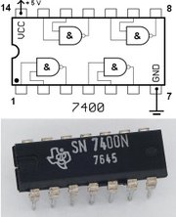
Logic Gates
One can buy gates separately
ex. 74xxx series of integrated circuits
cost ~$1 per chip, mostly for packaging and testing
Cumbersome, but possible to build devices using gates put together manually

Slide 46
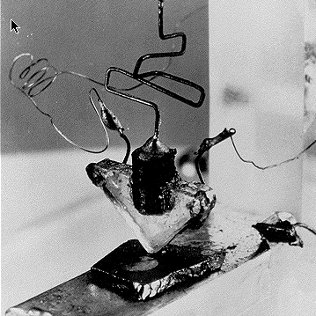
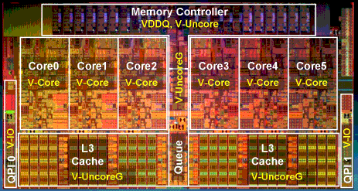
Then and Now
http://www.theregister.co.uk/2010/02/03/intel_westmere_ep_preview/
The first transistor
on a workbench at
AT&T Bell Labs in 1947
Bardeen, Brattain, and Shockley
An Intel Westmere
1.17 billion transistors
240 square millimeters
Six processing cores
Notes:
John Bardeen
Walter Brattain
William Shockley

Slide 47
Summary
Most modern devices are made from billions of on /off switches called transistors
We will build a processor in this course!
Transistors made from semiconductor materials:
MOSFET – Metal Oxide Semiconductor Field Effect Transistor
NMOS, PMOS – Negative MOS and Positive MOS
CMOS – Complimentary MOS made from PMOS and NMOS transistors
Transistors used to make logic gates and logic circuits
We can now implement any logic circuit
Can do it efficiently, using Karnaugh maps to find the minimal terms required
Can use either NAND or NOR gates to implement the logic circuit
Can use P- and N-transistors to implement NAND or NOR gates

Slide 48
Big Picture: Abstraction
Hide complexity through simple abstractions
Simplicity
Box diagram represents inputs and outputs
Complexity
Hides underlying P- and N-transistors and atomic interactions
Vdd
a
in
out
d
out
Vss
b
a
d
out
in
out
b

