Slide 1




Gates and Logic:
From switches to Transistors, Logic Gates and Logic Circuits
Hakim Weatherspoon
CS 3410, Spring 2013
Computer Science
Cornell University
See: P&H Appendix C.2 and C.3 (Also, see C.0 and C.1)

Slide 2
iClicker
Lab0 was
a) Too easy
b) Too hard
c) Just right
d) Have not done lab yet

Slide 3
Goals for Today
From Switches to Logic Gates to Logic Circuits
Logic Gates
  From switches
  Truth Tables
Logic Circuits
  Identity Laws
  From Truth Tables to Circuits (Sum of Products)
Logic Circuit Minimization
  Algebraic Manipulations
  Truth Tables (Karnaugh Maps)
Transistors (electronic switch)

Slide 4

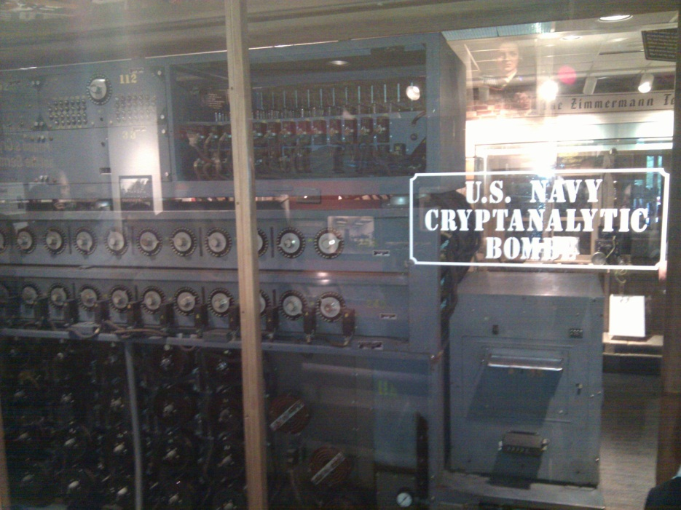

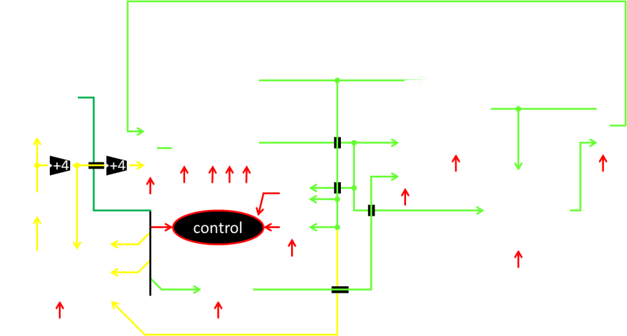
A switch
Acts as a conductor or insulator
Can be used to build amazing things…
The Bombe used to break the German
Enigma machine during World War II
Notes:
Pictures show the Bombe built by Alan Turing to break the enigma machine ciphers.
They were Fixed-Program Computers came before stored-program computers (general purpose)
The former required re-wiring (e.g. ENIAC took 3 weeks to “re-wire”).

Slide 5
Basic Building Blocks: Switches to Logic Gates
+
A
Truth Table
A | B | Light
OFF | OFF
A | B | Light
OFF | OFF
OFF | ON
A | B | Light
OFF | OFF
OFF | ON
ON | OFF
ON | ON
A | B | Light
-
A | B | Light
OFF | OFF
OFF | ON
ON | OFF
B
+
A
-
A | B | Light
OFF | OFF
A | B | Light
OFF | OFF
OFF | ON
A | B | Light
OFF | OFF
OFF | ON
ON | OFF
A | B | Light
OFF | OFF
OFF | ON
ON | OFF
ON | ON
A | B | Light
B
Notes:
Speed and size of a mechanical switch

Slide 6
Basic Building Blocks: Switches to Logic Gates
Either (OR)
Both (AND)
+
A
Truth Table
-
A | B | Light
OFF | OFF | OFF
OFF | ON | ON
ON | OFF | ON
ON | ON | ON
B
+
A
-
A | B | Light
OFF | OFF | OFF
OFF | ON | OFF
ON | OFF | OFF
ON | ON | ON
B
Notes:
Speed and size of a mechanical switch

Slide 7
Basic Building Blocks: Switches to Logic Gates
Either (OR)
Both (AND)
A
Truth Table
-
A | B | Light
OFF | OFF | OFF
OFF | ON | ON
ON | OFF | ON
ON | ON | ON
OR
B
A
-
A | B | Light
OFF | OFF | OFF
OFF | ON | OFF
ON | OFF | OFF
ON | ON | ON
AND
B
Notes:
Speed and size of a mechanical switch

Slide 8
Basic Building Blocks: Switches to Logic Gates
Either (OR)
Both (AND)
A
Truth Table
-
A | B | Light
0 | 0 | 0
0 | 1 | 1
1 | 0 | 1
1 | 1 | 1
OR
0 = OFF
1 = ON
B
A
-
A | B | Light
0 | 0 | 0
0 | 1 | 0
1 | 0 | 0
1 | 1 | 1
AND
B
Notes:
Speed and size of a mechanical switch

Slide 9
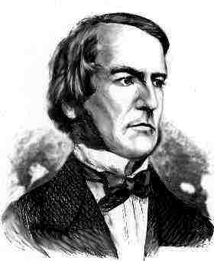
Basic Building Blocks: Switches to Logic Gates
A
OR
B
George Boole,(1815-1864)
A
Did you know?
George Boole Inventor of the idea of logic gates. He was born in Lincoln, England and he was the son of a shoemaker in a low class family.
AND
B
Notes:
E.g. logic statements:
“Jane will only go to the cinema tonight if a good film is on AND she has enough money.”
“Stuart will only go to the birthday party on Sunday if Katie OR Sujit is going too.”

Slide 10
Takeaway
Binary (two symbols: true and false) is the basis of Logic Design
Notes:
Add takeways at end of a block. Possibly build on takeaways throughout lecture

Slide 11
Building Functions: Logic Gates
A | Out
NOT:
AND:
OR:
Logic Gates
  digital circuit that either allows a signal to pass through it or not.
  Used to build logic functions
  There are seven basic logic gates:
  AND, OR, NOT,
  NAND (not AND), NOR (not OR), XOR, and XNOR (not XOR) [later]
In
A | B | Out
0 | 0 | 0
0 | 1 | 0
1 | 0 | 0
1 | 1 | 1
A
B
A | B | Out
0 | 0 | 0
0 | 1 | 1
1 | 0 | 1
1 | 1 | 1
A
B
Notes:
Flash Drives
Create truth table of AND or OR: state what they do

Slide 12
Building Functions: Logic Gates
A | Out
0 | 1
1 | 0
NOT:
AND:
OR:
Logic Gates
  digital circuit that either allows a signal to pass through it or not.
  Used to build logic functions
  There are seven basic logic gates:
  AND, OR, NOT,
  NAND (not AND), NOR (not OR), XOR, and XNOR (not XOR) [later]
In
A | B | Out
0 | 0 | 0
0 | 1 | 0
1 | 0 | 0
1 | 1 | 1
A
B
A | B | Out
0 | 0 | 0
0 | 1 | 1
1 | 0 | 1
1 | 1 | 1
A
B
Notes:
Flash Drives
Create truth table of AND or OR: state what they do
Did you know? Logic gates allow the computer to do things such as add, divide, multiply, do simple yes and no reasoning in certain situations along with other things.

Slide 13
Building Functions: Logic Gates
A | Out
0 | 1
1 | 0
NOT:
AND:
OR:
Logic Gates
  digital circuit that either allows a signal to pass through it or not.
  Used to build logic functions
  There are seven basic logic gates:
  AND, OR, NOT,
  NAND (not AND), NOR (not OR), XOR, and XNOR (not XOR) [later]
In
A | B | Out
0 | 0 | 0
0 | 1 | 0
1 | 0 | 0
1 | 1 | 1
A | B | Out
0 | 0 | 1
0 | 1 | 1
1 | 0 | 1
1 | 1 | 0
NAND:
A
A
B
B
NOR:
A | B | Out
0 | 0 | 0
0 | 1 | 1
1 | 0 | 1
1 | 1 | 1
A | B | Out
0 | 0 | 1
0 | 1 | 0
1 | 0 | 0
1 | 1 | 0
A
A
B
B
Notes:
Flash Drives
Create truth table of AND or OR: state what they do
Did you know? Logic gates allow the computer to do things such as add, divide, multiply, do simple yes and no reasoning in certain situations along with other things.

Slide 14
Activity#1.A: Logic Gates
Fill in the truth table, given the following Logic Circuit made from Logic AND, OR, and NOT gates.
What does the logic circuit do?
a | b | Out
a
b
Out
Notes:
Fill out table
Put, NOT, AND, OR labels in box

Slide 15
Activity#1.A: Logic Gates
XOR: out = 1 if a or b is 1, but not both;
out = 0 otherwise.
out = 1, only if a = 1 AND b = 0
OR a = 0 AND b = 1
a | b | Out
0 | 0 | 0
0 | 1 | 1
1 | 0 | 1
1 | 1 | 0
a
b
Out
Notes:
Fill out table

Slide 16
Activity#1.A: Logic Gates
XOR: out = 1 if a or b is 1, but not both;
out = 0 otherwise.
out = 1, only if a = 1 AND b = 0
OR a = 0 AND b = 1
a | b | Out
0 | 0 | 0
0 | 1 | 1
1 | 0 | 1
1 | 1 | 0
a
Out
b
Notes:
Fill out table
Remove instructions

Slide 17
Activity#1: Logic Gates
Fill in the truth table, given the following Logic Circuit made from Logic AND, OR, and NOT gates.
What does the logic circuit do?
a | b | d | Out
0 | 0 | 0
0 | 0 | 1
0 | 1 | 0
0 | 1 | 1
1 | 0 | 0
1 | 0 | 1
1 | 1 | 0
1 | 1 | 1
a
d
Out
b
Notes:
Fill out table

Slide 18
Activity#1: Logic Gates
Multiplexor: select (d) between two inputs (a and b) and set one as the output (out)?
out = a, if d = 0
out = b, if d = 1
a | b | d | Out
0 | 0 | 0 | 0
0 | 0 | 1 | 0
0 | 1 | 0 | 0
0 | 1 | 1 | 1
1 | 0 | 0 | 1
1 | 0 | 1 | 0
1 | 1 | 0 | 1
1 | 1 | 1 | 1
a
d
Out
b
Notes:
Fill out table
Ask rows in audience to fill in different rows of tabel

Slide 19
Goals for Today
From Switches to Logic Gates to Logic Circuits
Logic Gates
  From switches
  Truth Tables
Logic Circuits
  Identity Laws
  From Truth Tables to Circuits (Sum of Products)
Logic Circuit Minimization
  Algebraic Manipulations
  Truth Tables (Karnaugh Maps)
Transistors (electronic switch)

Slide 20
Next Goal
Given a Logic function, create a Logic Circuit that implements the Logic Function…
…and, with the minimum number of logic gates
Fewer gates: A cheaper ($$$) circuit!
Notes:
Can get logic circuit from truth table
Minimize logic circuit through algebraic reductions or Karnaugh Maps

Slide 21
Logic Gates
A | Out
0 | 1
1 | 0
NOT:
AND:
OR:
XOR:
L
ogic Equations
  Constants: true = 1, false = 0
  Variables: a, b, out, …
  Operators (above): AND, OR, NOT, etc.
In
A | B | Out
0 | 0 | 0
0 | 1 | 0
1 | 0 | 0
1 | 1 | 1
A
B
A | B | Out
0 | 0 | 0
0 | 1 | 1
1 | 0 | 1
1 | 1 | 1
A
B
A | B | Out
0 | 0 | 0
0 | 1 | 1
1 | 0 | 1
1 | 1 | 0
A
B
Notes:
XOR is not a basic Logic Gate since it can be created from AND and OR gates, but it is often used as a basic Logic Operator

Slide 22
Logic Gates
A | Out
0 | 1
1 | 0
NOT:
AND:
OR:
XOR:
L
ogic Equations
  Constants: true = 1, false = 0
  Variables: a, b, out, …
  Operators (above): AND, OR, NOT, etc.
In
A | B | Out
0 | 0 | 0
0 | 1 | 0
1 | 0 | 0
1 | 1 | 1
A | B | Out
0 | 0 | 1
0 | 1 | 1
1 | 0 | 1
1 | 1 | 0
NAND:
A
A
B
B
NOR:
A | B | Out
0 | 0 | 0
0 | 1 | 1
1 | 0 | 1
1 | 1 | 1
A | B | Out
0 | 0 | 1
0 | 1 | 0
1 | 0 | 0
1 | 1 | 0
A
A
B
B
XNOR:
A | B | Out
0 | 0 | 0
0 | 1 | 1
1 | 0 | 1
1 | 1 | 0
A | B | Out
0 | 0 | 1
0 | 1 | 0
1 | 0 | 0
1 | 1 | 1
A
A
B
B
Notes:
XOR is not a basic Logic Gate since it can be created from AND and OR gates, but it is often used as a basic Logic Operator

Slide 23

Logic Equations
NOT:
  out = ā = !a = ¬a
AND:
  out = a ∙ b = a & b = a ∧ b
OR:
  out = a + b = a | b = a ∨ b
XOR:
  out = a ⊕ b = a$\overline{b}$ + āb
Logic Equations
  Constants: true = 1, false = 0
  Variables: a, b, out, …
  Operators (above): AND, OR, NOT, etc.
Notes:
Apologize that there are three ways to represent the same logic equation
XOR is not a basic Logic Gate since it can be created from AND and OR gates, but it is often used as a basic Logic Operator
AND is “product”
OR is “sum”
Read outloud

Slide 24

Logic Equations
NOT:
  out = ā = !a = ¬a
AND:
  out = a ∙ b = a & b = a ∧ b
OR:
  out = a + b = a | b = a ∨ b
XOR:
  out = a ⊕ b = a$\overline{b}$ + āb
Logic Equations
  Constants: true = 1, false = 0
  Variables: a, b, out, …
  Operators (above): AND, OR, NOT, etc.
NAND:
  out = $\overline{a \text{∙} b}$ = !(a & b) = ¬ (a ∧ b)
NOR:
  out = $\overline{a+b}$ = !(a | b) = ¬ (a ∨ b)
XNOR:
  out = $\overline{a \text{⊕} b}$ = ab + $\overline{ab}$
  .
Notes:
Apologize that there are three ways to represent the same logic equation
XOR is not a basic Logic Gate since it can be created from AND and OR gates, but it is often used as a basic Logic Operator
AND is “product”
OR is “sum”
Read outloud

Slide 25
Identities
Identities useful for manipulating logic equations
  For optimization & ease of implementation
  a + 0 =
  a + 1 =
  a + ā =
  a ∙ 0 =
  a ∙ 1 =
  a ∙ ā =
Notes:
Minimization activity
Maybe use picture to go through
Complement a+ā=1 and aā=0

Slide 26
Identities
Identities useful for manipulating logic equations
  For optimization & ease of implementation
  a + 0 =
  a + 1 =
  a + ā =
  a ∙ 0 =
  a ∙ 1 =
  a ∙ ā =
  a
  1
  1
  0
  a
  0
a
b
a
b
Notes:
Minimization activity
Maybe use picture to go through
Complement a+ā=1 and aā=0

Slide 27

Identities
Identities useful for manipulating logic equations
  For optimization & ease of implementation
  $\overline{(a+b)}$ =
  $\overline{(a ∙b)}$ =
  a + a b =
  a(b+c) =
  $\overline{a(b+c)}$ =
Notes:
Minimization activity
Maybe use picture to go through
De Morgan’s Law: $\overline{(a+b)}$ = $\overline{a}$ ∙ $\overline{b}$ and $\overline{(a ∙b)}$ = $\overline{a}$ + $\overline{b}$

Slide 28

Identities
Identities useful for manipulating logic equations
  For optimization & ease of implementation
  $\overline{(a+b)}$ =
  $\overline{(a ∙b)}$ =
  a + a b =
  a(b+c) =
  $\overline{a(b+c)}$ =
A
↔
A
  $\overline{a}$ ∙ $\overline{b}$
  $\overline{a}$ + $\overline{b}$
  a
  ab + ac
  $\overline{a}$ + $\overline{b}$∙$\overline{c}$
B
B
A
↔
A
B
B
Notes:
Minimization activity
Maybe use picture to go through
De Morgan’s Law: $\overline{(a+b)}$ = $\overline{a}$ ∙ $\overline{b}$ and $\overline{(a ∙b)}$ = $\overline{a}$ + $\overline{b}$

Slide 29


Activity #2: Identities
a + 0 =
a + 1 =
a + ā =
a 0 =
a 1 =
a ā =
$\overline{(a+b)}$ =
$\overline{(a b)}$ =
a + a b =
a(b+c) =
$\overline{a(b+c)}$ =
  a
  1
  1
  0
  a
  0
  $\overline{a}$ $\overline{b}$
  $\overline{a}$ + $\overline{b}$
  a
  ab + ac
  $\overline{a}$ + $\overline{bc}$
Show that the Logic equations
below are equivalent.
(a+b)(a+c) = a + bc
(a+b)(a+c) =
Notes:
Minimization activity

Slide 30
Activity #2: Identities
a + 0 =
a + 1 =
a + ā =
a 0 =
a 1 =
a ā =
$\overline{(a+b)}$ =
$\overline{(a b)}$ =
a + a b =
a(b+c) =
$\overline{a(b+c)}$ =
  a
  1
  1
  0
  a
  0
  $\overline{a}$ $\overline{b}$
  $\overline{a}$ + $\overline{b}$
  a
  ab + ac
  $\overline{a}$ + $\overline{bc}$
Show that the Logic equations
below are equivalent.
(a+b)(a+c) = a + bc
(a+b)(a+c) = aa + ab + ac + bc
= a + a(b+c) + bc
= a(1 + (b+c)) + bc
= a + bc
Notes:
Minimization activity

Slide 31
Logic Manipulation
functions: gates ↔ truth tables ↔ equations
Example: (a+b)(a+c) = a + bc
a | b | c
0 | 0 | 0
0 | 0 | 1
0 | 1 | 0
0 | 1 | 1
1 | 0 | 0
1 | 0 | 1
1 | 1 | 0
1 | 1 | 1
Notes:
(a+b)(a+c)
= aa + ab + ac + bc
= a + a(b+c) + bc
= a(1 + (b+c)) + bc
= a + bc

Slide 32
Logic Manipulation
functions: gates ↔ truth tables ↔ equations
Example: (a+b)(a+c) = a + bc
a | b | c
0 | 0 | 0
0 | 0 | 1
0 | 1 | 0
0 | 1 | 1
1 | 0 | 0
1 | 0 | 1
1 | 1 | 0
1 | 1 | 1
 |  |  | a+b | a+c | LHS
 |  |  | 0 | 0 | 0
 |  |  | 0 | 1 | 0
 |  |  | 1 | 0 | 0
 |  |  | 1 | 1 | 1
 |  |  | 1 | 1 | 1
 |  |  | 1 | 1 | 1
 |  |  | 1 | 1 | 1
 |  |  | 1 | 1 | 1
 |  |  |  |  |  | bc | RHS
 |  |  |  |  |  | 0 | 0
 |  |  |  |  |  | 0 | 0
 |  |  |  |  |  | 0 | 0
 |  |  |  |  |  | 1 | 1
 |  |  |  |  |  | 0 | 1
 |  |  |  |  |  | 0 | 1
 |  |  |  |  |  | 0 | 1
 |  |  |  |  |  | 1 | 1
Notes:
(a+b)(a+c)
= aa + ab + ac + bc
= a + a(b+c) + bc
= a(1 + (b+c)) + bc
= a + bc

Slide 33
Takeaway
Binary (two symbols: true and false) is the basis of Logic Design
More than one Logic Circuit can implement same Logic function. Use Algebra (Identities) or Truth Tables to show equivalence.
Notes:
Add takeways at end of a block. Possibly build on takeaways throughout lecture

Slide 34
Notes:
Think-Pair-Share: Why does minimization matter

Slide 35
Goals for Today
From Switches to Logic Gates to Logic Circuits
Logic Gates
  From switches
  Truth Tables
Logic Circuits
  Identity Laws
  From Truth Tables to Circuits (Sum of Products)
Logic Circuit Minimization
  Algebraic Manipulations
  Truth Tables (Karnaugh Maps)
Transistors (electronic switch)

Slide 36
Next Goal
How to standardize minimizing logic circuits?

Slide 37
Logic Minimization
How to implement a desired logic function?
a | b | c | out
0 | 0 | 0 | 0
0 | 0 | 1 | 1
0 | 1 | 0 | 0
0 | 1 | 1 | 1
1 | 0 | 0 | 0
1 | 0 | 1 | 1
1 | 1 | 0 | 0
1 | 1 | 1 | 0
Notes:
Draw circuit and go through out=true cases
Have not done cheaply yet

Slide 38
Logic Minimization
How to implement a desired logic function?
Write minterm’s
sum of products:
OR of all minterms where out=1
a | b | c | out
0 | 0 | 0 | 0
0 | 0 | 1 | 1
0 | 1 | 0 | 0
0 | 1 | 1 | 1
1 | 0 | 0 | 0
1 | 0 | 1 | 1
1 | 1 | 0 | 0
1 | 1 | 1 | 0
minterm
a b c
a b c
a b c
a b c
a b c
a b c
a b c
a b c
Notes:
Show what out equals

Slide 39
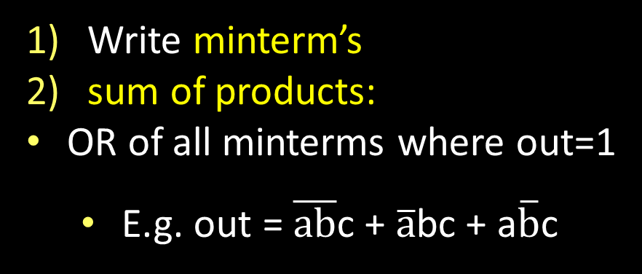
Logic Minimization
How to implement a desired logic function?
Write minterm’s
sum of products:
OR of all minterms where out=1
  E.g. out = $\overline{ab}$c + $\overline{a}$bc + a$\overline{b}$c
a | b | c | out
0 | 0 | 0 | 0
0 | 0 | 1 | 1
0 | 1 | 0 | 0
0 | 1 | 1 | 1
1 | 0 | 0 | 0
1 | 0 | 1 | 1
1 | 1 | 0 | 0
1 | 1 | 1 | 0
minterm
a b c
a b c
a b c
a b c
a b c
a b c
a b c
a b c
a
b
c
out
corollary: any combinational circuit can be implemented in two levels of logic (ignoring inverters)
Notes:
Show what out equals

Slide 40
Karnaugh Maps
        How does one find the most efficient equation?
          Manipulate algebraically until…?
          Use Karnaugh maps (optimize visually)
          Use a software optimizer
          For large circuits
          Decomposition & reuse of building blocks

Slide 41
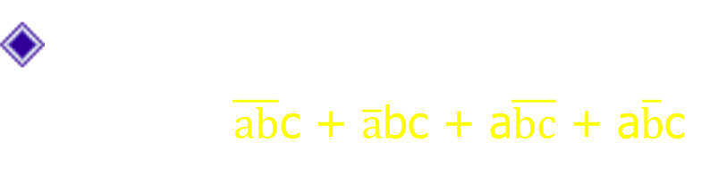
Minimization with Karnaugh maps (1)
Sum of minterms yields
  out = $\overline{ab}$c + $\overline{a}$bc + a$\overline{bc}$ + a$\overline{b}$c
a | b | c | out
0 | 0 | 0 | 0
0 | 0 | 1 | 1
0 | 1 | 0 | 0
0 | 1 | 1 | 1
1 | 0 | 0 | 1
1 | 0 | 1 | 1
1 | 1 | 0 | 0
1 | 1 | 1 | 0

Slide 42

Minimization with Karnaugh maps (2)
Sum of minterms yields
  out = $\overline{ab}$c + $\overline{a}$bc + a$\overline{bc}$ + a$\overline{b}$c
Karnaugh maps identify which inputs are (ir)relevant to the output
a | b | c | out
0 | 0 | 0 | 0
0 | 0 | 1 | 1
0 | 1 | 0 | 0
0 | 1 | 1 | 1
1 | 0 | 0 | 1
1 | 0 | 1 | 1
1 | 1 | 0 | 0
1 | 1 | 1 | 0
ab
c
00 01 11 10
0
0 | 0 | 0 | 1
1 | 1 | 0 | 1
1

Slide 43
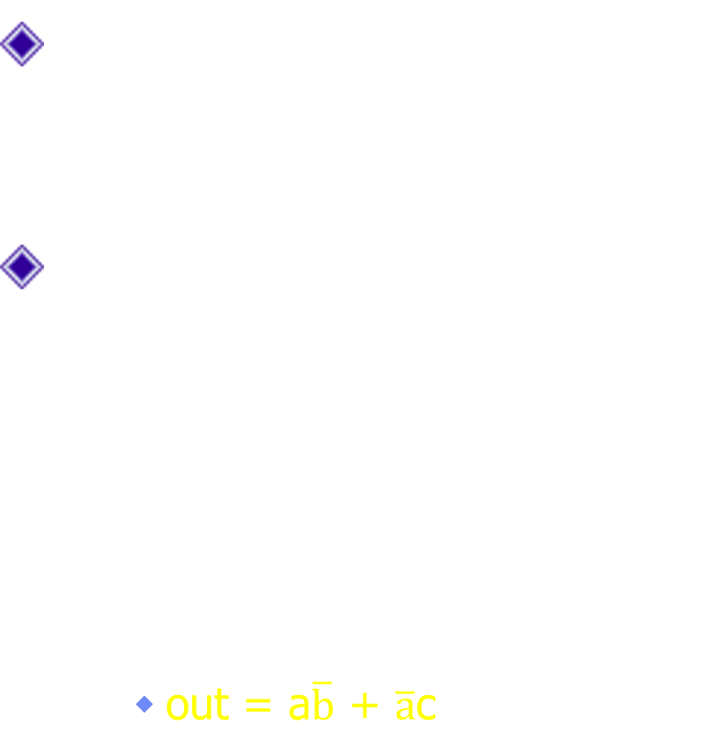
Minimization with Karnaugh maps (2)
Sum of minterms yields
  out = $\overline{ab}$c + $\overline{a}$bc + a$\overline{bc}$ + a$\overline{b}$c
Karnaugh map minimization
  Cover all 1’s
  Group adjacent blocks of 2^{n} 1’s that yield a rectangular shape
  Encode the common features of the rectangle
    out = a$\overline{b}$ + $\overline{a}$c
a | b | c | out
0 | 0 | 0 | 0
0 | 0 | 1 | 1
0 | 1 | 0 | 0
0 | 1 | 1 | 1
1 | 0 | 0 | 1
1 | 0 | 1 | 1
1 | 1 | 0 | 0
1 | 1 | 1 | 0
ab
c
00 01 11 10
0
0 | 0 | 0 | 1
1 | 1 | 0 | 1
1

Slide 44
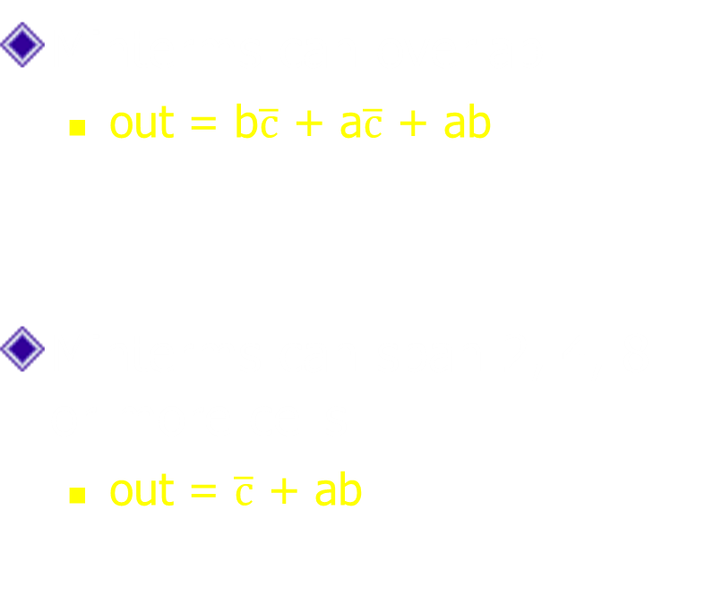
Karnaugh Minimization Tricks (1)
ab
c
00 01 11 10
Minterms can overlap
  out = b$\overline{c}$ + a$\overline{c}$ + ab
Minterms can span 2, 4, 8 or more cells
  out = $\overline{c}$ + ab
0
0 | 1 | 1 | 1
0 | 0 | 1 | 0
1
ab
c
00 01 11 10
0
1 | 1 | 1 | 1
0 | 0 | 1 | 0
1

Slide 45
Karnaugh Minimization Tricks (1)
ab
c
00 01 11 10
Minterms can overlap
  out = b$\overline{c}$ + a$\overline{c}$ + ab
Minterms can span 2, 4, 8 or more cells
  out = $\overline{c}$ + ab
0
0 | 1 | 1 | 1
0 | 0 | 1 | 0
1
ab
c
00 01 11 10
0
1 | 1 | 1 | 1
0 | 0 | 1 | 0
1

Slide 46

Karnaugh Minimization Tricks (2)
ab
cd
00 01 11 10
00
0 | 0 | 0 | 0
1 | 0 | 0 | 1
1 | 0 | 0 | 1
0 | 0 | 0 | 0
The map wraps around
  out = $\overline{b}$d
  out = $\overline{bd}$
01
11
10
ab
cd
00 01 11 10
00
1 | 0 | 0 | 1
0 | 0 | 0 | 0
0 | 0 | 0 | 0
1 | 0 | 0 | 1
01
11
10

Slide 47
Karnaugh Minimization Tricks (2)
ab
cd
00 01 11 10
00
0 | 0 | 0 | 0
1 | 0 | 0 | 1
1 | 0 | 0 | 1
0 | 0 | 0 | 0
The map wraps around
  out = $\overline{b}$d
  out = $\overline{bd}$
01
11
10
ab
cd
00 01 11 10
00
1 | 0 | 0 | 1
0 | 0 | 0 | 0
0 | 0 | 0 | 0
1 | 0 | 0 | 1
01
11
10

Slide 48

Karnaugh Minimization Tricks (3)
ab
cd
00 01 11 10
00
0 | 0 | 0 | 0
1 | x | x | x
1 | x | x | 1
0 | 0 | 0 | 0
“Don’t care” values can be interpreted individually in whatever way is convenient
  assume all x’s = 1
  out = d
  assume middle x’s = 0
  assume 4th column x = 1
  out = $\overline{bd}$
01
11
10
ab
cd
00 01 11 10
00
1 | 0 | 0 | x
0 | x | x | 0
0 | x | x | 0
1 | 0 | 0 | 1
01
11
10

Slide 49
Karnaugh Minimization Tricks (3)
ab
cd
00 01 11 10
00
0 | 0 | 0 | 0
1 | x | x | x
1 | x | x | 1
0 | 0 | 0 | 0
“Don’t care” values can be interpreted individually in whatever way is convenient
  assume all x’s = 1
  out = d
  assume middle x’s = 0
  assume 4th column x = 1
  out = $\overline{bd}$
01
11
10
ab
cd
00 01 11 10
00
1 | 0 | 0 | x
0 | x | x | 0
0 | x | x | 0
1 | 0 | 0 | 1
01
11
10

Slide 50
Multiplexer
A multiplexer selects between multiple inputs
  out = a, if d = 0
  out = b, if d = 1
Build truth table
Minimize diagram
Derive logic diagram
a
b
d
a | b | d | out
0 | 0 | 0
0 | 0 | 1
0 | 1 | 0
0 | 1 | 1
1 | 0 | 0
1 | 0 | 1
1 | 1 | 0
1 | 1 | 1
Notes:
What is the truth table

Slide 51
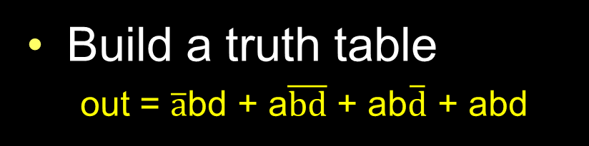
Multiplexer Implementation
a
Build a truth table
  out = $\overline{a}$bd + a$\overline{bd}$ + ab$\overline{d}$ + abd
b
d
a | b | d | out
0 | 0 | 0 | 0
0 | 0 | 1 | 0
0 | 1 | 0 | 0
0 | 1 | 1 | 1
1 | 0 | 0 | 1
1 | 0 | 1 | 0
1 | 1 | 0 | 1
1 | 1 | 1 | 1

Slide 52
Multiplexer Implementation
a
Build the Karnaugh map
b
d
ab
d
00 01 11 10
a | b | d | out
0 | 0 | 0 | 0
0 | 0 | 1 | 0
0 | 1 | 0 | 0
0 | 1 | 1 | 1
1 | 0 | 0 | 1
1 | 0 | 1 | 0
1 | 1 | 0 | 1
1 | 1 | 1 | 1
0
1

Slide 53
Multiplexer Implementation
a
Build the Karnaugh map
b
d
ab
d
00 01 11 10
a | b | d | out
0 | 0 | 0 | 0
0 | 0 | 1 | 0
0 | 1 | 0 | 0
0 | 1 | 1 | 1
1 | 0 | 0 | 1
1 | 0 | 1 | 0
1 | 1 | 0 | 1
1 | 1 | 1 | 1
0
0 | 0 | 1 | 1
0 | 1 | 1 | 0
1

Slide 54
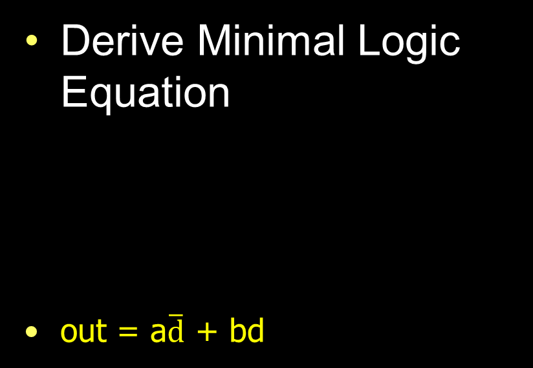
Multiplexer Implementation
a
Derive Minimal Logic Equation
  out = a$\overline{d}$ + bd
b
d
ab
d
00 01 11 10
a | b | d | out
0 | 0 | 0 | 0
0 | 0 | 1 | 0
0 | 1 | 0 | 0
0 | 1 | 1 | 1
1 | 0 | 0 | 1
1 | 0 | 1 | 0
1 | 1 | 0 | 1
1 | 1 | 1 | 1
0
0 | 0 | 1 | 1
0 | 1 | 1 | 0
1
a
d
out
b

Slide 55
Takeaway
Binary (two symbols: true and false) is the basis of Logic Design
More than one Logic Circuit can implement same Logic function. Use Algebra (Identities) or Truth Tables to show equivalence.
Any logic function can be implemented as “sum of products”. Karnaugh Maps minimize number of gates.
Notes:
Add takeways at end of a block. Possibly build on takeaways throughout lecture

Slide 56
Goals for Today
From Transistors to Gates to Logic Circuits
Logic Gates
  From transistors
  Truth Tables
Logic Circuits
  Identity Laws
  From Truth Tables to Circuits (Sum of Products)
Logic Circuit Minimization
  Algebraic Manipulations
  Truth Tables (Karnaugh Maps)
Transistors (electronic switch)

Slide 57
Activity#1 How do we build electronic switches?
Transistors:
6:10 minutes (watch from from 41s to 7:00)
http://www.youtube.com/watch?v=QO5FgM7MLGg
Fill our Transistor Worksheet with info from Video
Notes:
Everything that we have shown them can be constructed in silicon.

Slide 58
NMOS and PMOS Transistors
NMOS Transistor
Connect source to drain when gate = 1
N-channel
PMOS Transistor
Connect source to drain when gate = 0
P-channel
V_{D}
V_{S}
V_{G}
V_{G} = V_{S}
V_{G}
V_{G} = V_{S}
V_{G} = 0 V
V_{G} = 0 V
V_{S} = 0 V
V_{D} = 0 V

Slide 59
NMOS and PMOS Transistors
NMOS Transistor
Connect source to drain when gate = 1
N-channel
PMOS Transistor
Connect source to drain when gate = 0
P-channel
V_{D}
V_{S}
V_{G}
V_{G} = 1
V_{G}
V_{G} = 1
V_{G} = 0
V_{G} = 0
V_{S} = 0 V
V_{D} = 0 V

Slide 60
Inverter
V_{supply} (aka logic 1)
Function: NOT
Called an inverter
Symbol:
Useful for taking the inverse of an input
CMOS: complementary-symmetry metal–oxide–semiconductor
0
1
in
out
in
out
(ground is logic 0)
In | Out
0 | 1
1 | 0
Truth table

Slide 61
Inverter
V_{supply}
V_{supply} (aka logic 1)
Function: NOT
Called an inverter
Symbol:
Useful for taking the inverse of an input
CMOS: complementary-symmetry metal–oxide–semiconductor
1
0
in
out
in
out
(ground is logic 0)
In | Out
0 | 1
1 | 0
Truth table

Slide 62
Inverter
V_{supply}
V_{supply} (aka logic 1)
Function: NOT
Called an inverter
Symbol:
Useful for taking the inverse of an input
CMOS: complementary-symmetry metal–oxide–semiconductor
in
out
A = 0
Out = 1
A = 1
Out = 0
in
out
(ground is logic 0)
A | Out
0 | 1
1 | 0
Truth table

Slide 63
NAND Gate
V_{supply}
V_{supply}
Function: NAND
Symbol:
1
1
A
B
0
a
out
out
1
b
B
1
A
A | B | out
0 | 0 | 1
1 | 0 | 1
0 | 1 | 1
1 | 1 | 0

Slide 64
NOR Gate
V_{supply}
Function: NOR
Symbol:
A
0
0
a
B
out
1
b
out
0
0
A
B
A | B | out
0 | 0 | 1
1 | 0 | 0
0 | 1 | 0
1 | 1 | 0
Notes:
Example

Slide 65
Building Functions (Revisited)
NOT:
AND:
OR:
NAND and NOR are universal
  Can implement any function with NAND or just NOR gates
  useful for manufacturing
Notes:
Flash Drives
Create truth table of AND or OR: state what they do

Slide 66
Building Functions (Revisited)
NOT:
AND:
OR:
NAND and NOR are universal
  Can implement any function with NAND or just NOR gates
  useful for manufacturing
a
a
b
a
b
Notes:
Flash Drives
Create truth table of AND or OR: state what they do

Slide 67
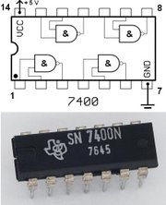
Logic Gates
One can buy gates separately
  ex. 74xxx series of integrated circuits
  cost ~$1 per chip, mostly for packaging and testing
Cumbersome, but possible to build devices using gates put together manually

Slide 68

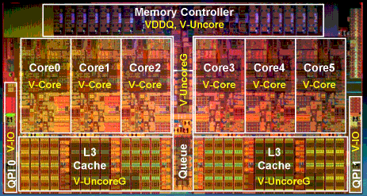
Then and Now
http://www.theregister.co.uk/2010/02/03/intel_westmere_ep_preview/
The first transistor
  on a workbench at
  AT&T Bell Labs in 1947
  Bardeen, Brattain, and Shockley
An Intel Westmere
  1.17 billion transistors
  240 square millimeters
  Six processing cores
Notes:
John Bardeen
Walter Brattain
William Shockley

Slide 69
Big Picture: Abstraction
Hide complexity through simple abstractions
  Simplicity
    Box diagram represents inputs and outputs
  Complexity
    Hides underlying NMOS- and PMOS-transistors and atomic interactions
Vdd
a
in
out
d
out
Vss
b
a
d
out
in
out
b

Slide 70
Summary
Most modern devices are made from billions of on /off switches called transistors
  We will build a processor in this course!
  Transistors made from semiconductor materials:
    MOSFET – Metal Oxide Semiconductor Field Effect Transistor
    NMOS, PMOS – Negative MOS and Positive MOS
    CMOS – Complimentary MOS made from PMOS and NMOS transistors
  Transistors used to make logic gates and logic circuits
We can now implement any logic circuit
  Can do it efficiently, using Karnaugh maps to find the minimal terms required
  Can use either NAND or NOR gates to implement the logic circuit
  Can use P- and N-transistors to implement NAND or NOR gates

