Slide 1
CS 3410: Computer System Organization and Programming
Hakim Weatherspoon
CS 3410, Spring 2013
Computer Science
Cornell University

Slide 2
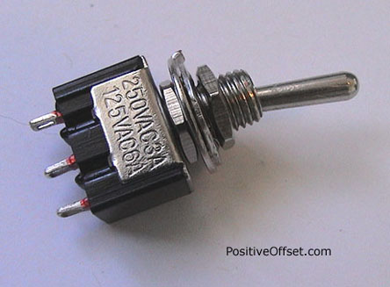

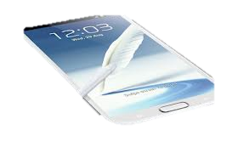
Basic Building Blocks: A switch
A switch is a simple device that can act as a conductor or isolator
Can be used for amazing things…

Slide 3
NMOS and PMOS Transistors
NMOS Transistor
Connect source to drain when V_{G} = V_{supply}
N-channel transistor
PMOS Transistor
Connect source to drain when V_{G} = 0 V
P-channel transistor
V_{supply}
V_{supply}
V_{supply}
V_{D}
V_{D} = 0V
V_{S} = V_{supply}
V_{G}
V_{G} = V_{Supply}
V_{G}
V_{G} = V_{Supply}
V_{G} = 0 V
V_{G} = 0 V
V_{S} = 0 V
V_{D}
V_{D} = V_{supply}
Closed switch
When V_{G} = V_{supply}
Closed switch
When V_{G} = 0 V
V_{S}: voltage at the source
V_{D}: voltage at the drain
V_{supply}: max voltage (aka a logical 1)
(ground): min voltage (aka a logical 0)

Slide 4
NMOS and PMOS Transistors
NMOS Transistor
Connect source to drain when gate = 1
N-channel transistor
PMOS Transistor
Connect source to drain when gate = 0
P-channel transistor
V_{supply}
V_{supply}
V_{supply}
D
D = 0
S = V_{supply}
G
G = 1
G
G = 1
G = 0
G = 0
S = 0V
D
D = 1
Closed switch
When V_{G} = V_{supply}
Closed switch
When V_{G} = 0 V
V_{S}: voltage at the source
V_{D}: voltage at the drain
V_{supply}: max voltage (aka a logical 1)
(ground): min voltage (aka a logical 0)

Slide 5
Inverter
V_{supply} (aka logic 1)
Function: NOT
Called an inverter
Symbol:
Useful for taking the inverse of an input
CMOS: complementary-symmetry metal–oxide–semiconductor
in
out
in
out
(ground is logic 0)
In | Out
0 | 1
1 | 0
Truth table

Slide 6
NAND Gate
V_{supply}
V_{supply}
Function: NAND
Symbol:
A
B
out
a
out
B
b
A
A | B | out
0 | 0 | 1
1 | 0 | 1
0 | 1 | 1
1 | 1 | 0

Slide 7
NOR Gate
V_{supply}
A
Function: NOR
Symbol:
B
out
A
B
A | B | out
0 | 0 | 1
1 | 0 | 0
0 | 1 | 0
1 | 1 | 0
a
out
b
Notes:
Example

Slide 8
Building Functions
NOT:
AND:
OR:
NAND and NOR are universal
  Can implement any function with NAND or just NOR gates
  useful for manufacturing
a
b
a
b
Notes:
Flash Drives

Slide 9

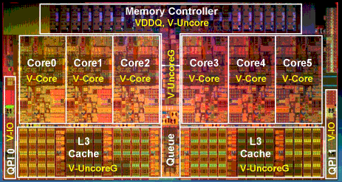
Then and Now
http://www.theregister.co.uk/2010/02/03/intel_westmere_ep_preview/
The first transistor
  on a workbench at
  AT&T Bell Labs in 1947
  Bardeen, Brattain, and Shockley
An Intel Westmere
  1.17 billion transistors
  240 square millimeters
  32 nanometer: transistor gate width
  Six processing cores
  Release date: January 2010
Notes:
John Bardeen
Walter Brattain
William Shockley

Slide 10
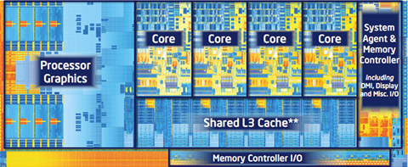
Then and Now
http://forwardthinking.pcmag.com/none/296972-intel-releases-ivy-bridge-first-processor-with-tri-gate-transistor
The first transistor
  on a workbench at
  AT&T Bell Labs in 1947
  Bardeen, Brattain, and Shockley
An Intel Ivy Bridge
  1.4 billion transistors
  160 square millimeters
  22 nanometer: transistor gate width
  Up to eight processing cores
  Release date: April 2012
Notes:
John Bardeen
Walter Brattain
William Shockley

Slide 11
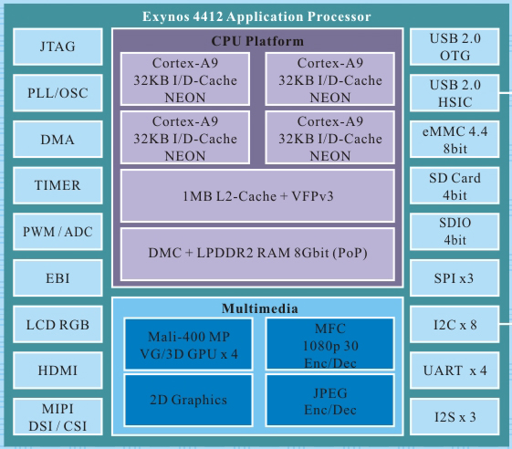
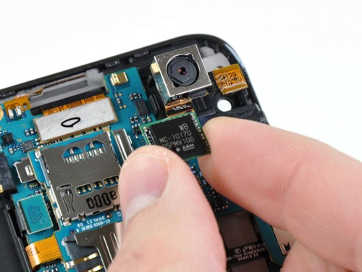
Then and Now
http://www.anandtech.com/show/6386/samsung-galaxy-note-2-review-t-mobile-/3
The first transistor
  on a workbench at
  AT&T Bell Labs in 1947
  Bardeen, Brattain, and Shockley
Samsung Galaxy Note II
  Eynos 4412 System on a Chip (SoC)
  ARM Cortex-A9 processing core
  32 nanometer: transistor gate width
  Four processing cores
  Release date: November 2012
Notes:
John Bardeen
Walter Brattain
William Shockley

Slide 12
Moore's Law
The number of transistors integrated on a single die will double every 24 months...
– Gordon Moore, Intel co-founder, 1965
Amazingly Visionary
1971 – 2300 transistors – 1MHz – 4004
1990 – 1M transistors – 50MHz – i486
2001 – 42M transistors – 2GHz – Xeon
2004 – 55M transistors – 3GHz – P4
2007 – 290M transistors – 3GHz – Core 2 Duo
2009 – 731M transistors – 2GHz – Nehalem
2012 – 1400M transistors – 2-3GHz – Ivy Bridge
Notes:
Complexity is *the* issue.

Slide 13
Course Objective
Bridge the gap between hardware and software
  How a processor works
  How a computer is organized
Establish a foundation for building higher-level applications
  How to understand program performance
  How to understand where the world is going

Slide 14
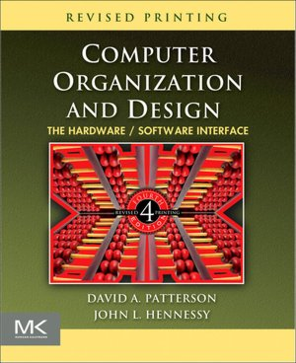
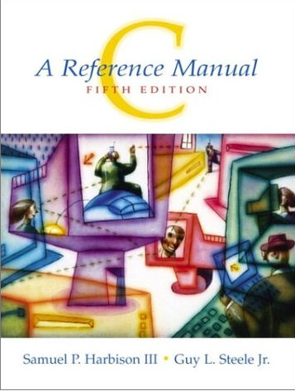

Announcements: How class organized
Instructor: Hakim Weatherspoon (hweather@cs.cornell.edu)
Lecture:
  Tu/Th 1:25-2:40
  Olin 155
Lab Sections:
  Carpenter 104 (Blue Room)
  Carpenter 235 (Red Room)
Required Textbooks
Suggested
Textbook

Slide 15

Who am I?
Prof. Hakim Weatherspoon
  (Hakim means Doctor, wise, or prof. in Arabic)
  Background in Education
    Undergraduate University of Washington
      Played Varsity Football
        Some teammates collectively make $100’s of millions
        I teach!!!
    Graduate University of California, Berkeley
      Some class mates collectively make $100’s of millions
      I teach!!!
  Background in Operating Systems
    Peer-to-Peer Storage
      Antiquity project - Secure wide-area distributed system
      OceanStore project – Store your data for 1000 years
    Network overlays
      Bamboo and Tapestry – Find your data around globe
    Tiny OS
      Early adopter in 1999, but ultimately chose P2P direction

Slide 16
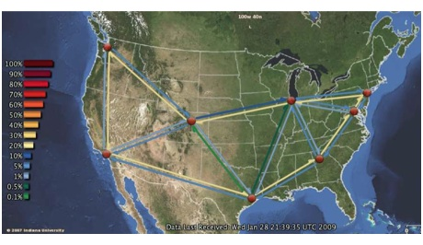
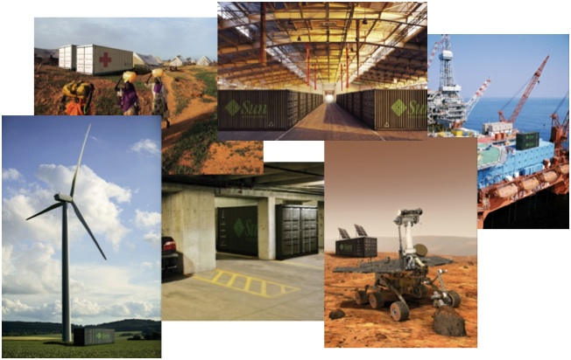
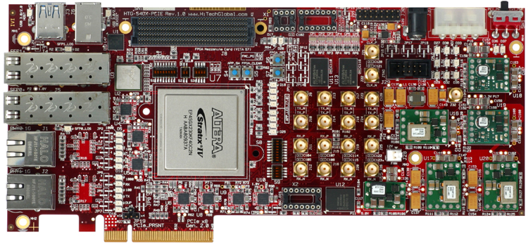
Who am I?
Cloud computing/storage
  Optimizing a global network of data centers
  Cornell Ntional λ-Rail Rings testbed
  Software Defined Network Adapter
  Energy: KyotoFS/SMFS
Antiquity: built a global-scale storage system

Slide 17
Course Staff
cs3410-staff-l@cs.cornell.edu
Lecture/Homwork TA’s
  Detian Shi (ds629@cornell.edu)
  Paul Upchurch (paulu@cs.cornell.edu) (lead)
  Paul Heran Yang (hy279@cornell.edu)
Lab TAs
  Efe Gencer (gencer@cs.cornell.edu)
  Erluo Li (el378@cornell.edu)
  Han Wang (hwang@cs.cornell.edu) (lead)
Lab Undergraduate consultants
  Roman Averbukh (raa89@cornell.edu)
  Favian Contreras (fnc4@cornell.edu)
  Jisun Jung (jj329@cornell.edu)
  Emma Kilfoyle (efk23@cornell.edu)
  Joseph Mongeluzzi (jam634@cornell.edu)
  Sweet Song (ss2249@cornell.edu)
  Peter Tseng (pht24@cornell.edu)
  Victoria Wu (vw52@cornell.edu)
  Jason Zhao (jlz27@cornell.edu)
  Administrative Assistant:
  Molly Trufant (mjt264@cs.cornell.edu)

Slide 18
Pre-requisites and scheduling
CS 2110 is required (Object-Oriented Programming and Data Structures)
  Must have satisfactorily completed CS 2110
  Cannot take CS 2110 concurrently with CS 3410
CS 3420 (ECE 3140) (Embedded Systems)
  Take either CS 3410 or CS 3420
    both satisfy CS and ECE requirements
  However, Need ENGRD 2300 to take CS 3420
CS 3110 (Data Structures and Functional Programming)
  Not advised to take CS 3110 and 3410 together

Slide 19
Pre-requisites and scheduling
CS 2043 (UNIX Tools and Scripting)
  2-credit course will greatly help with CS 3410.
  Meets Mon, Wed, Fri at 11:15am-12:05pm in Phillips (PHL) 203
  Class started yesterday and ends March 1st
CS 2022 (Introduction to C)
  1-credit course will greatly help with CS 3410
  Unfortunately, offered in the fall, not spring
  Instead, we will offer a primer to C next Monday, January 28th, 6-8pm. Location TBD.

Slide 20
Grading
Lab (45-50%)
  5-6 Individual Labs (15-17.5%)
    2 out-of-class labs (10%)
    3-4 in-class labs (5-7.5%)
  4 Group Projects (30%)
  Quizzes in lab (2.5%)
Lecture (45-50%)
  3 Prelims (32.5 - 37.5%)
    Tue Feb 26th, Thur Mar 28th, and Thur Apr 25th
  Homework (10%)
  Quizzes in lecture (2.5%)
Participation/Discretionary (5%)

Slide 21
Grading
Regrade policy
  Submit written request to lead TA,
  and lead TA will pick a different grader
  Submit another written request,
  lead TA will regrade directly
  Submit yet another written request for professor to regrade.
Late Policy
  Each person has a total of four “slip days”
  Max of two slip days for any individual assignment
  For projects, slip days are deducted from all partners
  25% deducted per day late after slip days are exhausted

Slide 22
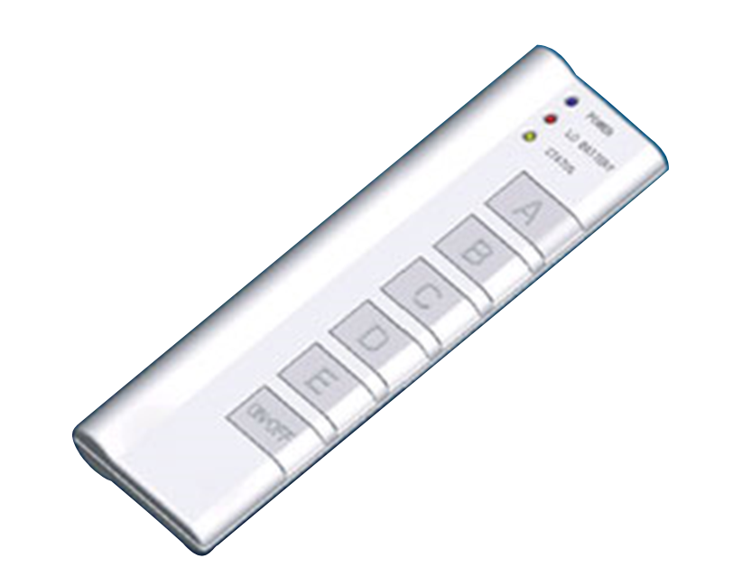
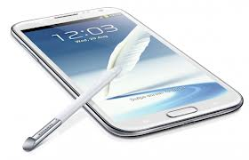

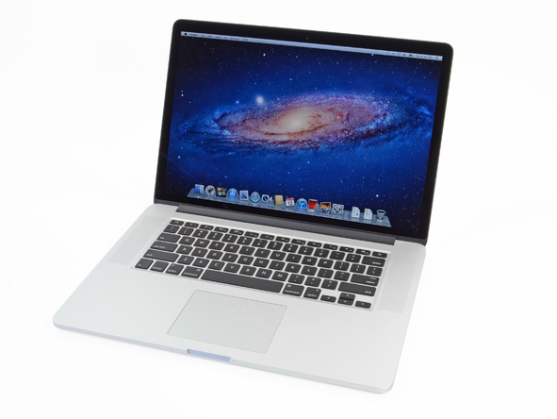
Active Learning
iClicker: Bring to every Lecture
Put all devices into Airplane Mode

Slide 23
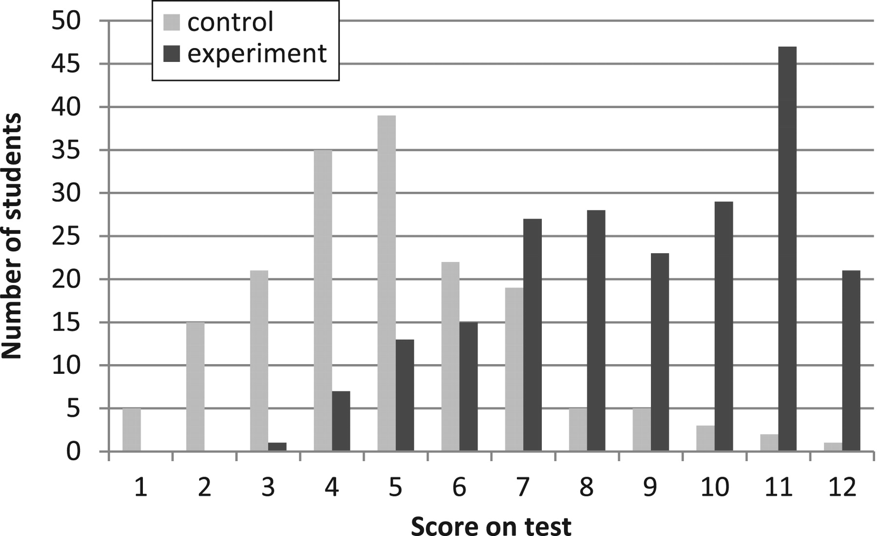

Active Learning
L Deslauriers et al. Science 2011;332:862-864
Fig. 1 Histogram of 270 physic student scores for the two sections:
Experiment w/ quizzes and active learning. Control without.
Published by AAAS
Notes:
Histogram of student scores for the two sections.
Active Learning Teaching Experiment
(by DeSlauriers, Schelew, and Wieman)
Control Class
Teaching: All traditional lecture
Test on week 11 content
Ave = 41%
Experimental Class
Teaching: Week 1 – 10: traditional
Week 11: high engagement
Test on week 11 content
Ave = 74%

Slide 24
Administrivia
http://www.cs.cornell.edu/courses/cs3410/2013sp
  Office Hours / Consulting Hours
  Lecture slides & schedule
  Logisim
  CSUG lab access (esp. second half of course)
Lab Sections (start today)
  Labs are separate than lecture and homework
  Bring laptop to Labs (optional)

Slide 25
Administrivia
http://www.cs.cornell.edu/courses/cs3410/2013sp
  Office Hours / Consulting Hours
  Lecture slides & schedule
  Logisim
  CSUG lab access (esp. second half of course)
Lab Sections (start today)
T 2:55 – 4:10pm Carpenter Hall 104 (Blue Room)
W 3:35 – 4:50pm Carpenter Hall 104 (Blue Room)
W 7:30—8:45pm Carpenter Hall 235 (Red Room)
R 8:40 – 9:55pm Carpenter Hall 104 (Blue Room)
R 11:40 – 12:55pm Carpenter Hall 104 (Blue Room)
R 2:55 – 4:10pm Carpenter Hall 104 (Blue Room)
F 2:55 – 4:10pm Carpenter Hall 104 (Blue Room)
  Labs are separate than lecture and homework
  Bring laptop to Labs
  This week: intro to logisim and building an adder

Slide 26
Communication
Email
  cs3410-staff-l@cs.cornell.edu
  The email alias goes to me and the TAs, not to whole class
Assignments
  CMS: http://cms.csuglab.cornell.edu
Newsgroup
  http://www.piazza.com/cornell/spring2012/cs3410
  For students
iClicker
  http://atcsupport.cit.cornell.edu/pollsrvc/

Slide 27
Lab Sections & Projects
Lab Sections start this week
  Intro to logisim and building an adder
Labs Assignments
  Individual
  One week to finish (usually Monday to Monday)
Projects
  two-person teams
  Find partner in same section
Notes:
We will pair you up if you don’t have a preferred partner
Design document due one week after handout
Start early, time management is key
Manage the team effort

Slide 28
Academic Integrity
All submitted work must be your own
  OK to study together, but do not share soln’s
  Cite your sources
Project groups submit joint work
  Same rules apply to projects at the group level
  Cannot use of someone else’s soln
Closed-book exams, no calculators
  Stressed? Tempted? Lost?
    Come see me before due date!
Plagiarism in any form will not be tolerated

Slide 29
Why do CS Students Need Transistors?
Notes:
Take a break
Think-Pair-Share

Slide 30
Why do CS Students Need Transistors?
Functionality and Performance
Notes:
Think-Pair-Share

Slide 31
Why do CS Students Need Transistors?
To be better Computer Scientists and Engineers
  Abstraction: simplifying complexity
  How is a computer system organized? How do I build it?
  How do I program it? How do I change it?
  How does its design/organization effect performance?
Notes:
Think-Pair-Share

Slide 32
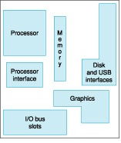
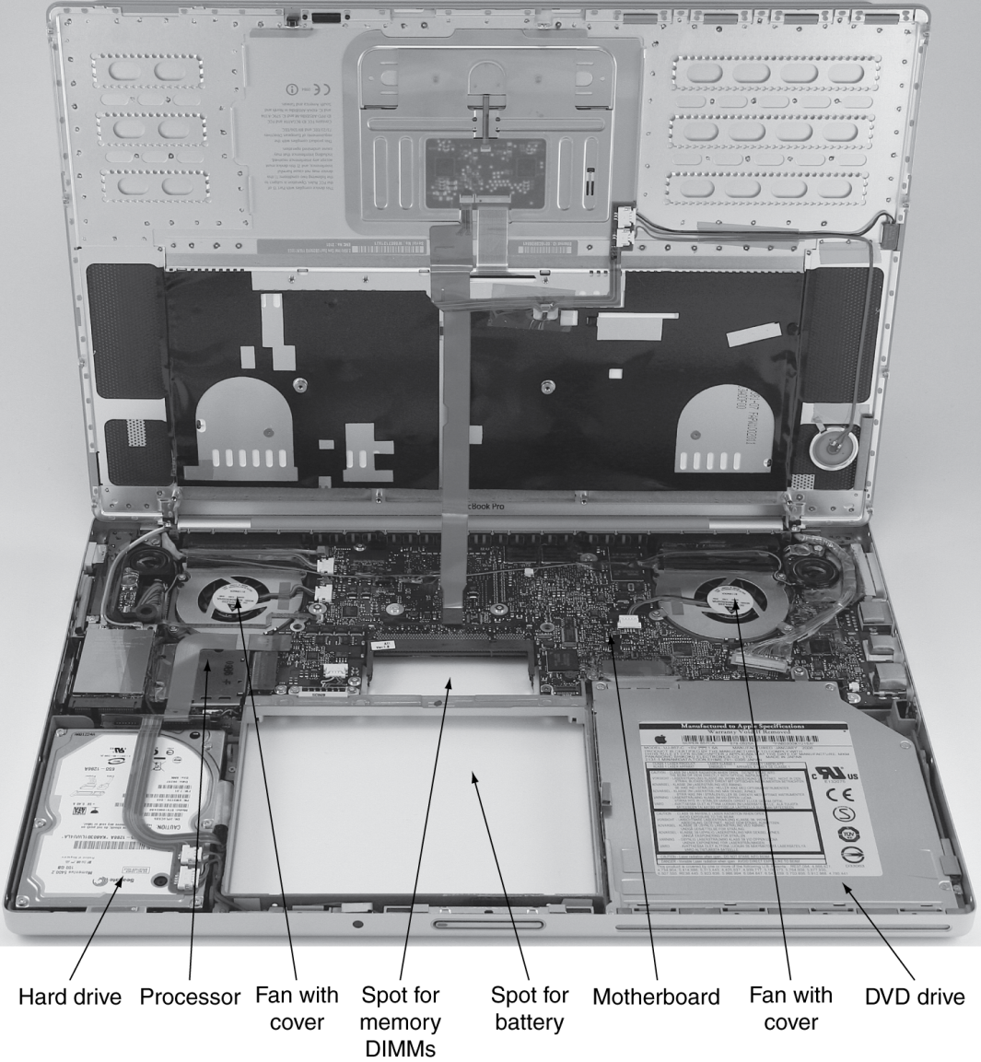
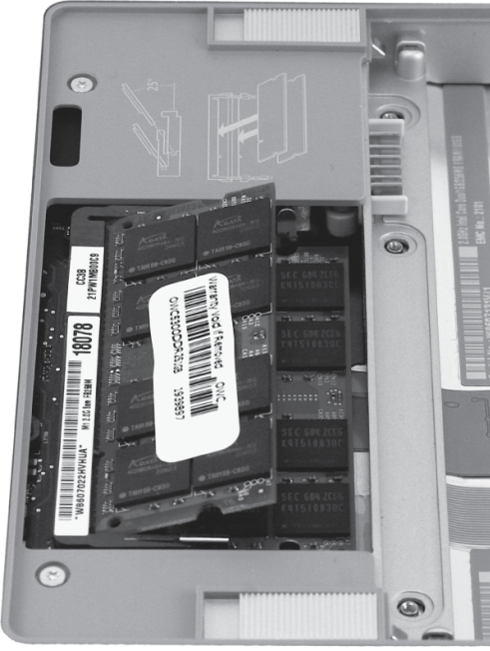
Computer System Organization

Slide 33
Computer System Organization
Computer System =
?
Input +
Output +
Memory +
Datapath +
Control
Keyboard
Mouse
Video
Network
USB
CPU
Registers
bus
bus
Serial
Memory
Disk
Audio

Slide 34
Compilers & Assemblers
C
int x = 10;
x = 2 * x + 15;
compiler
MIPS
assembly
language
addi r5, r0, 10
muli r5, r5, 2
addi r5, r5, 15
assembler
MIPS
machine
language
00100000000001010000000000001010
00000000000001010010100001000000
00100000101001010000000000001111
Notes:
32 bits, 4 bytes
What time is it?

Slide 35
Instruction Set Architecture
ISA
  abstract interface between hardware and the lowest level software
  user portion of the instruction set plus the operating system interfaces used by application programmers

Slide 36
Basic Computer System
A processor executes instructions
  Processor has some internal state in storage elements (registers)
A memory holds instructions and data
  von Neumann architecture: combined inst and data
A bus connects the two
01010000
10010100
…
bus
regs
addr, data,
r/w
processor
memory

Slide 37
How to Design a Simple Processor
inst
alu
memory
register file
32
2
00
5 5 5
pc
new pc
calculation
control
00: addi r5, r0, 10
04: muli r5, r5, 2
08: addi r5, r5, 15

Slide 38
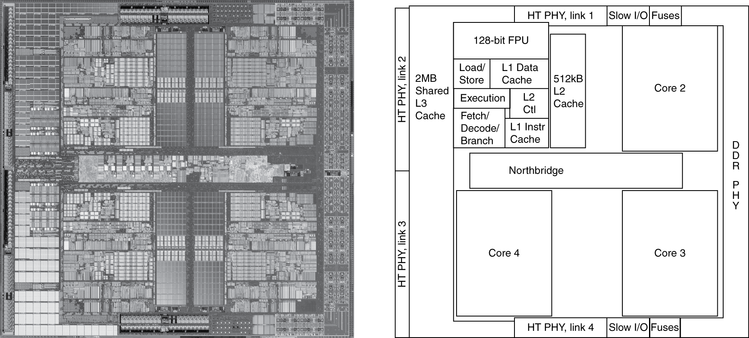
Inside the Processor
AMD Barcelona: 4 processor cores
Figure from Patterson & Hennesssy, Computer Organization and Design, 4th Edition

Slide 39
How to Program the Processor:
MIPS R3000 ISA
Registers
Instruction Categories
  Load/Store
  Computational
  Jump and Branch
  Floating Point
    coprocessor
  Memory Management
R0 - R31
PC
HI
LO
OP
rs
rt
rd
sa
funct
OP
rs
rt
immediate
OP
jump target

Slide 40
Overview
Application
Operating
System
Compiler
Firmware
Instruction Set
Architecture
Memory
system
Instr. Set Proc.
I/O system
Datapath & Control
Digital Design
Circuit Design
Notes:
For class handout

Slide 41
Applications
Everything these days!
  Phones, cars, televisions, games, computers,…

Slide 42
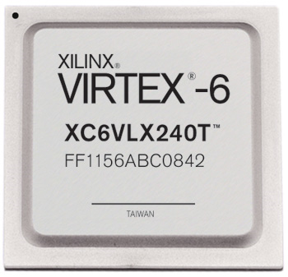

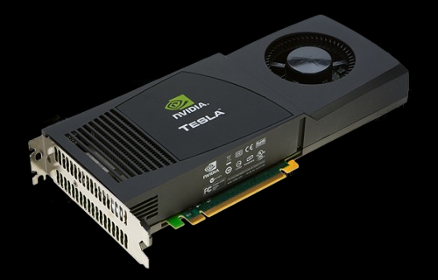

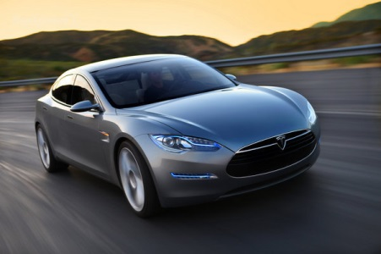
Applications
millions
Xilinx FPGA
Cloud
Computing
Berkeley mote
NVidia GPU
Cell Phone
Cars

Slide 43
Covered in this course
Application
Operating
System
Compiler
Firmware
Instruction Set
Architecture
Memory
system
Instr. Set Proc.
I/O system
Datapath & Control
Digital Design
Circuit Design
Notes:
For class handout

Slide 44
Reflect
Why take this course?
  Basic knowledge needed for all other areas of CS:
    operating systems, compilers, ...
  Levels are not independent
    hardware design ↔ software design ↔ performance
  Crossing boundaries is hard but important
    device drivers
  Good design techniques
    abstraction, layering, pipelining, parallel vs. serial, ...
  Understand where the world is going

