Slide 1
What does the Future Hold?
Hakim Weatherspoon
CS 3410, Spring 2012
Computer Science
Cornell University

Slide 2
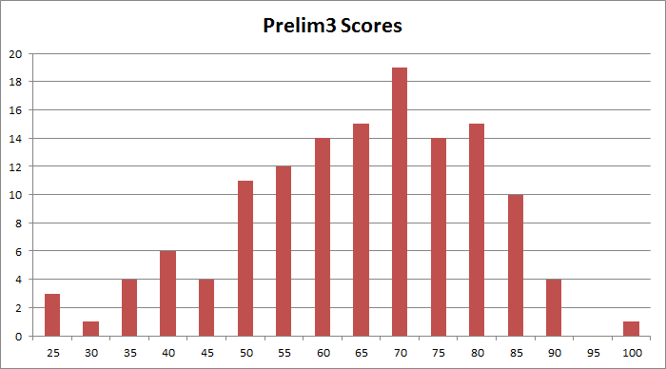
Announcements
Prelim3 Results
  Mean 62.2 ± 15.5 (median 64.5), Max 97
  Pickup in Homework Passback Room

Slide 3
Announcements
How to improve your grade?
Submit a course evaluation and drop lowest homework score
  To receive credit, Submit before Monday, May 7th

Slide 4

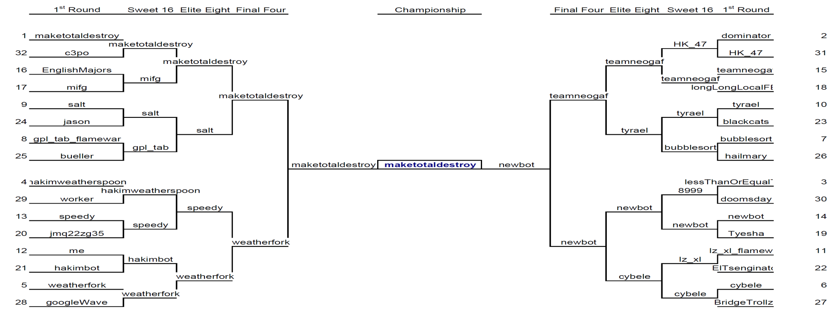
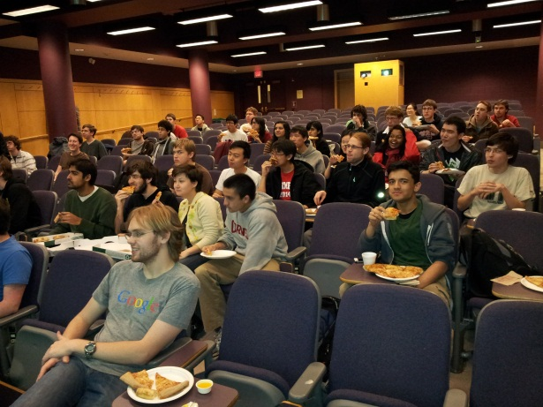
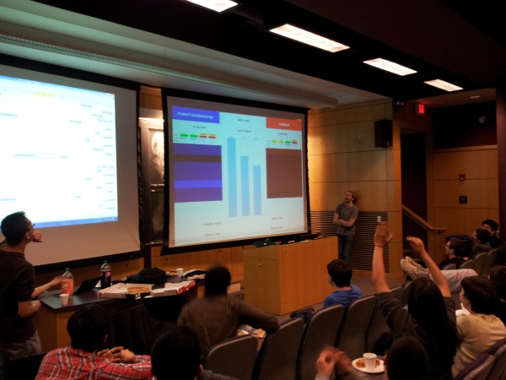
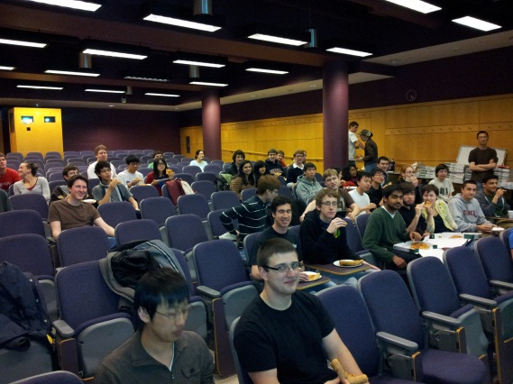
Announcements
FlameWar Pizza Party was great!
  Winner: Team MakeTotalDestroy
Kenny Deakins and Luis Ruigomez

Slide 5
Announcements
Final Project
Design Doc sign-up via CMS
sign up Sunday, Monday, or Tuesday
May 6th, 7th, or 8th
Demo Sign-Up via CMS.
sign up Tuesday, May 15th
or Wednesday, May 16th
CMS submission due:
  Due 6:30pm Wednesday, May 16th

Slide 6
Big Picture about the Future

Slide 7
Big Picture
How a processor works? How a computer is organized?
compute
jump/branch
targets
memory
register
file
A
alu
D
D
B
+4
addr
PC
inst
control
B
d_{in}
d_{out}
M
memory
new
pc
extend
imm
detect
hazard
forward
unit
Instruction
Fetch
Instruction
Decode
Write-
Back
ctrl
ctrl
ctrl
Execute
Memory
IF/ID
ID/EX
EX/MEM
MEM/WB
Notes:
Caching,
Virtual Memory, Paging, TLBs
Operating System, Traps, Exceptions,
Multicore and synchronization

Slide 8
What’s next?
More of Moore

Slide 9
Moore’s Law
Moore’s Law introduced in 1965
  Number of transistors that can be integrated on a single die would double every 18 to 24 months (i.e., grow exponentially with time).
Amazingly visionary
  2300 transistors, 1 MHz clock (Intel 4004) - 1971
  16 Million transistors (Ultra Sparc III)
  42 Million transistors, 2 GHz clock (Intel Xeon) – 2001
  55 Million transistors, 3 GHz, 130nm technology, 250mm2 die (Intel Pentium 4) – 2004
  290+ Million transistors, 3 GHz (Intel Core 2 Duo) – 2007
  731 Million transisters, 2-3Ghz (Intel Nehalem) – 2009
  1.17 Billion transistors, 2-3Ghz (Intel Westmere) – 2011
Notes:
Tbyte = 2^40 bytes (or 10^12 bytes)
Note that Moore’s law is not about speed predictions but about chip complexity

Slide 10
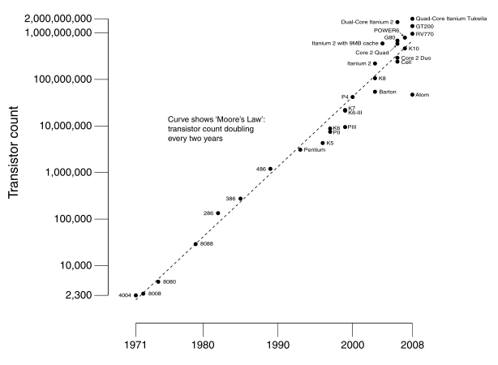
Processor Performance Increase
Slope ~1.7x/year
Intel Pentium 4/3000
Intel Xeon/2000
DEC Alpha 21264A/667
DEC Alpha 21264/600
DEC Alpha 5/500
DEC Alpha 5/300
DEC Alpha 4/266
DEC AXP/500
IBM POWER 100
HP 9000/750
IBM RS6000
MIPS M2000
MIPS M/120
SUN-4/260
Notes:
Another powerpoint “comic” – note that the y axis is log !
x/y where x is the model number and y is the speed in MHz
Rate of performance improvement has been between 1.5 and 1.6 times per year – how much longer will Moore’s Law hold?

Slide 11
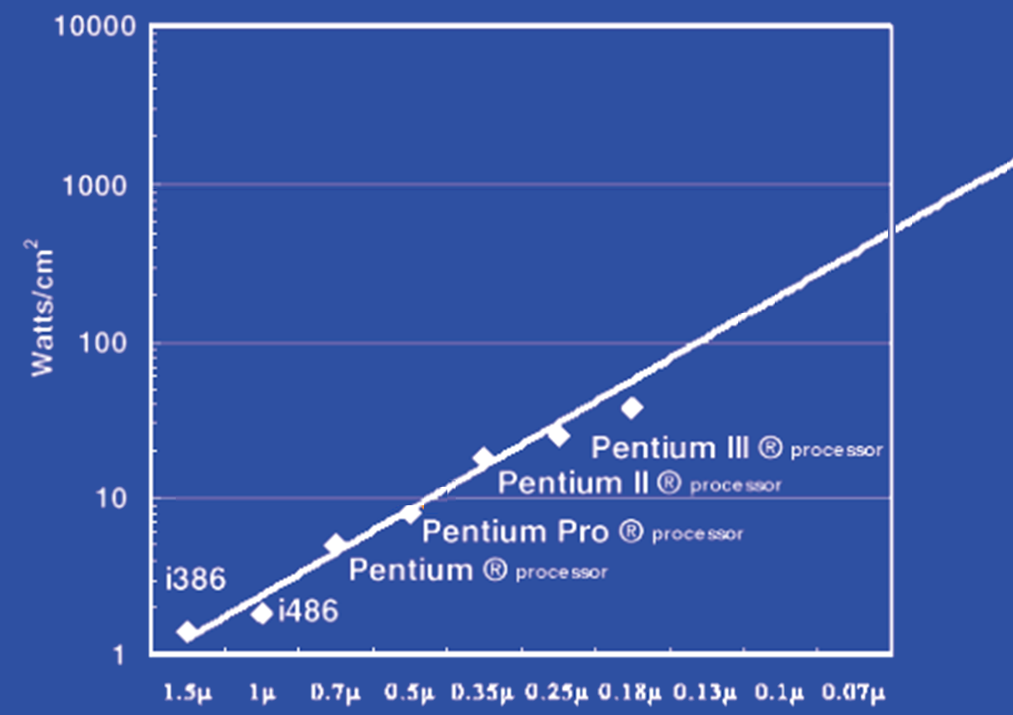
Power Limits
Surface of Sun
Rocket Nozzle
Nuclear Reactor
Xeon
Hot Plate
Notes:
Intel Westmere: 32 nm = 0.032u, 130W / 240mm^2 = 54 W/cm^2

Slide 12
What to do with all these transistors?
Multi-core

Slide 13

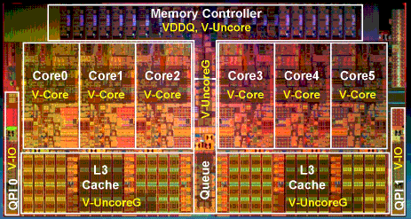
Multi-core
http://www.theregister.co.uk/2010/02/03/intel_westmere_ep_preview/
The first transistor
  on a workbench at
  AT&T Bell Labs in 1947
  Bardeen, Brattain, and Shockley
An Intel Westmere
  1.17 billion transistors
  240 square millimeters
  Six processing cores
Notes:
John Bardeen
Walter Brattain
William Shockley

Slide 14
What to do with all these transistors?
Many-core
and Graphical Processing units

Slide 15
Faster than Moore’s Law
One-pixel polygons (~10M polygons @ 30Hz)
Slope ~2.4x/year
nVidia
G70
10
9
(Moore's Law ~ 1.7x/year)
10
8
UNC/HP PixelFlow
ATI
Radeon 256
SGI
R-Monster
7
SGI
GeForce
10
Division
Pxpl6
IR
E&S
3DLabs
Nvidia TNT
(Δ's/sec)
UNC Pxpl5
Harmony
SGI
Cobalt
Accel/VSIS
Glint
Peak Performance
10
6
SGI SkyWriter
Voodoo
SGI VGX
SGI
Megatek
HP TVRX
RE1
SGI
RE2
E&S Freedom
PC Graphics
Flat
shading
HP VRX
10
5
E&S
Textures
Division VPX
Stellar GS1000
F300
UNC Pxpl4
SGI GT
Gouraud
shading
Antialiasing
HP CRX
10
4
SGI Iris
86
88
90
92
94
96
98
00
Year
Graph courtesy of Professor John Poulton (from Eric Haines)

Slide 16
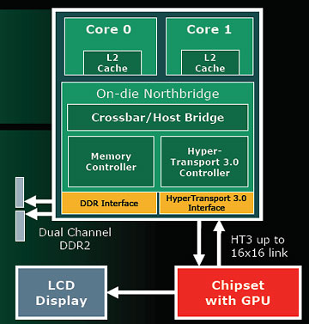
AMDs Hybrid CPU/GPU
AMD’s Answer: Hybrid CPU/GPU

Slide 17
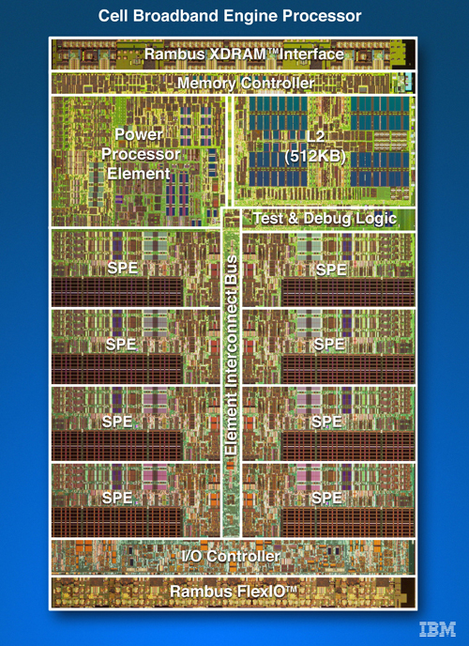
Cell
IBM/Sony/Toshiba
Sony Playstation 3
PPE
SPEs (synergestic)

Slide 18
Parallelism
Must exploit parallelism for performance
  Lots of parallelism in graphics applications
  Lots of parallelism in scientific computing
SIMD: single instruction, multiple data
  Perform same operation in parallel on many data items
  Data parallelism
MIMD: multiple instruction, multiple data
  Run separate programs in parallel (on different data)
  Task parallelism

Slide 19
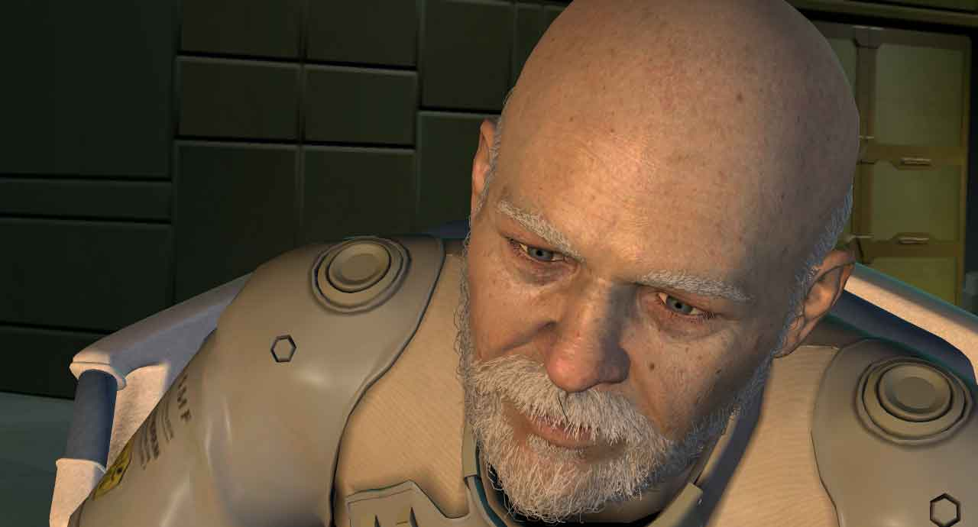
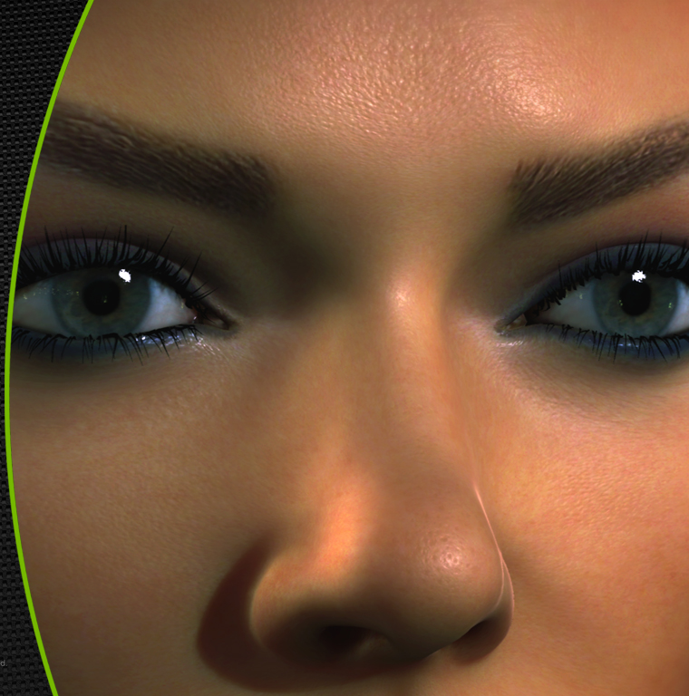

Slide 20
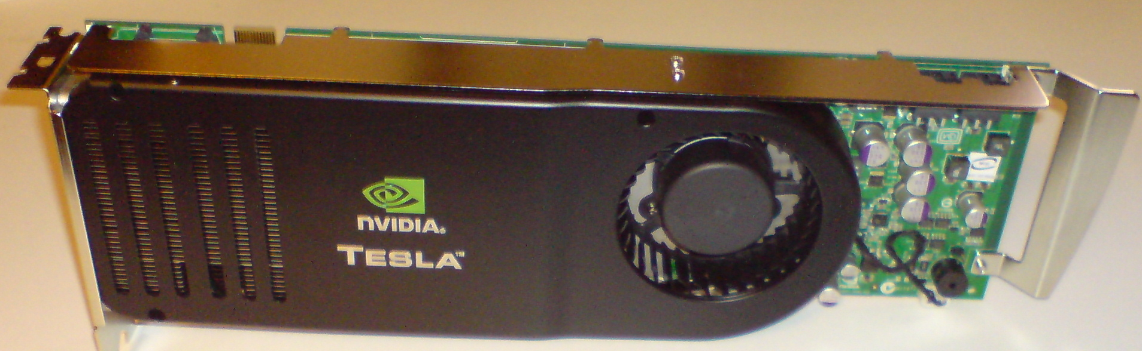
NVidia Tesla Architecture

Slide 21
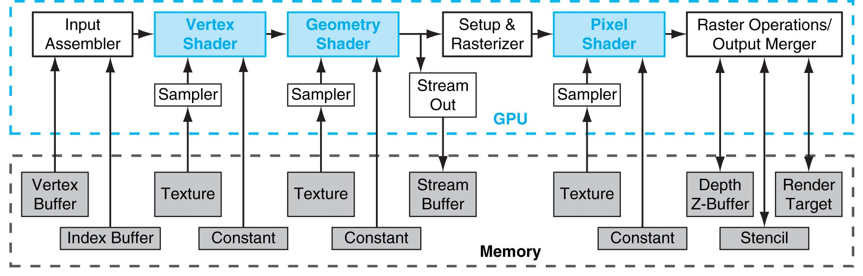
Why are GPUs so fast?
FIGURE A.3.1 Direct3D 10 graphics pipeline. Each logical pipeline stage maps to GPU hardware or to a GPU processor. Programmable shader stages are blue, fixed-function blocks are white, and memory objects are grey. Each stage processes a vertex, geometric primitive, or pixel in a streaming dataflow fashion. Copyright © 2009 Elsevier, Inc. All rights reserved.
Pipelined and parallel
Very, very parallel: 128 to 1000 cores

Slide 22
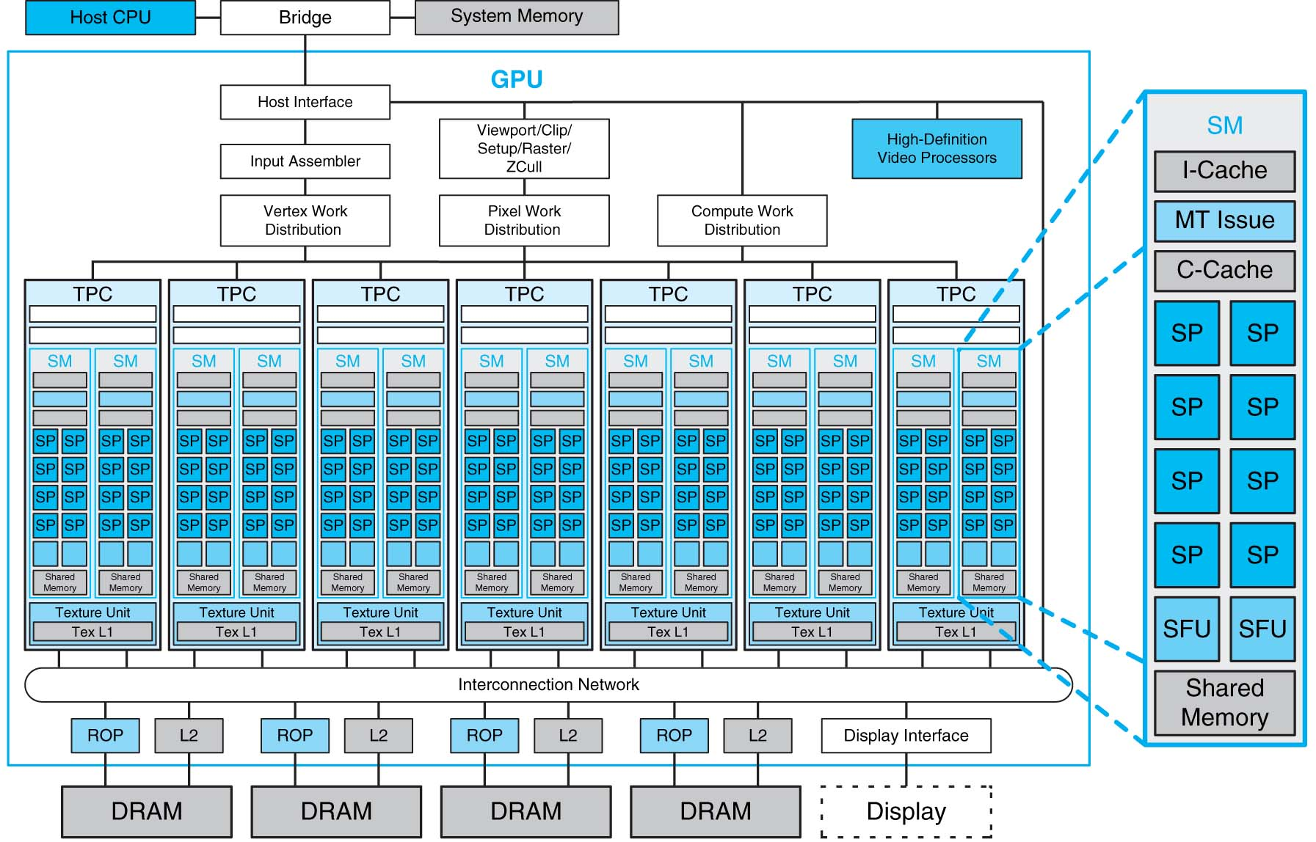
FIGURE A.2.5 Basic unified GPU architecture. Example GPU with 112 streaming processor (SP) cores organized in 14 streaming multiprocessors (SMs); the cores are highly multithreaded. It has the basic Tesla architecture of an NVIDIA GeForce 8800. The processors connect with four 64-bit-wide DRAM partitions via an interconnection network. Each SM has eight SP cores, two special function units (SFUs), instruction and constant caches, a multithreaded instruction unit, and a shared memory. Copyright © 2009 Elsevier, Inc. All rights reserved.

Slide 23
General computing with GPUs
Can we use these for general computation?
Scientific Computing
  MATLAB codes
Convex hulls
Molecular Dynamics
Etc.
NVIDIA’s answer:
Compute Unified Device Architecture (CUDA)
  MATLAB/Fortran/etc. → “C for CUDA” → GPU Codes

Slide 24
What to do with all these transistors?
Cloud Computing

Slide 25
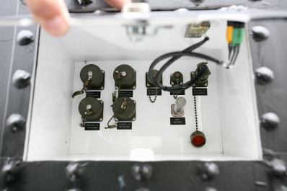
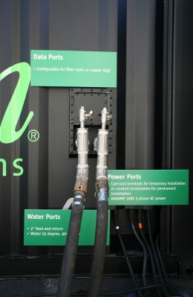
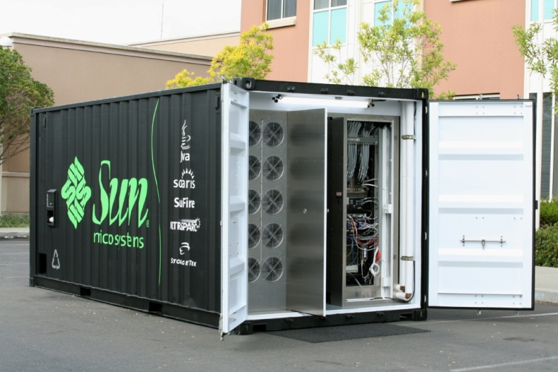
Cloud Computing
Datacenters are becoming a commodity
Order online and have it delivered
  Datacenter in a box: already set up with commodity hardware & software (Intel, Linux, petabyte of storage)
  Plug data, power & cooling and turn on
    typically connected via optical fiber
    may have network of such datacenters
Notes:
datacenters built from commodity components are becoming a commodity themselves
it’s as easy as ordering it online and have it shipped
comes with commodity hardware & software
simply plug power, data and potentially cooling & flip the switch
may have a bunch of these datacenters, typically connected over fiber residing at distant geographical location
Datacenters of commodity components have emerged as the computing platform of choice for a wide variety of applications, ranging from blunt content delivery to more advanced complete in-browser document & spreadsheet processing. In fact this paradigm has been so successful that it has driven datacenters to becoming a commodity themselves. It’s as easy as ordering one online and having it shipped to any location. These datacenters in a box typically come already set up with commodity hardware and software; all you need to do is plug the power, data and potentially cooling and flip the switch. This great ease is ushering in the global network of datacenters paradigm.

Slide 26
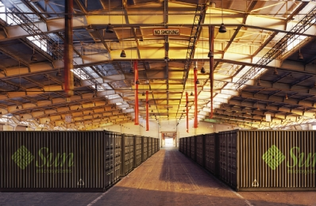

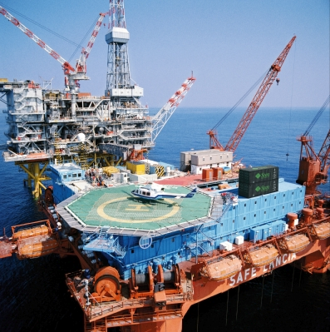
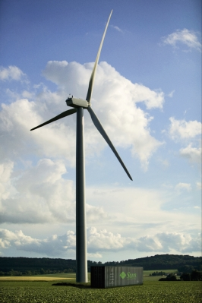
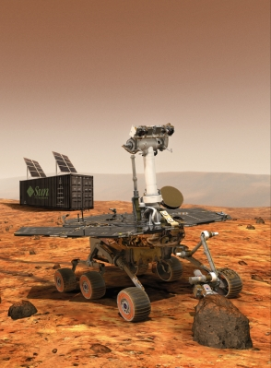
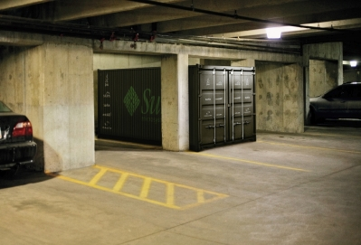
Cloud Computing = Network of Datacenters
Notes:
%Naturally, having multiple datacenters at various distant geographical locations raises the next challenge – coordinating them as part of a single global distributed system.
%Interconnecting the datacenters via high bandwidth, large latency links like optical fiber networks is a viable option today.
Interconnecting datacenters over distant geographical locations can be usually done via high bandwidth, optical fiber networks. Already laid down dark fiber is cheap and can be acquired in bulk – making private lambda networks a reality.
Although the raw bandwidth is cheap, these networks experience some level of packet loss due to cabling, equipment, dirty or degraded fiber and other glitches. Eliminating the packet loss altogether on such links is not an option – the general belief is that non congestion packet loss is unavoidable. For example, on managed links, tier 1 ISP service level agreements cite packet loss rates in the range of 0.1% - 0.3%-0.7%.
% for various reasons like transient malfunctions, poorly configured equipment and dirty or degraded optical fiber.

Slide 27
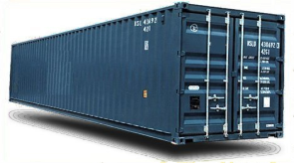
Cloud Computing
  Enable datacenters to coordinate over vast
  distances
  Optimize availability, disaster tolerance, energy
  Without sacrificing performance
  “cloud computing”
Drive underlying technological innovations.
Notes:
A Research and Development Agenda to Improve the Resiliency
of the Financial and Banking Sector
U.S. Department of Treasury - Office of Critical Infrastructure Protection and
Compliance Policy
Financial and Banking Information Infrastructure Committee
Financial Services Sector Coordinating Council
Design eloquent in its simplicity
Secure log promotes integrity
A hash asserts the data and order integrity of log
Byzantine quorums maintain consistency despite failure
Self-organizing via DHT technology
Narrow interface made it possible to implement and deploy system
Need to somehow summarize “Antiquity Design Summary” and “My Contributions” slides and somehow transition to SMFS and KyotoFS!
What one point should the audience take away from here?
This is also where we may discuss our research approach, or we can do it at the end

Slide 28
Cloud Computing
Vision
The promise of the Cloud
  A computer utility; a commodity
  Catalyst for technology economy
  Revolutionizing for health care, financial systems,
  scientific research, and society
However, cloud platforms today
  Entail significant risk: vendor lock-in vs control
  Entail inefficient processes: energy vs performance
  Entail poor communication: fiber optics vs COTS endpoints
Notes:
The cloud completes the commoditization process and makes storage and computation a commodity.

Slide 29
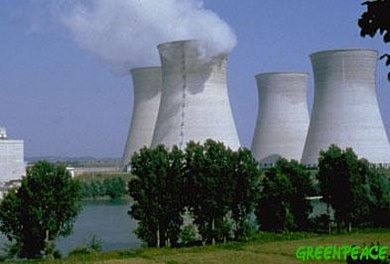

Example: Energy and Performance
Why don’t we save more energy in the cloud?
No one deletes data anymore!
  Huge amounts of seldom-accessed data
Data deluge
  Google (YouTube, Picasa, Gmail, Docs), Facebook, Flickr
  100 GB per second is faster than hard disk capacity growth!
  Max amount of data accessible at one time << Total data
New scalable approach needed to store this data
  Energy footprint proportional to number of HDDs is
  not sustainable

Slide 30
What to do with all these transistors?
Embedded Processors

Slide 31
Where is the Market?
Millions of Computers
Notes:
For “definitions” of desktop, servers, supercomputers (100’s to 1000’s of processors, Gbytes to Tbytes of main memory, Tbytes to Pbytes of secondary storage), and embedded systems (cell phones, automobile control, video games, entertainment systems (digital TVs), PDAs, etc.).
The computer (IT) industry is responsible for almost 10% of the GNP of the US.
The embedded market has shown the strongest growth (40% compounded annual growth compared to only 9% for desktops – where do laptops fit?). This chart/number does not include the low-end 8-bit and 16-bit embedded processors that are everywhere!
This is a good slide to talk about the other performance metrics in addition to speed (or see if the students can come up with them) including
Power, space/volume, memory space, cost, reliability

Slide 32
Where is the Market?
Millions of Computers
Notes:
For “definitions” of desktop, servers, supercomputers (100’s to 1000’s of processors, Gbytes to Tbytes of main memory, Tbytes to Pbytes of secondary storage), and embedded systems (cell phones, automobile control, video games, entertainment systems (digital TVs), PDAs, etc.).
The computer (IT) industry is responsible for almost 10% of the GNP of the US.
The embedded market has shown the strongest growth (40% compounded annual growth compared to only 9% for desktops – where do laptops fit?). This chart/number does not include the low-end 8-bit and 16-bit embedded processors that are everywhere!
This is a good slide to talk about the other performance metrics in addition to speed (or see if the students can come up with them) including
Power, space/volume, memory space, cost, reliability

Slide 33
Where is the Market?
Millions of Computers
Notes:
For “definitions” of desktop, servers, supercomputers (100’s to 1000’s of processors, Gbytes to Tbytes of main memory, Tbytes to Pbytes of secondary storage), and embedded systems (cell phones, automobile control, video games, entertainment systems (digital TVs), PDAs, etc.).
The computer (IT) industry is responsible for almost 10% of the GNP of the US.
The embedded market has shown the strongest growth (40% compounded annual growth compared to only 9% for desktops – where do laptops fit?). This chart/number does not include the low-end 8-bit and 16-bit embedded processors that are everywhere!
This is a good slide to talk about the other performance metrics in addition to speed (or see if the students can come up with them) including
Power, space/volume, memory space, cost, reliability

Slide 34
Where is the Market?
Millions of Computers
Notes:
For “definitions” of desktop, servers, supercomputers (100’s to 1000’s of processors, Gbytes to Tbytes of main memory, Tbytes to Pbytes of secondary storage), and embedded systems (cell phones, automobile control, video games, entertainment systems (digital TVs), PDAs, etc.).
The computer (IT) industry is responsible for almost 10% of the GNP of the US.
The embedded market has shown the strongest growth (40% compounded annual growth compared to only 9% for desktops – where do laptops fit?). This chart/number does not include the low-end 8-bit and 16-bit embedded processors that are everywhere!
This is a good slide to talk about the other performance metrics in addition to speed (or see if the students can come up with them) including
Power, space/volume, memory space, cost, reliability

Slide 35
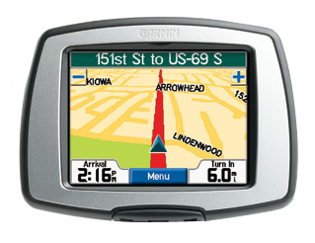
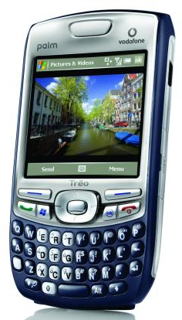


Slide 36
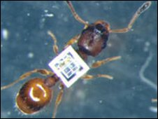
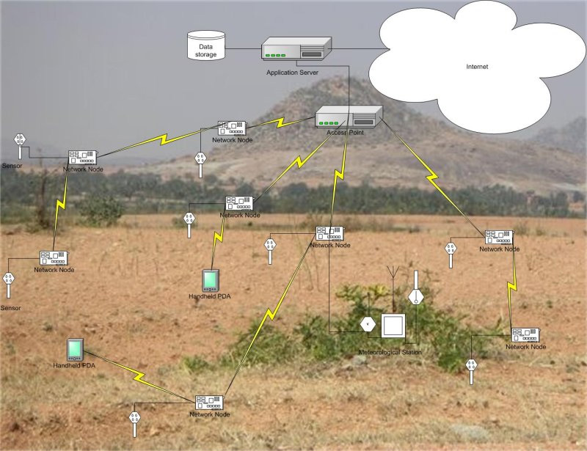
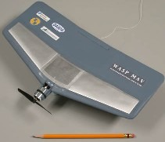
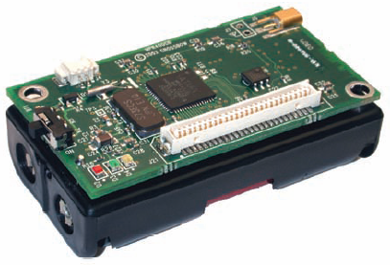
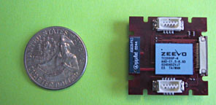
Where to?
Smart Dust….

Slide 37
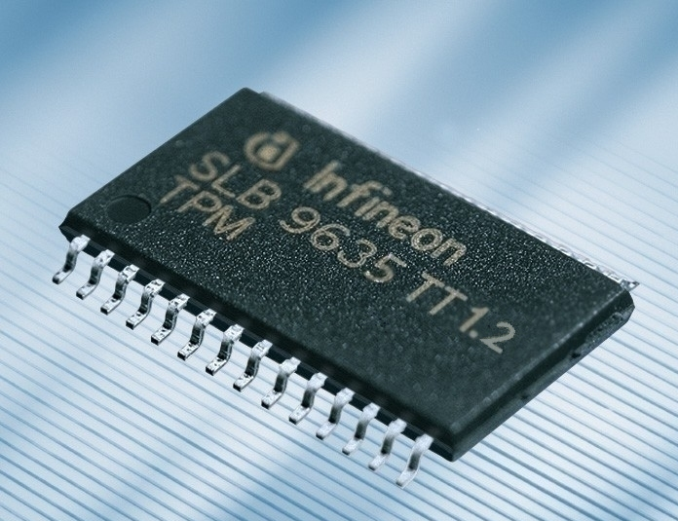
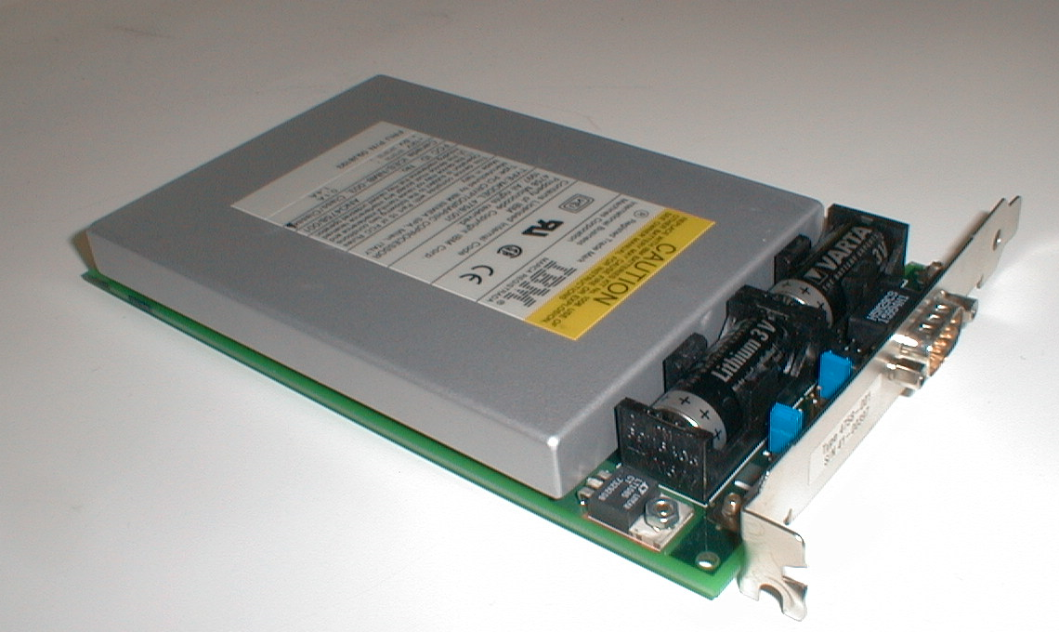
Security?
Cryptography and security…
TPM 1.2
IBM 4758
Secure Cryptoprocessor

Slide 38

Security?
Smart Cards…

Slide 39
What to do with all these transistors?
You could save the world one day?

Slide 40
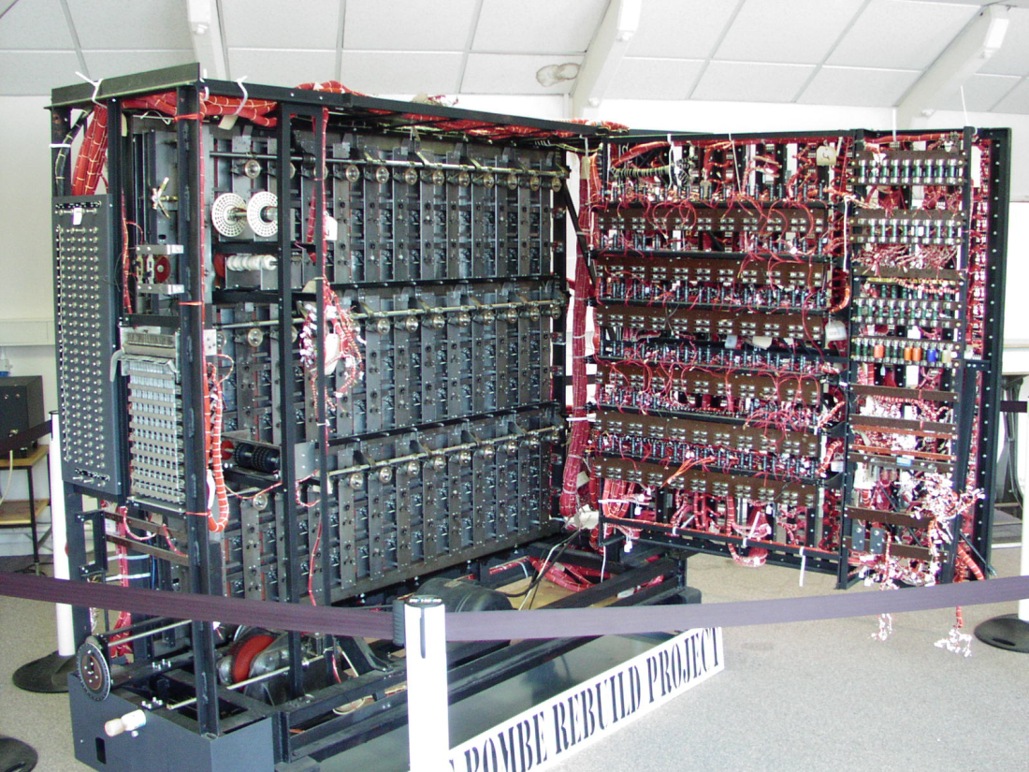
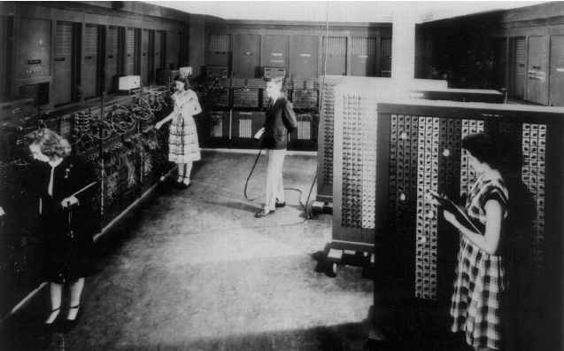
ENIAC - 1946
First general purpose
electronic computer. Designed
to calculate ballistic trajectories
Alan Turing’s Bombe
Used to crack Germany’s
enigma machine

Slide 41
Smart Dust
& Sensor Networks
Games
Embedded
Computing
Save the world?
Graphics
Security
Scientific
Computing
Cloud Computing
Quantum
Computing?
Cryptography

Slide 42
Survey Questions
Are you a better computer scientist and software engineering knowing “the low-level stuff”?
How much of computer architecture do software engineers actually have to deal with?
What are the most important aspects of computer architecture that a software engineer should keep in mind while programming?

Slide 43
Why?
These days, programs run on hardware...
… more than ever before
Google Chrome
→ Operating Systems
→ Multi-Core & Hyper-Threading
→ Datapath Pipelines, Caches, MMUs, I/O & DMA
→ Busses, Logic, & State machines
→ Gates
→ Transistors
→ Silicon
→ Electrons

Slide 44











Why?
Your job as a computer scientist will require knowledge the computer
Research/University
Industry
Government

Slide 45
Where to?
CS 3110: Better concurrent programming
CS 4410/4411: The Operating System!
CS 4420/ECE 4750: Computer Architecture
CS 4450: Networking
CS 4620: Graphics
CS 4821: Quantum Computing
MEng
5412—Cloud Computing, 5414—Distr Computing,
5430—Systems Secuirty,
5300—Arch of Larg scale Info Systems
And many more…

Slide 46
Thank you!
If you want to make an apple pie from scratch, you must first create the universe.
– Carl Sagan

