Slide 1
CS 3410: Computer System Organization and Programming
Hakim Weatherspoon
Spring 2012
Computer Science
Cornell University

Slide 2
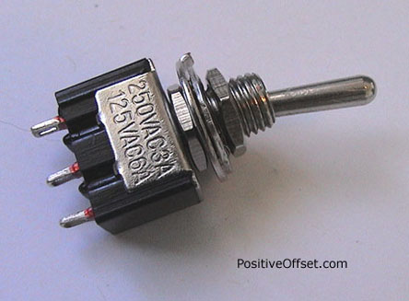
Basic Building Blocks: A switch
A switch is a simple device that can act as a conductor or isolator
Can be used for amazing things…

Slide 3
Basic Building Blocks: Switches
Either (OR)
Both (AND)
+
-
-
But requires mechanical force
Notes:
Speed and size of a mechanical switch

Slide 4
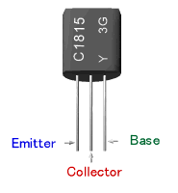
Basic Building Blocks: Transistors
Solid-state switch
  The most amazing invention of the 1900s
PNP and NPN
-
P
P
+
collector
N
emitter
base
collector
collector
+
N
N
-
NPN
base
P
base
PNP
emitter
emitter

Slide 5
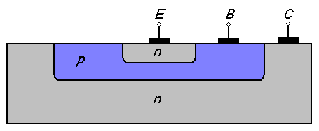
Basic Building Blocks: NPN Transistors
Semi-conductor
Connect E to C when
base = 1
E
B
C
collector
+
N
N
-
NPN
P
base
emitter
Notes:
Silicon doped with impurity makes it n-type or p-type (holes)
NPN is most common, since electrons move freely.

Slide 6
P and N Transistors
PNP Transistor
Connect E to C when
base = 0
NPN Transistor
Connect E to C when
base = 1
E
E
B
B
C
C

Slide 7
Inverter
Vdd
Function: NOT
Called an inverter
Symbol:
Useful for taking the inverse of an input
CMOS: complementary-symmetry metal–oxide–semiconductor
in
out
Vss
in
out
In | Out
0 | 1
1 | 0
Truth table

Slide 8
NAND Gate
Vdd
Vdd
Function: NAND
Symbol:
A
B
out
a
out
B
b
A
Vss
A | B | out
0 | 0 | 1
1 | 0 | 1
0 | 1 | 1
1 | 1 | 0

Slide 9
NOR Gate
Vdd
A
Function: NOR
Symbol:
B
out
A
B
A | B | out
0 | 0 | 1
1 | 0 | 0
0 | 1 | 0
1 | 1 | 0
Vss
Vss
a
out
b
Notes:
Example

Slide 10
Building Functions
NOT:
AND:
OR:
NAND and NOR are universal
  Can implement any function with NAND or just NOR gates
  useful for manufacturing
a
b
a
b
Notes:
Flash Drives

Slide 11

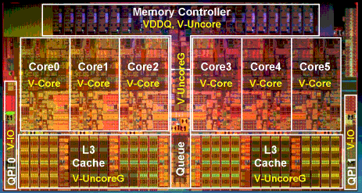
Then and Now
http://www.theregister.co.uk/2010/02/03/intel_westmere_ep_preview/
The first transistor
  on a workbench at
  AT&T Bell Labs in 1947
  Bardeen, Brattain, and Shockley
An Intel Westmere
  1.17 billion transistors
  240 square millimeters
  Six processing cores
Notes:
John Bardeen
Walter Brattain
William Shockley

Slide 12
Moore's Law
The number of transistors integrated on a single die will double every 24 months...
– Gordon Moore, Intel co-founder, 1965
Amazingly Visionary
1971 – 2300 transistors – 1MHz – 4004
1990 – 1M transistors – 50MHz – i486
2001 – 42M transistors – 2GHz – Xeon
2004 – 55M transistors – 3GHz – P4
2007 – 290M transistors – 3GHz – Core 2 Duo
2009 – 731M transistors – 2GHz – Nehalem
Notes:
Complexity is *the* issue.

Slide 13
Course Objective
Bridge the gap between hardware and software
  How a processor works
  How a computer is organized
Establish a foundation for building higher-level applications
  How to understand program performance
  How to understand where the world is going

Slide 14
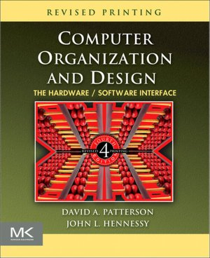
Announcements: How class organized
Instructor: Hakim Weatherspoon
(hweather@cs.cornell.edu)
Lecture:
  Tu/Th 1:25-2:40
  Hollister B14
Lab Sections:
  Carpenter 235 (Red Room)

Slide 15

Who am I?
Prof. Hakim Weatherspoon
  (Hakim means Doctor, wise, or prof. in Arabic)
  Background in Education
    Undergraduate University of Washington
      Played Varsity Football
        Some teammates collectively make $100’s of millions
        I teach!!!
    Graduate University of California, Berkeley
      Some class mates collectively make $100’s of millions
      I teach!!!
  Background in Operating Systems
    Peer-to-Peer Storage
      Antiquity project - Secure wide-area distributed system
      OceanStore project – Store your data for 1000 years
    Network overlays
      Bamboo and Tapestry – Find your data around globe
    Tiny OS
      Early adopter in 1999, but ultimately chose P2P direction

Slide 16
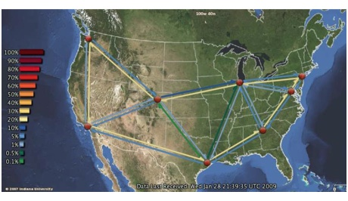
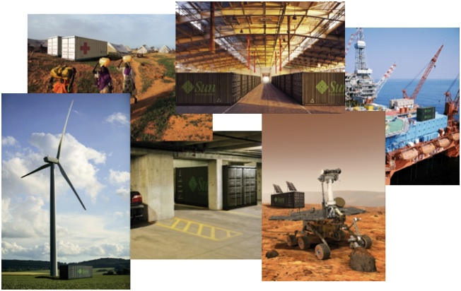
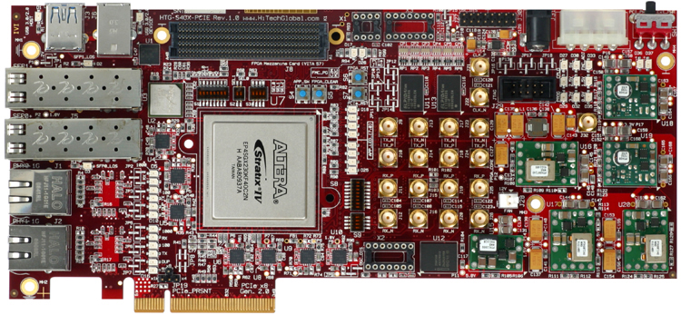
Who am I?
Cloud computing/storage
  Optimizing a global network of data centers
  Cornell Ntional λ-Rail Rings testbed
  Software Defined Network Adapter
  Energy: KyotoFS/SMFS
Antiquity: built a global-scale storage system

Slide 17
Course Staff
cs3410-staff-l@cs.cornell.edu
Lecture/Homwork TA’s
  Colin Ponce (cponce@cs.cornell.edu) (lead)
  Anish Ghulati (ag795@cornell.edu)
  Ming Pan (mp492@cornell.edu)
Lab TAs
  Han Wang (hwang@cs.cornell.edu) (lead)
  Zhefu Jiang (zj46@cs.cornell.edu)
Lab Undergraduate consultants
  Doo San Baik (db478@cornell.edu)
  Erluo Li (el378@cornell.edu)
  Jason Zhao (jlz27@cornell.edu)
  Peter Tseng (pht24@cornell.edu) (lead)
  Roman Averbukh (raa89@cornell.edu)
  Scott Franklin (sdf47@cornell.edu)
  Administrative Assistant:
  Randy Hess (rbhess@cs.cornell.edu)

Slide 18
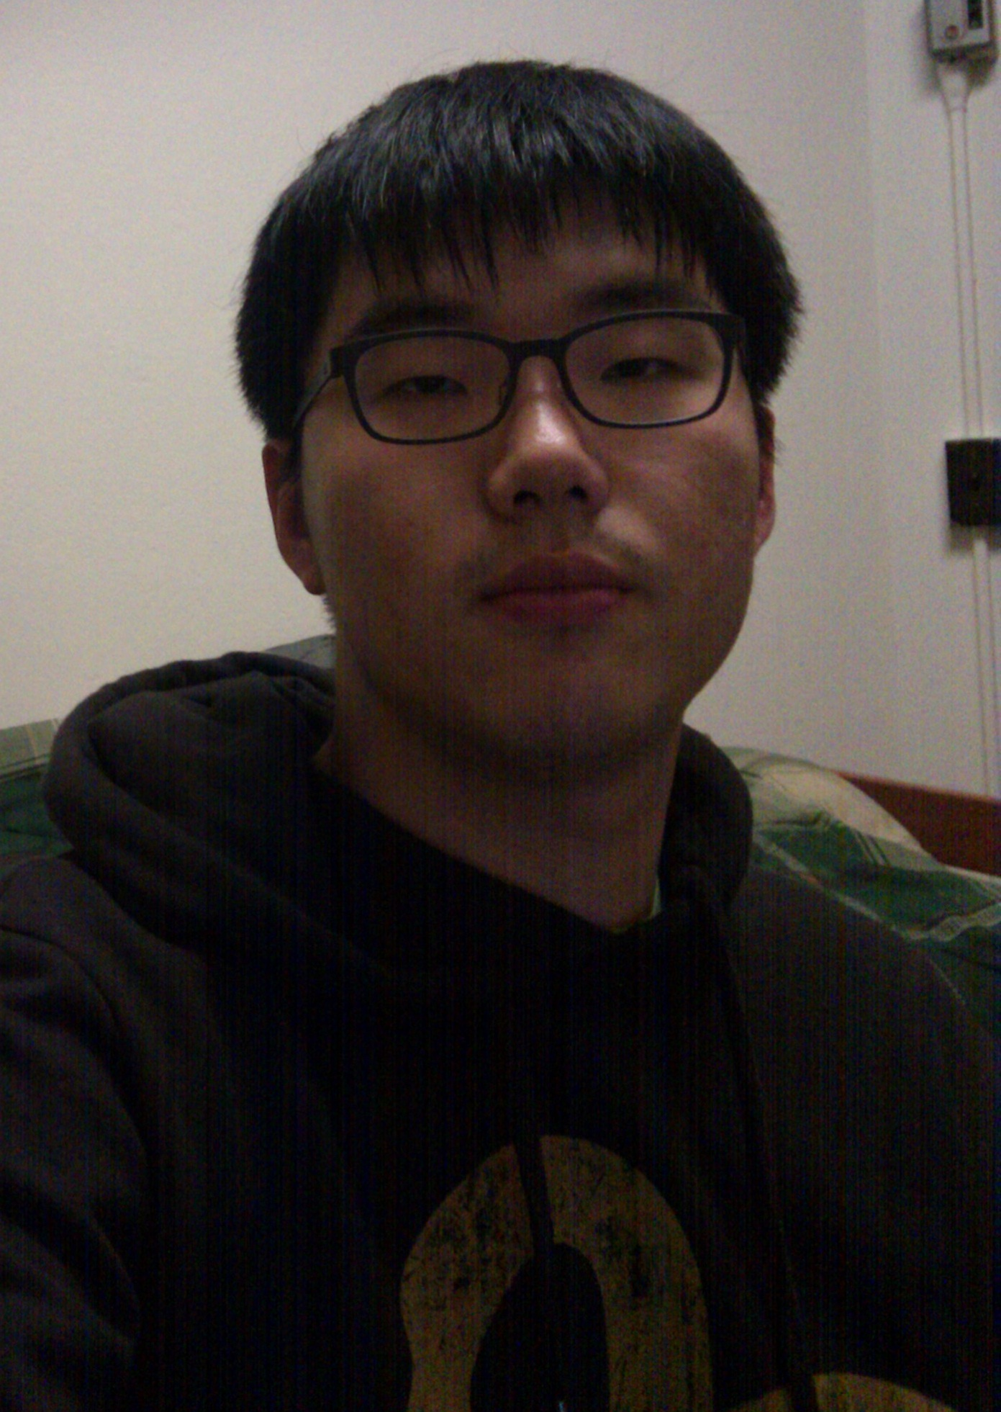
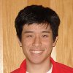
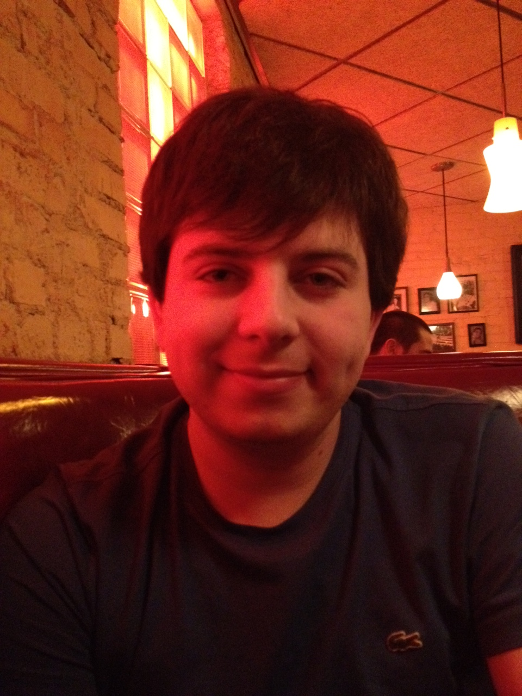
Course Staff
Doo San Baik
Roman Averbukh
Peter Tseng

Slide 19
Book
Computer Organization and Design
  The Hardware/Software Interface
David Patterson, John Hennessy
  Get the 4th Edition Revised

Slide 20
Pre-requisites and scheduling
CS 2110 is required
  Must have satisfactorily completed CS 2110
  Cannot take CS 2110 concurrently with CS 3410
CS 3420 (ECE 3140)
  Take either CS 3410 or CS 3420
    both satisfy CS and ECE requirements
  However, Need ENGRD 2300 to take CS 3420
CS 3110
  Not advised to take CS 3110 and 3410 together

Slide 21
Grading
Lab (45-50%)
  4-5 Individual Labs (15-20%)
  4 Group Projects (30-35%)
Lecture (45-50%)
  3 Prelims (35-40%)
  Homework (10%)
Participation/Discretionary (5%)

Slide 22
Grading
Regrade policy
  Submit written request to lead TA,
  and lead TA will pick a different grader
  Submit another written request,
  lead TA will regrade directly
  Submit yet another written request for professor to regrade.
Late Policy
  Each person has a total of four “slip days”
  Max of two slip days for any individual assignment
  For projects, slip days are deducted from all partners
  20% deducted per day late after slip days are exhausted

Slide 23
Administrivia
http://www.cs.cornell.edu/courses/cs3410/2012sp
  Office Hours / Consulting Hours
  Lecture slides & schedule
  Logisim
  CSUG lab access (esp. second half of course)
Lab Sections (start today)
  Labs are separate than lecture and homework
  Bring laptop to Labs (optional)

Slide 24
Administrivia
http://www.cs.cornell.edu/courses/cs3410/2012sp
  Office Hours / Consulting Hours
  Lecture slides & schedule
  Logisim
  CSUG lab access (esp. second half of course)
Lab Sections (start today)
T 2:55 – 4:10pm Carpenter Hall 235 (Red Room)
W 3:35 – 4:50pm Carpenter Hall 235 (Red Room)
W 7:30—8:45pm Carpenter Hall 235 (Red Room) R 11:40 – 12:55pm Carpenter Hall 235 (Red Room)
R 2:55 – 4:10pm Carpenter Hall 235 (Red Room)
F 2:55 – 4:10pm Carpenter Hall 235 (Red Room)
  Labs are separate than lecture and homework
  Bring laptop to Labs
  This week: intro to logisim and building an adder

Slide 25
Communication
Email
  cs3410-staff-l@cs.cornell.edu
  The email alias goes to me and the TAs, not to whole class
Assignments
  CMS: http://cms.csuglab.cornell.edu
Newsgroup
  http://www.piazza.com/cornell/spring2012/cs3410
  For students
iClicker
  http://atcsupport.cit.cornell.edu/pollsrvc/

Slide 26
Lab Sections & Projects
Lab Sections start this week
  Intro to logisim and building an adder
Labs Assignments
  Individual
  One week to finish (usually Monday to Monday)
Projects
  two-person teams
  Find partner in same section
Notes:
We will pair you up if you don’t have a preferred partner
Design document due one week after handout
Start early, time management is key
Manage the team effort

Slide 27
Academic Integrity
All submitted work must be your own
  OK to study together, but do not share soln’s
  Cite your sources
Project groups submit joint work
  Same rules apply to projects at the group level
  Cannot use of someone else’s soln
Closed-book exams, no calculators
  Stressed? Tempted? Lost?
    Come see me before due date!
Plagiarism in any form will not be tolerated

Slide 28
Why do CS Students Need Transistors?
Notes:
Take a break
Think-Pair-Share

Slide 29
Why do CS Students Need Transistors?
Functionality and Performance
Notes:
Think-Pair-Share

Slide 30
Why do CS Students Need Transistors?
To be better Computer Scientists and Engineers
  Abstraction: simplifying complexity
  How is a computer system organized? How do I build it?
  How do I program it? How do I change it?
  How does its design/organization effect performance?
Notes:
Think-Pair-Share

Slide 31
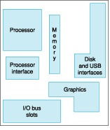
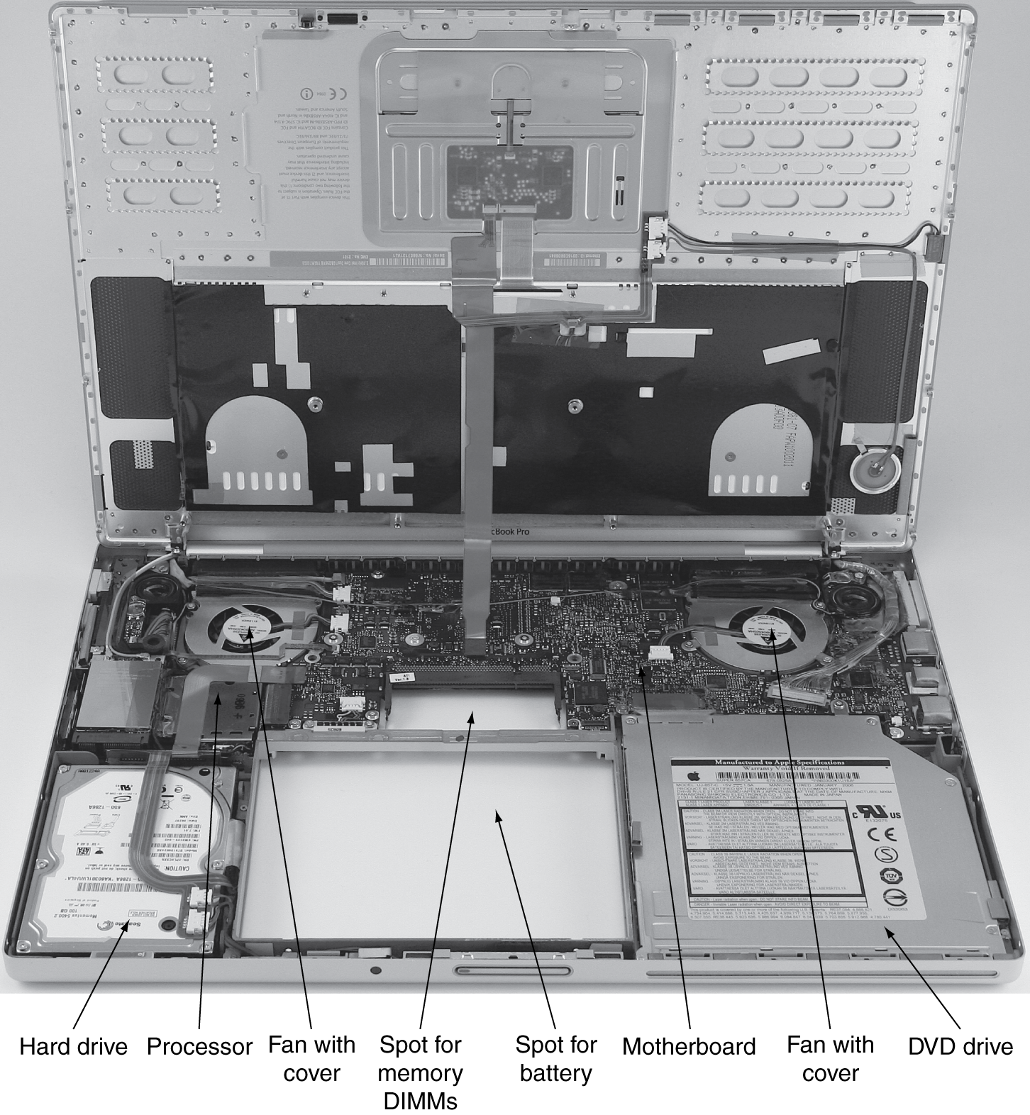
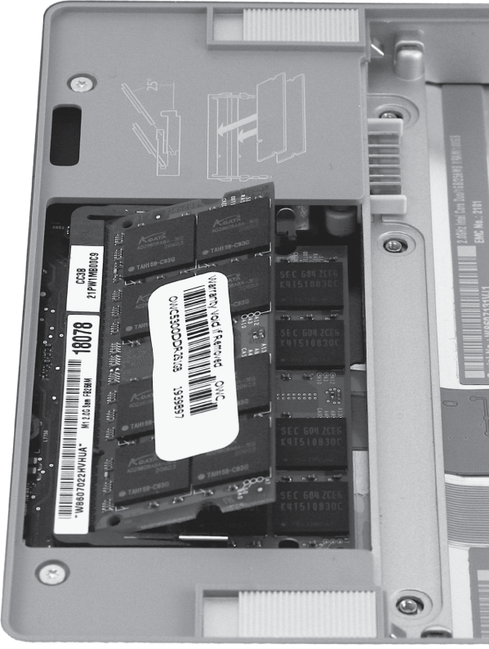
Computer System Organization

Slide 32
Computer System Organization
Computer System =
?
Input +
Output +
Memory +
Datapath +
Control
Keyboard
Mouse
Video
Network
USB
CPU
Registers
bus
bus
Serial
Memory
Disk
Audio

Slide 33
Compilers & Assemblers
C
int x = 10;
x = 2 * x + 15;
compiler
MIPS
assembly
language
addi r5, r0, 10
muli r5, r5, 2
addi r5, r5, 15
assembler
MIPS
machine
language
00100000000001010000000000001010
00000000000001010010100001000000
00100000101001010000000000001111
Notes:
32 bits, 4 bytes
What time is it?

Slide 34
Instruction Set Architecture
ISA
  abstract interface between hardware and the lowest level software
  user portion of the instruction set plus the operating system interfaces used by application programmers

Slide 35
Basic Computer System
A processor executes instructions
  Processor has some internal state in storage elements (registers)
A memory holds instructions and data
  von Neumann architecture: combined inst and data
A bus connects the two
01010000
10010100
…
bus
regs
addr, data,
r/w
processor
memory

Slide 36
How to Design a Simple Processor
inst
alu
memory
register file
32
2
00
5 5 5
pc
new pc
calculation
control
00: addi r5, r0, 10
04: muli r5, r5, 2
08: addi r5, r5, 15

Slide 37
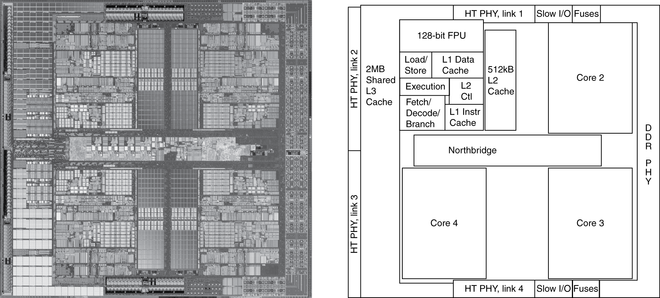
Inside the Processor
AMD Barcelona: 4 processor cores
Figure from Patterson & Hennesssy, Computer Organization and Design, 4th Edition

Slide 38
How to Program the Processor:
MIPS R3000 ISA
Registers
Instruction Categories
  Load/Store
  Computational
  Jump and Branch
  Floating Point
    coprocessor
  Memory Management
R0 - R31
PC
HI
LO
OP
rs
rt
rd
sa
funct
OP
rs
rt
immediate
OP
jump target

Slide 39
Overview
Application
Operating
System
Compiler
Firmware
Instruction Set
Architecture
Memory
system
Instr. Set Proc.
I/O system
Datapath & Control
Digital Design
Circuit Design
Notes:
For class handout

Slide 40
Applications
Everything these days!
  Phones, cars, televisions, games, computers,…

Slide 41
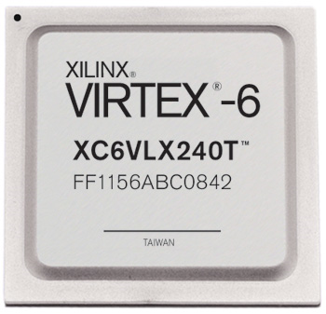
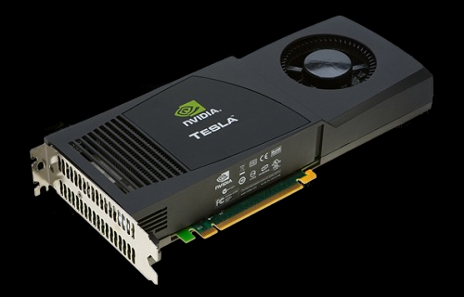

Example 3: New Devices
millions
Xilinx FPGA
Berkeley mote
NVidia GPU

Slide 42
Covered in this course
Application
Operating
System
Compiler
Firmware
Instruction Set
Architecture
Memory
system
Instr. Set Proc.
I/O system
Datapath & Control
Digital Design
Circuit Design
Notes:
For class handout

Slide 43
Reflect
Why take this course?
  Basic knowledge needed for all other areas of CS:
    operating systems, compilers, ...
  Levels are not independent
    hardware design ↔ software design ↔ performance
  Crossing boundaries is hard but important
    device drivers
  Good design techniques
    abstraction, layering, pipelining, parallel vs. serial, ...
  Understand where the world is going

