Slide 1
Cache

Slide 2
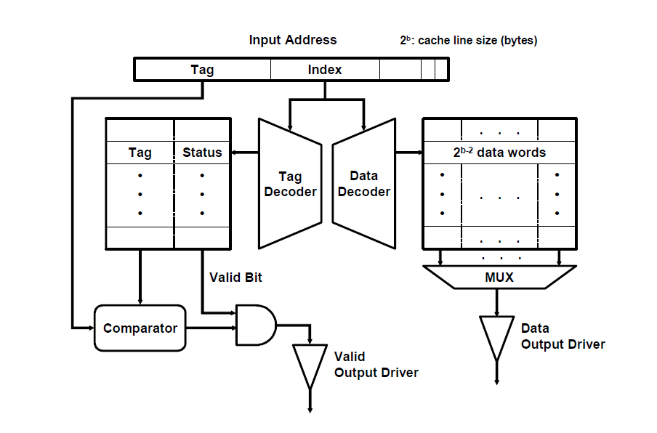
Direct-mapped Cache

Slide 3
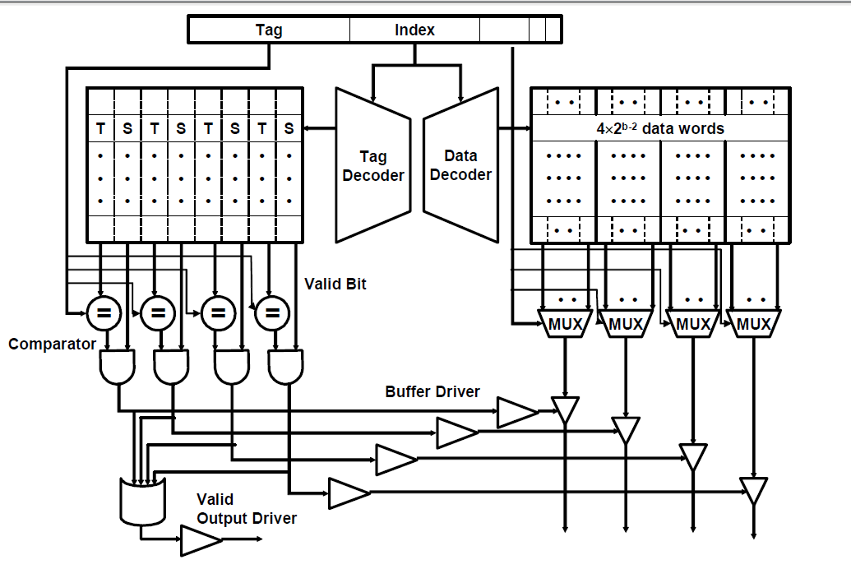
Four-way Set-associative cache

Slide 4
Exercise
Question set
Quiz

