Slide 1
Question 1.C, 1.D
Question 5
Quiz
Preview of HW3
Introduction to Unix

Slide 2
Quiz
Write an MIPS assembly program that computes the factorial of a given input. The integer input is passed through register $a0, and the result is returned in register $v0.
Show the contents of the stack after each function calls, assuming that the input is 4.
Notes:
Exercise 2.20

Slide 3
Why Bother?
Most programmers who learn UNIX end up finding it useful
Provides powerful command-line interface
Many simple tasks are easier to accomplish
Possible to script repetitive operations
Widely used in research and industry, and runs most of the servers on the Internet

Slide 4
UNIX Philosophy
Multiuser / multitasking
Toolbox approach
Combine multiple simple commands instead of using a single complex application
Designed by programmers for programmers

Slide 5
Shelling into CSUG
From Windows, use PuTTY
http://www.chiark.greenend.org.uk/~sgtatham/putty/
(Google can give you this URL)
Demo
From MacOS, open a terminal and type
ssh netid@csug01.csuglab.cornell.edu

Slide 6
Command Line Environment
Shell is the command line interpreter
Just another program
Bourne shell (bash)
C Shell (csh)
Default shell in CSUG is tcsh
This talk uses bash
Switch to bash: exec bash

Slide 7
Running Commands
Commands follow the form:
command <options> <arguments>
Options modify the command
Arguments indicate what file to operate on
Get help by typing man command
Example:
[msiegen@tiger ~]$ ls -l /usr
total 301
drwxr-xr-x 2 root root 69632 Oct 18 08:43 bin/
drwxr-xr-x 2 root root 4096 Aug 12 2004 etc/
drwxr-xr-x 2 root root 4096 Aug 12 2004 games/
drwxr-xr-x 117 root root 20480 Sep 12 20:40 include/
...

Slide 8
Plumbing
I/O Redirection
> Redirect standard output to file
>> Append standard output to file
< Get input from file
Pipes (|) are used to take the output of one program and use it as input to another
e.g. du -sk /home/* | sort -nr | head -10 > disk_hogs.txt

Slide 9
Practical Tips
Use less to view output that will not fit on your screen
e.g. ls -lR | less
Use grep to filter output, and wc to count lines
e.g. ps aux | grep “vim” | wc -l
Use && to run multiple commands in sequence
e.g. ./configure && make && make install
Many more possibilities!

Slide 10
File System
/
bin
etc
lib
usr
dev
tmp
home
sh
ls
cat
libc.so
ttya
null
passwd
group
bin
man
local
kwalsh
egs
msiegen
cs316
mail
bin
stuff

Slide 11
File System
Case sensitive!
Moving around, working with directories
cd Change working directory
pwd Print working directory
ls -la List all files in working directory
mkdir Make directory
rmdir Remove directory
cp Copy file
mv Move or rename file
rm Delete a file
Searching
e.g. find -name Makefile

Slide 12
Setting Up for HW1
Copy the HW1 files into your home directory:
cp –R /usr/local/cs316/hw1_codeExamples ~
Fix your path:
export PATH=\
$PATH:/usr/local/cs316/mipsel-linux/bin
Demo compiling hw1.s and hw2.s

Slide 13
Viewing File Contents
Use cat or less:
$ cat hw1.c # use cat for short files
#include “test-include.h”
_start() {
}
$ less hw1.s # use less for long files

Slide 14
Comparing Files
Use diff:
$ cat file1
Hello!
This is the contents of file1.
Goodbye.
$ cat file2
Hello!
This is the contents of file2.
Goodbye.
$ diff –u file1 file2
--- file1 2007-10-11 04:25:28.000000000 -0400
+++ file2 2007-10-11 04:25:45.000000000 -0400
@@ -1,3 +1,3 @@
Hello!
-This is the contents of file1.
+This is the contents of file2.
Goodbye.
Demo: diff –u hw1.s hw2.s

Slide 15
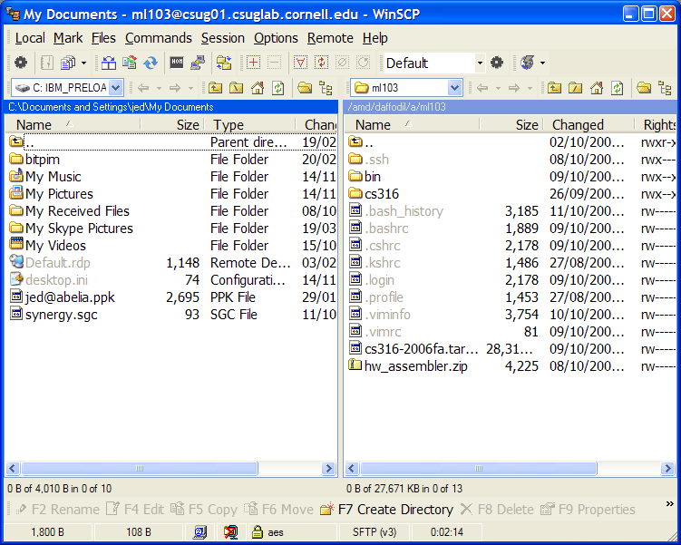
Transferring Files
Use WinSCP
http://winscp.net/

Slide 16
Further Reading
Manual (man) pages
O’Reilly Books
Free access on campus:
http://proquest.safaribooksonline.com/
Or from home through the Safari Tech Books link at:
http://www.englib.cornell.edu/erg/shortlist.php

Slide 17
Plumbing
Running multiple commands in sequence
Use semicolon (;) to run commands unconditionally
Use double ampersand (&&) to run commands only until the first error occurs
Use parentheses to group a sequence and redirect output
e.g. (date && ls) > logfile
Not the same as: date && ls > logfile

Slide 18
Wildcards
Shorthand for referencing multiple existing files on the command line
* any number of characters
? exactly one character
[abc] any one of a, b, or c
[!abc] any character except a, b, or c
Examples
ls -l *.c
lpr [Mm]akefile

Slide 19
File System Permissions
Permissions can be specified for
Owner
Group
All
Permissions are
Read
Write
Execute
Example:
-rwxr-xr-x 1 msiegen ta 10152 Sep 21 17:04 disassemble
-rw-r----- 1 msiegen ta 329 Sep 21 17:04 main.c
The disassembler may be executed by anyone on the system, but the source file may only be read by people in the ta group. Both files may only be edited by the user msiegen.

Slide 20
File System Permissions
For a directory, “read” means being able to list its contents, “execute” means being able to access files within the directory
Unless the files have more restrictive permissions
Use chmod to add or remove permissions (rwx) for user, group, and others (ugo):
chmod ugo+x Let anyone execute
chmod go-w Prevent non-owner form writing
Or, specify absolute permissions in octal
4=r, 2=w, 1=x
e.g. 755=rwxr-xr-x, 640=rw-r-----
e.g. chmod 755 filename

Slide 21
Job Control
Use & after a command to place job in background
Manage jobs:
jobs List jobs
fg %1 Bring job 1 to foreground
bg %2 Run job 2 in background
kill %3 Terminate job 3
^Z (control+Z) suspend foreground job
^C (control+C) terminate foreground job

Slide 22
Job Control
Example
[msiegen@tiger ~]$ sleep 800 &
[1] 16139
[msiegen@tiger ~]$ sleep 400 &
[2] 16141
[msiegen@tiger ~]$ jobs
[1]- Running sleep 800 &
[2]+ Running sleep 400 &
[msiegen@tiger ~]$ kill %1
[msiegen@tiger ~]$ jobs
[1]- Terminated sleep 800
[2]+ Running sleep 400 &
[msiegen@tiger ~]$ fg %2
sleep 400
^Z
[2]+ Stopped sleep 400
[msiegen@tiger ~]$ bg %2
[2]+ sleep 400 &

Slide 23
Environment Variables
Display all variables by typing env
Set a variable, example:
NETID=abc123; export NETID (bourne shell)
setenv NETID abc123 (c-shell)
Use a variable in a command, example:
echo $NETID
Environment variables are used to control various behaviours of the shell, as well as pass global information to other programs that are started from within the shell
The variable $PATH is used to locate programs that are run

Slide 24
Beyond a Single User
ps aux List all running processes
who; w Show who else is logged in
top Show CPU, memory usage (useful for finding out why a system is soooo slow, and who to blame)

Slide 25
Some Useful Commands
file Determine the type of a file
sort Sort lines in a text stream
uniq Eliminate duplicate lines
wc Count bytes, words, or lines
cal Display a calendar
grep Filter a text stream
sed Search and replace on text stream
awk (Slightly) more advanced scripting

Slide 26
Advanced Topics
Shell scripting
Anything which can be done from the command line, can be scripted
Regular expressions
Fancier version of wildcards
Allows complex matching and search and replace operations on text
Suppored by grep, awk, and many scripting/programming languages

