Slide 1
Section 2

Slide 2
Overview
Finite state machine
Homework 2 preparation
Q&A

Slide 3
Finite State Machine

Slide 4
FSM
Finite automata / State machines
Mathematical abstraction
Wide application
  Digital design
  Communication protocol
  Language parsing
  Neural System modeling
  …

Slide 5
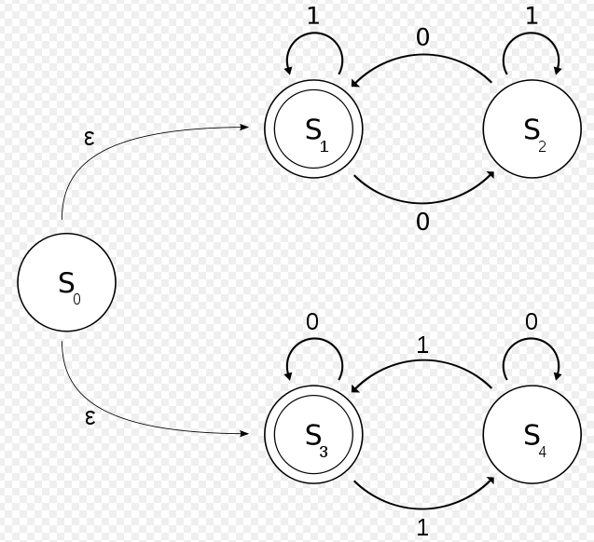
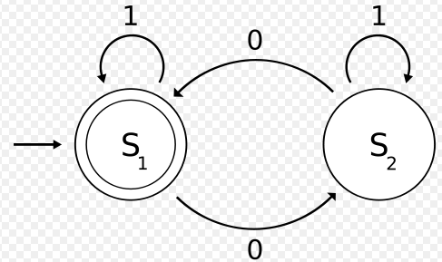
DFA and NFA
Deterministic and Non-deterministic
Deterministic means there is only one outcome for each state transition
Deterministic
Non-deterministic
Notes:
Deterministic FSM is what we design for this course. Non-deterministic needs a random element in the circuit to decide which state transition to take. In circuit, the random element is called an arbiter.

Slide 6
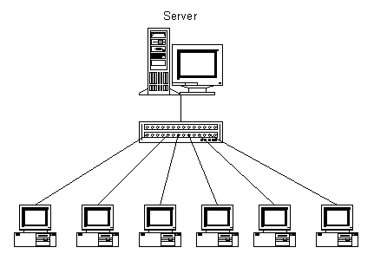
Design an FSM
We will design a synchronization circuitry that is used in Gigabit Ethernet.
Connection running
at 1 Gbit/s
…..10011001011110011….

Slide 7
FSM example: sync_fsm
FSM that looks for a specific sequence of bits, called comma character.
The Gigabit Ethernet standard specifies a few comma characters,
  0011111001
  0011111010
  0011111000
in this example, we will design for this pattern: 0011111xxx.
The leading zero is the first bit received.

Slide 8
Example Bit Stream
For example, if the incoming bit streams is 00011001110001001110001110011100011100110011100001111100001100111000111000……
The synchronization circuitry will catch the patterns in red, and flags the output sync bit to 1, (0 for not-in-sync).

Slide 9
Similar to …
Remember when you learn about regular expression?
ab*(c|ε) denotes the set of strings starting with a, then zero or more bs and finally optionally a c: {a, ac, ab, abc, abb, abbc, ...}
The circuit we design operates on 0 or 1 instead of a, b, c…

Slide 10
Elements of FSM
Combinational logic that computes next state
Memory element that remembers the current state
Input and output

Slide 11
State Machine Design Process
1. Determine the inputs and outputs
sync_fsm
  Input: bit_in , 1-bit
  Output: comma_detect, 1-bit

Slide 12
State Machine Design Process
2. Determine the machine states
sync_fsm, 0011111xxx
  S0, initial state
  S1, received first 0
  S2, received second 0
  S3 ~ S7, received 1s
  S8 ~ S10, received either 0 or 1.
  In S10, signal comma_detect

Slide 13
State Machine Design Process
3. Create state/bubble diagram – Mealy or Moore?

Slide 14
State Machine Design Process
4. State assignment – give each state a particular value.
  We have 11 states
    Needs at least 4 bits to encode (compact)
    One hot encoding (minimize decoding logic)
  We use the 4 bit encode.

Slide 15
State Machine Design Process
5. Create Transition/Output Table
Current State | Next State (Input == 0 ) | Next State (Input == 1) | Output
0000 |  |  | 0
0001 |  |  | 0
0010 |  |  | 0
0011 |  |  | 0
0100 |  |  | 0
0101 |  |  | 0
0110 |  |  | 0
Current State | Next State (Input == 0 ) | Next State (Input == 1) | Output
0111 |  |  | 0
1000 |  |  | 0
1001 |  |  | 0
1010 |  |  | 1

Slide 16
State Machine Design Process
6. Derive Next State Logic for each state element.

Slide 17
State Machine Design Process
Derive Output Logic
Ouput = S[3] & ~S[2] & S[1] & ~S[0]

Slide 18
State Machine Design Process
8. Implement in Logisim

Slide 19
Homework 2 preparation
Use tunnel
Demo

Slide 20
8-bit input => 10-bit output
8-bit input divided into
  3-bit blocks (HGF)
  5-bit blocks (EDCBA)
10-bit output divided into
  4-bit blocks (fghj)
  6-bit blocks (abcdei)

Slide 21
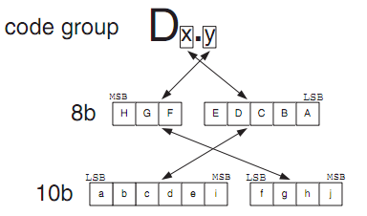

Slide 22
Running Disparity
The difference between the number of 1s transmitted and the number of 0s transmitted is always limited to ±2, and at the end of each state, it is either +1 or −1. This difference is known as the running disparity (RD).
This scheme only needs two states for running disparity of +1 and −1. It starts at −1.

Slide 23
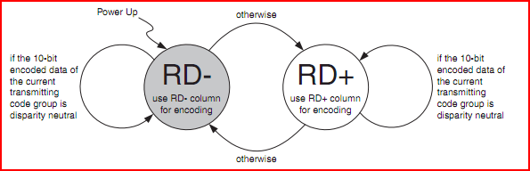

Slide 24
Difference between RD- and RD+ for an encoding is XOR.
Can minimize to figure out when to XOR and when not.

Slide 25
Split the circuit into smaller components
  Cleaner design and easier for testing
  5b/6b encoder, 3b/4b encoder, circuit to figure out more 1 or zero, fsm
Find resource (or ask for help) to understand how the encoding works
  Make sure any resource you find is the same as what we have on the appendix (Wikipedia isn’t always right)

Slide 26
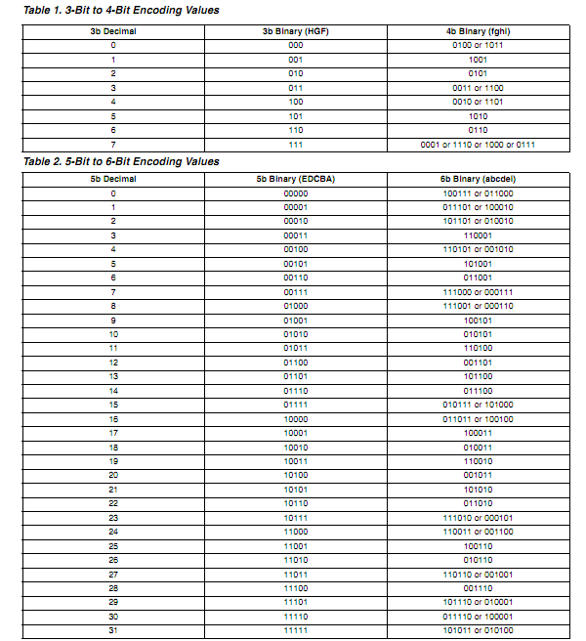

Slide 27
Hints
Split the circuit into smaller components
  Cleaner design and easier for testing
  5b/6b encoder, 3b/4b encoder, circuit to figure out more 1 or zero, fsm
Find resource (or ask for help) to understand how the encoding works
  Make sure any resource you find is the same as what we have on the appendix (Wikipedia isn’t always right)

