Slide 1
Logisim

Slide 2
HDL language and Logisim
Most real-world hardware design is done using a text-based hardware description language – VHDL, Verilog, etc.
Schematics can be compiled into a text decription
Can use a simulator to test the circuit
Other back-end tools optimize, perform layout and wire routing, floorplan, etc.
Final spec is either downloaded onto a programmable device, or etched into silicon.
We will use Logisim for all hardware design
Interactive, graphical schematic editor
Educational use, user-friendly

Slide 3
Verilog Example: Decoder

Slide 4
Other CAD tools in circuit design
Circuit level tool vendors
Cadence, Synopsys, etc.
other smaller players
Board level tool vendors
Altium, Eagle and many more

Slide 5
HDL language and Logisim
Most real-world hardware design is done using a text-based hardware description language – VHDL, Verilog, etc.
Schematics can be compiled into a text decription
Can use a simulator to test the circuit
Other back-end tools optimize, perform layout and wire routing, floorplan, etc.
Final spec is either downloaded onto a programmable device, or etched into silicon.
We will use Logisim for all hardware design
Interactive, graphical schematic editor
Educational use, user-friendly

Slide 6
To be covered…
Pins and subcircuits
Probes for debugging
Bundles/splitters
Logging
Test vectors
S-R latch, D latch, D flip-flop
Examples

Slide 7
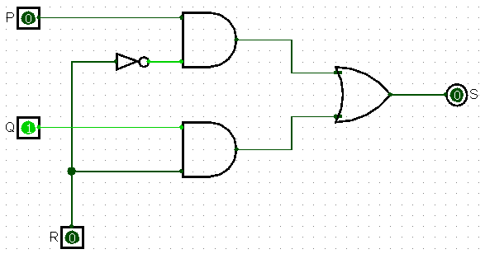
Example Circuit: 1 bit 2:1 Mux
S = P if R == 0
S = Q if R == 1

Slide 8
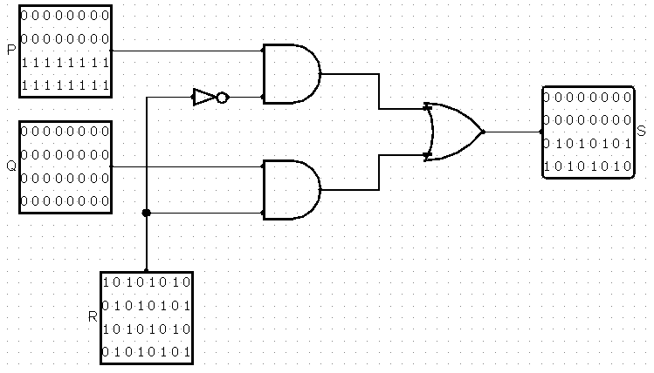
Example Circuit: 32-bit 2:1 Mux

Slide 9
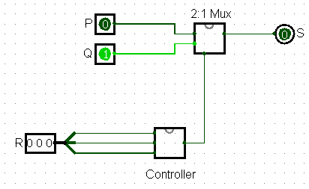
Subcircuits: 2:1 Mux and Controller
S = Q if R == 010
S = P otherwise

Slide 10
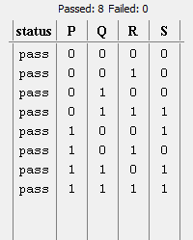
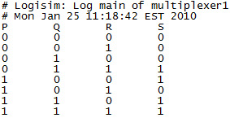
Logging and Test Vectors
Test Vector Truth Table
Log File

Slide 11
Logisim Don’ts
Leave wires floating
Works in logisim
Breaks in real life
Use a multiplexor instead of controlled buffer

Slide 12
Logisim Don’ts (cont.)
Don’t reinvent the wheel
Waste time
Confusing to grade
Almost every component is customizable
Number of inputs
Input bit width

Slide 13
Logisim Don’ts (cont.)
Avoid Constant input
Constants are almost never necessary
Exception is supplying value to extra input
Try to optimize away before using
Truth table

Slide 14
Logisim Don’ts (cont.)
Don’t make trivial subcircuits
Sub-circuit needs to perform some meaningful logic functions
You will never have a C function just to add two numbers up, do you?
Problems
Wasting time specifying inputs and outputs of small circuits
Big hierarchy hard to understand

Slide 15
Logisim Don’ts (cont.)
Don’t use invisible splitters
All you really need is just a wire
It is really hard to see them when we grade

Slide 16
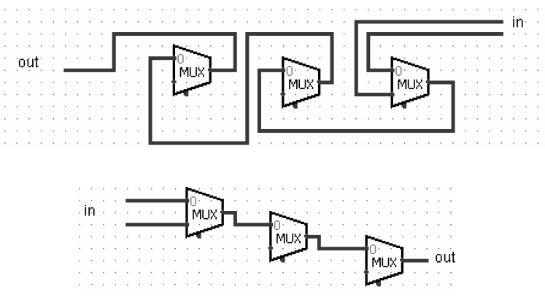
Logisim Don’ts (cont.)
Don’t work from Right to Left

Slide 17
Some more information
MIPS assignment:
32-bit ALU
32-bit pipelined processor
Looking for help?
Course webpage http://www.cs.cornell.edu/courses/cs3410/2011sp/
Newsgroup: cornell.class.cs3410
Staff email list: cs3410-staff-l@cs.cornell.edu

