Slide 1
What does the Future Hold?
Hakim Weatherspoon
CS 3410, Spring 2011
Computer Science
Cornell University

Slide 2
Announcements
Final Project
Demo Sign-Up:
  Signup sheet in front of room now.
  On desk in front of my office later today.
sign up Monday, May 16th
or Tuesday, May 17th
or Wednesday, May 18th
CMS submission due:
  Due 11:59pm Wednesday, May 18th
  Grace period until 4:59pm, May 19th

Slide 3
More of Moore

Slide 4
Moore’s Law
Moore’s Law introduced in 1965
  Number of transistors that can be integrated on a single die would double every 18 to 24 months (i.e., grow exponentially with time).
Amazingly visionary
  2300 transistors, 1 MHz clock (Intel 4004) - 1971
  16 Million transistors (Ultra Sparc III)
  42 Million transistors, 2 GHz clock (Intel Xeon) – 2001
  55 Million transistors, 3 GHz, 130nm technology, 250mm2 die (Intel Pentium 4) – 2004
  290+ Million transistors, 3 GHz (Intel Core 2 Duo) – 2007
  731 Million transisters, 2-3Ghz (Intel Nehalem) - 2009
Notes:
Tbyte = 2^40 bytes (or 10^12 bytes)
Note that Moore’s law is not about speed predictions but about chip complexity

Slide 5
Processor Performance Increase
Slope ~1.7x/year
Intel Pentium 4/3000
Intel Xeon/2000
DEC Alpha 21264A/667
DEC Alpha 21264/600
DEC Alpha 5/500
DEC Alpha 5/300
DEC Alpha 4/266
DEC AXP/500
IBM POWER 100
HP 9000/750
IBM RS6000
MIPS M2000
MIPS M/120
SUN-4/260
Notes:
Another powerpoint “comic” – note that the y axis is log !
x/y where x is the model number and y is the speed in MHz
Rate of performance improvement has been between 1.5 and 1.6 times per year – how much longer will Moore’s Law hold?

Slide 6
What’s next
Cloud Computing

Slide 7
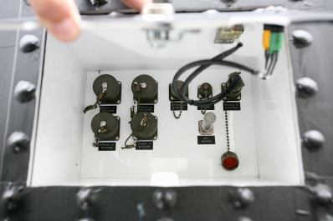
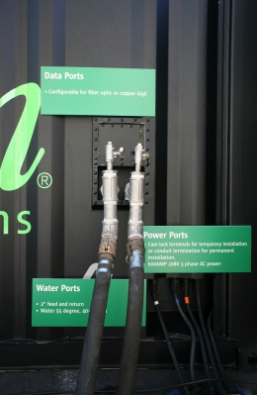
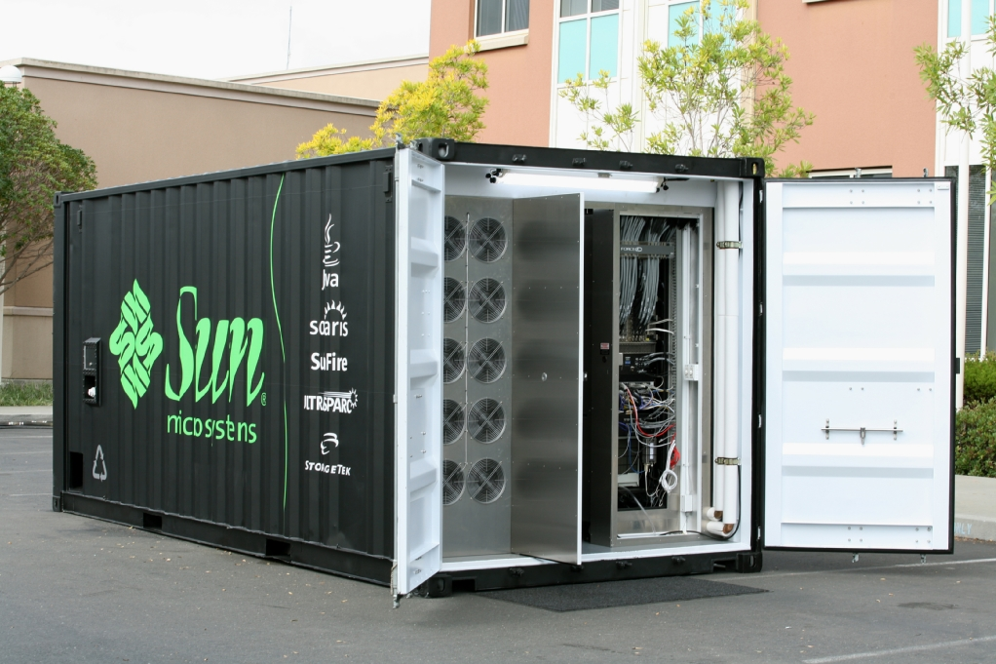
Cloud Computing
Datacenters are becoming a commodity
Order online and have it delivered
  Datacenter in a box: already set up with commodity hardware & software (Intel, Linux, petabyte of storage)
  Plug data, power & cooling and turn on
    typically connected via optical fiber
    may have network of such datacenters
Notes:
datacenters built from commodity components are becoming a commodity themselves
it’s as easy as ordering it online and have it shipped
comes with commodity hardware & software
simply plug power, data and potentially cooling & flip the switch
may have a bunch of these datacenters, typically connected over fiber residing at distant geographical location
Datacenters of commodity components have emerged as the computing platform of choice for a wide variety of applications, ranging from blunt content delivery to more advanced complete in-browser document & spreadsheet processing. In fact this paradigm has been so successful that it has driven datacenters to becoming a commodity themselves. It’s as easy as ordering one online and having it shipped to any location. These datacenters in a box typically come already set up with commodity hardware and software; all you need to do is plug the power, data and potentially cooling and flip the switch. This great ease is ushering in the global network of datacenters paradigm.

Slide 8
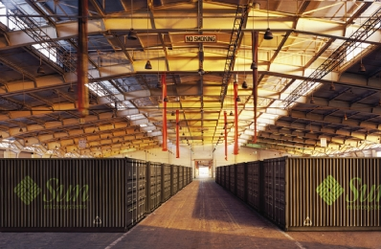

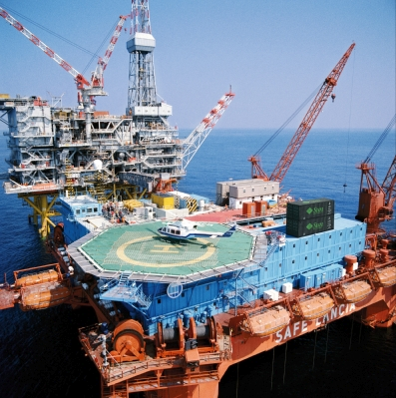
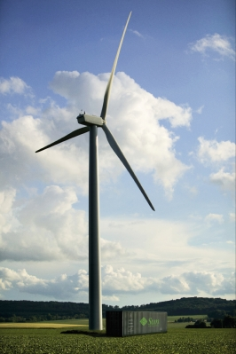
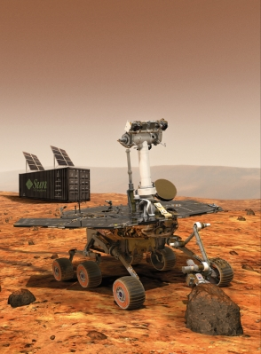
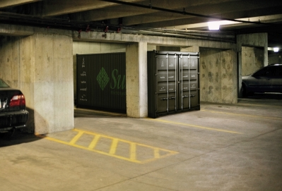
Cloud Computing = Network of Datacenters
Notes:
%Naturally, having multiple datacenters at various distant geographical locations raises the next challenge – coordinating them as part of a single global distributed system.
%Interconnecting the datacenters via high bandwidth, large latency links like optical fiber networks is a viable option today.
Interconnecting datacenters over distant geographical locations can be usually done via high bandwidth, optical fiber networks. Already laid down dark fiber is cheap and can be acquired in bulk – making private lambda networks a reality.
Although the raw bandwidth is cheap, these networks experience some level of packet loss due to cabling, equipment, dirty or degraded fiber and other glitches. Eliminating the packet loss altogether on such links is not an option – the general belief is that non congestion packet loss is unavoidable. For example, on managed links, tier 1 ISP service level agreements cite packet loss rates in the range of 0.1% - 0.3%-0.7%.
% for various reasons like transient malfunctions, poorly configured equipment and dirty or degraded optical fiber.

Slide 9
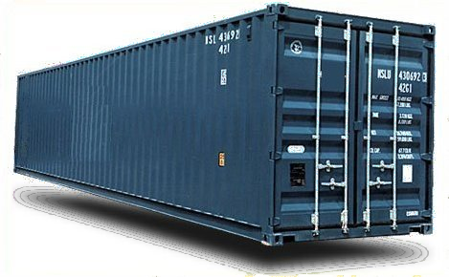
Cloud Computing
  Enable datacenters to coordinate over vast
  distances
  Optimize availability, disaster tolerance, energy
  Without sacrificing performance
  “cloud computing”
Drive underlying technological innovations.
Notes:
A Research and Development Agenda to Improve the Resiliency
of the Financial and Banking Sector
U.S. Department of Treasury - Office of Critical Infrastructure Protection and
Compliance Policy
Financial and Banking Information Infrastructure Committee
Financial Services Sector Coordinating Council
Design eloquent in its simplicity
Secure log promotes integrity
A hash asserts the data and order integrity of log
Byzantine quorums maintain consistency despite failure
Self-organizing via DHT technology
Narrow interface made it possible to implement and deploy system
Need to somehow summarize “Antiquity Design Summary” and “My Contributions” slides and somehow transition to SMFS and KyotoFS!
What one point should the audience take away from here?
This is also where we may discuss our research approach, or we can do it at the end

Slide 10
Cloud Computing
Vision
The promise of the Cloud
  A computer utility; a commodity
  Catalyst for technology economy
  Revolutionizing for health care, financial systems,
  scientific research, and society
However, cloud platforms today
  Entail significant risk: vendor lock-in vs control
  Entail inefficient processes: energy vs performance
  Entail poor communication: fiber optics vs COTS endpoints
Notes:
The cloud completes the commoditization process and makes storage and computation a commodity.

Slide 11
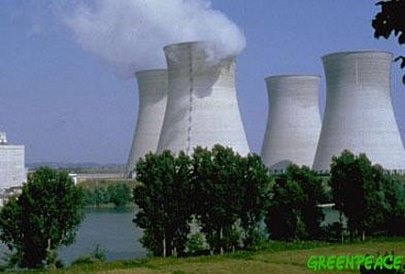

Example: Energy and Performance
Why don’t we save more energy in the cloud?
No one deletes data anymore!
  Huge amounts of seldom-accessed data
Data deluge
  Google (YouTube, Picasa, Gmail, Docs), Facebook, Flickr
  100 GB per second is faster than hard disk capacity growth!
  Max amount of data accessible at one time << Total data
New scalable approach needed to store this data
  Energy footprint proportional to number of HDDs is
  not sustainable

Slide 12
What’s next
Graphics Processing Units

Slide 13

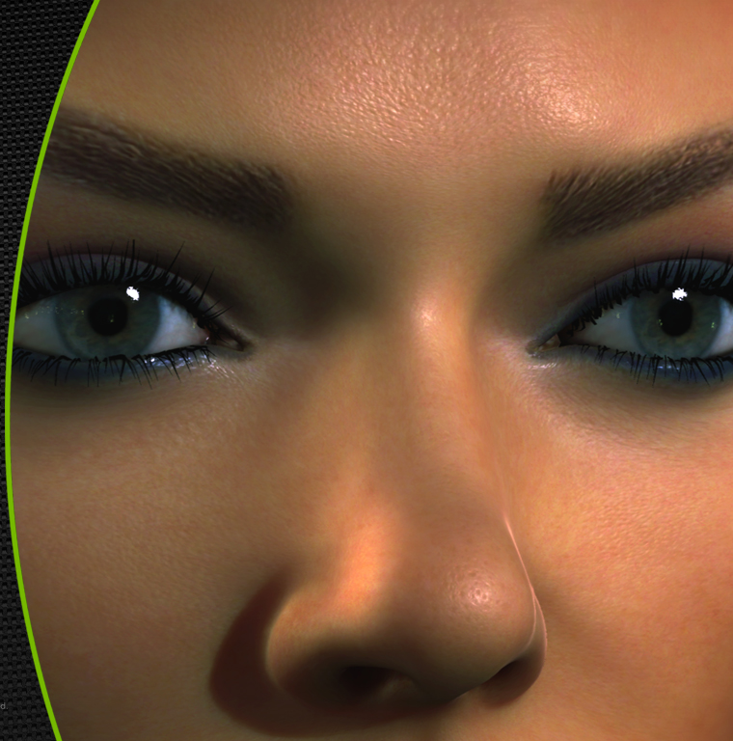

Slide 14
Brief History
Display
The dark ages (early-mid 1990’s), when there were only frame buffers for normal PC’s.
Rasterization
Some accelerators were no more than a simple chip that sped up linear interpolation along a single span, so increasing fill rate.
Projection
& Clipping
This is where pipelines start for PC commodity graphics, prior to Fall of 1999.
Transform
& Lighting
This part of the pipeline reaches the consumer level with the introduction of the NVIDIA GeForce256.
Application
Hardware today is moving traditional application processing (surface generation, occlusion culling) into the graphics accelerator.

Slide 15
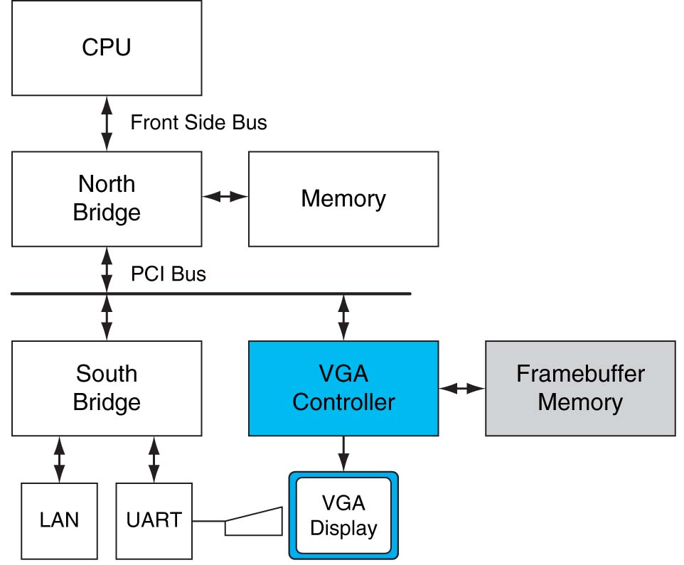
FIGURE A.2.1 Historical PC. VGA controller drives graphics display from framebuffer memory. Copyright © 2009 Elsevier, Inc. All rights reserved.

Slide 16
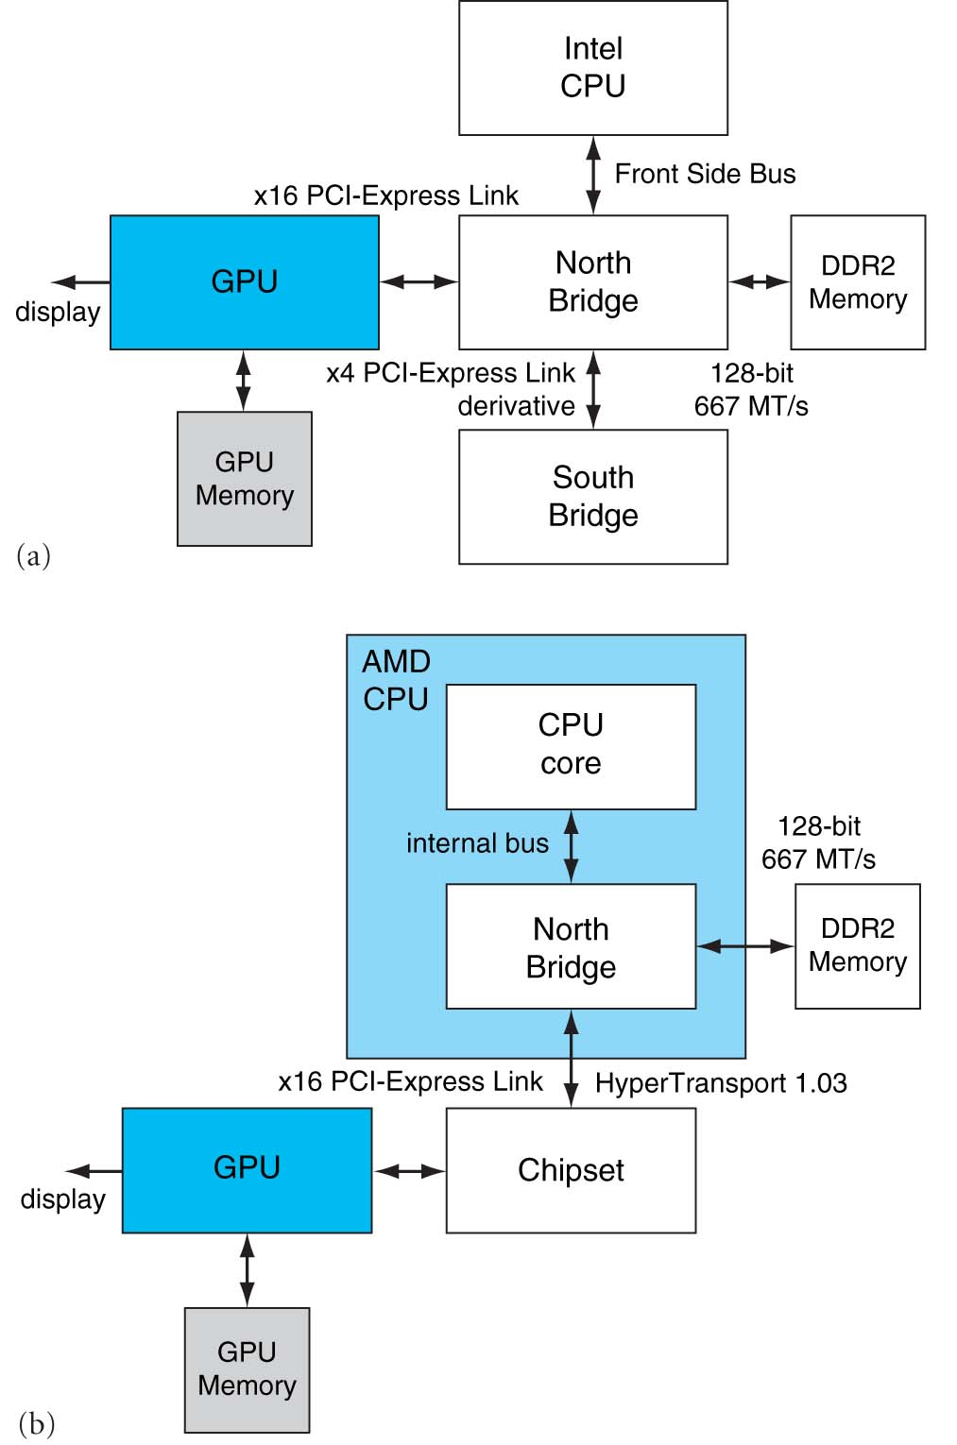

Slide 17
Faster than Moore’s Law
One-pixel polygons (~10M polygons @ 30Hz)
Slope ~2.4x/year
nVidia
G70
10
9
(Moore's Law ~ 1.7x/year)
10
8
UNC/HP PixelFlow
ATI
Radeon 256
SGI
R-Monster
7
SGI
GeForce
10
Division
Pxpl6
IR
E&S
3DLabs
Nvidia TNT
(Δ's/sec)
UNC Pxpl5
Harmony
SGI
Cobalt
Accel/VSIS
Glint
Peak Performance
10
6
SGI SkyWriter
Voodoo
SGI VGX
SGI
Megatek
HP TVRX
RE1
SGI
RE2
E&S Freedom
PC Graphics
Flat
shading
HP VRX
10
5
E&S
Textures
Division VPX
Stellar GS1000
F300
UNC Pxpl4
SGI GT
Gouraud
shading
Antialiasing
HP CRX
10
4
SGI Iris
86
88
90
92
94
96
98
00
Year
Graph courtesy of Professor John Poulton (from Eric Haines)

Slide 18
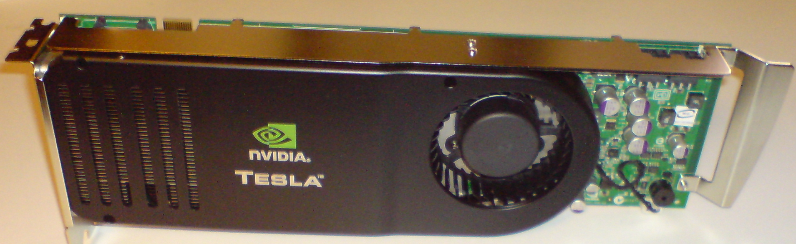
NVidia Tesla Architecture

Slide 19
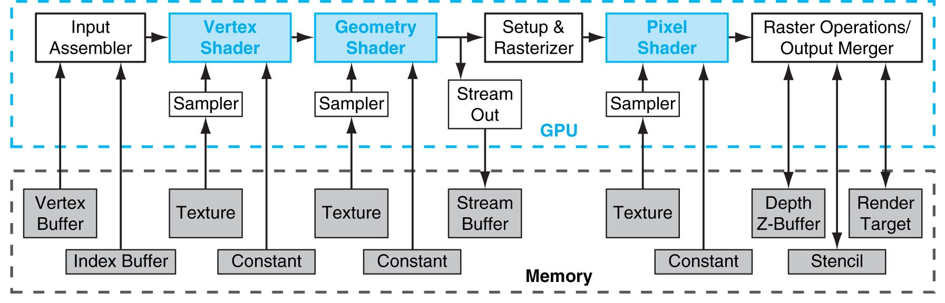
Why are GPUs so fast?
FIGURE A.3.1 Direct3D 10 graphics pipeline. Each logical pipeline stage maps to GPU hardware or to a GPU processor. Programmable shader stages are blue, fixed-function blocks are white, and memory objects are grey. Each stage processes a vertex, geometric primitive, or pixel in a streaming dataflow fashion. Copyright © 2009 Elsevier, Inc. All rights reserved.
Pipelined and parallel
Very, very parallel: 128 to 1000 cores

Slide 20
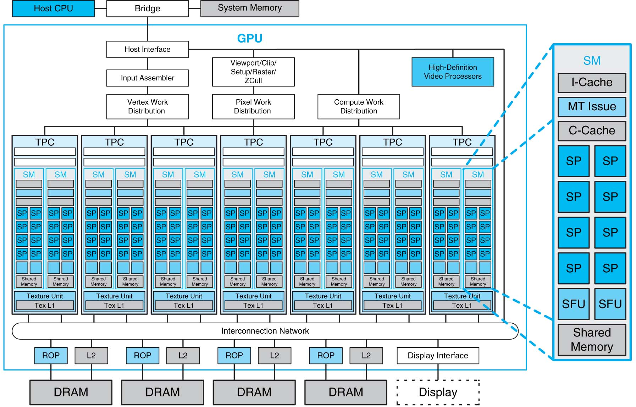
FIGURE A.2.5 Basic unified GPU architecture. Example GPU with 112 streaming processor (SP) cores organized in 14 streaming multiprocessors (SMs); the cores are highly multithreaded. It has the basic Tesla architecture of an NVIDIA GeForce 8800. The processors connect with four 64-bit-wide DRAM partitions via an interconnection network. Each SM has eight SP cores, two special function units (SFUs), instruction and constant caches, a multithreaded instruction unit, and a shared memory. Copyright © 2009 Elsevier, Inc. All rights reserved.

Slide 21
General computing with GPUs
Can we use these for general computation?
Scientific Computing
  MATLAB codes
Convex hulls
Molecular Dynamics
Etc.
NVIDIA’s answer:
Compute Unified Device Architecture (CUDA)
  MATLAB/Fortran/etc. → “C for CUDA” → GPU Codes

Slide 22
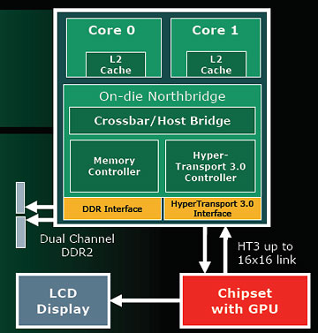
AMDs Hybrid CPU/GPU
AMD’s Answer: Hybrid CPU/GPU

Slide 23
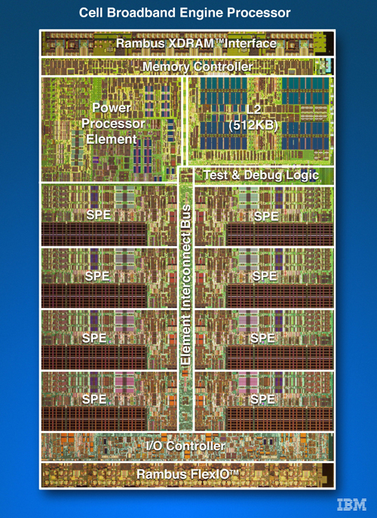
Cell
IBM/Sony/Toshiba
Sony Playstation 3
PPE
SPEs (synergestic)

Slide 24
Parallelism
Must exploit parallelism for performance
  Lots of parallelism in graphics applications
  Lots of parallelism in scientific computing
SIMD: single instruction, multiple data
  Perform same operation in parallel on many data items
  Data parallelism
MIMD: multiple instruction, multiple data
  Run separate programs in parallel (on different data)
  Task parallelism

Slide 25
What’s next
Embedded Processors

Slide 26
Where is the Market?
Millions of Computers
Notes:
For “definitions” of desktop, servers, supercomputers (100’s to 1000’s of processors, Gbytes to Tbytes of main memory, Tbytes to Pbytes of secondary storage), and embedded systems (cell phones, automobile control, video games, entertainment systems (digital TVs), PDAs, etc.).
The computer (IT) industry is responsible for almost 10% of the GNP of the US.
The embedded market has shown the strongest growth (40% compounded annual growth compared to only 9% for desktops – where do laptops fit?). This chart/number does not include the low-end 8-bit and 16-bit embedded processors that are everywhere!
This is a good slide to talk about the other performance metrics in addition to speed (or see if the students can come up with them) including
Power, space/volume, memory space, cost, reliability

Slide 27
Where is the Market?
Millions of Computers
Notes:
For “definitions” of desktop, servers, supercomputers (100’s to 1000’s of processors, Gbytes to Tbytes of main memory, Tbytes to Pbytes of secondary storage), and embedded systems (cell phones, automobile control, video games, entertainment systems (digital TVs), PDAs, etc.).
The computer (IT) industry is responsible for almost 10% of the GNP of the US.
The embedded market has shown the strongest growth (40% compounded annual growth compared to only 9% for desktops – where do laptops fit?). This chart/number does not include the low-end 8-bit and 16-bit embedded processors that are everywhere!
This is a good slide to talk about the other performance metrics in addition to speed (or see if the students can come up with them) including
Power, space/volume, memory space, cost, reliability

Slide 28
Where is the Market?
Millions of Computers
Notes:
For “definitions” of desktop, servers, supercomputers (100’s to 1000’s of processors, Gbytes to Tbytes of main memory, Tbytes to Pbytes of secondary storage), and embedded systems (cell phones, automobile control, video games, entertainment systems (digital TVs), PDAs, etc.).
The computer (IT) industry is responsible for almost 10% of the GNP of the US.
The embedded market has shown the strongest growth (40% compounded annual growth compared to only 9% for desktops – where do laptops fit?). This chart/number does not include the low-end 8-bit and 16-bit embedded processors that are everywhere!
This is a good slide to talk about the other performance metrics in addition to speed (or see if the students can come up with them) including
Power, space/volume, memory space, cost, reliability

Slide 29
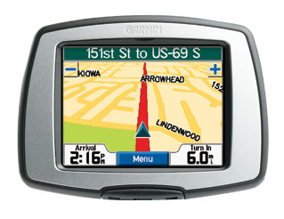
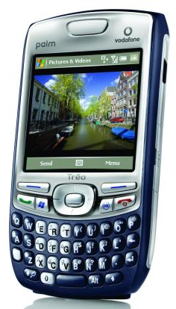


Slide 30
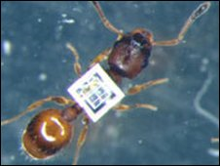
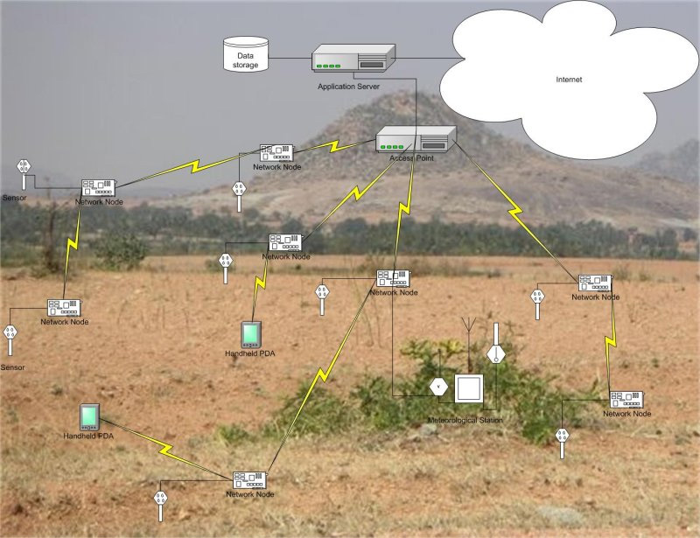
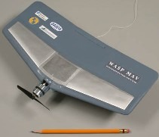
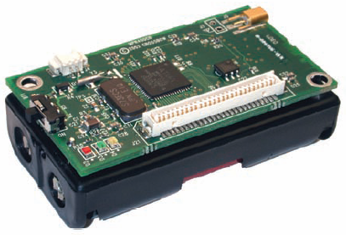
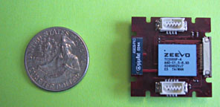
Where to?
Smart Dust….

Slide 31

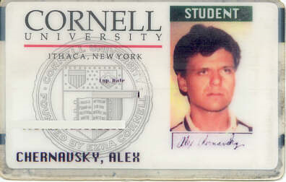
Security?
Smart Cards…

Slide 32
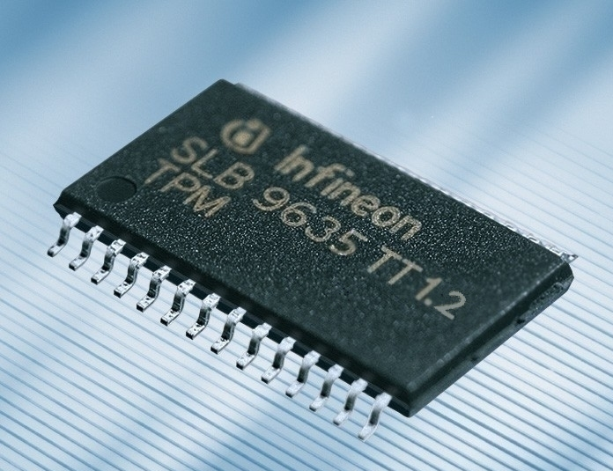
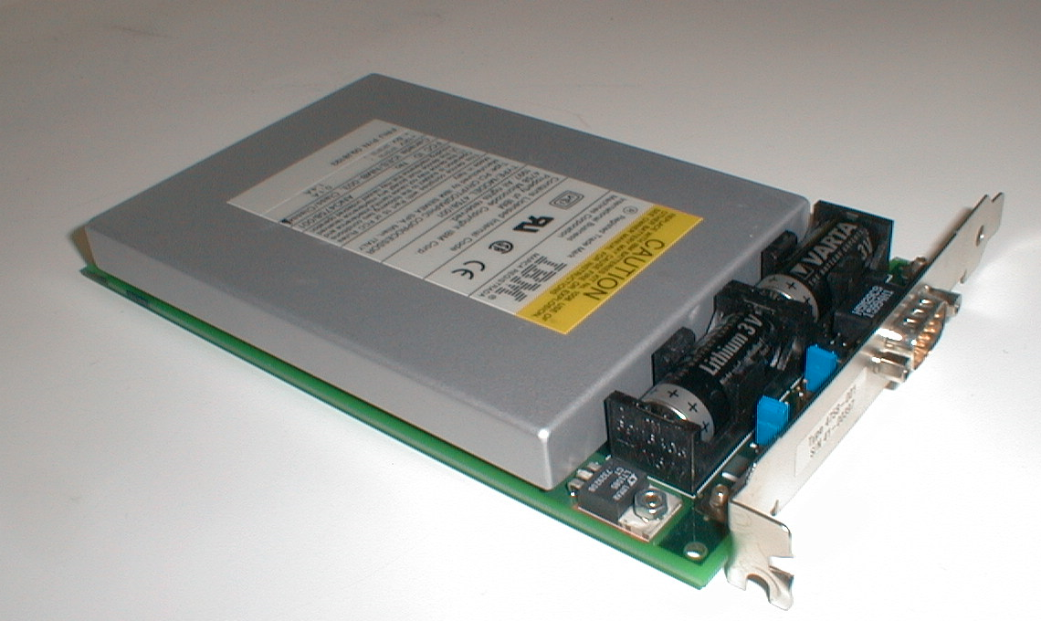
Cryptography and security…
TPM 1.2
IBM 4758
Secure Cryptoprocessor

Slide 33
Smart Dust
& Sensor Networks
Games
Embedded
Computing
Graphics
Security
Scientific
Computing
Cloud Computing
Quantum
Computing?
Cryptography

Slide 34
Survey Questions
How useful is this class, in all seriousness, for a computer scientist going into software engineering, meaning not low-level stuff?
How much of computer architecture do software engineers actually have to deal with?
What are the most important aspects of computer architecture that a software engineer should keep in mind while programming?

Slide 35
Why?
These days, programs run on hardware...
… more than ever before
Google Chrome
→ Operating Systems
→ Multi-Core & Hyper-Threading
→ Datapath Pipelines, Caches, MMUs, I/O & DMA
→ Busses, Logic, & State machines
→ Gates
→ Transistors
→ Silicon
→ Electrons

Slide 36
Where to?
CS 3110: Better concurrent programming
CS 4410: The Operating System!
CS 4450: Networking
CS 4620: Graphics
CS 4821: Quantum Computing
Meng
5412—Cloud Computing, 5414—Distr Computing,
5430—Systems Secuirty,
5300—Arch of Larg scale Info Systems
And many more…

Slide 37
Thank you!
If you want to make an apple pie from scratch, you must first create the universe.
– Carl Sagan

