Slide 1

xkcd/619

Slide 2
Multicore & Parallel Processing
Guest Lecture: Kevin Walsh
CS 3410, Spring 2011
Computer Science
Cornell University

Slide 3
Review
Execution time after improvement =
affected execution time
amount of improvement
+ execution time unaffected
Notes:
Amdahl’s Law

Slide 4
Problem Statement
Q: How to improve system performance?
→ Increase CPU clock rate?
→ But I/O speeds are limited
Disk, Memory, Networks, etc.
Recall: Amdahl’s Law
Solution: Parallelism

Slide 5
Instruction-Level Parallelism (ILP)
Pipelining: execute multiple instructions in parallel
Q: How to get more instruction level parallelism?
A: Deeper pipeline
Pipeline depth limited by…
    max clock speed (less work per stage ⇒ shorter clock cycle)
    min unit of work
    dependencies, hazards / forwarding logic
Notes:
Draw pictures: 250MHz 1-stage; 500Mhz 2-stage; 1GHz 4-stage; 4GHz 16-stage

Slide 6
Instruction-Level Parallelism (ILP)
Pipelining: execute multiple instructions in parallel
Q: How to get more instruction level parallelism?
A: Multiple issue pipeline
    Start multiple instructions per clock cycle in duplicate stages
Notes:
Draw picture; 4 stage, 4-way * 4GHz = 16B inst/cycles
Next: Static issue

Slide 7
Static Multiple Issue
Static Multiple Issue
a.k.a. Very Long Instruction Word (VLIW)
Compiler groups instructions to be issued together
  Packages them into “issue slots”
Q: How does HW detect and resolve hazards?
A: It doesn’t.
→ Simple HW, assumes compiler avoids hazards
Example: Static Dual-Issue 32-bit MIPS
  Instructions come in pairs (64-bit aligned)
    One ALU/branch instruction (or nop)
    One load/store instruction (or nop)
Notes:
show program, decode stage
Ideal CPI = 0.5

Slide 8
Scheduling Example
Compiler scheduling for dual-issue MIPS…
TOP: lw $t0, 0($s1) # $t0 = A[i]
lw $t1, 4($s1) # $t1 = A[i+1]
addu $t0, $t0, $s2 # add $s2
addu $t1, $t1, $s2 # add $s2
sw $t0, 0($s1) # store A[i]
sw $t1, 4($s1) # store A[i+1]
addi $s1, $s1, +8 # increment pointer
bne $s1, $s3, TOP # continue if $s1!=end
ALU/branch slot Load/store slot cycle
TOP: nop lw $t0, 0($s1) 1
nop lw $t1, 4($s1) 2
addu $t0, $t0, $s2 nop 3
addu $t1, $t1, $s2 sw $t0, 0($s1) 4
addi $s1, $s1, +8 sw $t1, 4($s1) 5
bne $s1, $s3, TOP nop 6
Notes:
assume 1 delay slot for loads
can move addi earlier
CPI = 6 cycles / 8 instructions = 0.75
CPI = 5 cycles / 8 instructions = 0.625

Slide 9
Limits of Static Scheduling
Compiler scheduling for dual-issue MIPS…
lw $t0, 0($s1) # load A
addi $t0, $t0, +1 # increment A
sw $t0, 0($s1) # store A
lw $t0, 0($s2) # load B
addi $t0, $t0, +1 # increment B
sw $t0, 0($s2) # store B
ALU/branch slot Load/store slot cycle
nop lw $t0, 0($s1) 1
nop nop 2
addi $t0, $t0, +1 nop 3
nop sw $t0, 0($s1) 4
nop lw $t0, 0($s2) 5
nop nop 6
addi $t0, $t0, +1 nop 7
nop sw $t0, 0($s2) 8
Notes:
Rename registers, move load B up, eliminate delay slot
But! s1 and s2 might be equal => Aliasing!

Slide 10
Dynamic Multiple Issue
Dynamic Multiple Issue
a.k.a. SuperScalar Processor (c.f. Intel)
  CPU examines instruction stream and chooses multiple instructions to issue each cycle
  Compiler can help by reordering instructions….
  … but CPU is responsible for resolving hazards
Even better: Speculation/Out-of-order Execution
  Execute instructions as early as possible
  Aggressive register renaming
  Guess results of branches, loads, etc.
  Roll back if guesses were wrong
  Don’t commit results until all previous insts. are retired

Slide 11
Does Multiple Issue Work?
Q: Does multiple issue / ILP work?
A: Kind of… but not as much as we’d like
Limiting factors?
  Programs dependencies
  Hard to detect dependencies → be conservative
    e.g. Pointer Aliasing: A[0] += 1; B[0] *= 2;
  Hard to expose parallelism
    Can only issue a few instructions ahead of PC
  Structural limits
    Memory delays and limited bandwidth
  Hard to keep pipelines full

Slide 12
Power Efficiency
Q: Does multiple issue / ILP cost much?
A: Yes.
→ Dynamic issue and speculation requires power
CPU | Year | Clock Rate | Pipeline Stages | Issue width | Out-of-order/ Speculation | Cores | Power
i486 | 1989 | 25MHz | 5 | 1 | No | 1 | 5W
Pentium | 1993 | 66MHz | 5 | 2 | No | 1 | 10W
Pentium Pro | 1997 | 200MHz | 10 | 3 | Yes | 1 | 29W
P4 Willamette | 2001 | 2000MHz | 22 | 3 | Yes | 1 | 75W
UltraSparc III | 2003 | 1950MHz | 14 | 4 | No | 1 | 90W
P4 Prescott | 2004 | 3600MHz | 31 | 3 | Yes | 1 | 103W
Core | 2006 | 2930MHz | 14 | 4 | Yes | 2 | 75W
UltraSparc T1 | 2005 | 1200MHz | 6 | 1 | No | 8 | 70W
→ Multiple simpler cores may be better?

Slide 13
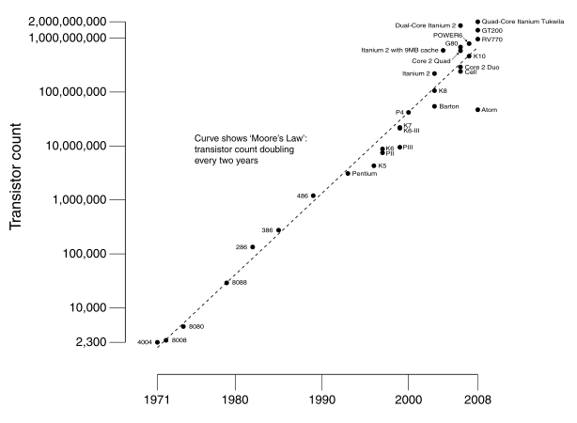
Moore’s Law
Dual-core Itanium 2
K10
Itanium 2
K8
P4
Atom
Pentium
486
386
286
8088
8080
4004
8008
Notes:
NVIDIA GF100 has 3B transistors

Slide 14
Why Multicore?
Moore’s law
  A law about transistors
  Smaller means more transistors per die
  And smaller means faster too
But: Power consumption growing too…

Slide 15
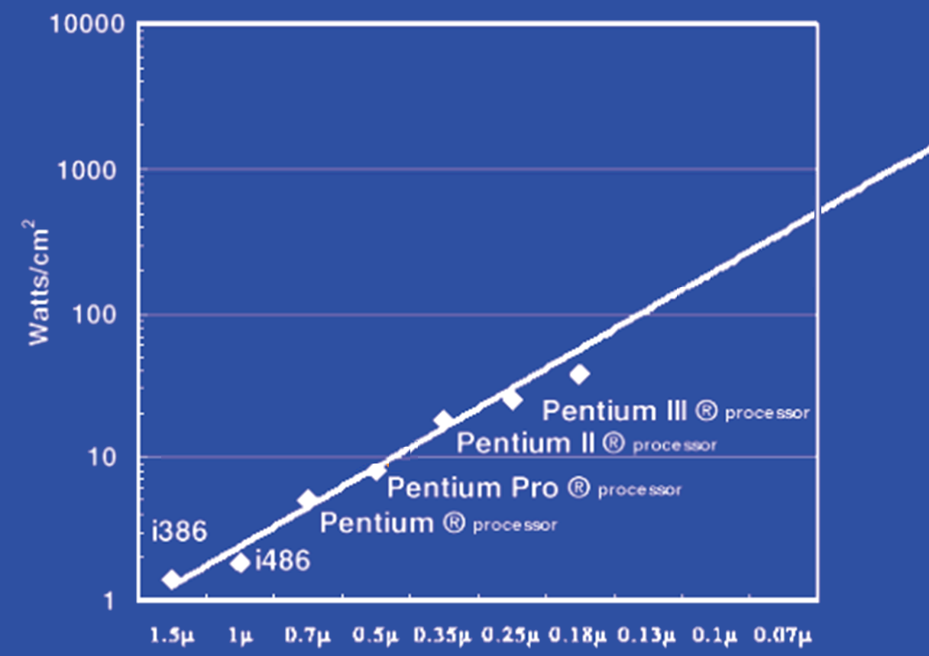
Power Limits
Surface of Sun
Rocket Nozzle
Nuclear Reactor
Xeon
Hot Plate
Notes:
Intel Westmere: 32 nm = 0.032u, 130W / 240mm^2 = 54 W/cm^2

Slide 16
Power Wall
Power = capacitance * voltage² * frequency
In practice: Power ~ voltage³
Reducing voltage helps (a lot)
... so does reducing clock speed
Better cooling helps
The power wall
  We can’t reduce voltage further
  We can’t remove more heat

Slide 17
Why Multicore?
Performance
1.2x
Single-Core
Overclocked +20%
Power
1.7x
Performance
1.0x
Power
Single-Core
1.0x
Performance
0.8x
1.6x
Single-Core
Underclocked -20%
Dual-Core
Underclocked -20%
Power
0.51x
1.02x

Slide 18
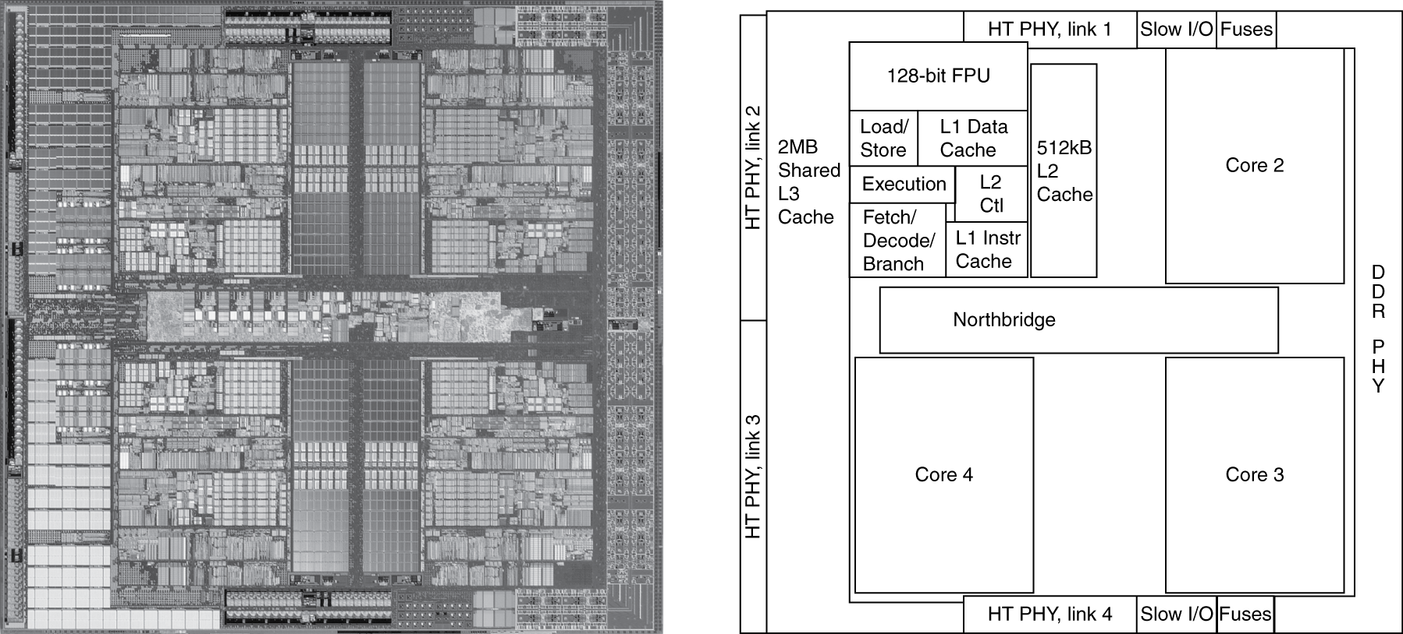
Inside the Processor
AMD Barcelona Quad-Core: 4 processor cores

Slide 19
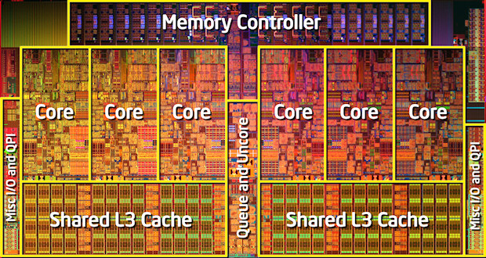
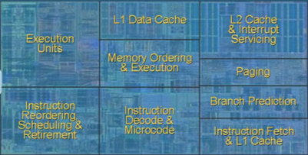
Inside the Processor
Intel Nehalem Hex-Core

Slide 20
Hyperthreading
Multi-Core vs. Multi-Issue
Programs:
Num. Pipelines:
Pipeline Width:
Hyperthreads (Intel)
  Illusion of multiple cores on a single core
  Easy to keep HT pipelines full + share functional units
vs. HT
Notes:
HT = MultiIssue + extra PCs and registers – dependency logic
HT = MultiCore – redundant functional units + hazard avoidance

Slide 21
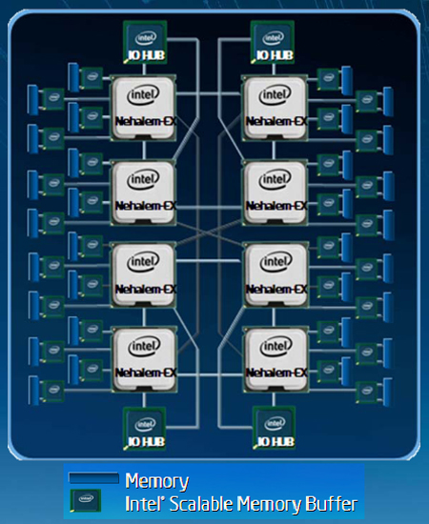
Example: All of the above
Notes:
MultiCore: 8 processors dies * 8 cores per processor die
Hyperthreading: 2 HT per core
Dynamic Multi-Issue: 4 issue
Pipeline: 16 stages

Slide 22
Parallel Programming
Q: So lets just all use multicore from now on!
A: Software must be written as parallel program
Multicore difficulties
  Partitioning work
  Coordination & synchronization
  Communications overhead
  Balancing load over cores
  How do you write parallel programs?
    ... without knowing exact underlying architecture?
Notes:
Or hyperthreads

Slide 23
Work Partitioning
Partition work so all cores have something to do

Slide 24
Load Balancing
Load Balancing
Need to partition so all cores are actually working

Slide 25
Amdahl’s Law
If tasks have a serial part and a parallel part…
Example:
step 1: divide input data into n pieces
step 2: do work on each piece
step 3: combine all results
Recall: Amdahl’s Law
As number of cores increases …
  time to execute parallel part?
  time to execute serial part?

Slide 26
Amdahl’s Law
Notes:
Underclocking messes up the ratios completely. Work through a 8x slowdown example.

Slide 27
Parallel Programming
Q: So lets just all use multicore from now on!
A: Software must be written as parallel program
Multicore difficulties
  Partitioning work
  Coordination & synchronization
  Communications overhead
  Balancing load over cores
  How do you write parallel programs?
    ... without knowing exact underlying architecture?
Notes:
Most is software, but hardware can help:
- communications (fast core-to-core interconnect)
- coordination and synchronization primitives (next time)

