Slide 1
I/O
Hakim Weatherspoon
CS 3410, Spring 2011
Computer Science
Cornell University
See: P&H Chapter 6.5-6

Slide 2
Goals for Today
Computer System Organization
How to talk to device?
Programmed I/O or Memory-Mapped I/O
How to get events?
Polling or Interrupts
How to transfer lots of data?
Direct Memory Access (DMA)

Slide 3
Computer System Organization
Computer System =
Input + Output + Memory + Datapath + Control
Keyboard
Mouse
Video
Network
USB
CPU
Registers
bus
bus
Serial
Memory
Disk
Audio

Slide 4
Challenge
How do we interface to other devices
Keyboard
Mouse
Disk
Network
Display
Programmable Timer (for clock ticks)
Audio
Printer(s)
Camera
iPod
Scanner
…

Slide 5
Interconnects
Bad Idea #1: Put all devices on one interconnect
We would have to replace all devices as we improve/change the interconnect
keyboard speed == main memory speed ?!
CPU
Video
Network
Cache
Keyboard
interconnect
Serial
Memory
Disk
Audio

Slide 6
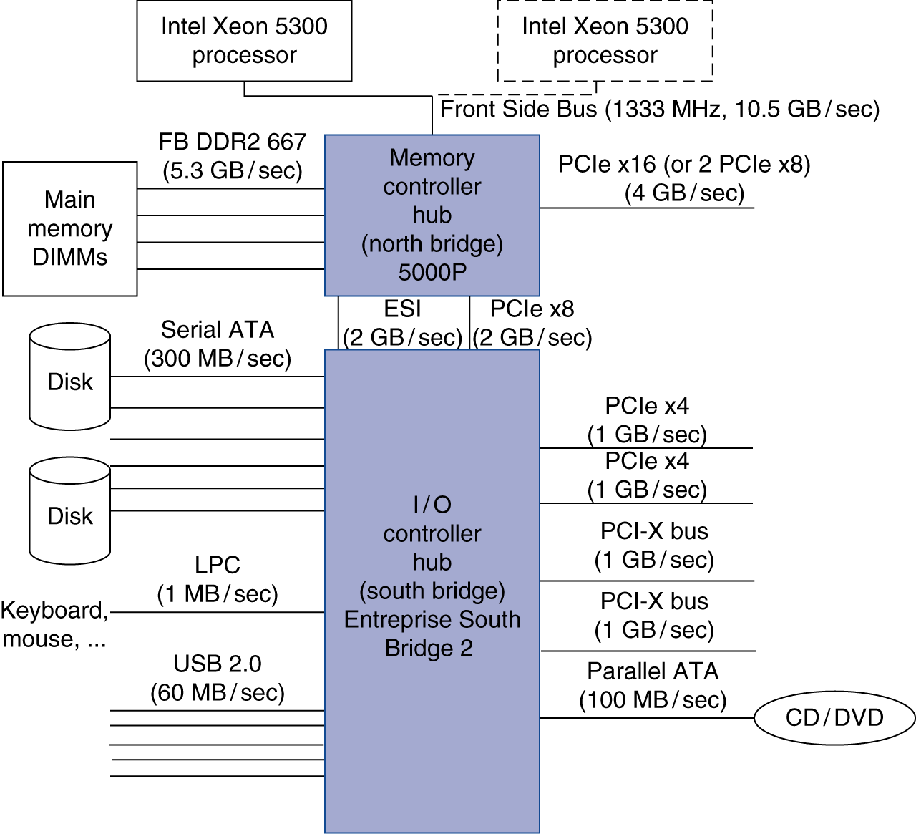
I/O Controllers
Decouple via I/O Controllers and “Bridges”
fast/expensive busses when needed; slow/cheap elsewhere
I/O controllers to connect end devices
Notes:
Graphics card lives on PCIe
Network card lives on PICe or PCI-X

Slide 7
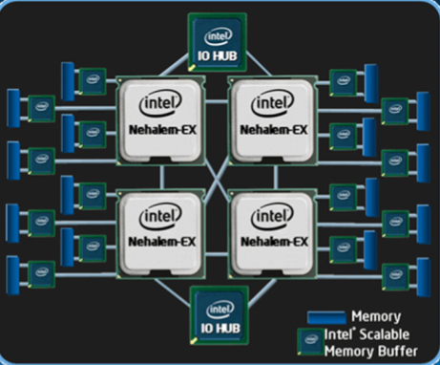
I/O Controllers
Decouple via I/O Controllers and “Bridges”
fast/expensive busses when needed; slow/cheap elsewhere
I/O controllers to connect end devices
Notes:
Graphics card lives on PCIe
Network card lives on PICe or PCI-X

Slide 8
Interconnecting Components
Interconnects are (were?) busses
parallel set of wires for data and control
shared channel
multiple senders/receivers
everyone can see all bus transactions
bus protocol: rules for using the bus wires
Alternative (and increasingly common):
dedicated point-to-point channels
Notes:
CPU – North Bridge / Memory Controller
North Bridge – South Bridge / SuperIO

Slide 9
Bus Parameters
Width = number of wires
Transfer size = data words per bus transaction
Synchronous (with a bus clock) or asynchronous (no bus clock / “self clocking”)

Slide 10
Bus Types
Processor – Memory (“Front Side Bus”. Also QPI)
Short, fast, & wide
Mostly fixed topology, designed as a “chipset”
CPU + Caches + Interconnect + Memory Controller
I/O and Peripheral busses (PCI, SCSI, USB, LPC, …)
Longer, slower, & narrower
Flexible topology, multiple/varied connections
Interoperability standards for devices
Connect to processor-memory bus through a bridge
Notes:
Note: USB is not really a bus, it is really a network.

Slide 11
Typical x86 PC I/O System
Notes:
FSB: > 10 bytes wide
LPC = 4 bits wide

Slide 12
Typical x86 PC I/O System
Notes:
FSB: > 10 bytes wide
LPC = 4 bits wide

Slide 13
I/O Device API
Typical I/O Device API
a set of read-only or read/write registers
Command registers
writing causes device to do something
Status registers
reading indicates what device is doing, error codes, …
Data registers
Write: transfer data to a device
Read: transfer data from a device

Slide 14
Simple (old) example: AT Keyboard Device
8-bit Status:
8-bit Cmd: 0xAA = “self test” 0xAE = “enable kbd” 0xED = “set LEDs”
…
8-bit Data: scancode (when reading) LED state (when writing) or …
PE | TO | AUXB | LOCK | AL2 | SYSF | IBS | OBS
Notes:
IBS = input buffer status: 0 = waiting for commands, 1 = busy
OBS = output buffer status: 0 = waiting for data, 1 = data is available

Slide 15
Communication Interface
Q: How does program OS code talk to device?
A: special instructions to talk over special busses
Programmed I/O
inb $a, 0x64
outb $a, 0x60
Specifies: device, data, direction
Protection: only allowed in kernel mode
*x86: $a implicit; also inw, outw, inh, outh, …

Slide 16
Communication Interface
Q: How does program OS code talk to device?
A: Map registers into virtual address space
Memory-mapped I/O
Accesses to certain addresses redirected to I/O devices
Data goes over the memory bus
Protection: via bits in pagetable entries
OS+MMU+devices configure mappings

Slide 17
Memory-Mapped I/O
Video Registers & Memory
Virtual
Address
Space
Physical
Address
Space
Audio Registers
RAM
Keyboard Registers

Slide 18
Device Drivers
Programmed I/O
char read_kbd()
{
do {
sleep();
status = inb(0x64);
} while (!(status & 1));
return inb(0x60);
}
Memory Mapped I/O
struct kbd {
char status, pad[3];
char data, pad[3];
};
kbd *k = mmap(...);
char read_kbd()
{
do {
sleep();
status = k->status;
} while (!(status & 1));
return k->data;
}

Slide 19
Communication Method
Q: How does program learn device is ready/done?
A: Polling: Periodically check I/O status register
If device ready, do operation
If device done, …
If error, take action
Pro? Con?
Predictable timing & inexpensive
But: wastes CPU cycles if nothing to do
Efficient if there is always work to do
Common in small, cheap, or real-time embedded systems
Sometimes for very active devices too…

Slide 20
Communication Method
Q: How does program learn device is ready/done?
A: Interrupts: Device sends interrupt to CPU
Cause identifies the interrupting device
interrupt handler examines device, decides what to do
Priority interrupts
Urgent events can interrupt lower-priority interrupt handling
OS can disable defer interrupts
Notes:
Con: unpredictable b/c event arrival depends on other devices’ activity

Slide 21
Typical x86 PC I/O System
Notes:
Show interrupt lines

Slide 22
I/O Data Transfer
How to talk to device? Programmed I/O or Memory-Mapped I/O
How to get events? Polling or Interrupts
How to transfer lots of data?
disk->cmd = READ_4K_SECTOR;
disk->data = 12;
while (!(disk->status & 1) { }
for (i = 0..4k)
buf[i] = disk->data;

Slide 23
DMA: Direct Memory Access
Programmed I/O xfer: Device ←→ CPU ←→ RAM
for (i = 1 .. n)
CPU issues read request
Device puts data on bus & CPU reads into registers
CPU writes data to memory
CPU
RAM
DISK

Slide 24
I/O Data Transfer
Q: How to transfer lots of data efficiently?
A: Have device access memory directly
Direct memory access (DMA)
OS provides starting address, length
controller (or device) transfers data autonomously
Interrupt on completion / error

Slide 25
DMA: Direct Memory Access
Programmed I/O xfer: Device ←→ CPU ←→ RAM
for (i = 1 .. n)
CPU issues read request
Device puts data on bus & CPU reads into registers
CPU writes data to memory
DMA xfer: Device ←→ RAM
CPU sets up DMA request
for (i = 1 ... n) Device puts data on bus & RAM accepts it
CPU
RAM
DISK
CPU
RAM
DISK

Slide 26
DMA Example
DMA example: reading from audio (mic) input
DMA engine on audio device… or I/O controller … or …
int dma_size = 4*PAGE_SIZE;
int *buf = alloc_dma(dma_size);
...
dev->mic_dma_baseaddr = (int)buf;
dev->mic_dma_count = dma_len;
dev->cmd = DEV_MIC_INPUT | DEV_INTERRUPT_ENABLE | DEV_DMA_ENABLE;

Slide 27
DMA Issues (1): Addressing
Issue #1: DMA meets Virtual Memory
RAM: physical addresses
Programs: virtual addresses
Solution: DMA uses physical addresses
OS uses physical address when setting up DMA
OS allocates contiguous physical pages for DMA
Or: OS splits xfer into page-sized chunks
(many devices support DMA “chains” for this reason)
CPU
MMU
RAM
DISK

Slide 28
DMA Example
DMA example: reading from audio (mic) input
DMA engine on audio device… or I/O controller … or …
int dma_size = 4*PAGE_SIZE;
void *buf = alloc_dma(dma_size);
...
dev->mic_dma_baseaddr = virt_to_phys(buf);
dev->mic_dma_count = dma_len;
dev->cmd = DEV_MIC_INPUT | DEV_INTERRUPT_ENABLE | DEV_DMA_ENABLE;

Slide 29
DMA Issues (1): Addressing
Issue #1: DMA meets Virtual Memory
RAM: physical addresses
Programs: virtual addresses
Solution 2: DMA uses virtual addresses
OS sets up mappings on a mini-TLB
CPU
MMU
RAM
DISK
uTLB

Slide 30
DMA Issues (2): Virtual Mem
Issue #2: DMA meets Paged Virtual Memory
DMA destination page may get swapped out
Solution: Pin the page before initiating DMA
Alternate solution: Bounce Buffer
DMA to a pinned kernel page, then memcpy elsewhere
CPU
RAM
DISK

Slide 31
DMA Issues (4): Caches
Issue #4: DMA meets Caching
DMA-related data could be cached in L1/L2
DMA to Mem: cache is now stale
DMA from Mem: dev gets stale data
Solution: (software enforced coherence)
OS flushes some/all cache before DMA begins
Or: don't touch pages during DMA
Or: mark pages as uncacheable in page table entries
(needed for Memory Mapped I/O too!)
CPU
L2
RAM
DISK

Slide 32
DMA Issues (4): Caches
Issue #4: DMA meets Caching
DMA-related data could be cached in L1/L2
DMA to Mem: cache is now stale
DMA from Mem: dev gets stale data
Solution 2: (hardware coherence aka snooping)
cache listens on bus, and conspires with RAM
Dma to Mem: invalidate/update data seen on bus
DMA from mem: cache services request if possible, otherwise RAM services
CPU
L2
RAM
DISK

Slide 33
I/O Summary
How to talk to device? Programmed I/O or Memory-Mapped I/O
How to get events? Polling or Interrupts
How to transfer lots of data?
DMA

