Slide 1
Caches
Hakim Weatherspoon
CS 3410, Spring 2011
Computer Science
Cornell University
See P&H 5.1, 5.2 (except writes)

Slide 2
Announcements
HW3 available due next Tuesday
  Work with alone partner
  Be responsible with new knowledge
Use your resources
  FAQ, class notes, book, Sections, office hours, newsgroup, CSUGLab
Next six weeks
  Two homeworks and two projects
  Optional prelim1 tomorrow, Wednesday, in Philips 101
  Prelim2 will be Thursday, April 28th
  PA4 will be final project (no final exam)

Slide 3
Goals for Today: caches
Caches vs memory vs tertiary storage
  Tradeoffs: big & slow vs small & fast
    Best of both worlds
  working set: 90/10 rule
  How to predict future: temporal & spacial locality
Cache organization, parameters and tradeoffs
associativity, line size, hit cost, miss penalty, hit rate
  Fully Associative → higher hit cost, higher hit rate
  Larger block size → lower hit cost, higher miss penalty

Slide 4
Performance
CPU clock rates ~0.2ns – 2ns (5GHz-500MHz)
Technology Capacity $/GB Latency
Tape 1 TB $.17 100s of seconds
Disk 2 TB $.03 Millions of cycles (ms)
SSD (Flash) 128 GB $2 Thousands of cycles (us)
DRAM 8 GB $10 (10s of ns)
SRAM off-chip 8 MB $4000 5-15 cycles (few ns)
SRAM on-chip 256 KB ??? 1-3 cycles (ns)
Others: eDRAM aka 1-T SRAM, FeRAM, CD, DVD, …
Q: Can we create illusion of cheap + large + fast?
50-300 cycles
Notes:
Capacity and latency are closely coupled
Cost is inversely proportional

Slide 5
Memory Pyramid
RegFile
100s bytes
< 1 cycle access
L1 Cache
(several KB)
1-3 cycle access
L3 becoming more common
(eDRAM ?)
L2 Cache (½-32MB)
5-15 cycle access
Memory Pyramid
Memory (128MB – few GB)
50-300 cycle access
Disk (Many GB – few TB)
1000000+
cycle access
These are rough numbers: mileage may vary for latest/greatest
Caches usually made of SRAM (or eDRAM)
Notes:
L1 L2 and even L3 all on-chip these days using SRAM and eDRAM

Slide 6
Memory Hierarchy
Memory closer to processor
  small & fast
  stores active data
Memory farther from processor
  big & slow
  stores inactive data

Slide 7
Active vs Inactive Data
Assumption: Most data is not active.
Q: How to decide what is active?
A: Some committee decides
A: Programmer decides
A: Compiler decides
A: OS decides at run-time
A: Hardware decides
at run-time
Notes:
90/10 rule

Slide 8
Insight of Caches
A: Data that will be used soon
Q: What is “active” data?
If Mem[x] is was accessed recently...
… then Mem[x] is likely to be accessed soon
  Exploit temporal locality:
… then Mem[x ± ε] is likely to be accessed soon
  Exploit spatial locality:
put recently accessed Mem[x] higher in the pyramid
put entire block containing Mem[x] higher in the pyramid
Notes:
soon = frequency of loads

Slide 9
Locality
Memory trace
0x7c9a2b18
0x7c9a2b19
0x7c9a2b1a
0x7c9a2b1b
0x7c9a2b1c
0x7c9a2b1d
0x7c9a2b1e
0x7c9a2b1f
0x7c9a2b20
0x7c9a2b21
0x7c9a2b22
0x7c9a2b23
0x7c9a2b28
0x7c9a2b2c
0x0040030c
0x00400310
0x7c9a2b04
0x00400314
0x7c9a2b00
0x00400318
0x0040031c
...
int n = 4;
int k[] = { 3, 14, 0, 10 };
int fib(int i) {
  if (i <= 2) return i;
  else return fib(i-1)+fib(i-2);
}
int main(int ac, char **av) {
for (int i = 0; i < n; i++) {
printi(fib(k[i]));
prints("\n");
}
}

Slide 10
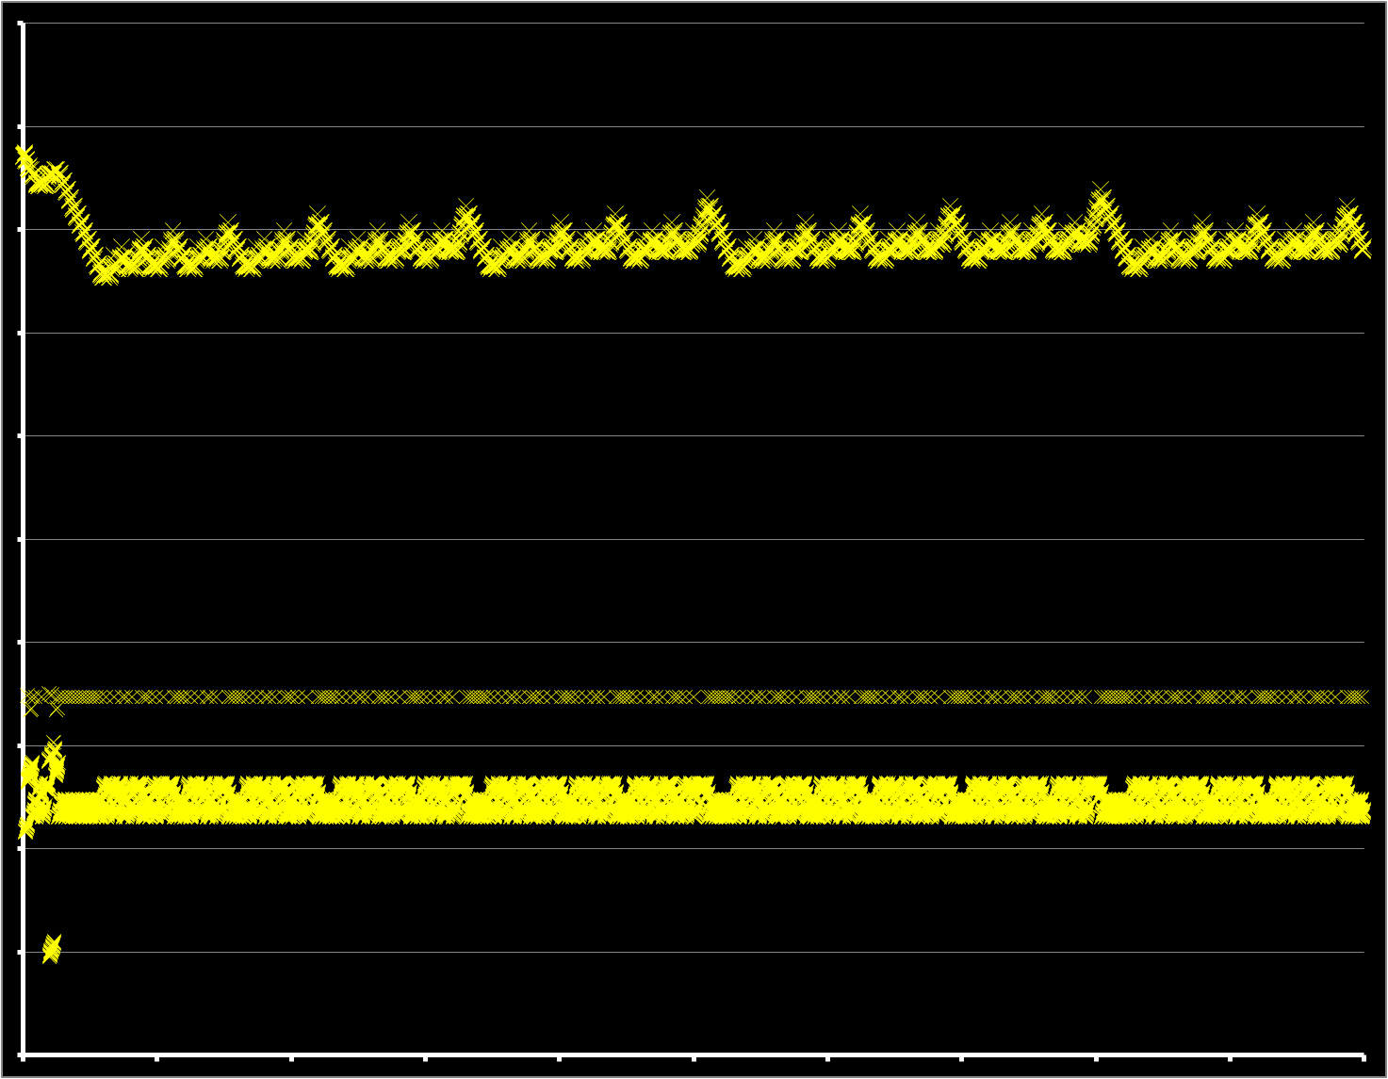
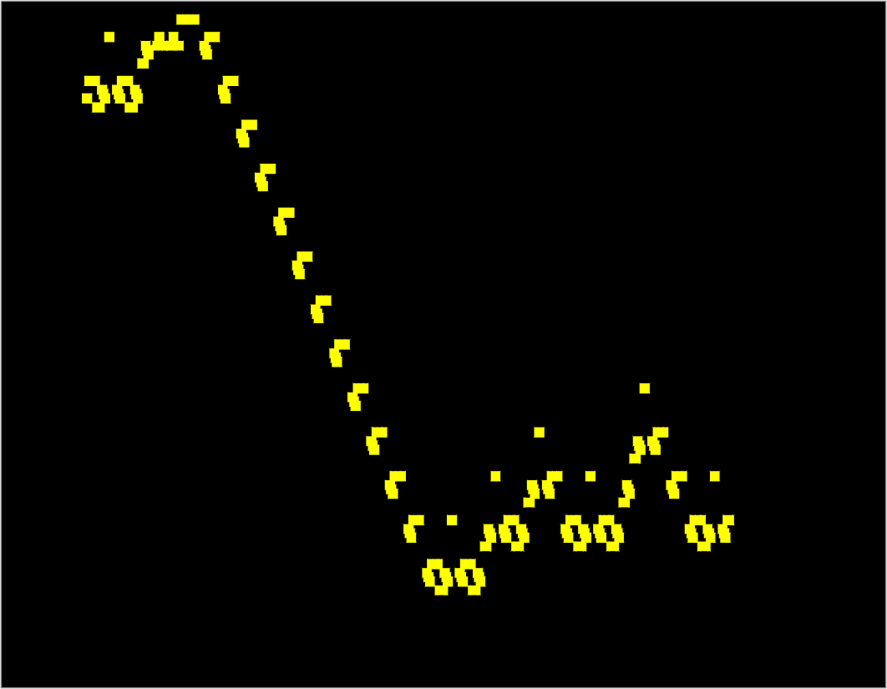
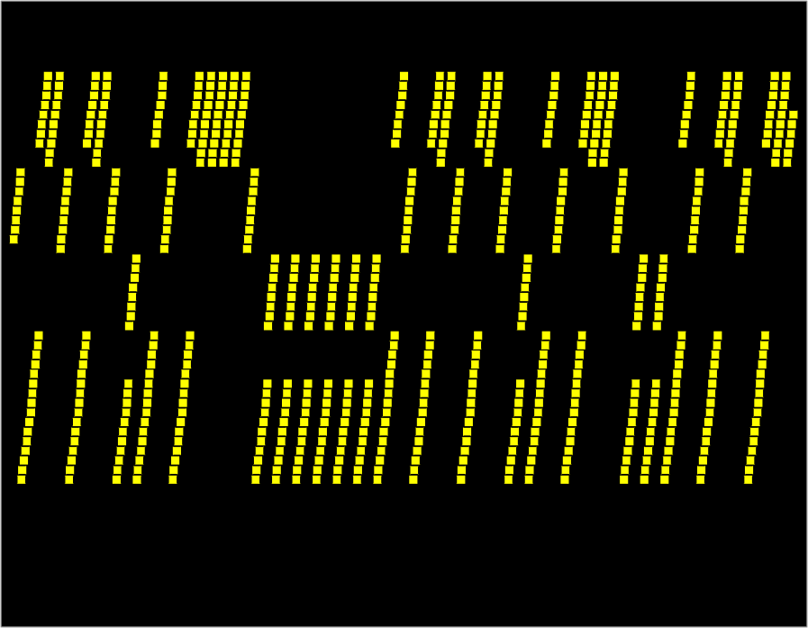
Locality
0x7c9a2b1f
0x00400318
0x00000000

Slide 11
Memory Hierarchy
Memory closer to processor is fast but small
  usually stores subset of memory farther away
    “strictly inclusive”
  alternatives:
    strictly exclusive
    mostly inclusive
  Transfer whole blocks
  (cache lines):
  4kb: disk ↔ ram
  256b: ram ↔ L2
  64b: L2 ↔ L1

Slide 12
Cache Lookups (Read)
Processor tries to access Mem[x]
Check: is block containing Mem[x] in the cache?
  Yes: cache hit
    return requested data from cache line
  No: cache miss
    read block from memory (or lower level cache)
    (evict an existing cache line to make room)
    place new block in cache
    return requested data
    → and stall the pipeline while all of this happens

Slide 13
Cache Organization
Cache Controller
CPU
Cache has to be fast and dense
  Gain speed by performing lookups in parallel
    but requires die real estate for lookup logic
  Reduce lookup logic by limiting where in the cache a block might be placed
    but might reduce cache effectiveness
Notes:
draw: dram on right; sram in controller; lookup logic;

Slide 14
Three common designs
A given data block can be placed…
  … in any cache line → Fully Associative
  … in exactly one cache line → Direct Mapped
  … in a small set of cache lines → Set Associative

Slide 15
Direct Mapped Cache
Direct Mapped Cache
  Each block number mapped to a single
  cache line index
  Simplest hardware
0x000000
0x000004
0x000008
0x00000c
0x000010
0x000014
0x000018
0x00001c
0x000020
0x000024
0x000028
0x00002c
0x000030
0x000034
0x000038
0x00003c
0x000040
0x000044
0x000048
line 0
line 1
Notes:
4 bytes each, 8 bytes per line, show tags

Slide 16
Direct Mapped Cache
Direct Mapped Cache
  Each block number mapped to a single
  cache line index
  Simplest hardware
0x000000
0x000004
0x000008
0x00000c
0x000010
0x000014
0x000018
0x00001c
0x000020
0x000024
0x000028
0x00002c
0x000030
0x000034
0x000038
0x00003c
0x000040
0x000044
0x000048
line 0
line 1
line 2
line 3
Notes:
4 bytes each, 8 bytes per line, show tags

Slide 17
Tags and Offsets
Assume sixteen 64-byte cache lines
0x7FFF3D4D
= 0111 1111 1111 1111 0011 1101 0100 1101
Need meta-data for each cache line:
  valid bit: is the cache line non-empty?
  tag: which block is stored in this line (if valid)
Q: how to check if X is in the cache?
Q: how to clear a cache line?
Notes:
bottom 2 = byte offset within word
bottom 6 = byte offset within cache line
next 4 = cache line index
remaining = tag

Slide 18
A Simple Direct Mapped Cache
Using byte addresses in this example! Addr Bus = 5 bits
Processor
Direct Mapped
Cache
Memory
0 | 101
1 | 103
2 | 107
3 | 109
4 | 113
5 | 127
6 | 131
7 | 137
8 | 139
9 | 149
10 | 151
11 | 157
12 | 163
13 | 167
14 | 173
15 | 179
16 | 181
lb $1 ← M[ 1 ]
lb $2 ← M[ 13 ]
lb $3 ← M[ 0 ]
lb $3 ← M[ 6 ]
lb $2 ← M[ 5 ]
lb $2 ← M[ 6 ]
lb $2 ← M[ 10 ]
lb $2 ← M[ 12 ]
0 | 101
1 | 103
2 | 107
3 | 109
4 | 113
5 | 127
6 | 131
7 | 137
8 | 139
9 | 149
10 | 151
11 | 157
12 | 163
13 | 167
14 | 173
15 | 179
16 | 181
A =
V tag data
$1
$2
$3
$4
Hits: Misses:
Notes:
4 cache lines
line size = 2 bytes
offset is 1 bit
index is 2 bits
tag is 2 bits

Slide 19
Direct Mapped Cache (Reading)
Tag Index Offset
V
Tag
Block
=
word select
data
hit?

Slide 20
Direct Mapped Cache Size
Tag Index Offset
n bit index, m bit offset
Q: How big is cache (data only)?
Q: How much SRAM needed (data + overhead)?
Notes:
(2**m bytes per line) (2**n lines) = 2**(n+m) bytes of data
(1+(32-n-m) bits of overhead per line) (2**n lines)
Some numbers: 32Kb cache, 64byte line size → 512 lines, 6bit offset, 9bit index, 17 bit tag → 18*512 = 16*512+1024 = 1024bytes + 128 bytes = 1152 bytes overhead

Slide 21
Cache Performance
Cache Performance (very simplified):
L1 (SRAM): 512 x 64 byte cache lines, direct mapped
Data cost: 3 cycle per word access
Lookup cost: 2 cycle
Mem (DRAM): 4GB
Data cost: 50 cycle per word, plus 3 cycle per consecutive word
Performance depends on:
Access time for hit, miss penalty, hit rate
Notes:
Hit rate 90%
.90 *5 + .10*(2+50+16*3) = 4.5 + 10.0 = 14.5 cycles on average
Hit rate 95 % → 9.5 cycles on average

Slide 22
Misses
Cache misses: classification
The line is being referenced for the first time
  Cold (aka Compulsory) Miss
  The line was in the cache, but has been evicted
Notes:
Q: What causes a cache miss?
conflict: collisions, competition

Slide 23
Avoiding Misses
Q: How to avoid…
Cold Misses
  Unavoidable? The data was never in the cache…
  Prefetching!
Other Misses
  Buy more SRAM
  Use a more flexible cache design
Notes:
fix program, prefetching = special instructions, prediction in CPU, prediction in cache controller, …

Slide 24
0
1
2
3
4
5
6
7
8
9
10
11
12
13
14
15
16
17
18
19
20
21
Bigger cache doesn’t always help…
Mem access trace: 0, 16, 1, 17, 2, 18, 3, 19, 4, …
Hit rate with four direct-mapped 2-byte cache lines?
With eight 2-byte cache lines?
With four 4-byte cache lines?
Notes:
What program is this? Memcpy

Slide 25
Misses
Cache misses: classification
The line is being referenced for the first time
  Cold (aka Compulsory) Miss
  The line was in the cache, but has been evicted…
  … because some other access with the same index
  Conflict Miss
… because the cache is too small
  i.e. the working set of program is larger than the cache
  Capacity Miss
Notes:
Q: What causes a cache miss?
conflict: collisions, competition

Slide 26
Avoiding Misses
Q: How to avoid…
Cold Misses
  Unavoidable? The data was never in the cache…
  Prefetching!
Capacity Misses
  Buy more SRAM
Conflict Misses
  Use a more flexible cache design

Slide 27
Three common designs
A given data block can be placed…
  … in any cache line → Fully Associative
  … in exactly one cache line → Direct Mapped
  … in a small set of cache lines → Set Associative

Slide 28
A Simple Fully Associative Cache
Using byte addresses in this example! Addr Bus = 5 bits
Processor
Fully Associative
Cache
Memory
lb $1 ← M[ 1 ]
lb $2 ← M[ 13 ]
lb $3 ← M[ 0 ]
lb $3 ← M[ 6 ]
lb $2 ← M[ 5 ]
lb $2 ← M[ 6 ]
lb $2 ← M[ 10 ]
lb $2 ← M[ 12 ]
0 | 101
1 | 103
2 | 107
3 | 109
4 | 113
5 | 127
6 | 131
7 | 137
8 | 139
9 | 149
10 | 151
11 | 157
12 | 163
13 | 167
14 | 173
15 | 179
16 | 181
A =
V tag data
$1
$2
$3
$4
Hits: Misses:
Notes:
4 cache lines
line size = 2 words
offset is 1 bit
tag is 4 bits

Slide 29
Fully Associative Cache (Reading)
Tag Offset
V
Tag
Block
=
=
=
=
line select
64bytes
word select
32bits
hit?
data
Notes:
“way” = line

Slide 30
Fully Associative Cache Size
Tag Offset
m bit offset
Q: How big is cache (data only)?
Q: How much SRAM needed (data + overhead)?
, 2^{n} cache lines
Notes:
(2**m bytes per line) (2**n lines) = 2**(n+m) bytes of data
(1+(32-m) bits of overhead per line) (2**n lines)
Some numbers: 32Kb cache, 64byte line size → 512 lines, 6bit offset, 26 bit tag → 27*512 = 24*512+1536 = 1536bytes + 192 bytes = 1728bytes overhead

Slide 31
0
1
2
3
4
5
6
7
8
9
10
11
12
13
14
15
16
17
18
19
20
21
Fully-associative reduces conflict misses...
… assuming good eviction strategy
Mem access trace: 0, 16, 1, 17, 2, 18, 3, 19, 4, 20, …
Hit rate with four fully-associative 2-byte cache lines?
Notes:
No temporal locality, but lots of spacial locality → larger blocks would help

Slide 32
… but large block size can still reduce hit rate
vector add trace: 0, 100, 200, 1, 101, 201, 2, 202, …
Hit rate with four fully-associative 2-byte cache lines?
With two fully-associative 4-byte cache lines?

Slide 33
Misses
Cache misses: classification
Cold (aka Compulsory)
  The line is being referenced for the first time
Capacity
  The line was evicted because the cache was too small
  i.e. the working set of program is larger than the cache
Conflict
  The line was evicted because of another access whose index conflicted
Notes:
conflict can’t happen with fully associative
block size influences cold misses

Slide 34
Summary
Caching assumptions
  small working set: 90/10 rule
  can predict future: spatial & temporal locality
Benefits
  big & fast memory built from (big & slow) + (small & fast)
Tradeoffs:
associativity, line size, hit cost, miss penalty, hit rate
  Fully Associative → higher hit cost, higher hit rate
  Larger block size → lower hit cost, higher miss penalty
Next up: other designs; writing to caches

