Slide 1
Circuits & Numbers
See: P&H Chapter 2.4, 2.5, 3.2, C.5

Slide 2
Office Hours
HW1
CSUGLab

Slide 3
Logic Minimization
How to implement a desired function?
sum of products:
OR of all minterms where out=1
a | b | c | out
0 | 0 | 0 | 0
0 | 0 | 1 | 1
0 | 1 | 0 | 0
0 | 1 | 1 | 1
1 | 0 | 0 | 0
1 | 0 | 1 | 1
1 | 1 | 0 | 0
1 | 1 | 1 | 0
minterm
a b c
a b c
a b c
a b c
a b c
a b c
a b c
a b c
corollary: any combinational circuit can be implemented in two levels of logic (ignoring inverters)

Slide 4
Karnaugh Maps
How does one find the most efficient equation?
Manipulate algebraically until…?
Use Karnaugh maps (optimize visually)
Use a software optimizer
For large circuits
Decomposition & reuse of building blocks

Slide 5
Voting machine
Voting Machine!
optical scan (thanks FL)
Assume:
vote is recorded on paper by filling a circle
fixed number of choices
don’t worry about “invalids”
Al Franken
Bill Clinton
Condi Rice
Dick Cheney
Eliot Spitzer
Fred Upton
Write-in

Slide 6
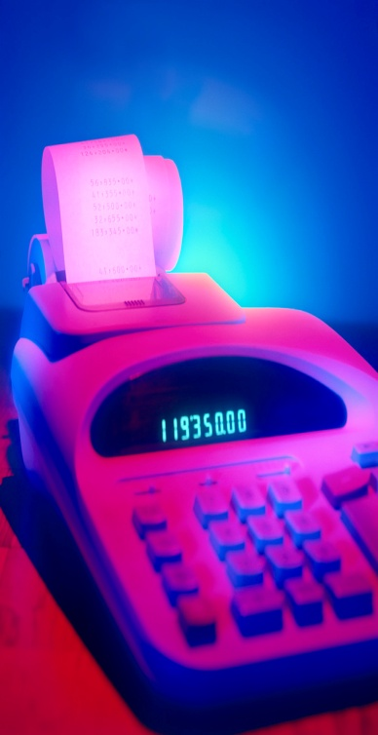
Voting Machine Components
5 Essential Components?
Input: paper with at exactly one mark
Datapath: process current ballot
Output: a number the supervisor can record
Memory & control: none for now
Ballots
The 3410 optical scan
vote counter reader
machine

Slide 7
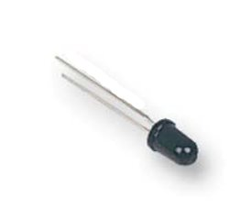
Input
Photo-sensitive transistor
photons replenish gate depletion region
can distinguish dark and light spots on paper
Use array of N sensors for voting machine input
Vdd
i0
i1
i2
i3
i4
i5
i6

Slide 8
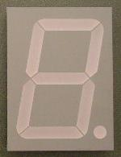
Output
d7
d6
d5
d4
7-Segment LED
photons emitted when electrons fall into holes
d3
d2
d1
d0

Slide 9
Block Diagram
N
8
detect
Notes:
could do big combinatorial circuit
truth table too large: 2^N rows
no possibility for re-use of components
routing N wires is expensive

Slide 10
Encoders
N might be large
Routing wires is expensive
More efficient encoding?
0
1
2
3
4
encoder
5
. . .
6
7
. . .
N
Notes:
N possible inputs -> log2(N) wires to encode

Slide 11
Number Representations
Base 10 - Decimal
Just as easily use other bases
Base 2 - Binary
Base 8 - Octal
Base 16 - Hexadecimal
6 3 7
10² 10¹ 10⁰

Slide 12
Counting
Counting

Slide 13
Base Conversion
Base conversion via repetitive division
Divide by base, write remainder, move left with quotient
Notes:
637 = 0o1175 = 0b1001111101 = 0x27D
oct: 637 : 79 : 9 : 1 : 0
bin: 637 : 318 : 159 : 79 : 39 : 19 : 9 : 4 : 2 : 1 : 0
hex: 637 : 39 : 2 : 0

Slide 14
Base Conversion
Base conversion via repetitive division
Divide by base, write remainder, move left with quotient
Notes:
637 = 0o1175 = 0b1001111101 = 0x27D
oct: 637 : 79 : 9 : 1 : 0
bin: 637 : 318 : 159 : 79 : 39 : 19 : 9 : 4 : 2 : 1 : 0
hex: 637 : 39 : 2 : 0

Slide 15
Base Conversion
Base conversion via repetitive division
Divide by base, write remainder, move left with quotient
Notes:
637 = 0o1175 = 0b1001111101 = 0x27D
oct: 637 : 79 : 9 : 1 : 0
bin: 637 : 318 : 159 : 79 : 39 : 19 : 9 : 4 : 2 : 1 : 0
hex: 637 : 39 : 2 : 0

Slide 16
Hexadecimal, Binary, Octal Conversions

Slide 17
Encoder Implementation
Implementation . . .
assume 8 choices, exactly one mark detected
i0
0
i1
1
i2
2
b0
i3
3
encoder
i4
b1
4
i5
5
b2
i6
6
i7
7
3-bit encoder
(8-to-3)
Notes:
o0 = lsb
o2 = msb

Slide 18
Ballot Reading
enc
detect
8
3
8

Slide 19
7-Segment LED Decoder
3 inputs
encode 0 – 7 in binary
7 outputs
one for each LED
7LED decode

Slide 20
7 Segment LED Decoder Implementation
b2 | b1 | b0 | d6 | d5 | d4 | d3 | d2 | d1 | d0
0 | 0 | 0
0 | 0 | 1
0 | 1 | 0
0 | 1 | 1
1 | 0 | 0
1 | 0 | 1
1 | 1 | 0
1 | 1 | 1
1 | 1 | 1 | 0 | 1 | 1 | 1
1 | 0 | 0 | 0 | 0 | 0 | 1
0 | 1 | 1 | 1 | 0 | 1 | 1
1 | 1 | 0 | 1 | 0 | 1 | 1
1 | 0 | 0 | 1 | 1 | 0 | 1
1 | 1 | 0 | 1 | 1 | 1 | 0
1 | 1 | 1 | 1 | 1 | 1 | 0
1 | 0 | 0 | 0 | 0 | 1 | 1
d1
d2
d0
d3
d4
d6
d5

Slide 21
Ballot Reading and Display
enc
7LED decode
detect
8
3
7
Ballots
The 3410 optical scan
vote counter reader
machine

Slide 22
Building Blocks
N
2^{N}
0
N
binary
encoder
1
N
N
2
N
N
Multiplexor
binary
decoder
. . .
2^{N}
N
2^{M}-1
M

Slide 23
Binary Addition
Addition works the same way regardless of base
Add the digits in each position
Propagate the carry
183 + 254
001110
+ 011100

Slide 24
1-bit Adder
A
B
Half Adder
Adds two 1-bit numbers
Computes 1-bit result and 1-bit carry
C
R

Slide 25
1-bit Adder with Carry
A
B
Full Adder
Adds three 1-bit numbers
Computes 1-bit result and 1-bit carry
Can be cascaded
Cout
Cin
R

Slide 26
4-bit Adder
A[4]
B[4]
4-Bit Full Adder
Adds two 4-bit numbers and carry in
Computes 4-bit result and carry out
Can be cascaded
Cout
Cin
R[4]

Slide 27
4-bit Adder
A₃ B₃
A₂ B₂
A₁ B₁
A₀ B₀
Cout
Cin
R₃
R₂
R₁
R₀
Notes:
carry-out = overflow indicates result does not fit in 4 bits

Slide 28
Summary
We can now implement any combinational (combinatorial) logic circuit
Decompose large circuit into manageable blocks
Encoders, Decoders, Multiplexors, Adders, ...
Design each block
Binary encoded numbers for compactness
Can implement circuits using NAND or NOR gates
Can implement gates using use P- and N-transistors

