Slide 1
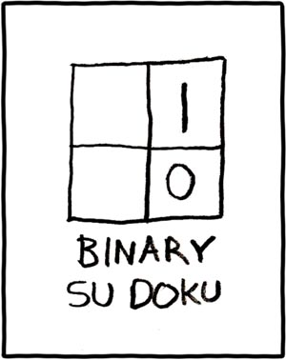
Gates and Logic
xkcd.com/74/
See: P&H Appendix C.2, C.3

Slide 2
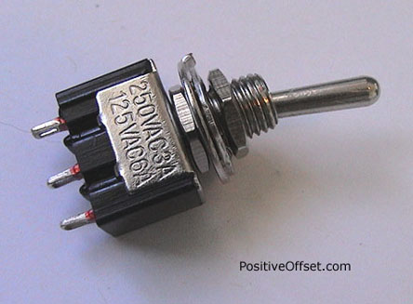
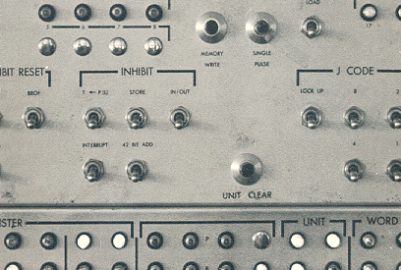

A switch
Acts as a conductor or insulator
Can be used to build amazing things…

Slide 3
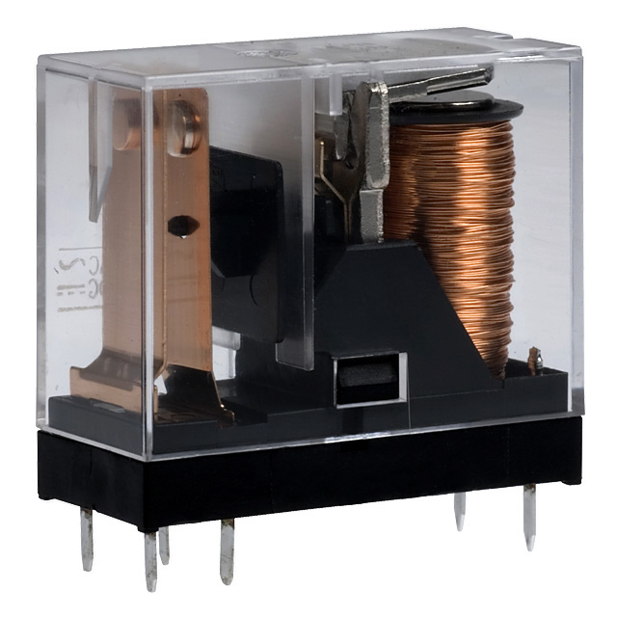
Better Switch
One current controls another (larger) current
Static Power:
  Keeps consuming power when in the ON state
Dynamic Power:
  Jump in power consumption when switching

Slide 4
Atoms
e
e
e
hole
e
e
e
N
e
P
P
N
P
P
P
N
N
N
N
P
P
N
e
e
e
e
e
e
e

Slide 5
Elements
e
e
e
B
e
Si
e
P
e
e
e
e
e
e
e
Boron
Silicon
Phosphorus

Slide 6
Silicon Crystal
Silicon
e
e
e
e
e
e
e
Si
e
Si
e
Si
e
Si
e
Si
e
Si
e
Si
e
e
e
e
e
e
e
e
e
e
e
e
e
e
e
e
e
e
e
e
e
e
Si
e
Si
e
Si
e
Si
e
Si
e
Si
e
Si
e
e
e
e
e
e
e
e
e
e
e
e
e
e
e
e
e
e
e
e
e
e
Si
e
Si
e
Si
e
Si
e
Si
e
Si
e
Si
e
e
e
e
e
e
e
e
e
e
e
e
e
e
e
e
e
e
e
e
e
e
Si
e
Si
e
Si
e
Si
e
Si
e
Si
e
Si
e
e
e
e
e
e
e
e
e
e
e
e
e
e
e
e
e
e
e
e
e
e
Si
e
Si
e
Si
e
Si
e
Si
e
Si
e
Si
e
e
e
e
e
e
e
e
e
e
e
e
e
e
e

Slide 7
Phosphorus Doping
N-Type: Silicon + Phosphorus
e
e
e
e
e
e
e
e
e
e
e
e
e
e
e
e
e
e
e
e
e
e
e
e
e
e
e
e
e
e
e
e
e
e
e
e
e
e
e
P
e
e
e
e
e
e
e
e
e
e
e
e
e
e
e
e
e
e
e
e
e
e
e
e
e
e
e
P
e
e
e
e
e
e
e
e
e
e
e
e
e
e
e
e
e
e
e
e
e
e
e
e
e
e
e
e
e
e
e
e
P
e
e
e
e
e
e
e
e
e
e
e
e
e
e
e
e
e
e
e
e
e
e
e
e
e
e
P
e
e
e
e
e
e
e
e
e
e
e
e
e
e
e
e
e
e
e
e
Notes:
neutral -> conductor
high voltage -> insulator

Slide 8
Boron Doping
P-Type: Silicon + Boron
e
e
e
e
e
e
e
e
e
e
e
e
e
e
e
e
e
e
e
e
e
e
e
e
e
e
e
e
e
e
e
e
e
e
e
e
e
e
e
e
B
e
e
e
e
e
e
e
e
e
e
e
e
e
e
e
e
e
e
e
e
e
e
e
e
B
e
e
e
e
e
e
e
e
e
e
e
e
e
e
e
e
e
e
e
e
e
e
e
e
e
e
e
e
e
B
e
e
e
e
e
e
e
e
e
e
e
e
e
e
e
e
e
e
e
e
e
e
e
e
B
e
e
e
e
e
e
e
e
e
e
e
e
e
e
e
e
e
e
e
Notes:
neutral -> conductor
low voltage -> insulator

Slide 9
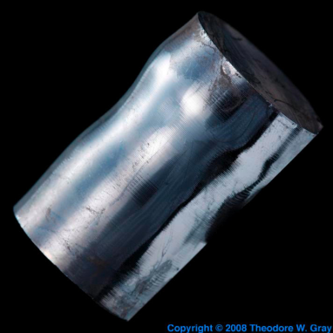



Semiconductors
Insulator
p-type (Si+Boron)
has mobile holes:
n-type (Si+Phosphorus)
has mobile electrons:
low voltage (depleted)
→ insulator
high voltage (mobile holes)
→ conductor
low voltage (mobile electrons)
→ conductor
high voltage (depleted)
→ insulator

Slide 10
Bipolar Junction
P-Type
N-Type
e
e
e
e
e
e
e
e
e
e
e
e
e
e
low v → insulator
high v → conductor
low v → conductor
high v → insulator

Slide 11
Reverse Bias
P-Type
N-Type
e
e
e
e
–
e
e
+
e
e
e
e
e
e
e
e
low v → insulator
high v → conductor
low v → conductor
high v → insulator

Slide 12
Forward Bias
P-Type
N-Type
e
e
e
e
e
e
e
e
e
e
–
+
e
e
e
e
e
e
e
e
e
e
e
e
e
e
e
e
e
e
low v → insulator
high v → conductor
low v → conductor
high v → insulator

Slide 13
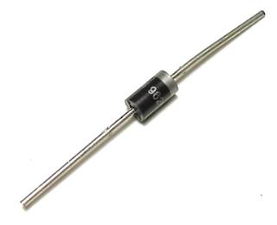
Diodes
PN Junction “Diode”
p-type
n-type
Conventions:
vdd = vcc = +1.2v = +5v = hi
vss = vee = 0v = gnd

Slide 14
PNP Junction
p-type
n-type
p-type

Slide 15
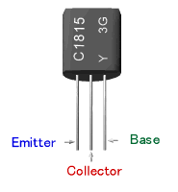
Bipolar Junction Transistors
Solid-state switch: The most amazing invention of the 1900s
Emitter = “input”, Base = “switch”, Collector = “output”
PNP Transistor
NPN Transistor
C
p
n
p
E=vdd
vss=E
n
p
n
C
B
B
vdd
E
C
B
B
C
E
vss

Slide 16
Field Effect Transistors
P-type FET
N-type FET
Drain = vdd
Drain
Gate
Gate
Source
Source = vss
Connect Source to Drain when Gate = lo
Drain must be vdd, or connected to source of another P-type transistor
Connect Source to Drain when Gate = hi
Source must be vss, or connected to drain of another N-type transistor

Slide 17
Multiple Transistors
+5v
Vdd
in
out
0v
t
Vss
Gate delay
transistor switching time
voltage, propagation, fanout, temperature, …
CMOS design
(complementary-symmetry metal–oxide–semiconductor)
  Power consumption =
  dynamic + leakage
In | Out
voltage

Slide 18
Digital Logic
+5v
Vdd
+2v
in
out
+0.5v
0v
Vss
t
In | Out
+5v | 0v
0v | +5v
In | Out
voltage
truth table
Conventions:
vdd = vcc = +1.2v = +5v = hi = true = 1
vss = vee = 0v = gnd = false = 0

Slide 19
NOT Gate (Inverter)
Function: NOT
Symbol:
Vdd
in
out
in
out
Vss
In | Out
0 | 1
1 | 0
Truth table

Slide 20
NAND Gate
Vdd
Vdd
Function: NAND
Symbol:
A
B
out
a
out
b
B
A
A | B | out
0 | 0 | 1
0 | 1 | 1
1 | 0 | 1
1 | 1 | 0
Vss

Slide 21
NOR Gate
Vdd
Function: NOR
Symbol:
A
a
out
B
b
out
A
B
A | B | out
0 | 0 | 1
0 | 1 | 0
1 | 0 | 0
1 | 1 | 0
Vss
Vss

Slide 22
Building Functions
AND:
OR:
NOT:

Slide 23
Universal Gates
NAND is universal (so is NOR)
  Can implement any function with just NAND gates
    De Morgan’s laws are helpful (pushing bubbles)
  useful for manufacturing
E.g.: XOR (A, B) = A or B but not both (“exclusive or”)
Proof: ?

Slide 24
Logic Equations
Some notation:
constants: true = 1, false = 0
variables: a, b, out, …
operators:
  AND(a, b) = a b = a & b = a ∧ b
OR(a, b) = a + b = a | b = a ∨ b
NOT(a) = ā = !a = ¬a

Slide 25
Identities
Identities useful for manipulating logic equations
  For optimization & ease of implementation
  a + 0 =
  a + 1 =
  a + ā =
  a 0 =
  a 1 =
  a ā =
  (a + b) =
  (a b) =
  a + a b =
  a(b+c) =
  a(b+c) =
  a
  1
  1
  0
  a
  0
  a b
  a + b
  a
  ab + ac
  a + bc

Slide 26
Logic Manipulation
functions: gates ↔ truth tables ↔ equations
Example: (a+b)(a+c) = a + bc
a | b | c
0 | 0 | 0
0 | 0 | 1
0 | 1 | 0
0 | 1 | 1
1 | 0 | 0
1 | 0 | 1
1 | 1 | 0
1 | 1 | 1
 |  |  | a+b | a+c | LHS
 |  |  | 0 | 0 | 0
 |  |  | 0 | 1 | 0
 |  |  | 1 | 0 | 0
 |  |  | 1 | 1 | 1
 |  |  | 1 | 1 | 1
 |  |  | 1 | 1 | 1
 |  |  | 1 | 1 | 1
 |  |  | 1 | 1 | 1
 |  |  |  |  |  | bc | RHS
 |  |  |  |  |  | 0 | 0
 |  |  |  |  |  | 0 | 0
 |  |  |  |  |  | 0 | 0
 |  |  |  |  |  | 1 | 1
 |  |  |  |  |  | 0 | 1
 |  |  |  |  |  | 0 | 1
 |  |  |  |  |  | 0 | 1
 |  |  |  |  |  | 1 | 1
Notes:
(a+b)(a+c)
= aa + ab + ac + bc
= a + a(b+c) + bc
= a(1 + (b+c)) + bc
= a + bc

