Slide 1
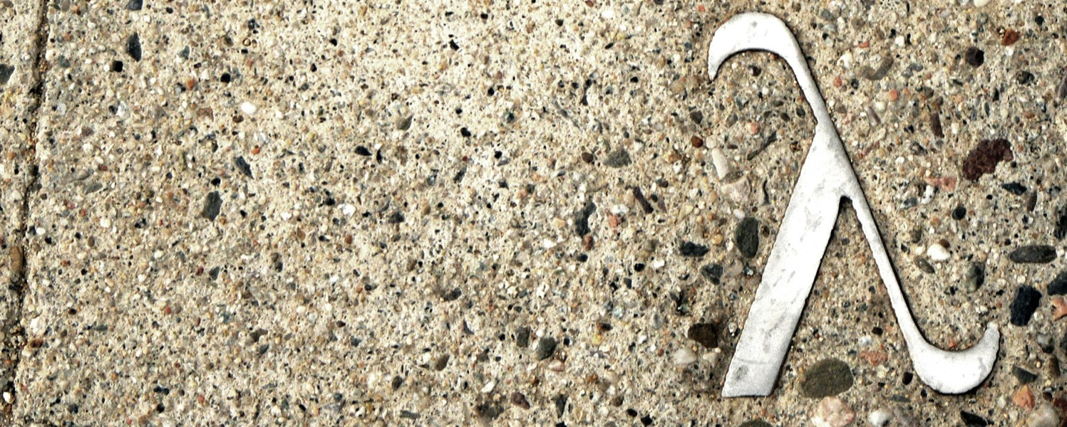
Data Structures and Functional Programming Algorithms for Big Data
http://www.flickr.com/photos/rofi/2097239111/
Ramin Zabih
Cornell University
Fall 2012

Slide 2
Motivation
Modern CS is largely about “big data”
Examples: web, genome, Walmart, AT&T call graph, Flickr, Facebook, Twitter, etc
How to find patterns in such large datasets?
Example: frequently purchased item sets
Today: A classical algorithm, its application to some image editing problems, and some state of the art research techniques
Slide credits: Alyosha Efros, Piotr Indyk and their students

Slide 3
Motivating example: sink that ship!
Credit: http://lafarren.com/images/ship-completion.png

Slide 4
How do we sink that ship?

Slide 5
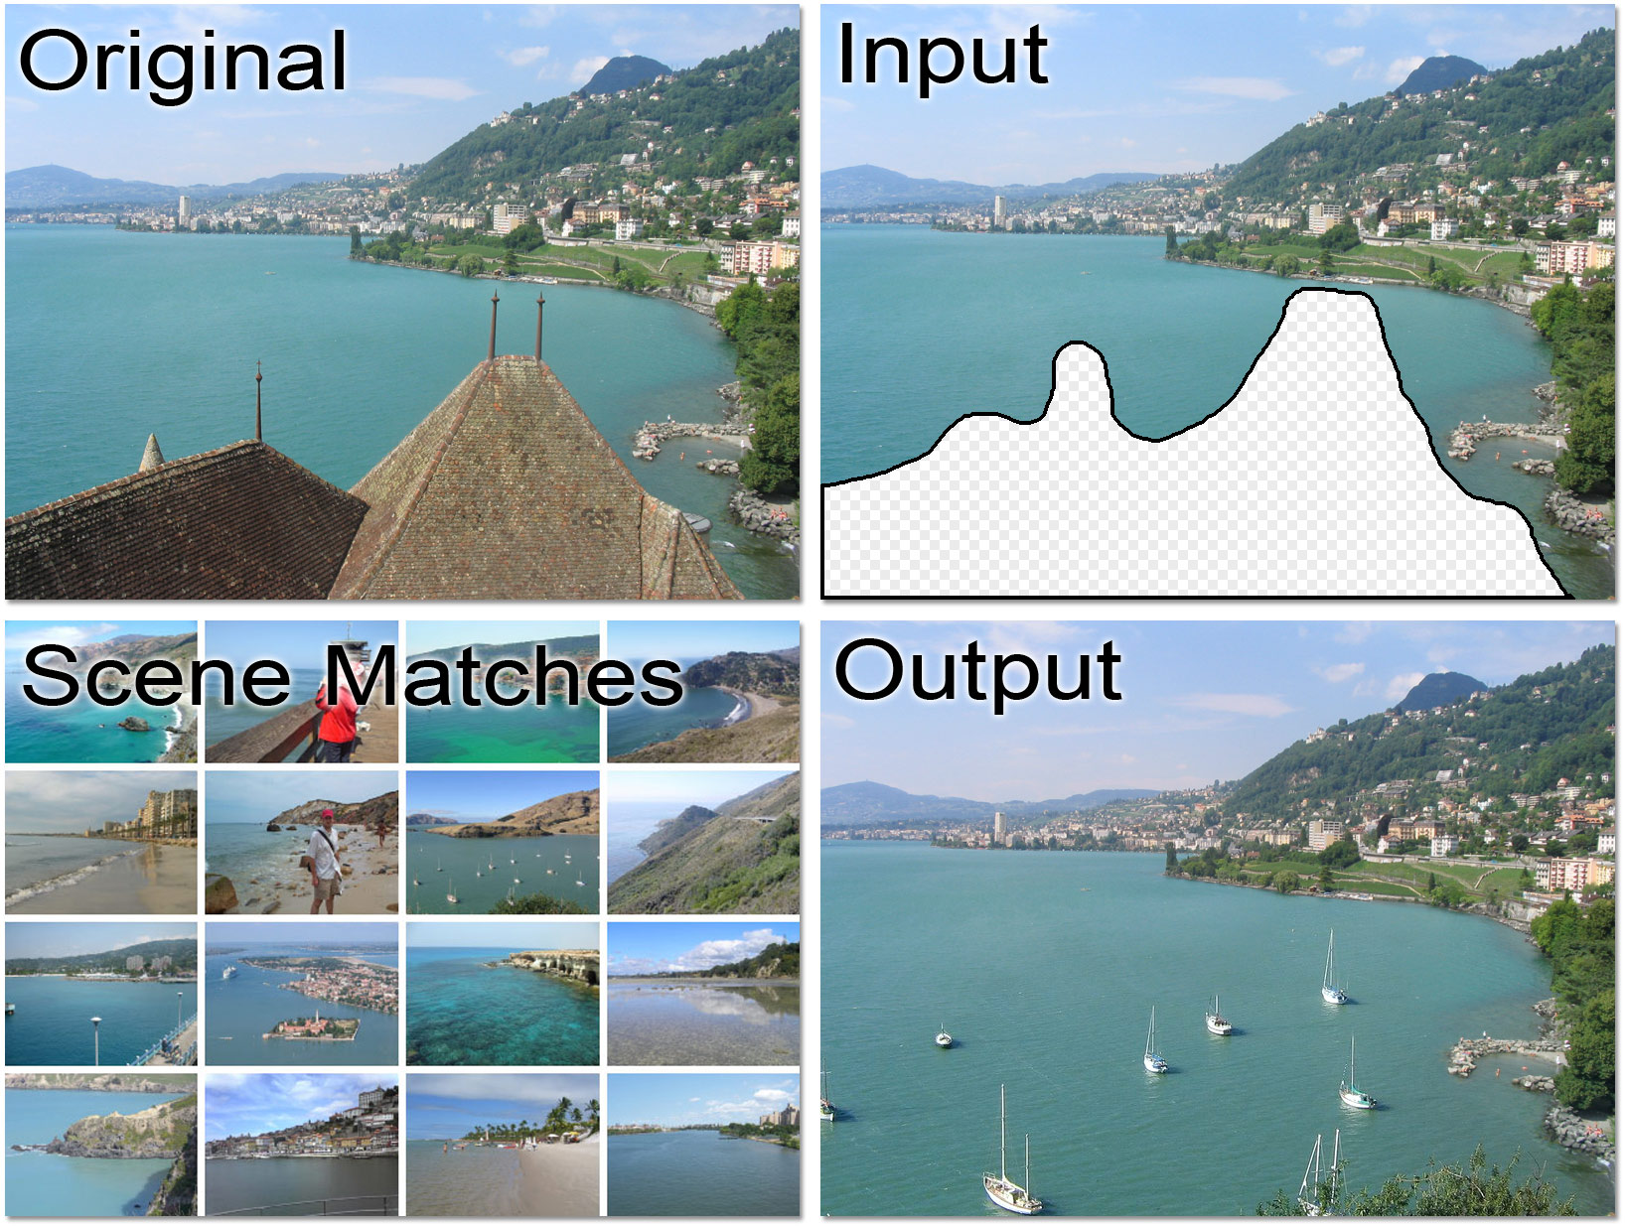
Another example: building removal
Credit: http://graphics.cs.cmu.edu/projects/scene-completion/ (Hays & Efros)

Slide 6
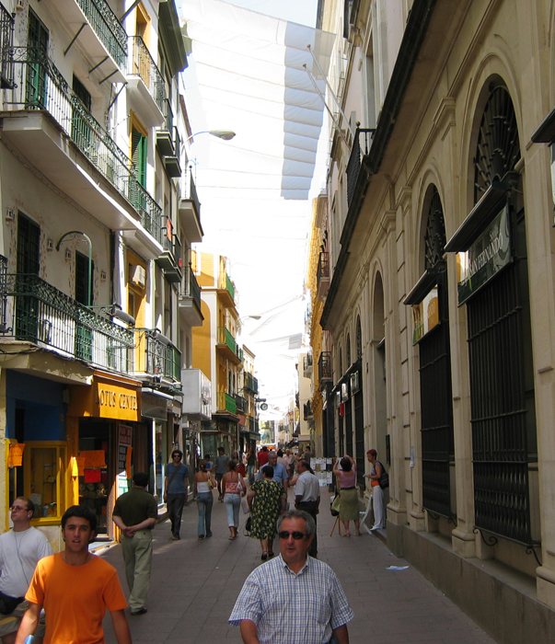
Hays and Efros, SIGGRAPH 2007
Notes:
not just for the cases where the data
needed simply isn't available in the source image (show several such examples)

Slide 7
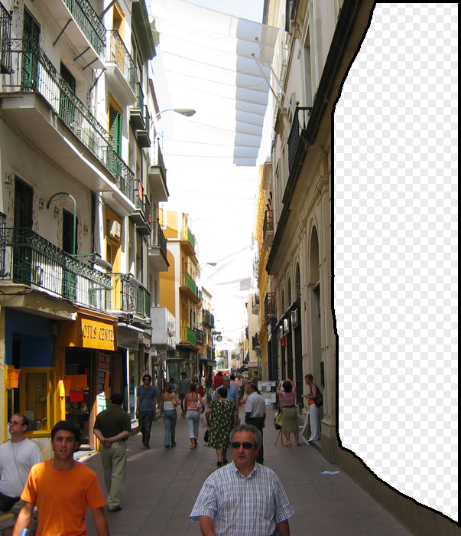
Hays and Efros, SIGGRAPH 2007
Notes:
not just for the cases where the data
needed simply isn't available in the source image (show several such examples)

Slide 8
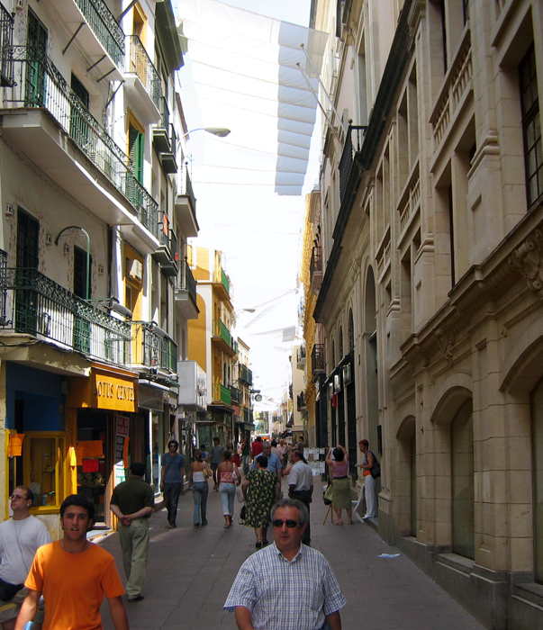
Hays and Efros, SIGGRAPH 2007
Notes:
not just for the cases where the data
needed simply isn't available in the source image (show several such examples)

Slide 9
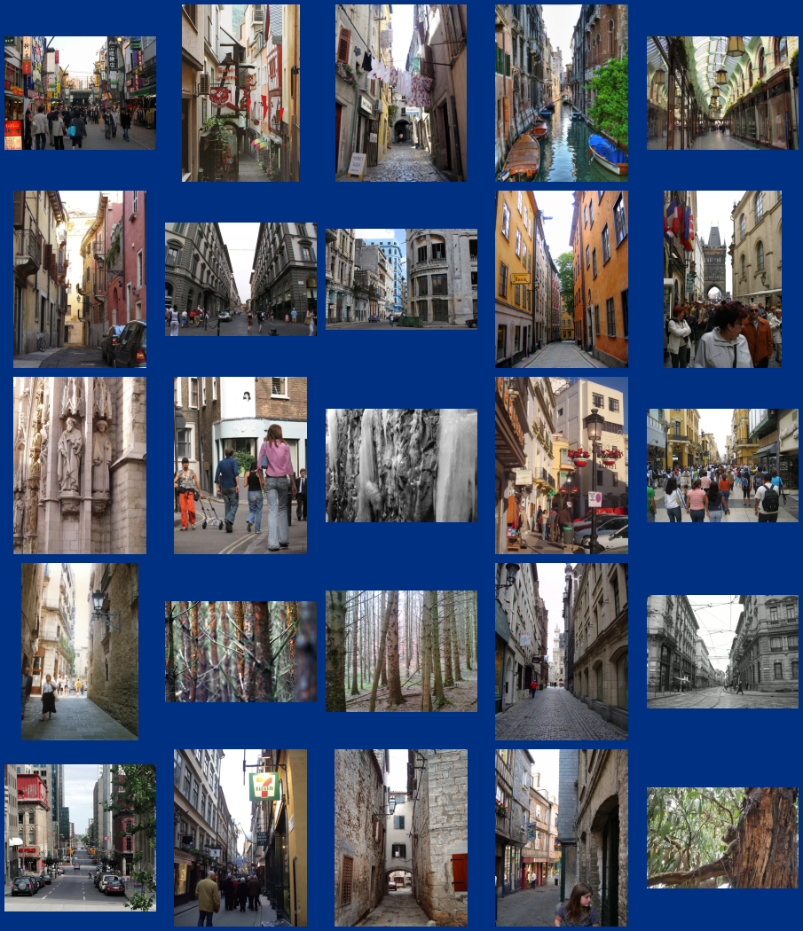
… 200 scene matches
Hays and Efros, SIGGRAPH 2007
Notes:
not just for the cases where the data
needed simply isn't available in the source image (show several such examples)

Slide 10
… 200 scene matches
Hays and Efros, SIGGRAPH 2007
Notes:
not just for the cases where the data
needed simply isn't available in the source image (show several such examples)

Slide 11
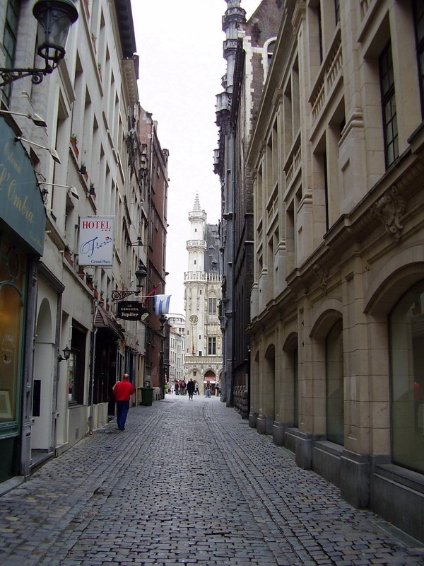
Hays and Efros, SIGGRAPH 2007
Notes:
not just for the cases where the data
needed simply isn't available in the source image (show several such examples)

Slide 12
Hays and Efros, SIGGRAPH 2007
Notes:
not just for the cases where the data
needed simply isn't available in the source image (show several such examples)

Slide 13
Nearest Neighbor Search
Given: a set P of n points in R^{d}
Goal: a data structure, which given a query point q, finds the nearest neighbor p of q in P
p
q

Slide 14
Variants of nearest neighbor
k-Nearest Neighbors: find the k nearest neighbors
Near neighbor (range search): find one/all points in P within distance r from q
Approximate near neighbor: find one/all points p’ in P, whose distance to q is at most (1+ε) times the distance from q to its nearest neighbor
Decision problem: is there a point within r of q?
Note: there can be many notions of distance!

Slide 15
Some early NN algorithms
One can always do exhaustive search
Note that a low-resolution version of the input data will allow you to ignore lots of points!
Linear in n and d (why?)
There are two simple data structure solutions: quad trees (and their variants, like k-d trees)
Voronoi diagrams
I won’t talk about these in any detail but will give you the basic idea

Slide 16
A quad tree

Slide 17
NN search in a quad tree

Slide 18
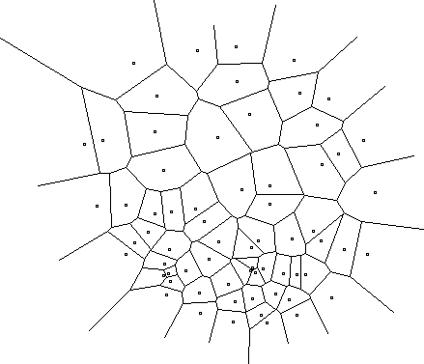
Voronoi diagram
Basic idea: represent decision regions, i.e. areas that have a given point as the NN
Every cell has 1 data point, and each location in that cell has that data point as its NN

Slide 19
Asymptotic behavior
Quadtree: space and query time both exponential in dimension d
kd-tree (smart variant) has linear space but still can take exponential query time in d
So you should run exhaustive search too!
Voronoi diagram generalization uses exponential space in d also

Slide 20
The curse of dimensionality
In high dimensional data almost everything is far away from anything else
The data tends to become sparse
So, your nearest neighbor is pretty dis-similar, simply because everything is dis-similar
The curse is not well defined, but for example you can compare the volume of a unit sphere to a unit hypercube
As dimension increases the ratio goes to zero, so “everything is far away from the center”

Slide 21
The curse of dimensionality (2)
Concretely, exact NN methods tend to scale poorly with dimension
Either space or query time goes up exponentially with dimension
So you are better off just using exhaustive search!
Alternatively: settle for approximate nearest neighbors, which is usually good enough
After all, your input data was noisy to start with!

Slide 22
Locality sensitive hashing (LSH)
Suppose we had a hash function such that:
Nearby points tend to hash to the same bucket
Far away points tend to hash to different buckets
We need a family of such hash functions, but if we have them we can achieve a cool guarantee:
Any data point within a specified distance of the query will be reported with a specified probability
Need to know distance r in advance
Space is O(n^{ρ}), time O(n^{1+ρ}), where ρ<1 depends on how accurate we need to be

Slide 23
Visualizing LSH
q
p

Slide 24
How do we find such hashing functions?
Not clear they always exist, but they do for lots of important problems
Consider binary vectors under the Hamming distance D(p,q), aka the XOR count
Given a parameter k < d, we create a hash function by picking k random coordinates and reporting the values of our input on them
Example: Pick 2nd and 4th coordinates of input = 01100101, answer = 10
This family of hash functions is locality sensitive!

Slide 25
Hash function behavior
Consider two binary vectors p,q. Hamming distance is D(p,q), so chance of picking a bit where they differ is D(p,q)/d
Probability that they have the same hash value is (1 - D(p,q)/d)^{k}
Some special cases:
Pr
k=1
Pr
k=2
distance
distance

Slide 26
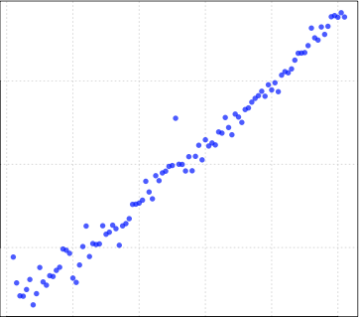
Dimensionality reduction
High dimensional data is painful. But perhaps your data isn’t really high dimensional?
There are many fascinating variants of this problem
For example, we could discover that some dimensions simply don’t matter at all
They could be uniform in all points, or random!
Simplest solution: project points onto a line

Slide 27
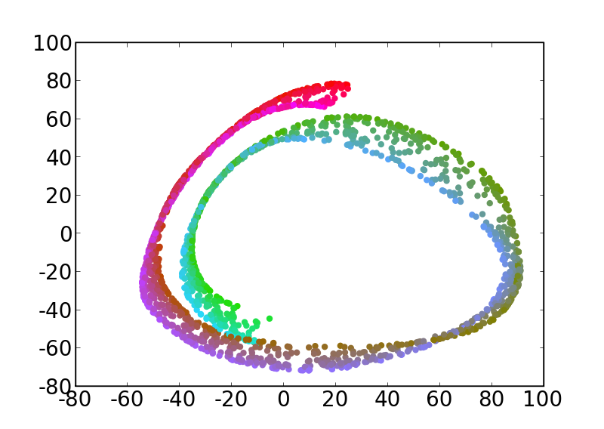
Swissroll example

Slide 28
Distance-preserving embeddings
Another variant: embed your data in a lower dimensional space so that the distances between pairs of points don’t change very much
After all, the distances are really the data
Multi-dimensional scaling (MDS)
There is an area of pure math that studies this kind of problem, called distance geometry
Bob Connelly (Cornell math) is a leader
Lots of interesting distances also, such as the Earth Mover’s Distance (EMD)
Related to L1 metric, can use LSH for this

