Slide 1

Threads & Concurrency
Lecture 24– CS2110 – Spring 2019

Slide 2
Prelim 2 Room assignments:
Exams page of course website!
Room 5:30:
Phillips 101
1. km..zz students who had a conflict with 7:30.
2. aa..al students
Statler Auditorium: 1. am..zz students
Room assignments for prelim 2, 7:30:
Phillips 101
1. aa..kk students who had a conflict with 5:30.
2. yk..zz students
Statler Auditorium: 1. km..yj students
Extra/quiet time: Gates 310

Slide 3
A6 and A7
A6: get 100 for correctness (perhaps minus a late penalty), you can use your A6 in A7. Otherwise, use our solution.
See pinned Piazza note for A7.
Wed morn: A6 grades available. Got 100? No feedback. BUT: Graders are checking adherence to Style guidelines in A6 handout and deducting points here or there. So your grade may be lowered.
Start on A7 soon. Don’t wait till the last minute. Deadline: 3 May. Nothing accepted later. We have to grade quickly and determine tentative course letter grades, so you can decide whether to take the final.

Slide 4
CPU Central Processing Unit. Simplified view
The CPU is the part of the
computer that executes
instructions.
Java: x= x + 2;
Suppose variable x is at
Memory location 800,
Instructions at 10
Machine language:
10: load register 1, 800
11: Add register 1, 2
12: Store register 1, 800
Register: Location to hold data
Basic uniprocessor-CPU computer. Black lines indicate data flow.
Red lines indicate control flow
From wikipedia

Slide 5
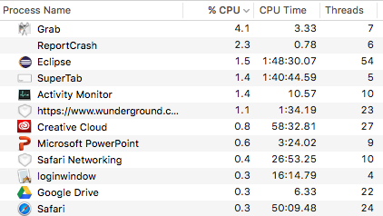
Part of Activity Monitor in Gries’s laptop
>100 processes are competing for time. Here’s some of them:

Slide 6
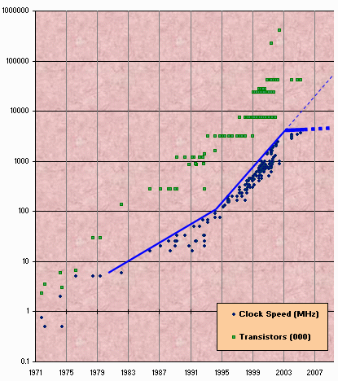
Clock rate
Clock rate “frequency at which CPU is running”
Higher the clock rate, the faster instructions
are executed.
First CPUs: 5-10 Hz
(cycles per second)
Now: MacBook Pro 3.5GHz
Your OS can control clock
rate, slow it down when
idle, speed up when
morework to do

Slide 7
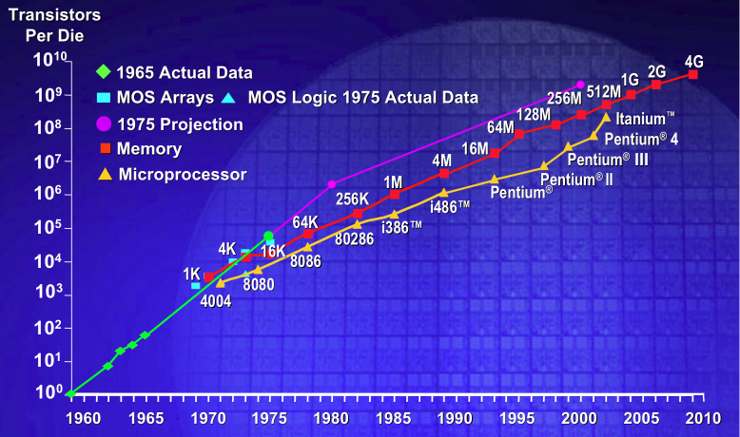
Why multicore?
  Moore’s Law: Computer speeds and memory densities nearly double each year

Slide 8
First computer memories: 1953–late 1970’s
Magnetic core memory.
Each ring is a bit:
magnetized or
unmagnetized
Run current through
two wires.
Sensing wire, running
through all cores, senses a change. .
www.computerhistory.org

Slide 9
Close-up view
Amateur inventor Frederick W. Viehe filed a core memory patent in 1947.
Harvard physicist An Wang in 1949.
RCA’s Jan Rajchman, 1950.
MIT’s Jay Forrester in 1951.
Jay Forrester holding
A core memory plane
32x32 = 1024 bits
www.computerhistory.org

Slide 10

But a fast computer runs hot
Power dissipation rises as square of the clock rate
Chips were heading toward melting down!
Put more CPUs on a chip:
with four CPUs on one
chip, even if we run each at
half speed we can perform
more overall computations!

Slide 11
Today: Not one CPU but many
Processing Unit is called a core.
Modern computers have “multiple cores” (processing units)
  Instead of a single CPU (central processing unit) on the chip 5-10 common. Intel has prototypes with 80!
We often run many programs/applications at the same time
Even with a single core (processing unit), your program may have more than one thing “to do” at a time
  Argues for having a way to do many things at once

Slide 12
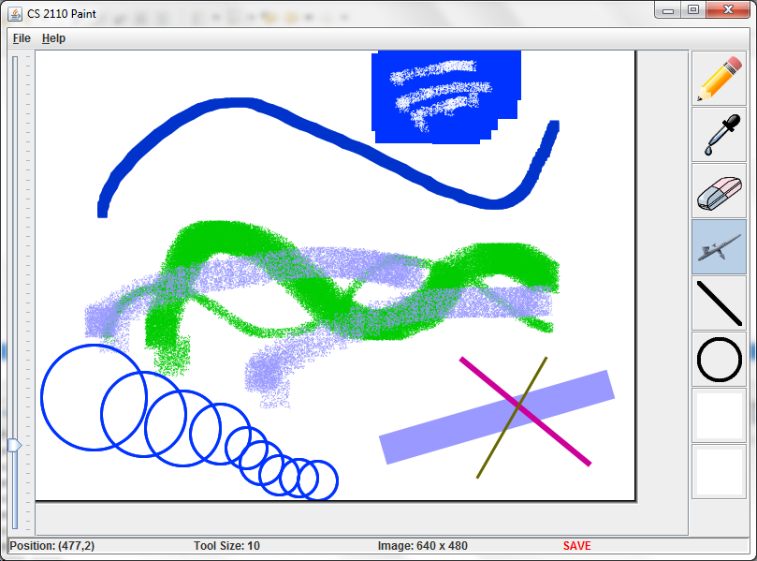
Many programs. Each can have several
“threads of execution”
We often run many programs at the same time
And each program may have several “threads of execution”
Example, in GUI paint program, when you click the pencil tool, a new thread of execution is started to call the method to process it:
Main GUI thread
Process pencil
click

Slide 13
Many processes are executed simultaneously on your computer
Operating system provides support for multiple “processes”
Usually fewer processors than processes
Processes are an abstraction:
at hardware level, lots of multitasking
  memory subsystem
  video controller
  buses
  instruction prefetching

Slide 14
Concurrency
Concurrency refers to a single program in which several processes, called threads, are running simultaneously
  Special problems arise
  They see the same data and hence can interfere with each other, e.g. one process modifies a complex structure like a heap while another is trying to read it
CS2110: we focus on two main issues:
  Race conditions
  Deadlock

Slide 15
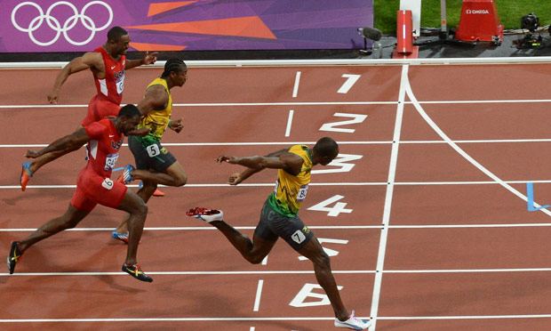
Race conditions
A “race condition” arises if two or more processes access the same variables or objects concurrently and at least one does updates
Example: Processes t1 and t2 x= x + 1; for some static global x.
Process t1 Process t2
… ...
x= x + 1; x= x + 1;
But x= x+1; is not an “atomic action”: it takes several steps

Slide 16
Race conditions
Suppose x is initially 5
Thread t1
Thread t2
LOAD x (register contains 5)
ADD 1 (register contains 6)
STORE x (x contains 6)
...
LOAD x (register contains 5)
ADD 1 (register contains 6)
STORE x (x contains 6)
... after finishing, x = 6! We “lost” an update

Slide 17
Race conditions
Typical race condition: two processes wanting to change a stack at the same time. Or make conflicting changes to a database at the same time.
Race conditions are bad news
  Race conditions can cause many kinds of bugs, not just the example we see here!
  Common cause for “blue screens”: null pointer exceptions, damaged data structures
  Concurrency makes proving programs correct much harder!

Slide 18

Deadlock
To prevent race conditions, one often requires a process to “acquire” resources before accessing them, and only one process can “acquire” a given resource at a time.
Examples of resources are:
  A file to be read
  An object that maintains a stack, a linked list, a hash table, etc.
But if processes have to acquire two or more resources at the same time in order to do their work, deadlock can occur. This is the subject of the next slides.

Slide 19





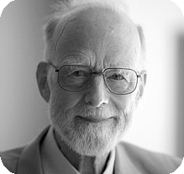
Dining philosopher problem
Five philosophers sitting at a table.
Each repeatedly does this:
1. think
2. eat
What do they eat?
spaghetti.
Need TWO forks to eat spaghetti!

Slide 20
Dining philosopher problem
Each does repeatedly :
1. think
2. eat (2 forks)
eat is then:
pick up left fork
pick up right fork
pick up food, eat
put down left fork
put down rght fork
At one point, they all pick up their left forks
DEADLOCK!

Slide 21
Dining philosopher problem
Simple solution to deadlock:
Number the forks. Pick up smaller one first
1. think
2. eat (2 forks)
eat is then:
pick up smaller fork
pick up bigger fork
pick up food, eat
put down bigger fork
put down smallerfork
5
4
3
1
2

Slide 22
Java: What is a Thread?
A separate “execution” that runs within a single program and can perform a computational task independently and concurrently with other threads
Many applications do their work in just a single thread: the one that called main() at startup
  But there may still be extra threads...
  ... Garbage collection runs in a “background” thread
  GUIs have a separate thread that listens for events and “dispatches” calls to methods to process them
Today: learn to create new threads of our own in Java

Slide 23
Thread
A thread is an object that “independently computes”
  Needs to be created, like any object
  Then “started” --causes some method to be called. It runs side by side with other threads in the same program; they see the same global data
The actual executions could occur on different CPU cores, but but don’t have to
  We can also simulate threads by multiplexing a smaller number of cores over a larger number of threads

Slide 24
Java class Thread
threads are instances of class Thread
  Can create many, but they do consume space & time
The Java Virtual Machine creates the thread that executes your main method.
Threads have a priority
  Higher priority threads are executed preferentially
  By default, newly created threads have initial priority equal to the thread that created it (but priority can be changed)

Slide 25
Creating a new Thread (Method 1)
class PrimeThread extends Thread {
long a, b;
PrimeThread(long a, long b) {
this.a= a; this.b= b;
}
@Override public void run() {
//compute primes between a and b
...
}
}
Call run() directly?
no new thread is used:
Calling thread will run it
overrides
Thread.run()
PrimeThread p= new PrimeThread(143, 195);
p.start();
Do this and
Java invokes run() in new thread

Slide 26
Creating a new Thread (Method 2)
class PrimeRun implements Runnable {
long a, b;
PrimeRun(long a, long b) {
this.a= a; this.b= b;
}
public void run() {
//compute primes between a and b
...
}
}
PrimeRun p= new PrimeRun(143, 195);
new Thread(p).start();

Slide 27
Example
Thread name, priority, thread group
Thread[Thread-0,5,main] 0
Thread[main,5,main] 0
Thread[main,5,main] 1
Thread[main,5,main] 2
Thread[main,5,main] 3
Thread[main,5,main] 4
Thread[main,5,main] 5
Thread[main,5,main] 6
Thread[main,5,main] 7
Thread[main,5,main] 8
Thread[main,5,main] 9
Thread[Thread-0,5,main] 1
Thread[Thread-0,5,main] 2
Thread[Thread-0,5,main] 3
Thread[Thread-0,5,main] 4
Thread[Thread-0,5,main] 5
Thread[Thread-0,5,main] 6
Thread[Thread-0,5,main] 7
Thread[Thread-0,5,main] 8
Thread[Thread-0,5,main] 9
public class ThreadTest extends Thread {
public static void main(String[] args) {
new ThreadTest().start();
for (int i= 0; i < 10; i++) {
System.out.format("%s %d\n",
Thread.currentThread(), i);
}
}
public void run() {
for (int i= 0; i < 10; i++) {
System.out.format("%s %d\n",
Thread.currentThread(), i);
}
}
}

Slide 28
Example
Thread name, priority, thread group
Thread[main,5,main] 0
Thread[main,5,main] 1
Thread[main,5,main] 2
Thread[main,5,main] 3
Thread[main,5,main] 4
Thread[main,5,main] 5
Thread[main,5,main] 6
Thread[main,5,main] 7
Thread[main,5,main] 8
Thread[main,5,main] 9
Thread[Thread-0,4,main] 0
Thread[Thread-0,4,main] 1
Thread[Thread-0,4,main] 2
Thread[Thread-0,4,main] 3
Thread[Thread-0,4,main] 4
Thread[Thread-0,4,main] 5
Thread[Thread-0,4,main] 6
Thread[Thread-0,4,main] 7
Thread[Thread-0,4,main] 8
Thread[Thread-0,4,main] 9
public class ThreadTest extends Thread {
public static void main(String[] args) {
new ThreadTest().start();
for (int i= 0; i < 10; i++) {
System.out.format("%s %d\n",
Thread.currentThread(), i);
}
}
public void run() {
currentThread().setPriority(4);
for (int i= 0; i < 10; i++) {
System.out.format("%s %d\n",
Thread.currentThread(), i);
}
}
}

Slide 29
Example
Thread name, priority, thread group
Thread[main,5,main] 0
Thread[main,5,main] 1
Thread[main,5,main] 2
Thread[main,5,main] 3
Thread[main,5,main] 4
Thread[main,5,main] 5
Thread[Thread-0,6,main] 0
Thread[Thread-0,6,main] 1
Thread[Thread-0,6,main] 2
Thread[Thread-0,6,main] 3
Thread[Thread-0,6,main] 4
Thread[Thread-0,6,main] 5
Thread[Thread-0,6,main] 6
Thread[Thread-0,6,main] 7
Thread[Thread-0,6,main] 8
Thread[Thread-0,6,main] 9
Thread[main,5,main] 6
Thread[main,5,main] 7
Thread[main,5,main] 8
Thread[main,5,main] 9
public class ThreadTest extends Thread {
public static void main(String[] args) {
new ThreadTest().start();
for (int i= 0; i < 10; i++) {
System.out.format("%s %d\n",
Thread.currentThread(), i);
}
}
public void run() {
currentThread().setPriority(6);
for (int i= 0; i < 10; i++) {
System.out.format("%s %d\n",
Thread.currentThread(), i);
}}}

Slide 30
Example
waiting...
running...
waiting...
running...
waiting...
running...
waiting...
running...
waiting...
running...
waiting...
running...
waiting...
running...
waiting...
running...
waiting...
running...
waiting...
running...
done
public class ThreadTest extends Thread {
static boolean ok = true;
public static void main(String[] args) {
new ThreadTest().start();
for (int i = 0; i < 10; i++) {
System.out.println("waiting...");
yield();
}
ok = false;
}
public void run() {
while (ok) {
System.out.println("running...");
yield();
}
System.out.println("done");
}
}
If threads happen to be sharing
a CPU, yield allows other waiting
threads to run.

Slide 31

Terminating Threads is tricky
Easily done... but only in certain ways
  Safe way to terminate a thread: return from method run
  Thread throws uncaught exception? whole program will be halted (but it can take a second or two ... )
Some old APIs have issues: stop(), interrupt(), suspend(),
destroy(), etc.
  Issue: Can easily leave application in a “broken” internal state.
  Many applications have some kind of variable telling the thread to stop itself.

Slide 32

Threads can pause
When active, a thread is “runnable”.
  It may not actually be “running”. For that, a CPU must schedule it. Higher priority threads could run first.
A thread can pause
  Call Thread.sleep(k) to sleep for k milliseconds
  Doing I/O (e.g. read file, wait for mouse input, open file) can cause thread to pause
  Java has a form of locks associated with objects. When threads lock an object, one succeeds at a time.

Slide 33

Background (daemon) Threads
In many applications we have a notion of “foreground” and “background” (daemon) threads
  Foreground threads are doing visible work, like interacting with the user or updating the display
  Background threads do things like maintaining data structures (rebalancing trees, garbage collection, etc.)
On your computer, the same notion of background workers explains why so many things are always running in the task manager.

Slide 34
Example: a lucky scenario
private Stack<String> stack= new Stack<String>();
public void doSomething() {
if (stack.isEmpty()) return;
String s= stack.pop();
//do something with s...
}
Suppose threads A and B want to call doSomething(),
and there is one element on the stack
1. thread A tests stack.isEmpty() false
2. thread A pops ⇒ stack is now empty
3. thread B tests stack.isEmpty() ⇒ true
4. thread B just returns – nothing to do

Slide 35
Example: an unlucky scenario
private Stack<String> stack = new Stack<String>();
public void doSomething() {
if (stack.isEmpty()) return;
String s= stack.pop();
//do something with s...
}
Suppose threads A and B want to call doSomething(),
and there is one element on the stack
1. thread A tests stack.isEmpty() ⇒ false
2. thread B tests stack.isEmpty() ⇒ false
3. thread A pops ⇒ stack is now empty
4. thread B pops ⇒ Exception!

Slide 36
Synchronization
Java has one primary tool for preventing race conditions.
you must use it by carefully and explicitly – it isn’t automatic.
  Called a synchronization barrier
  We study this in the next lecture

