Slide 1
Graph Algorithms
Lecture 19
CS 2110 — Spring 2019

Slide 2
JavaHyperText Topics
“Graphs”, topics:
4: DAGs, topological sort
5: Planarity
6: Graph coloring

Slide 3
Announcements
Monday after Spring Break there will be a CMS quiz about “Shortest Path” tab of JavaHyperText. To prepare:
Watch the videos (< 15 min) and their associated PDFs (in total 5 pages)
Especially try to understand the loop invariant and the development of the algorithm

Slide 4
Announcements
Yesterday, 2018 Turing Award Winners announced
Won for deep learning with neural networks
Facial recognition
Talking digital assistants
Warehouse robots
Self-driving cars
…see NYTimes article
Neural networks are graphs!

Slide 5
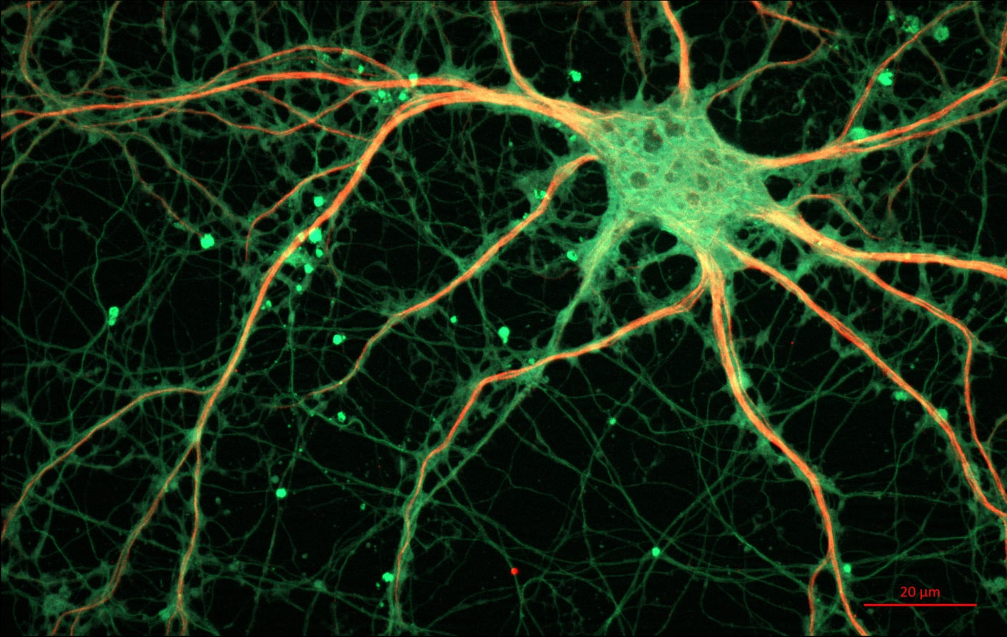
Neural Network
Neurons in brain receive input, maybe fire and activate other neurons
Notes:
Input is electrical signal
Send out signals along edges called synapses

Slide 6
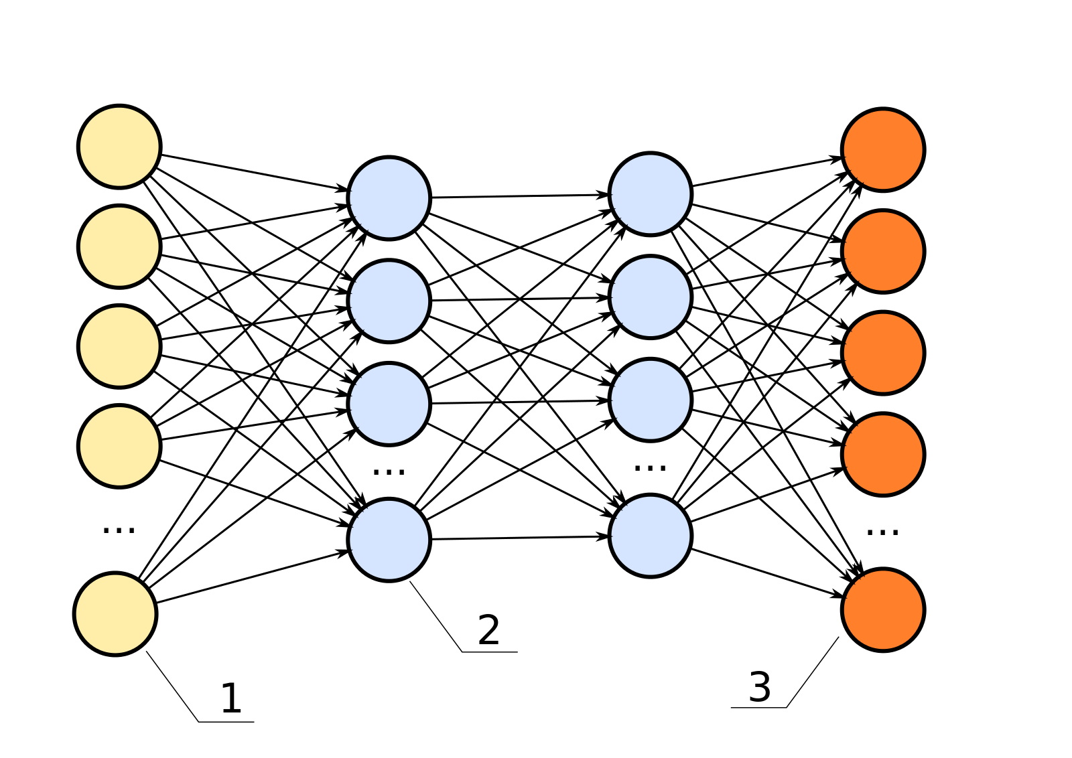
Neural Network
Hidden layers
Input layer
Ouput layer
Notes:
Each vertex a neuron
Receives input, possibly fires to next layer
Have to train the network to weight the amount by which each neuron ”listens” to its predecessors

Slide 7
Sorting

Slide 8
CS core course prerequisites
(simplified)
2110
3410
4410
1110
3110
2800
4820
Problem: find an order in which you can take courses without violating prerequisites
e.g. 1110, 2110, 2800, 3110, 3410, 4410, 4820
Notes:
Show: the CS prereq PDF in this directory
Other motivations: job scheduling, robot planning

Slide 9
Topological order
A topological order of directed graph G is an ordering of its vertices as v₁, v₂, …, v_{n}, such that for every edge (v_{i}, v_{j}), it holds that i < j.
Intuition: line up the vertices with all edges pointing left to right.
3410
4410
2110
1110
3110
4820
2800

Slide 10
Cycles
A directed graph can be topologically ordered if and only if it has no cycles
A cycle is a path v₀, v₁, ..., v_{p} such that v₀ = v_{p}
A graph is acyclic if it has no cycles
A directed acyclic graph is a DAG
A
A
B
B
C
C
E
D
D
E
DAG
Not a DAG

Slide 11
Is this graph a DAG?
B
D
C
Yes!
It was a DAG.
A
F
E
Deleting a vertex with indegree zero would not remove any cycles
Keep deleting such vertices and see whether graph “disappears”
And the order in which we removed vertices was a topological order!

Slide 12
Algorithm: topological sort
k= 0;
// inv: k nodes have been given numbers in 1..k in such a way that
if n1 <= n2, there is no edge from n2 to n1.
while (there is a node of in-degree 0) {
Let n be a node of in-degree 0;
Give it number k;
Delete n and all edges leaving it from the graph.
k= k+1;
}
A
B
C
D
E
F
0
1
k=
0
→1
1
→
0
2
B
D
2
→1
JavaHyperText shows how to implement efficiently: O(V+E) running time.
C
A
F
0
E
3
3
→2

Slide 13
Graph Coloring

Slide 14
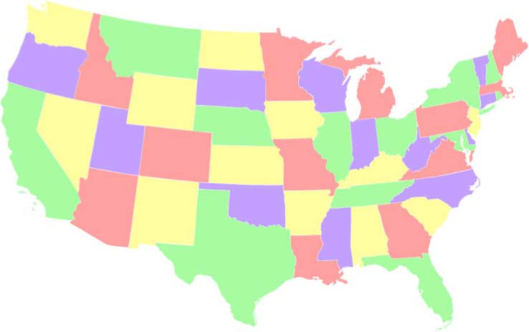
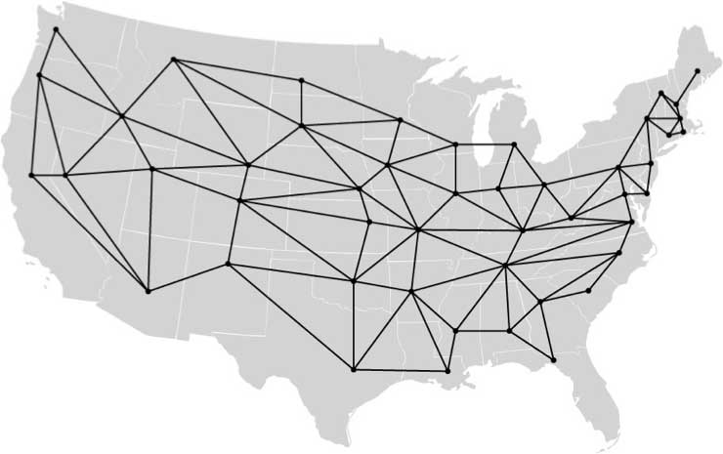
Map coloring
How many colors are needed to ensure adjacent states have different colors?

Slide 15
Graph coloring
Coloring: assignment of color to each vertex. Adjacent vertices must have different colors.
B
B
D
D
C
C
A
A
F
F
E
E
How many colors needed?

Slide 16
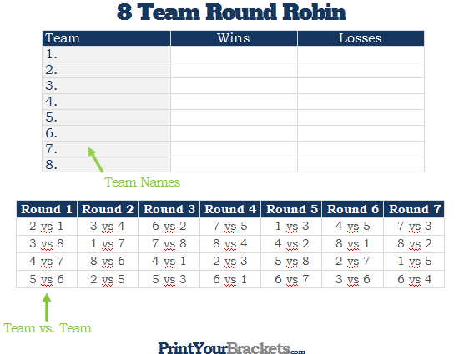
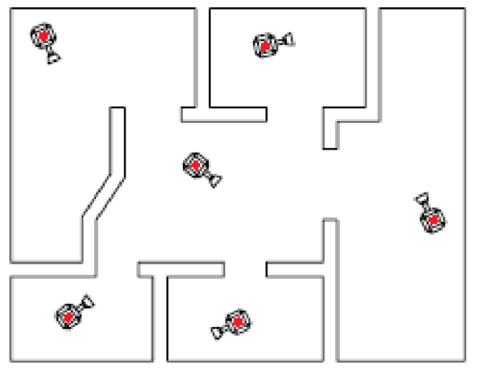
Uses of graph coloring
And more! http://ijcit.org/ijcit_papers/vol3no2/IJCIT-130101.pdf
Notes:
1. Maps
2. Round-robin sports scheduling
3. Placement of cameras in a security system
4. Compilers even use graph coloring to figure out storage for local variables! (i.e., register allocation: which variables can be stored in registers vs. spilled to stack frame. No need to go into that though.)

Slide 17
How to color a graph
void color() {
for each vertex v in graph:
c= find_color(neighbors of v);
color v with c;
}
int find_color(vs) {
int[] used;
assign used[c] the number of vertices in vs that are colored c
return smallest c such that used[c] == 0;
}
Assume colors are integers 0, 1, …

Slide 18
How to color a graph
void color() {
for each vertex v in graph:
c= find_color(neighbors of v);
color v with c;
}
int find_color(vs) {
int[] used= new int[vs.length() + 1];
for each vertex v in vs:
if color(v) <= vs.length():
used[color(v)]++;
}
return smallest c such that used[c] == 0;
}
Assume colors are integers 0, 1, …
If there are d vertices, need at most d+1 available colors

Slide 19
Analysis
Total time: O(E)
void color() {
for each vertex v in graph:
c= find_color(neighbors of v);
color v with c;
}
int find_color(vs) {
int[] used= new int[vs.length() + 1];
for each vertex v in vs:
if color(v) <= vs.length():
used[color(v)]++;
}
return smallest c such that used[c] == 0;
}
Time: O(# neighbors of v)
Time: O(vs.length())

Slide 20
Analysis
void color() {
for each vertex v in graph:
c= find_color(neighbors of v);
color v with c;
}
int find_color(vs) {
int[] used= new int[vs.length() + 1];
for each vertex v in vs:
if color(v) <= vs.length():
used[color(v)]++;
}
return smallest c such that used[c] == 0;
}
Use the minimum number of colors?
Maybe! Depends on order vertices processed.

Slide 21
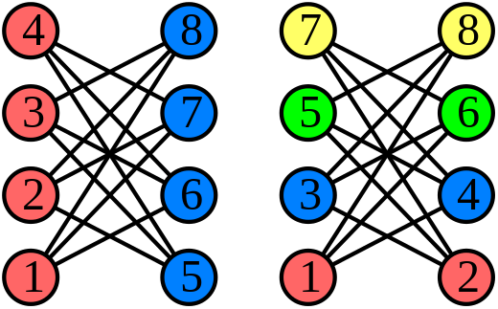
Analysis
Best coloring
Worst coloring
Vertices labeled in order of processing
Only 2 colors needed for this special kind of graph…
Source: https://en.wikipedia.org/wiki/Grundy_number#/media/File:Greedy_colourings.svg

Slide 22
Bipartite graphs
Bipartite: vertices can be partitioned into two sets such that no edge connects two vertices in the same set
Matching problems:
Med students & hospital residencies
TAs to discussion sections
Football players to teams
A
1
B
2
C
3
D
Fact: G is bipartite iff G is 2-colorable

Slide 23
Four Color Theorem
Every “map-like” graph is 4-colorable
[Appel & Haken, 1976]

Slide 24
Four Color Theorem
Proof required checking that 1,936 special graphs had a certain property
Appel & Haken used a computer program to check the 1,936 graphs
Does that count as a proof?
Gries looked at their computer program and found an error; it could be fixed
In 2008 entire proof formalized in Coq proof assistant [Gonthier & Werner]: see CS 4160

Slide 25
Four Color Theorem
Every “map-like” graph is 4-colorable
[Appel & Haken, 1976]
…“map-like”?
= planar

Slide 26
Planar Graphs

Slide 27
Planarity
A graph is planar if it can be drawn in the plane without any edges crossing
B
D
C
A
F
E
Discuss: Is this graph planar?

Slide 28
Planarity
A graph is planar if it can be drawn in the plane without any edges crossing
B
D
C
A
F
E
Discuss: Is this graph planar?

Slide 29
Planarity
A graph is planar if it can be drawn in the plane without any edges crossing
B
D
C
A
F
E
Discuss: Is this graph planar?
YES!

Slide 30
Detecting Planarity
Kuratowski's Theorem:
A graph is planar if and only if it does not contain a copy of K₅ or K_{3,3} (possibly with other nodes along the edges shown).
K₅
K_{3,3}

Slide 31
John Hopcroft & Robert Tarjan
Turing Award in 1986 “for fundamental achievements in the design and analysis of algorithms and data structures”
One of their fundamental achievements was a O(V) algorithm for determining whether a graph is planar.
Notes:
They worked together coincidentally. Hopcroft took a sabbatic at Stanford. There was little room. So he and Tarjan, a PhD student, were asked to share a room, since Tarjan was interested in data structures. And they started talking. The result was several algorithms, including their famous planarity checker.

Slide 32
David Gries & Jinyun Xue
Tech Report, 1988
Abstract: We give a rigorous, yet, we hope, readable, presentation of the Hopcroft-Tarjan linear algorithm for testing the planarity of a graph, using more modern principles and techniques for developing and presenting algorithms that have been developed in the past 10-12 years (their algorithm appeared in the early 1970's). Our algorithm not only tests planarity but also constructs a planar embedding, and in a fairly straightforward manner. The paper concludes with a short discussion of the advantages of our approach.
Notes:
Later, Gries looked at their algorithm and had great difficulty understanding it. He and a postdoc developed it afresh using stepwise refinement and loop invariants and other sound principles. They published a tech report on it in 1986.

Slide 33
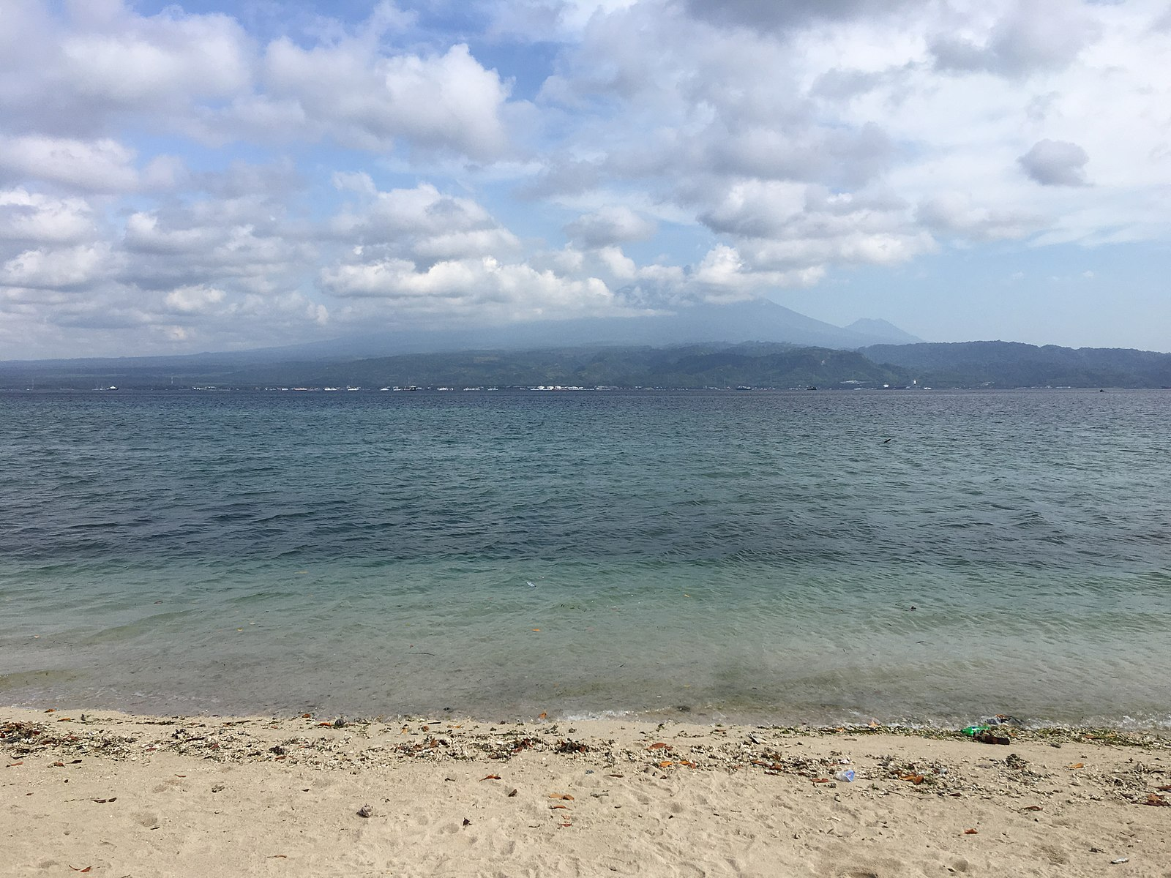
Java Island, Southeast Asia
Happy Spring Break!
Notes:
https://commons.wikimedia.org/wiki/File:Java_Island_seen_from_Bali_Barat_National_Park.jpg

