Slide 1
Trees, part 2
Lecture 13
CS2110 – Spring 2019
Notes:
I started this lecture by finishing what I didn’t get to in L12: worst-case search in BSTs

Slide 2
Finish Lec12

Slide 3
Announcements
Prelim conflict quiz was due last night. Too late now to make changes. We won’t be sending confirmations about time swaps (5:30 vs 7:30); if you requested it, you got it.
Room assignments for the prelim (including SDS accommodations) will be announced by Monday. Please be patient.

Slide 4
JavaHyperText topics
Tree traversals (preorder, inorder, postorder)
Stack machines
…will be added by the end of this weekend

Slide 5
Trees, re-implemented
Last time: lots of null comparisons to handle empty trees
A more OO design:
Interface to represent operations on trees
Classes to represent behavior of empty vs. non-empty trees
Demo
Notes:
And we could improve further by not revealing Empty vs Node in implementation, but that would require factory methods…

Slide 6
Iterate through data structure
Iterate: process elements of data structure
Sum all elements
Print each element
…
Data Structure | Order to iterate
Array | Forwards: 2, 1, 3, 0 Backwards: 0, 3, 1, 2
Linked List | Forwards: 2, 1, 3, 0
Binary Tree | ???
2
1
3
0
2
1
3
0
2
1
3
Notes:
There’s no notion of forwards or backwards

Slide 7
Iterate through data structure
5
2
8
0
3
7
9
Discuss: What would a reasonable order be?
Demo
Notes:
Demo: add to Tree.java:
public void print() {
if (left != null) left.print();
if (right != null) right.print();
}
Discuss when to print v; three possibilities!

Slide 8
Tree Traversals

Slide 9
Tree traversals
Iterating through tree is aka tree traversal
Well-known recursive tree traversal algorithms:
Preorder
Inorder
Postorder
Another, non-recursive: level order (later in semester)

Slide 10
Preorder
“Pre:” process root before subtrees
1st
value
2nd
3rd
left
subtree
right
subtree

Slide 11
Inorder
“In:” process root in-between subtrees
2nd
value
1st
3rd
left
subtree
right
subtree

Slide 12
Postorder
“Post:” process root after subtrees
3rd
value
1st
2nd
left
subtree
right
subtree

Slide 13
Poll
Which traversal would print out this BST in ascending order?
5
2
8
0
3
7
9

Slide 14
Example: Syntax Trees

Slide 15
Syntax Trees
Trees can represent (Java) expressions
Expression: 2 * 1 – (1 + 0)
Tree:
–
*
+
2
1
1
0
Notes:
This could be extended to other Java syntax—like classes and methods!

Slide 16
Traversals of expression tree
–
*
+
2
1
1
0
Preorder traversal
Visit the root
Visit the left subtree
Visit the right subtree
-
*
2
1
+
1
0

Slide 17
Traversals of expression tree
–
*
+
2
1
1
0
Preorder traversal
Postorder traversal
Visit the left subtree
Visit the right subtree
Visit the root
-
*
2
1
+
1
0
2
1
*
1
0
+
-

Slide 18
Traversals of expression tree
–
*
+
2
1
1
0
Preorder traversal
Postorder traversal
Inorder traversal
Visit the left subtree
Visit the root
Visit the right subtree
-
*
2
1
+
1
0
2
1
*
1
0
+
-
2
*
1
-
1
+
0

Slide 19
Traversals of expression tree
–
*
+
2
1
1
0
Preorder traversal
Postorder traversal
Inorder traversal
-
*
2
1
+
1
0
2
1
*
1
0
+
-
2
*
1
-
1
+
0
Original expression, except for parens
Notes:
What might preorder and postorder correspond to?

Slide 20
Prefix notation
Function calls in most programming languages use prefix notation: e.g., add(37, 5).
Aka Polish notation (PN) in honor of inventor, Polish logician Jan Łukasiewicz
Some languages (Lisp, Scheme, Racket) use prefix notation for everything to make the syntax uniform.
(- (* 2 1) (+ 1 0))
(define (fib n)
(if (<= n 2)
1
(+ (fib (- n 1) (fib (- n 2)))))

Slide 21
Postfix notation
Some languages (Forth, PostScript, HP calculators) use postfix notation
Aka reverse Polish notation (RPN)
2 1 mul 1 0 add sub
/fib { dup
3 lt
{ pop 1 }
{ dup 1 sub fib exch 2 sub fib add }
ifelse
} def

Slide 22
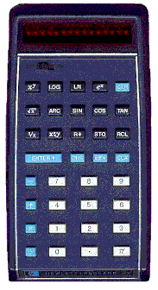
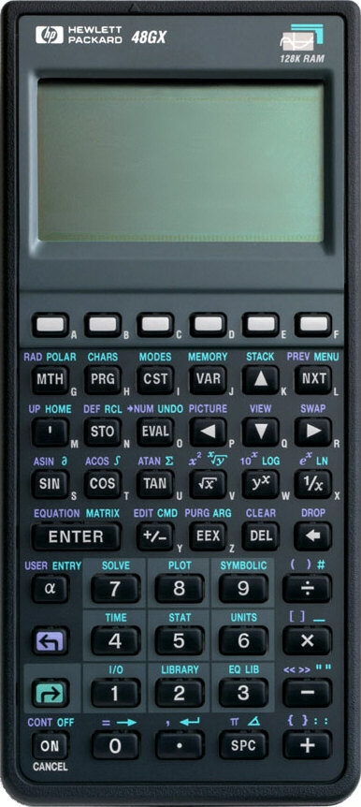
Postfix notation
In about 1974, Gries paid $300 for an HP calculator, which had some memory and used postfix notation.
Still works.
In about 1993, Clarkson paid $150 for an HP calculator with more memory, buttons, and screen.
Mac Calculator also does RPN
Demo
Notes:
Demo computation of 2 1 * 1 0 + * on a calculator
In defense of postfix: no parens needed! Same can be true of prefix if # operands known in advance for each operator.

Slide 23
Syntax trees: in code
public interface Expr {
int eval();
String inorder();
}
public class Int implements Expr {
private int v;
public int eval() { return v; }
public String inorder() { return " " + v + " "; }
}
public class Add implements Expr {
private Expr left, right;
public int eval() { return left.eval() + right.eval(); }
public String inorder() {
return "(" + left.infix() + "+" + right.infix() + ")";
}
}
(see website for full code)
Notes:
This is like our more OO implementation of trees: an interface with several implementations to customize behavior

Slide 24
Java syntax
Java compiler:
translates your text file (list of characters) into a syntax tree
decides whether program is legal
Grammar for legal programs: https://docs.oracle.com/javase/specs/jls/se8/html/jls-19.html
You could use it to generate every possible Java program. (That would take forever.)

Slide 25
Back to Trees

Slide 26
Recover tree from traversal
Suppose inorder is B C A E D.
Can we recover the tree uniquely?
Discuss.

Slide 27
Recover tree from traversal
Suppose inorder is B C A E D.
Can we recover the tree uniquely? No!
C
A
B
E
B
E
A
D
C
D

Slide 28
Recover tree from traversals
Suppose inorder is B C A E D
preorder is A B C D E
Can we determine the tree uniquely?

Slide 29
Recover tree from traversals
Suppose inorder is B C A E D
preorder is A B C D E
Can we determine the tree uniquely? Yes!
What is root? Preorder tells us: A
What comes before/after root A? Inorder tells us:
Before: B C
After: E D
Now recurse! Figure out left/right subtrees using same technique.

Slide 30
Recover tree from traversals
Suppose inorder is B C A E D
preorder is A B C D E
Root is A; left subtree contains B C; right contains E D
Left:
Inorder is B C
Preorder is B C
What is root? Preorder: B
What is before/after B? Inorder:
Before: nothing
After: C
Right:
Inorder is E D
Preorder is D E
What is root? Preorder: D
What is before/after D? Inorder:
Before: E
After: nothing

Slide 31
Recover tree from traversals
Suppose inorder is B C A E D
preorder is A B C D E
Tree is
A
B
D
C
E

