Slide 1
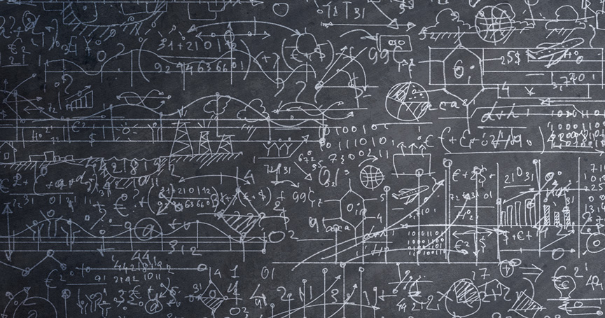
Asymptotic complexity
“Simplicity is a great virtue but it requires hard work to achieve it and education to appreciate it. And to make matters worse: complexity sells better.”
- Edsger Dijkstra
Lecture 10
CS2110 – Spring 2019

Slide 2
Announcements
Next Mon-Tues: Spring Break
No recitation next week
Regrade requests will be processed this weekend
Prelim is on Tuesday, 12 March. Prelim Review for prelim Sunday, 10 March, 1-3PM Next Thursday, we will tell you
What time you will be assigned to take it
What to do if you can’t take it then but can take the other one
What to do if you can’t take it that evening.
What to do if authorized for more time or quiet space

Slide 3
Help in providing code coverage
White-box testing: make sure each part of program is “exercised” in at least one test case. Called code coverage.
Eclipse has a tool for showing you how good your code coverage is! Use it on A3 (and any programs you write)
JavaHyperText entry:
code coverage
We demo it.

Slide 4
What Makes a Good Algorithm?
Suppose you have two possible algorithms that do the same thing; which is better?
What do we mean by better?
Faster?
Less space?
Simpler?
Easier to code?
Easier to maintain?
Required for homework?
FIRST, Aim for simplicity, ease of understanding, correctness.
SECOND, Worry about efficiency only when it is needed.
How do we measure speed of an algorithm?

Slide 5
Basic Step: one “constant time” operation
Constant time operation: its time doesn’t depend on the size
or length of anything. Always roughly the same. Time is bounded above by some number
Basic step:
Input/output of a number
Access value of primitive-type variable, array element, or object field
assign to variable, array element, or object field ***
do one arithmetic or logical operation
method call (not counting arg evaluation and execution of method body)

Slide 6
Counting Steps
// Store sum of 1..n in sum
sum= 0;
// inv: sum = sum of 1..(k-1)
for (int k= 1; k <= n; k= k+1){
sum= sum + k;
}
Statement: # times done sum= 0; 1
k= 1; 1
k <= n n+1
k= k+1; n
sum= sum + k; n
Total steps: 3n + 3
Linear algorithm in n
All basic steps take time 1.
There are n loop iterations. Therefore, takes time proportional to n.

Slide 7
Not all operations are basic steps
Statement: # times done s= ""; 1
k= 1; 1
k <= n n+1
k= k+1; n
s= s + 'c'; n
Total steps: 3n + 3
// Store n copies of ‘c’ in s
s= "";
// inv: s contains k-1 copies of ‘c’
for (int k= 1; k <= n; k= k+1){
s= s + 'c';
}
❌
Catenation is not a basic step. For each k, catenation creates and fills k array elements.

Slide 8
String Catenation
s= s + “c”; is NOT constant time. It takes time proportional to 1 + length of s
String@00
s
String@90
String
String
b
b
char[]
char[]
char[]@02
char[]@018
char[]
char[]
0
‘d’
0
‘d’
1
‘x’
1
‘x’
2
‘c’

Slide 9
Basic steps executed in s= s + ‘c’;
s= s + 'c’; // Suppose length of s is k
Create new String object, say C basic steps.
Copy k chars from object s to the new object: k basic steps
Place char ‘c’ into the new object: 1 basic step.
Store pointer to new object into s: 1 basic step.
Total of (C+2) + k basic steps.
In the algorithm, s= s + ‘c’; is executed n times:
s= s + ‘c’; with length of s = 0
s= s + ‘c’; with length of s = 1
…
s= s + ‘c’; with length of s = n-1
Total of n*(C+2) + (0 + 1 + 2 + … n-1) basic steps

Slide 10
Basic steps executed in s= s + ‘c’;
s= s + 'c’; // Suppose length of s is k
In the algorithm, s= s + ‘c’; is executed as follows:
s= s + ‘c’; with length of s = 0
s= s + ‘c’; with length of s = 1
…
s= s + ‘c’; with length of s = n-1
Total of n*(C+2) + (0 + 1 + 2 + … n-1) basic steps
0 + 1 + 2 + … n-1 = n(n-1) / 2. Gauss figured this out in the 1700’s
= n²/2 – n/2.
mathcentral.uregina.ca/qq/database/qq.02.06/jo1.html

Slide 11
Basic steps executed in s= s + ‘c’;
s= s + 'c’; // Suppose length of s is k
In the algorithm, s= s + ‘c’; is executed as follows:
s= s + ‘c’; with length of s = 0
s= s + ‘c’; with length of s = 1
…
s= s + ‘c’; with length of s = n-1
Total of n*(C+2) + (0 + 1 + 2 + … n-1) basic steps
Total of n*(C+2) + n²/2 – n/2 basic steps
Total of n*(C+2) + n²/2 – n/2 basic steps. Quadratic in n.

Slide 12
Not all operations are basic steps
// Store n copies of ‘c’ in s
s= "";
// inv: s contains k-1 copies of ‘c’
for (int k= 1; k <= n; k= k+1){
s= s + 'c';
}
Statement: # times # steps
s= ""; 1 1
k= 1; 1 1
k <= n n+1 1
k= k+1; n 1
s= s + 'c’; see to left
Total steps: …
Total steps:
2n + 3 +
n*(C+2) + n²/2 – n/2
Quadratic algorithm in n
for s= s + ‘c’;

Slide 13
Linear versus quadractic
// Store sum of 1..n in sum
sum= 0;
// inv: sum = sum of 1..(k-1)
for (int k= 1; k <= n; k= k+1)
sum= sum + n
// Store n copies of ‘c’ in s
s= “”;
// inv: s contains k-1 copies of ‘c’
for (int k= 1; k = n; k= k+1)
s= s + ‘c’;
Linear algorithm
Quadratic algorithm
In comparing the runtimes of these algorithms, the exact number of basic steps is not important. What’s important is that
One is linear in n —takes time proportional to n
One is quadratic in n —takes time proportional to n²

Slide 14
Looking at execution speed
Number of operations executed
2n+2, n+2, n are all linear in n, proportional to n
2n + 2 ops
n*n ops
n + 2 ops
n ops
Constant time
0 1 2 3 …
size n of the array

Slide 15
What do we want from a definition of “runtime complexity”?
1. Distinguish among cases for large n, not small n
Number of operations executed
2. Distinguish among important cases, like
n*n basic operations
n basic operations
log n basic operations
5 basic operations
n*n ops
2+n ops
5 ops
3. Don’t distinguish among trivially different cases.
5 or 50 operations
n, n+2, or 4n operations
0 1 2 3 …
size n of problem

Slide 16
"Big O" Notation
Formal definition: f(n) is O(g(n)) if there exist constants c > 0 and N ≥ 0 such that for all n ≥ N, f(n) ≤ c·g(n)
Get out far enough (for n ≥ N)
f(n) is at most c·g(n)
c·g(n)
f(n)
Intuitively, f(n) is O(g(n))
means that f(n) grows
like g(n) or slower
N

Slide 17
Prove that (2n² + n) is O(n²)
Formal definition: f(n) is O(g(n)) if there exist constants c > 0 and N ≥ 0 such that for all n ≥ N, f(n) ≤ c·g(n)
Example: Prove that (2n² + n) is O(n²)
Methodology:
Start with f(n) and slowly transform into c · g(n):
Use = and <= and < steps
At appropriate point, can choose N to help calculation
At appropriate point, can choose c to help calculation

Slide 18
Prove that (2n² + n) is O(n²)
Formal definition: f(n) is O(g(n)) if there exist constants c > 0 and N ≥ 0 such that for all n ≥ N, f(n) ≤ c·g(n)
Example: Prove that (2n² + n) is O(n²)
f(n)
= <definition of f(n)>
2n² + n
<= <for n ≥ 1, n ≤ n²>
2n² + n²
= <arith>
3*n²
= <definition of g(n) = n²>
3*g(n)
Transform f(n) into c·g(n):
Use =, <= , < steps
Choose N to help calc.
Choose c to help calc
Choose
N = 1 and c = 3

Slide 19
Prove that 100 n + log n is O(n)
Formal definition: f(n) is O(g(n)) if there exist constants c > 0 and N ≥ 0 such that for all n ≥ N, f(n) ≤ c·g(n)
f(n)
= <put in what f(n) is>
100 n + log n
<= <We know log n ≤ n for n ≥ 1>
100 n + n
= <arith>
101 n
= <g(n) = n>
101 g(n)
Choose
N = 1 and c = 101

Slide 20
O(…) Examples
Let f(n) = 3n² + 6n – 7
f(n) is O(n²)
f(n) is O(n³)
f(n) is O(n⁴)
…
p(n) = 4 n log n + 34 n – 89
p(n) is O(n log n)
p(n) is O(n²)
h(n) = 20·2^{n} + 40n
h(n) is O(2^{n})
a(n) = 34
a(n) is O(1)
Only the leading term (the term that grows most rapidly) matters
If it’s O(n²), it’s also O(n³)
etc! However, we always use the smallest one

Slide 21
Do NOT say or write f(n) = O(g(n))
Formal definition: f(n) is O(g(n)) if there exist constants c > 0 and N ≥ 0 such that for all n ≥ N, f(n) ≤ c·g(n)
f(n) = O(g(n)) is simply WRONG. Mathematically, it is a disaster.
You see it sometimes, even in textbooks. Don’t read such things.
Here’s an example to show what happens when we use = this way.
We know that n+2 is O(n) and n+3 is O(n). Suppose we use =
n+2 = O(n)
n+3 = O(n)
But then, by transitivity of equality, we have n+2 = n+3.
We have proved something that is false. Not good.

Slide 22
Problem-size examples
Suppose a computer can execute 1000 operations per second; how large a problem can we solve?
operations | 1 second | 1 minute | 1 hour
n | 1000 | 60,000 | 3,600,000
n log n | 140 | 4893 | 200,000
n² | 31 | 244 | 1897
3n² | 18 | 144 | 1096
n³ | 10 | 39 | 153
2^{n} | 9 | 15 | 21

Slide 23
Commonly Seen Time Bounds
O(1) | constant | excellent
O(log n) | logarithmic | excellent
O(n) | linear | good
O(n log n) | n log n | pretty good
O(n²) | quadratic | maybe OK
O(n³) | cubic | maybe OK
O(2^{n}) | exponential | too slow

Slide 24
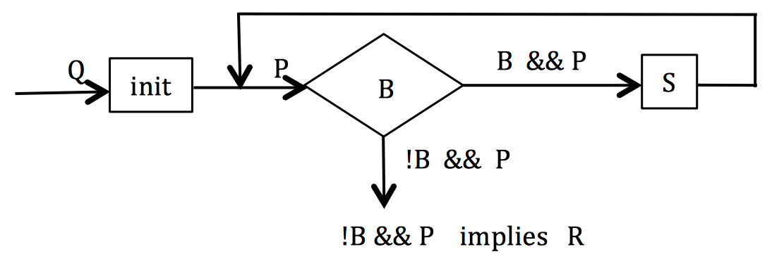
Search for v in b[0..]
Q: v is in array b
Store in i the index of the first occurrence of v in b: R: v is not in b[0..i-1] and b[i] = v.
Methodology:
Define pre and post conditions.
Draw the invariant as a combination of pre and post.
Develop loop using 4 loopy questions.
Practice doing this!

Slide 25
Search for v in b[0..]
Q: v is in array b
Store in i the index of the first occurrence of v in b: R: v is not in b[0..i-1] and b[i] = v.
0 b.length
b
Methodology:
Define pre and post conditions.
Draw the invariant as a combination of pre and post.
Develop loop using 4 loopy questions.
Practice doing this!
pre:
v in here
0 i b.length
b
post:
$$≠v v ?$$
0 i b.length
v in here
b
inv:
$$≠v$$

Slide 26
The Four Loopy Questions
Does it start right?
Is {Q} init {P} true?
Does it continue right?
Is {P && B} S {P} true?
Does it end right?
Is P && !B => R true?
Will it get to the end?
Does it make progress toward termination?

Slide 27
Search for v in b[0..]
Q: v is in array b
Store in i the index of the first occurrence of v in b: R: v is not in b[0..i-1] and b[i] = v.
0 b.length
i= 0;
b
pre:
while ( ) {
}
v in here
b[i] != v
0 i b.length
i= i+1;
b
post:
$$≠v v ?$$
0 i b.length
Each iteration takes constant time.
v in here
b
inv:
$$≠v$$
Worst case: b.length iterations
Linear algorithm: O(b.length)

Slide 28
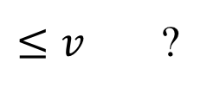
Binary search for v in sorted b[0..]
// b is sorted. Store in i a value to truthify R:
// b[0..i] <= v < b[i+1..]
0 b.length
b
Methodology:
Define pre and post conditions.
Draw the invariant as a combination of pre and post.
Develop loop using 4 loopy questions.
Practice doing this!
pre:
sorted
0 i b.length
b
$$≤v$$
post:
$$>v$$
0 i k b.length
b
inv:
$≤v$ ?
$$>v$$
b is sorted. We know that. To avoid clutter, don’t write in it invariant

Slide 29
Binary search for v in sorted b[0..]
// b is sorted. Store in i a value to truthify R:
// b[0..i] <= v < b[i+1..]
0 b.length
i= -1;
k= b.length;
b
pre:
sorted
while ( ) {
}
i+1< k
0 i b.length
int e=(i+k)/2;
// -1 ≤ i < e < k ≤ b.length
b
$$≤v$$
post:
$$>v$$
if (b[e] <= v) i= e;
else k= e;
0 i k b.length
b
inv:
$≤v$ ?
$$>v$$
e
0 i k
$≤v$
$≤v$
$$>v$$

Slide 30
Binary search for v in sorted b[0..]
// b is sorted. Store in i a value to truthify R:
// b[0..i] <= v < b[i+1..]
0 b.length
i= -1;
k= b.length;
b
pre:
sorted
while ( ) {
}
i+1< k
0 i b.length
int e=(i+k)/2;
// -1 ≤ e < k ≤ b.length
if (b[e] <= v) i= e;
else k= e;
b
$$≤v$$
post:
$$>v$$
0 i k b.length
b
inv:
$≤v$ ?
$$>v$$
Each iteration takes constant time.
Logarithmic: O(log(b.length))
Worst case: log(b.length) iterations

Slide 31
Binary search for v in sorted b[0..]
// b is sorted. Store in i a value to truthify R:
// b[0..i] <= v < b[i+1..]
This algorithm is better than binary searches that stop when v is found.
Gives good info when v not in b.
Works when b is empty.
Finds first occurrence of v, not arbitrary one.
Correctness, including making progress, easily seen using invariant
i= -1;
k= b.length;
while ( ) {
}
i+1< k
int e=(i+k)/2;
// -1 ≤ e < k ≤ b.length
if (b[e] <= v) i= e;
else k= e;
Each iteration takes constant time.
Logarithmic: O(log(b.length))
Worst case:
log(b.length) iterations

Slide 32
Dutch National Flag Algorithm

Slide 33
Dutch National Flag Algorithm
Dutch national flag. Swap b[0..n-1] to put the reds first, then the whites, then the blues. That is, given precondition Q, swap values of b[0.n-1] to truthify postcondition R:
0 n
?
Suppose we use
invariant P1.
What does the repetend do?
Q: b
0 n
R: b
reds whites blues
0 n
P1: b
reds whites blues ?
2 swaps to get a red in place
0 n
P2: b
reds whites ? blues

Slide 34
Dutch National Flag Algorithm
Dutch national flag. Swap b[0..n-1] to put the reds first, then the whites, then the blues. That is, given precondition Q, swap values of b[0.n-1] to truthify postcondition R:
Suppose we use
invariant P2.
What does the repetend do?
0 n
?
Q: b
0 n
R: b
reds whites blues
At most one swap per iteration
0 n
P1: b
reds whites blues ?
0 n
Compare algorithms without writing code!
P2: b
reds whites ? blues

Slide 35
Dutch National Flag Algorithm: invariant P1
0 n
Q: b
h= 0; k= h; p= k;
?
while ( ) {
}
0 n
p != n
if (b[p] blue)
else if (b[p] white) {
}
else { // b[p] red
}
R: b
reds whites blues
p= p+1;
0 n
h k p
swap b[p], b[k];
p= p+1; k= k+1;
P1: b
reds whites blues ?
swap b[p], b[h];
swap b[p], b[k];
p= p+1; h=h+1; k= k+1;

Slide 36
Dutch National Flag Algorithm: invariant P2
0 n
Q: b
h= 0; k= h; p= n;
?
while ( ) {
}
0 n
k != p
R: b
reds whites blues
if (b[k] white)
else if (b[k] blue) {
}
else { // b[k] is red
}
k= k+1;
0 n
h k p
P2: b
reds whites ? blues
p= p-1;
swap b[k], b[p];
swap b[k], b[h];
h= h+1; k= k+1;

Slide 37
Asymptotically, which algorithm is faster?
Invariant 1
Invariant 2
0 h k p n
0 h k p n
reds whites blues ?
reds whites ? blues
h= 0; k= h; p= k;
h= 0; k= h; p= n;
while ( ) {
}
p != n
while ( ) {
}
k != p
if (b[p] blue)
else if (b[p] white) {
}
else { // b[p] red
}
p= p+1;
if (b[k] white)
else if (b[k] blue) {
}
else { // b[k] is red
}
k= k+1;
swap b[p], b[k];
p= p+1; k= k+1;
p= p-1;
swap b[k], b[p];
swap b[p], b[h];
swap b[p], b[k];
p= p+1; h=h+1; k= k+1;
swap b[k], b[h];
h= h+1; k= k+1;

Slide 38
Asymptotically, which algorithm is faster?
Invariant 1
Invariant 2
0 h k p n
0 h k p n
reds whites blues ?
reds whites ? blues
h= 0; k= h; p= k;
h= 0; k= h; p= n;
might use 2 swaps per iteration
uses at most 1 swap per iteration
while ( ) {
}
p != n
while ( ) {
}
k != p
if (b[p] blue)
else if (b[p] white) {
}
else { // b[p] red
}
p= p+1;
if (b[k] white)
else if (b[k] blue) {
}
else { // b[k] is red
}
k= k+1;
swap b[p], b[k];
p= p+1; k= k+1;
p= p-1;
swap b[k], b[p];
These two algorithms have the same asymptotic running time
(both are O(n))
swap b[p], b[h];
swap b[p], b[k];
p= p+1; h=h+1; k= k+1;
swap b[k], b[h];
h= h+1; k= k+1;

