Slide 1
Conclusion
CS2110
Spring 2018

Slide 2
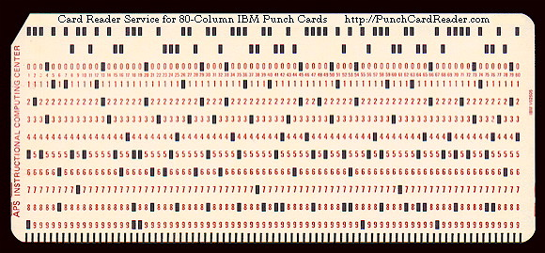
History
Programming and computers:
Momentous changes since the 1940s –or since even the use of punch cards and attempt at automation …

Slide 3
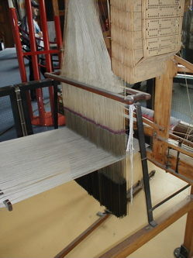
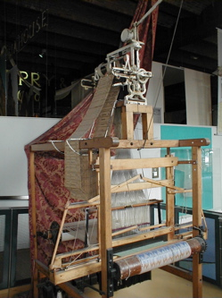
Punch cards
Jacquard loom
Loom still used in China
Mechanical loom invented by Joseph Marie Jacquard in 1801.
Used the holes punched in pasteboard punch cards to control the weaving of patterns in fabric.
Punch card corresponds to one row of the design.
Based on earlier invention by French mechanic Falcon in 1728.

Slide 4
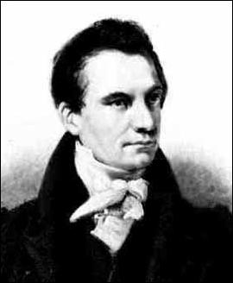
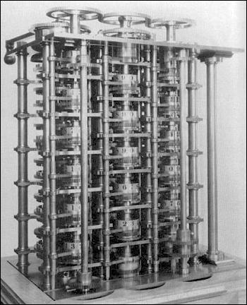
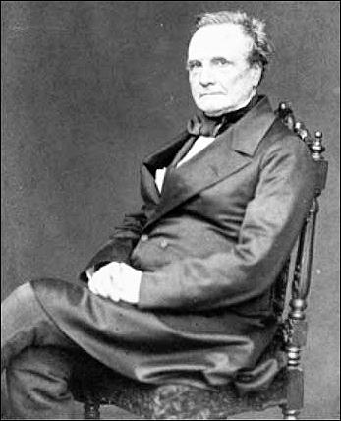
Charles Babbage designed a “difference engine” in 1822
Compute mathematical tables for log, sin, cos, other trigonometric functions.
No electricity
The mathematicians doing the calculations were called computers

Slide 5
Oxford English Dictionary, 1971
Computer: one who computes; a calculator, rekoner. spec. a person employed to make calculations in an observatory, in surveying. etc.
1664: Sir T. Browne. The calendars of these computers.
1704. T. Swift. A very skillful computer.
1744. Walpole. Told by some nice computers of national glory.
1855. Brewster Newton. To pay the expenses of a computer for reducing his observations.
The mathematicians doing the calculations were called computers

Slide 6
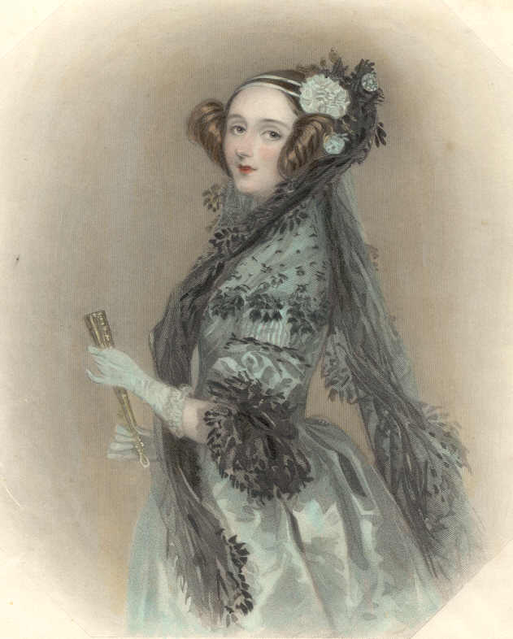
Charles Babbage planned to use cards to store programs in his Analytical engine. (First designs of real computers, middle 1800s until his death in 1871.)
First programmer was Ada Lovelace, daughter of poet Lord Byron.
Privately schooled in math.
One tutor was Augustus De Morgan.
The Right Honourable Augusta Ada, Countess of Lovelace.

Slide 7
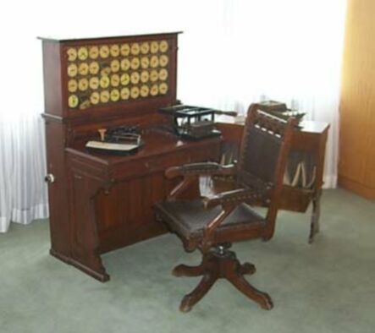
Herman Hollerith.
His tabulating machines used in compiling the 1890 Census.
Hollerith's patents were acquired by the Computing-Tabulating-Recording Co.
Later became IBM.
The operator places each card in the reader, pulls down a lever, and removes the card after each punched hole is counted.
Hollerith 1890 Census Tabulator

Slide 8
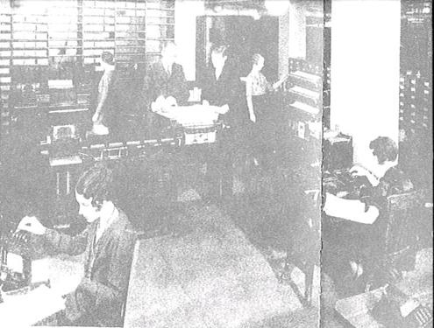
Computers, calculating the US census

Slide 9
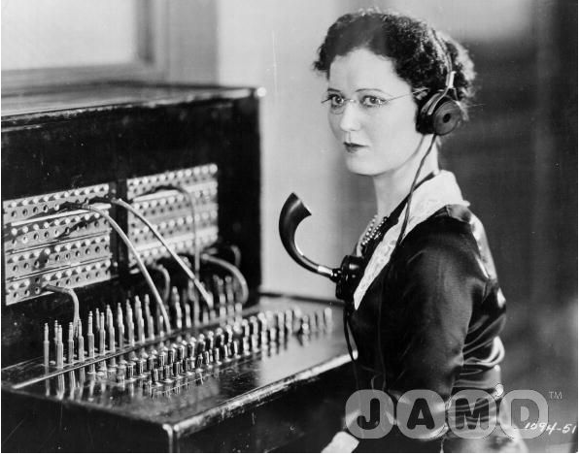
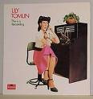
History of computers
1935-38. Konrad Zuse - Z1 Computer
1935-39. John Atanasoff and Berry (grad student). Iowa State
1944. Howard Aiken & Grace Hopper Harvard Mark I Computer
1946. John Presper Eckert & John W. Mauchly ENIAC 1 Computer 20,000 vacuum tubes later ...
1947-48 The Transistor, at Bell-labs.
1953. IBM. the IBM 701.
9
Notes:
www.youtube.com/watch?v=SvesMBkduQo

Slide 10
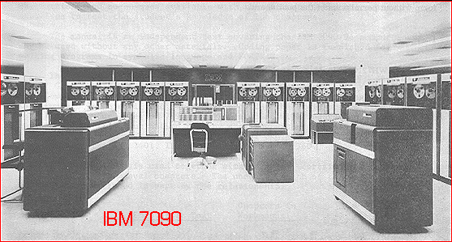
How did Gries get into Computer Science?
1959. Took his only computer course. Senior, Queens College.
1960. Mathematician-programmer at the US Naval Weapons Lab in Dahlgren, Virginia.
10

Slide 11
1960. Mathematician-programmer at the US Naval Weapons Lab in Dahlgren, Virginia.
Programmed in Fortran and IBM 7090 assembly language
if (SEX == ‘M’) MALES= MALES + 1; else FEMALES= FEMALES + 1;
CLI SEX,'M' Male?
BNO IS_FEM If not, branch around
L 7,MALES Load MALES into register 7;
LA 7,1(,7) add 1;
ST 7,MALES and store the result
B GO_ON Finished with this portion
IS_FEM L 7,FEMALES If not male, load FEMALES into register 7;
LA 7,1(,7) add 1;
ST 7,FEMALES and store
GO_ON EQU *
11

Slide 12
1960: Big Year for Programming Languages
LISP (List Processor): McCarthy, MIT (moved to Stanford). First functional programming language. No assignment statement. Write everything as recursive functions. (take 3110)
COBOL (Common Business-Oriented Language). Became most widely used language for business, data processing.
ALGOL (Algorithmic Language). Developed by an international team over a 3-year period. McCarthy was on it, John Backus was on it (developed Fortran in mid 1950’s). Gries’s soon-to-be PhD supervisor, Fritz Bauer of Munich, led the team.
12

Slide 13
1959. Took his only computer course. Senior, Queens College.
1960. Mathematician-programmer at the US Naval Weapons Lab in Dahlgren, Virginia.
1962. Back to grad school, in Math, at University of Illinois
Graduate Assistantship: Help two Germans write the ALCOR-Illinois 7090 Compiler.
John Backus, FORTRAN, mid 1950’s: 30 people years
This compiler: 6 ~people-years
Today, CS compiler writing course: 2 students, one semester
1963-66 Dr. rer. nat. in Math in Munich Institute of Technology
1966-69 Asst. Professor, Stanford CS
1969- Cornell!
13

Slide 14
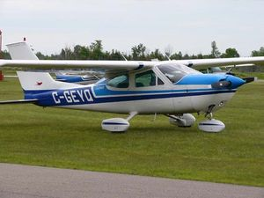
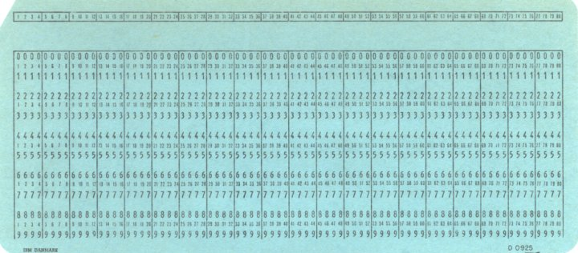
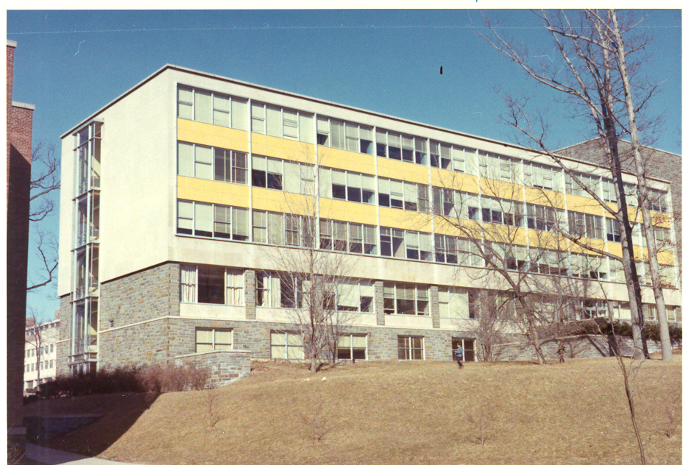
Late 1960s
Write programs on IBM “punch cards. Deck of cards making up a program trucked to Langmuir labs by the airport 2-3 times a day; get them back, with output, 3-4 hours later
IBM 360
Mainframes

Slide 15
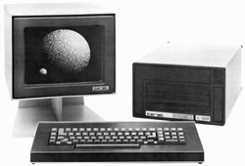
About 1973. BIG STEP FORWARD
1. Write program on punch cards.
2. Wait in line (20 min) to put cards in card reader in Upson basement
3. Output comes back in 5 minutes
About 1973. BIG STEP FORWARD
Switched to using the programming language Pascal, developed by Niklaus Wirth at Stanford.
About 1979. Teraks
Prof. Tim Teitelbaum sees opportunity. He and grad student Tom Reps develop “Cornell Program Synthesizer”. Year later, Cornell uses Teraks in its prog course.
40 lbs
November 1981,
Terak with 56K RAM, one floppy drive: $8,935.
Want 10MB hard drive?
$8,000 more

Slide 16
1983-84
Switched to Macintosh in labs
Late 1980s
Put fifth floor addition on Upson. We made the case that our labs were in our office and therefore we need bigger offices.
1980s
CS began getting computers on their desks.
Nowadays
Everybody has a computer in their office.
2014
Moved into Gates Hall!

Slide 17
Programming languages. Dates approximate
Year Major languages Teach at Cornell
1956’s Fortran
1960 Algol, LISP, COBOL
PL/I PL/C (1969)
1970 C
Pascal
1980’s Smalltalk (object-oriented) Pascal (1980’s)
1980’s (late) C++
Java C and C++
2008 Java / Matlab
2011 Python / Matlab / Java

Slide 18
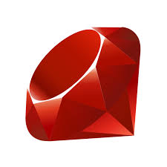
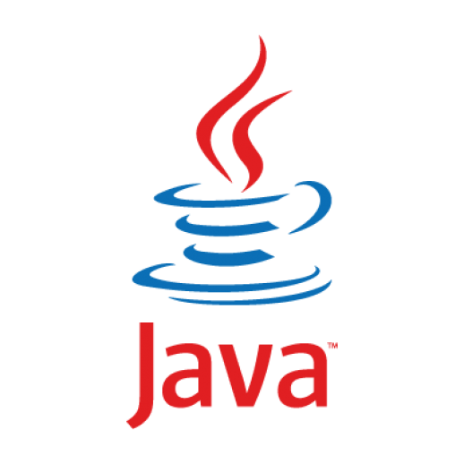
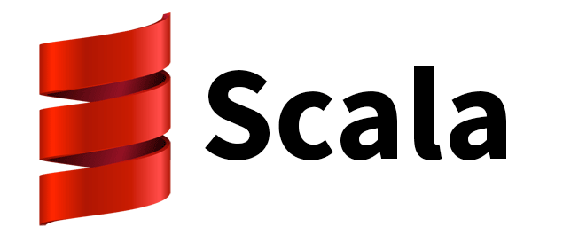
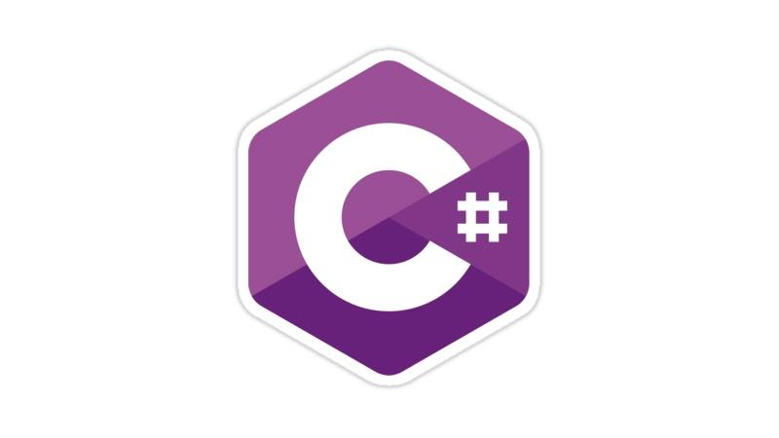
Java is not the Only OO Language

Slide 19
Java is not the Only OO Language
Usability
Performance
Security

Slide 20
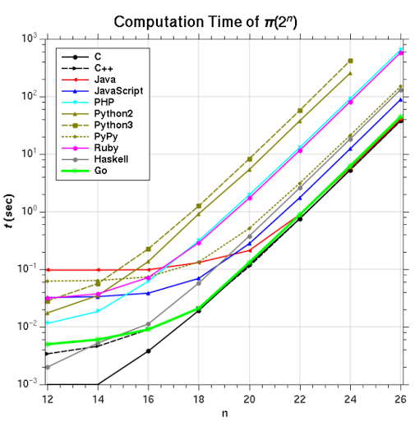
Performance
Java has a reputation for being slow
Early versions were slow
Java programs start up slow

Slide 21
Compiling in Java
Java Code
Compiler converts source code (*.java) into platform-neutral bytecode (*.class)
JVM runs bytecode using just-in-time compilation
JIT performs dynamic code optimization
Java Bytecode
Java Virtual Machine (JVM)
JIT
Machine Code

Slide 22
Garbage Collection
What happens to objects after you are done with them?
Why don't you run out of memory?
JVM implements garbage collection. It detects and frees objects that are no longer needed

Slide 23
Reachable Objects
An object is reachable if it is referenced anywhere in the call stack
local variables
method parameters
global variables
An object is reachable if it is referenced by a reachable object
fields
array elements

Slide 24
Mark-and-Sweep
Each object has an extra 1-bit field that is reserved for garbage collecting use
Garbage Collector (GC) operates in two phases:
mark: GC does a tree traversal of reachable objects from the stack and sets the GC field
sweep: GC scans all memory from start to finish and frees all objects that do not have the GC field set

Slide 25
Optimized Garbage Collection
Concurrent mark-and-sweep
Generational management
Garbage-First garbage collector

Slide 26
Performance

Slide 27
Shortcomings of Java
Java has no separation between specification and implementation
Writing correct concurrent programs in Java is hard and/or inefficient
People continue to develop new languages (e.g., Rust) that address some of these shortcomings
steeper learning curve
longer compile times

Slide 28
tl;dr;
Modern compiled, OO languages have similar performance
Different companies use different languages for historical, philosophical, or legal reasons
The concepts you learned in this class apply to any language
abstraction
isolation
inheritance
incremental development & testing
Notes:
Google: C, C++, Go, Java, Python, PHP
Facebook: Hack, PHP, Python, C++, Java, Erlang, D, XHP, Haskell
Amazon: Java, C++, Perl
Twitter: C++, Java, Scala, Ruby
Microsoft: C#

Slide 29
Object-Oriented Design
Problem: how to design a large program
Design considerations:
How easy to make changes? (Flexible)
How easy to reuse? (Reusable)
How easy to maintain? (Maintain)

Slide 30
Object-Oriented Design
What classes do you need?
What is the relationship between those classes?
What classes should do what?
How should objects interact?

Slide 31
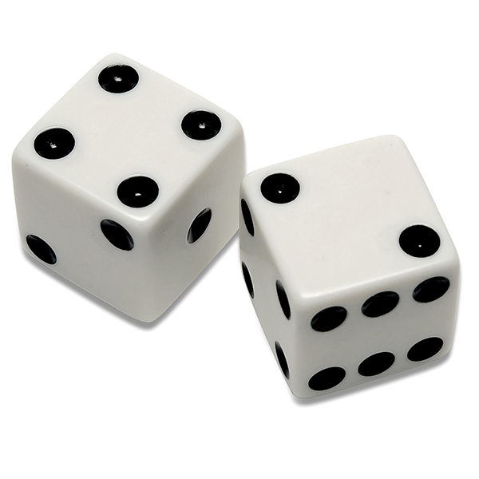
Example: Dice Game
Application domain: Play a dice game. Players requests to roll the dice. System presents results: If the dice face values sum to seven, player wins; otherwise player loses.

Slide 32
Example: Dice Game
What classes do you need?
What is the relationship between those classes?
How should objects interact?
What classes should do what?
Player
String name;
Die
int faceValue;
void roll()
int getFaceValue()
Plays
DiceGame
Die d1;
Die d2;
boolean play()
Rolls,
Reads val

Slide 33
Design Patterns
Design patterns are general, re-usable solutions to commonly recurring problems
OO design patterns typically show relationships and interactions between classes or objects
Not a magic solution; blindly applying design patterns can overcomplicate your code

Slide 34
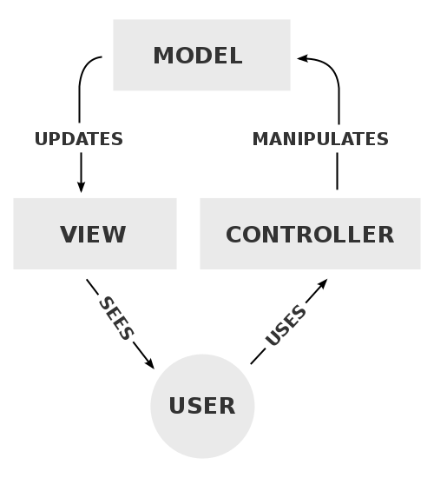
Example: MVC
Model-View-Controller is a common pattern for developing applications with GUIs

Slide 35
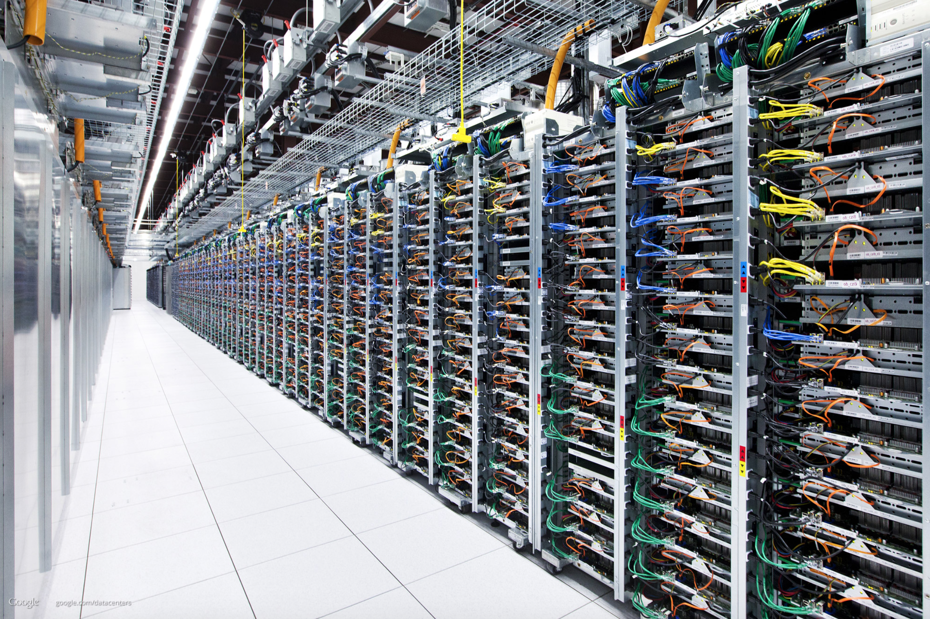
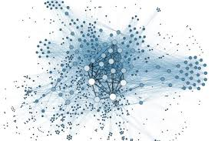

Slide 36
CS2110
Object-oriented programming, reasoning about complex problems
Testing; Reasoning about correctness
Algorithmic complexity, analyzing algorithms,
Data structures: linked lists, trees, hash tables, graphs, etc.
Programming paradigms: recursion, parallel execution

